Slide 1
Models for CMF

Slide 2
Note on the models
These models deal with the size, shape and number of cellulose chains in the smallest cellulose microfibrils, i.e., those residing in wood
CMFs residing in other plant fibres are considered multiplicates of these smallest microfibrils

Slide 3
Models for cellulose crystallite / microfibril: the 6×6 model
Figure taken from:
Okita et al. Biomacromoleuels 2010, 11, 1696.
The 6×6 model (rectangular)
Most common model for CMF
Based on circumstantial evidence on the 6×6 organisation of the rosette in biosynthesis
Roughly fits the evidence (XRD and microscopy data)
Much of the molecular modelling of CMFs is performed with this model
Endler and Persson Mol. Plant. 2011, 4, 199
(Review)

Slide 4
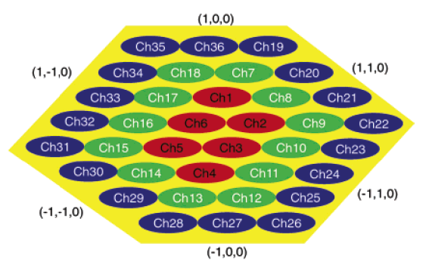
Alternative 6×6 model
The 6×6 model (irregular hexagon)
Based entirely on atomic force microscopy (AFM) data
Widely used despite the fairly weak experimental evidence
Used in some molecular modellings of CMFs
Ding and Himmel J. Agric. Food Chem. 2006, 54, 597

Slide 5
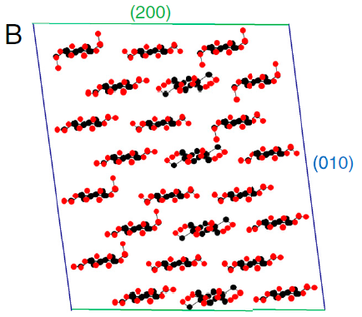
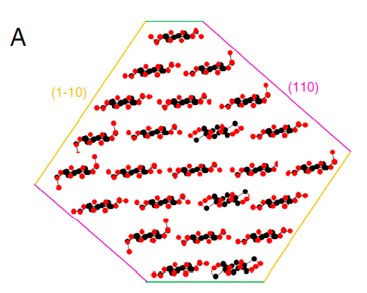
24 chain model
Two possibilities: rectangle or “diamond” model
Fernandes et al. PNAS 2011, 108, E1195

Slide 6
24 chain model
24 chain model
Based on several techniques: FTIR, NMR, and diffraction
A credible alternative
A disputed model but has the most substantial experimental data of all CMF models
Suggests that only 4 of the 6 rosettes are simultaneously active during biosynthesis
Fernandes et al. PNAS 2011, 108, E1195

Slide 7
18-24 chain model
18-24 chain model
Based on molecular dynamics simulations in aqueous environment
Comparison with previously published experimental data suggests that a 36 chain model is highly unlikely
Proposes that CMF is made of either 18 or 24 chains
Endorsed by the researchers who originally came up with the 24 chain model
Oehme et al. Plant Physiol. 2015, 168, 3

Slide 8
18-chain models
34443 model
234432 model
Hydrophobic plane (C-H groups)
Hydrophilic
plane (OH groups)
Deemed as the most probably option according computer simulations
Kubicki et al. Sci. Rep. 2018, 8, 13983.

