Slide 1
Twist along CMF

Slide 2
Simulations suggest twist
Conley et al.
Carbohydr. Polym. 2016, 135, 285.
Isolated cellulose chains twist in simulations
Computational models of very small cellulose crystals are twisting
The periodicity of the twist is longer than with individual chains
The twist is right-handed
Paavilainen et al.
J. Phys. Chem. B 2011, 115, 3747.

Slide 3
CMF twist: experimental evidence
Electron tomography on a cellulose nanocrystal
Experimental evidence on CMF twist is not unambiguous
Many images abound in literature but quantitative data is missing
Majoinen et al. J. Am. Chem. Soc. 2014, 136, 866.

Slide 4
CMF twist: experimental evidence
Visualization on CMF twist is not unambiguous
Many images abound in literature but quantitative data is missing
Usov et al. Nature Commun. 2015, 6, 7564.

Slide 5
Experimental and simulation evidence
Time-dependent density functional theory calculations combined with circular dichroism on CNCs with adsorbed Congo red dye molecules
Combined simulations and experimental evidence suggests a right-handed twist of 800 nm period in wood cellulose nanocrystals
Long period is probably the reason why the twist is so difficult to visualize from CNCs
Conley et al.
Cellulose 2017, 24, 479.

Slide 6
Proposed alteration of CMF twist
Some accounts suggest that the twist is altered and “localized” upon drying
Suggestion on what happens to a pristine CMF (a) upon drying (b) and in a totally dried state (c)
CMFs of M. denticulata alga after drying
Hanley et al. Cellulose 1997, 4, 209.

Slide 7
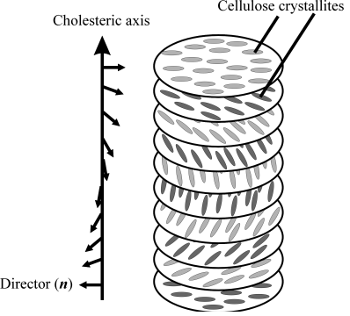
Implication of the CMF twist
Cellulose nanocrystals spontaneously forms a liquid crystal phase in solution
Chiral nematic phase
formed by cellulose
crystallites
Tight packing by the
chiral interaction of
screwlike rods
Photograph of liquid crystal suspension of cellulose nanocrystals
Revol et al. Int. J. Biol. Macromol. 1992, 14, 170.
Fleming et al. Chem. Eur. J. 2001, 7, 1831.
Habibi et al. Chem. Rev. 2010, 110, 3479.

