Slide 1
Fringed fibrillar model

Slide 2
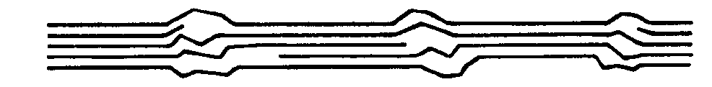
Longitudinal disorder: semi-crystallinity
Crystallographic data presents evidence
that cellulose within microfibrils is not
totally crystalline.
Proposition:
cellulose runs through alternating
crystalline and “ amorphous” regions.

Slide 3
Fringed-fibrillar model of CMFs
According to various models, disordered cellulose segments
coexists with crystalline cellulose in native cellulose microfibrils.
Hearle 1958
Dolmetsch 1968
Hess and Kiessig 1953

Slide 4
Semicrystallinity of microfibrils
Original models were designed for all polymeric fibrils: synthetic, regenerated and native alike
Fringed fibrillar model
Fringed micellar model
Mark J. Phys. Chem. 1940, 44, 764.
Hearle J. Polym. Sci. 1958, 28, 432.

Slide 5
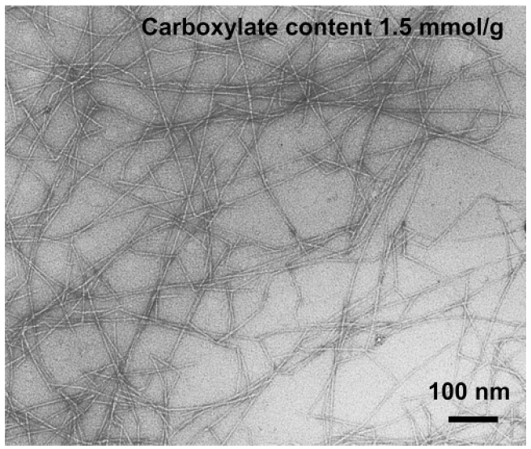
Synthetic polymers vs. cellulose
High resolution morphology by AFM
Cellulose microfibrils
isolated from wood pulp
Polyethylene
Amorphous segments visible
Amorphous segments NOT visible
Loos et al. Macromolecules 1999, 32, 8910.

Slide 6
The original fringed fibrillar model
Modern TEM images of microfibrils isolated by TEMPO-mediated oxidation do not support the Hearle model where fibrils are branched and polydisperse in width
Fringed fibrillar model
Saito et al. Biomacromolecules 2006, 7, 1687.
Saito et al. Biomacromolecules 2007, 8, 2485.
Hearle J. Polym. Sci. 1958, 28, 432.

Slide 7
More realistic picture of a microfibril
“Amorphous” regions are more like defects between the crystallites
Their length is probably very small (maybe 1-2 nm)
Defects: more realistic
Bulky amorphous regions: less realistic

Slide 8
Implications of fringed-fibrillar model
Alternating crystalline-amorphous regions explain well
the macroscopic mechanical properties of cellulosic materials.
The length and width of the crystalline domains
depend on the native source of the material.
Elastic properties of isolated cellulose
nanofibrils depend on their native source.
Page J. Pulp Paper Sci. 1983, 3, TR15.

Slide 9
Reservations with fringed fibrillar model
When you see data of the degree of crystallinity or crystallinity index of cellulose, its physical meaning is unclear
If the degree of crystallinity is, e.g., 64%, it does not mean that 64% of the cellulose is crystalline and 36% is ”amorphous”
Probably much of the material responsible for the ”amorphous” response resides on the microfibril surface
Cellulose I and cellulose II degrees of crystallinity should not be compared with each other
Systematic sets of data can be compared with each other if the crystalline forms, the analytical method, and the raw materials are similar

