Slide 1
ELEC-E7230 Mobile Communications System (5 cr) Guidelines for group work assignement on 6G whitepapers
Aalto School of Electrical Engineering,
Aalto University, Espoo, Finland

Slide 2
Background on group work assignment
In group work activity, members in a group study and prepare a presentation on a selected whitepaper from a shortlist of beyond 5G (6G) whitepapers, that relate to the theme of the course.
Whitepapers will not only expose students to concepts beyond legacy systems considered in the lectures, it will also further develop their presentation and research skills.
This activity contributes to 30% of course grade
The presentations will be held online on (precise presentation schedule to be confirmed):
Assignment - Paper presentation day 1: Mon 12.10.2020 , 12:00 - 14:00
Assignment - Paper presentation day 2: Wed 16.10.2020, 14:00 - 16:00

Slide 3
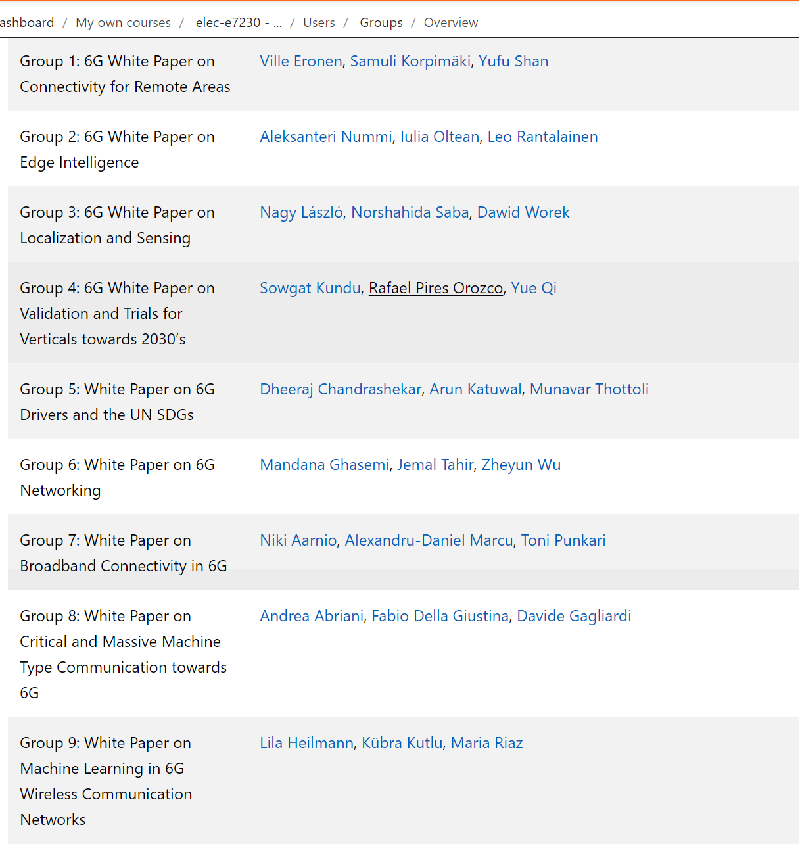
Who is in each group?

Slide 4
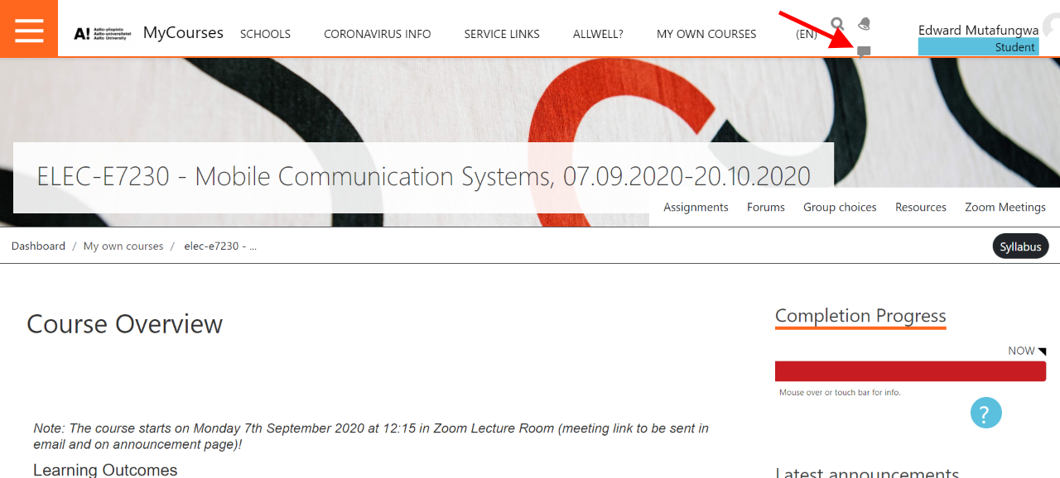
How to proceed as group
Make contact with your group members to kickoff the group assignment work
You contact group members using the messaging drawer in MyCourses (see red arrow in Figure below)
Alternatively, you may email members directly (email addresses can be found from: https://people.aalto.fi/)
Once in touch, feel free to use tool of choice for group interaction (Zoom, Skype, Slack, WhatsApp etc.)
Decide on group strategies, online meeting times, work timelines/milestones, activity allocations etc.

Slide 5
About the presentation
A template of the presentation is available on MyCourses, Assignments section
Note: There will be 15 minutes presentation time plus 5 minutes for questions and discussions.
So make sure have just the right number of slides to fit into that time slot.
Time spent per slide depends on type of content on the slide, presentation skills etc. It can be anywhere between 1-3 minutes.
It will help for group members to do practice run of the presentation before actual presentation.
To ensure maximum participation each group member should give part of the presentation!
Groups are free to decide how to assign which parts of the presentation to which presenter

Slide 6
How the presentation is graded
Grading criteria includes the following:
Presentation skills (clarity, comprehension etc.)
Slide quality
Understanding of the subject
Time
Critical thinking

Slide 7
Additional tips for preparing the presentation
Check the links and resources found in this MyCourses page for 90L55609 - Essential Academic Skills: Producing Text and Giving Presentations, https://mycourses.aalto.fi/mod/page/view.php?id=144590

