Slide 1
History of Earth Architecture in Asia
ARK-E0001 - Special Project of Architecture, Earth Architecture. Autumn 2020
Tapio Tuomi & Anna Mäkelä

Slide 2
Earth architecture in Asia
http://www.earth-auroville.com/world_techniques_introduction_en.php

Slide 3
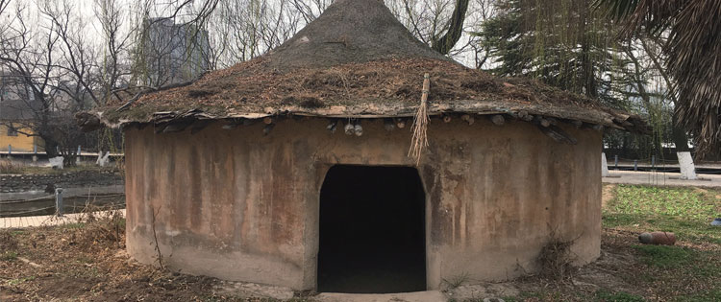
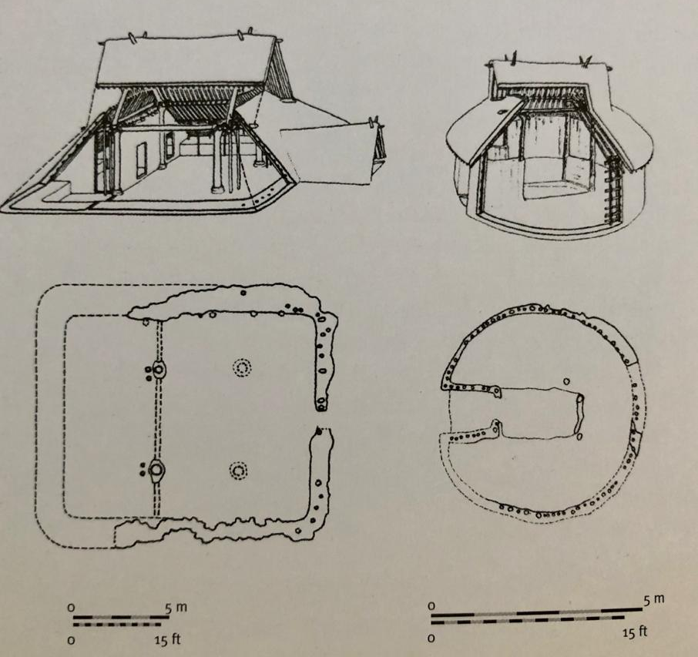
Neolithic houses in China
Banpo, Yellow River Valley, China ca. 2000 BCE
One of the oldest findings
Made of readily available materials - wood, thatch and earth
Dug half-story into the ground
Exterior walls have a thick layer of clay for the insulation
Central hearth for heating. Smoke gets of from the top of the roof
Reconstruction of a neolithic house
Reconstructions of Neolithic houses, Banpo, ca. 2000 BCE

Slide 4
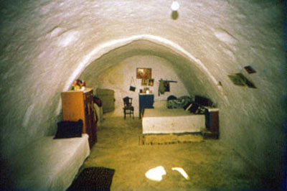
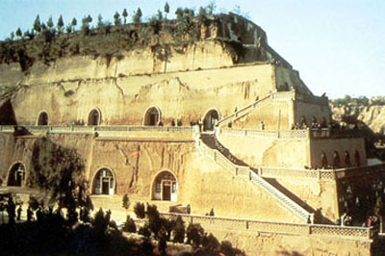
Earth Dug Out “Yaodong”
Dwellings are dug out in soft soils, tuffs, loess or porous lava in areas with hot and dry climate
Hunnan, Shanxi, and Gansu and other areas in northern China
History goes back to centuries and still more than 10 million people are living in these dwellings
China, Cave room
https://en.wikipedia.org/wiki/Yaodong
http://www.earth-auroville.com/earth_dug_out_en.php
China, Xiang region – School of Fenghuo (Photo J.P. Loubes)

Slide 5
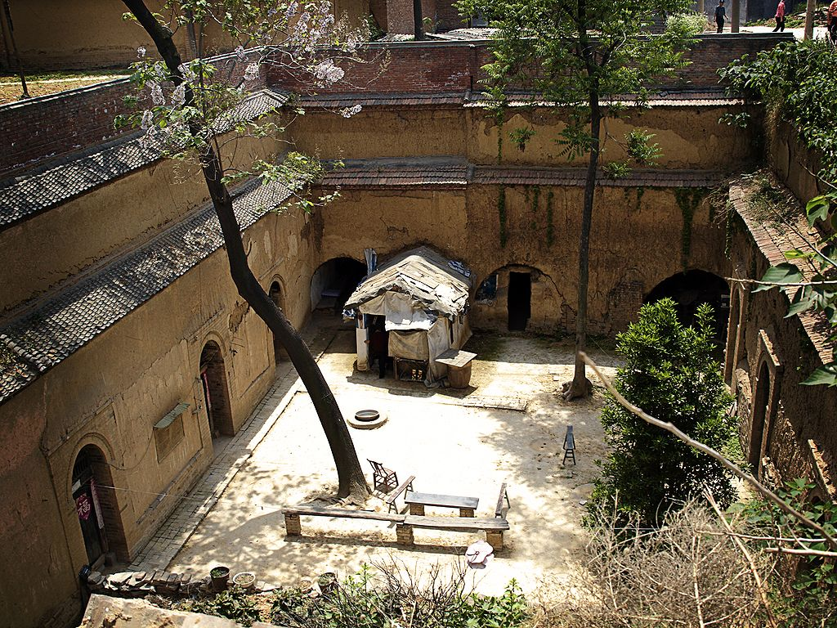
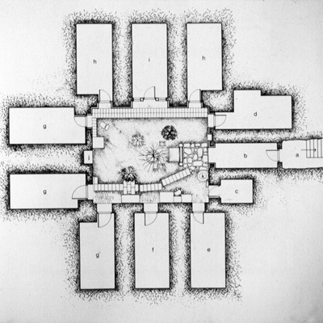
Cave dwelling – courtyard (Photo K. Poh)
China : Plan of dug out dwelling

Slide 6
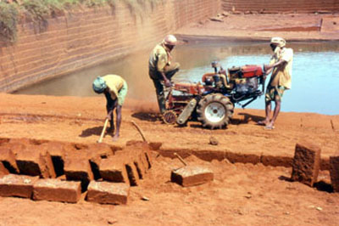
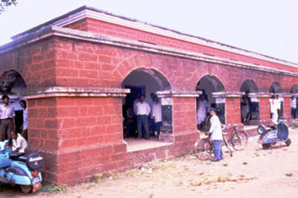
Cut Blocks
Used in Eastern India where the soil is tropical and cohesive
Hardens when exposed to air due chemical reaction
Can be used as a brick or stone in construction
India, Orissa, Near Narangarh - Petroplinthite cutting
India, Orissa, Khurda - Post office
http://www.earth-auroville.com/cut_blocks_en.php

Slide 7
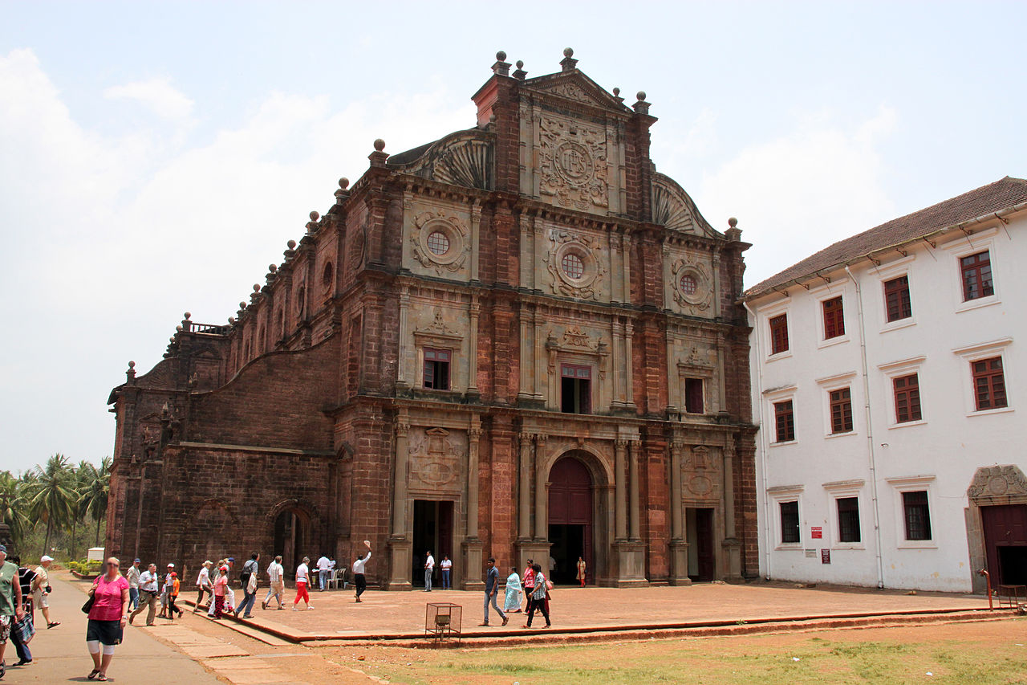
Basilica Bom Jesus
Roman Catholic basilica in Goa, India
Is part of UNESCO’s World Heritage Site
Built in 1605
Portuguese’s colonial architecture
Main structure made of cut block bricks
https://en.wikipedia.org/wiki/Basilica_of_Bom_Jesus
India, Goa - Basilica Bom Jesus, end 16th century

Slide 8
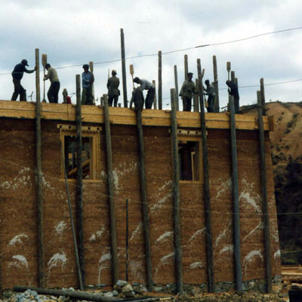
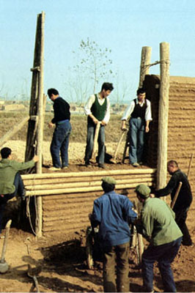
Traditional Rammed Earth
Has been used since ages worldwide like many other techniques
The earth is mixed well with water to get a homogeneous humid mix
Then it is poured into form in thin layers and rammed to increase its density
The ramming increases the structures compressive strength and its water resistance
This technique has allowed to build long lasting multi storey buildings
Good examples from Asia can be found from China and Himalayas area
Traditional way to make rammed earth
http://www.earth-auroville.com/traditional_rammed_earth_en.php

Slide 9
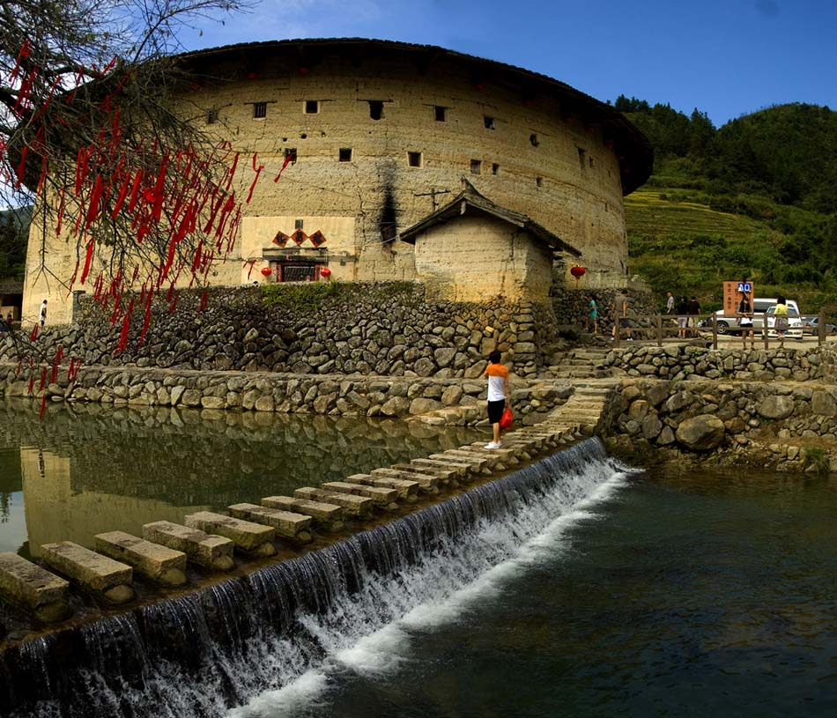
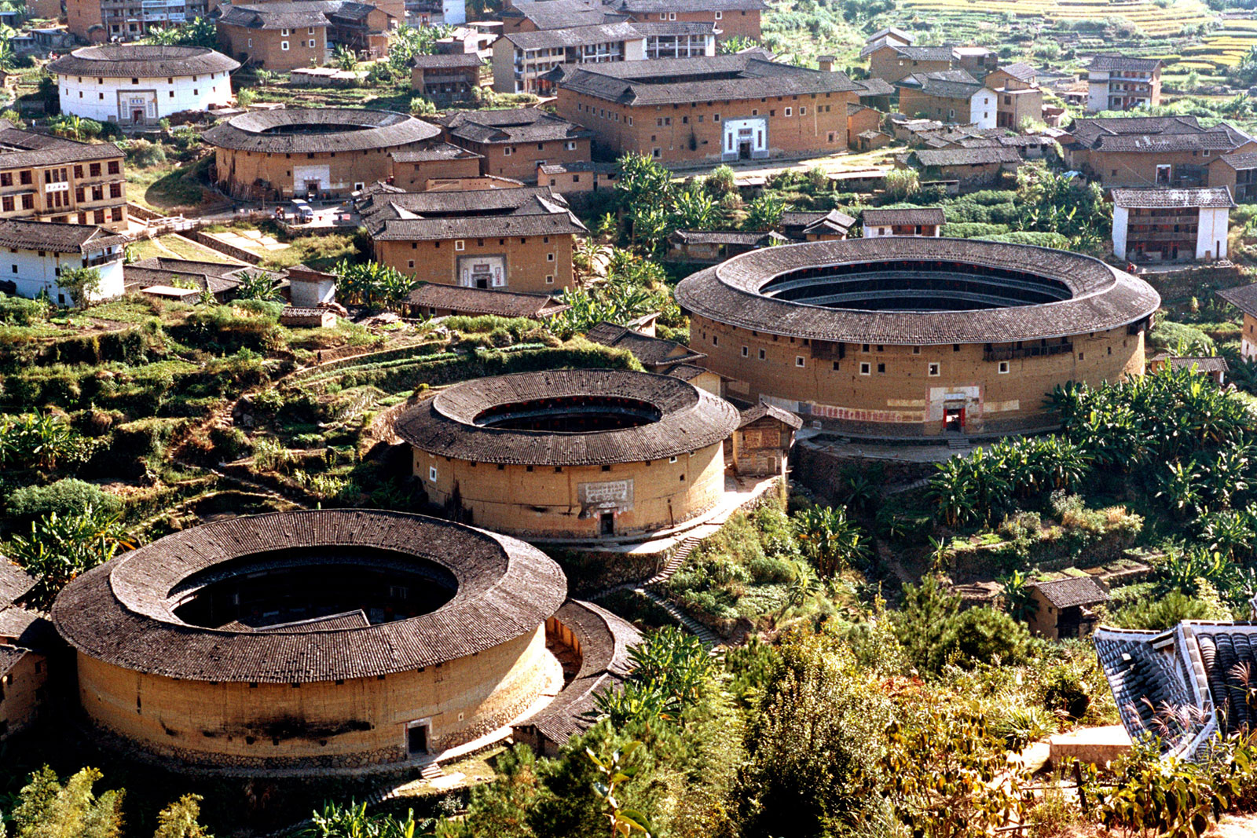
China, Fujian Province - Village / house of Hakkas clan

Slide 10
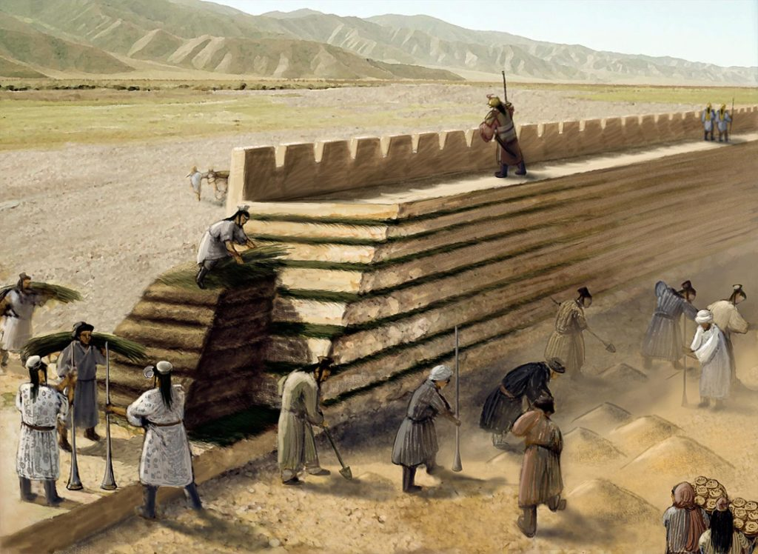
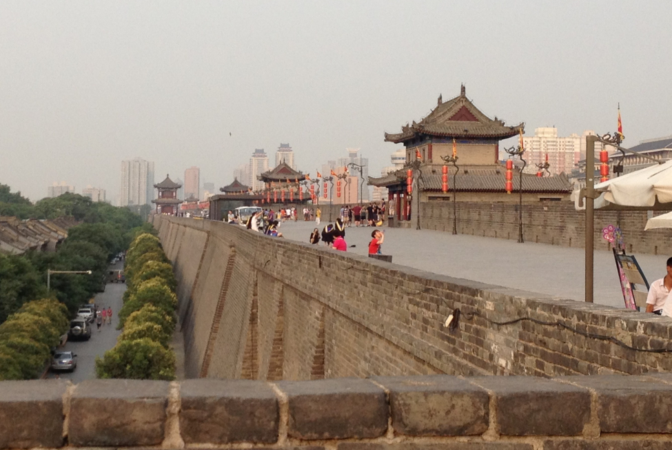
The Great Wall of China
The earliest parts from 700 BC
The first parts were made of rammed earth
Later old parts have been reinforced with stone and bricks
Rammed earth core of the Wall protects it from artillery fire
The early walls were made of layered earth and vegetation
https://historybitz.blog/2019/01/06/the-great-wall-of-china-in-need-of-a-great-clarification/

Slide 11
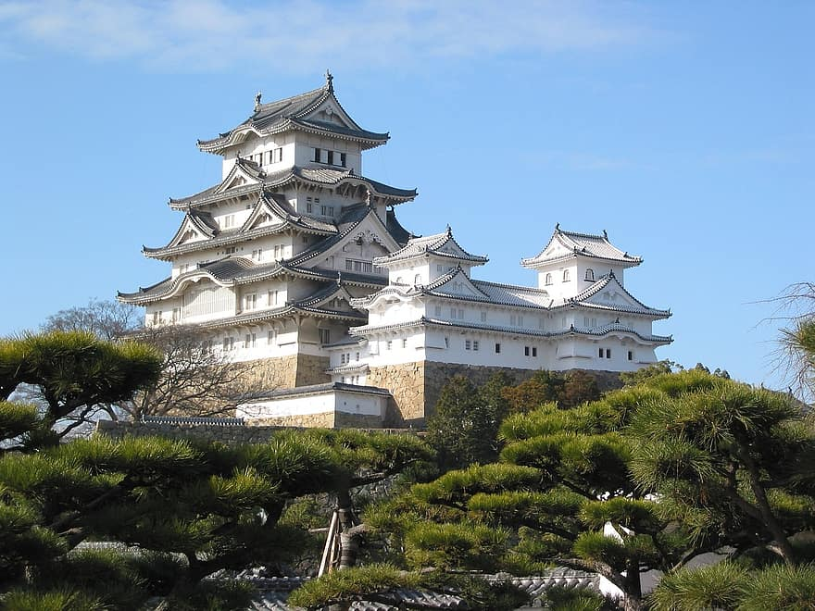
Earth plastering
Himeji castle, Japan
Historically widely used in Asia
Built between years 1333-1618
Primary materials are stone and wood, but white earth plastering is added to the walls to prevent fires
https://eartharchitecture.org/?cat=25

Slide 12
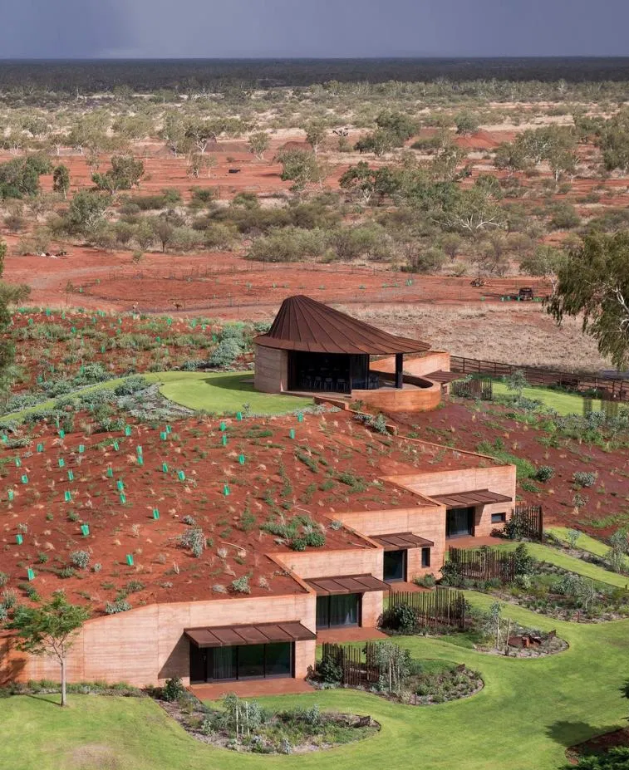
BONUS: Australia
The Great Wall of WA
https://www.archdaily.com/771780/the-great-wall-of-wa-luigi-rosselli
Photos by Edward Birch
Architect: Luigi Rosselli, 2016
450mm rammed earth facade, a dune roof
12 residences provide short-term accommodation for a cattle station during mustering season
Work in progress

Slide 13
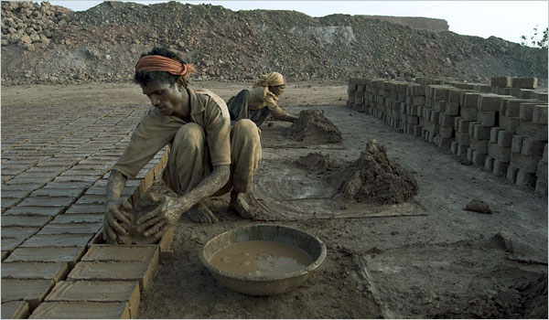
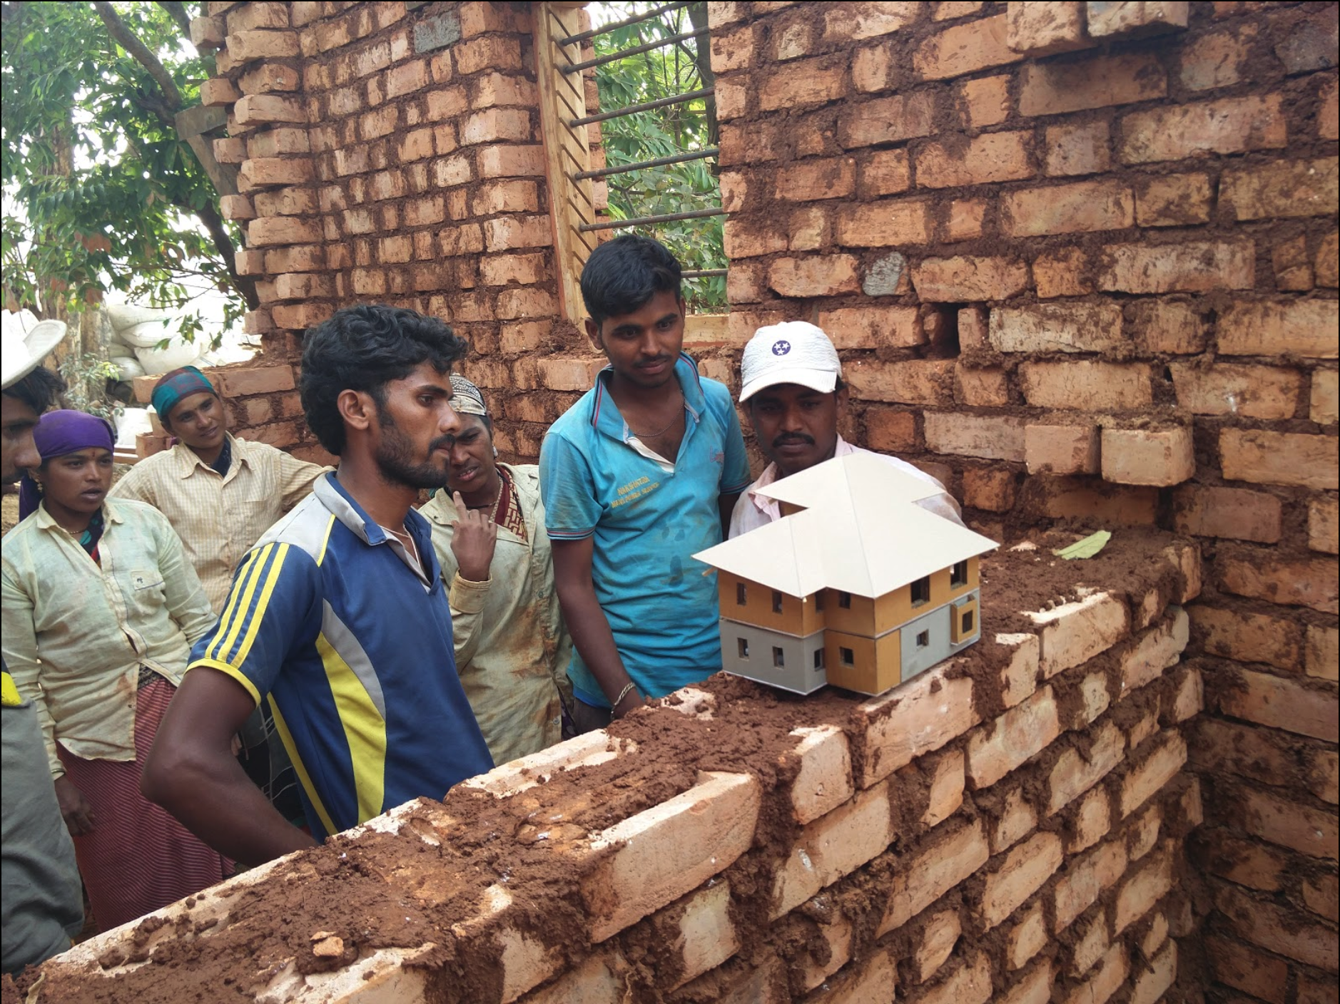
Old tradition is still alive in Asia
Indian mud brick makers
Specially adobe bricks and cut blocks are still in use in many Asian countries
Approximately 58% of all buildings in India are made of mud bricks
People are returning to earthen homes to defend against climate change → concrete making is one of the biggest causes of global warming
Builders explaining the structure through study model
https://eartharchitecture.org/?p=550
https://www.ozy.com/around-the-world/indias-new-defence-against-climate-change-a-return-to-handcrafted-mud-houses/225937/

Slide 14
Thanks for watching !

