Slide 1
MEC-E5004
Fluid Power Systems
5 credits
22.9.2020
jyrki.kajaste@aalto.fi

Slide 2
Structure of studies and Grade components
IN BRIEF
Presentations and lectures
Simulation assignments
  Tuning a hydraulic servo
  Building hydraulic simulation models
    Load Sensing (LS) system
    Direct Drive Hydraulic (DDH) system
  Each student: Individual Reports
Group assignment
  3 calculation assignments
  group’s discussions with the teacher
Common and organized Studies (almost) every Tuesday 16.15-18.00
Simulation (4) and servo simulation (2) exercises on 4 Wednesdays 16.00-18.00 (see detailed schedule)
Student groups arrange their own meetings and teamwork conventions

Slide 3
Introduction to Energy Efficient Fluid Power
The main theme of Fluid Power Systems course year 2020 is
Energy Efficient Fluid Power
The
Presentations
Lectures
given by our researchers support this main theme
Other relevant topics in modern and future Fluid Power also introduced.

Slide 4
Schedule
3 Calculation assignments
2 Simulation assignments
2 Servo simulations
Group meeting
Preliminary schedule
(under construction)
Tuesday sessions could be used also for simulations

Slide 5
Group assignments (group works)
18 students ?
Wish is to … have groups with 3 members
Output
3 calculation assignments
1 group’s meeting with the teacher ⇒ plan
Build up your team until Tuesday 15.9.2020
Use MyCourses page Assignments

Slide 6
Boundary conditions in calculations
Fluid Power Systems

Slide 7
Directional control valve (ON/OFF) - case
CASE 1
FOR TRADITIONAL HYDRAULICS with CONSTANT DISPLACEMENT PUMP
A
M
These lines missing -> valve is ON/OFF
Closed OR
Fully open
Some leakages, if spool valve
Pressure (and flow rate) transformation
Load
Differential cylinder
Pressure increasing
Reference system
A mass (gravitational) load
B differential cylinder
C directional control valve (ON/OFF)
D pump
E electric motor
F pressure relief valve
G reservoir/tank
H filter
B
IF the PRV pressure is high enough, the cylinder piston will be lifted with speed determined by
Pump’s flow rate
  Note pump leakages!
The boundary condition is
Pump’s flow rate q_{v.pump}
Pressures in the system and also pump pressure depend on
Load (gravity load) + seal friction
Flow friction
  In valve
  Pipe system
  Filter
Pressure increasing
C
A
B
P
T
Pressure increasing
q_{v.pump}
q_{v.pump} ⇒ v_{cylinder} ⇒ p_{system}
E
D
F
H
M
G
G
IF p_{P} > p_{PRV} ⇒ next page
Note!
If piston hits the cylinder end ⇒ boundary condition ⇒ p_{PRV}
If ON/OFF valve is closed ⇒ cylinder pressures depend on load and leakage

Slide 8
Proportional directional control valve - case
CASE 2
FOR MODERN HYDRAULICS with CONSTANT DISPLACEMENT PUMP
A
M
These lines present -> valve is proportional
Closed ⇔ Fully open
Some leakages, if spool valve
Pressure (and flow rate) transformation
Load
Differential cylinder
Equations
Cylinder’s force balance
  Load force
  Pressure A
  Pressure B
  (Friction) ⇒ equation
Cylinder pressures related to
  Pressure losses in proportional control valve’s control edge pressure losses
  E.g. Lifting equations for
  BT: v and U ⇒ p_{B} equation
  PA: p_{B}, v and U ⇒ p_{A} equation
Solve v (equation)
Pressure decreasing
IF the LOAD pressure OR/AND the pressure losses in valves etc. are high enough, the cylinder piston will be lifted with speed determined by
Pump’s (PRV’s) pressure
  Pump leakages NOT relevant!
Proportional control valve’s opening (area)
The boundary condition is
Pump’s (PRV’s) pressure (p_{P})
Pressures in the system and also pump pressure depend on
Load (gravity load) + seal friction
Flow friction
  In valve
  Pipe system
  Filter
B
Pressure decreasing
C
A
B
P
T
Pressure decreasing
q_{v.pump}
E
D
F
H
M
G
G
p_{pump} ⇒ v_{cylinder}
IF
Load force is the same
Pump pressure is the same ⇒ better controllability
IF p_{P} < p_{PRV} ⇒ previous page

Slide 9
Example, part 5
CONTROL BY USING (LARGE AREA) ON/OFF VALVES
ONLY MINOR PRESSURE LOSSES
N₂
Solution 2a
HYDRA concept – Multi-pressure system
(Tampere University of Technology and Aalto University)
The pump flow is directed into pressure accumulator
The system is controlled by using (”large”) ON/OFF valves to (1) allow or (2) prohibit flow (not to throttle flow) ⇒ pressure losses are small
Also the potential energy of the load can be utilized by directing flow of high pressure fluid into the accumulator
The power of the electric motor and pump can be small (average power)
Peak power is provided by the accumulator
G
x
CONTROL (ON/OFF)
VALVES
p_{B}
Pick the proper pressure!
Multiple pressure levels to choose from
ON
N₂
N₂
N₂
N₂
M
OFF
20 – 40 – 60 – 80 – … bars
p_{A}
SMALL ELECTRIC MOTOR AND PUMP
(AVERAGE POWER)
9

Slide 10
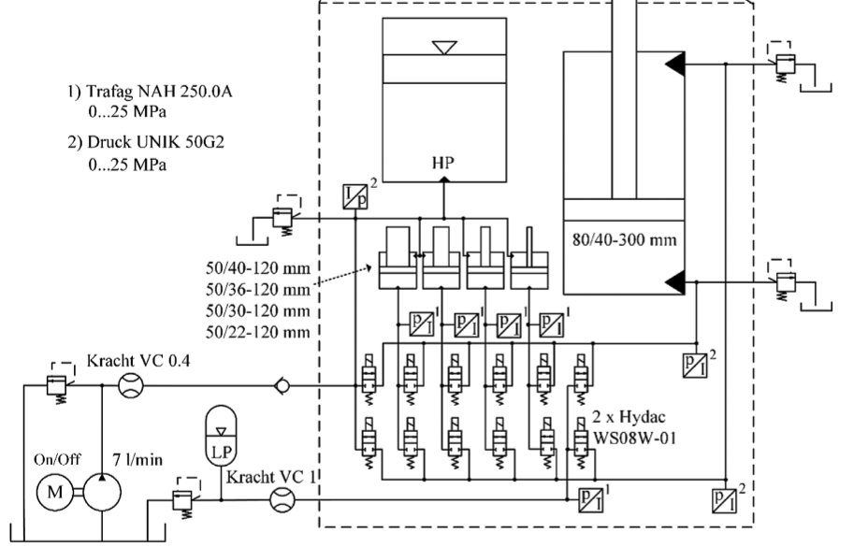
Example, part 6
APPLICATION OF DIGITAL HYDRAULICS
Multi-pressure system (6 pressure levels) – only 1 (or 2) accumulators
STORE
accumulator
USE OF POWER
actuator
Solution 2b
HYDRA concept
Accumulator provides power peaks, the pressure must be adapted by using pressure transformers ⇒ input pressure corresponds to the pressure needed by the actuator
The pressure losses in valves are small because a) provided pressure and actuator pressures are close to each other b) valve capacities are high (ON-OFF, NOT proportional control valves)
Potential energy and kinetic energy can be stored in accumulator and utilized/reused (⇔)
Very good energy efficiency!
ADAPTATION OF PRESSURE
Pressure transformers
p₁ A₁ = p₂ A₂
1
2
3
4
5
ADAPT
DIRECTING OF FITTED PRESSURE
on/off valves
TO ENERGY STORE
ACTUATOR
DIRECT
6
POWER SOURCE
pump

Slide 11
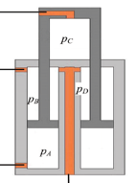
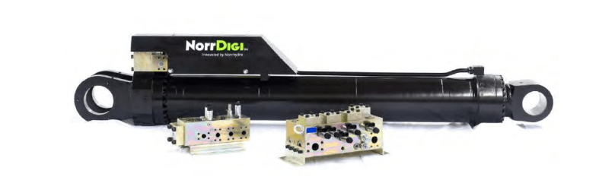
Multi chamber cylinders
C ↑
B ↓
A ↑
Norrhydro’s multi chamber cylinder system
D ↓
Video
https://www.youtube.com/watch?v=qEUYtT-CWuo
https://www.youtube.com/watch?v=egS1m3Qz_FM
Business talk in Finnish
https://www.youtube.com/watch?v=PMw8OVV-KSs
https://www.sijoittaja.fi/66653/analyysissa-norrhydro-tutustu-houkuttelevaan-osakeantiin
Cylinder with 4 chambers and piston areas
2 forces in plus direction
2 forces in minus direction

Slide 12
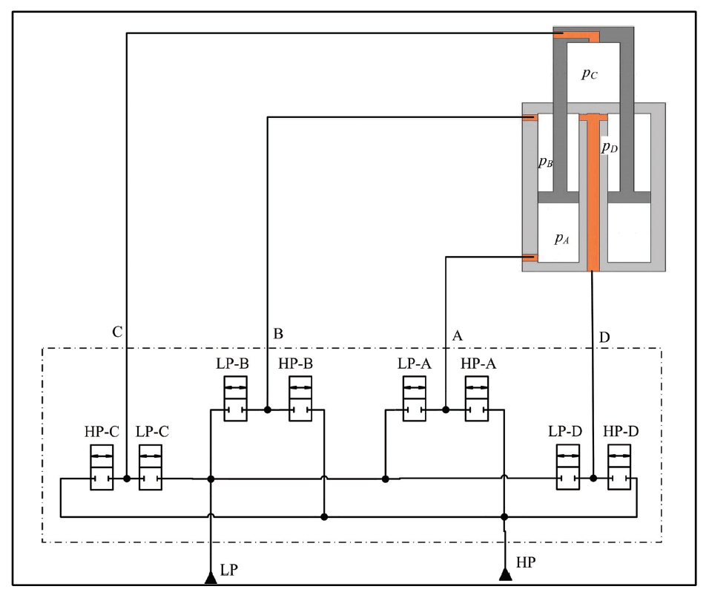




Multi chamber cylinder system
$$A_{A}=\frac{π}{4}\left(D_{1}^{2}−d_{1}^{2}\right)$$
$$A_{B}=\frac{π}{4}\left(D_{1}^{2}−d_{2}^{2}\right)$$
D2
d2
$$A_{C}=\frac{π}{4}D_{2}^{2}$$
D1
$$A_{D}=\frac{π}{4}\left(D_{2}^{2}−d_{1}^{2}\right)$$
d1
Piston areas A_{A} and A_{C} ⇒ Force UP
Piston areas A_{B} and A_{D} ⇒ Force DOWN
A_{A}:A_{B}:A_{C}:A_{D} ∼ 8:4:2:1
4 chambers ⇒ 16 forces
Two pressure sources
HIGH
LOW
LP
HP
M. Linjama, H.-P. Vihtanen, A. Sipola and M. Vilenius, “Secondary Controlled Multi-Chamber Hydraulic Cylinder,” in The 11th Scandinavian International Conference on Fluid Power, SICFP '09, June 2-4,2009, Linköping , 2009.

Slide 13
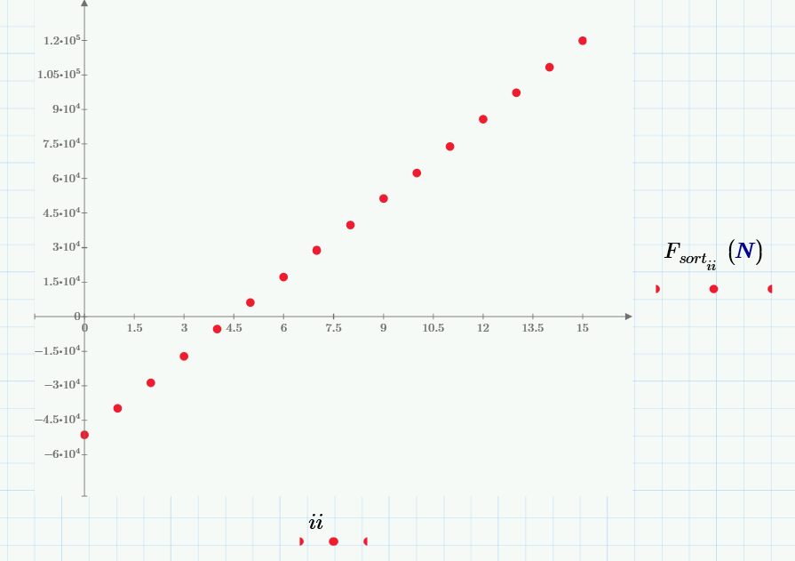
Force distribution
Test pressures
p_{high}= 200 bar
p_{low}= 20 bar

Slide 14
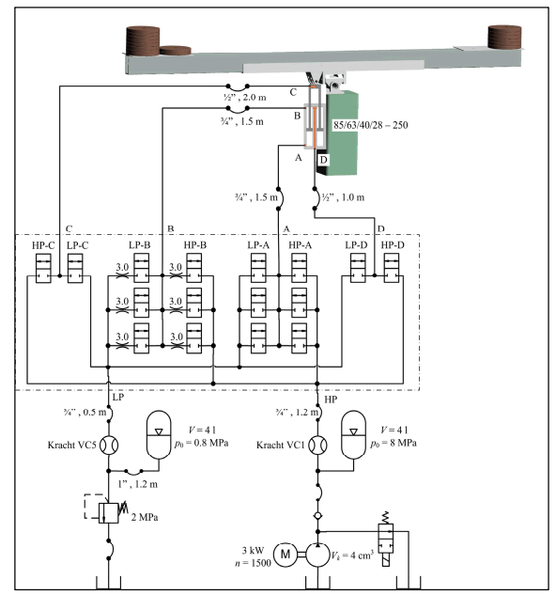
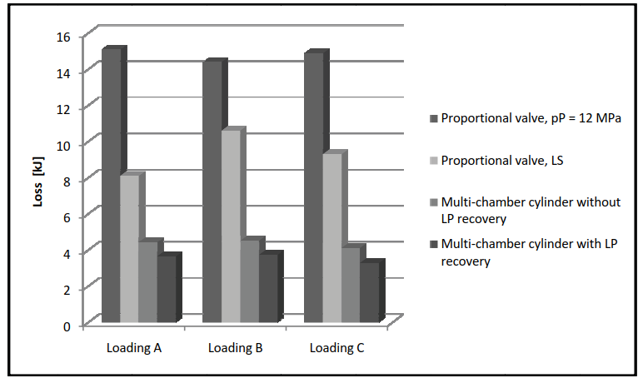
Test environment
Test bench in Tampere University of Technology (2009)
Comparison of systems’ energy losses
a) flow losses in valves, b) flow losses in hoses, and c) compressibility losses. The compressibility losses: energy stored in hydraulic capacitance is lost when the chamber switches from HP to LP

Slide 15
Multi chamber cylinder (NorrDigiTM)
The system is based on multi-chamber hydraulic cylinders. Also a digital control system is needed. Feedback from the accumulators controls the power utilization on the vehicle and optimizes the performance.
The combination of chambers allows the system to use the smallest possible area to move the load.
16 area combinations in cylinder are available.
Functions can share energy through the common pressure rail ⇒ multiple actuators with common accumulators
Excess energy (potential, braking) can be stored in accumulators. The prime mover doesn't need to run continuously (engine-off). It can recover and store energy with up to 80% efficiency (manufacturer’s numbers).
Particularly efficient in applications with high inertia loads, both linear and rotary, such as lowering or braking.
Manufacturer’s numbers: Fuel efficiency improvements by 45-60% and productivity increase by up to 12% were achieved in side-by-side tests with professional operators.
The system is consuming less energy than in the conventional systems. The prime mover (engine or electric motor + battery) can be down-sized.
  For electric vehicles ⇒ longer service time between charges.
  Vehicles with engines ⇒ engine is running in the “sweet spot” (manufacturer’s terminology), affects both noise and emissions + engine efficiency.
Flow rate is smaller compared with traditional systems. Pumps can be downsized.
Less power losses and heat ⇒ hydraulic cooler may be down-sized or eliminated.
http://www.oamk.fi/~eeroko/Opetus/AnturitJaOhjausjarjestelmat/Smart_Vision_NorrHydro_18112010.pdf

Slide 16
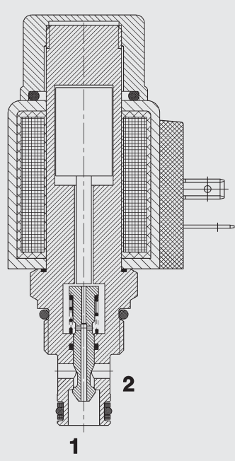
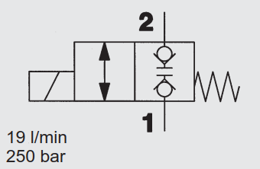
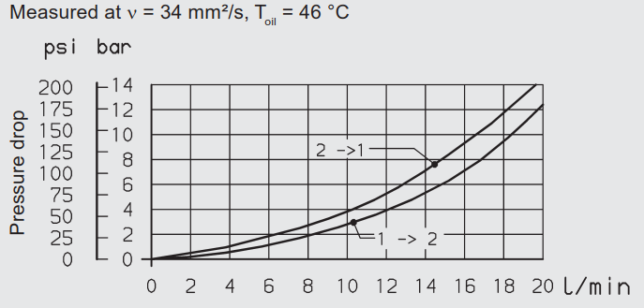
Hydac WS08W-01
2/2 Solenoid Directional Valve
Poppet Type,
Direct-Acting
Normally Closed
SAE-08 Cartridge
250 bar
Energized: approx. 35 ms
De-energized: approx. 50 ms

Slide 17
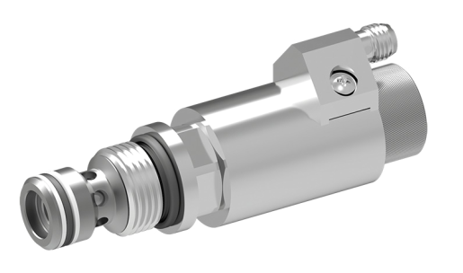
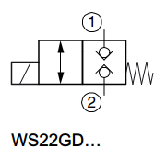
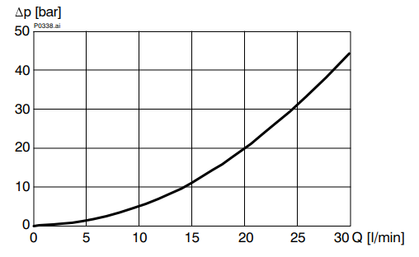
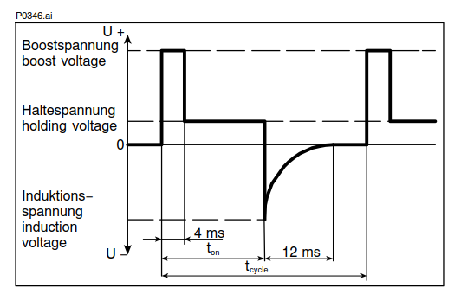
Bucher WS22 ON/OFF valve (digital)
Poppet/Seat (minimum leakage)
Cartridge valve (e.g. M20x1.5)
Maximum pressure 350 bar
Excitation voltage 48 V (DC)
Length of over-excitation 4…5 ms (boosting)
Supply voltage 12 V (DC)
Nominal power 15 W @ 12 V (DC)
Switching time 6 … 20 ms (energizing)
5 … 20 ms (de-energizing)
Coil inductance resists the change in coil current. This operation can be accelerated by using temporary high voltages (larger than solenoid’s nominal voltage).
Solenoid operation boosting
High voltage
Energizing the coil
Low voltage
During holding phase
Current control method
Peak-and-hold
Pressure loss

Slide 18
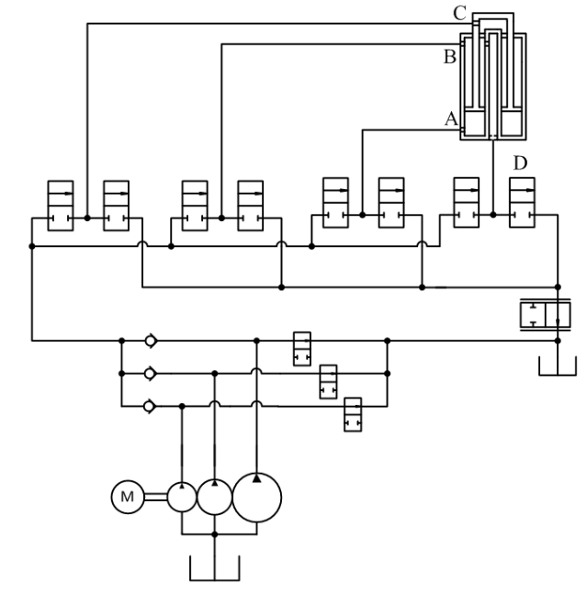
Variation 1
PARALLEL PUMP-CONTROLLED MULTI-CHAMBER CYLINDER
In this architecture 3 fixed displacement pumps in parallel connection are used to control the velocity of a multi-chamber cylinder piston. The basic principle is to combine
discrete flow supply control of parallel pumps with
discrete effective area control of a multi-chamber cylinder
to produce a speed control resolution for accurate velocity tracking and positioning.
Some throttling is used in the return line to control the system with overrunning loads.
Bypass function:
Pumps’ flow rates to tank
7 discrete flow rates

Slide 19
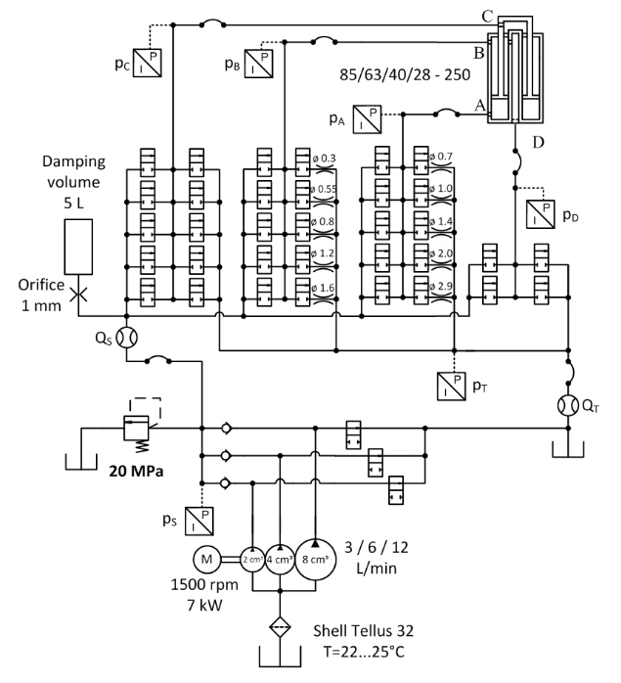
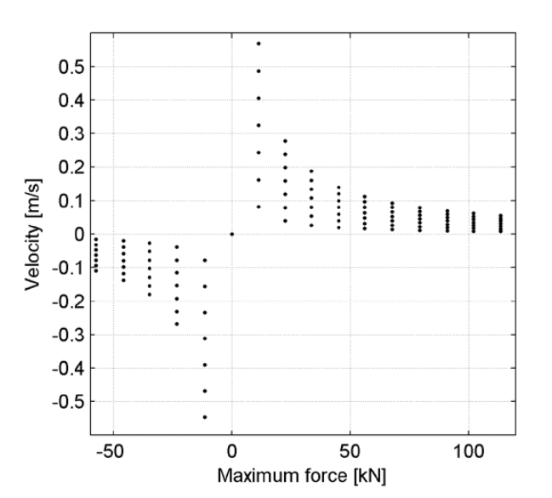
Test set-up
Available forces and velocities with 180 bar pressure

Slide 20
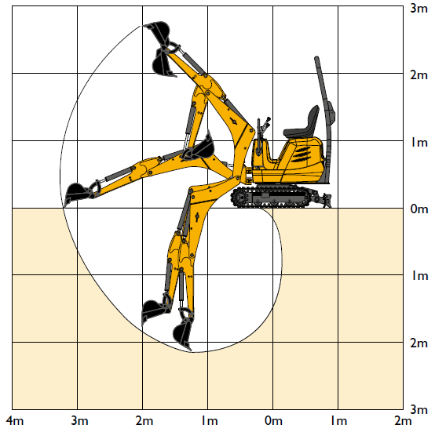
Multi-pressure actuator in enhancing the energy balance of mICRO-excavator
Husnain Ahmed¹, Otto Gottberg², Heikki Kauranne³, Jyrki Kajaste², Olof Calonius², Mikko Huova¹, Matti Linjama¹, Juha Elonen³, Pertti Kahra³, Matti Pietola²
¹⁾Tampere University, Automation and Hydraulic Engineering, Tampere, Finland
²⁾Aalto University, Mechanical Engineering, Espoo, Finland
³⁾Fiellberg Oy, Vantaa, Finland
Speaker:
DSc Jyrki Kajaste
1.1 tonne JCB Micro-excavator

Slide 21
Content of the presentation
Hydraulic systems and excavator used in the study will be introduced
Main interests of the study
Functionality of multi-pressure actuator in excavator application
    Boom inertia can change considerably
      High Inertia (extended boom) versus Low Inertia (folded boom), inertia ratio (10:1)
    Application is Boom swing motion – turning of boom back and forth around vertical axis
      Acceleration – steady velocity: winning of small friction forces - deceleration
Energy efficiency comparison
  Comparison with load-sensing system (LS) based on
    Pressure adjustment valve
    Constant pump
  Analysis of differences in systems
    Origins of power losses

Slide 22
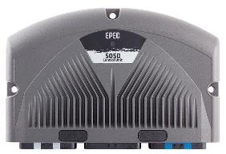
Multi-Pressure System
SYSTEM 1
Control unit
6 pressure levels — for cylinder
HP accumulator ⇒ piston / rod
4 pressure converters ⇒ piston / rod
LP accumulator ⇒ piston / rod
1
6
Multi-Pressure unit
Accumulator
Pressure converters
ON/OFF valves
Pressure relief valves
Pump system
Electric motor
Inverter
Pumps
  2 in parallel
  Pressure relief valve
Low pressure accumulators
  Pressure relief valve
Unloading valve (option)
EPEC 5050
1
42-55 bar
Actuator
2
3
4
5
8 bar
6
24 ON/OFF valves, 12 control edges

Slide 23
Operation – short version
Control unit
Control unit
Controls the valves and operation
Motion controller
Outer loop
Force controller
Inner loop
6 pressure levels available
Controller selects valves (ON/OFF)
Cost function used for valve selection
Hydraulic power from accumulator(s)
High power available
Pump system
Pump(s) used to recharge the HP accumulator (pressostat)
Average power needed (OFFLINE)
EPEC 5050
1
42-55 bar
2
3
4
5
8 bar
6

Slide 24
Load Sensing system, valve-based
SYSTEM 2
Pressure adjustment valve
takes care of 20 bar pressure difference over proportional control valve
3
4
1
Inverter operated
e-motor and pumps
(constant rotational speed during tests)
During motion excess flow is directed through pressure adjustment valve ⇒ remarkable power losses
During actuator standstill flow can be directed through unloading valve ⇒ reduces power losses
The pump flow rate could also be adapted to system’s flow need by rotational speed control (to emulate pump controlled LS) ⇒ reduces power losses
  This was not done in this case
  It has been simulated ⇒ OK
3
20 bar
2
4
2
3
1

Slide 25
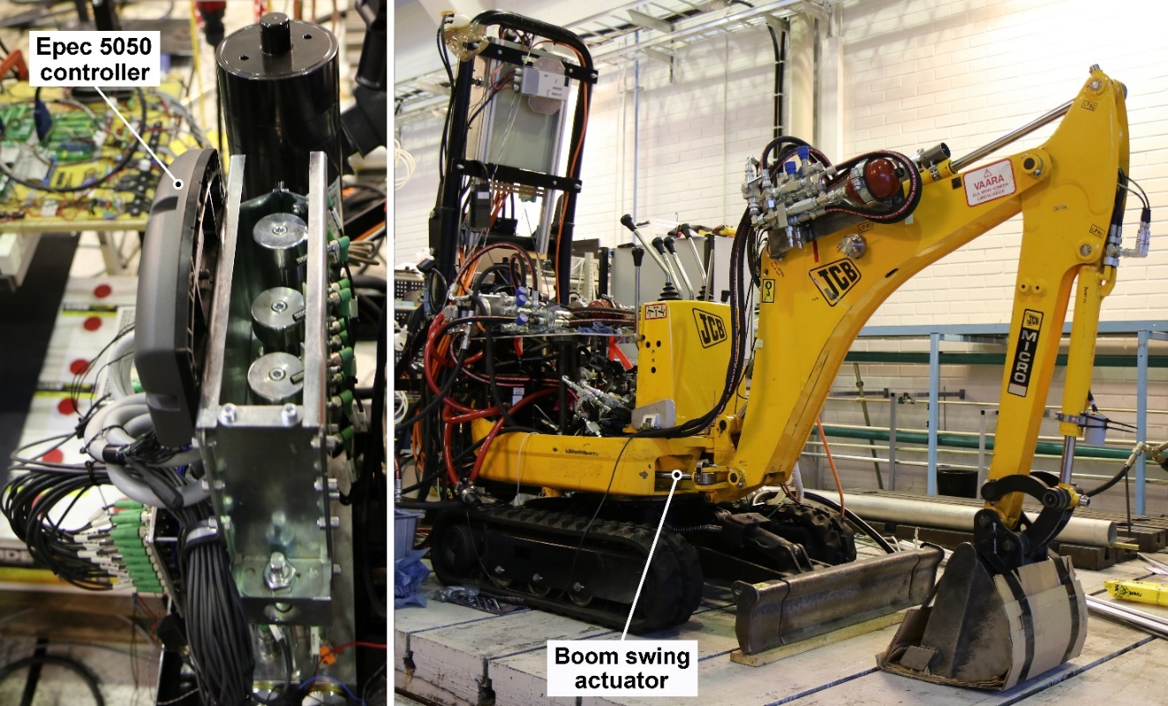
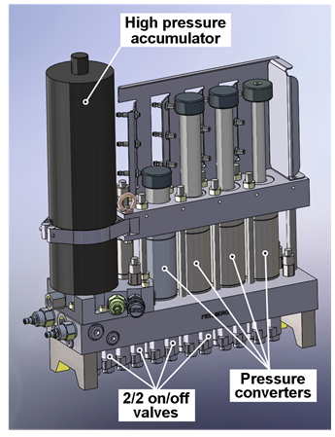
Test machine
Micro-excavator
1
Multi-Pressure system placed on the back of the cabin
Swing cylinder for turning of the boom
3
1
1
2
3
2
1
3 pump operated Direct Drive Hydraulics (DDH) systems for other boom functions
Boom
Stick
Bucket
1.1 tonne JCB Micro-excavator (electric motor operated)

Slide 26
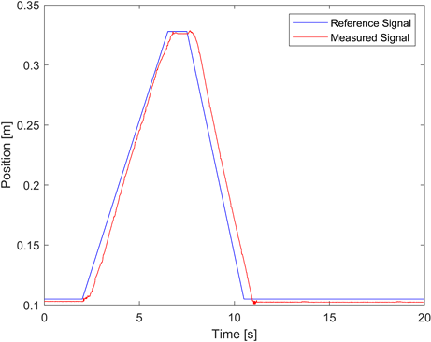
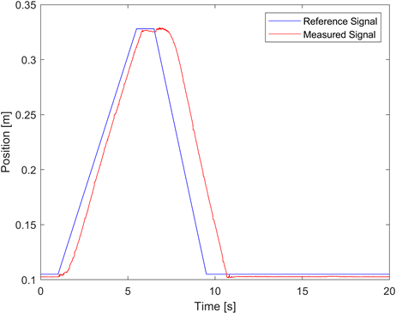
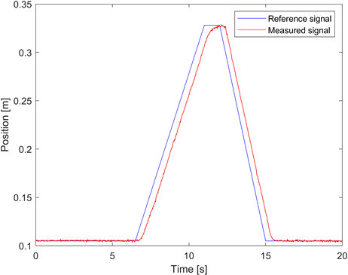

Position control
Low inertia case -1 | High inertia case – 10
DHMPA
system
Controllability OK
Boom swing - both directions
Can we control the system with changing inertia with simple constant gain P control?
Low and high inertia cases – relative inertia ratio 1/10
Position trajectory command signals
Actual actuator outputs
Constant gain for position control (P control) ⇒ OK
Inertia dependent gain ⇒ could be even better
LS
system

Slide 27
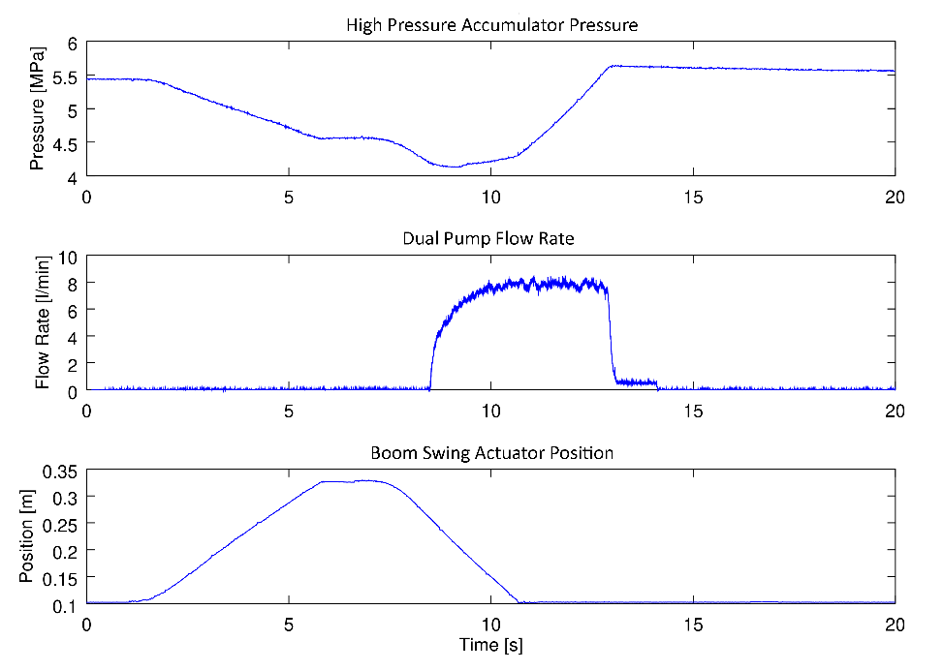
Multi-pressure system hydraulic variables during swing
5
Cylinder piston movement starts
Flow from accumulator, pressure decrease
Pressure reaches lower limit
Pump flow starts, accumulator is charged
Accumulator pressure rises, higher limit
Pump flow stops
Cylinder piston is back in start position
p [MPa]
HP
accumulator
q_{v} [l/min]
pump
x [m]
actuator
2
3
High-pressure accumulator pressure
Dual pump flow rate
Boom swing actuator position
DHMPA system in low inertia case
4
6
7
1

Slide 28
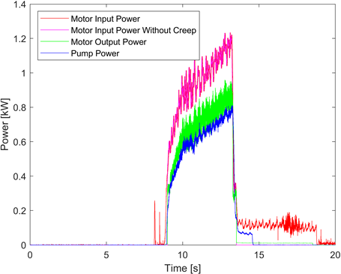
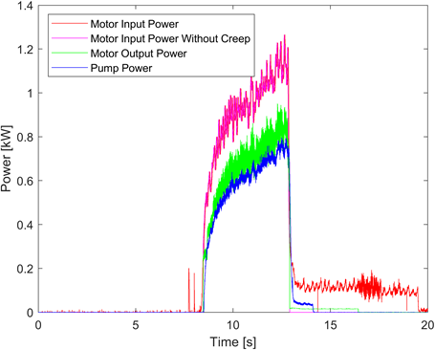
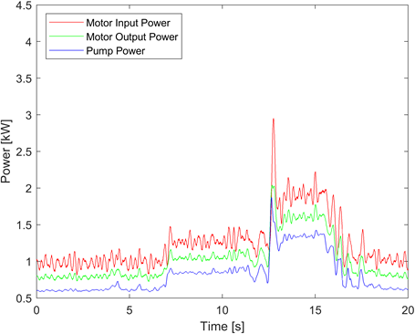
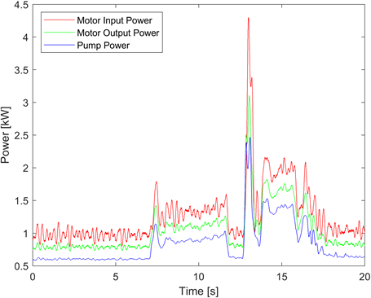
Power usage of multi-pressure and LS systems
Low inertia case - 1 | High inertia case - 10
Power usage for
Low (folded) - high inertia (extended) boom
Electric motor input
Electric motor output
Pump
1.4 kW
DHMPA system
Charging
Charging
Motion
Motion
DHMPA system
Pump power is needed only when the accumulator is charged
Accumulator(s) provide(s) the high power peaks (HP + LP)
LS system
Pump provides hydraulic power throughout the back and forth movement
Different scales
4.5 kW
LS system
Motion
Motion
t [s]

Slide 29
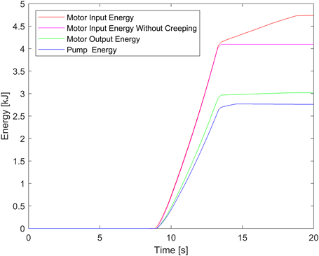
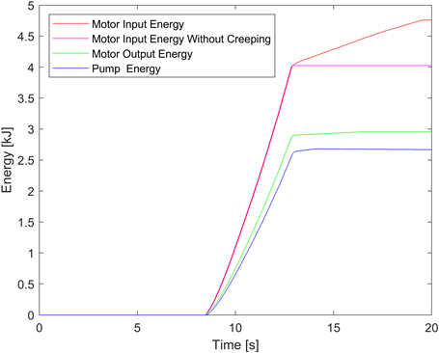
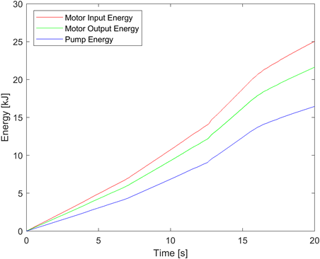
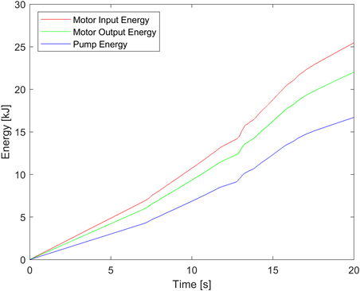
Cumulative energy consumption
With creeping
LS system energy used during motion
DHMPA energy used during accumulator charging
Energy
[kJ]
Energy type | Low inertia case |  | High inertia case
 | DHMPA (kJ) | LS system (kJ) | DHMPA (kJ) | LS system (kJ)
Electric energy | 4.09 | 14.92 | 4.01 | 15.43
Mechanical energy | 3.01 | 12.91 | 2.95 | 13.33
Hydraulic energy | 2.66 | 10.14 | 2.66 | 10.48
Motion
Motion
Charging Motion Charging Motion
t [s]
Straight comparison not meaningful because of Pressure Adjustment Valve losses etc. !!

Slide 30
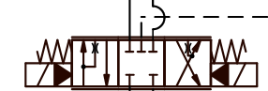
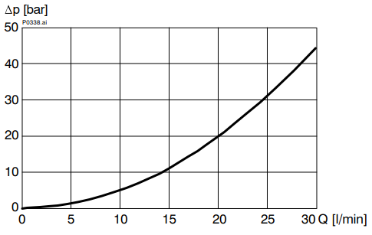
Origins of energy consumption differences
LS
Proportional valve
HIGH POWER
Function of valves
DHMPA
  Logic valve operation ⇒ pressure difference not needed for functionality
  You can have even more parallel valves
  Cartridge valves possible for high flows
LS
  Constant pressure difference (20 bar) for functionality
”Regenerative braking” in DHMPA
  Deceleration is realized by accumulators’ (HP or LP) counter pressures ⇒ acceleration
  Potential energy recovery in many cases
ON/OFF
Δp_{valve}
[bar]
DHMPA
2 parallel ON/OFF
DHMPA related losses
small
larger (p_{HP}= 55 bar)
Thermal
losses
REMEDY
Get rid of
PRV!
20% losses OFF
LP ⇒ PUMP
Friction
losses
8 bar
N₂
LP
Accumulator - Pressure Converter
PRV

Slide 31
Performance comparison?
Different systems
What to compare?
Power demand (Some of the power lost in pressure adjustment valve!)
  The peak powers for LS were high (acceleration)
  The power can be substantially lower in DHMPA system for
    Electric motor and Pump(s) ⇒ these are used OFFLINE
Rough calculations (measured results, including actuator ”work”)
  Energy consumption of DHMPA only 25 - 26% of LS system’s
More analytical version of the results, hydraulic power need during motion
  If hoses & PRV_{LP} included and actuator ”work” excluded, power need DHMPA 30% of LS system’s
  If hoses included and PRV_{LP} & actuator ”work” excluded, power need DHMPA 14% of LS system’s
Observations
  The bucket movement is FAST but the cylinder piston velocity is LOW.
  The hoses are of small diameter (6 mm)!
Huova et al. 2017
Comparison of measured energy losses in fast velocity trajectory
2.18 kJ (DHMPA) ⇔ 9.30 kJ (LS)
Energy consumption ratio 23.4%
Study of Energy Losses in Digital Hydraulic Multi-Pressure Actuator
SICFP’17, Linköping, Sweden
Pressure adjustment valve losses excluded here for LS system

Slide 32
Conclusions
Large energy efficiency improvements possible!
Two hydraulic systems in boom swing operation of 1.1 tonne JCB Micro excavator were tested
  Digital hydraulic multi-pressure actuator (DMHPA) system, second prototype
  LS system with constant pump and pressure adjustment valve
The controllability of both of the systems was adequate even though boom inertia changes (1:10)
Straight comparison of the energy efficiencies of the systems is not fair (LS system was valve controlled)
  Rough comparison gives 74% savings in energy consumption if DHMPA system is used
More detailed analysis gives conclusions as
The control valve (ON/OFF and proportional) power losses are of another magnitude since
  a) ON/OFF valves are doubled and b) cylinder piston velocity is moderate
  However, in high power applications the DHMPA system’s
    a) Amount of parallel valves can be multiplied or b) cartridge valves can be used instead
The low pressure PRV can be removed (tested) which enhances the energy efficiency
Estimated hydraulic system power consumptions of DHMPA are around 14 – 30% of LS system’s
Final conclusion: “Huge potential with low-cost components”

Slide 33
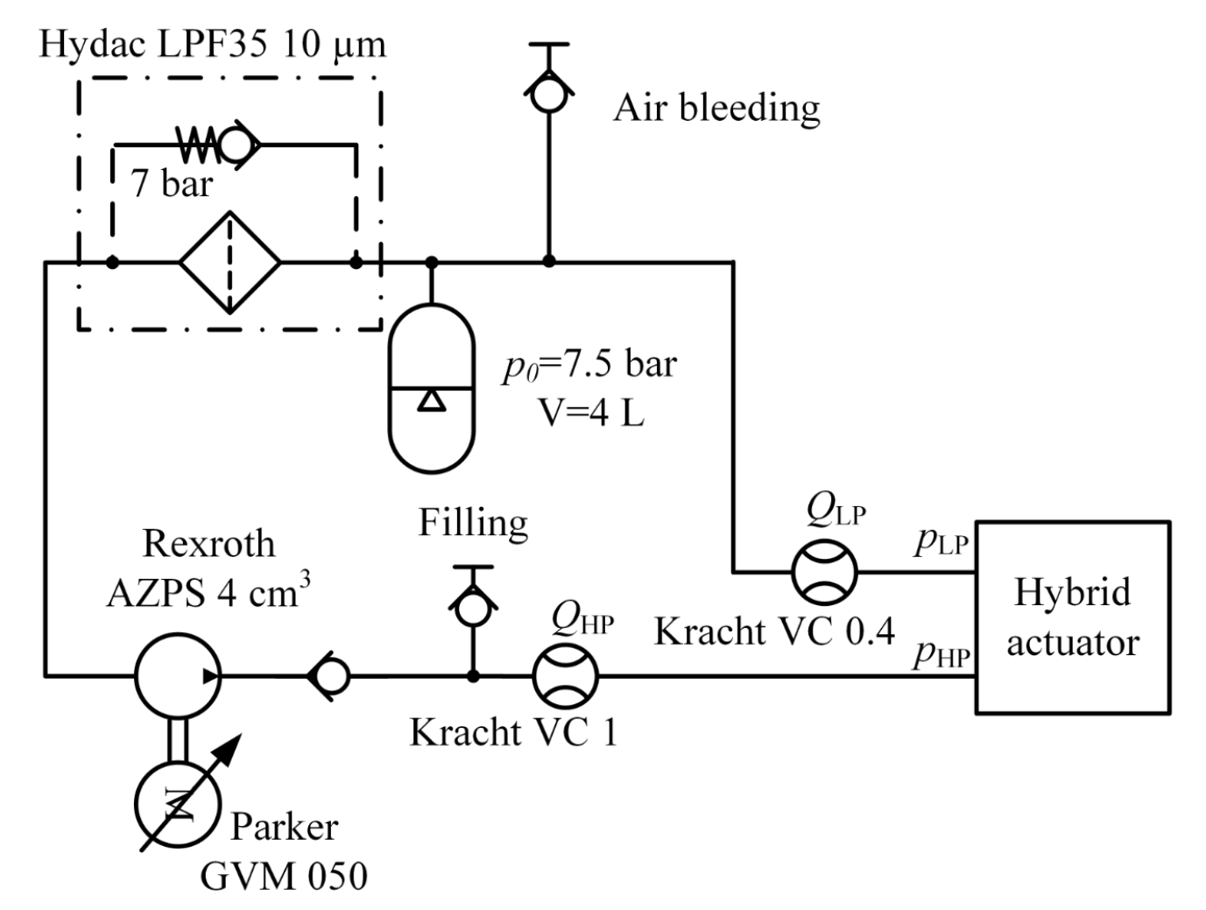
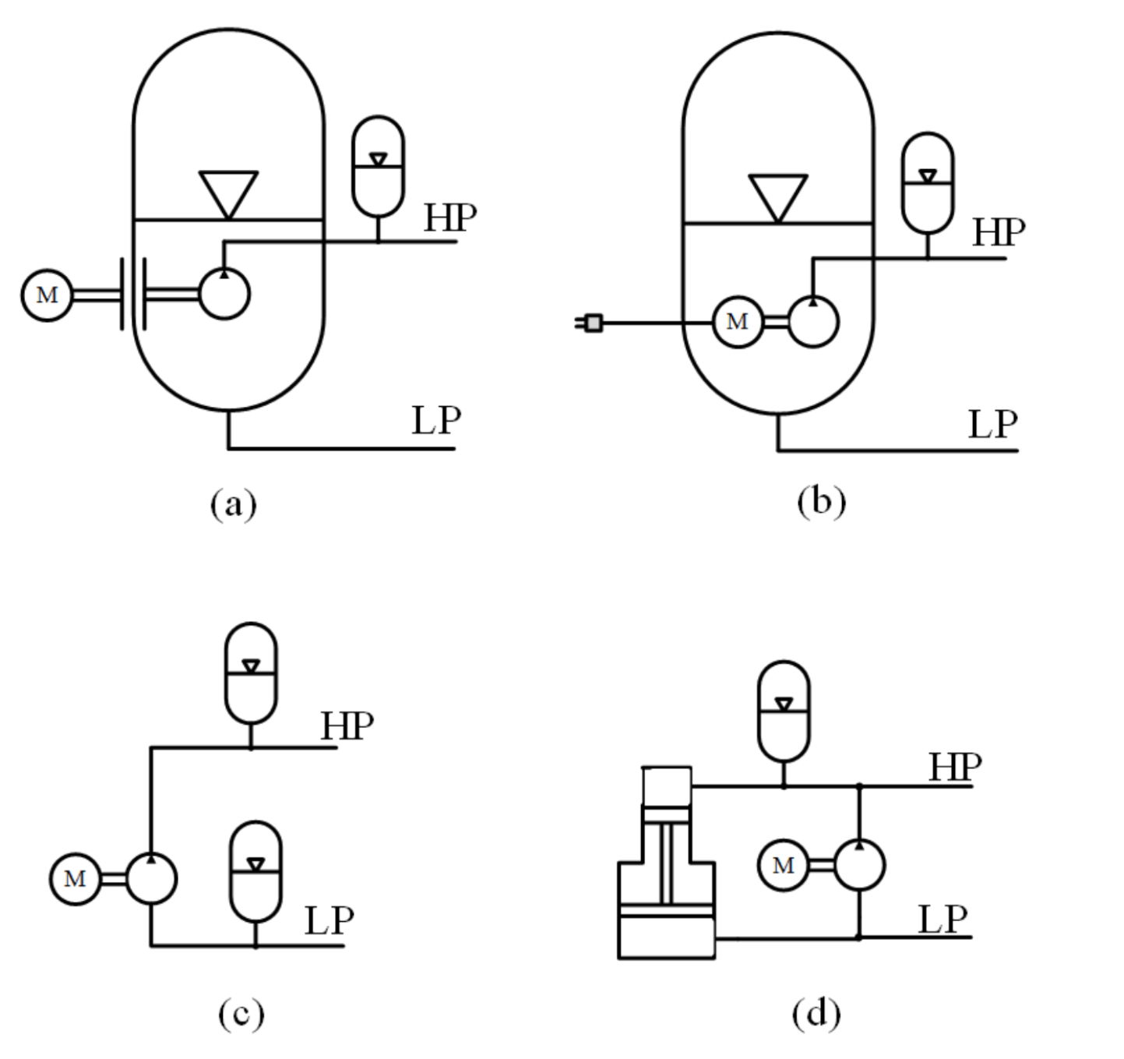
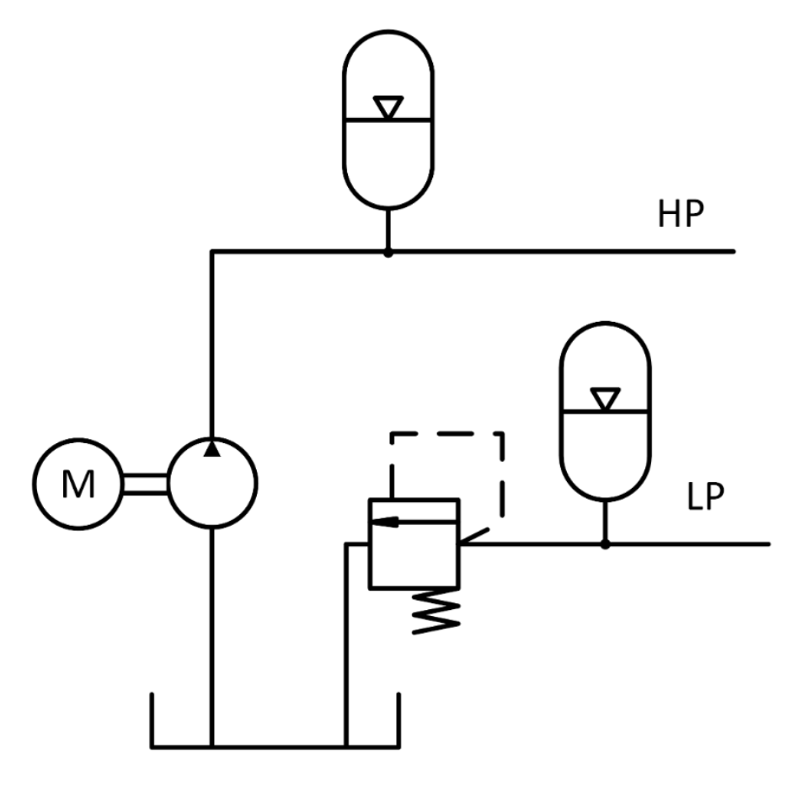
Pressurized tank line
Design ideas
Tested system
Technical challenge in options c) and d)
Both channels (LP and HP) pressurized
How to avoid in
  Gear pumps ⇒ shaft seal’s exit
  Piston pumps ⇒ high case pressure
Tested
  Special seal in gear pump
Pressure and power losses (Δp) in PRV

