Slide 1
Lecture 7: The firm: Owners, managers and employees
Juuso Välimäki
September 29, 2020

Slide 2
OUTLINE
Introduction
Firms
Owners and Managers
Employees
Labour Discipline Model
Principal-agent models

Slide 3
Introduction: Context for This Lecture
Work is an important part of human life and economic activity (Lectures 2-3 explored the individual tradeoff between work and leisure)
In models of economic interactions, bargaining determines the division of social surplus. (Lecture 6)
All parties gain from these interactions, but have conflicting interests over how these gains (profits) are shared.
How are wages determined within firms?
What are the economy-wide effects of firm interactions?

Slide 4
This Lecture
Analyze how firms differ from markets
Use a model of strategic interactions within the firm to explain how wages are determined, and how this influences unemployment
Explain the problem of incomplete contracts and hidden actions
Contrast with competitive labor market (Principles II will take a more detailed look at the labor market)

Slide 5
Firms: What is a firm?
Firm = a business organization which maximizes the profit from its operations
Employs workers and rents or owns capital
Purchases intermediate goods from the market to produce goods and services to be sold in the market
Intermediate goods: goods used as inputs in the production of the final product to be sold in the market
Profit is the difference between market revenues from sales and costs of operation (labor and capital costs and purchase of intermediate products)
May have market power to set the price of its products
For next Lecture, read and be ready to discuss “The Social Responsibility of Business Is to Increase its profit” by Milton Friedman available at https://www.nytimes.com/1970/09/13/archives/a-friedman-doctrine-the-social-responsibility-of-business-is-to.html

Slide 6
Firms vs. markets
In a capitalist economy, the division of labour is coordinated in two ways: firms and markets.
Coordination within firm differs from coordination via markets:
concentration of economic power in the hands of the owners/managers allows them to issue commands to workers
Power is decentralized in markets, so decisions are autonomous and voluntary
“The firm in a capitalist economy is a miniature, privately owned, centrally planned economy.”

Slide 7
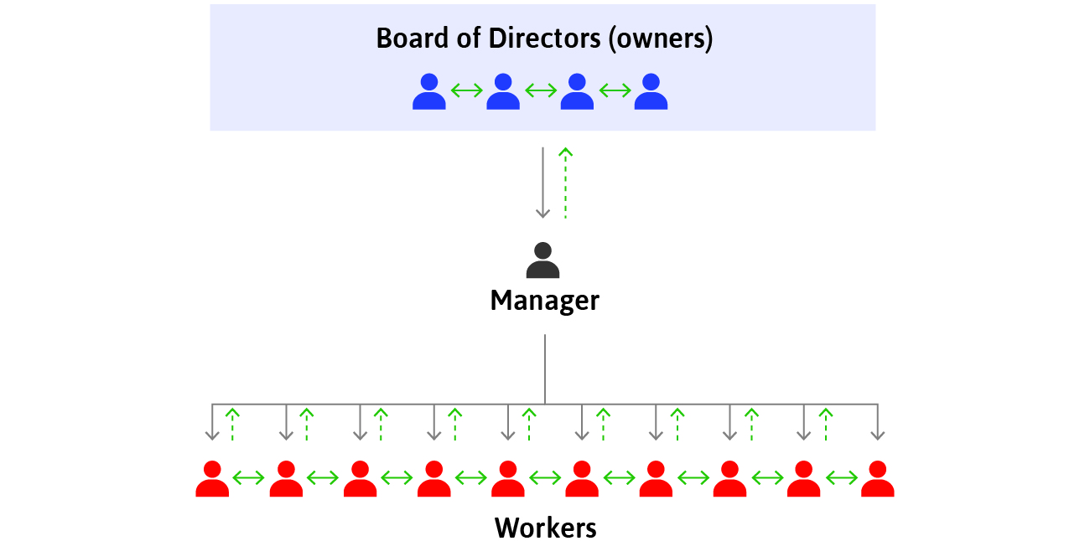
Structure of a firm
Owners decide on long-term strategy
Managers implement their decisions by assigning tasks to workers and monitoring them
Solid arrows denote commands, dashed arrows information flows

Slide 8
Contracts
Firms and markets differ in the contracts that form the basis of exchange.
Contract = a legal document or understanding that specifies a set of actions that parties to the contract must undertake.
Contracts for products sold in markets permanently: transfer ownership of the good from the seller to the buyer.
Contracts for labour temporarily transfer authority over a person’s activities from the employee to the manager or owner.

Slide 9
Relationships within a firm
Unlike in markets, relationships within a firm may extend over a long period of time.
creation of network of colleagues
acquisition of skills necessary for the job
These skills, networks, and friendships are firm-specific assets.
They are valuable only while the worker remains employed in a particular firm.
When the relationship ends, value is lost to both sides.
It is important to take good care of this relationship

Slide 10
Owners and Managers: Separation of ownership and control
Managers ≠ owners
Separation of ownership and control = when managers decide on the use of other people’s funds.
Why is this separation so prevalent?
What other forms of organizing are there? What explains these alternative forms in particular markets?
Economics of organizations

Slide 11
Asymmetric information
The dashed upward green arrows represent a problem of asymmetric information between levels in the firm’s hierarchy.
Owners or managers do not always know what their subordinates know or do, not all of their directions or commands are necessarily carried out.
Do the managers always want to report favourable market conditions?
Can the managers see directly the work effort of their employees?

Slide 12
Owners and managers: conflict of interest
The firm’s profits legally belong to the people who own the firm’s assets.
managers’ actions have impact on profits
but if profits increase thanks to managers’ work, they will not automatically benefit
This may create a conflict of interest between managers and owners.

Slide 13
Aligning interests
To solve the conflict of interest between managers and owners:
link the managers’ pay to the performance of the company’s profit or share price
monitor the managers’ performance
But this is not easy:
performance depends on factors beyond managers’ control
how large is the impact of any single individual on performance?
if effort is costly to individuals, social dilemmas in the firm may result
maybe the most important aspects of individual performance are the hardest to monitor

Slide 14
Employees in Firms: Incomplete Contracts
Hiring employees is different from buying other goods and services.
The contract between a firm and its employees is incomplete:
some tasks depend on future (unknown) events
some aspects of the job are difficult to measure and base wages on e.g. effort
Incomplete contract does not specify, in an enforceable way, every aspect of the exchange that affects the interests of parties.
The quality of employee services depends on the terms of the relationship: successful employment relation can be seen as repeated gift giving between employers and employees

Slide 15
Piece rate pay
Why not base pay directly on output: pay a fixed rate for a completed construction project, fixed pay per liters of berries picked etc.
Piece rate work = a type of employment in which the worker is paid a fixed amount for each piece of production.
Piece rate pay gives workers an incentive to exert effort.
Nevertheless, they are rarely used in most of today’s firms:
it is difficult to measure output in modern jobs
employees often work as a part of a team

Slide 16
Workers’ effort
If firms can’t directly measure effort, why do workers work hard?
Social concerns
work ethic: upbringing, self-signaling etc.
feelings of responsibility and solidarity towards other team members
to reciprocate a feeling of gratitude for good working conditions (gift giving to the employer)
Selfish motives
benefits for measurable output
promotions (based on measured or reported outcomes)
fear of being fired (fear of losing a good deal)

Slide 17
Employment Rents
Employees fear getting fired when they are paid more than their opportunity cost of working given by their reservation option: by working, they receive employment rent.
Employment rent = cost of job loss, which includes
Lost income while searching for a job
Costs required to start a new job e.g. relocation
Loss of non-wage benefits e.g. medical insurance
Social costs (stigma of being unemployed)

Slide 18
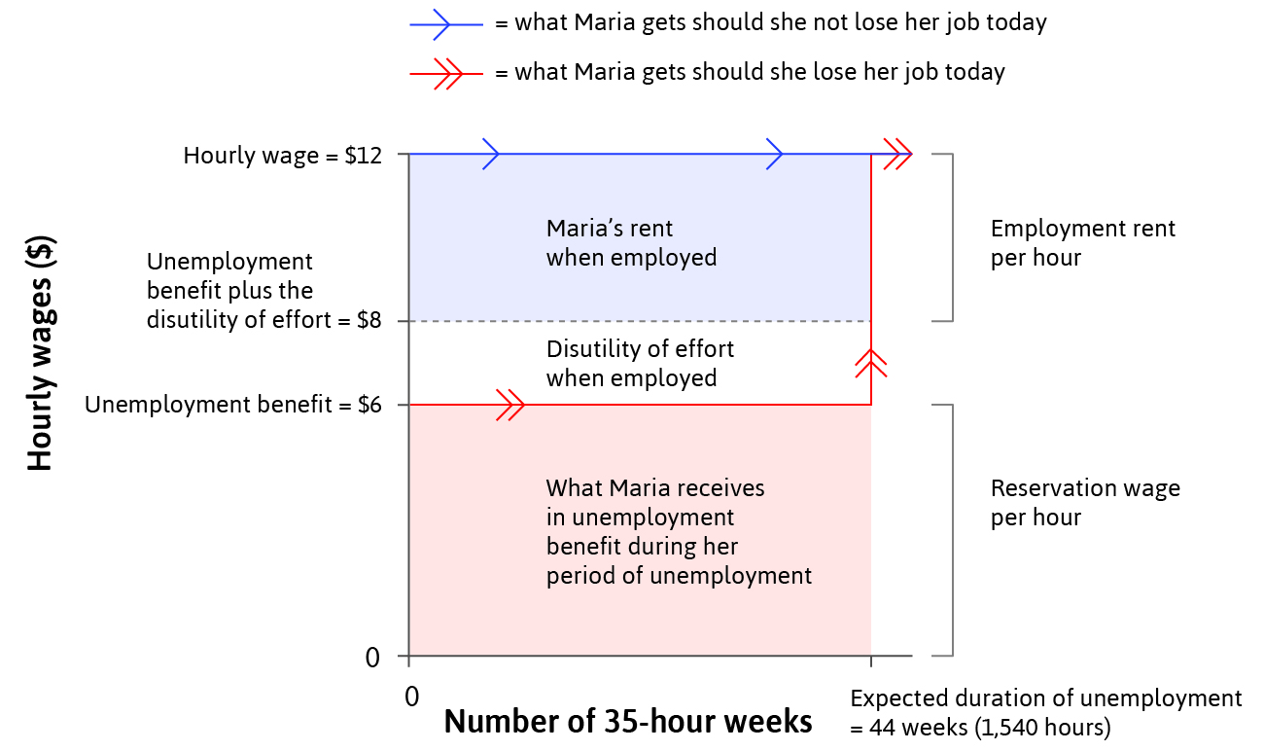
Calculating Employment Rents
Reservation wage = opportunity cost = value of
the next best option
(other employment or unemployment benefits)
Employment rent =
wage – reservation wage
– disutility of effort

Slide 19
Losing a job in Finland
How to estimate the monetary effect of job loss?
challenge for empirical work: selection
those losing their jobs might be different
maybe managers get rid of unproductive workers
future wages may be lower because
unemployment lowers lifetime expected income
less productive workers would have earned less in any case
more credible etstimates of the effects for plant closings during recessions

Slide 20
Earnings and income after job loss due to plant closing
Source: Gathmann, Jernström, Huttunen, Stitzing, Sääksvuori: ”In Sickness and Health: Job Placement and Health Spillovers in Couples”, 2020, IZA DP 13329.

Slide 21
Labor Discipline Model: Wages and Effort
The employer cannot directly measure the worker’s effort
Large employment rent → large cost of job loss →
worker puts in more effort to reduce chance of getting fired
One way to increase the cost of job loss is for the firm to raise wages.

Slide 22
The Employment Game
The employer chooses a wage per hour worked. As long as the worker works hard enough, she will keep her job at the offered wage.
The worker chooses a level of work effort, taking into account the costs of losing her job if she does not provide enough effort.
Payoffs:
Firm: profit = worker's output – wage
Worker: employment rent

Slide 23
Backward Induction
This is a two-stage game (similar to ultimatum game)
In the last stage, after receiving a wage offer, employer chooses her effort level
When offering a wage, the employer can anticipate the resulting effort
The wage is chosen so that the benefit to the employer from the resulting effort net of wage costs is maximized
Backward induction means that the analysis starts with the last stage

Slide 24
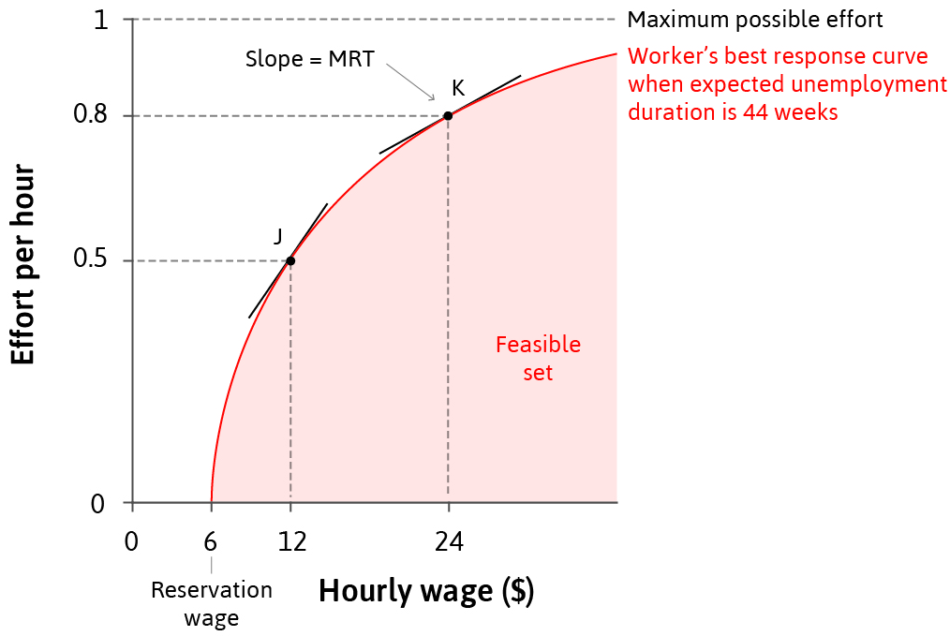
Worker’s Best Response Curve
Best response curve shows the optimal amount of effort workers will exert for each wage offered
Represents the firm’s feasible frontier for wages and effort
Slope of best response curve = MRT for the firm. Extra pay needed for additional effort.

Slide 25
Firm’s best response
To maximise profits, firms want to minimise the costs of production.
Because there is a trade-off between wages and effort, the employer should find a feasible combination of effort and wage that minimises the cost per unit of effort.

Slide 26
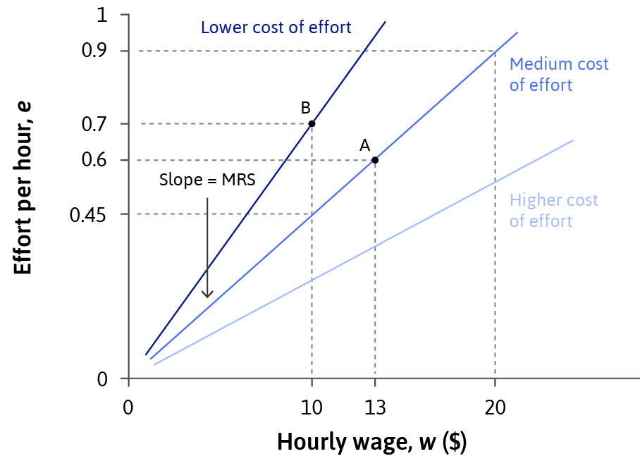
Isocost lines for effort
The cost of effort is the same at all points on an isocost line.
Slope of isocost curve = MRS = the rate at which the employer is willing to increase wages to get higher effort.

Slide 27
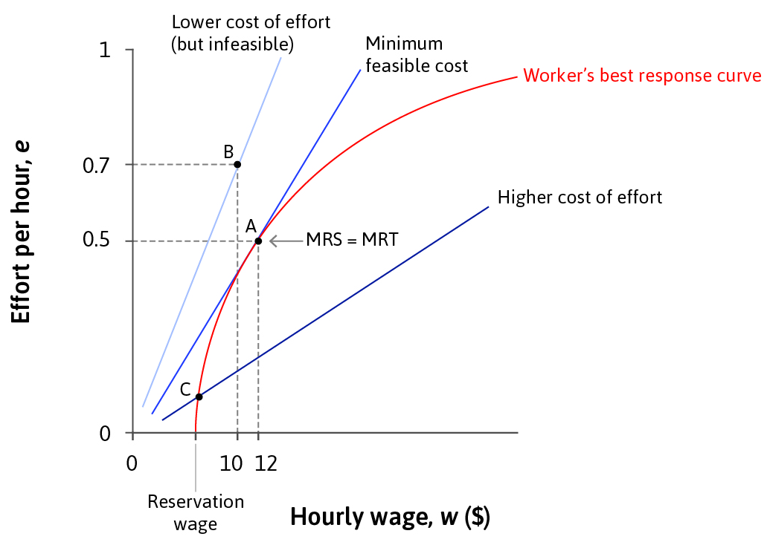
Determining wages
Profits are maximised at the steepest isocost line, subject to the worker’s best response curve.
MRS = MRT
Efficiency wage = wages set higher than the reservation wage so workers will care about losing the job and provide more effort.

Slide 28
Involuntary unemployment
Involuntary unemployment = being out of work, but preferring to have a job at the wages and working conditions that otherwise identical employed workers have.
There must always be involuntary unemployment or some other form of punishing the worker with a loss of employment rent (shift to less pleasant jobs etc. without an immediate possibility of getting a new good job at another firm)
Why? In equilibrium, both wages and involuntary unemployment have to be high enough to ensure employment rent is high enough for workers to put in effort.

Slide 29
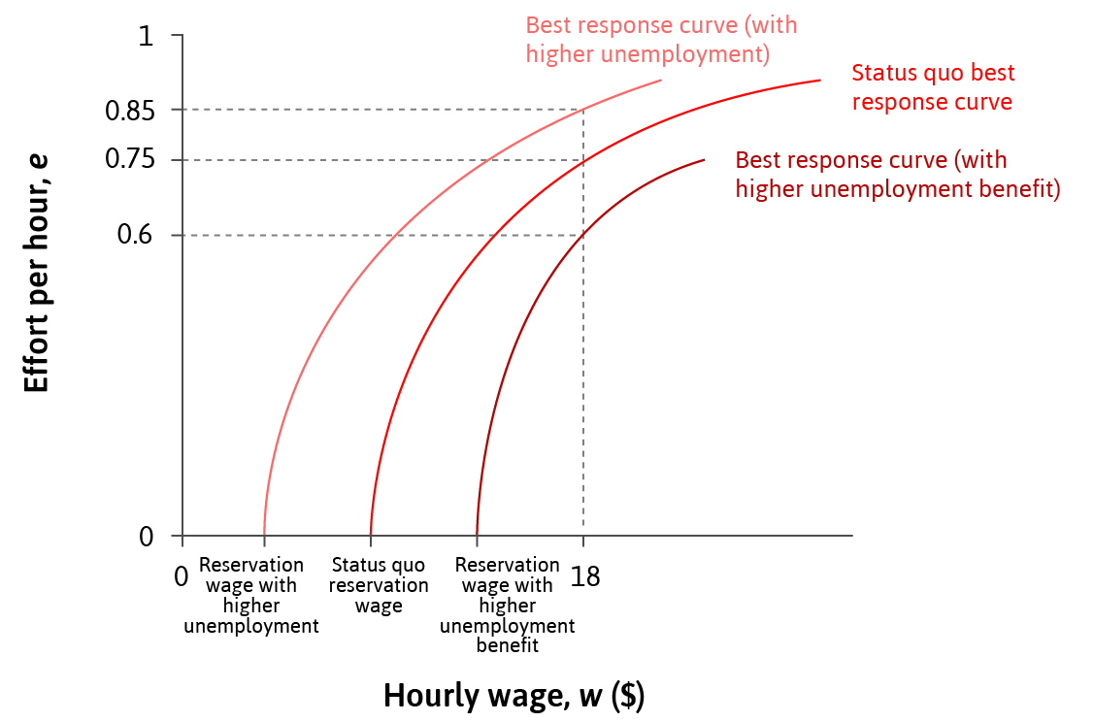
Factors shifting the equilibrium
The best response function will shift in reaction to changes in:
the utility of the things that the wage can buy
the disutility of effort
the reservation wage
the probability of getting fired at each effort level

Slide 30
Principal-Agent Models and Contracting in general
Incomplete contracts do not only occur in employment relationships.
Incomplete contracts arise when:
information is not verifiable
the relationship covers periods of time
there is uncertainty
there are difficulties with measurement
preferences for omitting some information

Slide 31
Principal-agent models
Principal-agent models capture interactions under asymmetric information
e.g. manager -> principal and worker -> agent
owner -> principal, manager -> agent
banker -> principal, entrepreneur -> agent
insurance company -> principal, insured -> agent
Agent takes action that is hidden or has information that is hidden from the principal
moral hazard and adverse selection
these terms arose in insurance: risky behaviour (e.g. drinking or smoking) and prior info on risk type (e.g. pre-existing condition, family health history)

Slide 32
Hidden Action Problems
A hidden action problem occurs when there is a conflict of interest between the principal and the agent
over some action that is taken by the agent
and this action cannot be subjected to a complete contract.
The information about the action may be either asymmetric (the principal does not have the information) or unverifiable (the information cannot be used in court to enforce the contract)
More about contracting in future courses

Slide 33
Summary
Firms: owners and managers have power over workers
Contracts are incomplete – do not cover worker effort
Employment rents motivate workers to exert effort
An example of a hidden action problem between a principal (firm) and an agent (worker)
2. Labour-discipline model of wage-setting within firms
Isocost curves = firm’s ‘indifference curves’
Best response curve = maximum feasible effort, given wages
Profit-maximising choice where MRS = MRT
Involuntary unemployment as a feature of the equilibrium

Slide 34
In the next lecture
Models of interactions between firms and customers
How the gains from trade are divided between consumers and owners of the firm
The effects of taxes and firm competition on prices and purchases

