Slide 1
Stress and Time management – Tips from Study Psychologists
Materials by Aalto psychologists, 2020.
Study psychologist Sanni Saarimäki
sanni.saarimaki@aalto.fi
Mikkeli campus, Zoom-meetings 7.-8.10.2020

Slide 2
Agenda for today
16.00-16.10 Getting to know each other (a bit, at least) and what we gonna do today
16.10-16.20 Flinga: Beginner’s guide to stressing…
16.20-16.45 Sanni: Psychological flexibility and stress
Break 5 minutes
16.50-17.10 ABC-time management exercise
17.10-17.20 Tips for remote learning
17.20-17.40 Instructions for group work (2nd workshop) and “meeting” your group
17.40 Any questions? If not, finishing our workshop today ☺

Slide 3
Getting to know each other
Write down in Zoom chat: Introduce yourself to others (name, where are you from) and also, mention one thing you have done for your wellbeing in recent weeks, no matter how small or big act it has been
It’s important to write your name in chat, because it is also marking that you have taken part in this session today! ☺

Slide 4
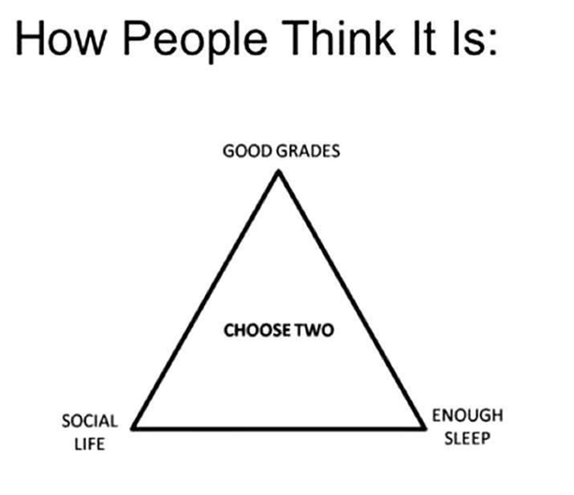
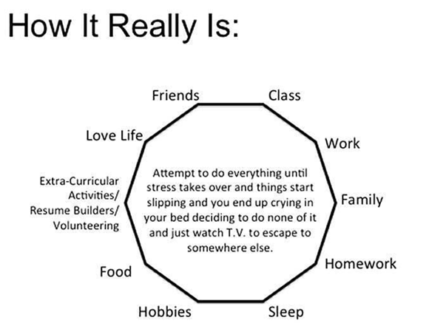

Slide 5
Beginners’ guide to stressing yourself out…
You got 5 minutes – write down in Flinga https://flinga.fi/s/FQMJJ8A :
How to cause as much stress as possible in your position for
  yourself
  your study group?
Think about your own and other’s influence (actions) but also situational and other factors you can/ can’t modify.

Slide 6
Time management (and learning to use a calendar) may sound boring and tedious and are often seen as being in the same category as managing your personal finances: You really don't think about it, until it's already "too late".
Do these sound familiar to you?: ‘I know how to plan, but the problem is putting the plans into action!’ ‘I do make plans, but I just don’t have enough time to do all I should!’
Time management is not just about taking care of responsibilities. It helps you see what you really spend your time on and why. The underlying question is a fundamental one: how do you spend your limited time on this Earth? Your calendar says a great deal about what you actually spend your time on.
Does your calendar reflect your values and the things you hold dear? Does it take you towards something meaningful? If not, what do you think should change?

Slide 7
I end up living inside my mind, worrying about or glorifying future or past. I don’t really live in this moment.
I feel really stressed and end up avoiding things I should be doing: I’ll start Netflix-marathon, FB, cleaning my room... Or I ruminate and worry inside my head.
I’m not sure what my values are, or I’m not truly committed for them, or it’s not possible to follow my values for some reason
Psychological inflexibility
I start to believe my negative thoughs are reality, and end up acting upon them.
I end up following impulses, without no goals, or I start over-doing everything, or became really passive.
Things don’t go as I hope, and I’ll end up blaming myself
Lähde: ks. Esim. Lappalainen & alt, Hyväksymis- ja omistautumisterapia käytännön terapiatyössä, 2009.

Slide 8
Be present and kind for yourself. Live more in this moment and have compassion for yourself.
Acceptance:
Accept that you have thoughts and feelings, you have a history and that there are things you can’t change. But, change what you can: your actions.
Values:
What is important to you? Now and in the long run?
Psychological flexibility
Don’t let your mind control you.
You are not the same as your thoughts – you HAVE thoughts.
Acts that are based on your values!
Healthy self-image:
Let go of negative thoughs (this is not the same as avoiding them!)
Lähde: ks. Esim. Lappalainen & alt, 2009.

Slide 9
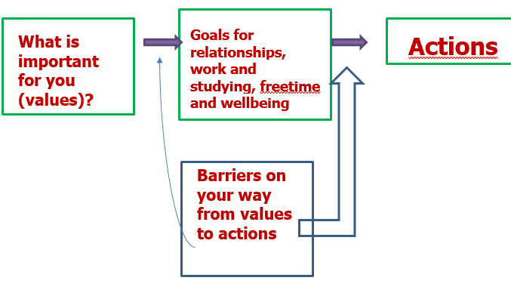

Slide 10
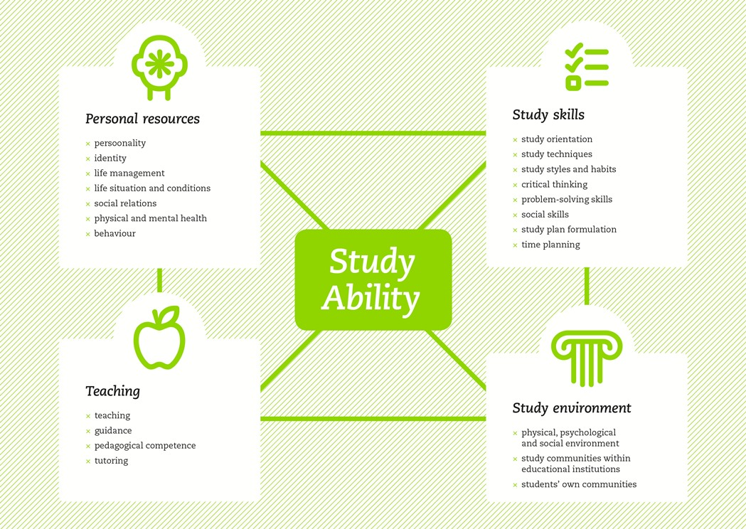
Many things can stress
Kunttu, 2008, 2009
Study techinique does not fit to university?
Something happens in your life?
Teaching methods are not suitable for you?
No one to study with?

Slide 11
ABC- the time management exercise
See instructions: https://mycourses.aalto.fi/mod/book/view.php?id=637910

Slide 12
Stress
Stress is natural part of life and learning.
Stress is an experience in which requirements from environment (studying, working, relationships, etc.) are /seem higher than your own resources, right now, for coping
Short term and not too strong stress is important and beneficial and can help you do better.
Stress is not only on your mind. Physiological changes are real part of stress.
Strong or long term stress might reduse your health and/ or performance.

Slide 13
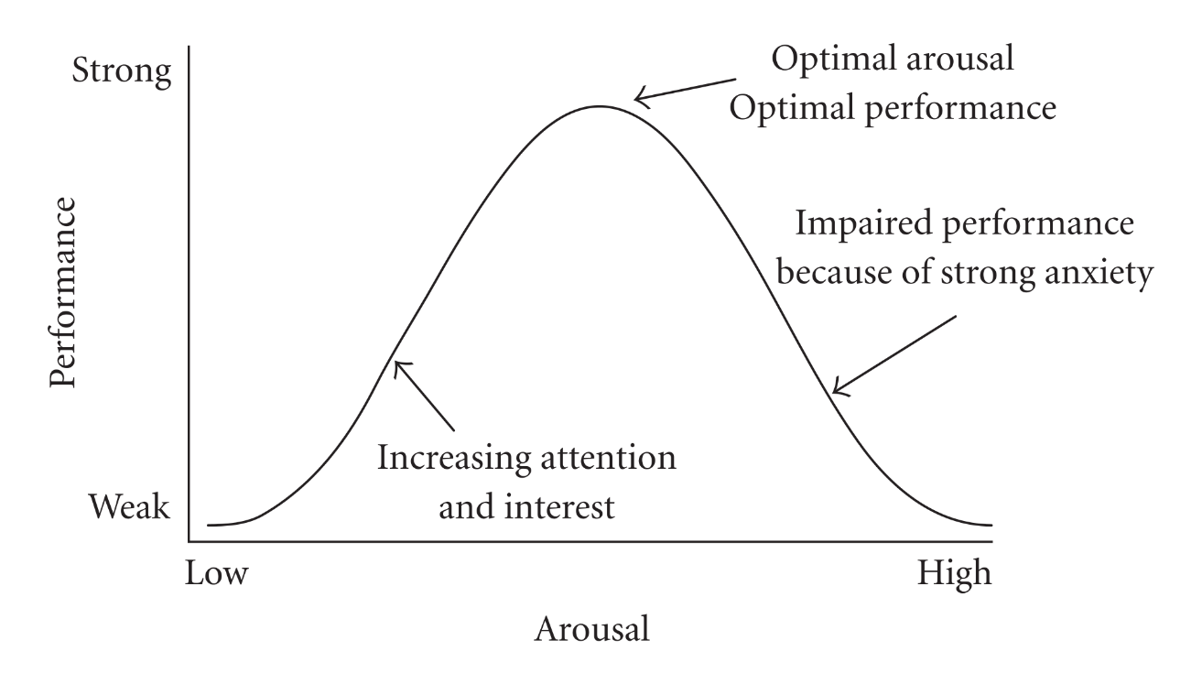
Yerkes–Dodson law

Slide 14
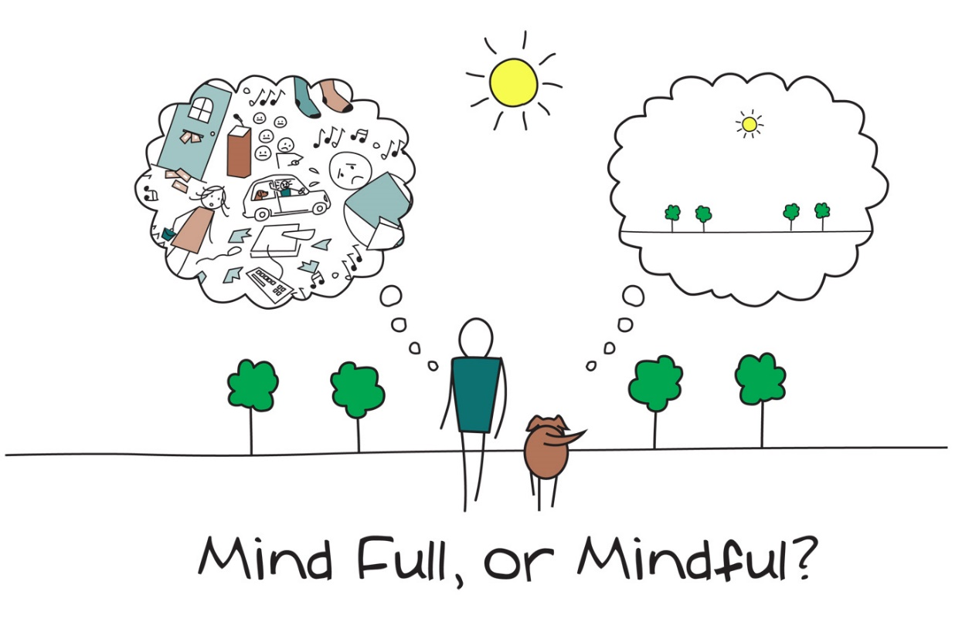
Stress is just an experience?
https://www.uhs.umich.edu/files/uhs/field/image/Mindfulness.jpg

Slide 15
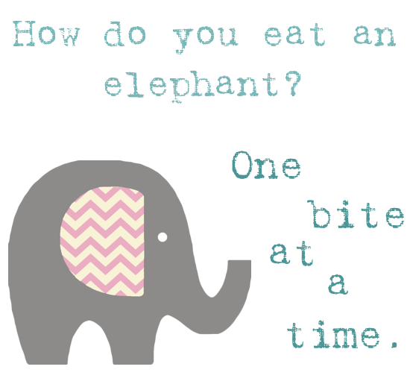
Points to consider
Make a plan
Start with writing down ”big” dates
Longterm / shortterm goals
Devide goals on tasks and devide tasks on smaller tasks – the smaller the better!
Be realistic when you set goals
Don’t leave tasks too close to the ”big” dates

Slide 16
Points to consider
Monitor your use of time
Write down everything, you need to get your brain capacity on working - use calenders, notes, to-do-lists
Consider where you work and when you work - what’s your prime time and place?
What is the best study method for this project?
Be constant - try to avoid work/study days when you end up doing nothing because you haven’t planned anything in advance.
Remember to rest and have freetime. Plan in advance that you have time for that!

Slide 17
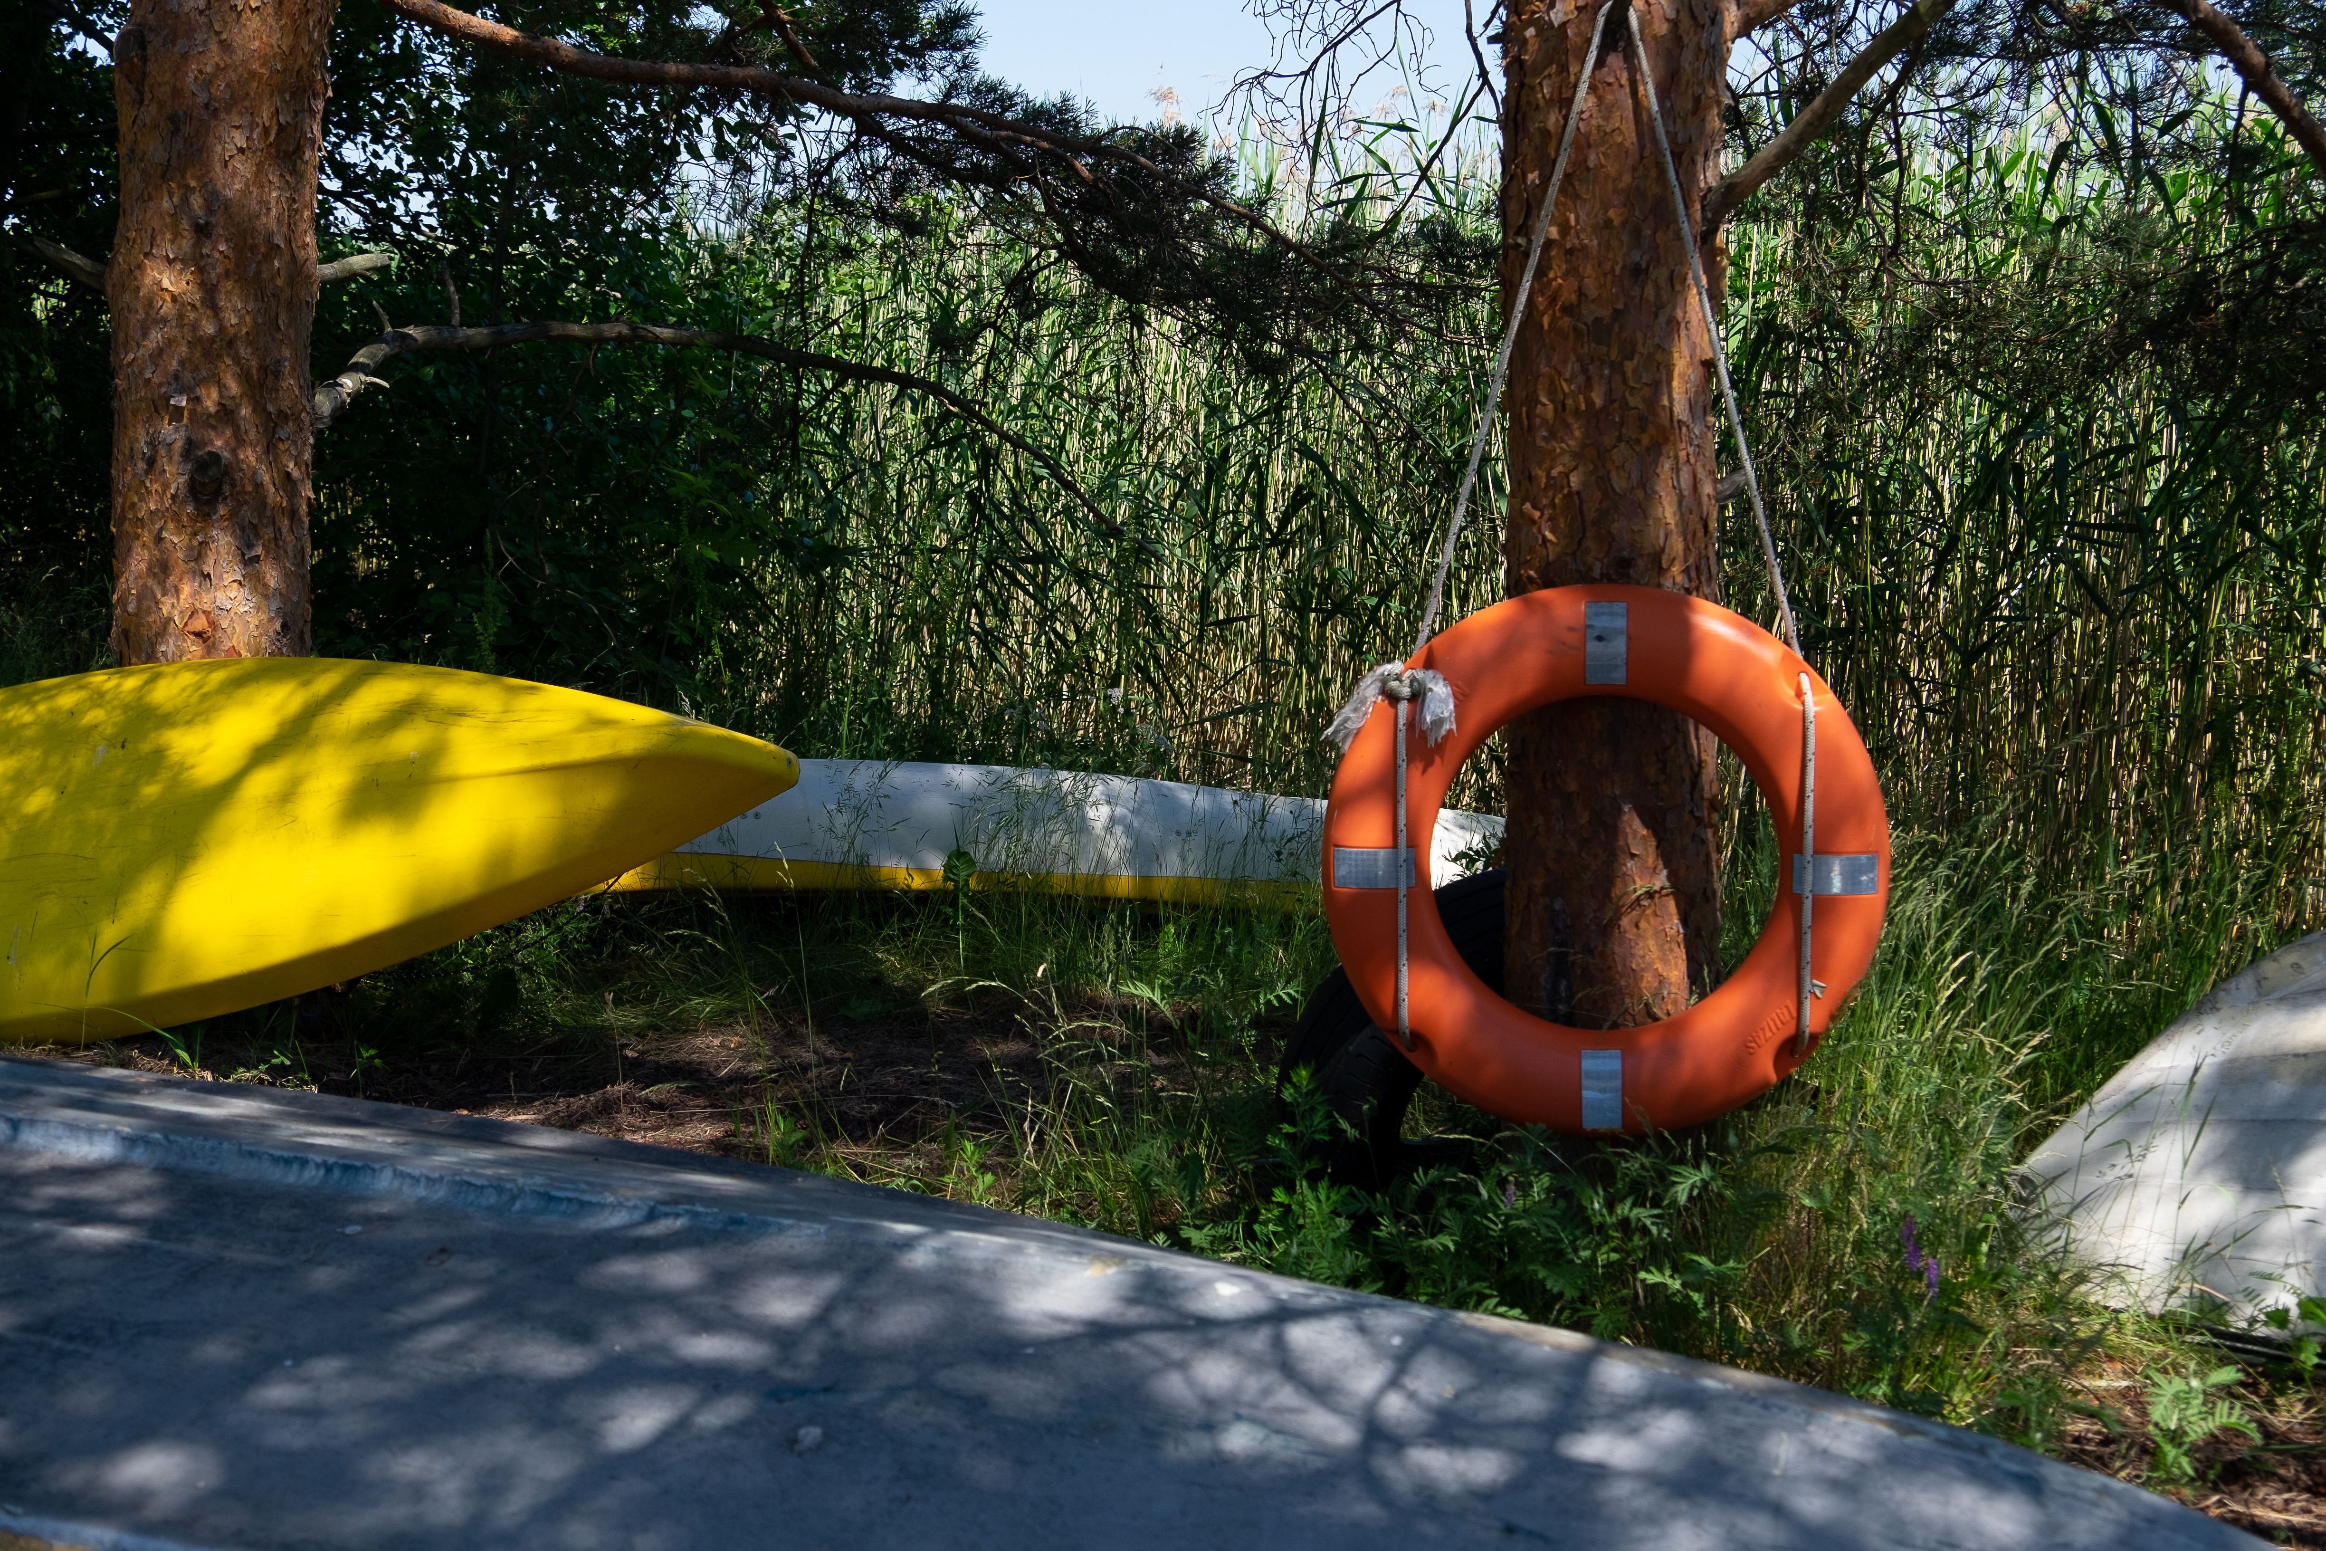
Supporting your study ability in learning remotely
Four elements to successful remote studying
Student Services
August 2020

Slide 18
1. Joy and wellbeing
Focus on things that are meaningful to you and bring you joy
Take the time to exercise the way that suits you best – remember both, your body and mind
Try to get enough sleep
Eat healthy food
Most of all - be kind to yourself
2. Study habits and daily rhythm
Create a daily study schedule with enough breaks
Sometimes plans fail -try to accept it and try again
Set small and clear goals that keep you motivated
Focus on one thing at a time – be mindful and avoid interruptions. For example, try putting your phone in an airplay mode when you study
Make your studying space as cozy as possible
3. Teaching and learning
Attend to remote study groups and tutoring online
Remember that you can always reach out, ask for advice, feedback and guidance from your teacher, academic advisor and Learning services
4. Aalto Community
Schedule video study groups with your peers
Schedule online social time with your peers
Set shared goals with your peers and set rewards for work completed
In addition to being kind towards yourself, be kind and non-judgmental towards others

Slide 19
Manage Your Energy!
PHYSICAL ENERGY
Enhance your sleep by setting an earlier bedtime and reducing alcohol use.
Reduce stress by engaging in cardiovascular activity at least three times a week and strength training at least once.
Eat small meals and light snacks every three hours.
Learn to notice signs of imminent energy flagging, including restlessness, yawning, hunger, and difficulty concentrating.
Take brief but regular breaks, away from your desk, at 90- to 120-minute intervals throughout the day.
EMOTIONAL ENERGY
Defuse negative emotions—irritability, impatience, anxiety, insecurity—through deep abdominal breathing.
Fuel positive emotions in yourself and others by regularly expressing appreciation to others in detailed, specific terms through notes, e-mails, calls, or conversations.
Look at upsetting situations through new lenses. Adopt a “reverse lens” to ask, “What would the other person in this conflict say, and how might he be right?” Use a “long lens” to ask, “How will I likely view this situation in six months?” Employ a “wide lens” to ask, “How can I grow and learn from this situation?”

Slide 20
Manage Your Energy!
MENTAL ENERGY
Reduce interruptions by performing high concentration tasks away from phones and e-mail.
Respond to voice mails and e-mails at designated times during the day.
Every night, identify the most important challenge for the next day. Then make it your first priority when you arrive at work in the morning.
SPIRITUAL ENERGY
Identify your “sweet spot” activities—those that give you feelings of effectiveness, effortless absorption, and fulfillment. Find ways to do more of these. One executive who hated doing sales reports delegated them to someone who loved that activity.
Allocate time and energy to what you consider most important. For example, spend the last 20 minutes of your evening commute relaxing, so you can connect with your family once you’re home.
Live your core values. For instance, if consideration is important to you but you’re perpetually late for meetings, practice intentionally showing up five minutes early for meetings.

Slide 21
In groups, share ideas about following questions:
What a balanced (study or work) life means for you? How do you notice if your life is in balance or not? How distant/remote studying and learning can affect your study motivation and wellbeing (positively and negatively)?
What could “balance” mean for you (students) in these times of global uncertainty? How can you make your life a balanced-one? Or is it even possible during pandemia-times? If yes/not, why? What obstacles or stressors can there be waiting for you?
What helps you when problems might arrive? What can you do in advance to make it easier for you to overcome problems?
How can you support each other's wellbeing and study/work motivation?
From where can you get help/ support/ tips when you or your fellow-students need it?
What kind of stress and time management tips would you recommend to others (what have you tried yourself and found useful) especially for remote/distant studying and promoting your study-wellbeing?

Slide 22
More information?
Read more about: Self management and time management: https://into.aalto.fi/display/enopisk/Self-management+and+time+management
Condition to study: https://into.aalto.fi/display/enopisk/Condition+to+study
  Especially useful for study and work-life are texts titled “Self-compassion” and “Perfectionism”.

Slide 23
Wondering how your career plans fit in all this?
MyCourses / Career Planning Exercises
https://mycourses.aalto.fi/course/view.php?id=19069
This self-help material is designed to help you to process the key elements of career planning individually.
The sequence of exercises is numbered. You can do them in the same order or you can choose only the ones that appeal to you most and seem to help you. Having completed an exercise, reflect the results. What do the results of that reflection add to your self-awareness, your current thinking and goals of a good future as an individual and as a member of a society? How can you use the results? What will you do next?
How to enroll into the workspace
Login to MyCourses
Go to the enrollment page and click the "Enroll me" button

Slide 24
Next steps
Read material from MyCourses and this pp-slide-show in advance and think your own answers for those group-work questions. Then, let’s meet again:
Group A, groupwork:
Wednesday, October 28 at 16-18 (Finnish time, UTC +3) https://aalto.zoom.us/j/69680866834
Group B, groupwork:
Thursday, October 29 at 16-18 (Finnish time, UTC +3) https://aalto.zoom.us/j/66081055391

