Slide 1
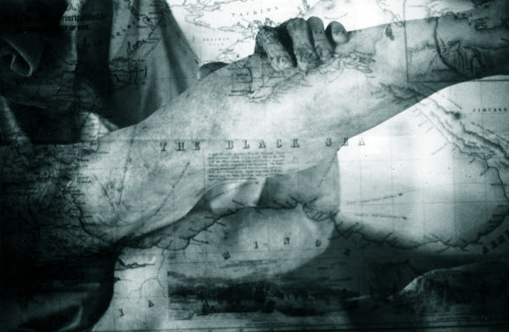
POLITICS
REPRESENTATION
EMERGING PRACTICES
INDUSTRY
COMMUNITY OF PRACTITIONERS
WORK OF ART
AUTHORSHIP
CRAFT
PRACTICE/CONVENTION
PROFESSIONAL IDENTITY, PRACTICES IN THE FIELD ETC.
What particular aspect of practice does your
experimenting in your artistic /practice component relate to?
CHALLENGING THE ”WAY WE DO IT”
MAKING TACIT KNOWLEDGE VISIBLE
FORMS, CONVENTIONS OF MAKING, STYLES, METHODS
PRACTICE-LED/
ARTISTIC RESEARCH
QUESTIONS
”New” methods, forms, aesthetics
POETICS (MAKING)
PRAXIS(DOING)
CRITICAL RELATION TO TRADITION,
CONVENTIONS
REDEFINING THE TRADITION WITHIN SOME PARTICULAR CONTEXT OF PRACTICE

