Slide 1
Bio Inspired design – MEC E-3002 Methods in Early Product Development
By: Mikko Sjöholm 481111
Gustavo Alves Alarcon 800349
Tuukka Virkki 432597
Filimon Paasilahti 670553
16.10.2020

Slide 2
Bio-Inspired Design
Definition:
Bio-Design: “Integration of design with biological systems, often to achieve better ecological performance. Bio-Design incorporates living organisms into design as building blocks, material sources, energy generators, etc” (Myers, 2012, pg.1).
Biomimicry/Bio-Inspired Design: “A thoughtful approach to design and engineering that looks to nature as inspiration, measure and mentor” (Myers, 2012, pg.7). “Biomimicry involves the translation of knowledge obtained from the natural world into new innovations” (van Leeuwen, n.d)

Slide 3
Meaning to Product Development
A response to the need to build and manufacture sustainably
Generally requires collaboration between designers and life scientists
Biology knowledge has grown over the years, which allowed for fundamental progress in engineering and design.
High potential for products/systems that alleviate impacts of the legacies left behind by industrial revolutions, wars, etc.
High potential for products/systems that improve quality of life of humankind, whilst making the primary design principle to be sustainability.

Slide 4
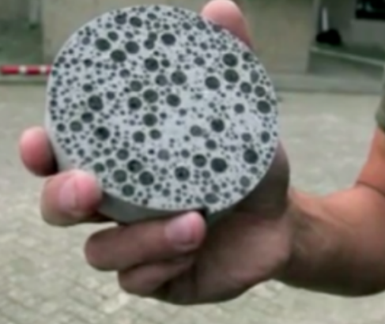
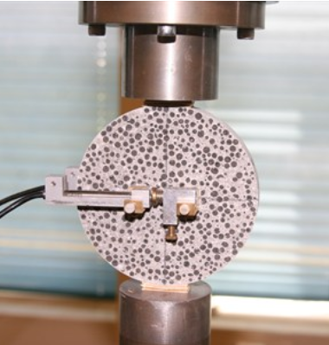
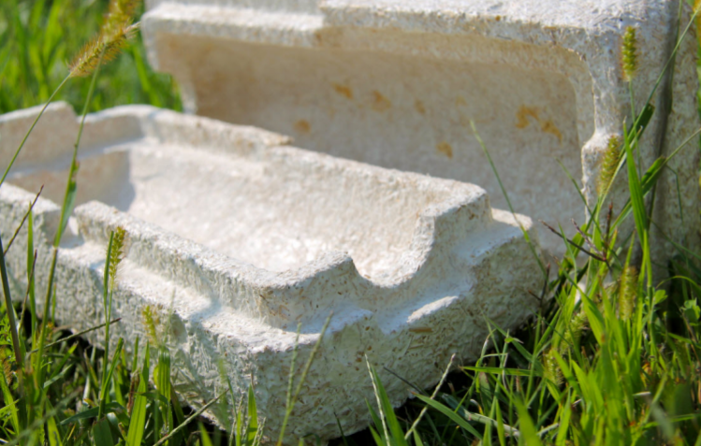
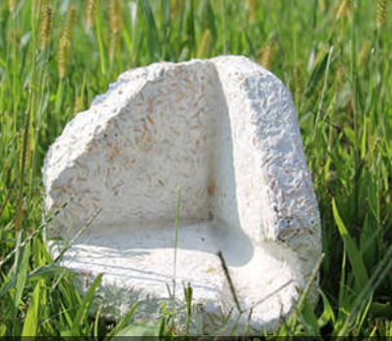
Examples of Bio-Design
Bio Concrete
Developed by Henk Jonkers at Technology University of Delft
Makes use of bacterium Sporosarcina pasteurii, which naturally secretes limestone under certain conditions
As naturally occurring cracks in concrete occur, the limestone secreted by bacteria effectively repair the concrete
Cheaper maintenance costs and increased service life of concrete at the expense of reduced mechanical properties
Current Studies
Microbes found within nuclear reactors that are able to continually protect and repair own DNA even during constant exposure to radiation. Potential for use in cancer treatment patients.
A microorganism that has been found to survive outside Space Stations for over 500 days, in freezing and in vacuum of space conditions.
Study of the radial glia stem cell that allows geckos to regrow their tails. Potential for use in spinal injury treatment.
EcoCradle
Developed by Ecovative Design, US-based company
Eco-Friendly packaging product made from crop waste and mushroom roots (mycelium, a group of fungal cells which acts as a glue)
Competitive alternative to petroleum polymer foam, which can last thousands of years.
Can be formed/moulded to create virtually any shape, size or form.
Images 1 and 2 – "Bio Concrete", Myers, 2012 pg. 3
Images 3 and 4 – "EcoCradle", Myers, 2012, pg. 4

Slide 5
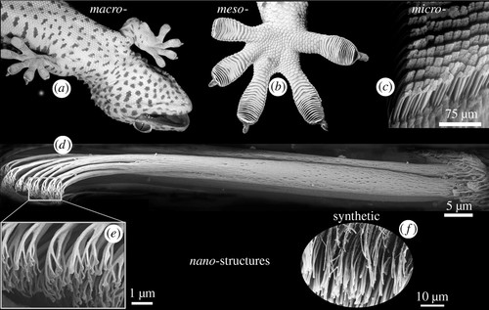
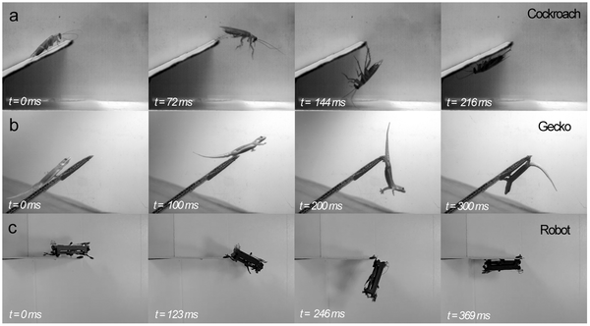
Examples of Biomimicry
Geckos and Their Feet
Geckos have millions of nano-sized hairs on their feet (as small as 0.2um)
The tips are so small, that they use Van der Waals force to attach to surfaces on a molecular level
This finding has inspired thousands of nano-sized adhesives that have evolved to a billion-dollar industry
Japanese Bullet Train
The old bullet train did a sonic boom when exiting tunnels, which generated noise pollution in urban areas.
A team was assembled to design a faster, more silent and efficient train.
In the team they hired, the general manager of technical development team, Eiji Nakatsu, who was a bird watcher. He found inspiration to the project from birds in their natural habitat. More information on the next page.
Cockroaches – Robust and Mobile
Cockroaches can withstand forces up to 800 times their own body weight
They can maintain mobility with only 3 legs, altering their own movement
They are fast to chance direction and avoid falling off ledges by grabbing the ledge and swinging at an acceleration of 4 G’s.
These abilities have been mimicked by scientist to design a robot that can maneuver in rough terrain
Image 5 – "Gecko Feet NanoStructure" Mongeau JM et al., 2012
Image 6 – "Cockroach Robot Testing" Mongeau JM et al., 2012

Slide 6
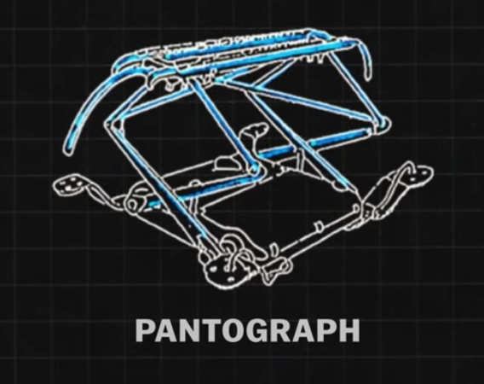
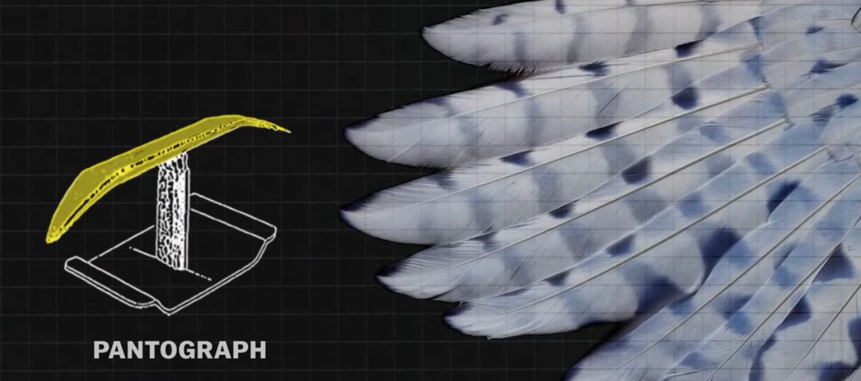
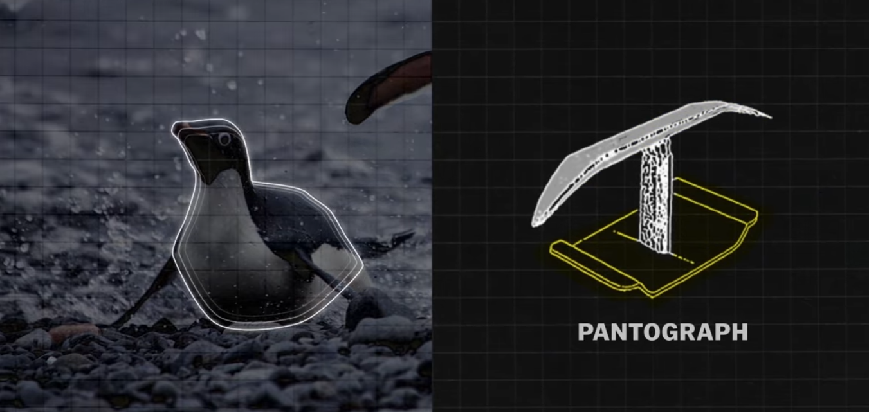
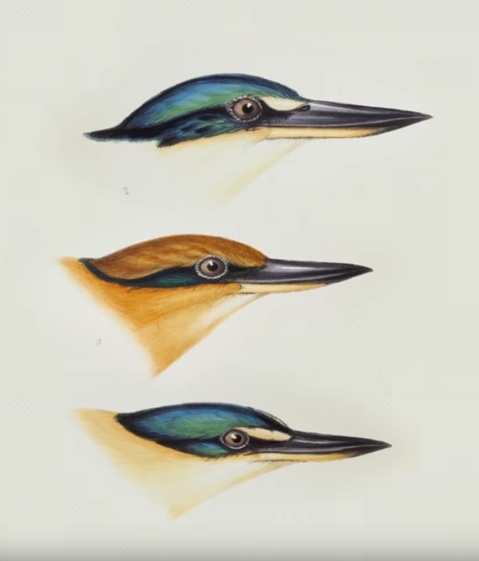
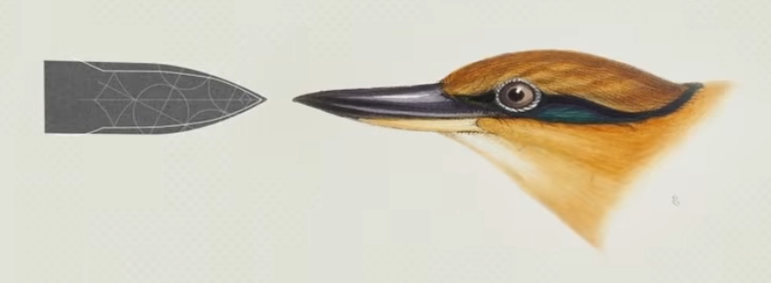
Japan’s bullet trains needed to be reviewed.
Owls inspired the pantograph, the part through which the trains get its electricity from.
The bottom half, the supporting shaft was inspired by adélie penguins, whose bodies allow them to swim and slide effortlessly. This reduced drag on the whole structure.
But the most important part, the nose of the train, was modelled by the kinfisher bird's beak. They tested the train nose designs by shooting bullets shaped like the tarain nose designs through pipes, measuring air pressure in the pipe.
Eiji Nakatsu designed the top part by the owl's feathers, which reduce noise, like when owls silently hunt their pray. He used the same curvature and serrations, as the owl's feathers have.
The old pantograph
The winning design was the one that was the most closely designed by the kinfishers beak.
Japan’s bullet train [15.10.2020] <https://youtu.be/iMtXqTmfta0>
The kingfisher bird
The nose designs shot through the pipe

Slide 7
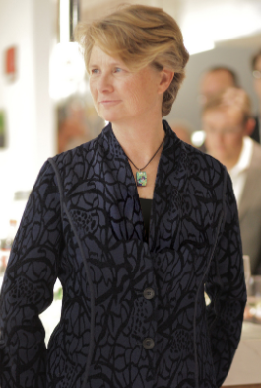
Janine Benyus – Co-Founder, Biomimicry Institute
“We are awake now, and the question is how do we stay awake to the living world? How do we make the act of asking nature’s advice a normal part of everyday inventing?”
- Janine Benyus
Biomimicry Institute, n.d

Slide 8
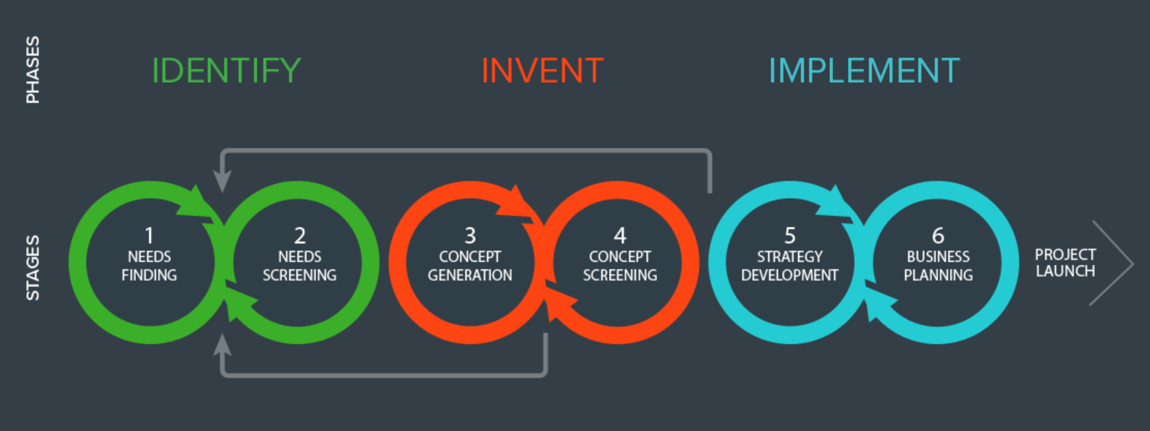
Stanford Byers Center for Bio-Design
Platform for Stanford University students, staff and fellows to become health technology innovators.
Interdisciplinary program in school of medicine, engineering and business.
Developed own Bio-Design Innovation Process: Identify / Invent / Implement. More can be found in the published book Biodesign: The Process of Innovating Medical Technologies by Stefanos A. Zenios, Josh Makower and Paul G. Yock.
In terms of relevance to this course (Methods in Early Product Development), the Identify stage is what we are looking at.
Their approach is based on finding unmet health needs. This is mostly done by observation of the patient-condition relationship. Hundreds of ideas/needs are generated and then filtered. The two/three most promising needs will have the greatest impact on health of the patients.
Images 7 – Stanford Byers Center for Biodesign. “Our Process", n.d
Video 1 – Tom Krummel: Solving for the Need, Stanford Byers Center for BioDesign, 23 Sept. 2016

Slide 9
Bio inspired design – Predicting stock market development
Can we learn from nature when making investment decisions?
The SHORT answer is yes.
Different forecasting models are used on a daily basis to make decisions in the stock market. However, the main problem in forecasting is the human bias. We don't always act rationally and make constantly errors resulting as lost profit and other resources. But still fund managers and traders are able to benefit from market inefficiency. This means, there must be way to beat the market returns.
However, a disclaimer must be added:
No-one can for sure predict future development ….
But we can discover irrationalities and benefit from them.
Yudong Zhang and Lenan Wu (2008) describe one example based on back propagation neural network approach in their article:
Stock market prediction of S&P 500 via combination of improved BCO approach and BP neural network
The purpose of the study was to investigate the suitability of improved chemotaxis optimization (IBCO) integrated in BP to predict SP 500 index (500 biggest US stock listed companies) development.
The BP neural network is based on the functionality of human brain, where inputs recognize relationships in different set of data. At this case, the relationships were modelled to mimic IBCO behaviour.
Implemented results are shown in figure 2 where model got more accurate as the input data increased. MSE (mean squared error) felled substantially during the training period.
Model resulted as:
Less computational complexity
Better precision accuracy
Less training time
Which means the model was accurate to predict SP500 development in short term based on models found in nature.
Long term forecasting is a totally different story …
Fig.1. The architecture of Back Propagation Neural Network. Zhang and Wu (2008)
Fig.2 Learning characteristics of S&P 500 for one day advance model by Zhang and Wu (2008)008)

Slide 10
Example – Ants as portfolio managers?
See it yourself!
Sparsh Agrawal describes how he mimics ants sophisticated clustering intelligence to optimize his portfolio balance. This decentralization system allows to remove human bias from investment decisions.
Ant clustering is based on the mechanism which encourages them to divide their relevant resources into smaller subsets of similar items. These smaller subsets helps ants to prevent risks, if one pile of eggs is demolished for natural causes. This dynamic model was an inspiration to reconsider other areas that require rational decision making in constantly changing environment.
Existing portfolio theory arises from viewpoint of generating profits with least amount risk. One of the crucial elements avoiding risks is efficient distribution of portfolio. In other words don’t put all your eggs in one basket. In this example Sparsh Agrawal used ant brood sorting algorithm to outsource his portfolio distribution decisions. This nature driven inspiration allowed him to make abnormal returns with lower risks by avoiding similar stocks in portfolio. See how Sparh’s algorithm developed during 2013 – 2016 (3.00-4.27 in the video) .
Sparsh´s model resulted as 37 % higher returns with beta of 0.6 (market beta = 1, where higher beta indicates higher risk).
Why I Trust Ants for Investment Decisions | Sparsh Agrawal | TEDxWpg

Slide 11
Further Bio-Design Approaches
Aalborg Bio-Inspired Design Process by Colombo, 2007
Design Stage | Description
1. Analysis | Identification of the “need” and the suitable natural system to satisfy the “need”
2. Transformation | Transformation of the selected system into technical and mechanical terms
3. Implementation | Implementing the technical and mechanical concepts to develop product ideas
4. Product Development | Evaluation of selected products with focus on environmental and economical factors for all life stages of the product.
Biomimicry Design Method by Junior et al., 2002
Design Stage | Description
1. Identification of Need | Identification of the unmet “need” that allows for the potential of various solutions based on subsequent analysis of environment
2. Selection and Sampling | Selection of natural solution, gathering of evidence and knowledge.
3. Observation | Analysis of the selected natural solution and how it is applicable to the problem at hand
4. Analogy of the Natural System and Product | Designer is able to generate and perhaps prototype possible and feasible applications of the selected natural solution to the problem at hand
5. Design Implementation | The proposed selected product is analysed in terms of functionality, feasibility, morphology, structure and design requirements.
Aalborg Bio-Inspired Design Process:
Focus on environmental and economical factors
Designers responsible for evaluation of product
Little to no importance for organizational issues
More suitable for independent designers and bio-design focused designers
Identifies solution first, then the problem it solves
Biomimicry Design Method:
Focus on natural sampling collection and analysis
Identifies problem first, then the solution
Lacks iteration of design process to optimize product
Little to no importance for oganizational aspects
More suitable for single goal functional performance

Slide 12
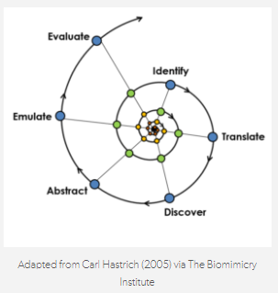
Further Bio-Design Approaches
Spiral Design Method by Biomimicry Institute, 2007
Design Stage | Description
Identify | Generation of list of functions, i.e what you need your design to perform
2. Translate | The list of functions is than translated/interpreted in words and in a biological sense
3. Discover | Identification of strategies nature uses to deal with the functions in list of functions
4. Abstract | Reverse engineering of natural strategies to see how it could translate into engineering design
5. Emulate | Use of professional skills to generate design solution based on selected natural strategy
6. Evaluate | Evaluate design against list of functions, design requirements and sustainability requirements
Bio-Inspired Design Method by Helms et al., 2009
Design Stage | Description
1. Problem Definition | Identification of “unmet” need by suitable means
2. Reframe the Problem | Redefine problem by application of biological terms
3. Biological Solution Search | Identification of natural solutions that satisfy the “need” by suitable means
4. Define the Biological Solution | Identify the structure and mechanisms of the biological solution and how it can be used to solve the problem at hand
5. Principle Extraction | Extraction of the principle behind of the biological solution, removing environmental constraints
6. Principle Application | Bio-inspired solution translated into its interpretation in a new domain, such as engineering and with the addition of new constraints
Bio-Inspired Design Method:
Identifies problem first, then the solution
Focus on extraction of the principle from nature to solve an issue
Optimization and multiple requirements are disregarded in this method
Spiral Design Method:
Identifies problem first, then the solution
Method has shortcomings in solving multiple requirements/needs
Organizational effectiveness is not considered in this method

Slide 13
Further Bio-Design Approaches
Bio-Solution in Search of a Problem Method (Adapted from Helms et al., 2009)
Design Stage | Description
1. Biological Solution Identification | Analysis of a natural phenomena on a macro/micro scale to identify potential solution applicable and transferable to human problem solving
2. Define the Biological Solution | Deeper analysis of natural phenomena, involving identification of components and systems at play in this solution
3. Principle Extraction | Extraction of the principle behind of the biological solution, removing environmental constraints
4. Reframe the Solution | Designers to reframe solution in terms of how useful the biological function can be in solving human problems
5. Problem Search | Identification of suitable problems in which the application of the biological solution may be a feasible option
6. Problem Definition | Establishment of a parallel connection between the biological solution and the selected problem
7. Principle Application | A working principle of the technological concept based on the biological solution is needed. This tends to generate product ideas and prototypes
Bio-Solution in Search of a Problem Method:
Identifies solution first, then the solveable problem
Based on iterative generation of bio-inspired design concepts
Little to no importance of organizational structure of biological system
Although adapted from Helms et al, 2009 approach, it is very different as it focuses on finding a problem in our human world, which is much wider than the finite documented biological world.

Slide 14
References
References:
Mongeau JM, McRae B, Jusufi A, Birkmeyer P, Hoover AM, et al. (2012) Rapid Inversion: Running Animals and Robots Swing like a Pendulum under Ledges. PLOS ONE 7(6): e38003. <https://journals.plos.org/plosone/article?id=10.1371/journal.pone.0038003>
Versos, C.A.M. & Coelho, Denis. (2011). Biologically Inspired Design: Methods and Validation. 10.5772/20326. <https://www.researchgate.net/publication/221919411_Biologically_Inspired_Design_Methods_and_Validation>
Coelho, Denis & Versos, C.A.M.. (2011). A comparative analysis of six bionic design methods. International Journal of Design Engineering. 4. 114-131. 10.1504/IJDE.2011.045131. <https://www.researchgate.net/publication/224831644_A_comparative_analysis_of_six_bionic_design_methods>
Full, Robert. 2014. “The secrets of nature's grossest creatures, channeled into robots”. Retrieved from https://www.ted.com/talks/robert_full_the_secrets_of_nature_s_grossest_creatures_channeled_into_robots
Melo, Leonardo & Ogliari, Andre. (2015). A Biomimética no Desenvolvimento de Produtos: A relação entre forma e função para obtenção de leiautes iniciais. <https://www.researchgate.net/publication/324246674_A_Biomimetica_no_Desenvolvimento_de_Produtos_A_relacao_entre_forma_e_funcao_para_obtencao_de_leiautes_iniciais>
“Janine Benyus.” Biomimicry Institute, n.d, biomimicry.org/janine-benyus/.

Slide 15
References
References:
Stanford Byers Center for Biodesign. “Our Process.” Stanford Byers Center for Biodesign, biodesign.stanford.edu/about-us/process.html.
Tom Krummel, director. Tom Krummel: Solving for the Need, Stanford Byers Center for BioDesign, 23 Sept. 2016, <www.youtube.com/watch?v=gX4ZX5Z8p9c>.
Denise DeLuca. “The Power of the Biomimicry Design Spiral.” Biomimicry Institute, 14 Jan. 2016, biomimicry.org/biomimicry-design-spiral/#:~:text=The Biomimicry Design Spiral is,innovative and sustainable design solutions.&text=To use this method, you,to be able to do.
William Myers. “BioDesign.” DesignDebates, 10 May 2012.
Elliot W. Hawkes, Eric V. Eason, David L. Christensen and Mark R. Cutkosky. (2015). Human climbing with efficiently scaled gecko-inspired dry adhesives. Journal of the royal society Interface. <https://doi.org/10.1098/rsif.2014.0675>
Johan van Leeuwen. “Biomimicry, Bio-Inspired Design.” Wageningen University & Research, <www.wur.nl/en/Dossiers/file/Biomimicry-Bio-Inspired-Design.htm.
Japan’s bullet train [15.10.2020] <https://youtu.be/iMtXqTmfta0>
Yudong Z. & Lenan W. Stock market prediction of S&P 500 via combination of improved BCO approach and BP neural network. 2009. Vol 36. Doi:https://doi.org/10.1016/j.eswa.2008.11.028
Why I Trust Ants for Investment Decisions | Sparsh Agrawal | TEDxWpg,available at: <https://www.youtube.com/watch?v=QCS64_KH1rk>. Referenced 12.10.2020

