Slide 1
Heuristic Evaluation
Compare an interface to an established list of heuristics – best practices – to identify usability problems.
Notes:
1

Slide 2
Heuristic Evaluation
Compare an interface to an established list of heuristics – best practices – to identify usability problems.
A HEURISTIC/
Is defined by a person or a group of people
Is deemed to be a “good principle” to follow
Is recognized by others as a “good principle”
Is not a hard/fast rule
Is not always right
Notes:
2

Slide 3
Heuristic Evaluation: The Basics
On your own, compare an interface to a list of heuristics
Determine which heuristics are violated by the interface
As a group, combine these lists into a more exhaustive listing
Write a report and include redesign suggestions
Notes:
3

Slide 4
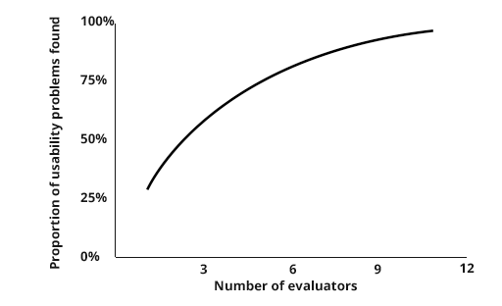
Heuristic Evaluation: Evaluators
No users required in Heuristic Evaluation. Instead, do the initial evaluation yourself, and then combine your results with a team.
Different evaluators find different problems, with diminishing returns after 5-6 evaluators:
Notes:
4

Slide 5
Logging Heuristic Evaluation Findings
Unique Identifier | Unique Screen ID | Problem Description | Evidence – Heuristic Violated | Severity (1-5, 5 is high) | Frequency (1-5, 5 is common) | Proposed Solution
JK_1 | 1.4.A | Required fields during signup are not obvious | Visibility of System Status | 3 | 4 | Indicate required fields with a red asterisk (*)
JK_2 | 1.4.B | Errors during form validation are not uniquely defined | Help users Recognize, Diagnose and Recover from Errors | 3 | 4 | Use a verbose description of changes that have to occur when alerting the user of an error
Use a unique identifier that combines the initials of the evaluator with a running number tally (JK = Jon Kolko, 1 = incident number one)
Identify the heuristic that is violated
Define a severity and frequency rating to indicate the relative impact of the critical incident and the number of times this incident is likely to be identified by a user
Notes:
5

