Slide 1
Heuristic Evaluation
Game Usability

Slide 2
Heuristic Evaluation
One or (ideally) more researchers examine a game and evaluate its compliance with recognised design principles (‘heuristics’)
Pros
Comparatively fast and cheap to implement
Maximises value from more expensive methods
Comparing your game to conventional design is useful even if you disagree
Cons
Less comprehensive than they seem on paper
Effectively interpreting and applying heuristics requires some design expertise
Rigid application of 'authoritative' design principles can rob games of unique qualities

Slide 3
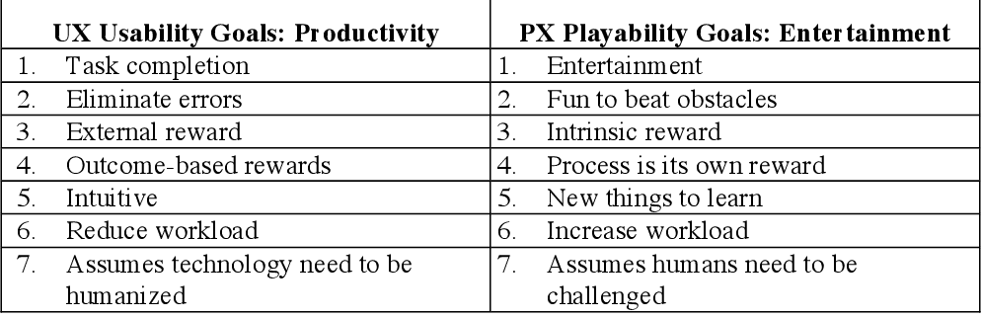
Usability vs. Playability
Usability: interactions are effective, efficient, and satisfying (ISO 9241-11 standard)
Playability: the interface is unobtrusive, design intent is clear, and the game is suitably difficult and engaging (Korhonen, 2016)

Slide 4
Game Usability Heuristics
Code | Game Usability Heuristics
GU1a | audiovisual representation supports the game
GU1b | a view to the game world supports smooth interaction and the camera behaves correctly
GU2 | screen layout is efficient and visually pleasing
GU3 | device UI and game UI are used for their own purposes
GU4 | indicators are visible
GU5 | the player understands the terminology
GU6 | navigation is consistent, logical, and minimalist
GU7 | game controllers are consistent and follow standard conventions
GU8 | game controls are convenient and flexible
GU9 | the game gives feedback on the player’s actions
GU10 | the player cannot make irreversible errors
GU11 | the player does not have to memorise things unnecessarily
GU12 | the game contains help

Slide 5
Gameplay Heuristics (Playability)
Code | Gameplay Heuristics
GP1 | the game provides clear goals or supports player-created goals
GP2 | the player sees the progress in the game and can compare the results
GP3 | the players are rewarded and the rewards are meaningful
GP4 | the player is in control
GP5 | challenge, strategy, and pace are in balance
GP6 | the first-time experience is encouraging
GP7 | the game story, if any, supports the gameplay and is meaningful
GP8 | there are no repetitive or boring tasks
GP9 | the players can express themselves
GP10 | the game supports different playing styles
GP11 | the game does not stagnate
GP12 | the game is consistent
GP13 | the game uses orthogonal unit differentiation
GP14 | the player does not lose any hard-won possessions

Slide 6
Application
Form groups of 4
Agree on a game to evaluate
You may need to limit the evaluation to a particular game segment to make this manageable
In pairs, play through your chosen game (segment), with one person noting any heuristic violations
Note all violations – even if they're not actually problems
Discuss your individual findings and decide on the most important issues
Write up your findings and design recommendations in a report

