Slide 1
Interviews

Slide 2
Interviews
A researcher asks individual players about the topic(s) of interest, while taking notes and recording audio
Pros
Generates contextual data that can stand alone, or explain other results
Follow-up questions can help generate new insights
An audio record provides a full account for later reference
Cons
Researcher bias is not always obvious
Can be difficult to prepare and run without experience
Considered less rigorous or valid than quantitative data by some

Slide 3
Interview Formats
Structured
Fully scripted, with no deviations from the question list
Guaranteed to probe a particular topic of interest
Unusual for scripted questions to be comprehensive
Semi-structured
Scripted question list, with room to deviate / follow-up
Flexible (and personally preferred)
Unstructured
No script (beyond an initial question)
Largely directed by the participant's interests
Not terribly useful for testing a specific research question

Slide 4
Interview Timing
Post-play
Most common time
Can follow up on notes from observation
Memories of the experience (and related game elements) are most salient
During play / review of in-game footage (contextual enquiry)
Not particularly common for games
Investigate strategic decisions, metagaming, 'obvious' behaviours

Slide 5
Other Notes
It's not a conversation
Establish credibility without showing off
Don't talk about yourself; participants don't care
Developing a rapport with participants is essential
Keep game screenshots / video / the game itself available for reference
Participants will sometimes want to show what they mean via play

Slide 6
Writing Questions
Leading questions
A question that suggests a possible answer
Bad: 'Were you furious when he said that?'
Good: 'How did you react when he said that?'
Double questions
'How old were you when that happened and what effect did it have on you?'
Abstract language

Slide 7
Writing Questions
Ground mapping questions
Widely framed
Open up a topic
Followed up with probing questions
'Have you ever...'
'What did you notice most...'

Slide 8
Writing Questions
Perspective-widening questions
Going further into a topic, in a way that suits the research question
'You've said ..., but was there anything you didn't like about [topic]?'
'Are there other cases where your decision would be different?'

Slide 9
Writing Questions
Content mining (follow-up questions)
Get a more complete description
Understanding why participants hold a belief or attitude
'Can you tell me a little more about...'
'What gave you that impression?'
'Can you give me an example...'
'What makes you say that?'
'Can you explain why...'
'What do you mean when you say...'

Slide 10
Broad Opening Questions

Slide 11
Follow-up Questions – Leading(?)

Slide 12
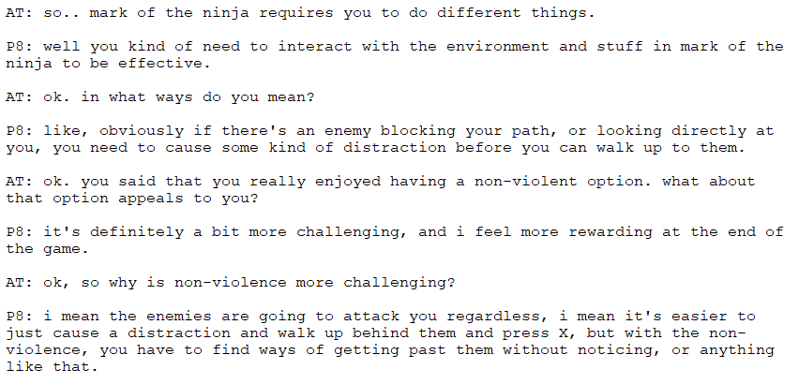
Follow-up Questions

Slide 13
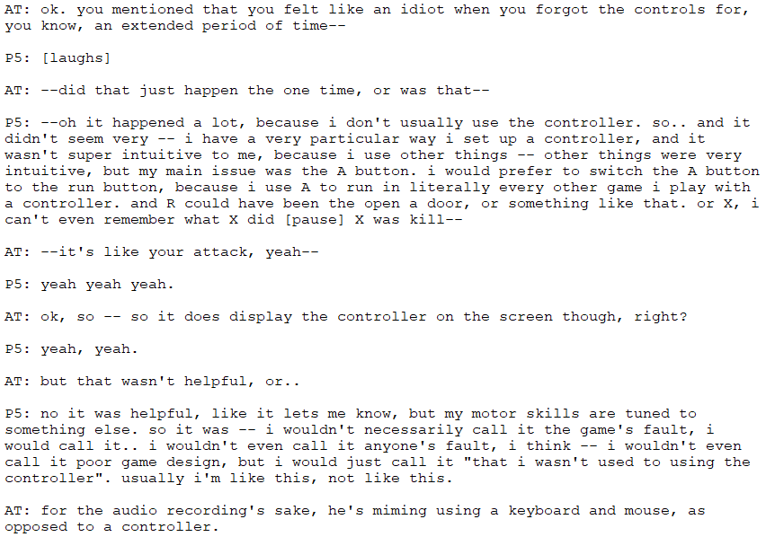
Interruptions + Limits of Audio

Slide 14
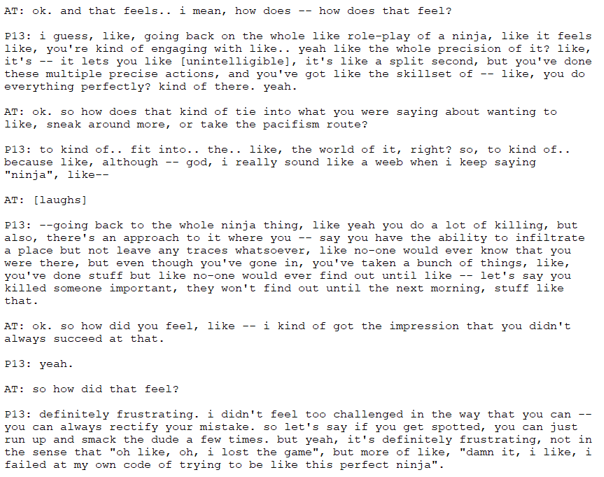
Repetition for Depth

Slide 15
Application
Form groups of 3 (moderator, note-taker, participant)
Collectively, write a short interview script (~3-5 questions)
Topic: most recent play experience (outside this course)
Plan potential follow-up questions
Interview each other, rotating between roles
Compile your group's results into a single document
To be analysed later

Slide 16
Data Interpretation & Consolidation

Slide 17
Interpretation Session
A group meeting consisting of the interviewer plus 2–5 team members
Is conducted shortly (within 48 hours) after the interview
As a rule: Lasts approximately the same amount of time as the (Contextual) Interview or inquiry
Procedure:
The interviewer tells the story of the interview
Team members ask questions, drawing out details that might have been overlooked and indicate what is important to capture
At least person writes affinity notes, the others for example capture design models

Slide 18
Affinity Notes
Key practice issues
Identity and cultural observations
Tool and activity successes and breakdowns
Task patterns
The use of time, place and different devices
Design ideas
And any other issues that have relevance to the project
Problem
Design Idea
DI: Capitalize on the competitive or fun aspect of travel planning – gamification, getting the best deal.
She knows prices change over time, so she searches at all different times of the day and days of the week looking for the best deal.
To her it’s not a hassle to keep checking prices – she thinks travel planning is fun. “I do love it.”
Quote

Slide 19
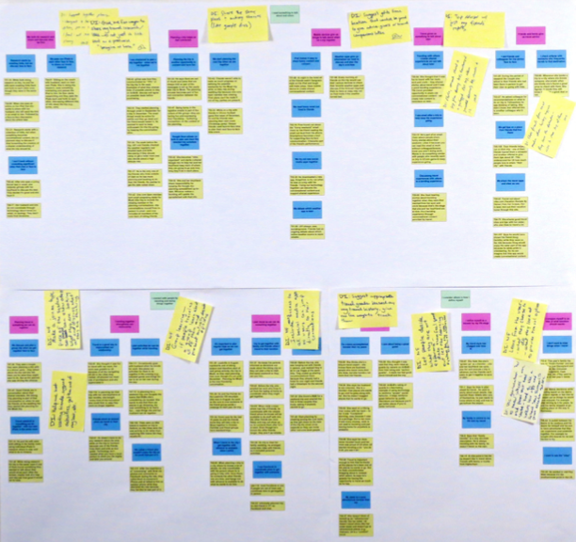
Affinity Diagram
The process of consolidation is easiest to see in building the Affinity Diagram, but it is similar for all models.
Grouping the individual affinity notes into a wall-sized, hierarchical diagram
Shows the common issues, themes, and scope of the customer problems and needs in one place
Acts as the voice of the customer and tells the story of the user’s life

Slide 20
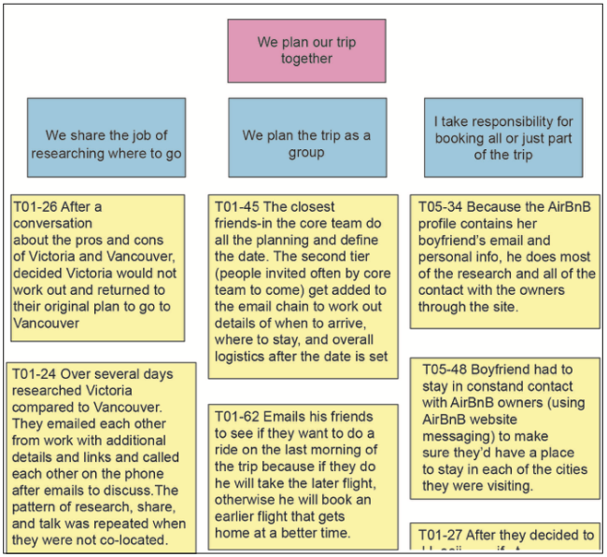
Affinity Diagram

Slide 21
Application 1
1. Interpretation Session
Every interviewer tells the story of the interview, one after the other.
Team members ask questions about the interview, drawing out details that the interviewer might have overlooked and indicate what is important to capture
Team Members write Affinity Notes on sticky notes

Slide 22
Application 2
2. Data Consolidation
Group the sticky notes on the wall, each grouping describes a single issue or a point
Keep the groups small, four to six notes in a group
Label the groups with blue sticky notes to characterize the point made by the group
Organize the blue labels into larger areas of interest under pink labels

