Slide 1
The goals:
To understand what people do, why they do it, and how they feel about it.
To empathize with people who are not like you are.

Slide 2
Getting Prepared
You can never be overly prepared.
Organize your equipment:
Video/audio recording
Tapes/memory cards
Batteries (and backup batteries)
Pens/paper
Script
Questions
Have a list of questions you want to have answered
Be open to following the direction the work takes you
Consent Form

Slide 3
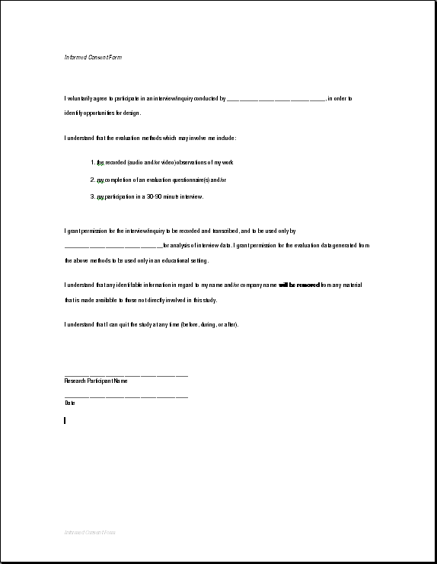
Informed Consent
Protects both you and the participant
Explains any compensation that will occur
Explains the scope of the study
Explains how the results of the study will be used
Explains exactly how the individual's name, image, and words will be used
Print two copies per participant; you keep one, they keep the other.

Slide 4
Running Productive Interviews
Engaging participants: Establish a rapport, make the participant comfortable and keep the conversation on track.
Note-taking: Capture any comments worth following up on. Don't take so many notes that participants feel uncomfortable.
INTERVIEW BASICS/
Ask 1 question at a time.
Be patient; count to 5.
Ask open-ended questions.
Ask “why,” even if you know the answer.
Summarize, interpret, and reference previous statements. Refer to your notes.

Slide 5
Techniques
Participants can easily answer things they know about.
What they do
How they do things
Their opinions about their current activities
Their complaints about their current activities
How much they like or dislike something they know about, as compared to another thing they know about

Slide 6
Techniques
Successful techniques for interviewing include:
Repetition/Rephrase (So what you mean is..)
Ask for an example (Can you show me an example?)
Determine steps in a sequence (What do you do next?)
Question a term or concept (When you say ‘doohikie’, what do you mean?)
Summarize what was said and draw out a conclusion or a concept (So what you are saying is… is that right?)
Question pronoun references (Who is “She” or “Bob”?)
Ask for anecdotes & stories; check for deviant cases (Can you remember a situation where that didn’t work?)

