Slide 1
Surveys

Slide 2
Common Questionnaires
Player Experience Inventory (PXI)
dx.doi.org/10.1016/j.ijhcs.2019.102370
Subscales measure experiences (e.g., immersion) and game elements (e.g., ease of control)

Slide 3
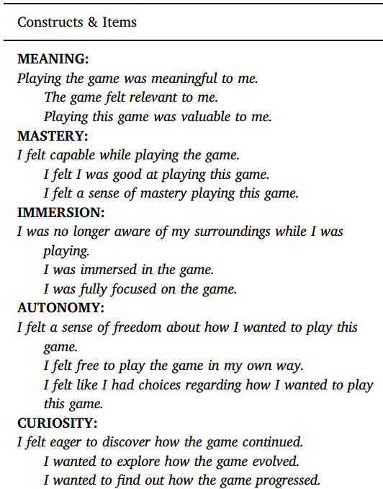
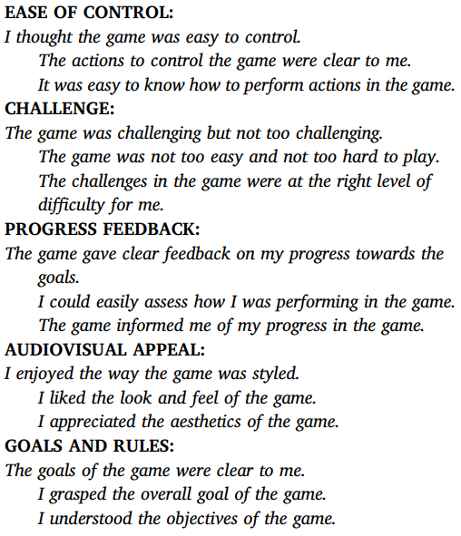
Common Questionnaires

Slide 4
Common Questionnaires
Ubisoft Perceived Experience Questionnaire (UPEQ)
dx.doi.org/10.1145/3235765.3235780
Based on self-determination theory (SDT)
Competence, autonomy, and relatedness subscales
Relatedness toward other players and NPCs

Slide 5
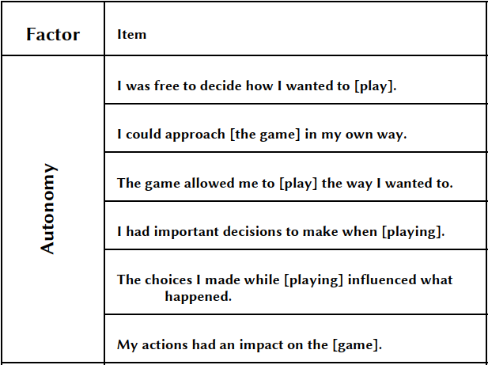
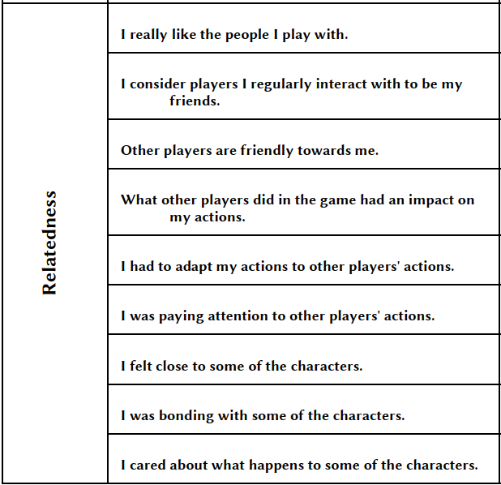
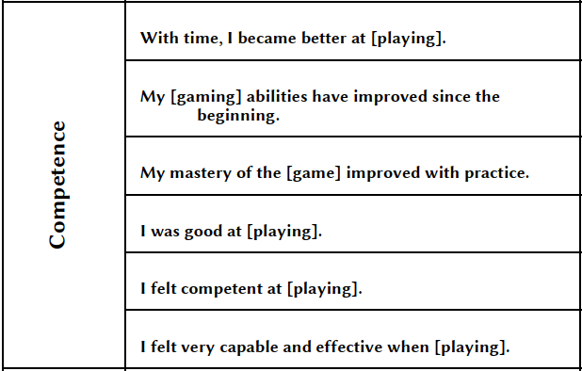

Slide 6
Other (not game-specific) Questionnaires
Subjective Vitality Scale
Independently validated
Measures wellbeing (short- or long-term)
Different from positive affect, happiness, etc.

Slide 7
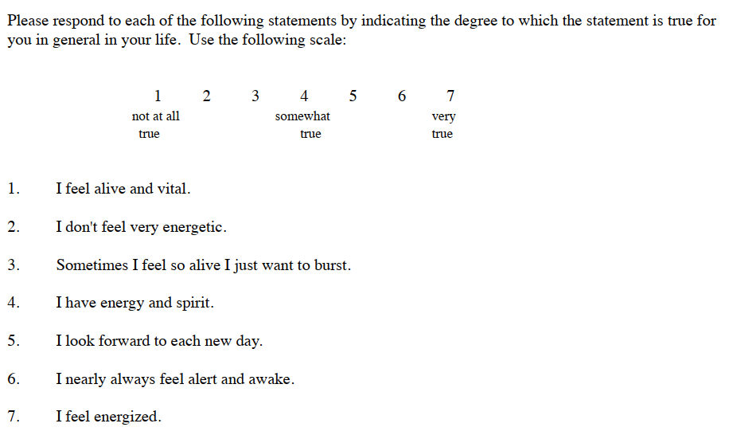
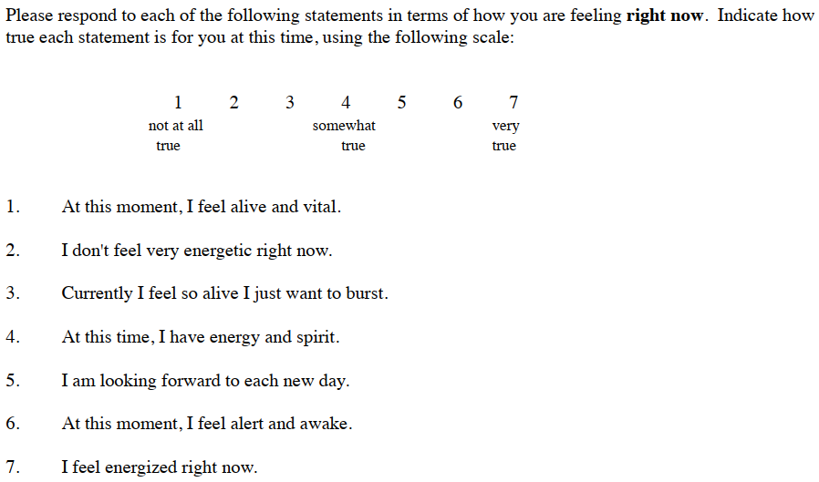
Long-term
Short-term
Item #2 removed in independent
validation study (Bostic et al., 2000)

Slide 8
Other (not game-specific) Questionnaires
Positive and Negative Affect Schedule – eXpanded (PANAS-X)
https://ir.uiowa.edu/cgi/viewcontent.cgi?article=1011&context=psychology_pubs
Standard emotional measure (used since 1999)
Overall positive / negative affect scores, or more specific emotions:
Joviality, self-assurance, attentiveness, surprise, serenity
Fear, sadness, hostility, guilt, shyness, fatigue

Slide 9
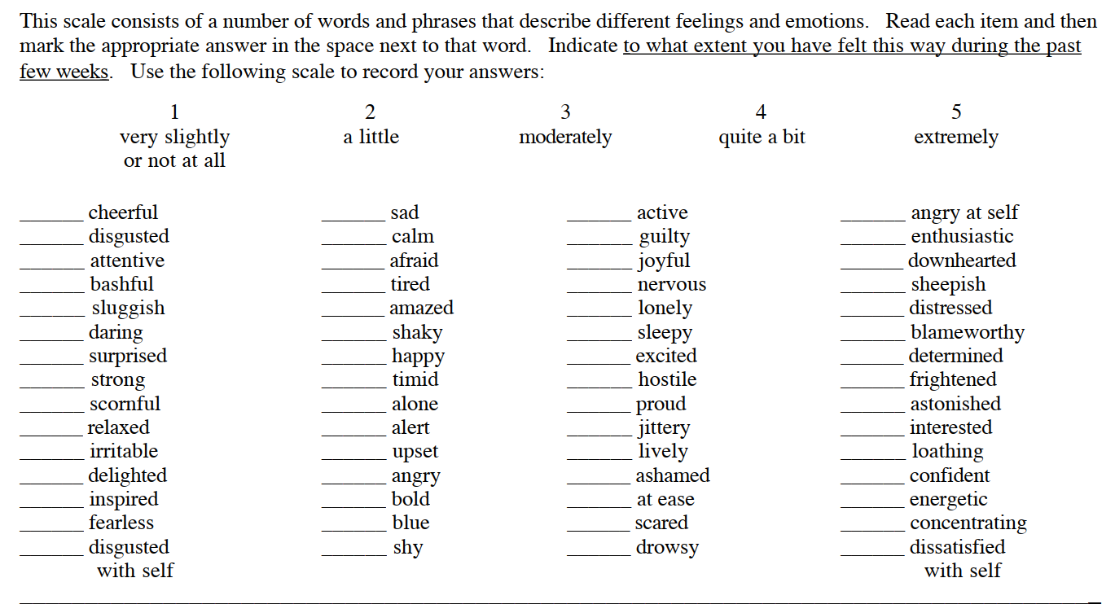

Slide 10
Other (not game-specific) Questionnaires
Intrinsic Motivation Inventory
Based on self-determination theory
Long and short forms
Independently validated*

Slide 12
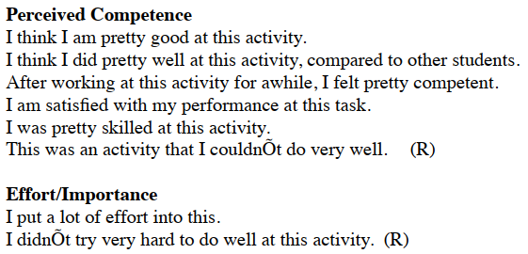
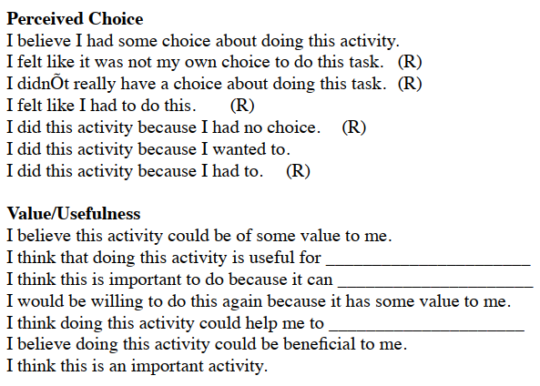
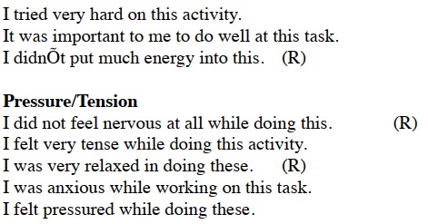
^Not validated

Slide 13
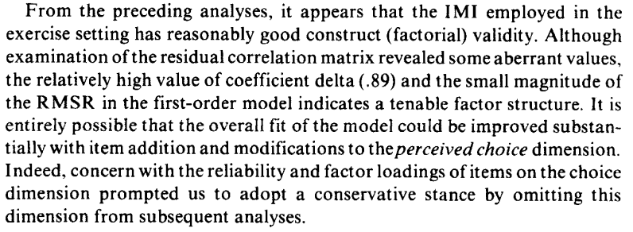
McAuley et al., 1991 dx.doi.org/10.1111/j.1559-1816.1991.tb00493.x

Slide 14
Other (not game-specific) Questionnaires
User Motivation Inventory (UMI)
dx.doi.org/10.1145/3173574.3173680
Based on SDT
Forms of motivation (as in Elisa's MOBA paper)

Slide 15
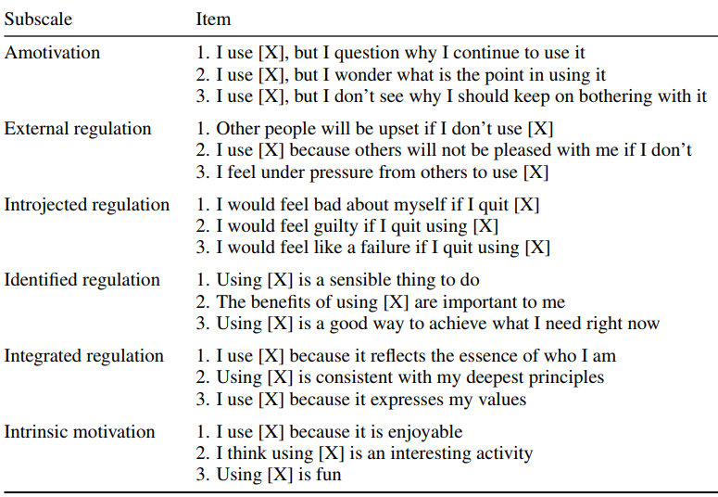
'Good' forms
of motivation

Slide 16
Statistics Software
JASP: https://jasp-stats.org
R backend
Free
Still in development; semi-regular updates
Portable version
Alternatives:
R Studio / Python (free, less user-friendly, more features)
SPSS (up-front cost, legacy UI, slow)
Mplus, STATA, ...
Not personally familiar with these

Slide 17
Common Evaluation Study Designs
A/B Test
2 games, 1 measurement occasion
Pre-post design
1 game, 2 measurements (before and after play)
Mixed design
2+ games, 2+ measurements

Slide 18
Statistical Tests
A/B Test
2 games, 1 measurement occasion
Comparison of 2 independent (i.e., separate) groups
No-one plays both games
Welch's t-test
A/B/C... Test
3+ games, 1 measurement occasion
ANOVA

Slide 19
Statistical Tests
Pre-post design
1 game, 2 measurements (before and after play)
Comparing 1 group of players' responses to scale items over time
Paired-samples / dependent t-test
Experience sampling (or similar)
1 game, many measurements
Repeated measures ANOVAs

Slide 20
Statistical Tests
Mixed design
2+ games, 2+ measurements
An A/B test with pre-post measures
Repeated measures ANOVA (again)

Slide 21
Statistical Tests
Prediction
'Does player experience predict in-game spending?'
Regression

Slide 22
Example Dataset
Run tests on data from Denson et al. (2020)
Non/violent game play -> facial recognition task
Aggression Questionnaire (AQ)
Positive and Negative Affect Schedule (PANAS)
Depression, Anxiety, and Stress Scales (DASS)
Pulse
Reaction time (RT) before deciding to back out of a fight

Slide 23
Exploring the Data
Descriptive statistics
Check if groups are similar enough on pretest measures
AQ_Total (trait aggression)
prePANASangry / negative
DASSanxiety
Check if groups differ on outcome measures
postPANASangry / negative
Angry / NeutralRecogTotal (# of facial expressions correctly identified)
'StrongandIntimidating' (ratings of pictures of men on physical attributes)

Slide 24
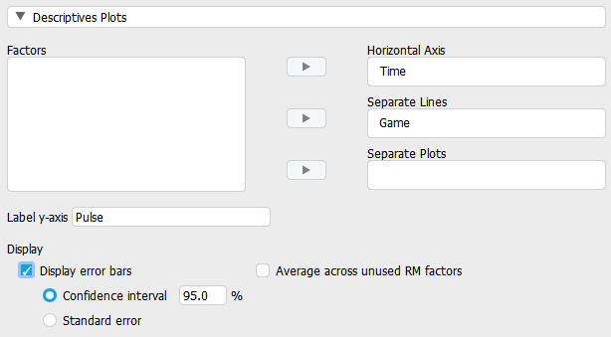
Do Some Games Influence Pulse Rate?
Test: RM-ANOVA
Between-subjects (grouping) variable: Game
Within-subjects (temporal) variable: prePulse, postPulse
Plot the results

Slide 25
Do violent games make players angry?
Outcome (dependent) measure: postPANASanger
Predictor (independent) measures:
prePANASanger
GameType (violent/non-violent)
AQ_Total (trait aggression)?
?

Slide 26
Which variables predict expected bench press weight?
Participants rated pictures of men on how tough they were and how much they could bench press
5-point scale: 1 = less than 40 kg; 5 = more than 100 kg
Which (measured) factors might influence this estimate?

Slide 27
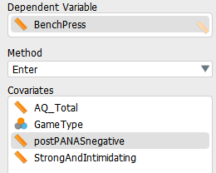
Which variables predict expected bench press weight?

