Slide 1
Surveys
DOM-E5082
Prof Elisa Mekler

Slide 2
Surveys
A web form (or rarely, paper) with questions on players' attitudes and experiences
May include open text questions
Pros
Relatively easy to deploy
Can be applied to many topics
Standard experience measures already exist
Little training necessary
Efficient, low-cost
Cons
Statistics knowledge is required to interpret quantitative results
Larger samples (N>100) are typically needed to test hypotheses

Slide 3
The Importance of Good (Quant) Measures
“We’ve got thousands of game designers in Australia. No problem at all, but we have very, very few experienced project managers, and that’s meant most of the attempts [to adapt to post-GFC industry changes] have fizzled out, because if you think of the build-measure-learn cycle, we built, we didn’t quite know what we were measuring, and we learned nothing.”
-George Fidler (Kixeye), 2014 interview with John Banks

Slide 4
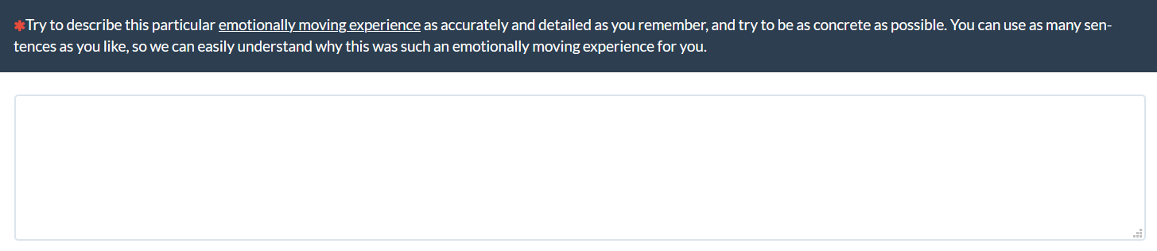
Survey Question Types
Open-ended questions
  Qualitative analysis
Closed questions
  Questionnaires, rating scales, etc
  Quantitative Analysis

Slide 5
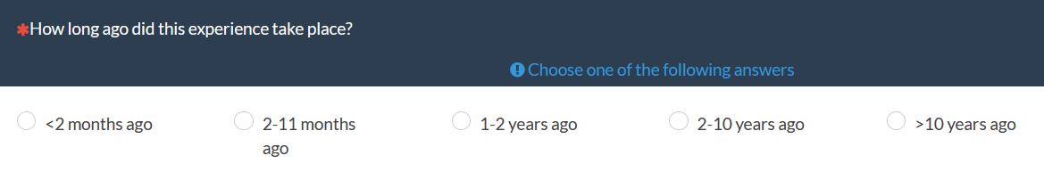
Closed Question Types
Single-choice questions
Multiple-choice questions
Ranking Questions
Notes:
Ranking questions
Rating questions
Multiple-choice questions

Slide 6
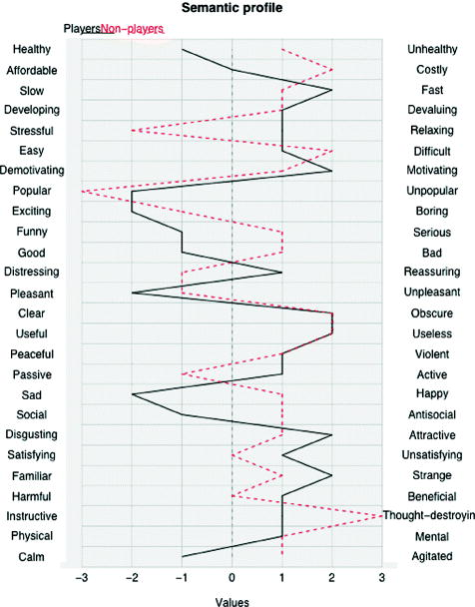
Closed Question Types
Rating Questions:
Likert Scale ->
Semantic Differential ->

Slide 7
Survey Question Types Strengths
Open-ended questions
  Provides nuanced insights into player experience, not available via quantitative measures
Closed questions
    Quantitative/quantified responses tend to be very persuasive for different stakeholders

Slide 8
What can be asked with surveys?
Self-reports of…
  Objective facts: Behaviors and facts that are observable -> but often not representative of actual behavior
  Subjective states: Feelings, attitudes, thoughts -> Experience

Slide 9
What can you do with surveys?
Have participants self-report about different aspects of their experience:
Attitudes, feelings and experiences: Benchmark, compare subjective experience with objective (behavioral) measures
Motives: Why are people playing a game at a given time?

Slide 10
What can you do with surveys?
Personal characteristics: Personality traits, gaming habits, familiarity with design, etc
  Can be used to create groups post-hoc
Comparison: Questionnaire data can be used for comparing between designs, groups of people, over time

Slide 11
When to use online surveys?
Pros:
Focus on user demographics, opinions and motivations
Reach a large number of people
Lower bias due to respondent anonymity
Cons:
Self-reports of behaviour unlikely to be accurate
Can’t easily ask follow-up questions
Lower hurdle for participants to drop out

Slide 12
Developing an online survey
E.g., Platforms such as Google Forms, Webropol, Limesurvey (my recommendation, more flexible and GDPR compliant)
Plan the survey timeline
Design the survey offline
Implement online survey
Pilot the survey
Recruit participants

Slide 13
Designing a survey: Example structure
Study information: goal, topic, approx. time to complete, contact person
Informed consent
Demographic questions
Main survey questions
Debriefing

Slide 14
Choosing survey questions
What are the goals of the survey? What do you want to find out?
What types of information do you need to collect from players?

Slide 15
Choosing survey questions
Draft your own questions
Or use questions from other existing surveys
But: Just because it was used before doesn’t mean it is a good question

Slide 16
Good vs Bad Survey Questions

Slide 17
Open Questions
DON’T: “Do you like the game?”
DO: “Which parts of the game do you like in particular?”
More open-ended question → more useful answers

Slide 18
Avoid double-barreled questions
DON’T: “I considered the level fun and exciting”
DO: “I considered the level fun”; “I considered the level exciting”

Slide 19
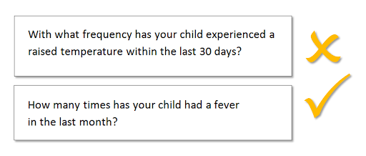
Make it simple and clear
Simple questions and wording are easier to understand

Slide 20
Make it simple and clear
DON’T: “To what extent did you experience a sense of flow?”
DO: “To what extent were you concentrated on playing?”
Create questions that players have enough information and knowledge to actually respond to

Slide 21
Avoid leading questions
DON’T: “This game has a Metacritic score of 93. How much fun did you experience with the game?”
DO: “How fun was it to play the game?”

Slide 22
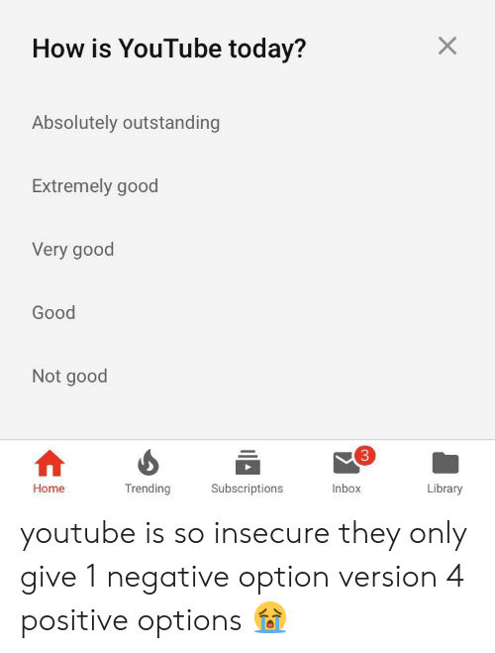
Other questions to avoid: Positivity Bias
Notes:
Positivity bias

Slide 23
Other questions to avoid
What players would do / like / want in hypothetical scenarios, e.g., “Over the next month, how frequently will you access the PlayStation store?”; “Which of the following features would make you have more fun with this game?”
How often players do things (better to ask how many hours they played this week; more concrete and more recent)
Notes:
Positivity bias

Slide 24
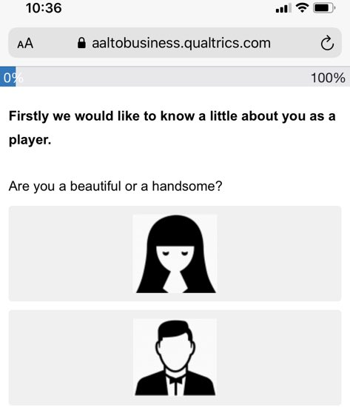
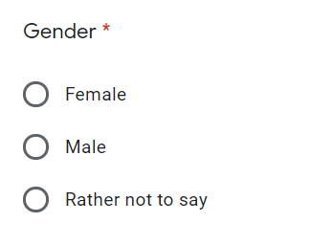
Asking about gender: DON’Ts

Slide 25
Asking about gender: DOs
Open answer question about gender, so participants can self-identify
“What is your gender: _________”
“How old are you: ___”
No assumptions made

Slide 26
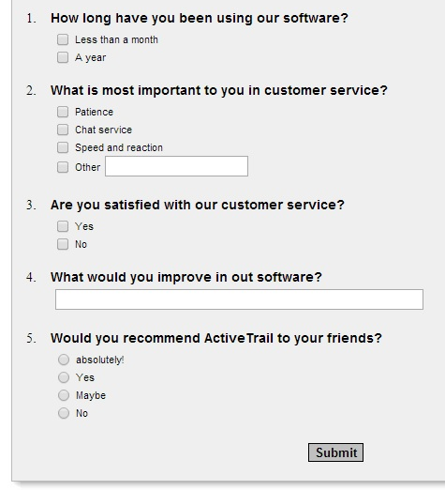
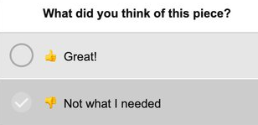
Bad Survey Practices

Slide 27
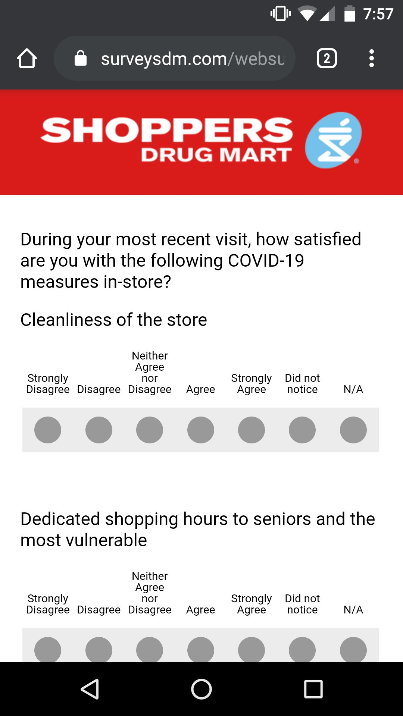
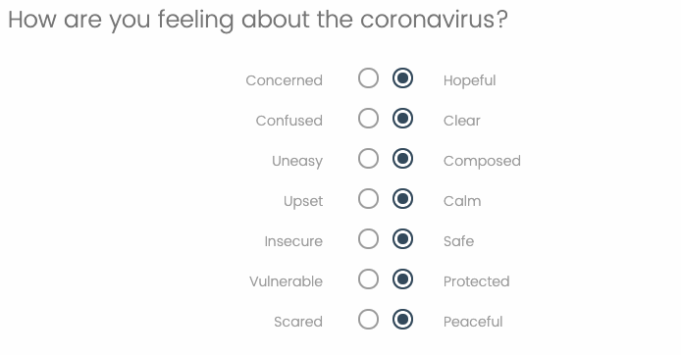
Bad Survey Practices
Source (and more great bad examples): https://twitter.com/badsurveyq

Slide 28
Order of the questions
Survey is similar to conversations
Start with easy to respond questions
Group questions of the same topic together
Ask potentially sensitive questions later in the survey

Slide 29
Things to keep in mind
How long do participants need to complete the survey?
Do participants understand the questions?
How is the flow of the survey?
Pilot the survey: with colleagues, friends, potential participants

Slide 30
Diary studies
  People complete a diary at a specified time or interval
  Journals, cameras, voice, video
  Tailor the recording to the context
  Can scale better than direct observation
  Easier tools -> better results
  May require some practice, training, reminding

Slide 31
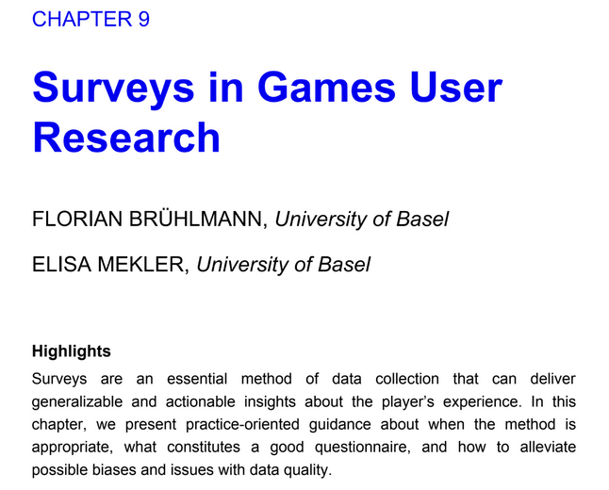
Sources for creating unbiased surveys
https://doi.org/10.1007/978-1-4939-0378-8_10
https://psyarxiv.com/2csa4/download?format=pdf

Slide 32
Example Surveys

Slide 34
Aim of the Survey
RQ1: What draws people to MOBAs?
RQ2: What motivates people to keep playing MOBAs?
  2a: How does experience change when playing in teams of friends, strangers, or a combination of the two groups?
  2b: How do players develop in-game friendships?
RQ3: What causes people to stop playing MOBAs?
  3a: What factors affect MOBA players’ churn rates?
  3b: What factors can affect players’ reasons for returning to MOBAs after long periods of absence?

Slide 35
Survey
760 survey responses, age 18 – 40, 84% men, majority of participants recruited on Reddit, Facebook groups, Twitter
Survey contained single-choice, multiple-choice, and rating questions
Originally 924 responses -> some had to be removed because incomplete responses were provided, or participants provided bogus answers (e.g., answering 1 for all rating questions)

Slide 36
Excerpt
Results RQ2
What players value when playing with strangers vs friends
Mood when playing w strangers vs friends
Notes:
Based on survey and interview data
Majority of surveyed players (65%) start, because their friends are already playing MOBAs

Slide 38
Aim of the Survey
Explore how players’ motivation relate to their experience and in-game behaviour in League of Legends
Behavioural data from League of Legends API
Rating questions from established psychological questionnaires about motivation and player experience

Slide 39
Survey
750 participants, majority male players, age 18 – 65, recruited on League of Legends Subreddit
Several GB of behavioural data from API using Riot-Watcher
  Over a million individual matches
The two data sets were matched based on participants’ Summoner name

Slide 40
Results
Latent Profile Analysis to identify patterns in self-reported motivational data
Intrinsic motivation high overall, but still distinct motivational profiles

Slide 41
Results
Distinct player experience based on motivational profile

Slide 42
Results
Few obvious behavioural differences
Intrinsic and autonomous motivation groups more likely to assist than amotivated players

Slide 43
Quantitative Questionnaires

Slide 44
Some scientific terminology
Concept: Description of some specific phenomenon, e.g., ”Experience”, ”Fun”, ”Challenge”, ”Flow”
Operationalization: Turning concepts into something that we can ask about or measure

Slide 45
Some scientific terminology
Construct: A concept that is operationalized into a questionnaire, i.e., a dimension of a questionnaire
Item: Describes an individual question in a questionnaire, several items make up a construct
  E.g., construct fun
  -> Items may be ”I find this game fun to play”, ”I find this game entertaining”, ”I had a good time playing this game”

Slide 46
Questionnaire quality criteria
Construct Validity: Does the questionnaire measure what we think it should measure? Does it adequately approximate the felt subjective experience?
Discriminant validity: Do unrelated construct items not relate to each other?
Test via Factor Analysis (among other statistical analyses)

Slide 47
Questionnaire quality criteria
Reliability: Is the questionnaire consistent?
Internal reliability: Are all items of a (intended) construct measuring the same?
Test-retest reliability: Does the questionnaire work consistently over repeated use?

Slide 48
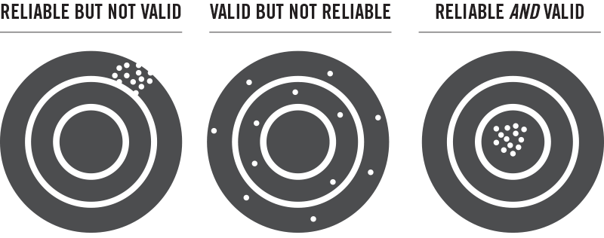
Questionnaire quality criteria

Slide 49
Questionnaire quality criteria
Should be clear and easy to understand
Easy to read
Balanced: Enough items for maintaining reliability, not too many to exhaust research participants

Slide 50
Selecting a Questionnaire

Slide 51
Selecting a questionnaire
It’s perfectly legit to select an existing questionnaire
BUT: Some commonly used questionnaires may not work as well as advertised
Pay attention to the scientific rigor with which the questionnaire has been tested

Slide 52
Check your sources!!

Slide 53
Game Experience Questionnaire (GEQ): A cautionary tale

Slide 54
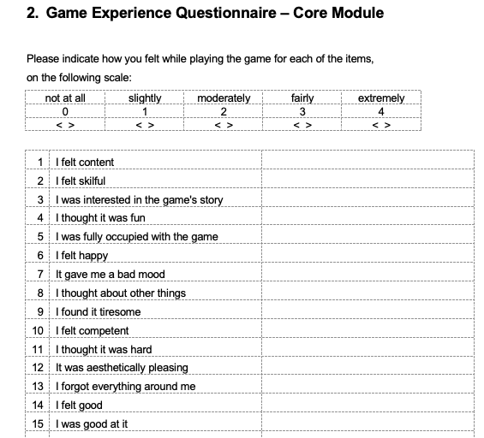
Game Experience Questionnaire (GEQ): Excerpt

Slide 55
Game Experience Questionnaire (GEQ)
Intended to assess 7 distinct factors of the player experience: challenge, competence, flow, immersion, tension, positive and negative affect
Formal validation never published by original authors (Curran, 2013; Johnson et al., 2018; Norman, 2013)

Slide 56
Study Findings
Online survey, n = 633 recruited via MTurk
Original 7-factor structure could not be replicated
Compromised reliability for negative affect and challenge
Poor discriminant validity for negative affect, challenge, tension, immersion and competence

Slide 57
Factor structure

Slide 58
Factor structure: Close-up
Not all ”Challenge” items load on the same factor / construct
Poor internal reliability

Slide 59
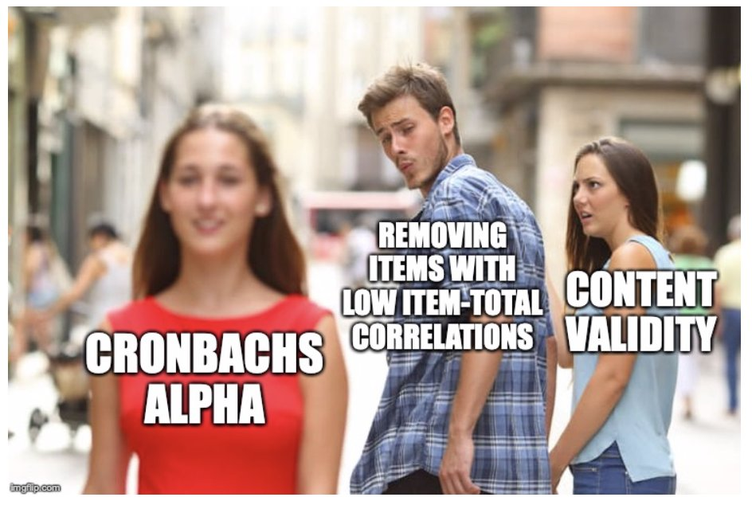
But don’t do this!

Slide 60
Factor structure: Close-up
Tension, negative affect and 1 item from Challenge load on same factor
Poor discriminant validity

Slide 61
Best practices for validating questionnaires
https://doi.org/10.1080/10447318.2015.1087664

Slide 62
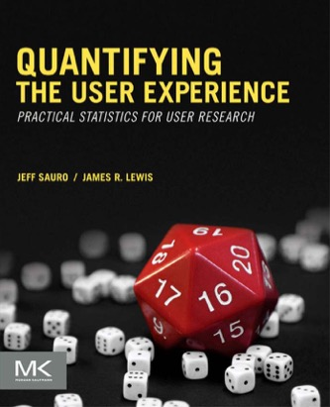
Introduction to Statistics for Questionnaires
If you want to test if there are statistically significant differences between designs (Null Hypothesis Significance Testing)
Very pragmatic, don’t rely on it for academic/scientific projects! E.g., sample size

