Slide 1
Healthcare company case study – for trainers
Notes:
You can change the picture under the slide-master.
Just go to “View” and select Slide Master.
Take the first slide of the title slide master and right click → change picture

Slide 2
Let’s watch an introduction

Slide 3


Our case study concerns a healthcare company in one unknown European country
5 different units around the country
Most of the customers are in the capital region, where the customers are divided into two different units
Other units are distributed around the country

Slide 4


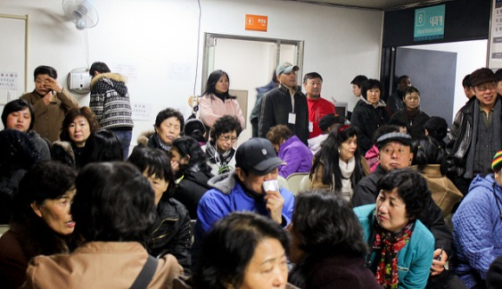
COO of the company has been concerned that the current premises are not enough …
From the 5 units, concerns have been raised that the current premises don’t suffice
COO doesn’t yet understand the problem so she calls a team of fellow Green Belts inside the company
COO would like to know what is the deal with room usage in the company

Slide 5
COO has sent you the following mail:
Dear GB,
Could take a look at our room usage in different units? I’ve heard that problems exist but no idea why…
We need, in my opinion, to make a project out of this. I’m currently on vacation, but I suggest we meet in a week to go through your initial findings and your plan on how to conduct the project.
Attached is the data file I found from my archives. Maybe you could take a preliminary look at it…
-COO

Slide 6
Your task will be to fulfill the COO’s request and lead her project
Please do the following tasks:
  Project charter
  First quick and dirty data analysis – more to come so do not do anything extensive. Just respond to the questions and get an overview of the issue.
Submit the filled template presentation in MyCourses with your name

Slide 7
Template slides for the project charter

Slide 8
Define the goal(s) for the project

Slide 9
Define a problem statement

Slide 10
What kind of roles you would have in the team, and what knowledge is required
Role | Knowledge required OR suggested person
Role | Knowledge required OR suggested person

Slide 11
Key process measures: What would you measure and how would you measure it?

Slide 12
Baseline measurements:
Create 4 slides from the given data:
  Slide 1: How are the unit sizes in the company?
  Slide 2: What are the most common specialities inside the company?
  Slide 3: How is the room usage in the different units?
  Takeaways: What kind of information would be helpfull in the future steps?
If possible, use graphics to present your data

Slide 13
[PUT YOUR OWN TITLE HERE]

Slide 14
Takeaways:
Question 1: What data would you like to have in order to understand the problem better?
Question 2: What kind of other information you would need in order to understand the problem?

Slide 15
Part B

Slide 16
COO has sent you the following mail:
Dear GB,
Thank you for your first analysis. As agreed on the meeting, let’s concentrate your project to unit Capital B.
IT gathered some data. Could you investigate does the usage rate vary between rational subgroups? As a piece of advise – Stay as high level as possible”.
Please find the attached data file from IT.
-COO

Slide 17
Room types
Special
Office
Different room types
Appointment
Not defined

Slide 18
Your task will be to fulfill the COO’s request
What was the utilization rate in that unit (Capital B)?
What were the most critical times from the room use standpoint?
Should you focus your inquery some how?
  Provide an example of that
What kind of information would you need to continue with your improvement project?
Please return your presentation to MyCourses

Slide 19
Part C

Slide 20
COO has sent you the following mail:
Dear GB,
Thank you for your work so far. As agreed on the meeting, please find out an aswer to the following questions:
What is the split between usage rate and utilization rate during the most critical hours?
If your analysis gives new insights, what could be causing them?
  What would be next steps to find them?
Please find the new data file from IT as an attachment.
-COO

Slide 21
Calculation of Usage and Utilization rates
When the room is reserved
Usage rate
When there is a professional in the room
Utilization rate

Slide 22
Room types
Special
Office
Different room types
Appointment
Not defined

