Slide 1
Practice-led research, documenting and reflective writing
Kirsi Niinimäki

Slide 2
Way to create argumentation
Own activity, read the text before hand
Your opinions do matter
Create a dialogue between reading and your own thoughts (agreeing or disagreeing). Construct a discussion (verbal or written one)
Learn to argument, tell your thoughts to others in discussion
If you are able to do this, you are also able to write down the argumentation

Slide 3
Nithikul Nimkulrat (2007) The Role of Documentation in Practice-Led Research

Slide 4
As a practitioner-researcher belonging to the art and design research community, I would rather define this form of research in a broad sense, as an interpretive engagement with artistic production and experience.
Such research feeds on practice as well as the practitioner’s reflections, such that the practical and the reflective parts could stimulate each other.
What would be a suitable method for conducting this type of research? Since practice (i.e., artistic production and experience) plays a significant role in such research, it is usually performed in dialogue with practice.
Research questions generally originate from within practice.
In order to answer the research questions, the artistic production and experience--both facts and feelings--are to be captured, whether in visual or textual formats.
The captured visuals and texts become data that can be used as research material.

Slide 5
Practice-led
In my research project, I examine the relationship between materials and artistic expression, in the context of contemporary art.
When physically experiencing a material, an artist senses the visual and tactile aspects of the material.
The material influences the artist’s sensation, feelings, emotions, and cognition.

Slide 6
Documentation
I recorded every step of my artistic process from conceptualizing to manipulating the materials and executing the artworks in multiple ways, including a written diary, sketchbook, my own voice recordings, and photographs.
These are documents that could affirm my consciousness in my artistic process.
The role of documentation may be underestimated in practice-led research. It connects practice with the world of research.
Documentation renders the implicit artistic experience accessible and discussable in the context of disciplined inquiry.

Slide 7
Documenting, being honest towards the process
I not only recorded the concrete and tangible parts such as the choices of materials used and the reasons for choosing them, but also the less tangible ones such as my feeling when touching and manipulating a material.
The tactile and visual experience is difficult to record; it requires utmost care and thoroughness.
In addition, both successes and failures are to be recorded.
As a practitioner, without multiple methods of documentation, I would have never been critical of my own creative process.

Slide 8
Knowing in creative process
As Polanyi (1969) asserted, knowing and doing are rarely exercised in isolation and their combination is present in the working of our sense organs.
Haptic knowledge
Tacit knowledge
The Tacit Dimension argues that tacit knowledge—tradition, inherited practices, implied values, and prejudgments—is a crucial part of scientific knowledge (Polanyi)

Slide 9
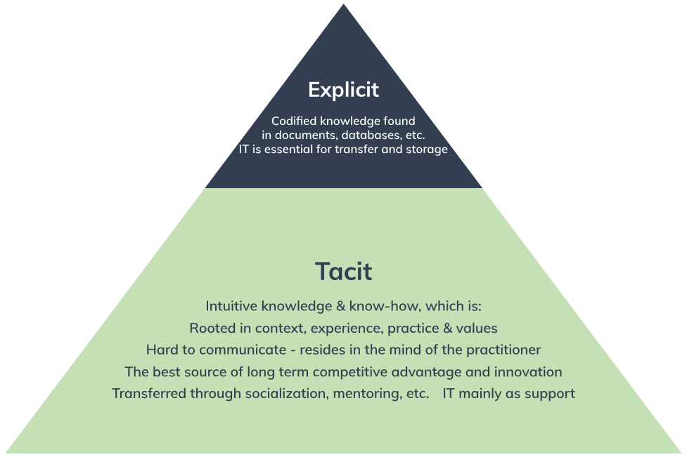
https://helpjuice.com/blog/tacit-knowledge

Slide 10
Group discussion
What to document in your own creative process
What are key elements/materials/ingredients in your creative process
What enhances/inspires your creativity and thinking/understanding
What kind of questions you ask from yourself when you do your creative practice
How you build your knowledge
Reflect this to the reading

Slide 11
Practice-led, Practice-based, Research through design readings
Maarit Mäkelä
Nithikul Nimkulrat
Linda Candy
Tim Ingold
Juha Varto
Michael Polanyi
Kristina Niedderer
Ilpo Koskinen
Christopher Frayling
Tim O'Riley

Slide 12
Context building

Slide 13
Context building
What is the framing of your work
Against what your design makes sense and meaning
Art context?
Social context?
Theoretical context?

Slide 14
Context building
How you position your work
How others see your work and its value
How your work is understood and evaluated
When you read academic text or previous MA thesis, evaluate, what is the context in this work

Slide 15
Context building
The interpretations of the viewers were rather divergent from my interpretations. This result raised several questions that led me to the study of some theories such as phenomenology, semiotics, and museology. (Nimkulrat 2007)

Slide 16
Context building
Documentation renders the implicit artistic experience accessible and discussable in the context of disciplined inquiry.
Discipline; fashion design, textile design, design, material-based/contemporary art
In my research project, I examine the relationship between materials and artistic expression, in the context of contemporary art (Nimkulrat 2007)
MA thesis=Disciplined inquiry positioned in a selected context

Slide 17
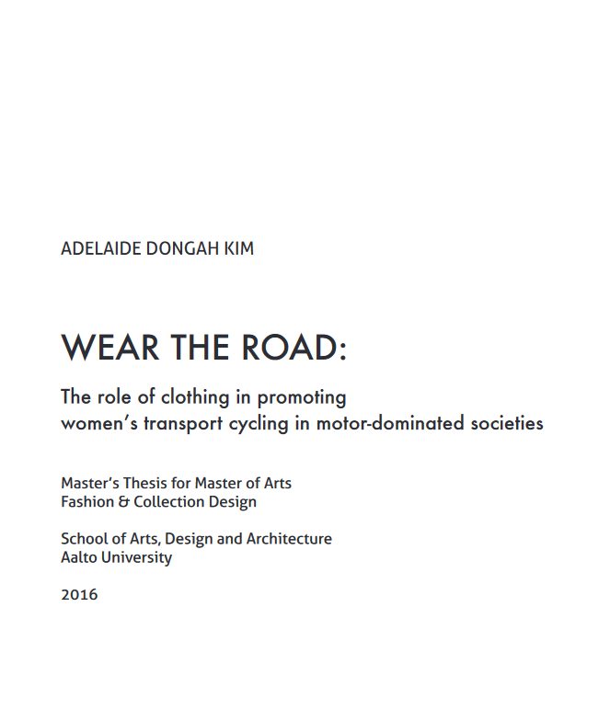
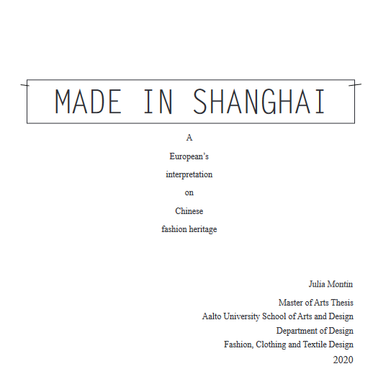
https://aaltodoc.aalto.fi/

Slide 18
Creativity in research
Four foundational abilities that reflect things that creative people do
being aware of your thoughts and behaviors,
understanding and using emotions,
making sure that you solve the right problem,
and learning through iteration and experimentation. (Nicola Ulibarri , Amanda E. Cravens , Anja Svetina Nabergoj , Sebastian Kernbach , Adam Royalt (2019) Creativity in Research )

Slide 19
Creativity in research
Three additional abilities that help create the conditions for creative thinking; support structures.
The support structures are using language and stories to
generate the creative behaviors and identity you want to adopt,
managing your energy to create motivation,
and using input from other people to amplify your creativity (Nicola Ulibarri , Amanda E. Cravens , Anja Svetina Nabergoj , Sebastian Kernbach , Adam Royalt (2019) Creativity in Research )

Slide 20
(Nicola Ulibarri , Amanda E. Cravens , Anja Svetina Nabergoj , Sebastian Kernbach , Adam Royalt (2019) Creativity in Research )

Slide 21
Context
Support structure to create the meaning to your design/creativity/process
Meaning making
Research context; Lab, Field, Gallery (Koskinen, Binder, Redström 2006)

