Slide 1
Lecture 2 – A Short History of consumer SUBJECTS

Slide 2
Intended Learning Outcome
We all become better consumers and human beings and somehow come together to save the planet from destruction (Go Team Aalto Biz)
AND
Understand different theoretical approaches to investigate what goes on with consumers and consumption contexts
Exhibit fluency with the theoretical and practical building blocks of consumer cultures

Slide 3
Practical/Cross-Sectional Takeaway
Diversity in Research Design
Historical/Archaeological Analysis
Longitudinal Ethnographic Immersion
Depth Interviews

Slide 5
When did ”consumer culture” take root?
Source: Alamy Stock Photo Archive

Slide 6
The Pre-Modern consumer

Slide 7
The Third Place??
https://vimeo.com/25412981

Slide 8
Robust Historiography

Slide 10
Sociopleasure

Slide 11
Physiopleasure

Slide 12
Historicize This
“We propose that the original source of the eighteenth-century British coffeehouse, the Ottoman coffeehouse, served to form the Ottoman public sphere.”

Slide 13
The Citizen Consumer

Slide 15
Diffusion and Acceleration
The Military-Consumer Complex

Slide 16
New Social Bulwark
Replacing religion as the dominant social structure

Slide 17
Consuming Americana
“When you buy the dozens of things you never bought or even thought of before . . . you are helping to build greater security for the industries of this country. . . . What you buy and how you buy it is very vital in your new life—and to our whole American way of living”

Slide 18
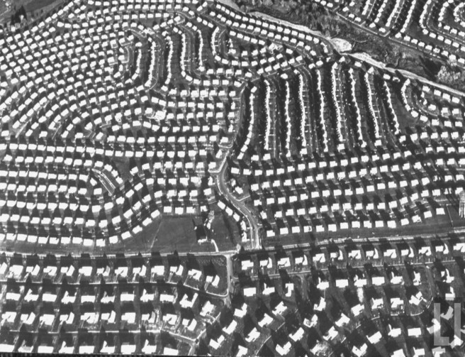
Marketization = Social Reproduction
“He’s probably a nice guy, but every time I look at him I see $2000 drop off the value of my house” (Life 1957)

Slide 19
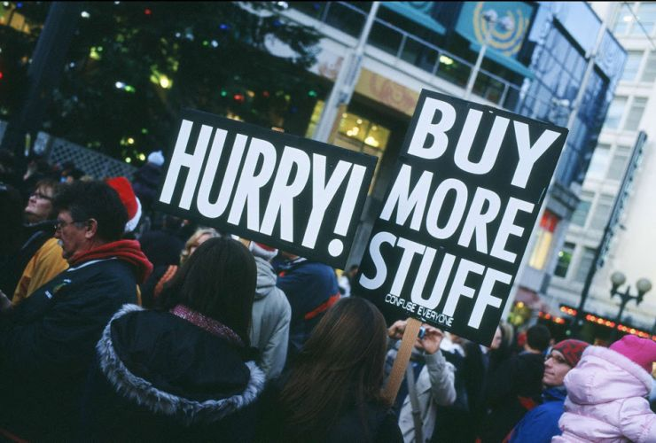
Consumption ≄ Citizenship
”Knowingly or not, they speak in an idiom that evolved out of the perhaps initially naive but ultimately misguided conviction of the Consumers’ Republic that private markets could solve the nation’s social and political as well as economic problems, somehow delivering greater democracy and prosperity to one and all at the very same time."
Copyright: John Henderson

Slide 20
The less-industrialized consumer

Slide 21
Signalling Status through Consumption
Copyright: Meng.co.uk

Slide 22
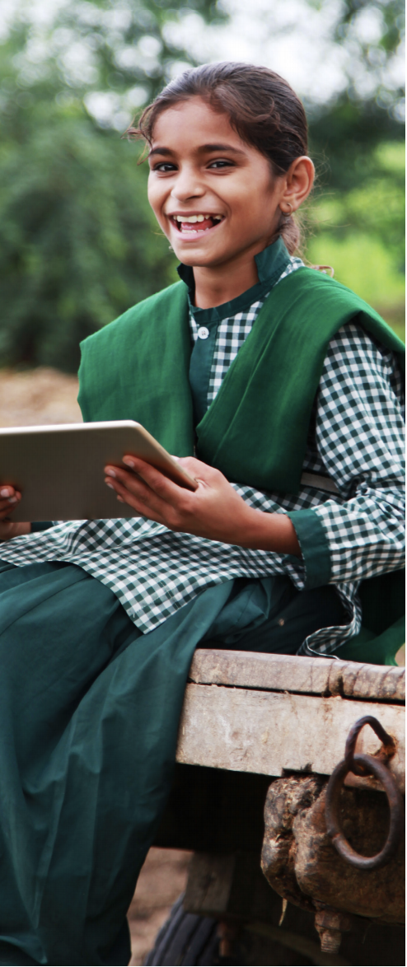
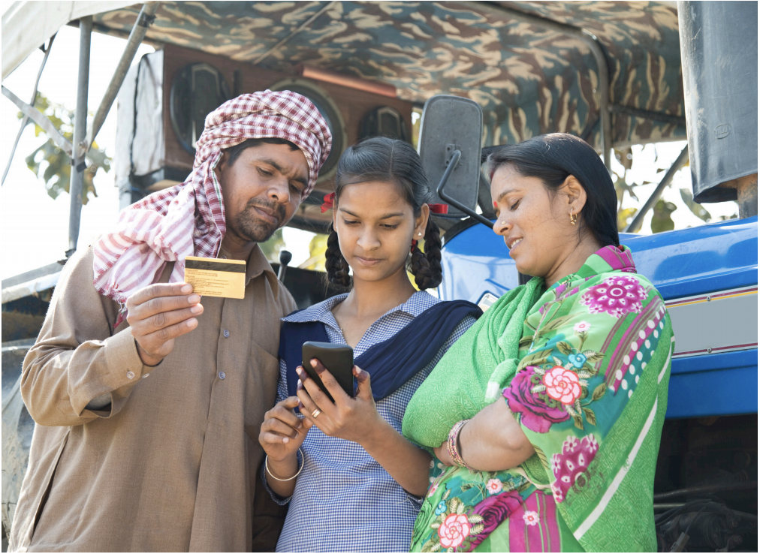
Emerging Middle-Class Consumer
Copyright: World Economic Forum
“Mimics” the existing models of consumption
Carbon and Resource Intensive
Copyright: World Economic Forum
Notes:
No signalling without energy

Slide 24
The Western Lifestyle Myth

Slide 25
The Western Lifestyle Myth

Slide 26
Indigenous Trickle Down

Slide 27
Consumption as Power
Aliye comments that most boutique hotels are very cute, clean, and nice, but that they lack air-conditioning. So whenever they go to a boutique hotel, Aliye and her husband bring their own window air-conditioner in their SUV. They have the hotel serviceman break one of the windows and install the air conditioner. When they check out, they pay for the window replacement. She says “I know it looks boorish from outside, but we just like to live that way. We want to have the best. We never limit ourselves when we travel.”

Slide 30
Status Anxiety
“Akcan: Most of my furniture comes from outside of Turkey. I give very much importance to design. I have some designer furniture, and there is no way you can find another of the same design anywhere else. For example, I own Sottsass chairs. Nobody understands this. I know it. Only a few in Turkey knows who Sottsass is. But he is one of the most important designers in the world [Smiles]. And I own his chairs.”

Slide 31
The responsible consumer!!

Slide 32
Whose subjects are we anyway?
Image Credit: Pixabay by gonghuimin468

Slide 33
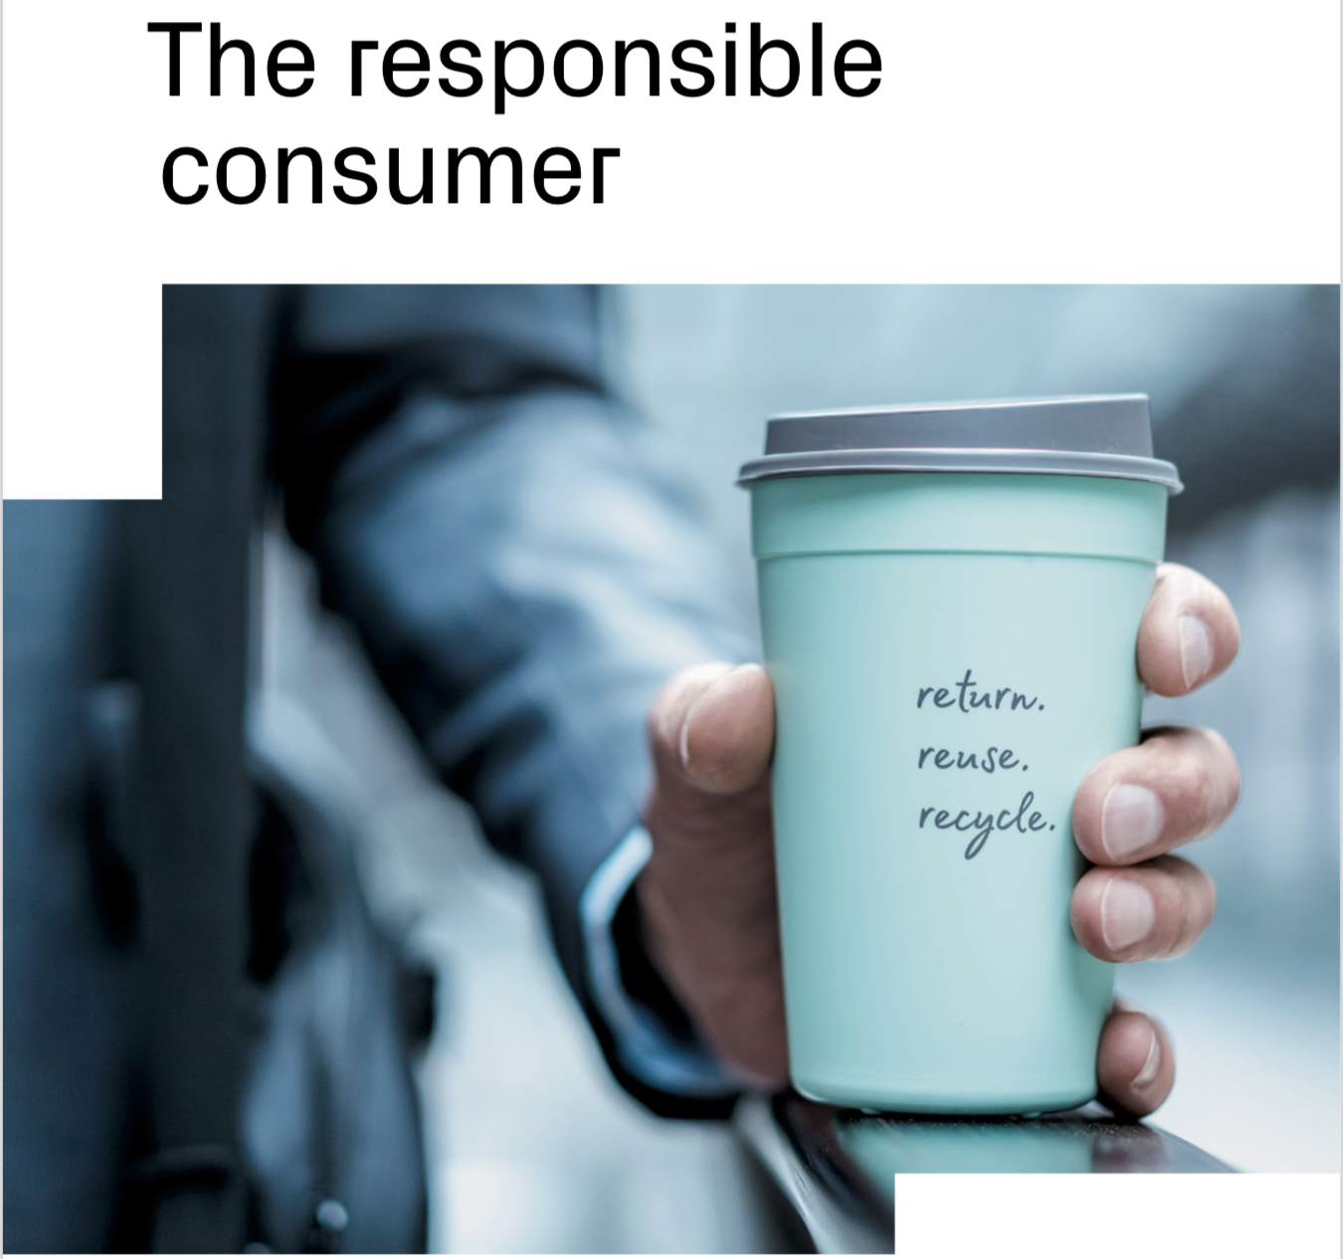
Image Credit: Credit Suisse

Slide 34
REflectionS

Slide 35
Key Takeaways
The good life is a social construct
Consumption is closely embedded in stories of nation building, social upliftment, distinction, ethics and morality
Brands have multiple sources of power and legitimacy that go beyond product or category features/promises

