Slide 1
An Introduction to Consumer Culture
The Concept and the Course
Kushagra Bhatnagar, BTech, MBA, PhD

Slide 2
Agenda
Introduction
Course Practicalities
Course Kick off - Understanding basic concepts

Slide 3
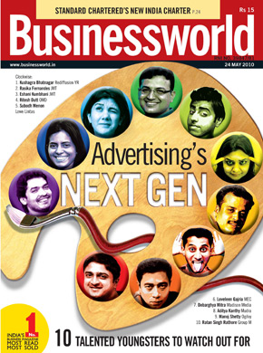
WHO AM I
Born in New Delhi, India
Studied Computer Science for Bachelors
Majored in Finance, Minor in Marketing for Master’s
Worked in Investment Banking, Advertising, Marketing Consultancies
Eventually became an entrepreneur (2011-2015)
Started PhD at Aalto (2015 - About to Graduate)
Live in Espoo with wife and 5-year old daughter

Slide 4
Why Consumer Cultures interest me!!
We are all customers now
Pleasure and Sorrow
Can’t live with them,
Can’t live without them

Slide 5
Course Practicalities

Slide 6
Learning Objectives – Conceptual Level
Understand the evolutionary trajectory of consumer culture
Align epistemological assumptions with appropriate approach
Exhibit fluency with the building blocks of consumer culture
Analyse and critique the dark side of consumer culture

Slide 7
Learning Objectives – Practical Level
Apply appropriate socio-cultural theories and toolkits to uncover cultural insights
Get hands-on experience in conducting qualitative consumer research

Slide 8
Course content - What do we do when we interrogate consumer culture?
A global and contemporary perspective on different consumer cultures
The constraints, challenges, facilities and advantages of consumption
As well as the dark side of consumer culture

Slide 9
Assessment Plan
Self Assessment (Attendance and Evaluation Sheet)
Peer Assessment (Class Discussion)
Teacher Assessment (Evaluation and Feedback on presentations and final paper)

Slide 10
Forms of Teacher Assessment
Formative Assessment (Throughout the course)
Summative Assessment (At the end of the course)

Slide 11
Expectations from Final Report

Slide 12
Why come to class?
Share-Collaborate-Cocreate
Challenge-Constructive Critique
Safe Experimentation
In short, this is where the magic happens

Slide 13
The Teacher’s role
Facilitator
Kickstarter
Counsellor
Keeping us all awake…

Slide 14
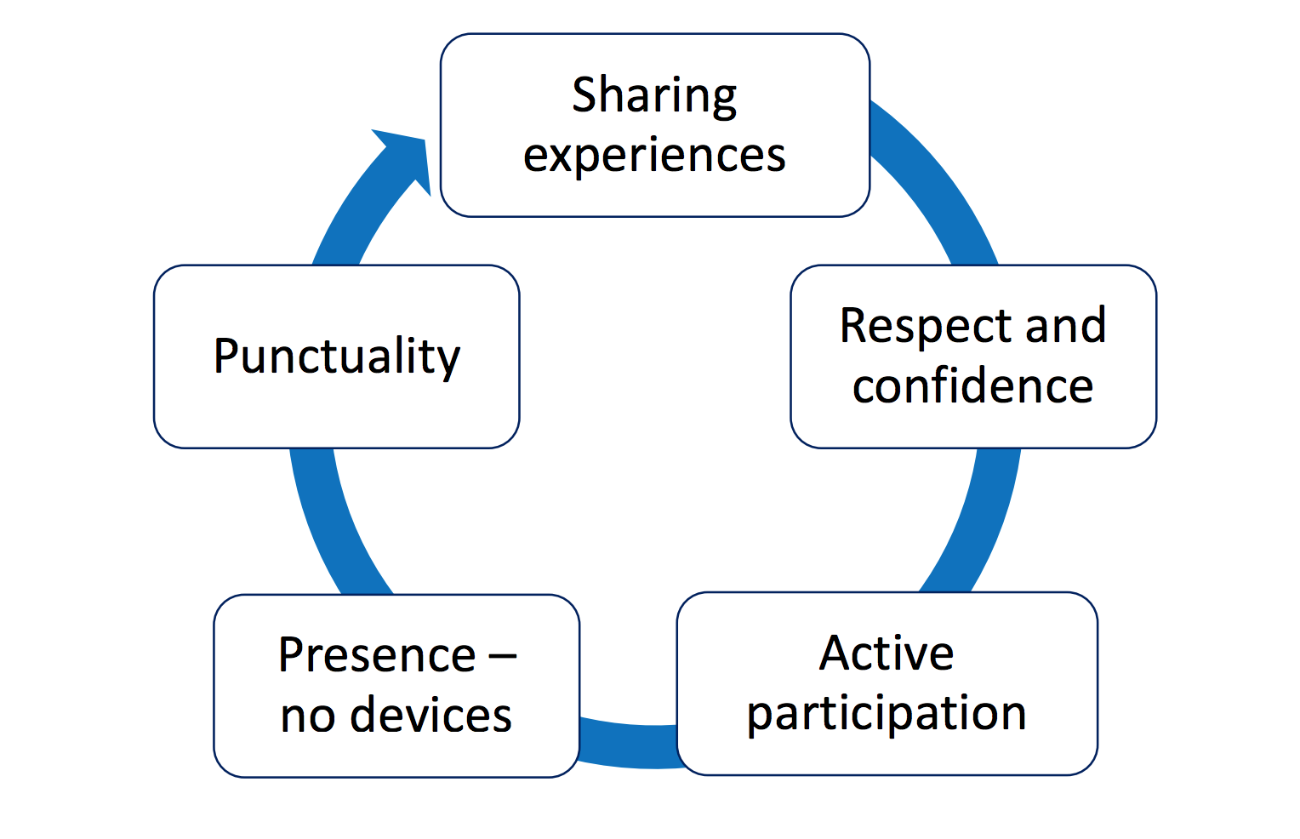
Some rules of the game
Source: Paivi Kinnunen & Christa-Uusi Rauva

Slide 15
Weekly cultural insight task
Total Weightage – 40%

Slide 16
ASSIGNMENT 1 : Consumption, Identity, Market Insight
Choose an FMCG product that you’ve bought recently. How did you get convinced that this was the right product/brand for you to buy? Try and go beyond the product characteristics.
Remember, don't focus on the brand messaging too much, but on what makes it interesting and powerful to you.

Slide 17
ASSIGNMENT 2: Consumption and the maintenance of social relations
The consumption of goods and services in contemporary consumer culture often contributes to positive social interactions. Discuss a consumer brand/product that exploited the connections between consumption and the desire for positive social interactions. (250-300 words)
(PS: You can draw on arguments from any class readings/discussions)

Slide 18
ASSIGNMENT 3: Consumer Power
We live in an age where the customer is king. Nowhere is this more true than online consumer reviews. Discuss any recent review that you found interesting from the point of view of consumer power. These may be your own reviews, those written down by friends/family or even some reviews discussed in popular media (250-300 words).
(PS: I have attached a short article for inspiration.)

Slide 19
ASSIGNMENT 4: Consuming Technology
Identify a key technology service/possession that you use. Think of the way you imagined using that possession/service and contrast it with the way you actually use it.

Slide 20
Final assignment
Weightage – 25%

Slide 21
Blending Original Thinking and Theoretical Learning
5 questions
500-600 words per question
Connect them to the articles/concepts we read and discussed in class
Equal weightage for original insight and theoretical connections to concepts discussed in class

Slide 22
Q1) Consumer Identity & Symbolic Consumption
Choose a contemporary category of products/services. Laptops, mobile phone, electric scooters – anything. Identify four different brands within the category and map the identity projects/positions that each of the brands supports. How do these brands support these identity projects?

Slide 23
Q2) Global flows of consumers
Identify a country that heavily depends on tourism revenue. Look at their most recent tourism-oriented communication. Analyse the key cultural insight that the country offers to tourists. You can connect it to authenticity, commodification, hedonic consumption etc.

Slide 24
Q3) Consumer Culture and Social Institutions
Think of a important religious/cultural/national festival or celebration. Now think of a “pure” consumption festival (Fyre fest, Flow, slush etc.). In what ways are the “pure” consumption occasions similar to religious/cultural festivals. In what ways are they different. Also, comment about the evolutionary trajectories of these occasions.

Slide 25
Q4) Paradoxes of consumer culture
Think of how a technology possession/service has changed the way you consume other objects, experience personal or public spaces, and enact social interactions. How has this technology impacted your consumption habits and norms, expectations?

Slide 26
Q5) The Experience Culture
Think of the last moment/occasion that you felt truly happy/ecstatic/immersed in the moment etc. What kind of a consumption ensemble were you a part of? Now think of you might have answered this question 15 years ago? What has changed in those years?

Slide 27
Understanding the building blocks

Slide 28
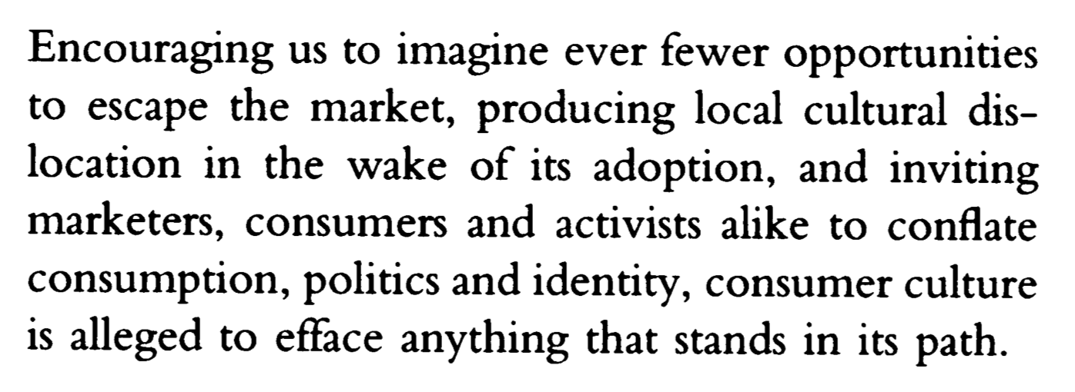
Culture is what culture does!!

Slide 29
https://www.youtube.com/watch?v=FjSzqpArMcU

