Slide 1
Exercise B
Building a portfolio of codesign activities

Slide 2
The idea of portfolio of codesign activities
In many settings single codesign action is too limited even if multiplied
Diverse aims and publics for participation call for different activities
Some people prefer light and quick participation - others deep and influential
Some people have high abilities to contribute to design and require only modest support – others require thorough support or can only participate in less demanding design tasks
Different people prefer different types and channels of particiapation: f2f, digiplatform, events, invitational workshops, hearings, participation in tailored tasks…
Some actions can be sequential building on each other (but not necessarily and not necessarily a ‘series’ with same peoples)
Some actions can be parallel, complementing each other
Some actions can be quick and cheap per contacted person
Some actions can be deep and intensive and more expensive
The resources spent on pre-in-post practicalities and analysing the codesign activities and turning them to design concepts and solutions need to be considered (but also potential resources gained from users!)
The strategic aims from the codesign need to be considered; is something else than design achieved as well?

Slide 3
Outcome of the exercise
List of the codesign actions you seek to pursue (for inspiration see codesign journey planner, actioncalogue.eu, DSCC slides etc resources)
  1-2 slides max
Short desciption (3-4 sentences) why each action is done: who it targets, for what reason and by what means
Short explanation of how the different actions relate to each other ie the ‘logic’ in your portfolio
  Max 2 slides, aime at 1
Additional considerations, max 1 slide
To sanity check your portfolio
  Estimate how much resources go to each action ‘
  Estimate what all is gained with the portfolio
  Estimate how the participation is turned into design solutions and when

Slide 4
Brief: Aim and scope
Build a portfolio of participation activities that supports the design of a flagship library of the new era
Most of the features of the library are new cultural production (not just access to culture): music and film studios, digital learning spaces, digital-physical making, open workspaces, public event spaces, games…
Timeframe: two years
Stage: preplanning ie the stage where the scope is set (e.g. 20 000m2, max 100m€, central location) but exact space and service offering is as yet only a draft to be defined (see space reservations in the below info pack part of the slides)
Resources:
  two full time participation planners, other staff available for occasional events (to an extent)
  cost budget 10 000€ for design, but parallel marketing budget 50 000€ a year
  more budget could be attracted through partnering … but remember that parners have a say!
  If you use the spaces owned by the city, the space use is free (but needs to be booked)
  Costs example: 1 halfday basic workshop with 50 people; 2 days to plan, one day to run, two weeks to refine the results, additional running costs 500€ (the planning and refining time goes down if you repeat) (x2 people)
  Cost example: external codesign consultant 750€ a day, senior 1500€ a day
  Cost example: running an open call one day event (two days to plan, 5 people to run, 4 weeks to analyse the results)
  Cost example: Digi and platform development 500€ a day

Slide 5
With whom? ie the ‘public’ and ‘customers’
The library is for ‘everyone’ but it is also seeking to renew what libraries are, who uses them and for what
The heaviest current userbase tends towards educated, +60 and female customers … as well as families with children.
Continuing with the current operation model and clientele has led to gradual decline in loans and visitors in next to all other countries, questioning the remit (right to existence) of libraries
This has not happened (at least not as yet) in Finland and libraries are by far the most popularly visited cultural insitution
Most of the new features of the library would be used by groups of people that do not use library spaces intensively currently: games, studios, learning spaces, digital-physical making, open workspaces, public event spaces…
The participation activities need to reach ‘everyone’ openly as well as ‘counter-sample’ to those peoples whose participation the new era library needs (see the above bullet on activities)
Various close city internal stakeholder groups: immigration, tourism, youth services, other cultural institutions, busines services

Slide 6
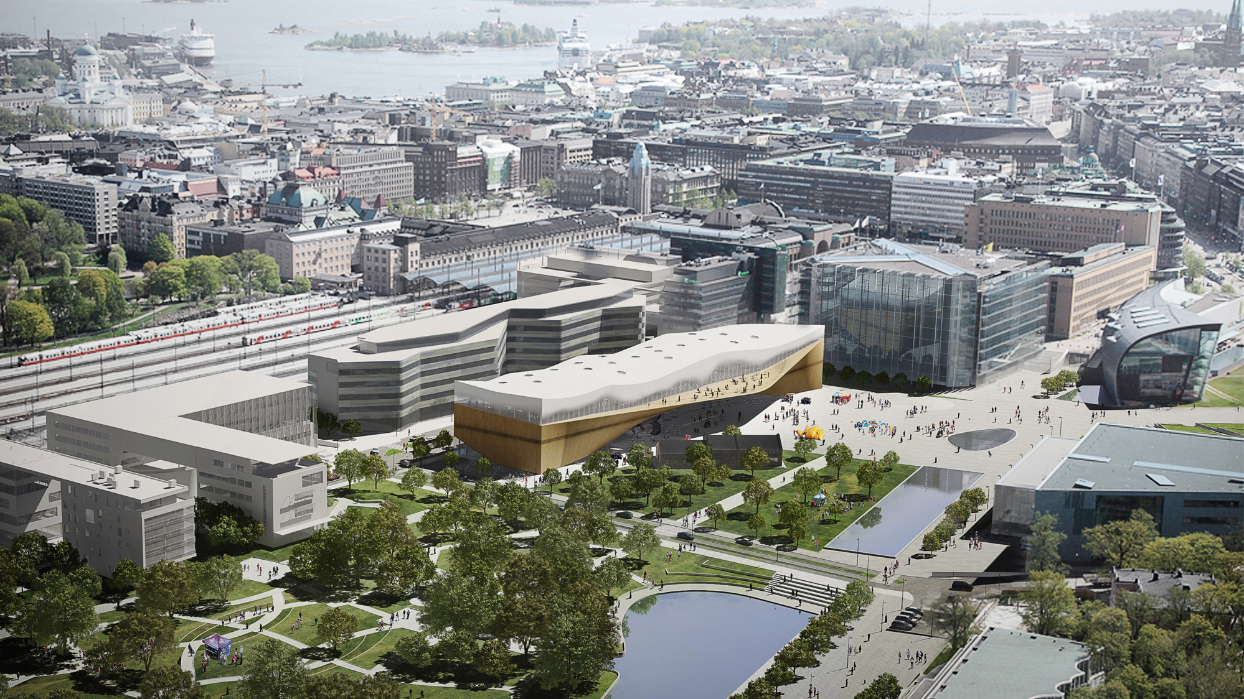
155 years old institution creating something new…
|Meeting- and lounge area 440 m2 | Stage 30 m2 | Pop-up-infos 100m2 | Cinema 490m2 | Multi-purpose hall 350m2 | Lobby areas 150m2 | Back Stage 40m2 | Living lab 200m2 | Exhibition spaces 300m2 | Café 200m2 | Restaurant 300m2 | Interactive spaces 240m2 | Living rooms 500m2 | Children’and Families’ World 600m2 | PersonalOffice-area 400m2 | Studios 160m2 | Makerspace 100m2 | Listening, viewing, game rooms 230m2 | Music, recording and videostudio 400m2 | Service-points & collection area 1600 m2
Future library transitioning to a space for citizens, and community connections
From
storing books
to support
citizens’ needs;
from collections
to connections

Slide 7
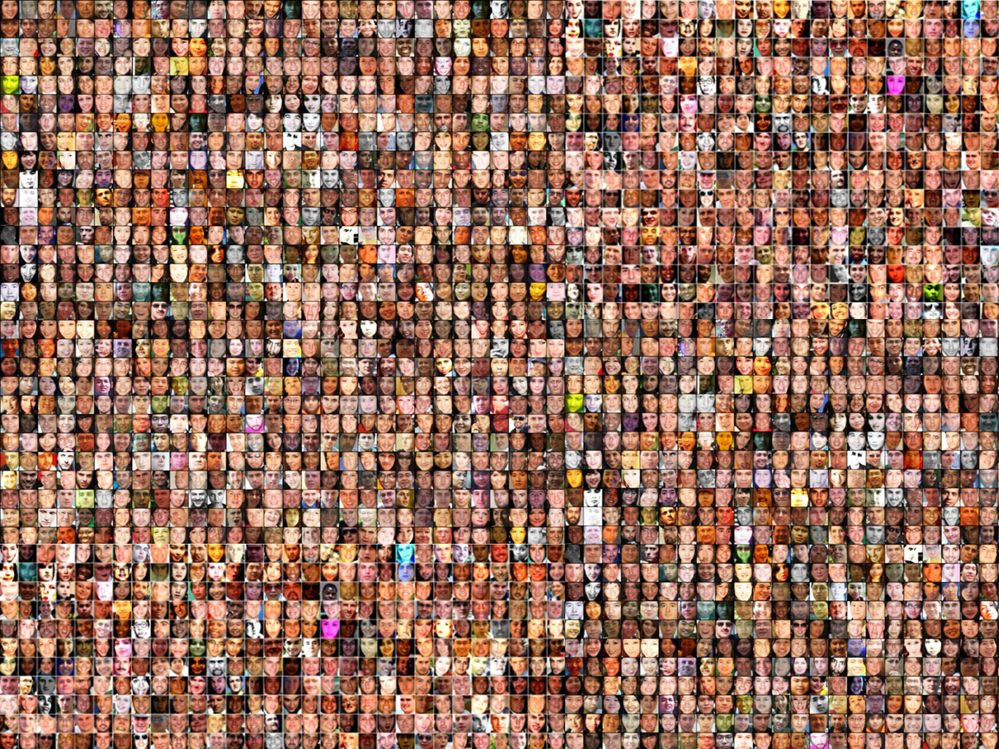
2,5 million
10 000

Slide 8
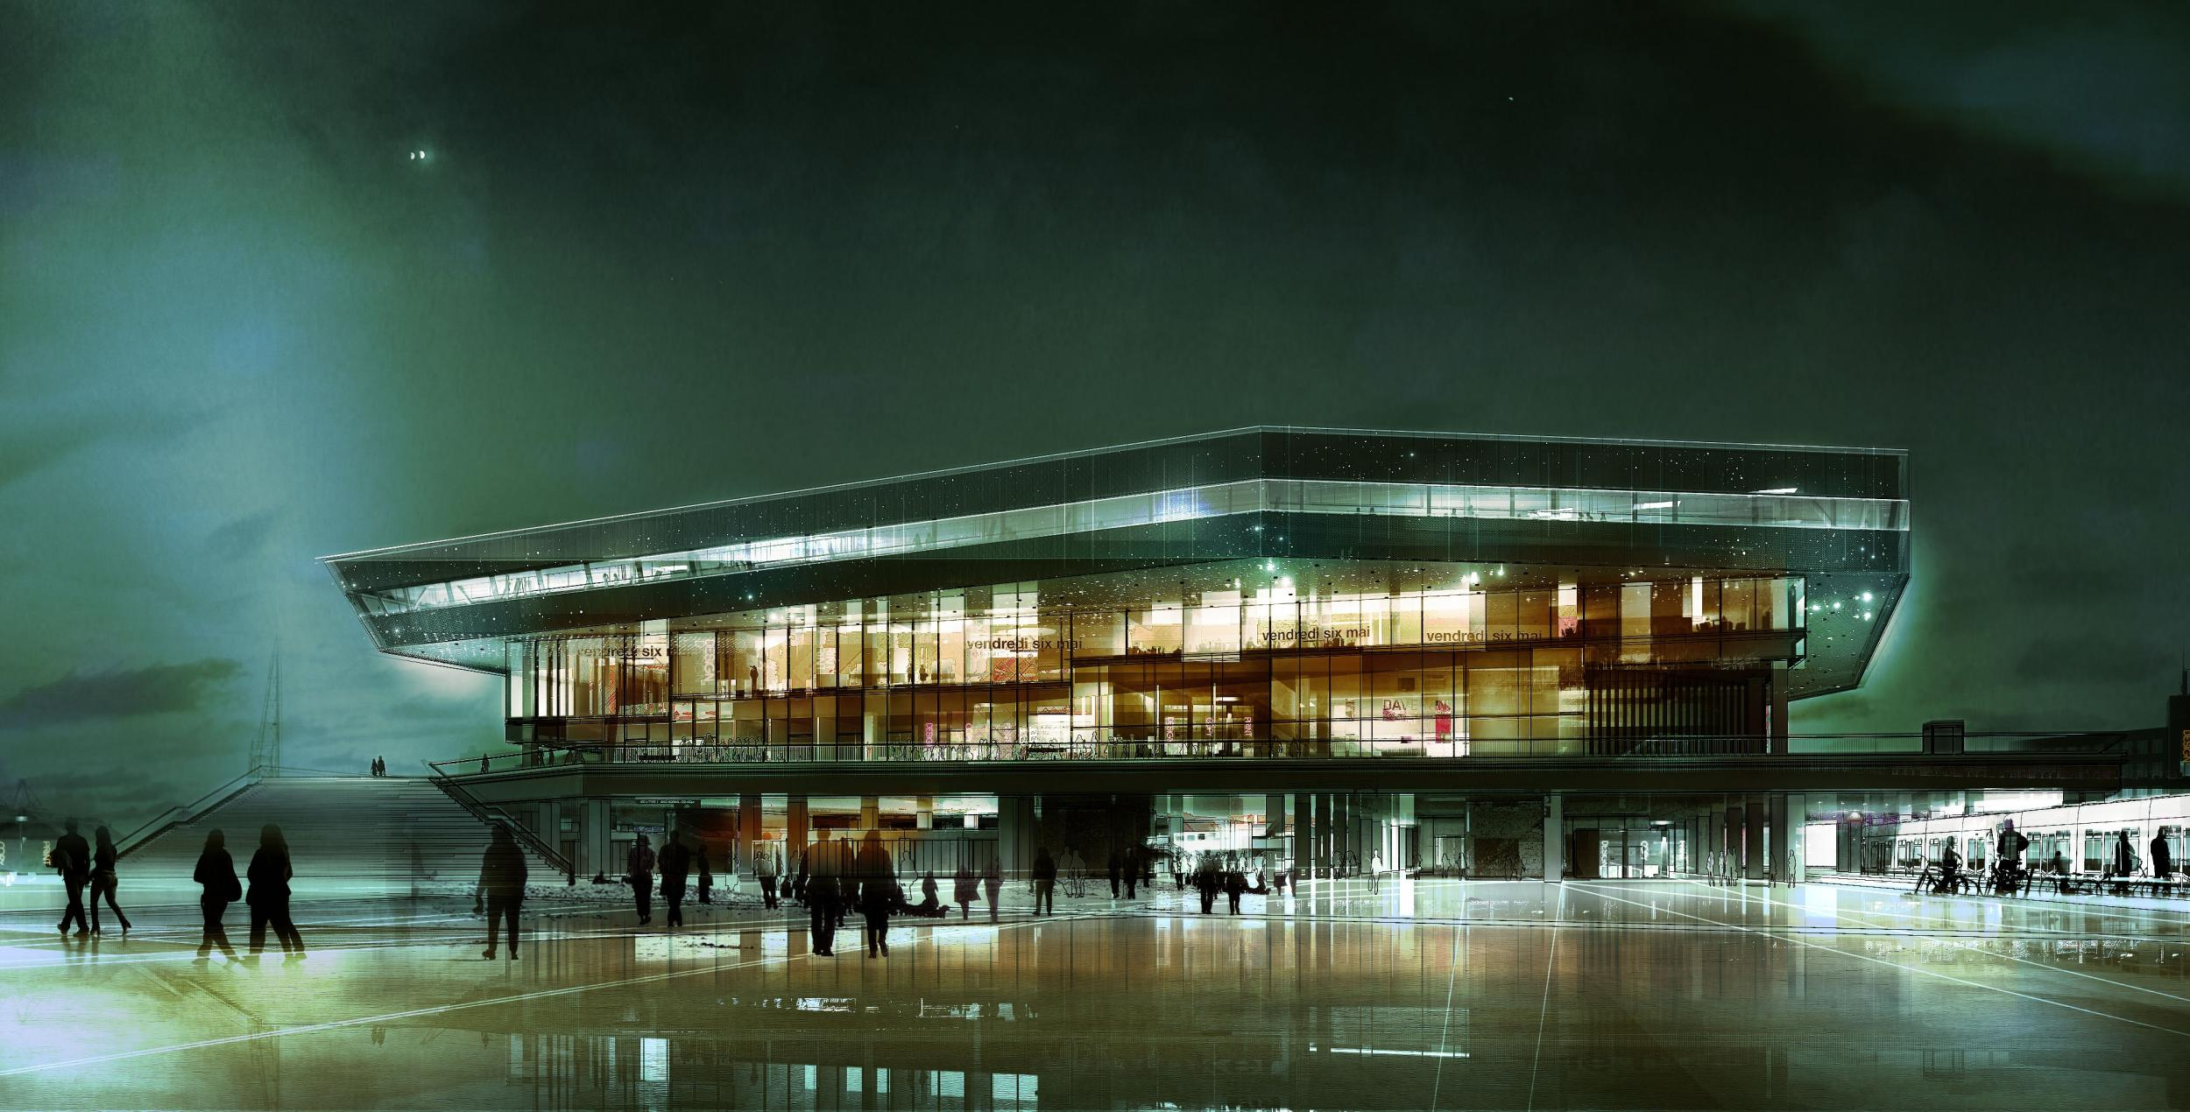

Aarhus/ Dokk 1
Urban Mediaspace will provide you with many opportunities for experience, learning, activity and contemplation.

Slide 9
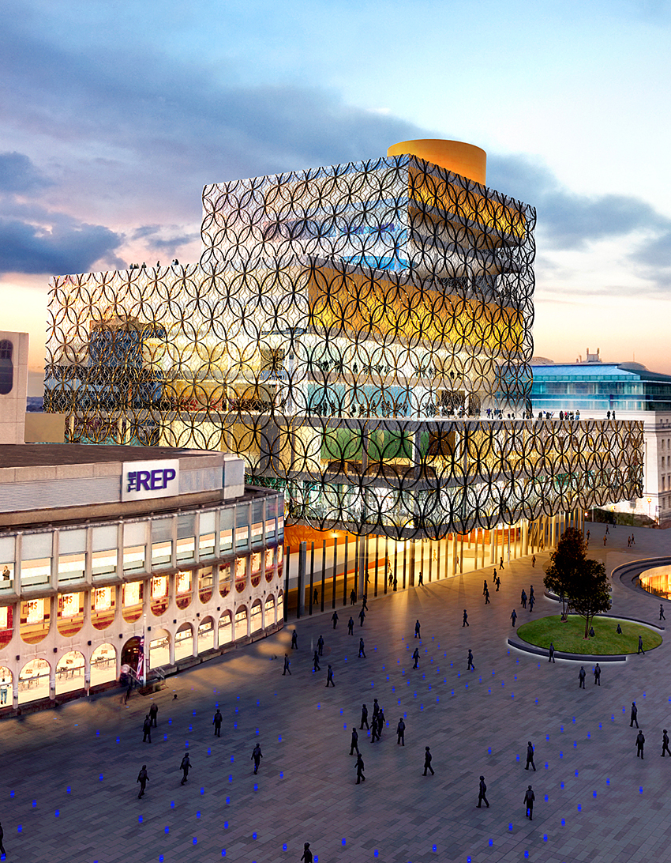
Birmingham
Rewriting the book. We aim to transform lives through learning, knowledge and culture.

Slide 10
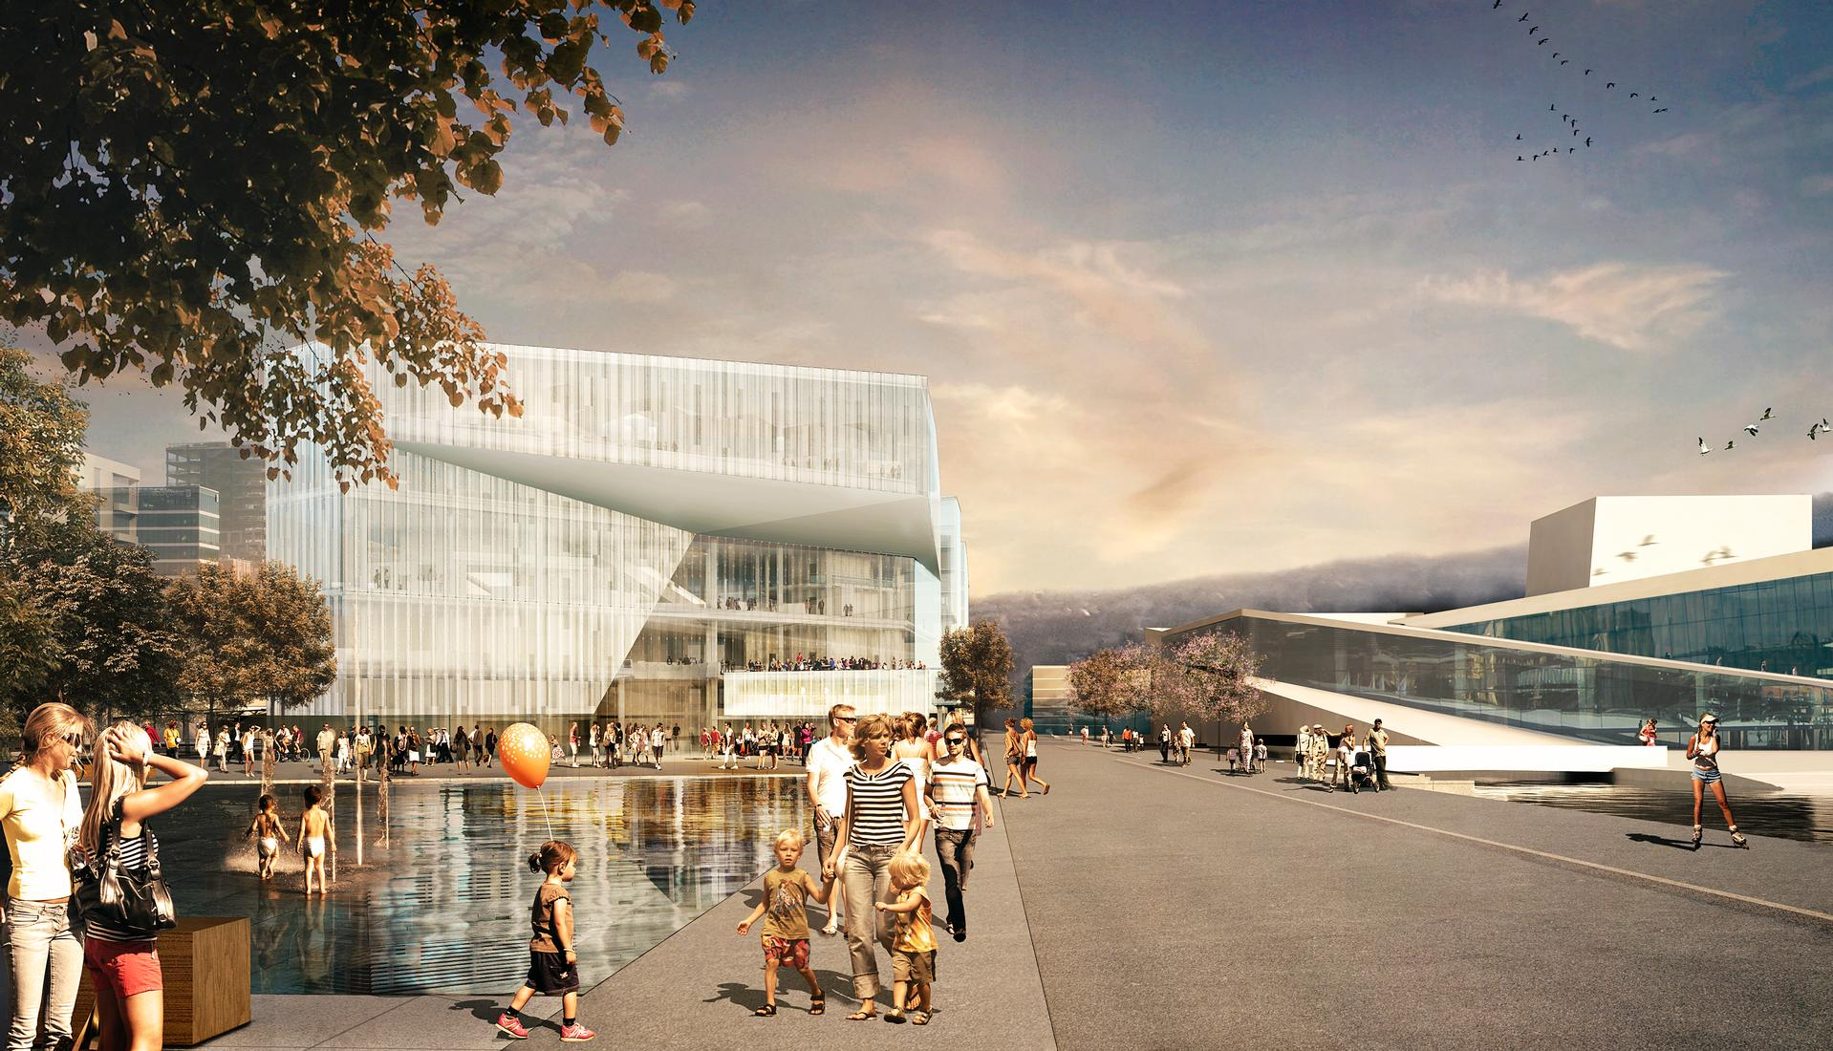
Oslo/ New Deichmanske
Keeps Oslo awake. The most innovative, visible and available library and public space in Europe.

Slide 11
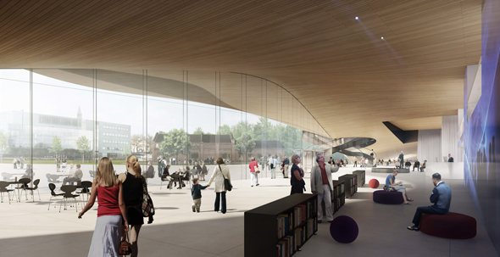
Three different floors, three different athmospheres
The ground floor is busy and frequently updated space suitable for quick visits and walk-throughs. The active, zero-threshold public spaces in the ground floor will be visible, attractive, understandable and welcoming to all visitors.

Slide 12
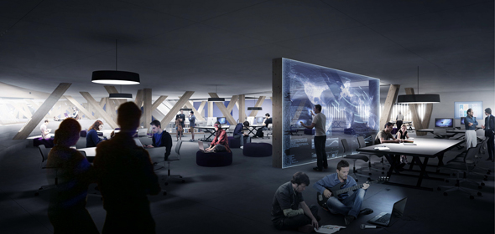
Three different floors, three different athmospheres
The middle floor will offer opportunities for working, concentrating and learning-by-doing in an environment optimized for media and latest tools. It will contain workshop spaces for music and multimedia, as well as a public sauna and a citizen balcony.

Slide 13
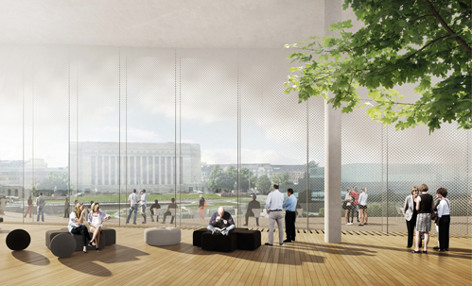
Three different floors, three different athmospheres
The traditional, serene library atmosphere can be found on the top floor. This will be a calm area for contemplation, floating above the busy central Helsinki. It will offer great views to the surrounding park and cityscape.

Slide 14

The Budget
Costs total 96 million €
Operating costs 7 million € yearly
            Costcontrol is very strict:
            All planning proposals are under calculation of costs
            Decisions are made after the calculation of costs is finalized

Slide 15
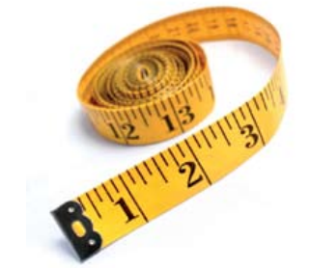
Schedule
Preparations with the winning team 8/2013-11/2013
The consultant of construction and technical planners are chosen according to the EU regulations 11/2013
The project plan is ready for the decision making 9/2014, legal 3/2015
Possible changes in the City Plan 10/2013-3/2015
The implementation planning 3/2015-3/2016
Preparations for construction, EU tender requests 4/2016-10/2016
Construction begins 11/2016
The masonry of the ”foundation stone” 4/2017
The building is completed 8/ 2018
Interior decoration and furnishing 9-11/2018
The opening ceremony 12/2018

Slide 16
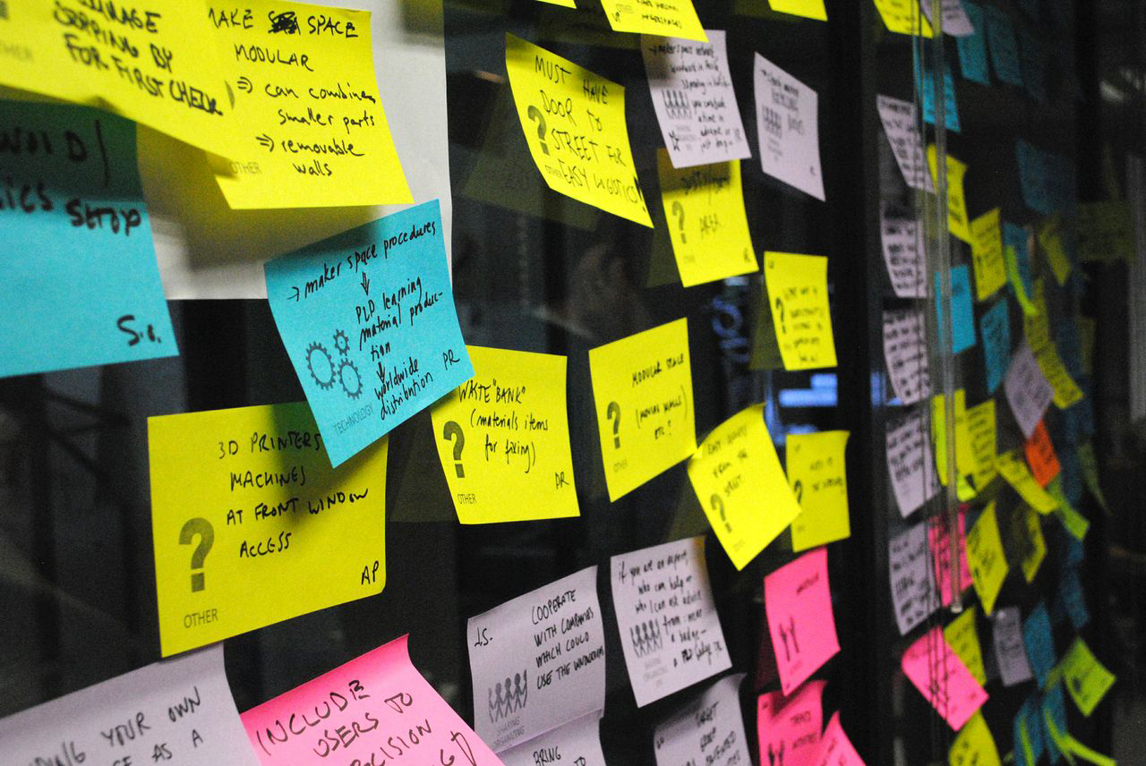
The Future library is designed for with you - Participatory planning
Helsinki Central Library 2018 is a new type of project where the contents and modes of activity are developed through collaboration between the library, city residents and partners.

Slide 17
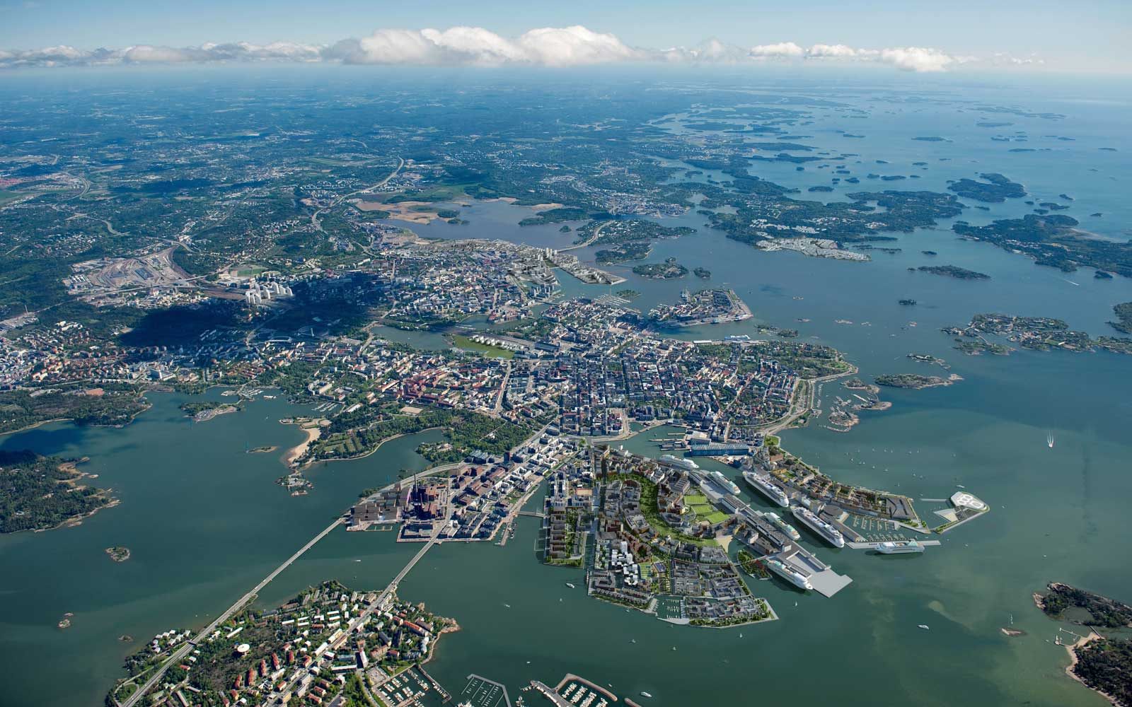
Central Library – a Flagship for All The Libraries
Operations of the Central Library are already being
created in pilots and projects with the help of local
libraries and libraries also nationally.

Slide 18
Political positining of Renewing library through a new flagship
Move from access to cultural productions to fostering cultural production and its peer sharing agreed in principle among library sector
… but inertia of the old books and music focus amongst librarians
Investments into flagship – build cost and running costs – contested from the left as resources a way from the neighbourhood library network, particularly by the political far left
  A counter argument is that the renewal cannot be done in small neighborhood libraries and without it the whole institution will stifle and loose its right to funding and existence
Investment into central flagship library contested by the political far right and populists as waste of money of insignificant cultural pastime that just increases taxes
  A counter argument is that the library of the new area creates grassroots skillsets in new digital and entrepreneurial culture among the youth, the re-educating and the unemployed

