Slide 1
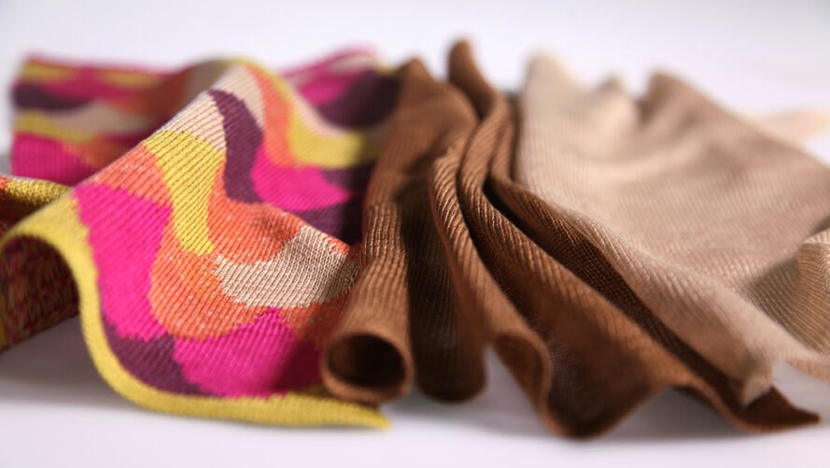
Dissolution of cellulose in an ionic liquid
Photo: Eeva Suorlahti

Slide 2
After today, you should be able to
Explain the difference between a solution and a suspension
Identify some factors that affect the solubility of a given polymer (in our case, cellulose)
Dissolve cellulose in an ionic liquid and regenerate it in water

Slide 3
Polymers
Large molecules that consist of repeating units (monomers)
Synthetic (e.g. polystyrene, polyethylene) or natural (e.g. cellulose, starch)
Linear (e.g. cellulose), branched (e.g. xylan), or crosslinked (e.g. lignin)

Slide 4
Polymer solubility depends on
Temperature
Molecular size
Presence of branching or crosslinking
Crystallinity
Solvent
Sometimes a true solution is not achieved but a suspension can still be formed (common for cellulose)

Slide 5
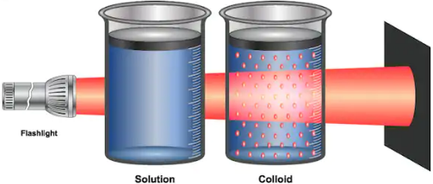
Solution vs. suspension
Solution
Suspension
Isolated molecules in a solvent
e.g. cellulose in [Emim][Ac]
Solid particles in a solvent
e.g. cellulose fibers in water
Light source
Solution
Suspension
https://vivadifferences.com/true-solution-vs-colloidal-solution-vs-suspension/
Notes:
Here it is important to note the difference between a solution and a suspension. Cellulose can take both forms, the suspension form being much more typical (as cellulose is quite difficult to dissolve). The difference is ultimately about size: individual molecules are much smaller than for example pulp fibers or even nanocellulose! The so-called Tyndall effect can be utilized to tell the difference between a solution and a suspension.

Slide 6
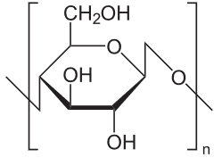
Dissolving cellulose is not easy
n can be several thousands here!
Cellulose is not soluble in water or most organic solvents
“soluble in a few classes of solvents, which, according to current understanding, have no apparent common properties” (Medronho et al. 2012)
soluble in e.g. [Emim][Ac], DMAC/LiCl, NMMO, NaOH (in low temperature)
Generally, large molecules are difficult to dissolve
Cellulose has a high self-affinity – explained by a combination of H-bonding and hydrophobic interactions
Ionic liquids have gained attention as ecological solvents for cellulose
Notes:
Cellulose is notoriously difficult to dissolve, despite having a large number of OH groups that interact readily with water. Cellulose does swell and soften in water, but it remains as solid particles there, resisting full dissolution.
The reason for this has been explained by a combination of entropic factors (large molecular size) and cellulose self-affinity (tendency to stick to itself due to an optimal coupling of H-bonding and hydrophobic interactions).

Slide 7
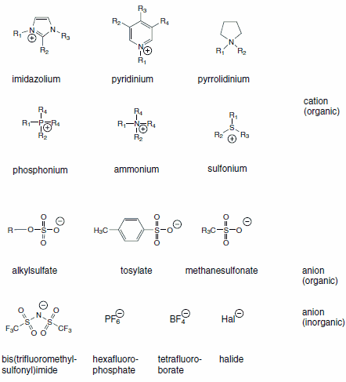
Ionic liquids
Molten salts (melting points below 100 °C)
Consist of ions (anions and cations)
Highly viscous (T-dependent)
Low vapor pressure (do not evaporate easily)
Water-soluble
https://www.sigmaaldrich.com/technical-documents/articles/chemfiles/ionic-liquids0.html

Slide 8
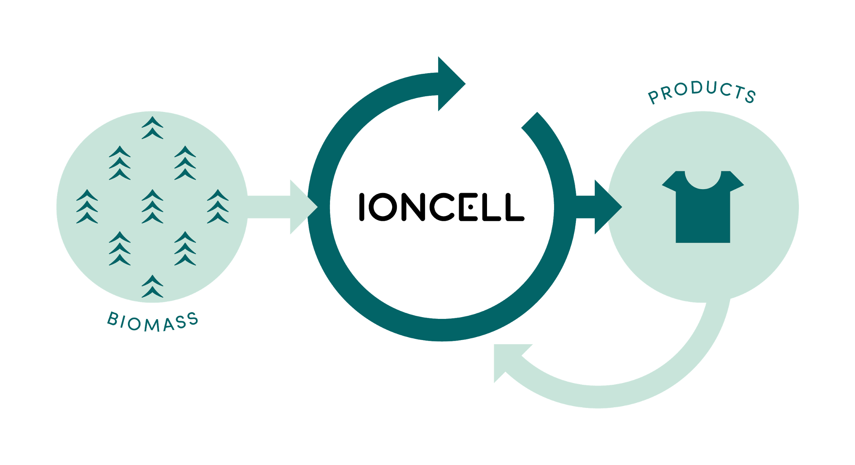
IONCELL process
https://www.youtube.com/watch?v=cSe5PKDkpR4
Notes:
Ioncell is a process developed here in Aalto (Herbert Sixta’s group) in collaboration with the University of Helsinki (organic chemistry). It is presently tested in pilot scale, aiming to take it into full industrial scale.

Slide 9
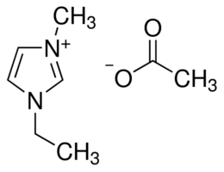
What happens in the IONCELL process?
Cellulose dissolves in an ionic liquid
In this session, we use an ionic liquid called 1-ethyl-3-methylimidazolium acetate ([Emim][Ac])
When dissolved, cellulose molecules can be spun into thin filaments with a nozzle
Then, the filaments enter a water bath that regenerates cellulose into solid form, forming long fibers (several cm, not mm like in wood)
Long fibers can be used for textile manufacturing
Notes:
Cellulose has no melting point (it gets burned rather than melts), so in order to process it into desired shape it must be softened in some way. In the Ioncell process, this is done by dissolution.

Slide 10
Why is IONCELL not a commercial process yet?
Ionic liquids are expensive (e.g. [Emim][Ac] about 500 €/L from Sigma)
Need to reuse the solvent in a closed loop system
Ionic liquids are extremely hygroscopic
Separation from water consumes a lot of energy

Slide 11
Further reading
Medronho, B., Romano, A., Miguel, M. G., Stigsson, L., & Lindman, B. (2012). Rationalizing cellulose (in) solubility: reviewing basic physicochemical aspects and role of hydrophobic interactions. Cellulose, 19(3), 581-587.
Asaadi, S., Hummel, M., Hellsten, S., Härkäsalmi, T., Ma, Y., Michud, A., & Sixta, H. (2016). Renewable high‐performance fibers from the chemical recycling of cotton waste utilizing an ionic liquid. ChemSusChem, 9(22), 3250-3258.

