Slide 1
Aalto University Shop
Pricing 27.11.2020

Slide 2
DISCLAIMER
“There is no absolute right or wrong way to approach pricing” - (Daniel Abild, 2019)

Slide 3
Overview
- Relationship between retailer and content creator
- Financial basics - retailer
- Calculators and models
- Calculating a price point
- Examples (products)
- Deciding on the relationship
- Things to consider
- Leaving thoughts

Slide 4
Retailer & Content Creator
- Mutually beneficial relationship
- Does include negotiation
- Both parties interested in €

Slide 5
Financial Basics - Retailer
- Business plan (Financial plan)
- P&L (Profit and loss)
- Costs (rent, staff, utilities etc.)
- Sales Forecast
- COGS (Cost of goods sold)
- Margin (markup)

Slide 6
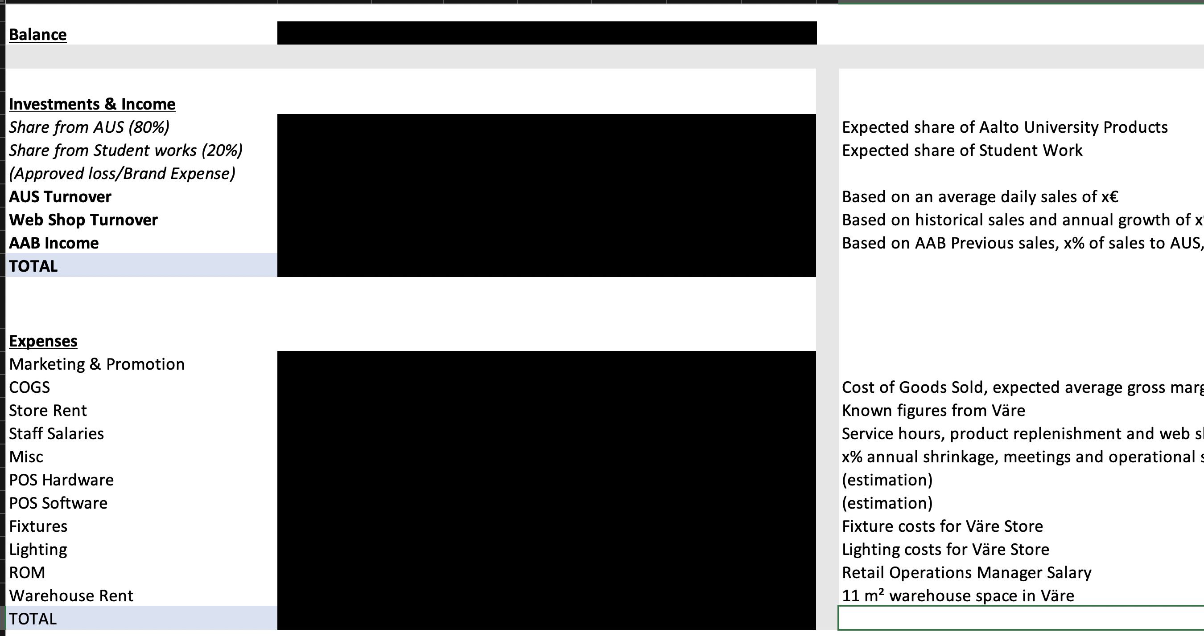

Slide 7
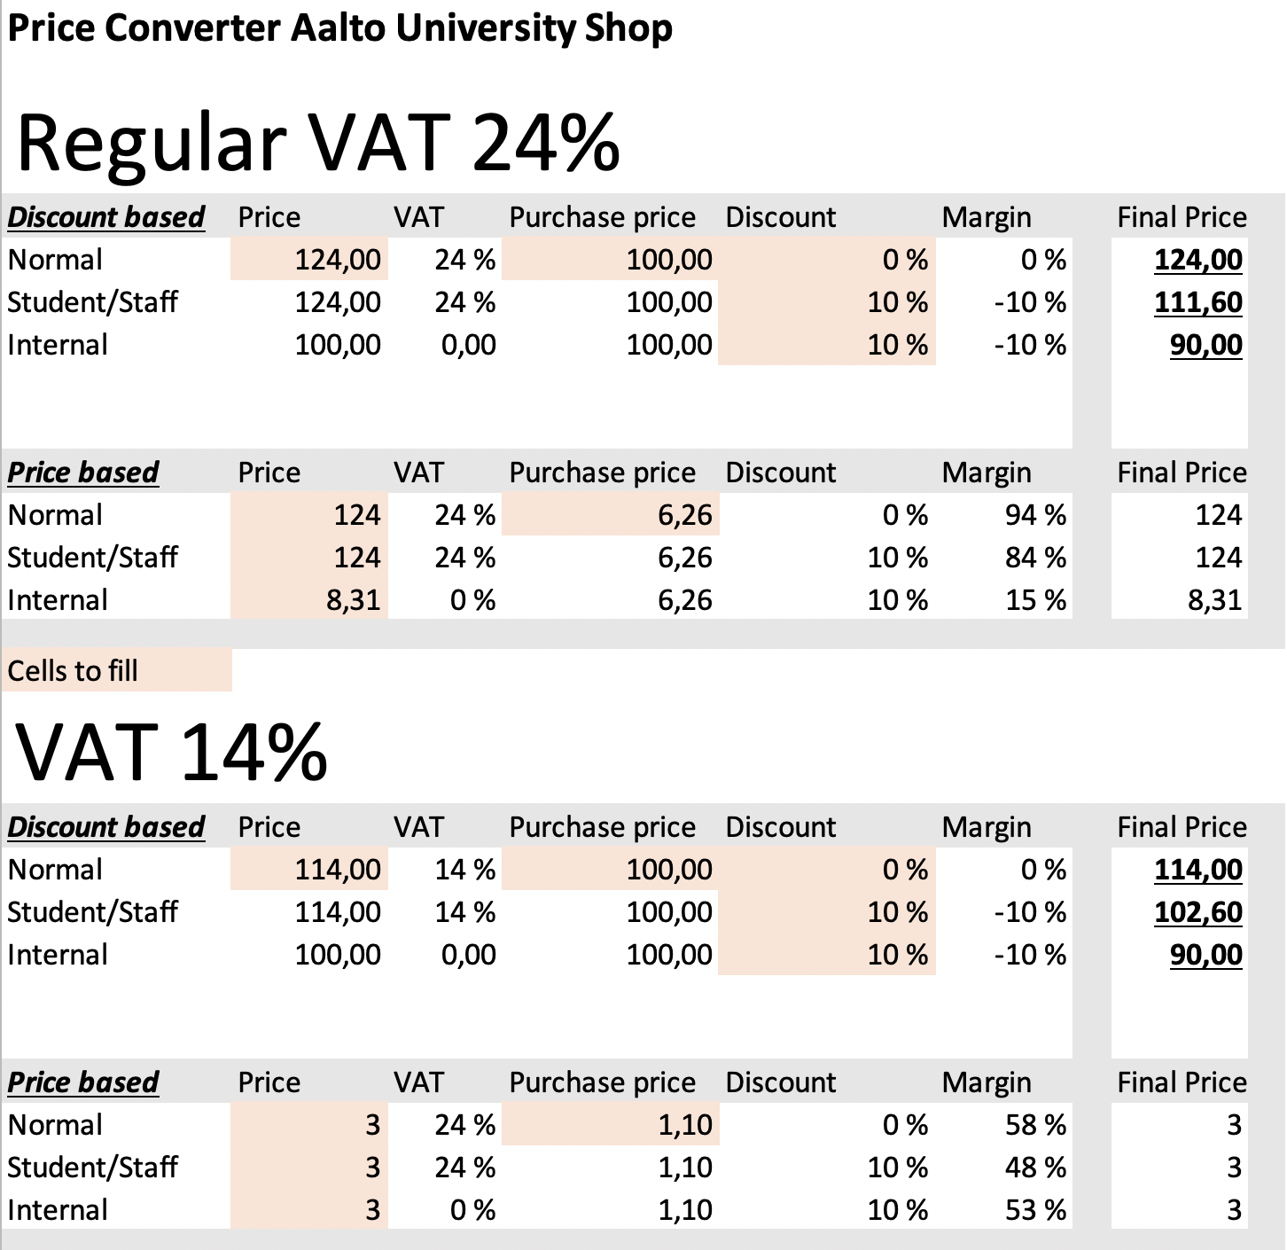

Slide 8
Retailer Services
- Space/destination
- Service
- E-commerce (Server, Development, Payments, Shipping)

Slide 9
Calculating a price point
- Material costs
- Hours spent
- Break-even point (with or without timeline)
- Market value (perception, comparability)
- Demand / Volume

Slide 10
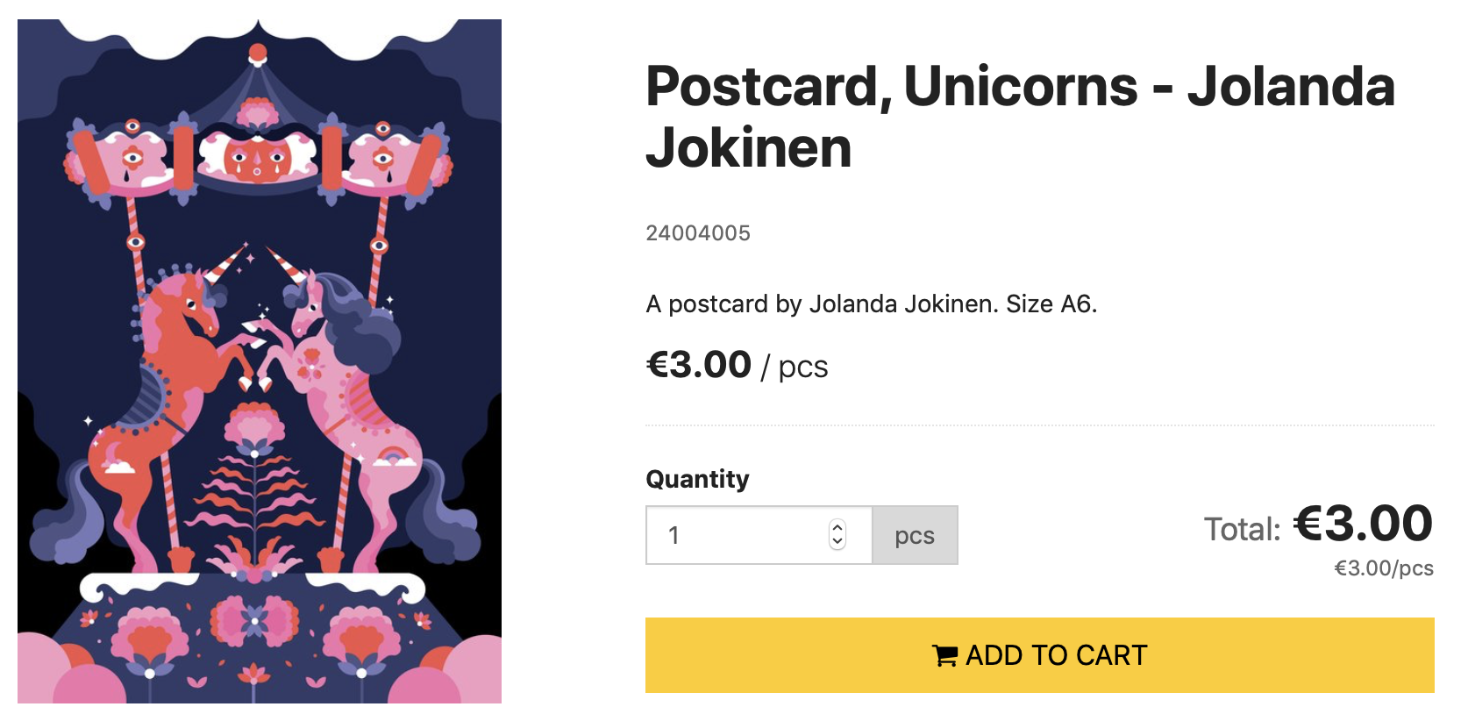
Examples

Slide 11
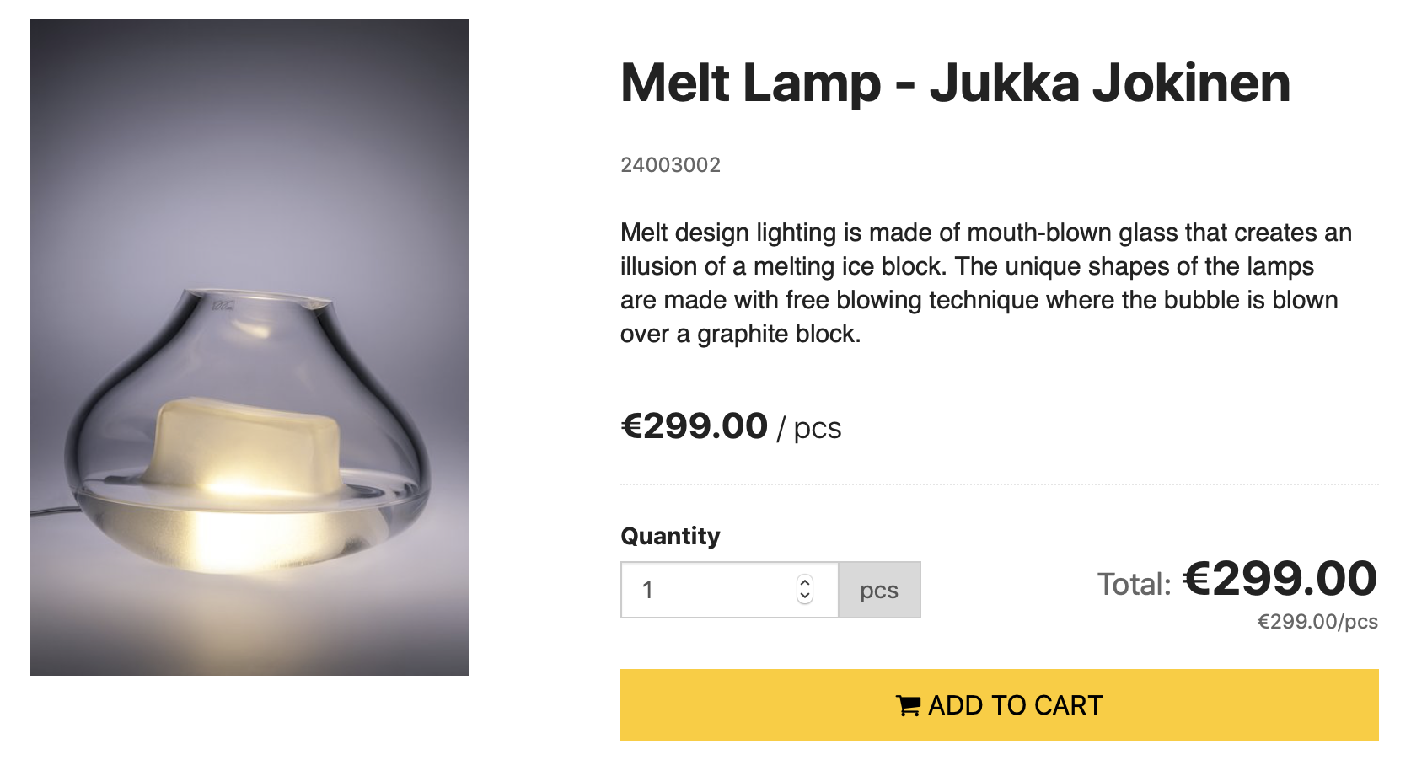
Examples

Slide 12
Deciding on relationship
- Vendor to retailer approach
- Concession method

Slide 13
Other things to consider
- Liability
- Customer relationships
- Marketing

Slide 14
Thoughts and discussion

