Slide 1
Functionality through nanoscale
In the context of soft materials

Slide 2
“Functional” – sometimes replaced by smart
Functionality through physical qualifiers: Mechanic properties, electric properties, magnetic properties, thermal properties, and optical properties
Functionality through chemical qualifiers: Self-healing materials? Catalysis?
Functionality through size: Small-scale makes a difference (both large surface area and quantum phenomena relevant)
Functionality through shape and/or structure: Surface phenomena
Functionality through organization and directionality: colloidal crystals, block copolymers, liquid crystals
Functionality through emergent properties: composite materials and structurally hierarchical materials
Functionality through interaction: stimuli-responsive materials, adaptive materials, learning materials

Slide 3
Welcome to nanoscale!
What makes nanoscale functional?

Slide 4
Warm-up: Welcome to nanoscale!
  Approximate what is an average diameter of a
      human hair?
      red blood cell?
      Water molecule?
  Define “X” and “Y” in the following sentence: Nanoscience concerns object of dimensions ranging from approximately X to Y.
  What physical attributes make a material behave differently at nanoscale than at bulk?

Slide 5
Warm-up: Welcome to nanoscale!
  Approximate what is an average diameter of a
      human hair? 80 0000 nm
      red blood cell? 7 000 nm
      Water molecule? 0.3 nm
  Define “X” and “Y” in the following sentence: Nanoscience concerns object of dimensions ranging from approximately 0.2 nm to 100 nm.
  What physical attributes make a material behave different: large surface area and quantum effects

Slide 6
Why is it important to talk about the length scales?

Slide 7
Why is it important to talk about the length scales?

Slide 8
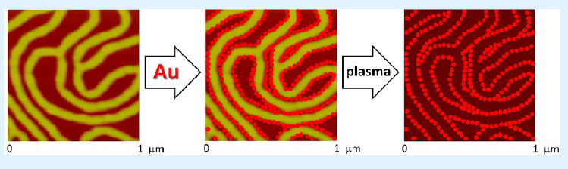
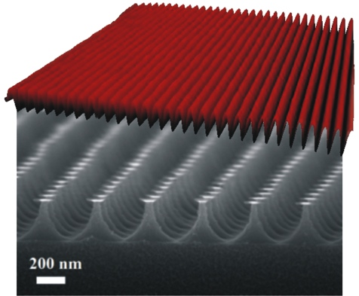
Why is it important to talk about the length scales?
Creating successful applications in…
    Templated self-assembly
    Micro- and nanofabrication
    Separation membranes
…requires understanding of the length scales

Slide 9
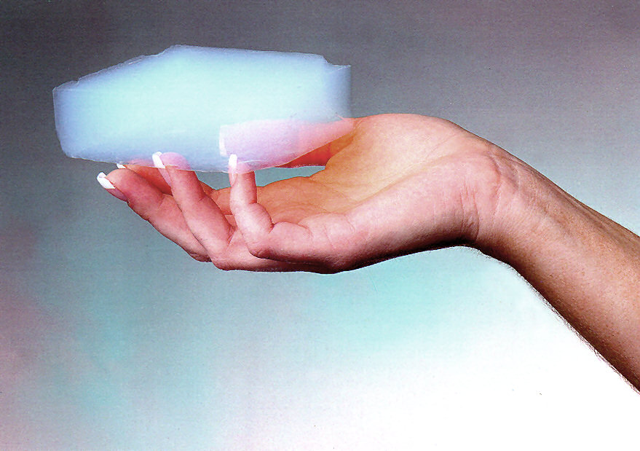
What makes nano special – hard matter vs. soft matter comparison
“Hard” atomistic materials:
    Difference 1: most of the atoms on the surface of the material
      Depression of the melting point
      Large specific surface area -> important for applications, such as catalytic materials
    Difference 2: propagation of waves/energy is limited by the small scale
      Quantum phenomena become relevant -> classical physics needs to be replaced by quantum physics -> important for applications, such as plamonics
Soft materials:
    Difference 1: Relatively large interfacial/surface areas
      Mobility and malleability of the building blocks very different at the surfaces than in the bulk
    Difference 2: propagation of waves/energy limited by frequent interfaces (reduced length of the “free mean path”
      Important in applications such as optical light management films and in insulating materials

Slide 10
Welcome to nanoscale!
How to fabricate structures in the nanoscale?

Slide 11
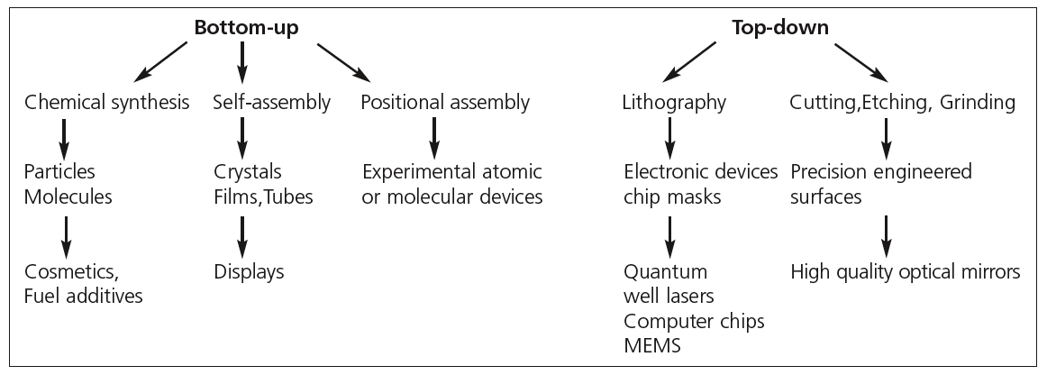
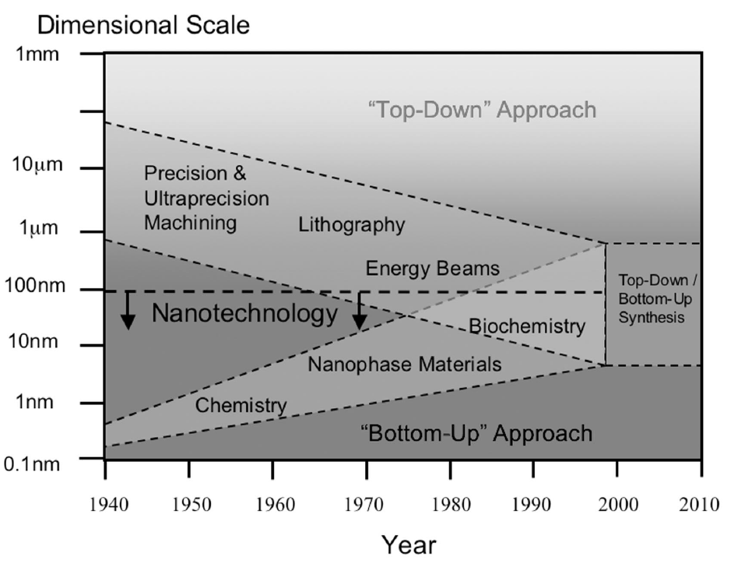
Nanofabrication methods: Top down vs. bottom up

Slide 12
Bottom-up: Chemical synthesis
  Metal oxides, such as titanium dioxide, zinc oxide, silicon dioxide, aluminium oxide, zirconia and iron oxide, are currently the most commercially important nanoparticles.

Slide 13
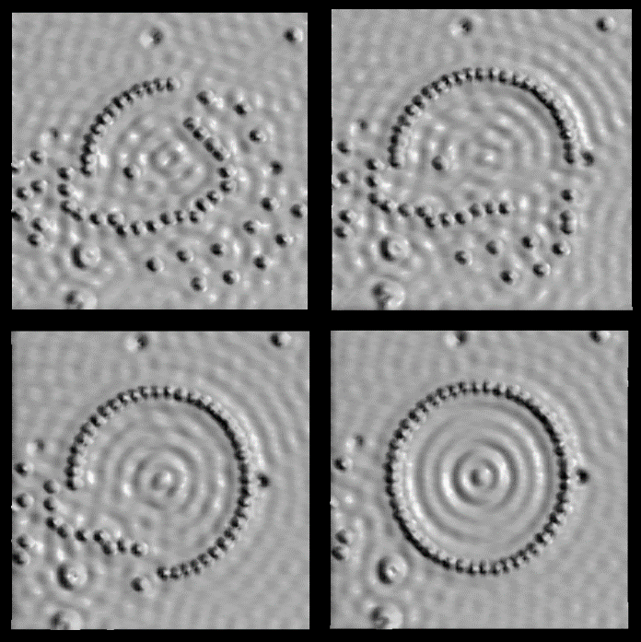
Bottom-up: Positional assembly
48-atom Fe ring constructed on the Cu(111) surface. Average diameter of ring (atom center to atom center) is 142.6A.
  Atoms, molecules or clusters are deliberately manipulated and positioned one-by-one -> extremely laborious, not industrially feasible (currently…)
M.F. Crommie, C.P. Lutz, D.M. Eigler. “Confinement of electrons to quantum corrals on a metal surface”, Science, 1993, 262, 218-220.

Slide 14

Bottom-up: Self-assembly
  Present in nature (from DNA and proteins to snowflakes), but man-made industrial application all very new
  Atoms or molecules arrange themselves into ordered nanoscale structures by physical or chemical interactions between the units

Slide 15

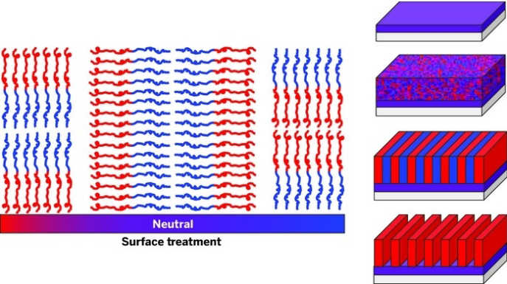
Block-copolymers – self-assembly route to the structures of 10 to 100 nm
Precisely controllable structures
at the scale of 10 nm!
Jacoby, C & EN News, 2014, 92, 12

Slide 16
Enthalpy vs. entropy in block copolymer self-assembly
  High enthalpy of mixing: Minimizing the contact between A and B blocks
Note #1: If two blocks are two miscible or one block is very small as compared to the other, no phase separation!
Note #2: It is possible to trap non-equilibrium states by quenching!

Slide 17
How to tune the forming nanostructures?
  Flory-Huggins interaction parameter
  Architecture (number of blocks, linear vs. other)
  Volume fraction (by synthesis or by selective additives)
  Non-homogeneous substrates
  Sample preparation conditions

Slide 18
Reflection point #1: Discuss with your neighbour
  List advantages/disadvantages of bottom-up fabrication of nanostructures as compared to top-down approaches
  What are the three main bottom-up nanofabrication strategies? What are the advantages/disadvantages of each of them as compared to each other? Do they have limitations in the context of soft materials?

Slide 19
Functionality through nanoscale
Case of mechanical properties - Password for today’s session: nanoissmall

Slide 20
Increase of mobility at polymer-air interface – effects on mechanical properties
Analogous to the metal nanoparticles, which undergo melting point depression at nanoscale, also polymer chains at interfaces face different environment and thus different mobility than in the bulk of the polymer
For polymers, depression of the glass transition temperature occurs at the air-polymer interface
Also, for the nanocomposites containing PS spheres, the decreasing interparticle distance will lead to the softening of the material
Furthermore, polymer chain entanglement often affected by confinement
    The effect on mechanical properties is often nonlinear.

Slide 21
Layered structures can reach mechanical performance beyond individual materials
A classical example: natural nacre consists of 95 volume-% of inorganic calcium carbonate platelets bound together by 5 volume-% of elastic biopolymer.

Slide 22
Functionality through nanoscale
Case of optical properties

Slide 23

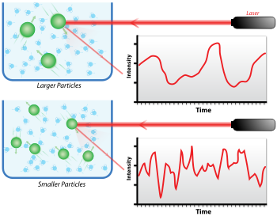
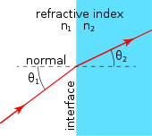
Fundamentals of optical properties in non-absorbing media
At every scattering event, light deviates from its initial trajectory depending on the geometrical characteristics and the refractive index of the scatterer (parameters that are described by the scattering cross-section)
Non-absorbing homogeneous materials scatter (reflect) light only at their interfaces (surfaces). Therefore, their appearance is determined by the refractive index contrast between the external medium and the homogeneous system
For inhomogeneous materials, light transport is a bulk phenomenon. Therefore, their appearance results from the interplay between: 1) the single-scatterer properties as the scattering cross-section; 2) the ensemble properties as the filling fraction (i.e., the volume percentage occupied by the scatterers), the average orientation of the scatterers, and the structure factor (i.e., the spatial organization of the scatterers)

Slide 24
Bulk materials consisting of nanoscale elements can have very different optical properties
The appearance of a disordered material is directly determined by the optical thickness. This parameter is defined as the ratio between the physical thickness of a medium and the transport mean free path, that is, the average distance over which light loses memory of its initial direction.

Slide 25
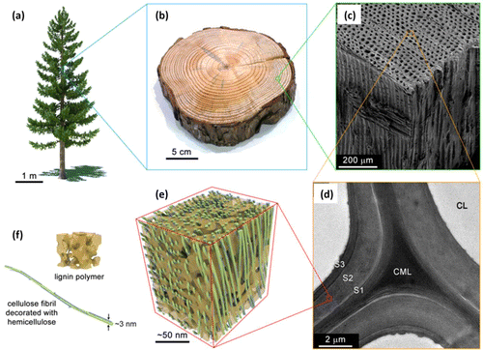
Nanoscale materials can have a complex impact to the final optical properties
Ensemble properties: volume occupied by the scatterers, average orientation of the scatterers and spatial organization of the scatterers
    CNC films can be shifted between almost completely transparent and almost completely opaque

Slide 26
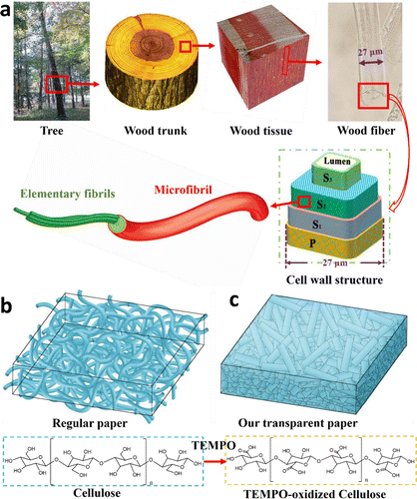
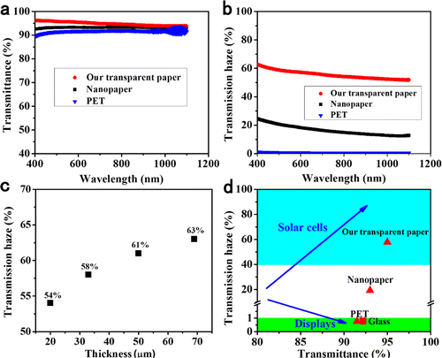
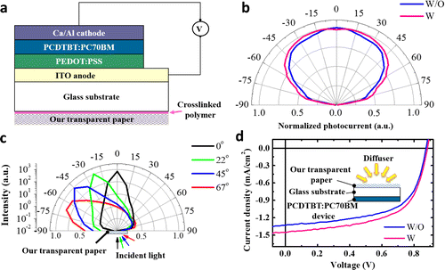
These light-management layers can significantly increase the power conversion efficiency of photovoltaics

Slide 27
Nanoscale materials at the interface can serve in antireflection
Impact on the refractive index – decreasing the refractive index contrast at the scale smaller than wavelength of visible light
    Antireflection coatings thin films
    Antireflective surface nanostructures

Slide 28
Functionality through nanoscale
Case of large specific surface area nanoporous materials

Slide 29
Applicability of porous materials
Porosity is of interest for catalysis, photocatalysis, insulation, adsorption, separation, controlled release and tissue engineering applications
Generally, nanopores can be divided into three different length scales: micro (< 2 nm), meso (2–50 nm) and macropores (> 50 nm)

Slide 30
General properties of aerogels
A light, highly porous solid formed by replacement of liquid in a gel with a gas so that the resulting solid is the same size as the original.
Light, highly porous: low weight, low density, 95-99% are air in volume
The same size as the original: drying process doesn't destroy the structure
Xerogel
Thermal or vacuum drying
Sol formation
Gelation
Washing
Solution precursors
Sol
Gel
Drying process
Supercritical drying
Aerogel
Freeze drying
Cryogel
By Courtesy NASA/JPL-Caltech - NASA Stardust Website, Public Domain, https://commons.wikimedia.org/w/index.php?curid=35155

Slide 31

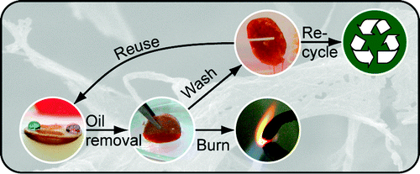
Biomedical and environmental application of nanoporous materials
Carries for poorly water soluble drugs, cytotoxic drugs, polypeptide-based drugs -> another twist, see FreshPack innovation (University of Helsinki)
Synthetic bones grafts for regenerative medicine
Dressings for wound healing
Absorbents, adsorbents, sensors and catalysts
Sound and thermal insulators

Slide 32
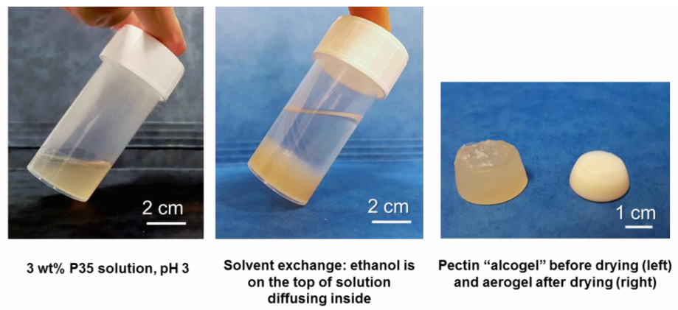
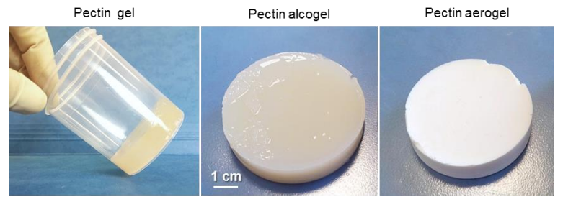
Example: Thermally super-insulating bioaerogels
Preparation
  Dissolution
    Ca²⁺ could be added for ionic gelation
  Gelation
    Solution
    Gel
  Solvent exchange
    Solution (a): washed with ethanol
    Gel (b): immersion precipitation
    Both resulting in 3D pectin “alcogel”
  Supercritical CO₂ drying
a)
b)
3 wt% P35 gel, pH 1.5 (no calcium added)
Supplementary materials for Groult, S. and Budtova, T. (2018) ‘Thermal conductivity/structure correlations in thermal super-insulating pectin aerogels’, Carbohydrate Polymers. Elsevier Ltd, 196, pp. 73–81. doi: 10.1016/j.carbpol.2018.05.026.

Slide 33
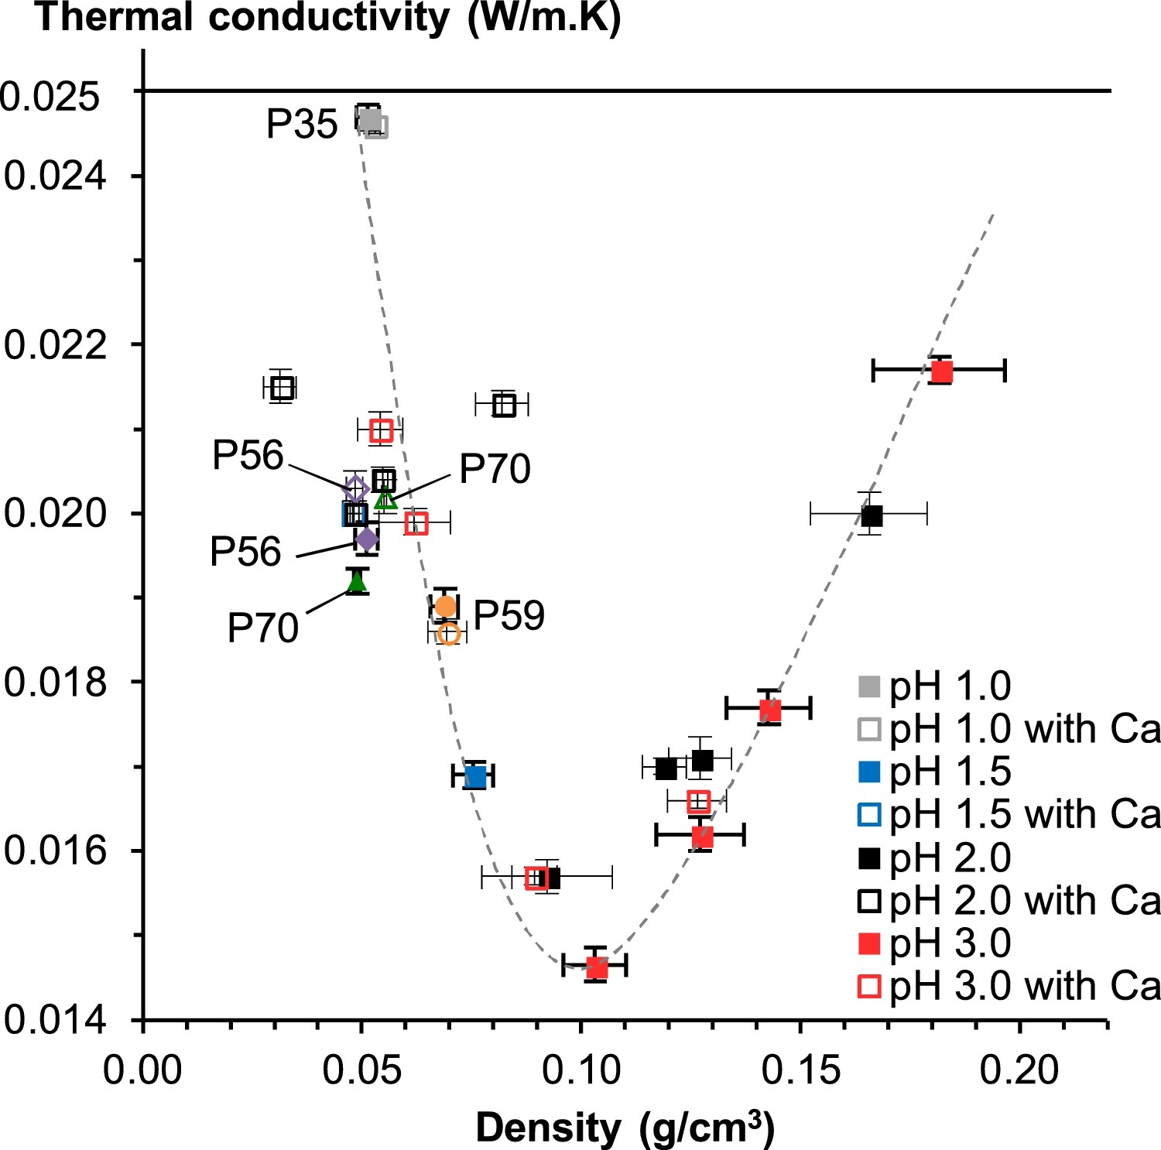
Example: Thermally super-insulating bioaerogels
2wt% pectin, at 3 pH without Ca²⁺
Thermal Super-insulating: 0,01465 W/(mK)
Density: 103 (kg/m³)
Specific surface area: 541 ± 24 (m²/g)
Porosity: 93.1 %
Potential application in building and automotive and aerospace industry
Groult, S. and Budtova, T. (2018) ‘Thermal conductivity/structure correlations in thermal super-insulating pectin aerogels’, Carbohydrate Polymers. Elsevier Ltd, 196, pp. 73–81. doi: 10.1016/j.carbpol.2018.05.026.

Slide 34
Reflection point #2: Discuss with your neighbour
  How does material “being at the nanoscale” make a difference for
      Optical films
      Super-tough materials
      Controlled-release applications
      Thermally super-insulating materials?
  What type of future applications can you envision for these materials?

