Slide 1
Business Communication (3cr)
MLI61A130
Session 1
Lecturer: Mark Badham

Slide 2
Today’s agenda
About me
Course overview
Communication strategy
Persuasive techniques
Instructions for A1 Written Request
Effective Business Writing
Session 1 Reflection
Session 2 info

Slide 3
Zoom session guidelines
Participation & engagement
Cameras
Microphones
Respect
Session 2 (13.00-16.00, Thursday, 4 February) These times may change to 12.00-15.00 due to SKIBBA ski trip departure tomorrow.

Slide 4
1. Introduction: Mark Badham
Finland
G’day mate!

Slide 5
Teaching EXPERIENCES:
Australia:
Bond University
Finland:
Aalto University School of Business
Jyväskyla University School of Business & Economics
University of Helsinki
Lithuania & Estonia
COMMUNICATION EXPERIENCES:
Gloria Jeans Coffees
Politicians & Australian Government
NSW Health (state government)
Gold Coast City Council (local government)
ENTREPRENEURIAL EXPERIENCES:
Mark 4:8 Strategic Communications
Party in Fiji
Magazines

Slide 6
Business communication:
Speeches (eg media spokesperson) & speech writing
Publications (annual reports, magazines, newsletters, brochures, books, white papers, websites, intranets)

Slide 7
Contact me:
Via MyCourses
mark.badham@aalto.fi

Slide 8
2. Course overview

Slide 9
MyCourses
Lectures in class
Exercises in class
Reading inputs
Assignments

Slide 10
Schedule in Syllabus
Session 1 (13.00-16.00, Monday, 4 January) Introduction Course overview Communication strategy Persuasion techniques Effective business writing Instructions for A1 Written request A1 Orion case analysis (in teams) | Prepare for next class: A1: Written request 1st version (team assignment) Have your A1 Written Request 1st Version ready for peer feedback tomorrow. Another team will give you feedback in class. Final version due Friday. Read Inputs 1, 2 and 3 (communication strategy, persuasive techniques, effective writing), available in MyCourses

Slide 11
What should you expect in each session?
’Teaching’: I will mostly present theoretical ideas and practical knowledge about the topic for each session
’Facilitating’: During session ’exercises’ you will take active role in learning & I will facilitate your learning
Be interactive: read relevant Inputs for each session
Time for reflection & Qs
Breaks

Slide 12
Learning outcomes
On completion you will be able to:
analyse audiences & define objectives to create targeted messages
write coherent, convincing, reader-friendly emails
plan and deliver clear, focused and engaging business presentations
critically assess your own and others’ business communications

Slide 13
ECTS Student Workload
 | Number of Hours
Faculty-led engagement | 24
Self-study hours | 56
Work with course materials, eg required reading 16
Exam preparation 7
Individual research & writing 18
Team projects (meetings, research, preparation, etc.) 15
Total of all student workload hours | 80

Slide 14
 | Grading (5 assignments + participation & contribution)
Course Requirements and Values |  | Due | Weighting (%) or maximum points
A1 Written request. Group. |  | 13.00 Session 3 | 10%
A2a Persuasive presentation outline. Individual. |  | 13.00 Session 4 | 15%
A3 In-class test. Quiz (10%) + Written Task (20%). Individual. |  | In class Session 5 | 30%
A4 Team presentation. Group. |  | In class Sessions 7 / 8 | 15%
A5 Critical presentation appraisal. Individual. |  | 11 pm Sunday, 14 February | 20%
Requirement 6 Participation (including contribution to group assessment work) |  | A6 Contribution to group assessment work: 11 pm Sunday, 14 February | 10%
Total |  |  | 100

Slide 15
 | Grading (5 assignments + participation & contribution)
Course Requirements and Values |  | Due | Weighting (%) or maximum points
A1 Written request. Group. |  | 13.00 Session 3 | 10%
A2a Persuasive presentation outline. Individual. |  | 13.00 Session 4 | 15%
A3 In-class test. Quiz (10%) + Written Task (20%). Individual. |  | In class Session 5 | 30%
A4 Team presentation. Group. |  | In class Sessions 7 / 8 | 15%
A5 Critical presentation appraisal. Individual. |  | 11 pm Sunday, 14 February | 20%
Requirement 6 Participation (including contribution to group assessment work) |  | A6 Contribution to group assessment work: 11 pm Sunday, 14 February | 10%
Total |  |  | 100
75% individual
25% group

Slide 16
Attendance
Regular Zoom session attendance is required
Attendance records kept for each session.
Students expected to be in session on time.
Late arrivals seen as being discourteous to teacher and other students.
If you are going to be late, you MUST email me to say why you will be late (standard professional practice).
SEE ATTENDANCE POLICY IN SYLLABUS

Slide 17
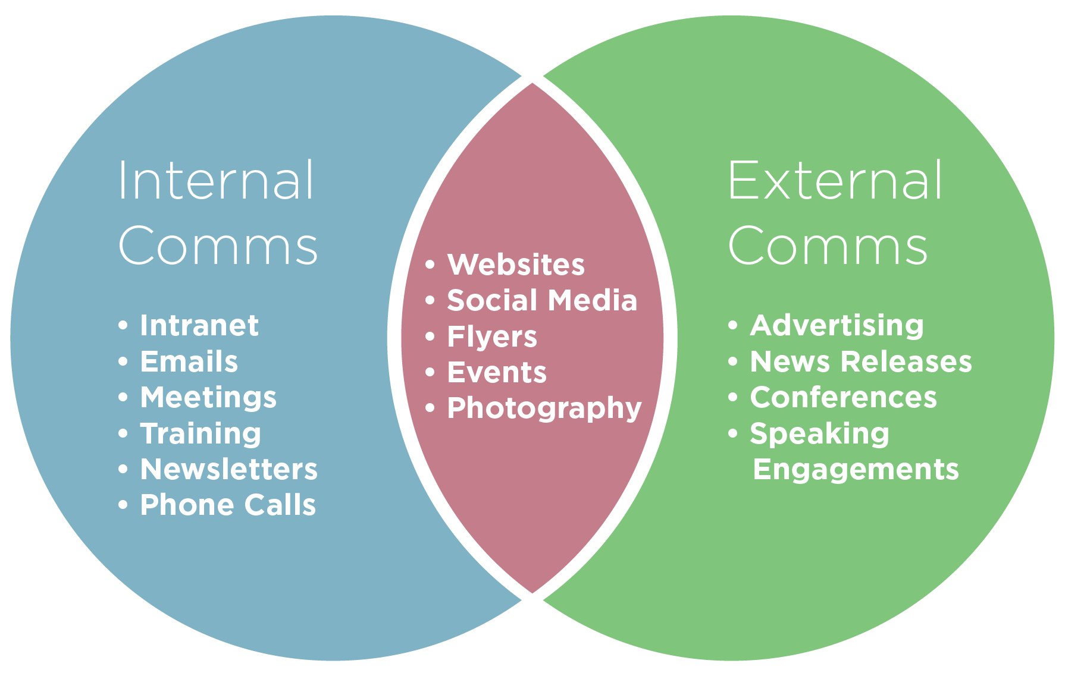
Business Communication

Slide 18
3. Communication Strategy (based on Input 1)
Want to communicate with busy professionals?
Compete for their time & attention!
So, need a strategy

Slide 19
Your strategy:
plan of action designed to achieve overall aim within specific time period
the art of planning and directing overall military operations and movements in war
RACE

Slide 20
COMMUNICATION SITUATION
Define
objectives,
choose style
Analyse
audience
Assess
credibility
Communicating
strategically
Craft
Message (Select & organize content
MESSAGE DESIGN
Choose
channel

Slide 21
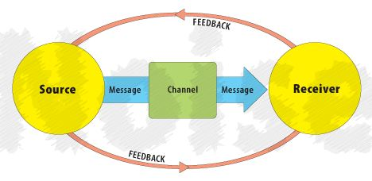
Early communication model
Shannon-Weaver Model (1949)

Slide 22
“AUDIENCE STRATEGY”
“Communication takes place in the mind of the listener, not in the speaker” – Peter Drucker, Management Consultant & Author
5 Qs to understand your audience:
Who are they? (primary, secondary & influencers)
What do they know, want & expect regarding your topic?
How do they feel? (positive, negative, deadline & budget pressures)
What objections might they have?
What will persuade them? (WIIFT)
Analyse
audience
Munter (2012) adapted

Slide 23
What will persuade them?
Audience benefits:
Analyse
audience
Job benefits?
Ego benefits?
Career benefits?

Slide 24
Define
objectives,
choose style
SITUATION
Analyse
audience
Assess
credibility
Communicating
strategically
DESIGN
Choose
channel
Craft
message

Slide 25
“COMMUNICATOR STRATEGY”
Communication objective: ‘As a result of this message, I want my audience to…’
If the objective is not clear to you, it won’t be clear to the audience
Define
objectives,
choose style
Munter (2012) adapted

Slide 26
How will your objective influence the overall communication style?
Relational message: to build / maintain good relationship with audience (use “we”, “you”)
Informational message: clearly explains & describes (use facts)
Promotional (persuasive) message: to sell an idea, concept, service or product
Transformational message: to inspire or challenge (use personal story)
Define
objectives,
choose style

Slide 27
Communication objective : ‘As a result of this message, I want my audience to…’
... know how to write effectively. (informational)
... be a speaker at our event. (persuasive)
... feel that they belong to our company. (relational)
... be inspired to change their lives. (transformational)

Slide 28
Define
objectives,
choose style
SITUATION
Analyse
audience
Assess
credibility
Communicating
strategically
Craft
Message (Select & organize content
DESIGN
Choose
channel

Slide 29
Acquired credibility – through communication
Initial credibility

Slide 30
Assess your credibility as a communicator
Your credibility affects your communication with the audience…
and it affects the content you choose…
How well do they know you?
Same hierarchical level?
Similar background / profession & age?
Level of message formality depends on relationship with audience
Read Input 1 for more info

Slide 31
“COMMUNICATOR STRATEGY”
(Your) Rank
(Their) Goodwill (towards you)
(Your) Expertise
(Their) Image (of you)
(Your & their) Common ground
Kotter (1982) , Munter (2012)

Slide 32
Assess and enhance credibility
Factor Emphasise
Rank title, position
Goodwill established relationship with audience
Expertise knowledge, qualifications, track record
Image attributes the audience finds attractive
Com ground shared values, ideas, and beliefs
Based on Power and Influence, Kotter (1982) and Guide to Managerial Communication, Munter (2012)

Slide 33
My credibility with you
Factor My Emphasis
Rank Dr with PhD
Goodwill I love teaching (want you to succeed)
Expertise 20+ years teaching & experience
Image I worked with CEOs, politicians, PM
Com ground My son studying 2nd year Economics, so I understand student challenges

Slide 34
Define
objectives,
choose style
SITUATION
Analyse
audience
Assess
credibility
Communicating
strategically
Craft
Message (Select & organize content
DESIGN
Choose
channel

Slide 35
Choose
channel

Slide 36
Print channels: memos, brochures, newsletters, reports, policy manuals, annual reports...
Electronic channels: email, Intranet, blogs, podcasts, social media, video conferencing
Choose
channel
Face-to-face channel tools: speeches, team meetings, board meetings, social events...

Slide 37
Media Richness (for engagement) Hierarchy
Rich
Physical presence (F2F)
Choose
channel
Interactive media (phone)
Interactive media (email, texts)
Personal static media (letters)
Impersonal static media (reports)
Lean
Adapted from Lengel & Daft (1988)

Slide 38
When to write?
Record
Precision
Mass audience
Choose
channel
When to present?
Instant feedback / interaction
Build community
Everyone gets message at same time? (Bradford)
When to combine?

Slide 39
Define
objectives,
choose style
SITUATION
Analyse
audience
Assess
credibility
Communicating
strategically
Craft
Message (Select & organize content
DESIGN
Choose
channel

Slide 40
“MESSAGE STRATEGY”
Beginnings & endings
Message organisation: Direct (get to the point) or indirect?
Message content:
Ethos (character/trustworthiness)
Pathos (emotions)
Logos (logic).
Craft
Message (Select & organize content
Aristotle in Business Communication (2007)

Slide 41
Choose message organisation
Direct
Indirect
Main idea
Explain
Explain
Main idea

Slide 42
“MESSAGE STRATEGY”
Direct best when:
Purely informational message
Audience likes your message
You present a sensitive message + you have high credibility &/or the audience wants results
Indirect best when:
You have a sensitive message
Audience has negative attitude to message
You lack credibility
Audience is analytical
Aristotle in Business Communication (2007)

Slide 43
4. Persuasive techniques (based on Input 2)
4 considerations:
Ethos of the communicator (character, credibility, trustworthiness, expertise)
Pathos of the audience (emotions, needs, concerns, fears, attitude)
Logos of the content (logic: evidence, benefits).
Persuasion through message structure

Slide 44
Ethos: persuading through communicator credibility
Establish credibility for yourself as communicator (make your “own character look right” – Aristotle)
Establish credibility through quality of message (make your message “worthy of belief” – Aristotle)

Slide 45
2. Logos: persuading through claims based on relevant evidence
Elements of a convincing argument:
Claim: what do I want to prove?
Evidence: how can I support my argument?
Warrant: what is the link between claim & evidence? (Why is all this important / relevant?)

Slide 46
3. Pathos: persuading by appealing to audience emotions
Show empathy

Slide 47
4. Persuasion through message structure
Opening & Closing
Establish common ground before disagreeing
Problem / Solution (Here’s the problem… help!)
Foot-in-the-door technique (1st a small request, then bigger request)
2-sided structure (list all objections – both sides of argument)
”Ask for more” technique (extreme + acceptable options)
Point out danger of no action
Use persuasive patterns…

Slide 48
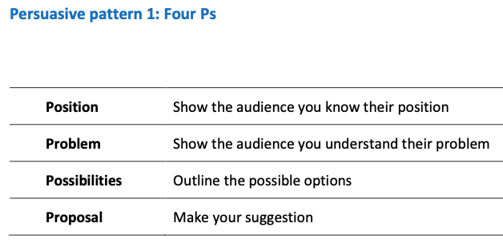

Slide 49
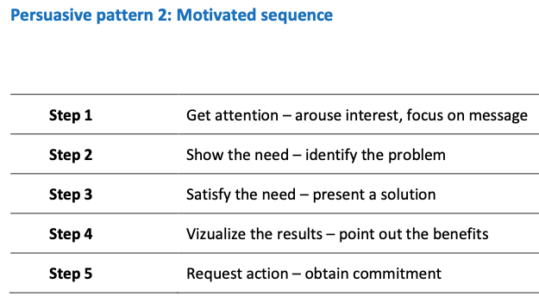
German, Gronbeck, Ehninger & Monroe (2010)

Slide 50
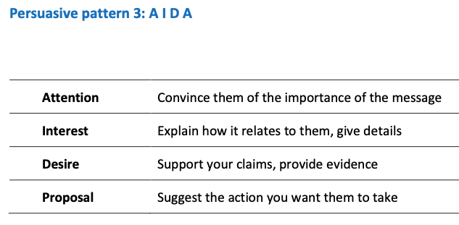

Slide 51
5. Instructions for A1 Written request
Work in TEAMS (for A1 Written request + A4 Team presentation)
Teams:
Assignment A1 is done in a team of 4 students.
We'll form teams now

Slide 52
A1 Written request: ORION (10%)
Situation
Write a request to ORION to persuade them to participate in your university course project
Writer (your group)
Aalto Biz student & management intern at Orion
Recipient
Orion’s Corporate Responsibility Manager
Draft (1st version) due Session 2 (tomorrow)
Final version due Session 3

Slide 53
A1 Written request (group)
Learning outcomes:
analyse an audience and define objectives to create a targeted business message
write a coherent and convincing, reader-friendly business message (request)
critically assess other business messages

Slide 54
A1 Written request (group)
Situation:
You are an Aalto Biz student and work as a part-time employee for Orion, a leading pharmaceutical company in Finland. In your job as a management intern, you have become increasingly aware of and frustrated with the fact that many people in developing countries cannot afford basic medicine that would improve their health and, for instance, reduce child mortality.
You are currently participating in the course ‘How to change the world: social responsibility projects’ (6 cr). The purpose of the course projects is to find creative solutions to real-life social challenges that are linked to case companies. You have decided to approach Orion to request them to participate in your team’s project.

Slide 55
A1 Written request (group)
With your group members, develop your creative solution to improve the access to affordable medicines in developing countries. Write an email request to Orion’s Corporate Responsibility Manager to persuade her / her unit to participate in your team’s project.
Think carefully about:
Reader benefits. Why would the company want to help you? What's in it for them? (WIIFT)
The arguments that you use carefully in order to get the response you want.

Slide 56
A1 Written request (group)
Thoroughly analyse the situation with your team by using the ideas discussed in Input 1 (communicating strategically) and Input 2 (persuasive techniques).
Then write the email request.

Slide 57
A1 Written request (group)
Deadlines:
• Have your 1st version written to show peers in next session (Session 2).
Treat it as a final version to get good feedback.
• Get feedback in class
• Submit final version to MyCourses by 13.00 Session 3
Evaluation rubric available in MyCourses A1 submission box

Slide 58
Communication strategy for A1
What is your objective in the case / in the email?
How much and what kind of credibility do you as the communicator have?
How does your rather low credibility influence your message?
Who is your audience?
What does the audience know / not know?
How is the audience likely to feel about your request?
How can you persuade this specific audience? i.e. what can you offer them?
How should you structure your message, and why?

Slide 59
6. Effective Business Writing
Learning outcomes
By the end of this session, you will be able to
Write persuasive, clear and concise business messages
Write with a strong audience focus
Ensure you get the desired response from readers

Slide 60
BUSINESS WRITING
When you write well…
Enhances your credibility
More chance of reader receiving & understanding your message
More chance of reader doing what you want
So let’s learn to write well!
Applies to emails, WhatsApp messages, executive summaries, PowerPoint reports…

Slide 61
BUSINESS WRITING
Composing Techniques
FIRST (yesterday’s session):
Communicator strategy
Audience strategy
Message strategy
Channel Choice strategy
Then COMPOSE (write)…
Tips:
Strategize
Write 1st draft
Edit &/or ask someone to check &/or test it
Edit again

Slide 62
Composing Techniques
1. Conduct research:
Interview/s
Company documents (eg online)
Company communications (eg emails)
Surveys
4. Draft your text:
Organize (eg main points)
Start writing
Don’t edit yet
2. Organize (overall structure):
Group ideas: mindmap/idea chart
5. Edit (in this order):
For strategy & focus 1st
For macro issues
For micro issues
For correctness (eg spelling, grammar & punctuation)
3. Narrow your focus:
Skim
Nutshell
Bottom line
Elevator pitch

Slide 63
Composing Techniques
3. Narrow your focus
Skim (HSV: High Skim Value):
Imagine reader skimming…
What does reader need to know 1st, 2nd, 3rd… if he/she skims text?

Slide 64
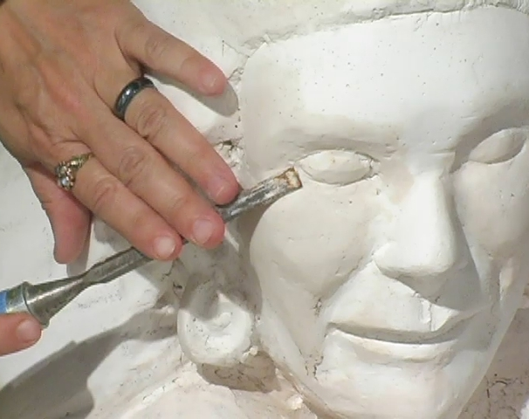
Composing Techniques
4. Draft your text
Don’t start with blank page - start with lots of unedited text
Like sculpture, begin with ‘mess’ (in Draft stage) & methodically perfect (in Edit stage)

Slide 65
Composing Techniques
5. Edit
MACRO
MACRO: structures (eg headings & paragraphs) – to suit your arguments
MICRO: sentences & words
Brevity (conciseness)
Transitions
Appropriate style (formal/informal)
Language correctness (eg spelling, grammar & punctuation)
MICRO

Slide 66
MACRO Writing
Effective paragraphs have:
clear topic sentence +
supporting sentences +
signposts +
are short
Effective paragraph example:
An effective document structure includes three main items. First, you should create high skim value with message headings and enough white space. Second, you should use signposts to show connection in the text. Finally, each paragraph should start with a topic sentence, which all other sentences then support.
MACRO
Topic sentence
MICRO
Signposts

Slide 67
MICRO Writing
Design text to enable reader to read it all quickly + slowly
MACRO
Make text easy to skim
- gain High Skim Value (HSV) through:
Headings (that highlight key messages)
Numbered & bulleted lists
Parallel headings & lists
White space
Easy-to-read typography
MICRO

Slide 68
Headings (& sub-headings)
Effective headings have 3 features:
Tell (summarize) the message (main point) in the paragraph
Are parallel (conceptually & grammatically)
Have stand-alone sense

Slide 69
Headings tell (summarize) the message (main point) in each paragraph
Reader can skim quickly

Slide 70
Action verbs in headings – because most business communication involves making recommendations (persuading)
Compare these:
We recommend that management take the following 4 steps:
A clear timeframe for the introduction of the new database important
Communication of the timeframe to all staff
Organising training sessions to ensure smooth implementation
Important to clarify job descriptions and explain to personnel how their input impacts the whole organisation
We recommend that management take the following 4 steps:
Establish a clear timeframe for the introduction of the new database
Communicate the timeframe to all staff
Organise training sessions to ensure smooth implementation
Clarify job descriptions and explain to personnel how their input impacts the whole organisation

Slide 71
Numbered & bulleted lists
Rule of thumb:
Use numbering when the sequence or number of items is relevant.
Use bullets when the number or the order of the items doesn’t matter.
Example:
Before arriving in Finland, please take the following four actions. First, enroll at www.abcevent.fi/registration. In this address, you will be able to indicate any dietary restrictions. Second, pay the registration fee through your mobile bank. If you don’t have access to a mobile bank, please contact us. Third, book your hotel room through www.abcevent.fi/hotel to be able to benefit from a discounted rate. Finally, if you have any questions, please contact us.

Slide 72
Before arriving in Finland, please take the following four actions.
Enroll and indicate dietary restrictions at www.abcevent.fi/registration
Pay the registration fee through your mobile bank or contact us for payment
Book your hotel room through www.abcevent.fi/hotel to benefit from a discounted rate
Contact us if you have any questions
Notice action verbs
Before arriving in Finland, please take the following four actions.
Enroll and indicate dietary restrictions at www.abcevent.fi/registration
Pay the registration fee through your mobile bank or contact us for payment
Book your hotel room through www.abcevent.fi/hotel to benefit from a discounted rate
Contact us if you have any questions
What can you notice here?

Slide 73
Parallel headings & lists
Make sure they are conceptually and grammatically parallel, i.e. equal
Conceptual parallelism – making sure headings/listed items have the same relationship to the title of the document/list
Helps busy reader quickly skim & understand
No conceptual parallelism:
Here are the main findings:
All the steps in the process were carefully monitored
15% of the raw material was defective
The finished product was tested at 5 minute intervals
2% of the seals received insufficient adhesive
Conceptual parallelism:
The pricing of the holiday apartments will depend on:
location on the coast
amenities in the neighbouring area
number of bedrooms
quality of furniture and fittings

Slide 74
Parallel headings & lists
Parallel headings are similar items
Here are 3 actions you should take:
Send contact info to Susan Smith
Pay the course fee
Prepare the pre-course assignment
Note about emails: treat subject line as heading = put message in subject line
Examples:
“Brochure” vs. “New brochure for comments by Monday”
“Meeting” vs. “Board meeting: Tue 9 am, Room 102”

Slide 75
MACRO
Avoid wordiness (Pleonasm: the use of unnecessary words)
Shorten & vary lengths of sentences
White space: increases readability
Typography: Bolding, underlining, italics – use sparingly, don’t combine them
MICRO

Slide 76
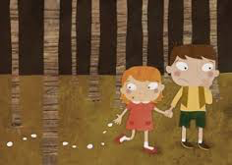
Transitions (Hansel & Gretel bread crumbs):
Addition: And, in addition, again, also, similarly, finally…
Contrast: But, however, or, nevertheless, on the other hand…
Example: For example, for instance, such as, that is…
Sequence: First, second, third… then…
Conclusion: Finally, therefore, in conclusion, as a result…
Clarification/summary: In other words, what this means is, to summarize…

Slide 77
Clear & logical structure
Introductions (openings): provide background, explain why you are writing, preview rest of text
Length depends on how familiar reader is with topic
Effective intro does 3 things
Explains why you are writing
Establishes context
Previews rest of text

Slide 78
Examples:
As Alina told us last week, our customer feedback has been below target. To address the issue, we (Mikko, Matti and Salla) were assigned to suggest measures to enhance our customer experience. This report outlines…
We met at the Speak IT! event last month, and you told me that you give workshops on inspirational leadership.
I am writing to ask if you would be interested in giving a workshop on this topic to our employees…

Slide 79
Closings: reinforce main ideas, state action points, give deadlines, offer help
Examples:
I will call you at the beginning of next week so that we can talk more about the workshop and possibly start organizing the details.
In order to take this process a stage further, could you please let us have ...
I look forward to receiving your comments on the attached draft by 3 pm on 31 August.
If you require more data on ... I would be happy to collate it for you.

Slide 80
Styles
Formal or informal? Professional or casual?
Depends on who is writing to whom + what you are trying to achieve (communication objective).
3 different examples:
Do not hesitate to contact me if you have further questions or would like additional information. Our office hours are ...
If you'd like more information, feel free to call me anytime between 8.00 and 16.30 Monday to Friday.
Want to know more? Just give me a call. I’m in the office 8-16, Monday to Friday.

Slide 81
Styles
Use a reader-centric 'you' attitude: what’s in it for them (WIIFT)
Beginning (salutation) and ending (complimentary close) that reflects your relationship with the reader
Note:
Dear Ms + name is the most common way to address women, regardless of marital status.
If you do not know whether the recipient is a man or a woman, simply use the full name, e.g. Dear Eun-Young Park

Slide 82
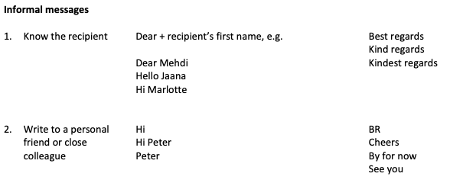

Slide 83
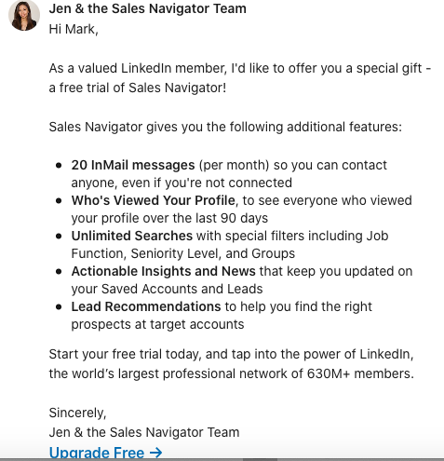

Slide 84
7. Session 1 Reflection (in MyCourses)

Slide 85
8. Work due Session 2
A1 Written request:
Write your email request (in your teams) - consider:
• Audience focus – what’s in it for them? • Style – e.g. be polite (+ remember pathos)
• Readability – e.g. high skim value
• Content – reader must understand:
why you are writing
what it is that you want
how they would benefit
Have your 1st Version ready for peer feedback tomorrow.
You will work on it in class + show it to another team
Final version due Thursday

Slide 86
Session 2
13.00-16.00
A1 Written request 1st Version:
Peer feedback
Instructions for A2a & A2b: Individual, 5-minute persuasive presentation (a) outline & (b) presentation
Instructions for A5 Critical reflection
Read Inputs 1, 2 and 3 (communication strategy, persuasive techniques, effective writing) - available in MyCourses

Slide 87
References / Acknowledgments
See in-text citations
Mike Baker, Christa Uusi-Rauva

