Slide 1
Business Communication (3cr)
MLI61A130
Session 3
Lecturer: Mark Badham

Slide 2
Today’s agenda
A2a Individual Presentation Strategy Outline
A2b Individual Persuasive Presentations:
Peer review of A2a strategy outline draft (in pairs)
2-minute topic presentations
3. Lecture: High Impact Presentations
4. Instructions for A2 Presentations tomorrow
5. Instructions for A3 Test (Monday)

Slide 3
Session 2 Reflection feedback
Is the A2a supposed to be a manuscript of the speech we are going to give in session 4?

Slide 4
1. A2a Individual Presentation Strategy Outline
Topic: You can freely choose the topic, as long as it is persuasive, business-related and appropriate.
Write a strategy outline which
(a) covers points about presentation situation & components of persuasion +
(b) links your analysis to the theory presented in Input 1 (communicating strategically) and Input 2 (persuasive techniques).

Slide 5
A2a Assignment instructions:
Presentation situation in a nutshell:
Presentation topic: What is the presentation about?
Title: What would be a catchy title for your presentation?
Message outcome / objective: What do you want your audience to think, feel or do as a result of your message? (COMMUNICATOR STRATEGY)
Audience analysis: Who is your audience? What do they know and expect? What don't they know? How do they feel about your topic? What objections might they have? How can you persuade them? (AUDIENCE STRATEGY)

Slide 6
Components of persuasion: input 2 persuasive techniques:
Ethos (eg credibility) (COMMUNICATOR STRATEGY)
Logos (your arguments)
Pathos (audience feelings) (AUDIENCE STRATEGY)
Persuading through structure
Your A2a should also include your choice of Direct/Indirect message.
See assignment instructions in MyCourses for full details

Slide 7
2. A2b Individual Persuasive Presentations
1st Activity:
In pairs (in Breakout Rooms), check & fine-tune each others’ Strategy Outline. Download & use the following 2 documents in ‘A2a Strategy Outline Peer Feedback’ activity in MyCourses) (15 minutes)
‘Students Feedback Sheet for A2a Strategy Outline’
‘A2a Guidelines for Peer Evaluation of A2a Strategy Outline’
Then do this with a 2nd partner (10 minutes)

Slide 8
Discussion
After checking & fine-tuning each others’ Strategy Outline in pairs: What were the main challenges?
Note that A2a Rubrics are in MyCourses under A2a assignment submission box.

Slide 9
2nd Activity:
Present your topic (max. 2 minutes, no slides)
Explain the context + how you will plan your presentation (eg what arguments?)
Audience strategy
Communicator strategy
Message strategy
Persuasion through Message Structure: Persuasion Pattern?

Slide 10
3. High Impact Presentations
(See Input 4)

Slide 11
Planning High Impact Presentations
Common problems:
information overload
unclear structure: no clear storyline
poor visuals: way too much information
lack of enthusiasm
Solutions:
Plan message first:
define objective,
choose content
plan storyline.
2. Then plan visuals to support story

Slide 12
Select Content
Steps to help you plan content:
Decide on communication objective: ‘By the end of this presentation, I want my audience to...’
Create short, easy-to-grasp, interesting title (reflecting objective)
Define 3 key claims (ideas/reasons/benefits) (to support objective)
Choose stories, examples, statistics etc - evidence to support claims

Slide 13
Example: Systematic presentation planning steps
Objective: By the end of this presentation, I want my audience to start using 3 time management techniques to help them have more free time.
Presentation title: Adopt time management techniques – have enjoy more free time
Key claims (techniques):
1. Schedule your priorities (Stephen Covey);
2. Prioritize your to-do lists (Eisenhower);
3. Start every day by ‘eating the frog’ (Mark Twain).
Evidence (support for claims): quantitative &/or qualitative evidence of impact of using these techniques:
getting more done in shorter time
enjoying more free time.

Slide 14
Example: Systematic presentation planning steps
Objective: By the end of this presentation, I want my top management audience to consider moving towards a more customer-centric focus to product development.
Presentation title: Partnering with customers to drive R&D offers significant HUGE benefits
Key claims (benefits):
1. Increases possibility of innovation and customized products
2. Reduces development lead times significantly
3. Creates a closer customer relationship, enhances our brand & gives us a competitive advantage
Evidence (support for claims): quantitative &/or qualitative evidence of impact of implementing using a more customer-driven approach:
customer survey results,
voice of own personnel at customer interface,
case examples,
research data.

Slide 15
Tell a Story
Build your message around (subtle) story
Give them powerful mental visualizations – metaphors, similes… like fireworks in their imagination
Beginning, middle, end
Hero’s struggle up mountain to reach summit
Together through Storm to Final Destination
David (us) & Goliath (competitor, problems)
Rocky: believe in yourself, work really hard, rewards will come

Slide 16
Clear Structure
Preview slide
Signposts:
During the next 10 minutes, I will present 3 time management techniques that are easy to use and will help you enjoy more free time: scheduling your priorities, prioritizing your to-do lists, and starting each day by eating the frog. (preview at beginning)
Let’s start by looking at the 1st time management technique: Scheduling your priorities... (details...)
Now that we’ve looked at the 1st time management technique (Scheduling your priorities), let’s explore the 2nd technique - Prioritizing your to-do lists... (details...)
3rd, now that we’ve discussed how to schedule your priorities and prioritize your to-do lists, let’s focus on the last time management technique - Eating the frog... (details...)
To conclude, by scheduling your priorities, prioritizing your to-do lists, and starting each day by eating the frog, you will be able to work more effectively – and thereby have much more free time on your hands.

Slide 17
High Impact Signpost Transitions
First… next…
State key point, then: “Why? Because…"
Now let’s look at…
State problem, then: “Here’s how I think we can solve this problem”
State goal, then: “You may be asking ‘How do we achieve that?’ Well, let me tell you”
Here’s my next point

Slide 18
High Impact Engagement
Relate to audience, speak directly to their needs, problem, situation:
“You may be a first-year student looking for part-time work.”
“You may be sitting there thinking ‘So what’s in it for me?’”
“When you go back to your office tomorrow, do this…”

Slide 19
More High Impact Presentation Tips
Kill your darlings
Use preview (agenda) slide
Consider the audience your friends
Own the content (Bit Bang experience)
Be a team

Slide 20
SMARTWEAR: The New Media Platform
Shuchen Wang
School of Arts, Design and Architecture
Hasan Islam
School of Science
Timo Itälä
School of Science
Tutor: Jan Kallenbach
School of Science
Siru Sihvonen
School of Engineering
Mark Badham
School of Business

Slide 21
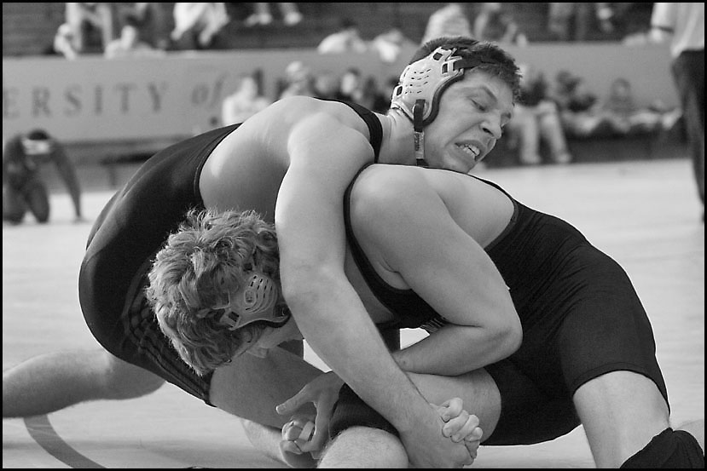
More High Impact Presentation Tips
Simplify complexities (eg “wrestling” to show tensions)

Slide 22
High Impact Intros
Take the stage: 1st 5-15 seconds, presence, don’t rush, silence, body language, eye contact, audience’s mental preparation
Don’t say: “Hello I’m here to talk to you about…”
Give direction: Preview for longer presentations & for team presentations, remove boring/meaningless headings (eg ‘Contents’, ‘Conclusion’), section slides

Slide 23
High Impact Intros
Create motivation: WIIFT
Promise of new ideas or info
Solution to a problem they are facing
Gain & re-set credibility
Context/Overview
Arouse interest – “grabbers”
Great Grabbers!
Surprise: interesting facts, stats or controversial claims
Question???
Quotation: ‘However beautiful the strategy, you should occasionally look at the results.’ – Sir Winston Churchill

Slide 24
High Impact Conclusions
Summarize (repeat key messages/points)
Call for action - next steps
Finish on high note (something to clap about & get audience talking in the break)

Slide 25
High Impact Conclusions
10-30 seconds to close
No boring/meaningless ‘Thank You’ slide!
STAR (Something They’ll Always Remember) - What do you want them to remember 24 hrs later?
Repeat key message/s
Link back to Intro
“Feelgood” or “goodwill” endings

Slide 26
Visual design (slides)
Visually oriented
Suitable amount of information
Avoids ‘chartjunk’ (unnecessary shading, borders, 3-D, clipArt)
Headings convey narrative

Slide 27
Appropriate in number (of slides):
…a 20-minute PowerPoint presentation should have 10 slides and contain no font smaller than 30 points.

Slide 28
Chilean Exports
Fresh fruit leads Chile's export mix - Chile emerges as major supplier of fresh fruit to world market due to ample natural resources, consumer demand for fresh fruit during winter season in U.S. and Europe, and incentives in agricultural policies of Chilean government, encouraging trend toward diversification of exports and development of nontraditional crops - U.S. Dept. of Agriculture, Economic Research Service Report
Chile is among the developing economies taking advantage of these trends, pursuing a free market economy. This has allowed for diversification through the expansion of fruit production for export, especially to the U.S. and Western Europe. Chile has successfully diversified its agricultural sector to the extent that it is now a major fruit exporting nation. Many countries view Chile's diversification of agriculture as a model to be followed.
Meanwhile, the U.S. remains the largest single market for Chile's fruit exports. However, increasing demand from the EC and Central and East European countries combined may eventually surpass exports to the U.S., spurring further growth in Chile's exports.
If you’ve read this far, your eyes probably hurt and you’ve been reading this tedious long-winded text instead of listening to me. I’m insulted- can’t you see I’m doing a presentation up here? Look at me! Congratulations, however, on having such good eyesight.

Slide 29
Beginner Motorcycles
My personal favorite: the Suzuki Savage
Light weight (~380lbs)
Adequate power (650cc engine)
Low seat height fits most riders

Slide 30
Buying a New Suit

Slide 31
Which looks better?
Cross-company analyses revealed that 6% of all employees were unaware of the changes in our Healthcare coverage.
OR
6% not aware of Healthcare changes

Slide 32
Images & text
Talking about pollution in China? Present 4 bullet points of pollution data… Or read the stats & show a photo?

Slide 33
Compare…

Slide 34
Team names
Email me your team names by 10am Monday

Slide 35
4. A2b Presentations (Monday)
Due: in class on Monday 8 February.
Topic: You can freely choose the topic, as long as it is persuasive, business-related and appropriate.
Length: 5 minutes
Visual support material: PowerPoint slides, Prezi-visuals or the like should NOT be used for the presentation. You may use props – eg show audience a product

Slide 36
Procedure in class in small groups:
Give your 5-minute presentations in turns. The others act as the audience, and they also write down written feedback (on a feedback sheet) during the presentation. See & download feedback sheet in ‘A2b Individual Persuasive Presentation’ activity in MyCourses.
After each presentation, the group should spend about 7 minutes giving oral feedback to the presenter. Talk about both the good points of the presentation and the points to consider. It is important that the presenter gets comprehensive feedback in order to know what her/his strong and weaker points are.
Ask for each presenter's email address and email your feedback forms to each presenter at the end of the session.

Slide 37
Peer feedback to be based on:
Audience orientation
Organization: intro, body, conclusion
Delivery
Language (oral delivery)

Slide 38
5. A3 In-class test (Session 5 Tuesday)
Based on your reading of 4 Inputs + teacher’s lectures
Multiple-choice questions
1 writing task
Begin at 13.00
Total 90 minutes (45 minutes each)
Closed book: no notes, no textbook
Upload to Test folder in MyCourses

Slide 39
Session 3 Reflection
(do tonight or tomorrow morning in MyCourses)

Slide 40
Preparation for session 4 (Monday)
A2a: Individual, 5-min persuasive presentation outline
Upload to MyCourses by 13.00 on Monday.
A2b: Individual, 5-min persuasive presentation to be given in class (Monday)

