Slide 1
Writing Workshop 1
Audience, Style & Purpose
Teacher: Laura Humphries

Slide 2
What is good academic writing?

Slide 3
What is “good” Academic Writing?
Objectivity
Complexity: lexically and grammatically more complex
Formality
Precision with facts & figures
Explicitness: signposting / linking ideas
Accuracy: narrow specific terminology
Hedging: cautious language indicating a degree of certainty
Responsibility: support claims with evidence, use sources, critically assess sources
(Gillet, 2015)
Notes:
Gillet, A. (2015). “Features of Academic Writing.” Using English for Academic Purposes: A Guide for Students in Higher Education. [Website] Retrieved from: http://www.uefap.com/writing/feature/featfram.htm

Slide 4
How is English academic writing different?

Slide 5
Kaplan’s (1966) cross-cultural writing conventions*
Notes:
Robert Kaplan CULTURAL THOUGHT PATTERNS IN INTER-CULTURAL EDUCATION

Slide 6
Differences between Academic Writing in English and your language
Reader-responsible writing culture – the responsibility for understanding the message is on the reader
  Avoids stating the obvious
  Avoids repetition
  Preference for complicated structures
Hinds, J. (1987). Reader versus writer responsibility: A new typology. In U. Connor & R. B. Kaplan (Eds.), Writing across languages: Analysis of L2 Text (pp. 141-152). Reading, MA: Addison-Wesley.

Slide 7
Differences between Academic Writing in English and your language
Writer-responsible writing culture – the responsibility for getting the message across is on the writer
  Gives a lot of background information
  Repetition and summaries
  Language is clear and simple
Hinds, J. (1987). Reader versus writer responsibility: A new typology. In U. Connor & R. B. Kaplan (Eds.), Writing across languages: Analysis of L2 Text (pp. 141-152). Reading, MA: Addison-Wesley.

Slide 8
Structuring the introduction

Slide 9
The Toulmin-Zappen model
(Problem-solution pattern)
Arguably, the most important pattern of organization in
academic writing.
This model and its variants are commonly found in:
argumentative and evaluative critical thinking
Bachelor, Master’s and Doctoral thesis introductions and abstracts
research articles
research reports and proposals

Slide 10
The Problem-Solution Pattern
Four rhetorical moves
Situation
What is relevant or important about the topic?
Problem
What is wrong with the current situation?
What is needed or lacking?
Solution
What is the solution?
Evaluation
Is this a good solution?
If not, repeat move 3 & 4.

Slide 11
Creating a Research Space
(Swales 1990)
Move 1: Establishing a Territory
Move 2: Establishing a Niche
Move 3: Occupying the Niche
*See ’Cars’ model in handouts

Slide 12
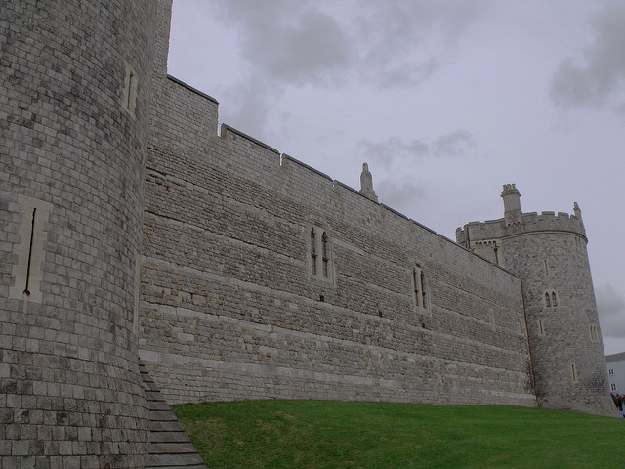
England 1066 AD
Notes:
Duke William II, or William the Conquer defeats the English King Harold
Anglo-Norman French: Government
Latin: the Church, Commerce

Slide 13
Formality – Verbs
Anglo-Saxon verbs
Be
Do
Get
Give
Be going to
Happen
Have
Have to
Mean
Put
Use
Latinate verbs
Be situated, be listed, serve as
Perform, implement, execute
Become, acquire, procure
Provide, supply, contribute
Will
Occur
Possess, include, contain
Should, must
Denote, indicate
Place, attach, insert
Employ, utilize, apply, exploit
(McAnsh & Pennington, 2005)
Notes:
McAnsh, A. and Pennington, K. (2005) “Vocabulary Choice.” Academic Writing in English. [Website] Retrieved 27.11.2013 from http://sana.tkk.fi/awe/style/vocabulary/verbs/index.html.

Slide 14
Formality – Nouns
Informal
a thing
know-how
trouble
an idea
the meaning (of)
Formal
a device, object, instrument
expertise
difficulty, challenge
a concept, plan, notion
the purpose, aim, objective, target
(McAnsh & Pennington, 2005)

Slide 15
Formality – Adjectives
Informal
good
bad
small, tiny
big
different
Formal
suitable, effective, beneficial
poor, ineffective, unsuitable
minute, insignificant
major, high, large, great
various, a variety of, separate
(McAnsh & Pennington, 2005)

Slide 16
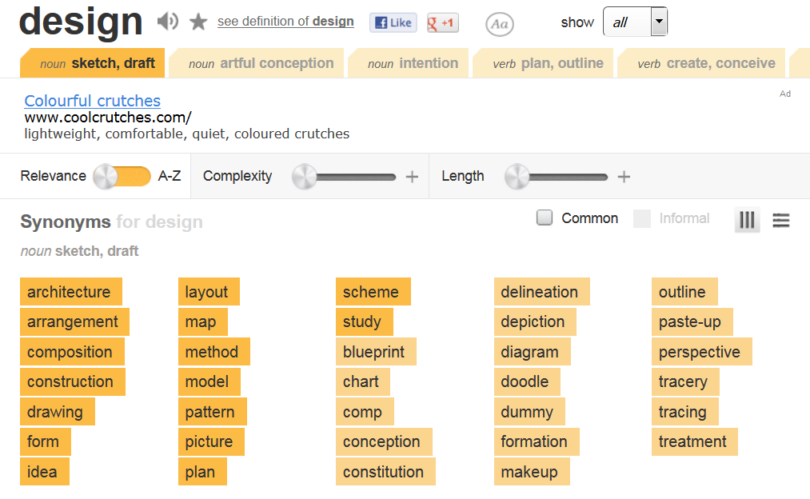
Thesaurus
Notes:
Thesaurus.com

Slide 17
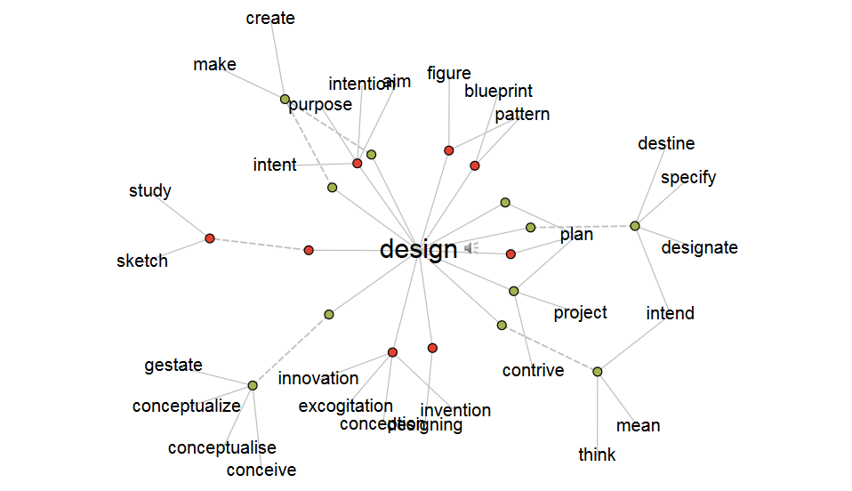
Visual Thesaurus

Slide 18
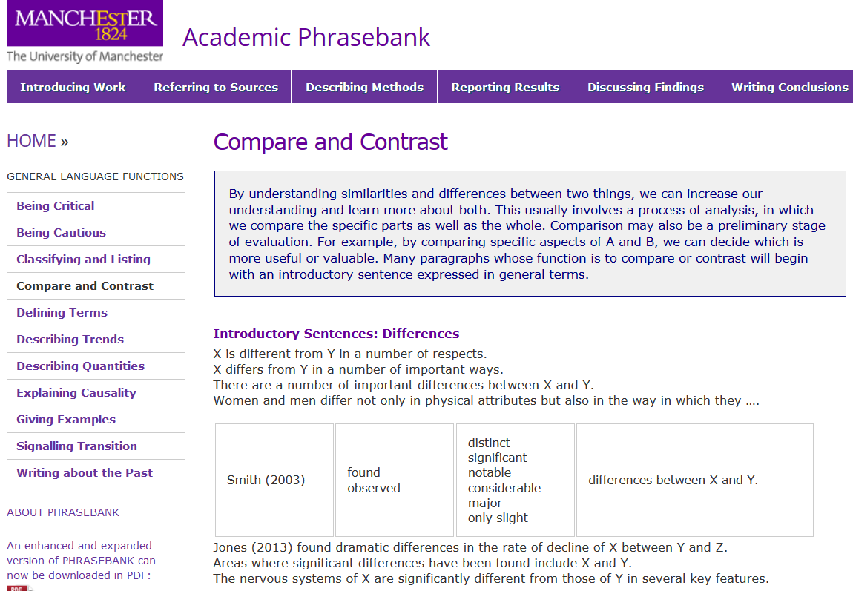

Slide 19
Hedging
Level of certainty
Likelihood
Distance
Softening generalizations
(Swales and Feak, 2012)

Slide 20
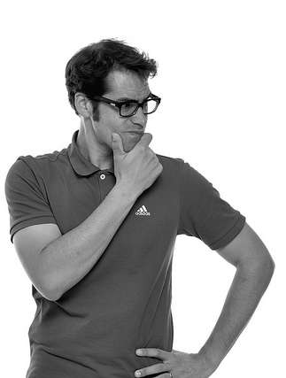
Level of Certainty
Small groups
Arrange from most to least certain
Establish
Contend
Refute
Suggest
Imply
Prove

Slide 21
Level of Certainty
Prove
Validate
Confirm
Corroborate
Affirm
Refute
Attest
Establish
Demonstrate
Show
Indicate
Claim
Contend
Argue
Concede
Admit
Suggest
Propose
Imply
Hint
MOST
Toikka et al. (2002)
LEAST
(Lappalainen, 2016)

Slide 22
Likelihood – Modal verbs
Word-of-mouth advertising influences a consumer’s incentive to purchase a product.
can influence
could influence
may influence
might influence
(Swales and Feak, 2012)

Slide 23
Likelihood – Phrases
Stronger
It is clear that…
It is rather clear that…
It is very probable/highly likely that…
It is probable/likely that…
It is possible that…
It is unlikely that…
word-of-mouth advertising influences a consumer’s incentive to purchase a product.
Weaker
(Swales and Feak, 2012)

Slide 24
Distance
Based on the limited data available…
According to the preliminary study…
Based on previous surveys…
According to some earlier studies…
In the view of many scholars…
the African continent has considerable potential for developing solar energy for domestic needs and for export.
(Swales and Feak, 2012)

Slide 25
Softening generalizations
Children living in poverty do poorly in school. (Strong)
(Swales and Feak, 2012)

Slide 26
Softening generalizations
Children living in poverty do poorly in school. (Strong)
appear to
tend to
seem to
(Softening verbs)
(Swales and Feak, 2012)

Slide 27
Softening generalizations
Children living in poverty do poorly in school. (Strong)
Many
A majority of
Some
In most parts of the world,
(Limit the subject)
(Swales and Feak, 2012)

Slide 28
Active versus Passive Voice
Active – Subject performs the action of the verb
They designed this product to improve efficiency.
Passive – Subject receives the action of the verb
The product was designed (by them) to improve efficiency.
Which should you use? Why?

Slide 29
Avoid personal pronouns
I propose a new solution for recycling plastic…
Use the inanimate agent
This thesis proposes a new solution for recycling plastic…
This thesis analyzes…
This paper argues…
This report discovered…
This article researched…

Slide 30
Verb tense – Present simple
The data suggests…
There is evidence that…
Uses:
To introduce your work
To make general statements, conclusions, or interpretations about research
To introduce evidence or support

Slide 31
Verb tense – Past Simple
Swales (2002) found…
A paired samples t-test was run…
Uses:
To introduce others’ research work
To describe methods and data in your work

Slide 32
Verb tense – Present Perfect
Some studies have shown…
Researchers have discovered...
Uses:
To connect the past (previous research) with the present (your research).

Slide 33


Which dialect to use?

Slide 34
Common Dialectal Differences
British English
Programme
Autumn
16.00
Honour
Metre
Recognise
Analyse
Analogue
Cancelled
American English
Program
Fall
4:00 PM
Honor
Meter
Recognize
Analyze
Analog
Canceled

Slide 35
Common Dialectal Differences
British English
However I would suggest…
Based on the current evidence further research would be…
Dr Smith
Yours sincerely
American English
However, I would suggest…
Based on the current evidence, further research would be…
Dr. Smith
Sincerely yours,

Slide 36
Peer feedback
Read through your partner’s paper.
Make note of the following:
Anglo-Saxon verbs
Verb tense
Use of active and passive
Any shift in English dialect

