Slide 1
Measuring ballistocardiography signals using a stabilized bedframe
Samu Sorvari
Maximilian Siebert
06.04.2018

Slide 2
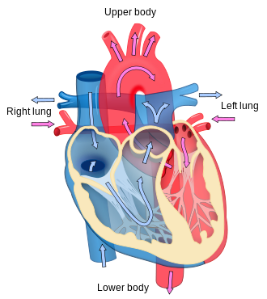
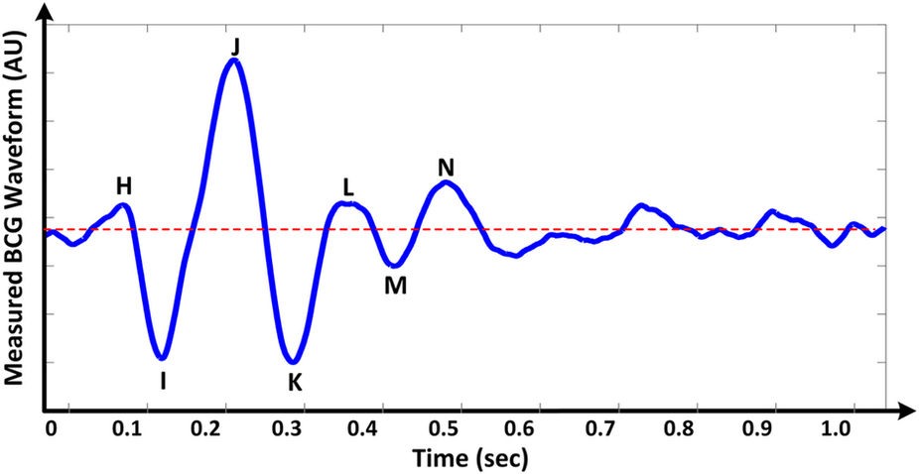
Ballistocardiography
Forces from Heart

Slide 3
Introduction
Ballistocardiography measures the movement of the heart
heart efficiency can be monitored
early detection of degradation can prevent heart failures
100%
heart
efficency
Point of no return!
time

Slide 4
The bedframe

Slide 5
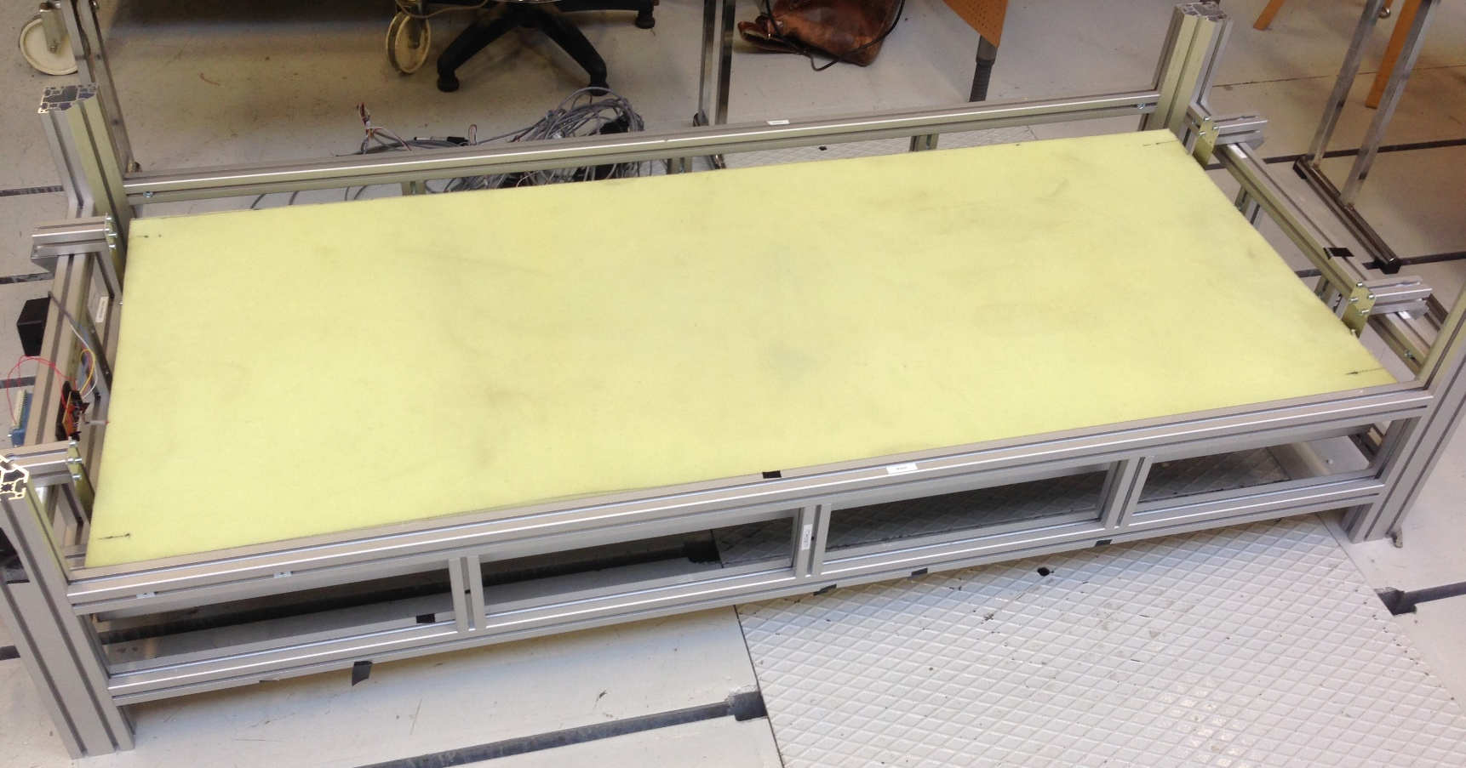
The bedframe
fixed outer bedframe
moving inner bedframe

Slide 6
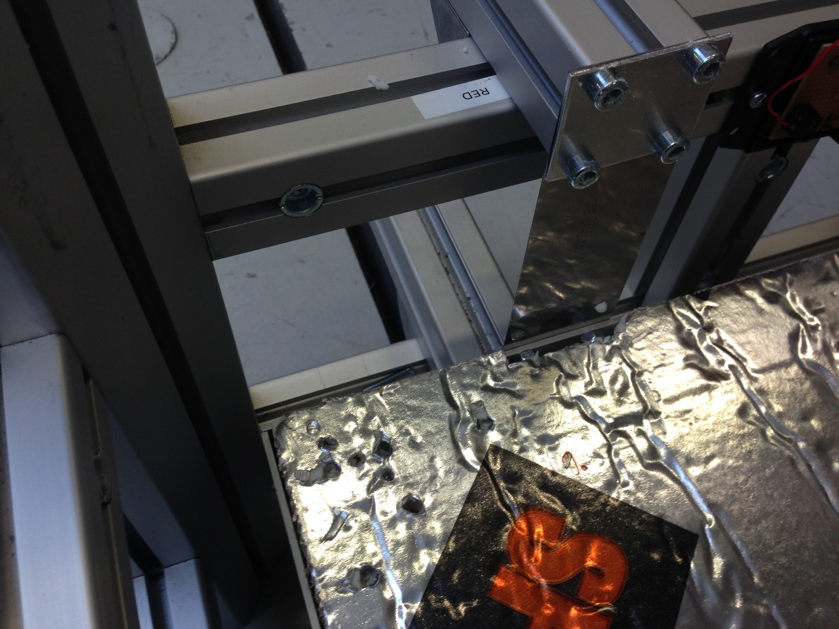
The bedframe
fixed outer bedframe
moving inner bedframe

Slide 7
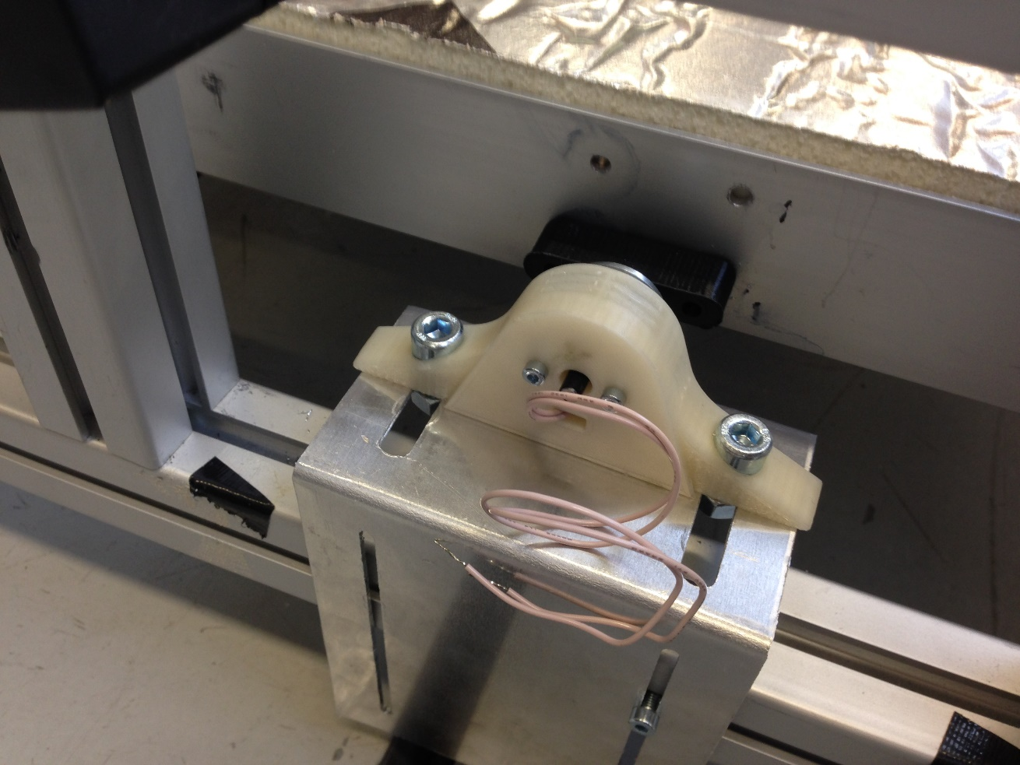
Concept
Applying contraious force with a linear actuator mounted between the two bedframes

Slide 8
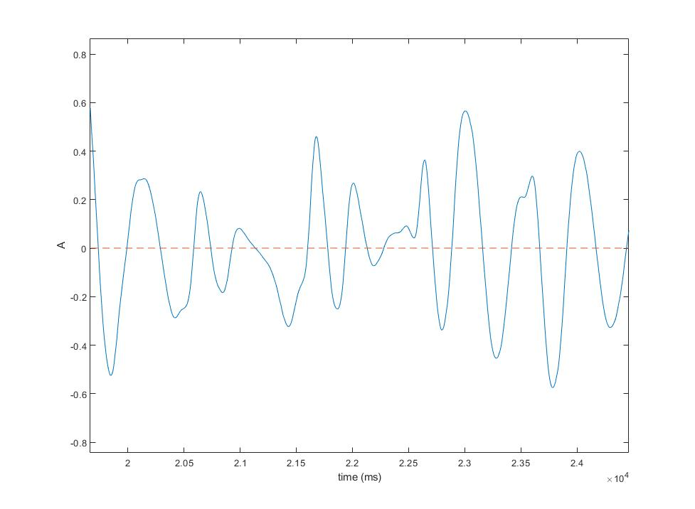
Results & Conclusion
-> Further signal processing is needed!

