Slide 1
Hydraulic pulsation device for nanocellulose dewatering
Aleksi Heikkinen
Toni Niinivirta
Juuso Pulkkinen

Slide 2
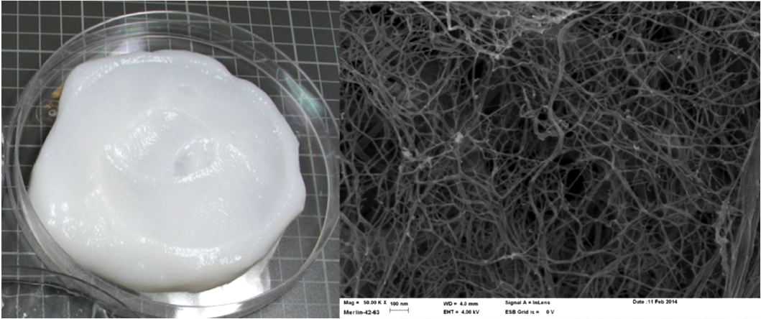
Nanocellulose
-Organic material
-Improved properties
1. Optical
2. Surface
3. Stronger

Slide 3
Challenges
-High water retention rate
-Dense film formation
-Difficult to produce

Slide 4
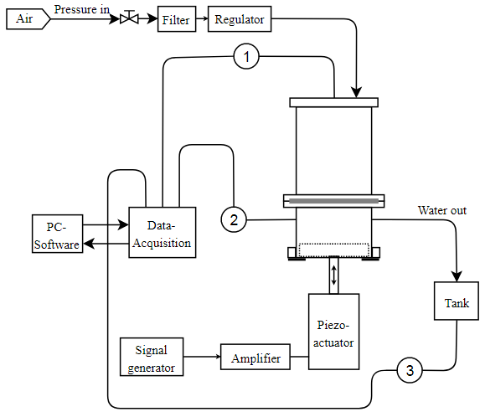
Design
-Pressure dewatering
-Hydraulic pulsation
-Measurement points
Pressure
Hydraulic pulsation
Dewatering rate

Slide 5
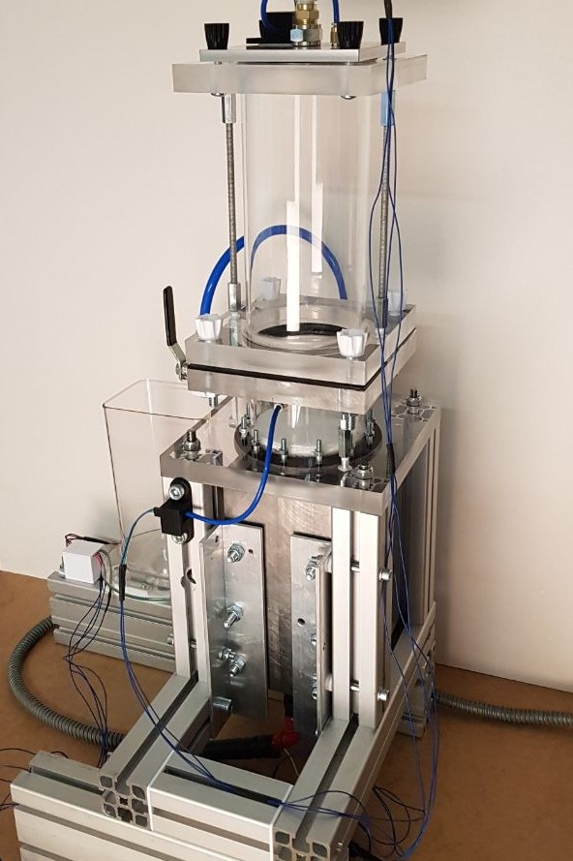
Testing procedure
-1 litre of nanocellulose suspension
-Testing parameters:
Frequency
Dewatering pressure
Pulsation amplitude

Slide 7
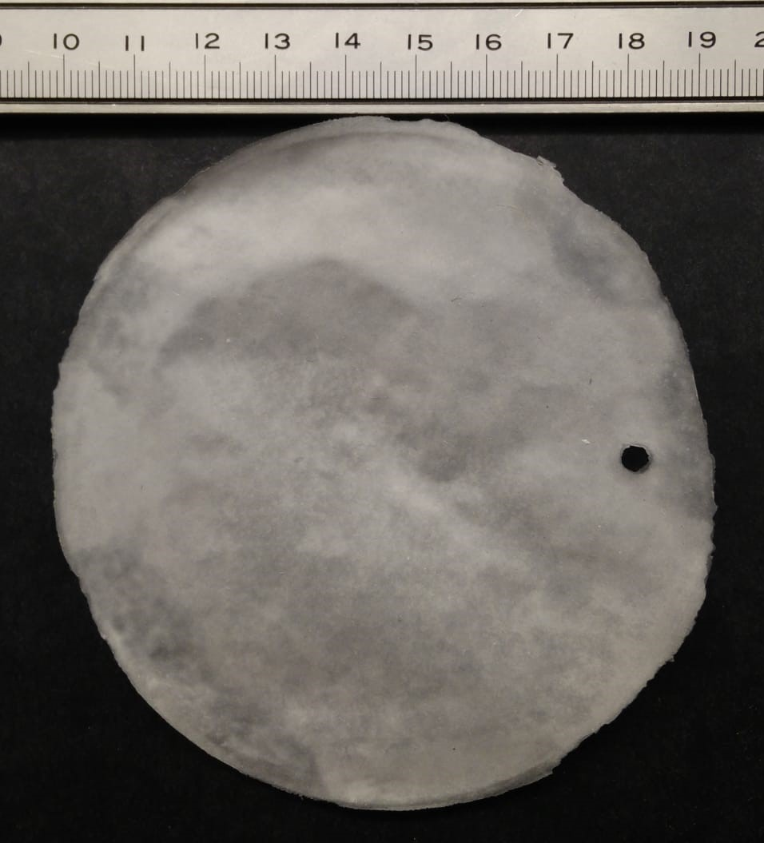
Results and discussion
-Pulsation reduces dewatering time
-Design improvements
-Future research

Slide 8
Questions?
Thank you!

