Slide 1
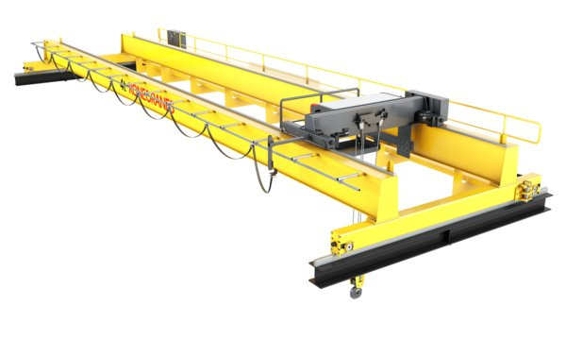
Improving the load positioning accuracy of an automated overhead crane
Team HALI
Notes:
•Cranes are one of the most important transportation methods for heavy goods, used in shipping yards, construction sites and warehouses
•Further automation of processes has made automated lifting operations more important
We are team HALI and we are improving the load positioning accuracy of an automated overhead crane

Slide 2
Notes:
https://youtu.be/lvHb4XTkC0A?t=20s
Here is an example of industry use of crane that we were particulary interested
Half millimeter play between stator and the frame
Manually operated crane requires expert workers
Sway
Frame is heated, stator needs to be lowered quite fast as the stator is shrink fritted
Not only lifting operation where skilled crane users are needed.

Slide 3
Notes:
https://youtu.be/lvHb4XTkC0A?t=20s
Mikä on pihvi? Nosturin automaatioasennuksen kehittäminen
Half millimeter play between stator and the frame
Manually operated crane requires expert workers
Sway
Frame is heated, stator needs to be lowered quite fast as the stator is shrink fritted
Not only lifting operation where skilled crane users are needed.

Slide 4
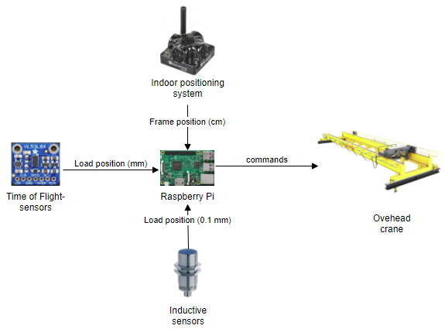
Test setup
Stator and frame model
Notes:
we are simulating the previous industry example with scaled down…
System explanation

Slide 5
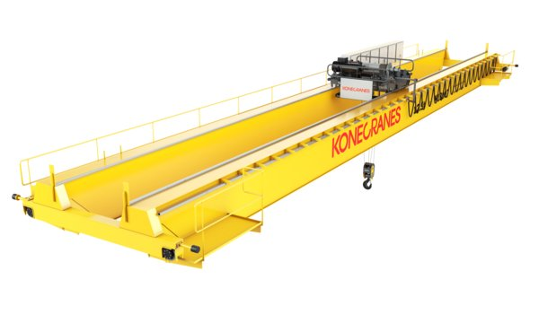
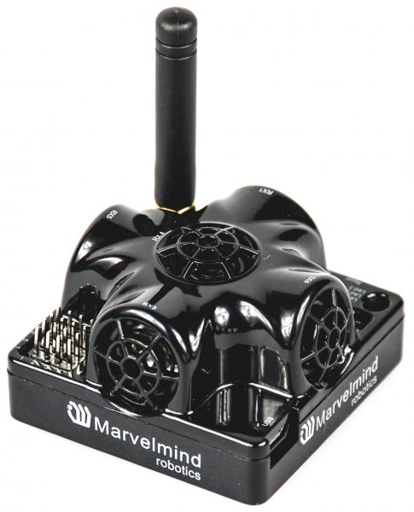
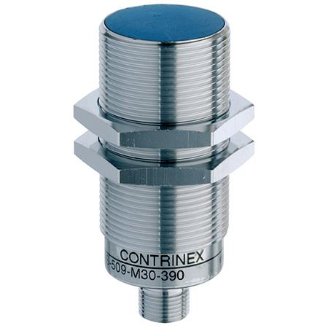
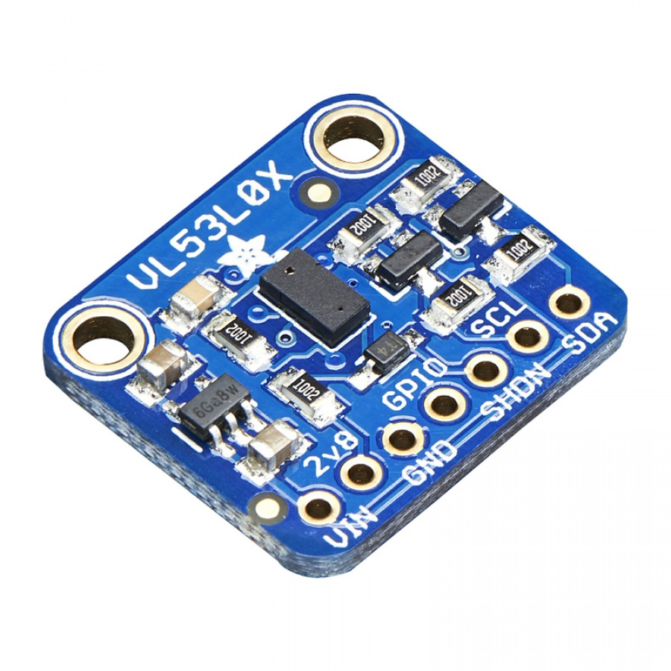
Old vs New
+
Play between
0.5 mm
± 2 cm
~ 1 mm
~ 5 μm
Old system
Notes:
Aim of our research

Slide 6
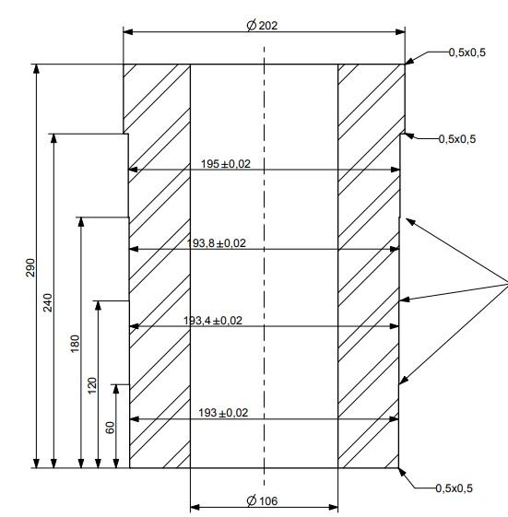
Test method
Old vs new system
10 repeated lift operations
Measured: How far can we lower the cylinder without contact?
Notes:
Selitä eri diameetterit

Slide 7
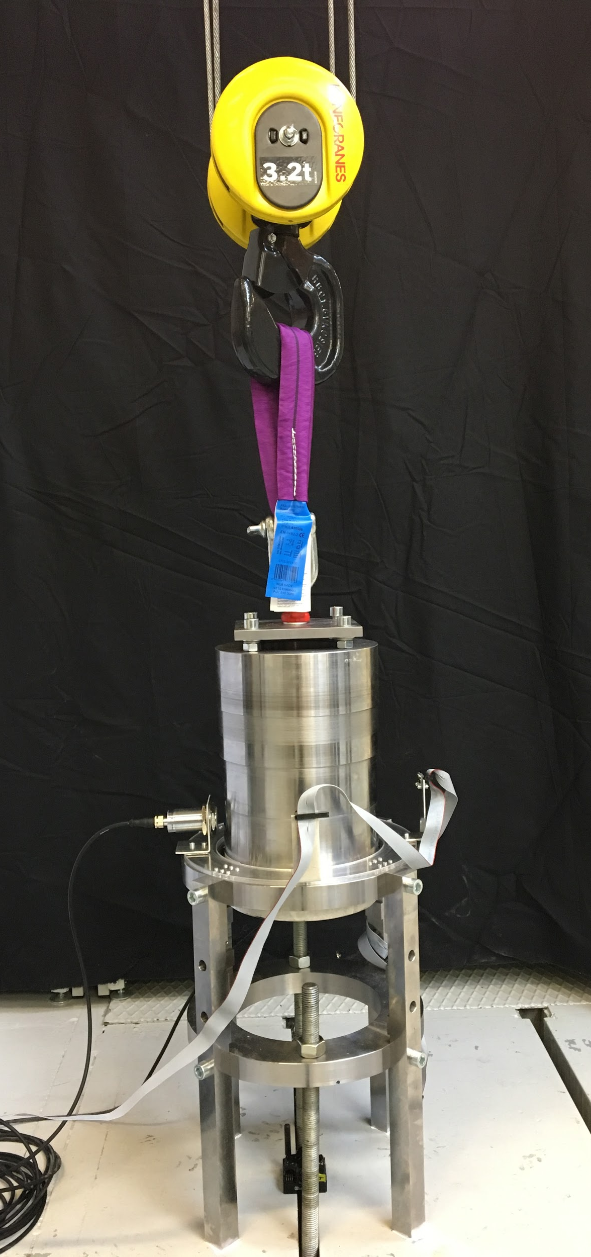
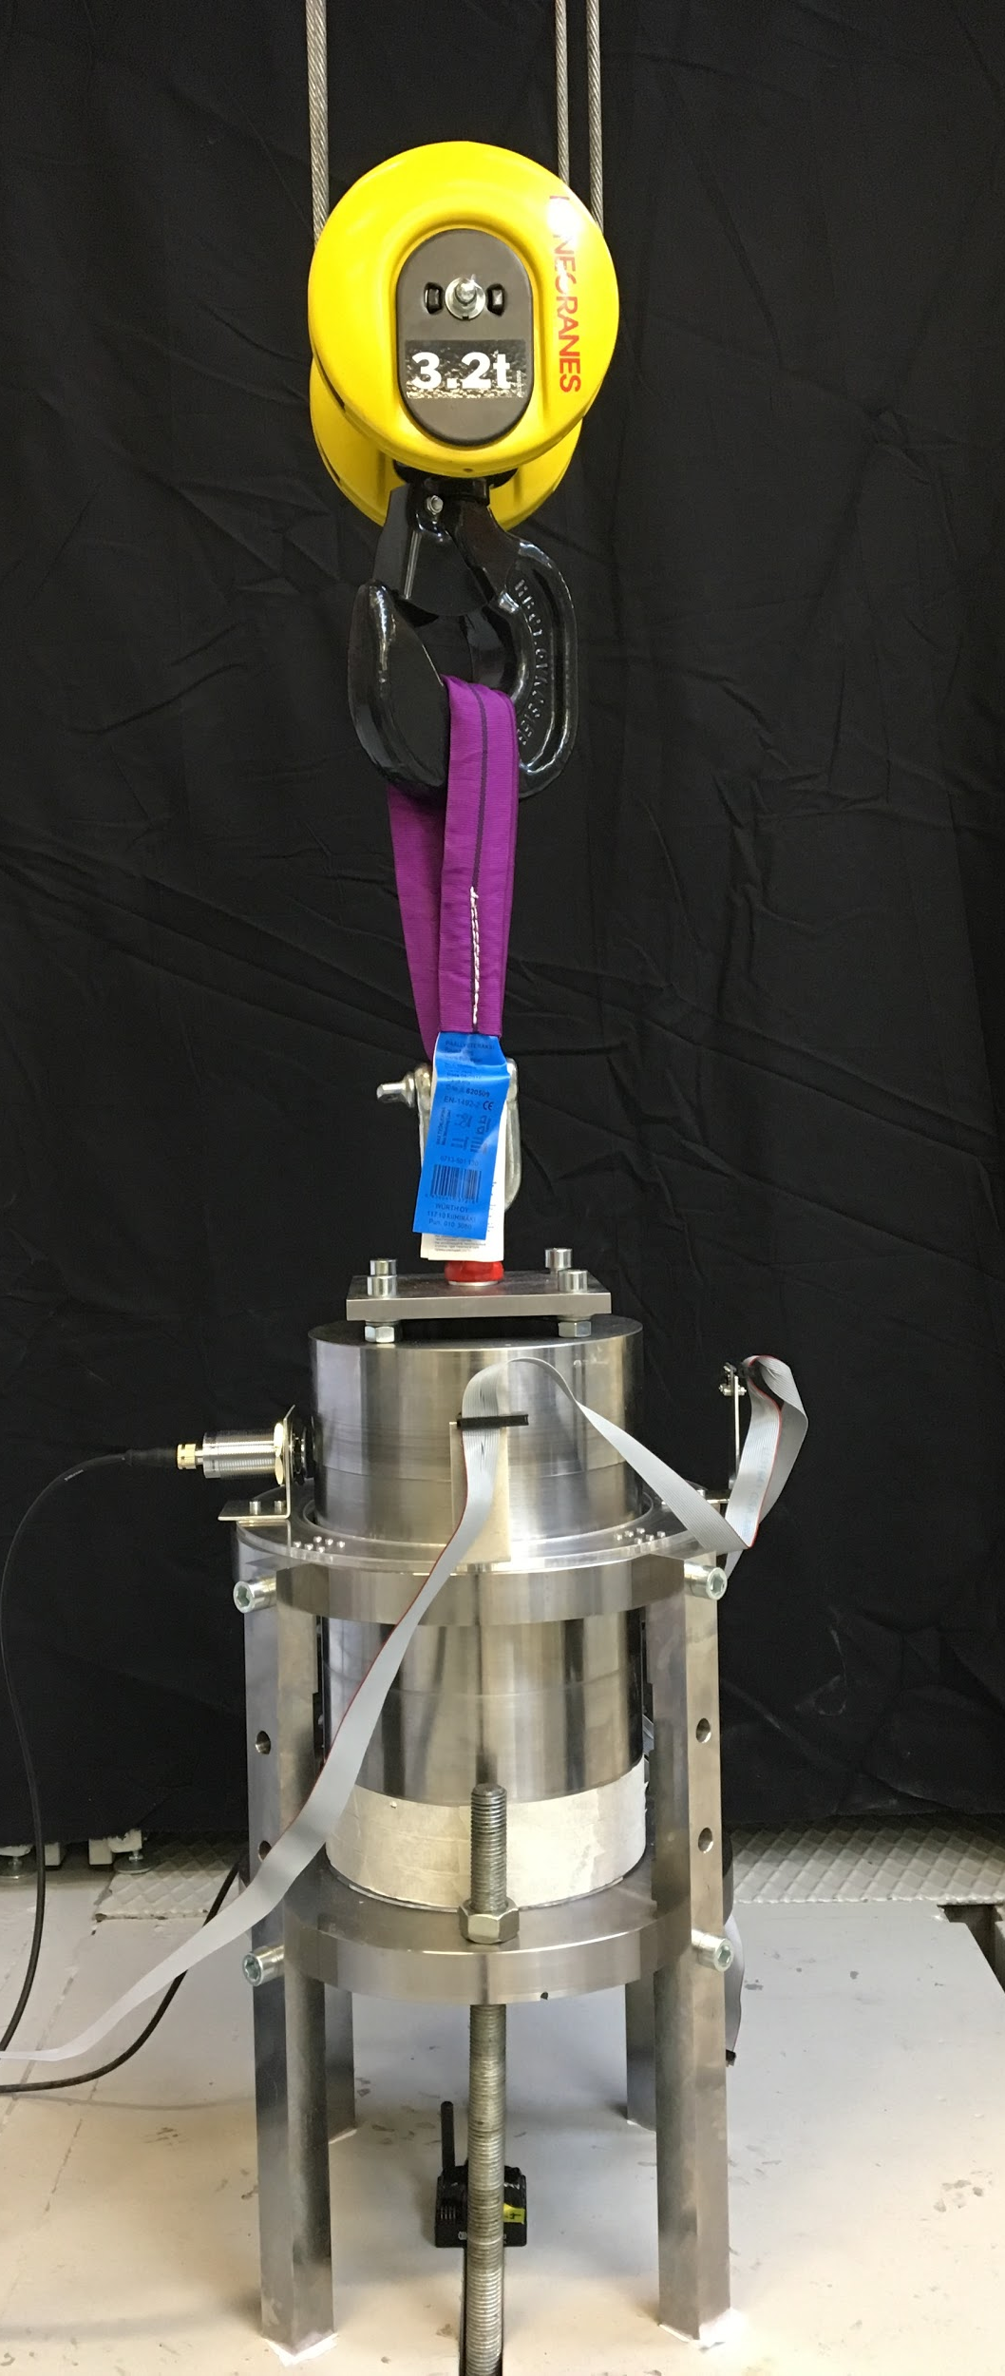

Slide 8
Results
Old system : 1/10
New system: 4/10

Slide 9
Discussions
Sensor accuracy?
Sway?
Scaling up?

Slide 10
Questions?
RyhmäHALI
Riku, Jukka, Kimmo and Matias

