Slide 1

Business Communication (3cr)
MLI61A130
Session 2
Lecturer: Mark Badham

Slide 2


Today’s agenda
Session 1 Reflection feedback
QFOTY Team Exercise
Effective Business Writing
A1 1st Version – Peer review
Session 2 Reflection
Instructions for A2a & A2b Individual Persuasive Presentation Strategy Outline & Presentation
Instructions for A5 Critical Reflection

Slide 3
1. Session 1 Reflection feedback
Can we build ethos based on someone else’s credibility? For example by using their expertise and arguments?
Will Zoom sessions be recorded and posted afterwards or not?

Slide 4
2. QFOTY

Slide 5
TEAM EXERCISE: Queensland Father of the Year (QFOTY) sponsorship request
Fathers Day: early September in Australia
Background context: The state of Queensland (in Australia) celebrates QFOTY every year. SU Qld (a youth and children’s not-for-profit organization) hosts and runs the annual QFOTY awards. SU Qld is officially endorsed by the Queensland Government’s Education Department as the organization that employs chaplains in government/public schools. (www.suqld.org.au)
SU Qld’s CEO, Tim Mander, stated: “Fathers play such a key role in the healthy development of our children. We want to honour our fathers and promote the vital role fathers play in families and society in general.”
SU Qld seeks a 5-star resort venue to announce the 2021 QFOTY winner to the news media and to a live audience (eg families of nominated fathers).

Slide 6
Communication Strategy
Audience Strategy:
Marketing Manager, Hyatt Regency Sanctuary Cove, Gold Coast, Australia – decision-maker & influencer (to CEO) – responsible for events that market resort
Potential objections: no budget & busy staff (no time & money to get involved) – they budget 1 year in advance
WIIFT
Message Strategy - Communication Objective: As a result of this message, I want him to agree to sponsor the event at the resort (catering, room costs, prize for winner).
Communicator Strategy - Credibility Assessment:
SU Qld track record running QFOTY media publicity & marketing
Large successful organisation – positive image (show media reports & marketing material from past years)
Common ground: families as our target market (Hyatt & SU Qld)
Channel Strategy:
Final goal to get a FTF meeting with Marketing Manager
Email seeking FTF meeting

Slide 7
QFOTY Media Release
http://qldfatheroftheyear.org.au
https://www.ihg.com/intercontinental/hotels/us/en/sanctuary-cove/bneql/hoteldetail

Slide 8

Team task: You are asked to seek sponsorship from a 5-star resort for this event.
Plan your communication strategy. Approx. 10 minutes team collaboration (How will you obtain sponsorship from the resort? How will you write your sponsorship request?):
  Audience Strategy
  Message Strategy
  Communicator Strategy
  Channel Strategy
Begin writing an email to the resort. 10 minutes individual, then 10 minutes team collaboration
Submit your draft text (as document) in MyCourses (under ‘QFOTY’)

Slide 9
3. Effective Business Writing
Today’s learning outcomes
By the end of today, you will be able to
Write persuasive, clear and concise business messages
Write with a strong audience focus
Ensure you get the desired response from readers

Slide 10

BUSINESS WRITING
When you write well…
Enhances your credibility
More chance of reader receiving & understanding your message
More chance of reader doing what you want
So let’s learn to write well!
Applies to emails, WhatsApp messages, executive summaries, PowerPoint reports…

Slide 11

BUSINESS WRITING
Composing Techniques
FIRST (yesterday’s session):
Communicator strategy
Audience strategy
Message strategy
Channel Choice strategy
Then COMPOSE (write)…
Tips:
Strategize
Write 1st draft
Edit &/or ask someone to check &/or test it
Edit again

Slide 12
Composing Techniques
1. Conduct research:
Interview/s
Company documents (eg online)
Company communications (eg emails)
Surveys
4. Draft your text:
Organize (eg main points)
Start writing
Don’t edit yet
2. Organize (overall structure):
Group ideas: mindmap/idea chart
5. Edit (in this order):
For strategy & focus 1st
For macro issues
For micro issues
For correctness (eg spelling, grammar & punctuation)
3. Narrow your focus:
Skim
Nutshell
Bottom line
Elevator pitch

Slide 13

Composing Techniques
3. Narrow your focus
Skim (HSV: High Skim Value):
Imagine reader skimming…
What does reader need to know 1st, 2nd, 3rd… if he/she skims text?

Slide 14
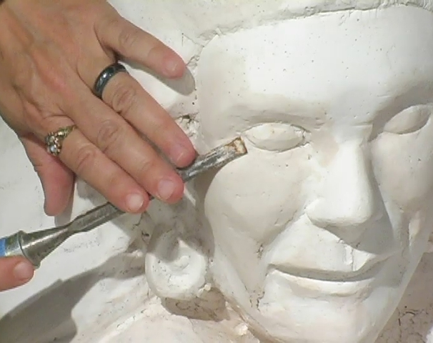
Composing Techniques
4. Draft your text
Don’t start with blank page - start with lots of unedited text
Like sculpture, begin with ‘mess’ (in Draft stage) & methodically perfect (in Edit stage)

Slide 15
Composing Techniques
5. Edit
MACRO
  MACRO: structures (eg headings & paragraphs) – to suit your arguments
MICRO: sentences & words
  Brevity (conciseness)
  Transitions
  Appropriate style (formal/informal)
  Language correctness (eg spelling, grammar & punctuation)
MICRO

Slide 16
MACRO Writing
Effective paragraphs have:
clear topic sentence +
supporting sentences +
signposts +
are short
Effective paragraph example:
  An effective document structure includes three main items. First, you should create high skim value with message headings and enough white space. Second, you should use signposts to show connection in the text. Finally, each paragraph should start with a topic sentence, which all other sentences then support.
MACRO
Topic sentence
MICRO
Signposts

Slide 17
MICRO Writing
Design text to enable reader to read it all quickly + slowly
MACRO
Make text easy to skim
- gain High Skim Value (HSV) through:
Headings (that highlight key messages)
Numbered & bulleted lists
Parallel headings & lists
White space
Easy-to-read typography
MICRO

Slide 18

Headings (& sub-headings)
Effective headings have 3 features:
Tell (summarize) the message (main point) in the paragraph
Are parallel (conceptually & grammatically)
Have stand-alone sense

Slide 19
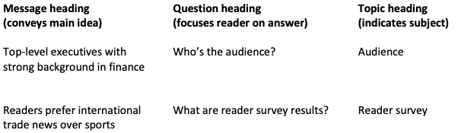
Headings tell (summarize) the message (main point) in each paragraph
Reader can skim quickly

Slide 20
Action verbs in headings – because most business communication involves making recommendations (persuading)
Compare these:
We recommend that management take the following 4 steps:
A clear timeframe for the introduction of the new database important
Communication of the timeframe to all staff
Organising training sessions to ensure smooth implementation
Important to clarify job descriptions and explain to personnel how their input impacts the whole organisation
We recommend that management take the following 4 steps:
Establish a clear timeframe for the introduction of the new database
Communicate the timeframe to all staff
Organise training sessions to ensure smooth implementation
Clarify job descriptions and explain to personnel how their input impacts the whole organisation

Slide 21
Numbered & bulleted lists
Rule of thumb:
Use numbering when the sequence or number of items is relevant.
Use bullets when the number or the order of the items doesn’t matter.
Example:
Before arriving in Finland, please take the following four actions. First, enroll at www.abcevent.fi/registration. In this address, you will be able to indicate any dietary restrictions. Second, pay the registration fee through your mobile bank. If you don’t have access to a mobile bank, please contact us. Third, book your hotel room through www.abcevent.fi/hotel to be able to benefit from a discounted rate. Finally, if you have any questions, please contact us.

Slide 22
Before arriving in Finland, please take the following four actions.
Enroll and indicate dietary restrictions at www.abcevent.fi/registration
Pay the registration fee through your mobile bank or contact us for payment
Book your hotel room through www.abcevent.fi/hotel to benefit from a discounted rate
Contact us if you have any questions
Notice action verbs
Before arriving in Finland, please take the following four actions.
Enroll and indicate dietary restrictions at www.abcevent.fi/registration
Pay the registration fee through your mobile bank or contact us for payment
Book your hotel room through www.abcevent.fi/hotel to benefit from a discounted rate
Contact us if you have any questions
What can you notice here?

Slide 23
Parallel headings & lists
Make sure they are conceptually and grammatically parallel, i.e. equal
Conceptual parallelism – making sure headings/listed items have the same relationship to the title of the document/list
Helps busy reader quickly skim & understand
No conceptual parallelism:
Here are the main findings:
All the steps in the process were carefully monitored
15% of the raw material was defective
The finished product was tested at 5 minute intervals
2% of the seals received insufficient adhesive
Conceptual parallelism:
The pricing of the holiday apartments will depend on:
location on the coast
amenities in the neighbouring area
number of bedrooms
quality of furniture and fittings

Slide 24
Parallel headings & lists
Parallel headings are similar items
  Here are 3 actions you should take:
  Send contact info to Susan Smith
  Pay the course fee
  Prepare the pre-course assignment
Note about emails: treat subject line as heading = put message in subject line
Examples:
  “Brochure” vs. “New brochure for comments by Monday”
  “Meeting” vs. “Board meeting: Tue 9 am, Room 102”

Slide 25
MACRO
Avoid wordiness (Pleonasm: the use of unnecessary words)
Shorten & vary lengths of sentences
White space: increases readability
Typography: Bolding, underlining, italics – use sparingly, don’t combine them
MICRO

Slide 26
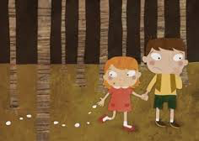
Transitions (Hansel & Gretel bread crumbs):
Addition: And, in addition, again, also, similarly, finally…
Contrast: But, however, or, nevertheless, on the other hand…
Example: For example, for instance, such as, that is…
Sequence: First, second, third… then…
Conclusion: Finally, therefore, in conclusion, as a result…
Clarification/summary: In other words, what this means is, to summarize…

Slide 27
Clear & logical structure
Introductions (openings): provide background, explain why you are writing, preview rest of text
Length depends on how familiar reader is with topic
Effective intro does 3 things
Explains why you are writing
Establishes context
Previews rest of text

Slide 28

Examples:
  As Alina told us last week, our customer feedback has been below target. To address the issue, we (Mikko, Matti and Salla) were assigned to suggest measures to enhance our customer experience. This report outlines…
  We met at the Speak IT! event last month, and you told me that you give workshops on inspirational leadership.
  I am writing to ask if you would be interested in giving a workshop on this topic to our employees…

Slide 29
Closings: reinforce main ideas, state action points, give deadlines, offer help
Examples:
  I will call you at the beginning of next week so that we can talk more about the workshop and possibly start organizing the details.
  In order to take this process a stage further, could you please let us have ...
  I look forward to receiving your comments on the attached draft by 3 pm on 31 August.
  If you require more data on ... I would be happy to collate it for you.

Slide 30
Styles
Formal or informal? Professional or casual?
Depends on who is writing to whom + what you are trying to achieve (communication objective).
3 different examples:
  Do not hesitate to contact me if you have further questions or would like additional information. Our office hours are ...
  If you'd like more information, feel free to call me anytime between 8.00 and 16.30 Monday to Friday.
  Want to know more? Just give me a call. I’m in the office 8-16, Monday to Friday.

Slide 31
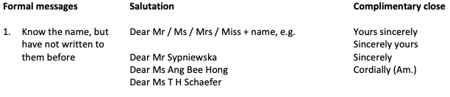
Styles
Use a reader-centric 'you' attitude: what’s in it for them (WIIFT)
Beginning (salutation) and ending (complimentary close) that reflects your relationship with the reader
Note:
Dear Ms + name is the most common way to address women, regardless of marital status.
If you do not know whether the recipient is a man or a woman, simply use the full name, e.g. Dear Eun-Young Park

Slide 32
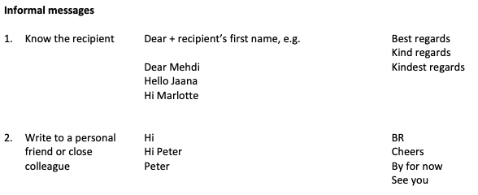

Slide 33
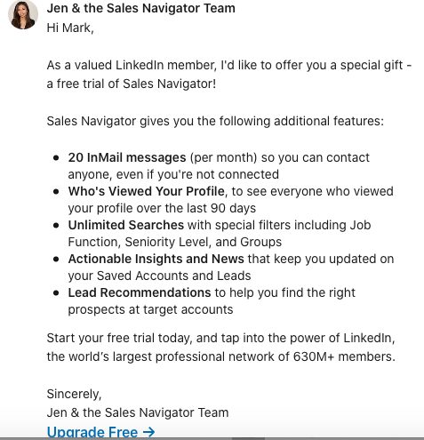

Slide 34
4. A1 1st Version – Peer review
Share your A1 Written Task 1st Version with another team– each individual member to write their feedback on document. See 'A1 Team Feedback Guidelines' PDF. (10 minutes)
Read their comments & make changes - each individual member to read feedback, discuss in team, make changes. (10 minutes)
Return to the Main Room in Zoom. Be prepared to show me what you have written (eg share your screen)

Slide 35
Document sharing instructions:
Save team document somewhere online (eg in Google docs) so that you can give the other team access to your document so they can review it.
List of teams and team members is available as a file under 'Teams' in MyCourses. Apply Room number (eg Room 1) to Team number (eg Team 1). Team 1 will share document with Team 2, Team 2 with Team 3, etc. Team 10 with Team 1.
Each team should choose one team member to be responsible as a contact person for this Peer Review activity. Team contact person in Team 1 to contact team contact person in Team 2 and arrange for document sharing… etc. Use private chat function in Zoom.

Slide 36
5. Session 2 Reflection (in MyCourses)

Slide 37
6. A2 Individual persuasive presentation (15%)
Due 13.00 on Friday 8 January (Session 4)
Deliverables
The assignment is divided into 2 parts as follows:
  A2a Presentation Strategy Outline: submit to the MyCourses submission box before class on Session 4
  A2b Presentation (to peers): held in Session 4 Zoom Breakout Rooms

Slide 38
5-minute individual persuasive (sell) presentation that you will deliver in class
Your target audience could be:
school: Aalto Mikkeli management, fellow students, potential students, exchange students, corporate partners, student club management
company where you (used to) work: top management, colleagues, company personnel, customers, suppliers, buyers, partners etc

Slide 39
2019 Topics:
Supporting a football team is an effective investment to improve mental health
The Fidget Cube: new, revolutionary device that will make you more productive during the day + help reduce stress.
Why is negative economic effects a bad argument against immigration?
2020 Topics:
Why buying sustainable clothing is worth it
Is the legalization of marijuana a plan made by the devil?
Why do we need to hire more women?
Why is it important that we start plastic recycling in Mikkeli?
Why should employers pay interns?

Slide 40
The presentations will be given in small groups (in Zoom Breakout Rooms) - you will get and discuss feedback on the presentations in these small groups.
Before the actual presentation (assignment A2b), you will need to analyze the situation and plan properly to ensure that your presentation will be effective.
As an outcome of your analysis and planning, you will need to present your plan as a written outline (A2a).

Slide 41
Length: 1-2 pages, single-spaced
Evaluation criteria: See grading rubric (in MyCourses submission box)
SEE MORE DETAILS IN ASSIGNMENT INSTRUCTIONS IN MYCOURSES

Slide 42
7. A5 Individual Reflection on Presentation Performance (20%)
Due: 11 pm on Friday 15 January
Length: maximum 3 pages.
  This assignment requires you to write a critical appraisal of the two persuasive presentations you have given in this course – A2 individual and A4 team – and to assess your overall presentation performance.
The assignment thus has 3 parts:
Critical appraisal of A2 individual presentation
Critical appraisal of A4 team presentation
You as a presenter: overall assessment of your presentation performance
Use comments & written feedback from lecturer and fellow classmates + theories of communication.

Slide 43
Part 1: Critical appraisal of A2 individual presentation
To what extent was your presentation persuasive? Discuss 3-5 points.
What areas could you have done better in terms of persuasion? Discuss 3-5 points.
What do you intend to do differently in the next persuasive presentation assignment?
Part 2: Critical appraisal of A4 team presentation
What aspects of your team’s presentation made the presentation persuasive? Discuss 3-5 points.
In what ways could it have been more persuasive? Discuss 3-5 points.
How did what you learnt in the first presentation affect the way you approached the second presentation in terms of preparation and delivery?
Part 3: You as a presenter: an overall assessment of your BCS presentation performance
What seem to be your strengths as a presenter?
What areas do you feel you still need to develop?

Slide 44
All three parts (A,B & C) of the appraisal should cover:
Communication strategy
Audience analysis (Input 1)
Choice of content and structure (Input 1)
Argument: claims & evidence (Input 2)
Benefits (Input 2)
Presentation delivery
Introduction & conclusion (Input 4)
Slide design (Input 4)
Nonverbal communication (Input 4)
Language (Input 4)

Slide 45
Work due Session 3
Read Input 4 (impactful presentations) available in MyCourses
A1: Written request final version (team). Due 13.00 (upload to MyCourses)
A2a 1st version:
Choose A2 topic
Prepare A2a draft version to show peers in class
Come to class prepared to present your topic (max. 2 minutes, no slides) - explain context + how you will plan your presentation (eg arguments)

Slide 46
References / Acknowledgments
See in-text citations
Mike Baker, Christa Uusi-Rauva

