Slide 1
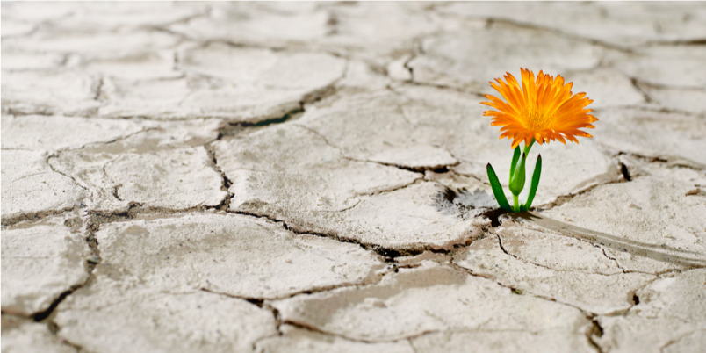
POSTHUMAN INTERCONNECTIVITY
From theory to practice
Dr. Christine Daigle
Research Director/Core Fellow, Helsinki Collegium for Advanced Studies
Professor of Philosophy and Director of the Posthumanism Research Institute, Brock University

Slide 2
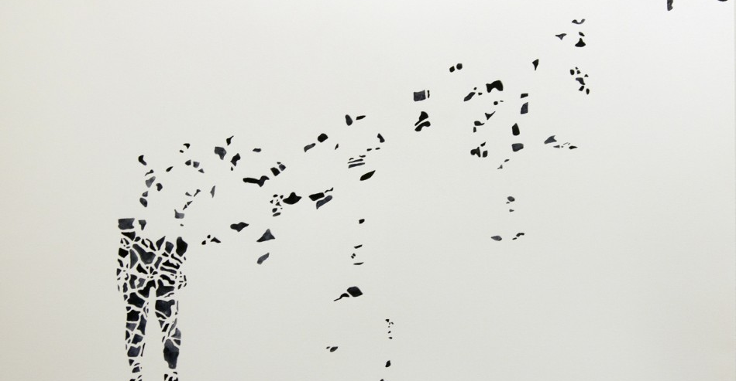
Posthumanist Material feminism
Rejection of human exceptionalism and anthropocentrism
Agentic capacity
Interconnectivity -- vulnerability

Slide 3
Becoming and interconnectivity
The human is
in perpetual becoming
grounded in fluctuating processes
radically entangled … subjectively AND materially

Slide 4
Material entanglement
Beings are permeated by their habitats.
Porous membranes allow for vital traffic to take place: an unfolding necessary process that sustains life

Slide 5
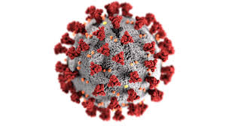
AGENTIC CAPACITY
Agency is not the willful expression of freedom by an autarkic and autonomous being.
Undermines the fantasy of human mastery and exception
Attention to materiality unveils collective material agency/agentic capacity

Slide 6
From theory to practice
Reconceptualizing the human, the nonhuman, the world and their relations should impact how we do things: Theory is not (or should not be) done in a vaccuum.
How does it impact the way we choose to inhabit the world through our housing, urban development, and use of the environment? How do we share the space with nonhumans?

Slide 7
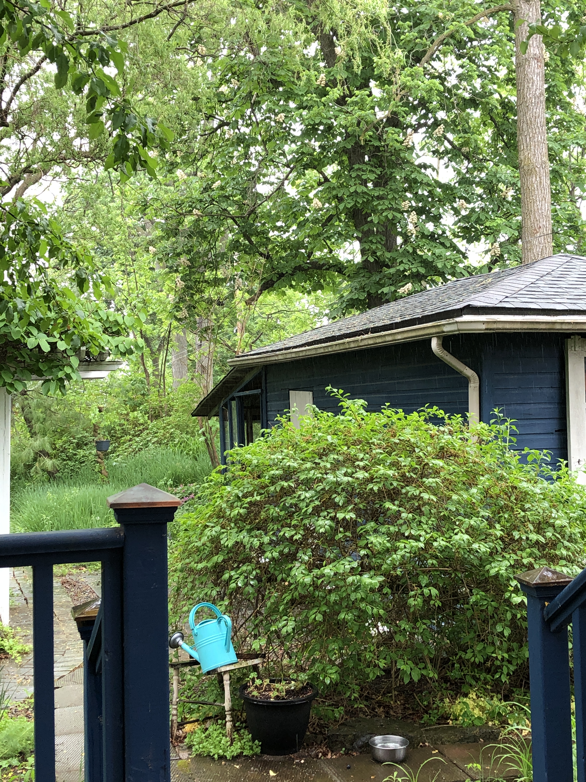
Sharing spaces with nonhumans
The Thorold forest – aka my backyard – is home to many beings.

Slide 8
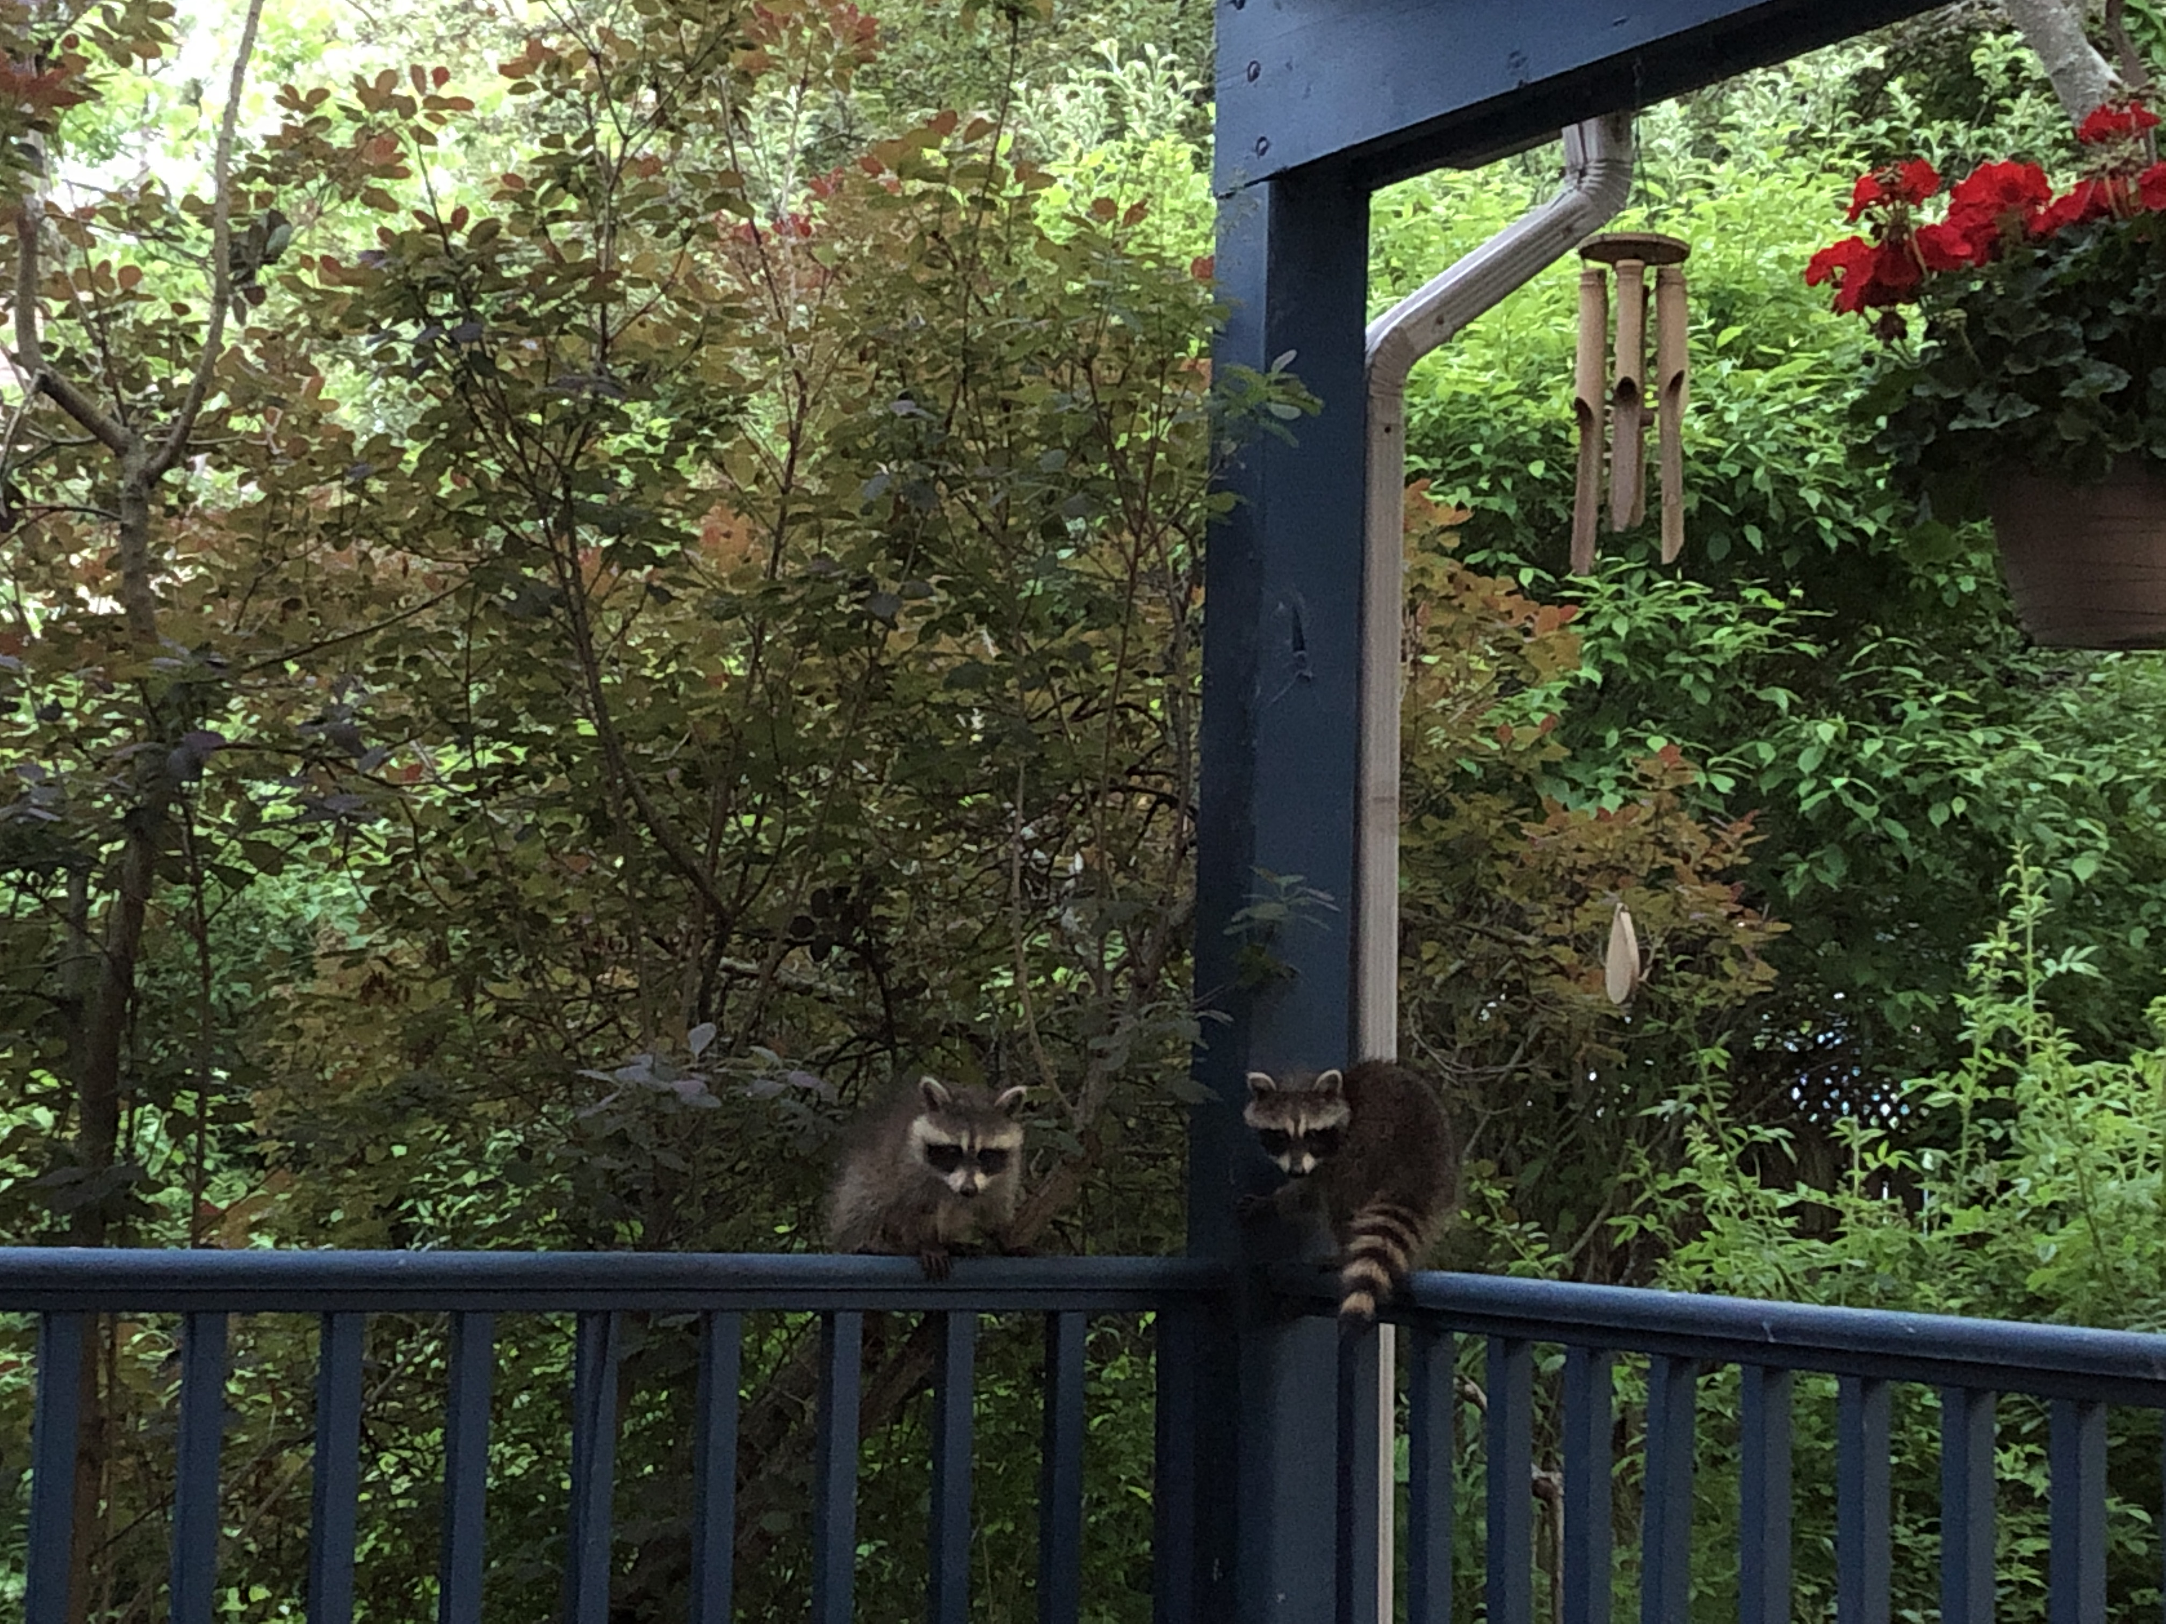
Sharing spaces with nonhumans

Slide 9
Sharing spaces with nonhumans

Slide 10
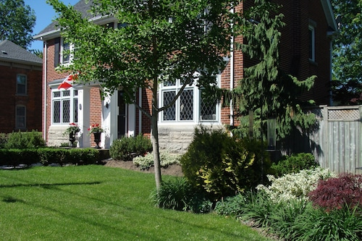
Yards: manicured or wild?

Slide 11
Urban development

Slide 12
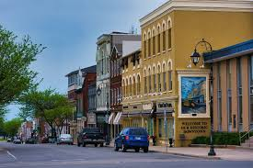
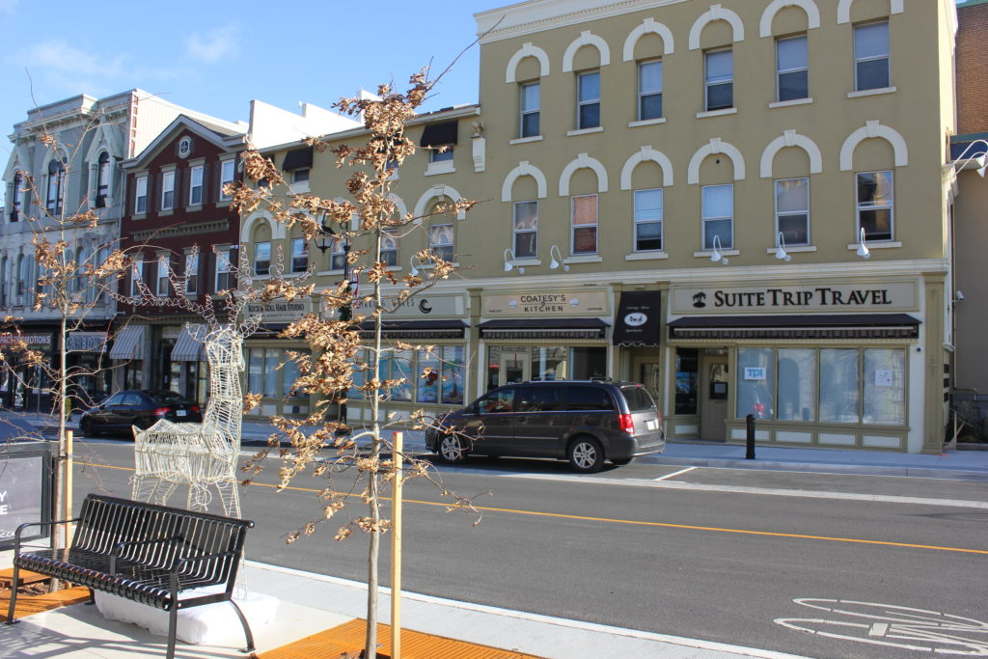
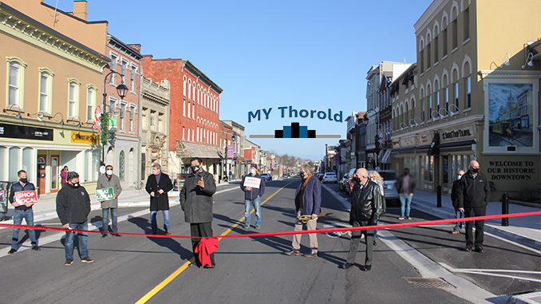
Redesigning downtown Thorold

Slide 13
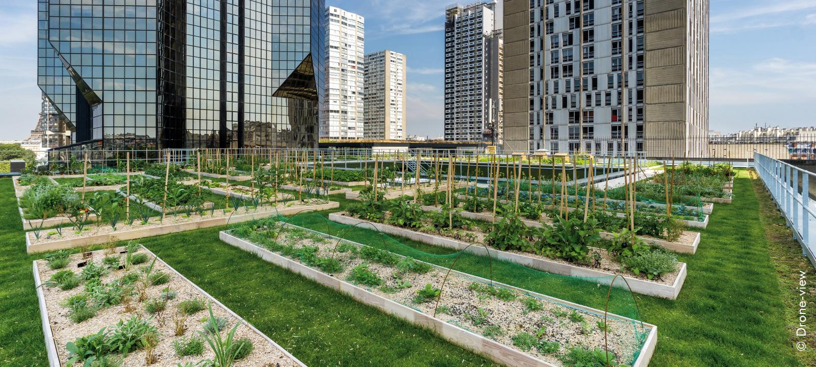
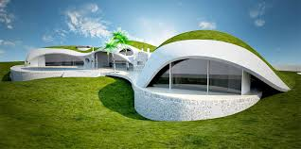
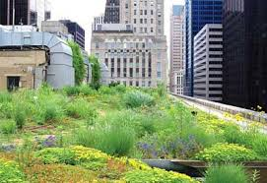
Urban design with posthumanist principles?

