Slide 1
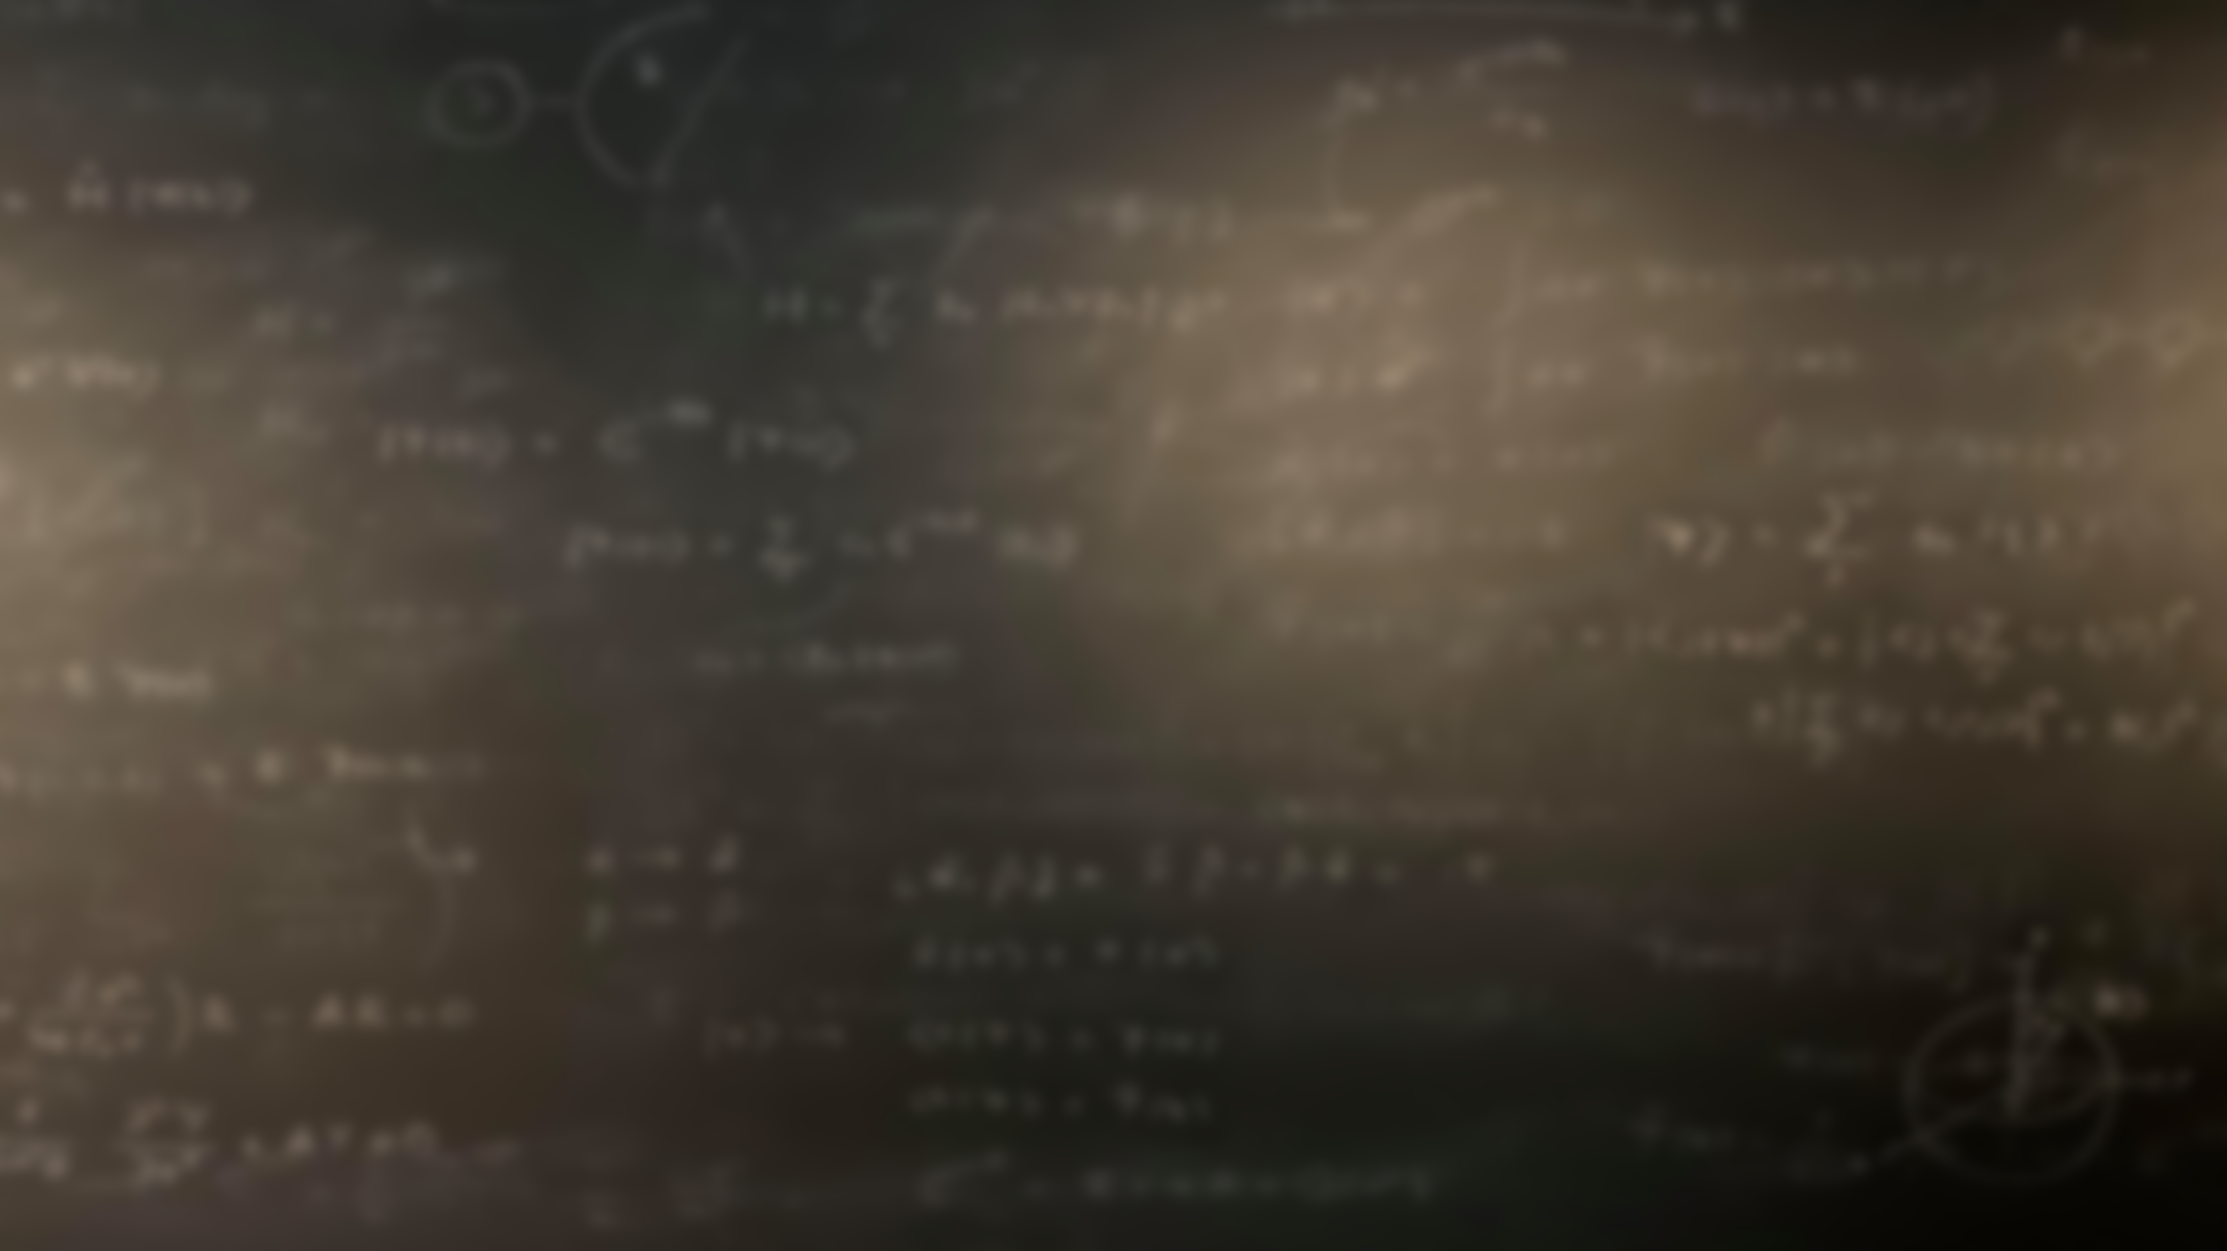
Quantum Mechanics
and Spectroscopy
Lauri Partanen

Slide 2
Physical phenomena that require a quantum mechanical explanation
List two such phenomena on a piece of paper
Discuss in Breakout rooms
Introduce yourself and get to know each other. Discuss With what feelings and expectations are you attending the course. What would you like to learn more about during the course?
Compare your choices for the quantum mechanical phenomena. Explain why quantum mechanics is necessary for the phenomena you chose
Each pair chooses one of such phenomena and explains it to the classroom.

Slide 3
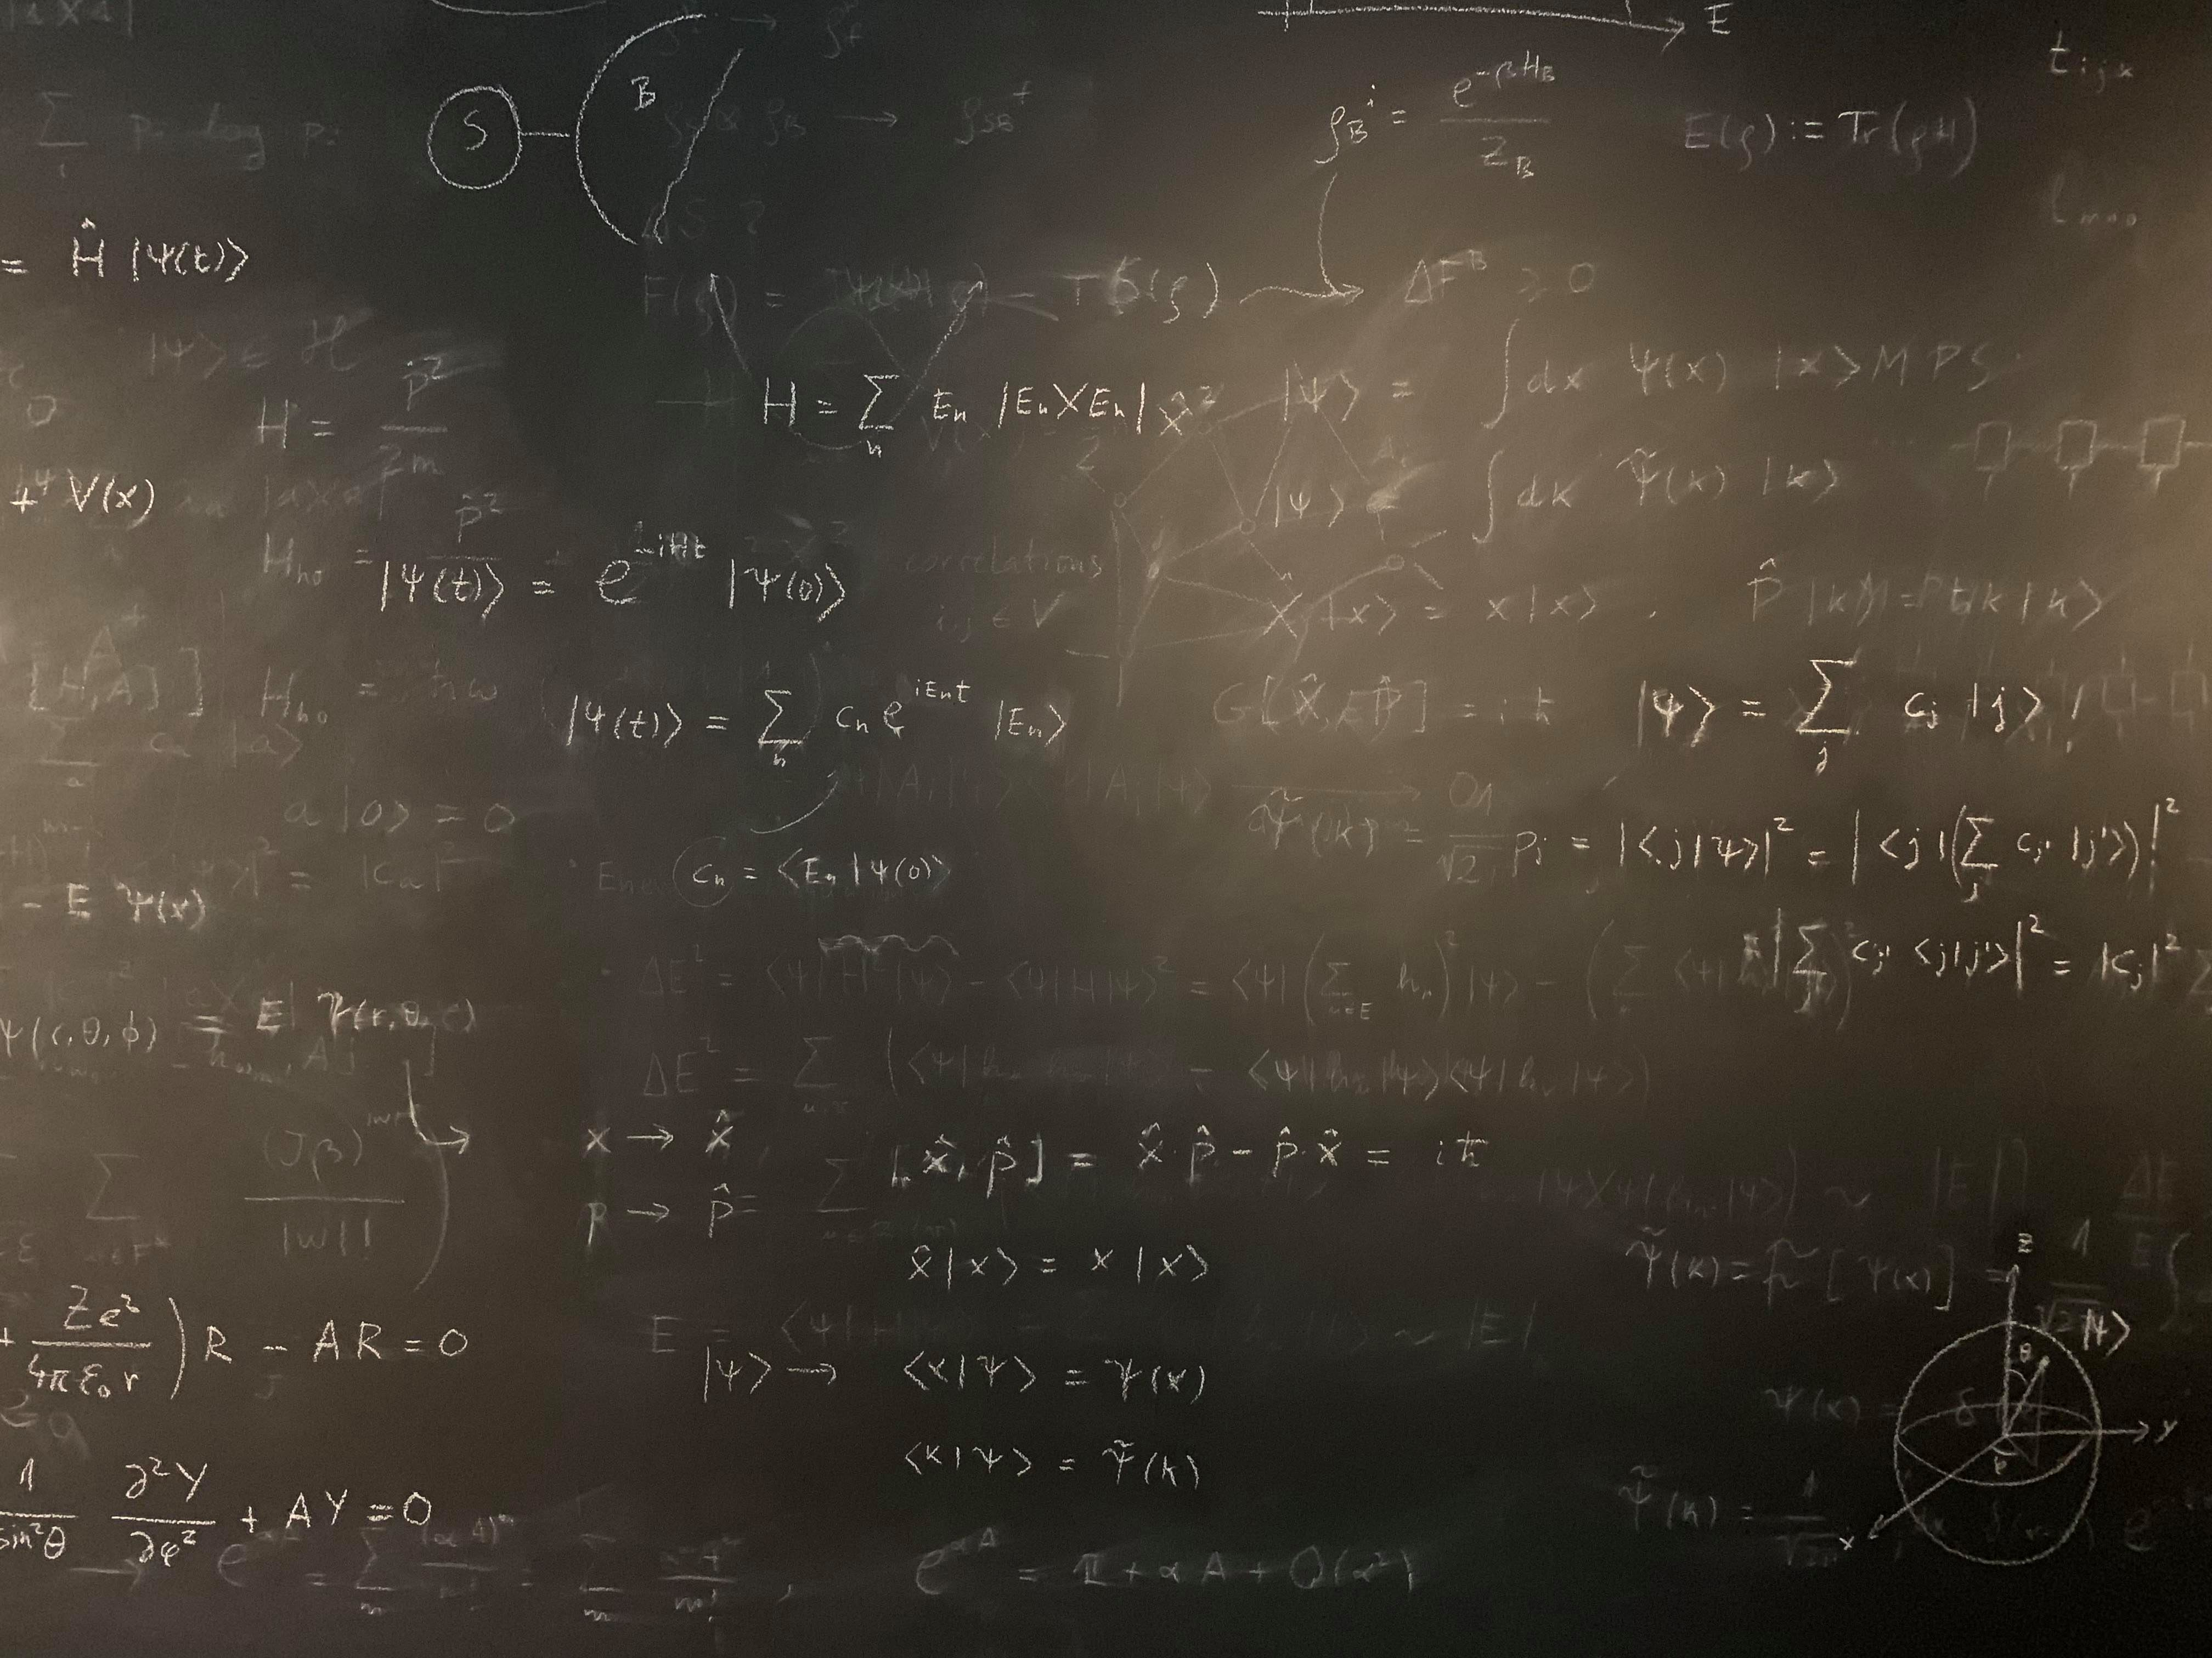
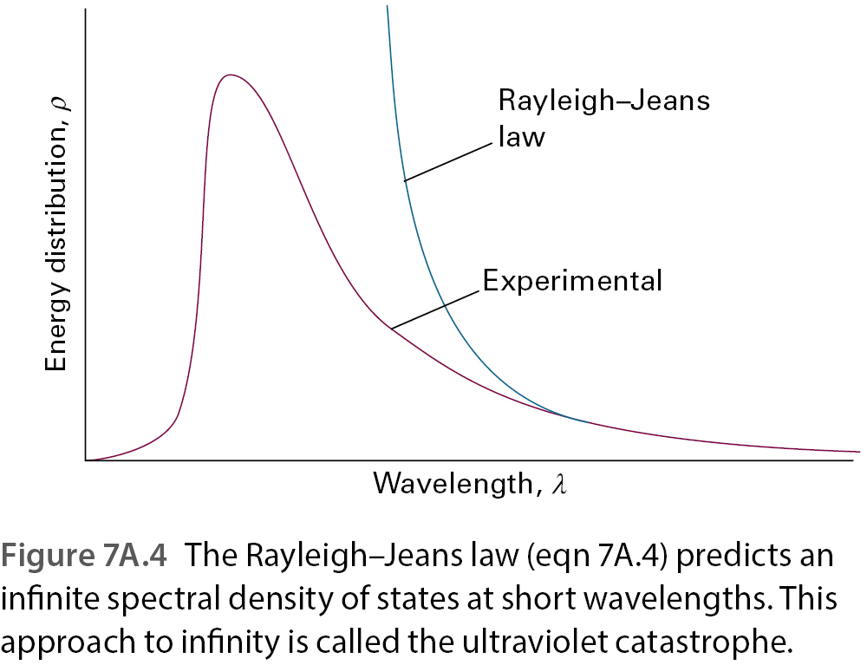
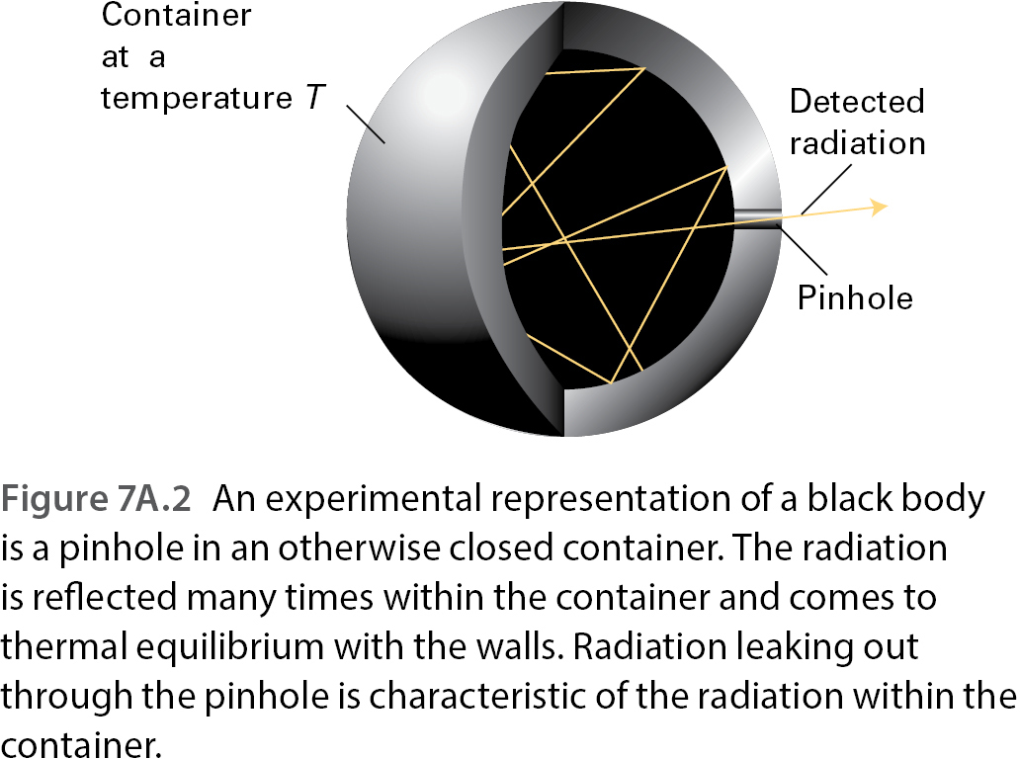
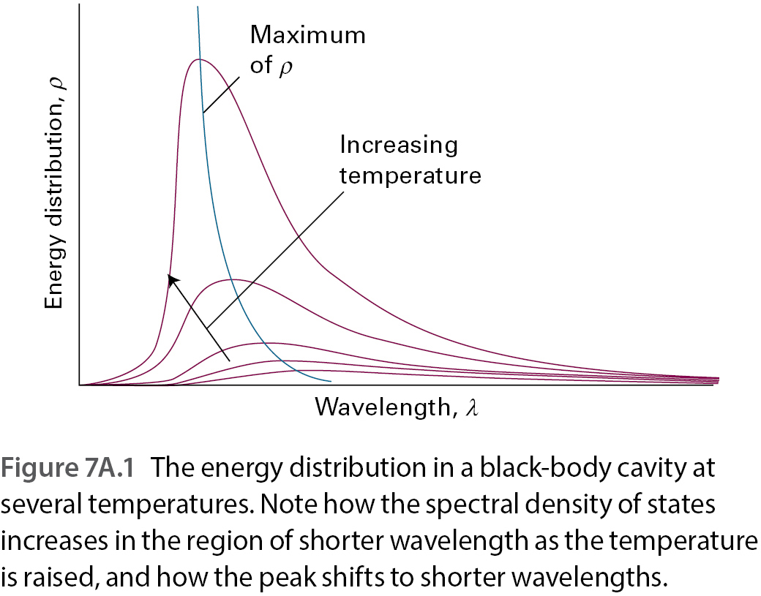
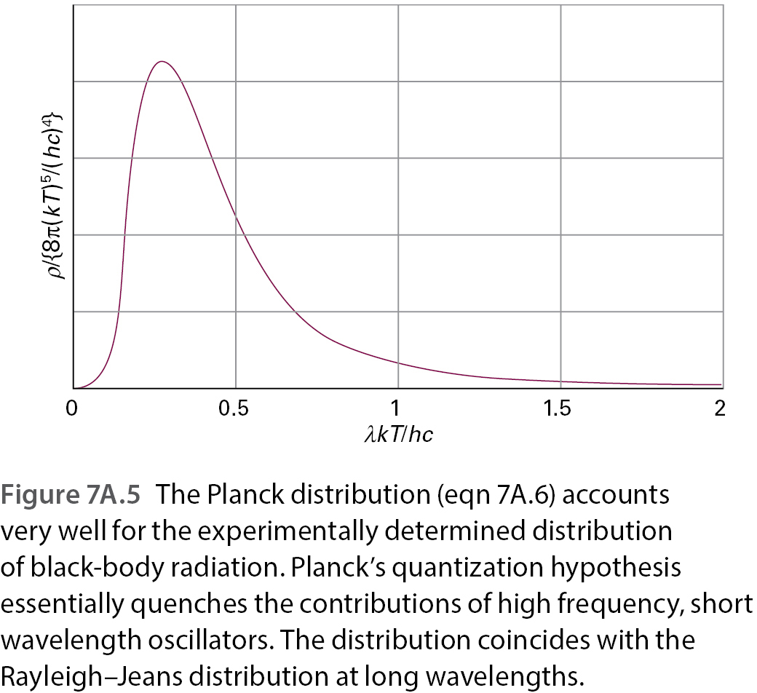
1) Quantization of electromagnetic radiation – the black body

Slide 4
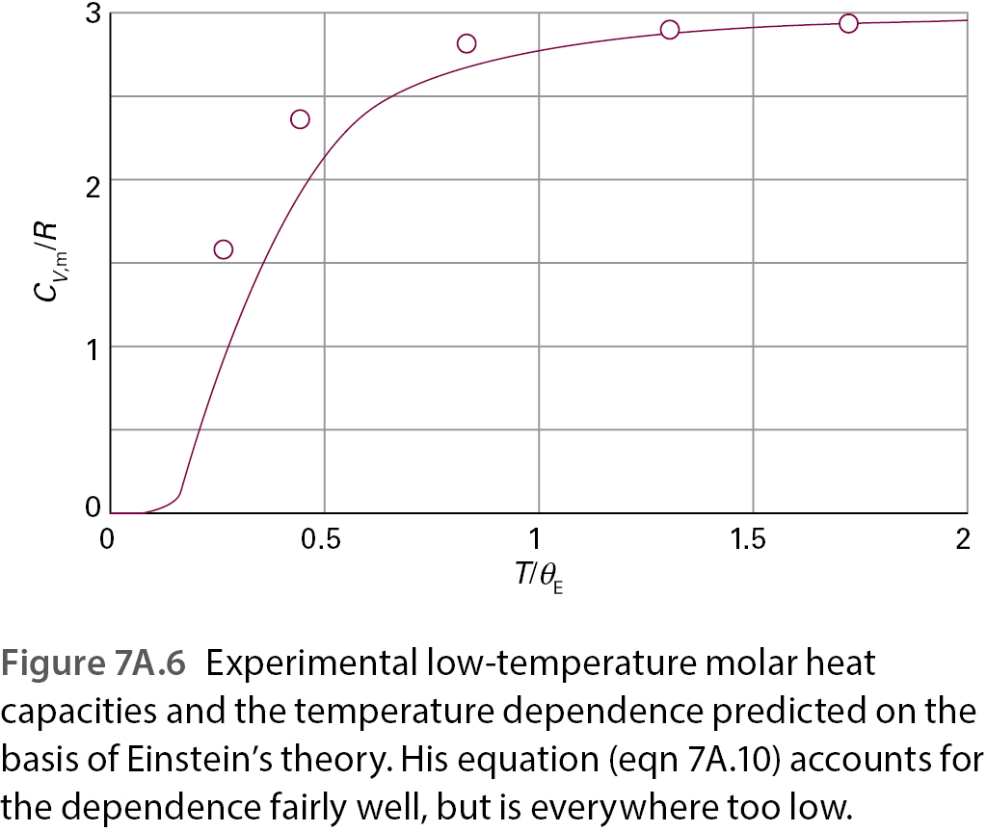
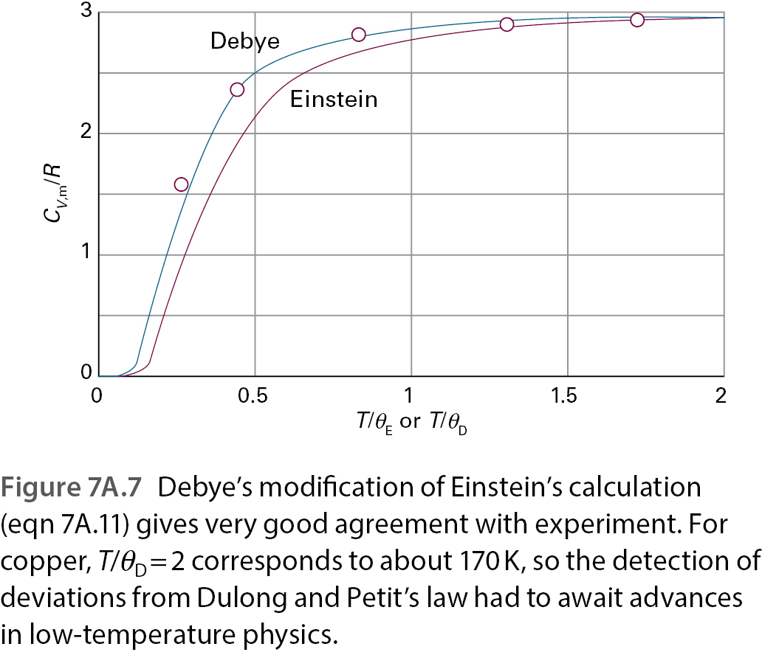
2) Quantization of mechanical motion – low temperature heat capacities
Classical
Experimental
Einstein

Slide 5
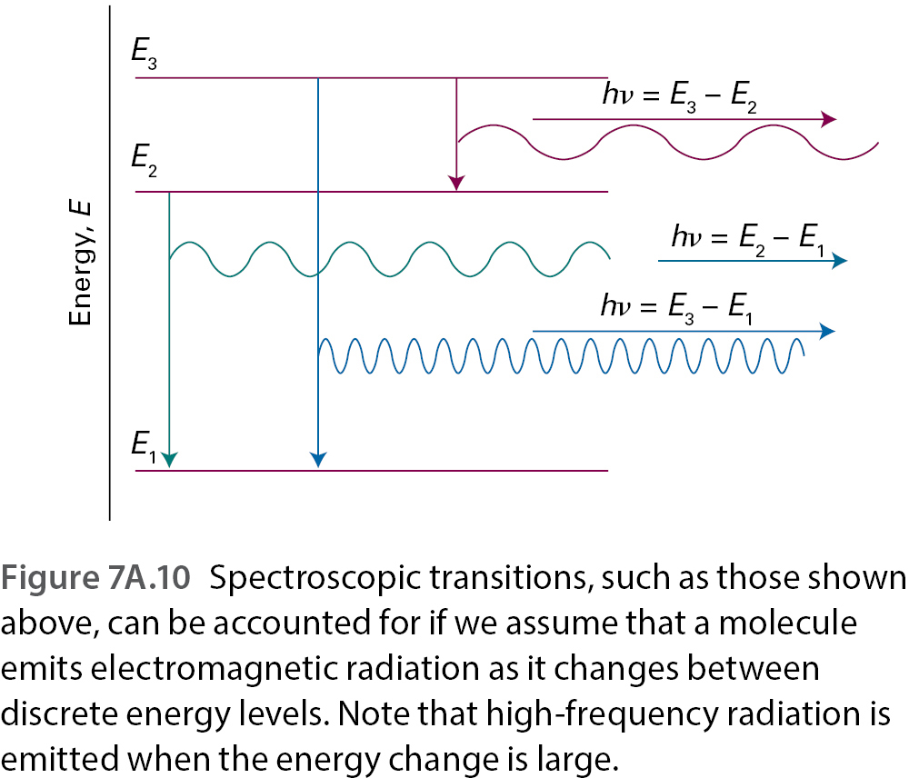
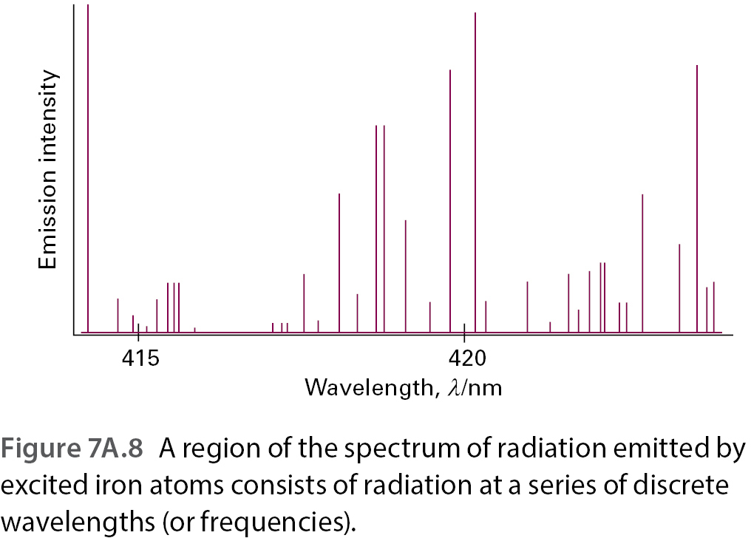
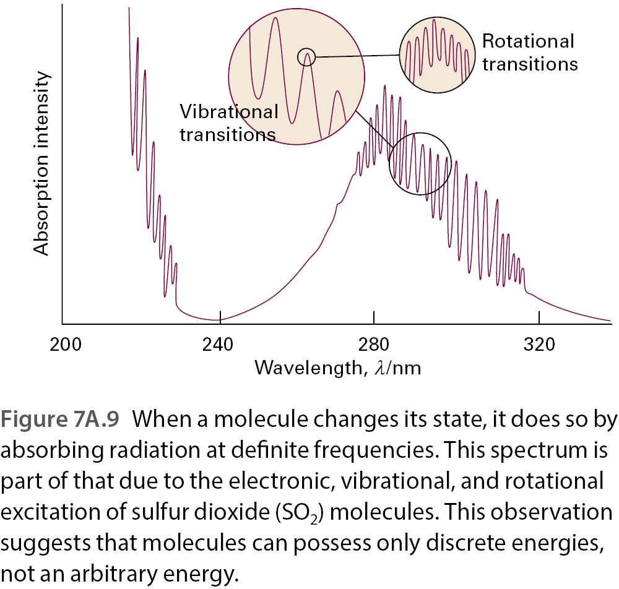
3) Quantization of energy in general – spectroscopy

Slide 6
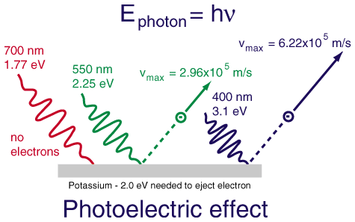
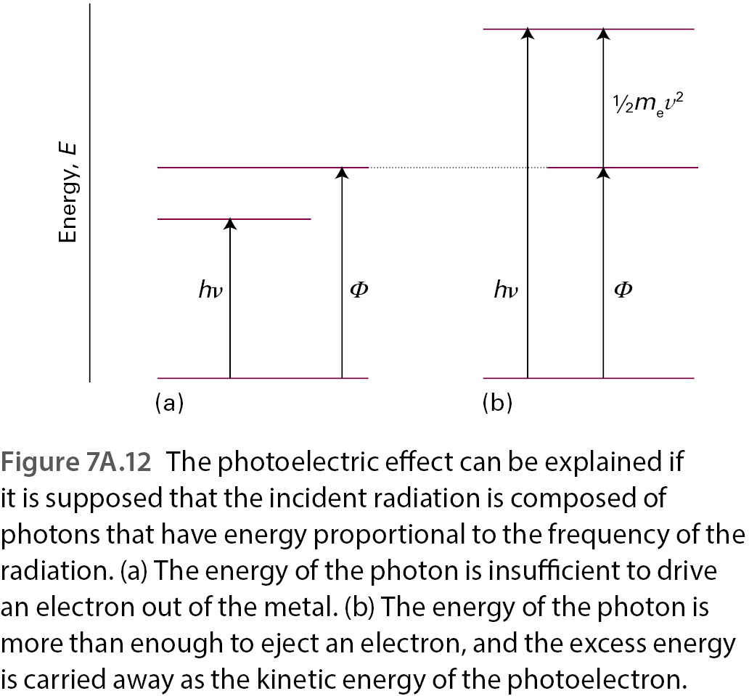
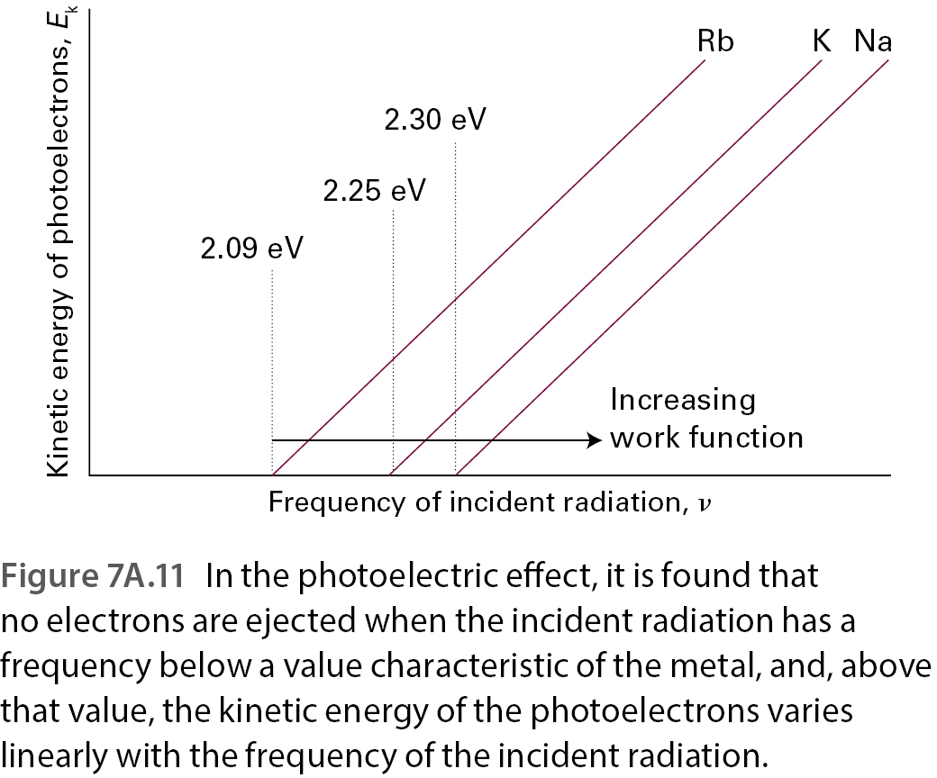
4) Particle nature of electromagnetic radiation – Photoelectric effect
Anon., Photoelectric effect, accessed 8.1.2020., source https://sites.google.com/site/advancedphysicsfortheadvanced/quantum-physics/photoelectric-effect

Slide 7
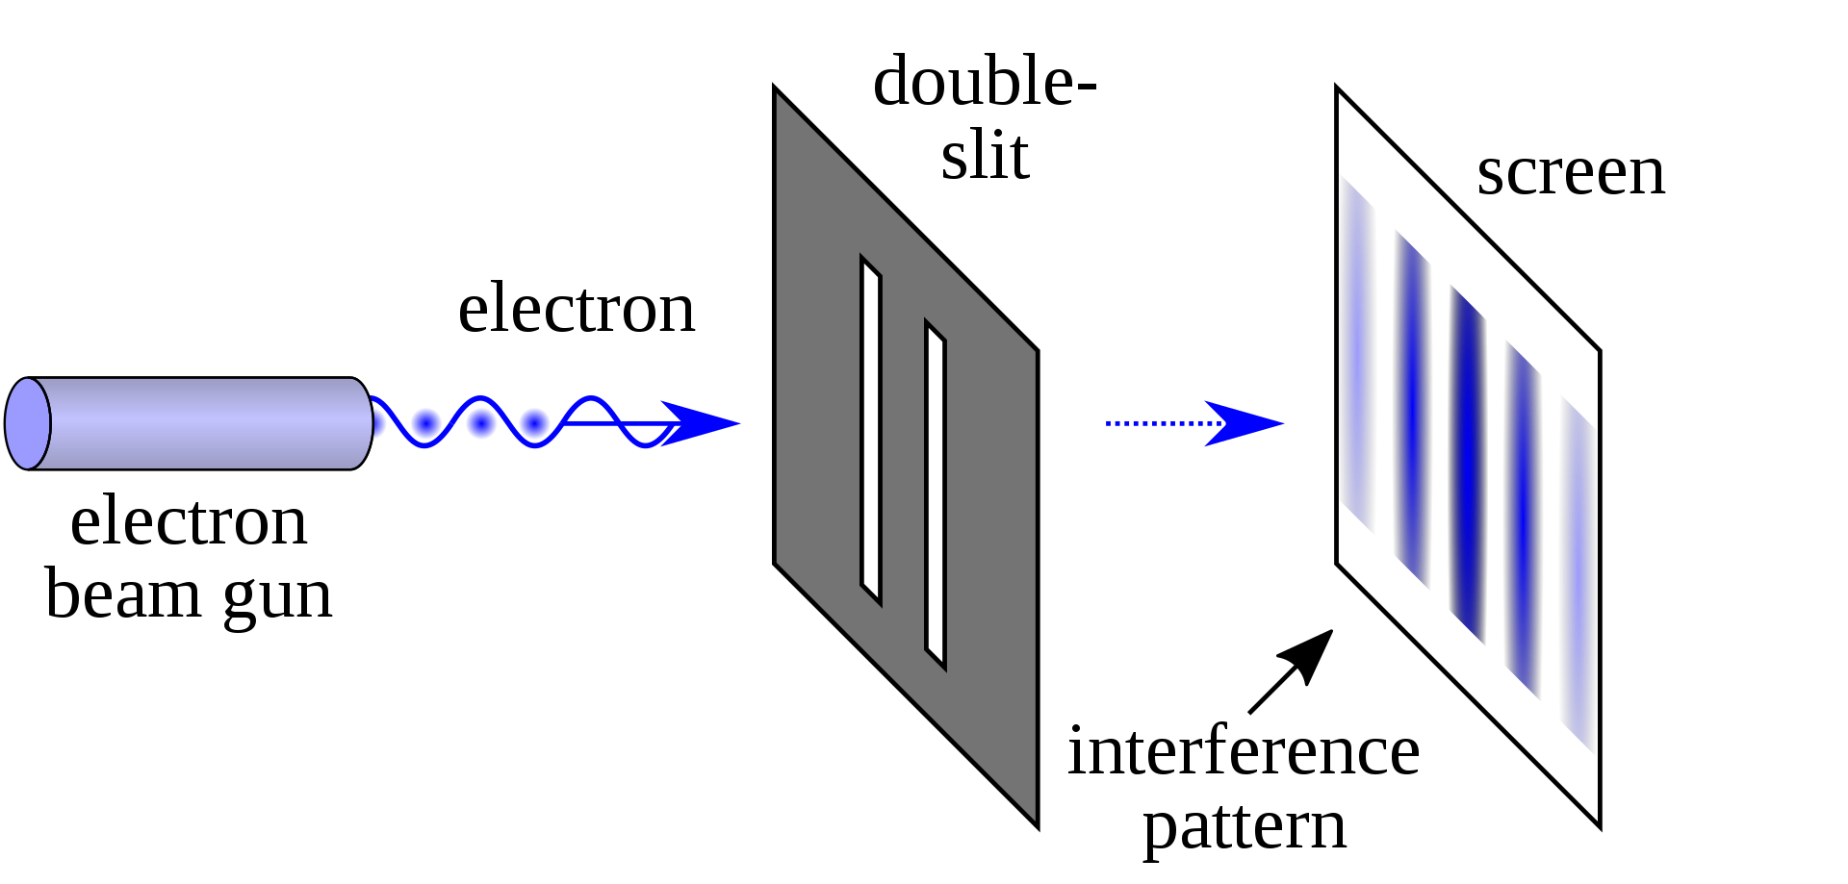
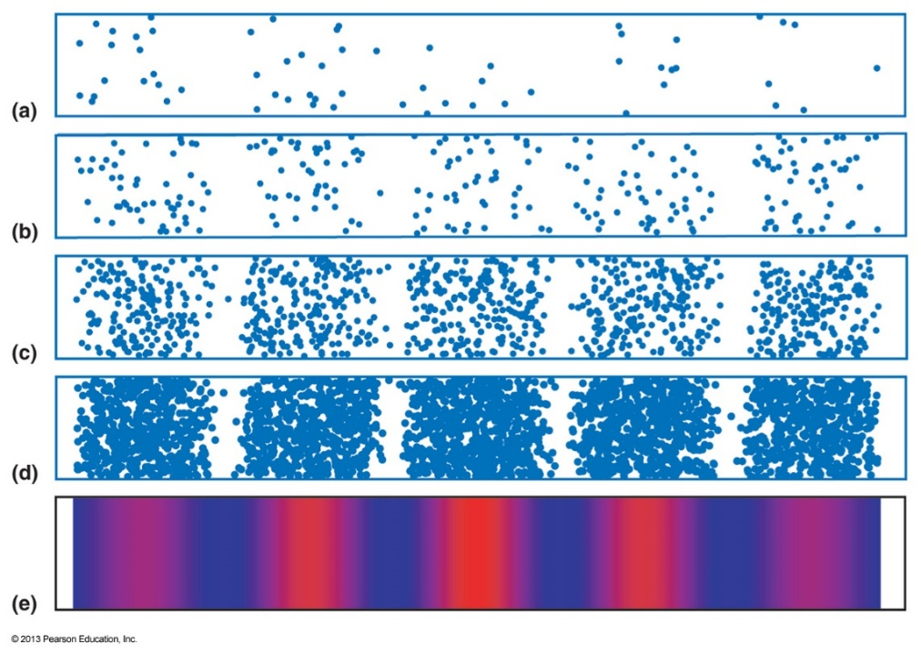
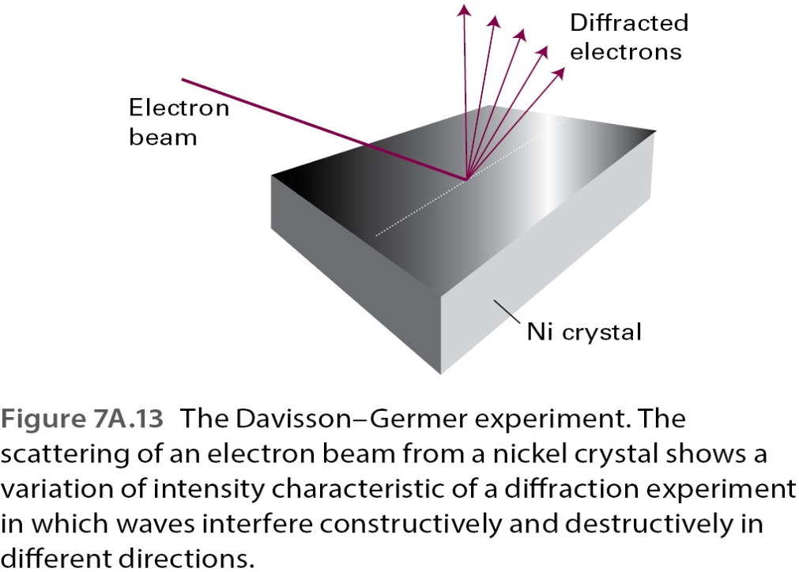
5) Wave nature of particles – Diffraction and slit experiments
¹ NekoJaNekoJa, (2017) Double slit experiment. Accessed 8.1.2020. Source
https://en.wikipedia.org/wiki/Double-slit_experiment#/media/File:Double-slit.svg /CC: https://creativecommons.org/licenses/by-sa/4.0/
² Engel T. ja Reid, P. (2013), Chapter 1 Figure 1.9 Double Slit Experiment [Diagram], Source Quantum Chemistry and Spectroscopy, 3rd edition, Pearson, Harlow, England

Slide 8
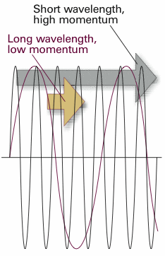
6) Wave - particle duality and the de Broglie wavelength
$$λ=\frac{h}{p}$$

Slide 9
Figure references
Unless otherwise noted all Figures are taken from Chapter 7 of Atkins, P. ja De Paula, J. , L. (2014), Atkins’ Physical Chemistry, 10th edition, Oxford University Press, Oxford, New York. The exact Figure numbers and descriptions are provided under each figure.

