Slide 1
Quantum Mechanics
and Spectroscopy
Lauri Partanen

Slide 2
What is a wavefunction?
Review:
First think by yourself: How would you define a wavefunction? What properties does a wavefunction has to fulfill? (5 mins)
In breakout rooms (10 mins)
Introduce yourself and get to know each other. Discuss your experiences with the first Perusall exercises. What were your impressions of the reading material?
Compare your definitions of the wavefunction. Incoporate aspects from each other’s definition to improve your original ones. List the properties that the wavefunction has to fulfill.

Slide 3
The Schrödinger equation
$$−\frac{ℏ^{2}}{2m}\frac{d^{2}}{dx^{2}}ψ+V\left(x\right)ψ=Eψ$$
Work with your pair:
Identify the different components of the Schrödinger equation
What constraints does fulfilling the Schrödinger equation put on the wavefunction?

Slide 4
Our recipe for success
Since the Schrödinger equation (SE) is the key to the system’s wavefunction we can formulate a strategy for tackling every single quantum mechanical system:
Find out the system’s SE (approximations etc.)
Solve the SE to obtain the wavefunction ψ
Use the wavefunction to calculate all desired properties
Anon., Screen capture from the film The Matrix Reloaded, 2003, accessed 9.1.2020 Source https://www.meme-arsenal.com/en/create/template/1205992
NeonNSX (2008), Screen capture from the film The Matrix Reloaded, 2003, accessed 9.1.2020 Source http://www.nsxprime.com/forum/showthread.php/103101-How-Matrix-Reloaded-should-have-been-with-an-NSX
Lanswyn, Screen capture from the film The Matrix Reloaded, 2003, accessed 9.1.2020 Source https://gifer.com/en/gifs/the-matrix

Slide 5
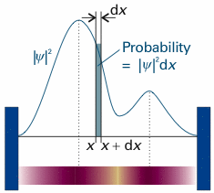
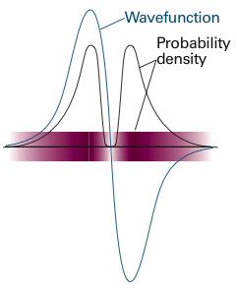
The Born interpretation
Work with your pair:
What is the Born interpretation? What constraints does place on the wavefunction?
What is the role of normalization in quantum mechanics?
The probability of finding the particle from an infinitesimal region $[x, x+dx] is$ proportional to ${\left|ψ\right|}^{2}dx$

Slide 6
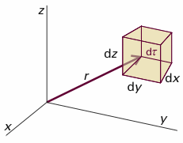
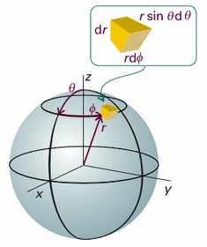
Example: The wavefunction corresponding to the 2p_{z} orbital for hydrogen has the form $ψ_{2p_{z}}=\cos{θ}re^{−\frac{r}{2a}}$
Is this wavefunction normalized? If not, normalize it.

Slide 7
Example: The wavefunction corresponding to the 2p_{z} orbital for hydrogen has the form $ψ_{2p_{z}}=\cos{θ}re^{−\frac{r}{2a}}$
Is this wavefunction normalized? If not, normalize it.

Slide 8
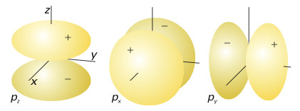
Example: The wavefunction corresponding to the 2p_{z} orbital for hydrogen has the form $ψ_{2p_{z}}=\cos{θ}re^{−\frac{r}{2a}}$
Is this wavefunction normalized? If not, normalize it.
Sketch the probability densities of the wavefunction on the x,y, and z axes. Describe the probabilities of finding the electron in different regions.

Slide 9
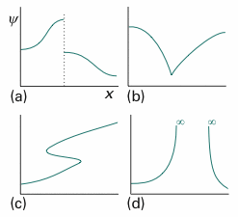
Properties of the wavefunction?
What properties of the wavefunction are not fulfilled in each of these cases?
Not differentiable (not continuous)
Not differentiable (1st derivative does not exist)
Not a function (multivalued)
Not a probability density (infinite value over finite region)

Slide 10
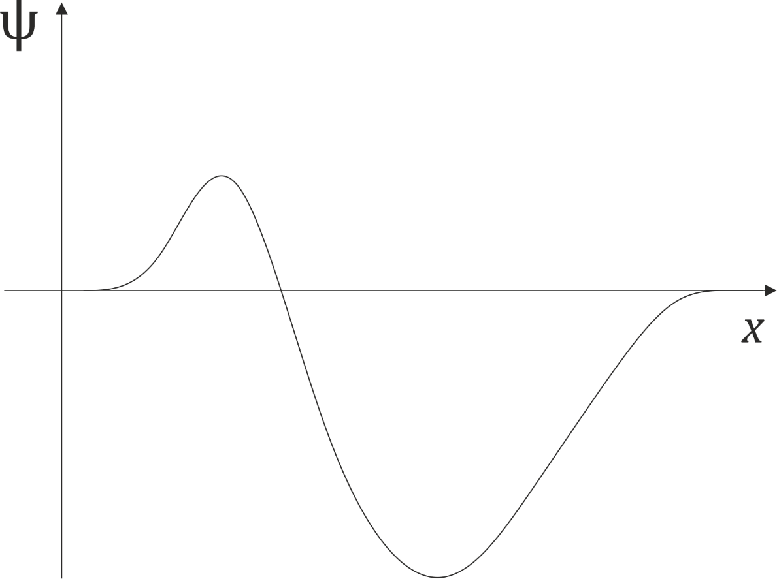
The Born interpretation
The picture on the right describes the wavefunction.
1) Where is the most likely place to find the particle?
2) Is this an ok wavefunction?
Partanen, L. (2016).,Sketch of a possible wavefunction?

Slide 11
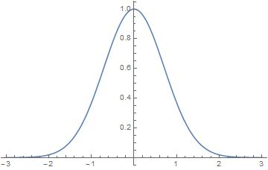
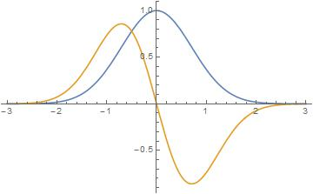
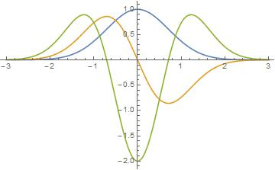
What can the wave function tell us?
Calculate the first and second derivatives of the function $f\left(x\right)=e^{−2x^{2}}$ What do these derivatives tell of the behaviour of the original function?

Slide 12
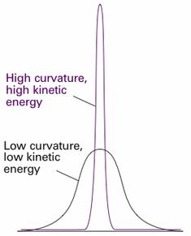
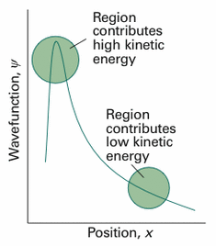
What can the wave function tell us?
In the Schrödinger equation, the second derivative (and thus the curvature of the wavefunction) is related to the kinetic energy of the particle: $\hat{T}=−\frac{ℏ^{2}}{2m}\frac{d^{2}}{dx^{2}}$

Slide 13
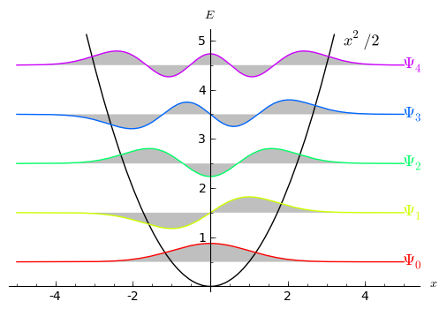
Discussion: A CO molecule at it’s lowest vibrational state (constant total energy) has the wavefunction depicted by the red curve in the picture. What can you say about its kinetic and potential energies in different regions?

Slide 14
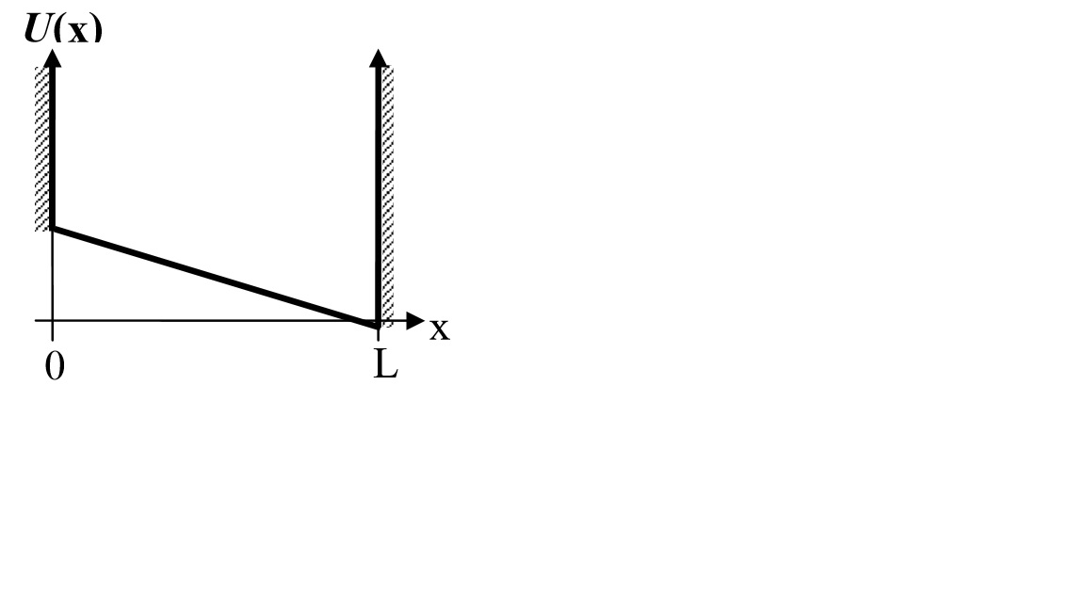
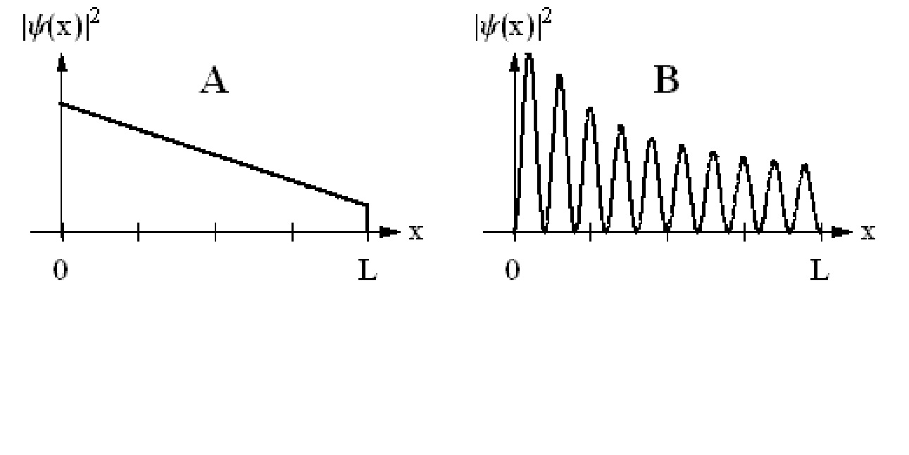
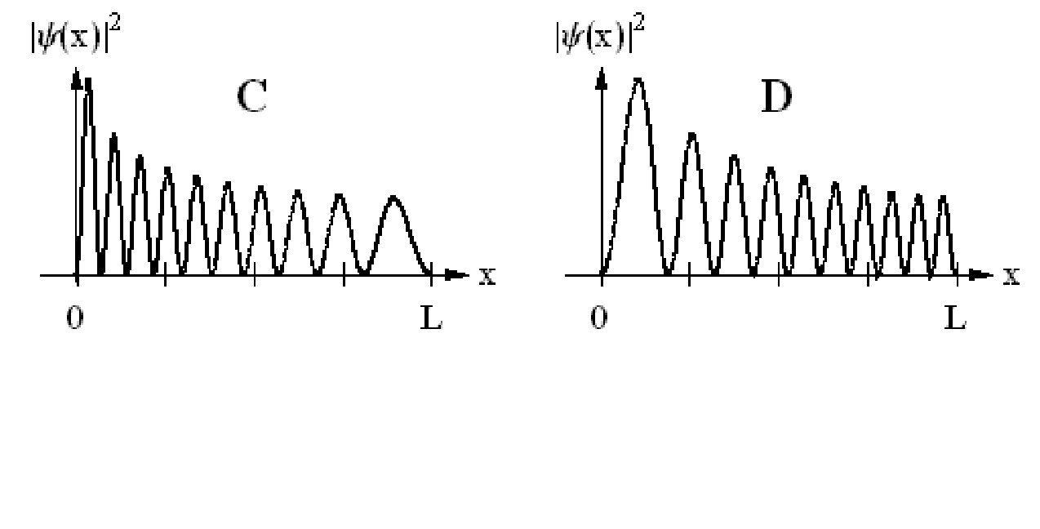
Presemo: A particle is in a potential hole as depicted on the right on an energy level E, which of the given wavefunctions best describes this state?
A
B
C
D
More info is required
No clue
Notes:
Vaatii johdantopohdintatehtävän

Slide 15
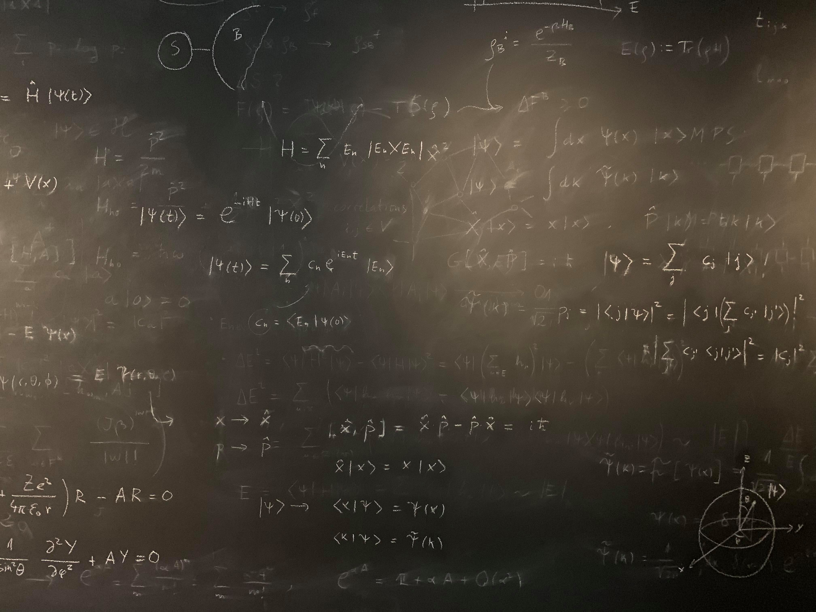
Figure references
Unless otherwise noted all Figures are taken from Chapter 7 of Atkins, P. ja De Paula, J. , L. (2014), Atkins’ Physical Chemistry, 10th edition, Oxford University Press, Oxford, New York.

