Slide 1
Quantum Mechanics
and Spectroscopy
Lauri Partanen

Slide 2
Stop and think: (5 mins):
Write down the complete Schrödinger equation for helium. What do the different terms signify?
$$−\frac{ℏ^{2}}{2m_{n}}∇_{n}^{2}ψ−\frac{ℏ^{2}}{2m_{e1}}∇_{e1}^{2}ψ−\frac{Ze^{2}}{4πε_{0}r_{e1,n}}ψ−\frac{ℏ^{2}}{2m_{e}}∇_{e2}^{2}ψ−\frac{Ze^{2}}{4πε_{0}r_{e2,n}}ψ+\frac{e^{2}}{4πε_{0}r_{e1,e2}}ψ=E_{tot}ψ$$
Kinetic energy of the nucleus
Interaction potential energy of electron 1 and the nucleus
Interaction potential energy of electron 2 and the nucleus
The repulsion interaction potential energy of electrons 1 and 2
Kinetic energy of electron 1
Electron 2 kinetic energy

Slide 3
Work with your pair: (5 mins):
After separating out the movement of the center of mass the SE for the movement of electrons around the nucleus becomes
$$\hat{H}ψ=−\frac{ℏ^{2}}{2m_{e1}}∇_{e1}^{2}ψ−\frac{Ze^{2}}{4πε_{0}r_{e1,n}}ψ−\frac{ℏ^{2}}{2m_{e}}∇_{e2}^{2}ψ−\frac{Ze^{2}}{4πε_{0}r_{e2,n}}ψ+\frac{e^{2}}{4πε_{0}r_{e1,e2}}ψ=Eψ$$
What is the orbital approximation and how is it related to this Schrödinger equation?
What consequences does the orbital approximation have for the wavefunction?

Slide 4
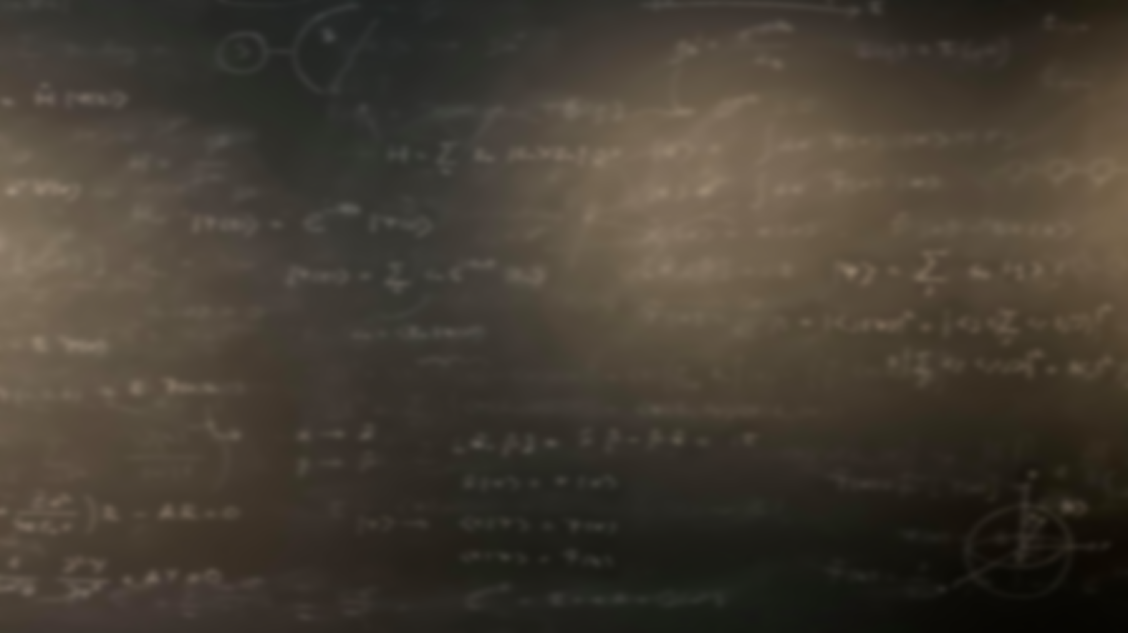
$$\hat{H}ψ=−\frac{ℏ^{2}}{2m_{e1}}∇_{e1}^{2}ψ−\frac{Z_{eff}e^{2}}{4πε_{0}r_{e1,n}}ψ−\frac{ℏ^{2}}{2m_{e}}∇_{e2}^{2}ψ−\frac{Z_{eff}e^{2}}{4πε_{0}r_{e2,n}}ψ=Eψ$$
$$\hat{H}ψ=−\frac{ℏ^{2}}{2m_{e1}}∇_{e1}^{2}ψ−\frac{Ze^{2}}{4πε_{0}r_{e1,n}}ψ−\frac{ℏ^{2}}{2m_{e}}∇_{e2}^{2}ψ−\frac{Ze^{2}}{4πε_{0}r_{e2,n}}ψ+\frac{e^{2}}{4πε_{0}r_{e1,e2}}ψ=Eψ$$
Separation of electronic motion
$$ψ\left(r_{e1},r_{e2}\right)=ψ\left(r_{e1} \right)ψ\left(r_{e2} \right)$$

Slide 5
Work with your pair: (10 mins):
Write out the ground state of Helium using the orbital approximation.
Describe the concept of spin. How are particles classified in terms of their spin?

Slide 6
“Mathematically, spin behaves analogously to an angular momentum. For an electron, the spin quantum number $s=\frac{1}{2}$, and hence the spin magnetic quantum number can have two values $m_{s}=−\frac{1}{2}$ and $\frac{1}{2}$. These correspond to spin eigenfunctions $β$ and $α$, respectively.“
Example: Based on the above text calculate the following operators and integrals
$${\hat{s}}^{2}β$$
$${\hat{l}}^{2}Y_{l,m_{l}}=ℏ^{2}l\left(l+1\right)Y_{l,m_{l}}$$
$${\hat{s}}^{2}α$$
$${\hat{s}}_{z}β$$
$${\hat{s}}_{z}α$$
$$\int_{σ}{β^{∗} }βⅆσ$$
$$\int_{σ}{α^{∗} }αⅆσ$$
$$\int_{σ}{β^{∗} }αⅆσ$$
$${\hat{l}}_{z}Y_{l,m_{l}}=m_{l}ℏY_{l,m_{l}}$$
$$\int_{σ}{α^{∗} }βⅆσ$$

Slide 7
$${\hat{s}}^{2}α=ℏ^{2}\frac{1}{2}\left(\frac{1}{2}+1\right)α=\frac{3}{4}ℏ^{2}α$$
$${\hat{s}}^{2}β=ℏ^{2}\frac{1}{2}\left(\frac{1}{2}+1\right)β=\frac{3}{4}ℏ^{2}β$$
$${\hat{l}}^{2}Y_{l,m_{l}}=ℏ^{2}l\left(l+1\right)Y_{l,m_{l}}$$
$${\hat{s}}_{z}α=\frac{ℏ}{2}α$$
$${\hat{s}}_{z}β=−\frac{ℏ}{2}β$$
$${\hat{l}}_{z}Y_{l,m_{l}}=m_{l}ℏY_{l,m_{l}}$$
Note! $σ$ is a spin variable so the integration is not over spatial coordinates!
$$\int_{σ}{α^{∗} }βⅆσ=\int_{σ}{β^{∗} }αⅆσ=0$$
$$\int_{σ}{α^{∗} }αⅆσ=\int_{σ}{β^{∗} }βⅆσ=1$$

Slide 8
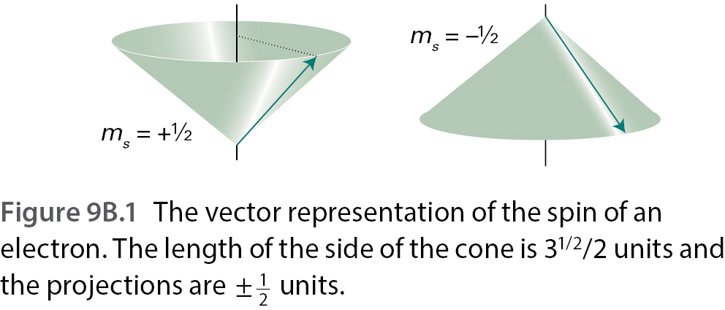

Slide 9
Work with your pair: (5 mins):
Explain the Pauli principle.
Write down the explicit form of the ground state wave function for He, when $ψ_{1s}\left(r_{1}\right)=R_{1,0}\left(r_{1}\right)Y_{0,0}\left(θ_{1},φ_{1}\right)$ with $Z$ replaced by $Z_{eff}$. (You don’t need to open the $ψ_{1s}\left(r\right)$ functions). Remember to include spin!
$$ψ_{1s}\left(r_{1}\right)=R_{1,0}\left(r_{1}\right)Y_{0,0}\left(θ_{1},φ_{1}\right)$$
Atomic orbital
Sign remains under exchange of fermions!
$$ψ\left(r_{1},r_{2}\right)=ψ_{1s}\left(r_{1}\right)ψ_{1s}\left(r_{2}\right) σ_{−}\left(2,1\right)$$
Singlet!
Spin function
Sign changes under exchange of fermions!
$$σ_{−}\left(2,1\right)=\frac{1}{\sqrt{2}}[α\left(2\right)β\left(1\right)−β\left(2\right)α\left(1\right)]$$
Superposition because the electrons are indistinguishable!

Slide 10
Stop to think (5 mins)
Write down the complete wavefunctions for an excited 1s¹2s¹ He-atom.
$$ψ_{1s}\left(r_{1}\right)=R_{1,0}\left(r_{1}\right)Y_{0,0}\left(θ_{1},φ_{1}\right)$$
Atomic orbital
Sign changes upon electron exchange
$$ψ\left(r_{1},r_{2}\right)=\frac{1}{\sqrt{2}}\left[ψ_{1s}\left(r_{1}\right)ψ_{2s}\left(r_{2}\right)−ψ_{2s}\left(r_{1}\right)ψ_{1s}\left(r_{2}\right)\right] σ_{+}\left(2,1\right)$$
Sign cannot change upon electron exchange due to Pauli principle!
Superposition because electrons are indistinguishable!
Spin function
Superposition because electrons are indistinguishable!
$$σ_{+}\left(2,1\right)=\left\{\begin{matrix}α\left(2\right)α\left(1\right) \\ \frac{1}{\sqrt{2}}[α\left(1\right)β\left(2\right)+β\left(1\right)α\left(2\right)] \\ β\left(2\right)β\left(1\right)\end{matrix}\right.$$
Triplet!

Slide 11
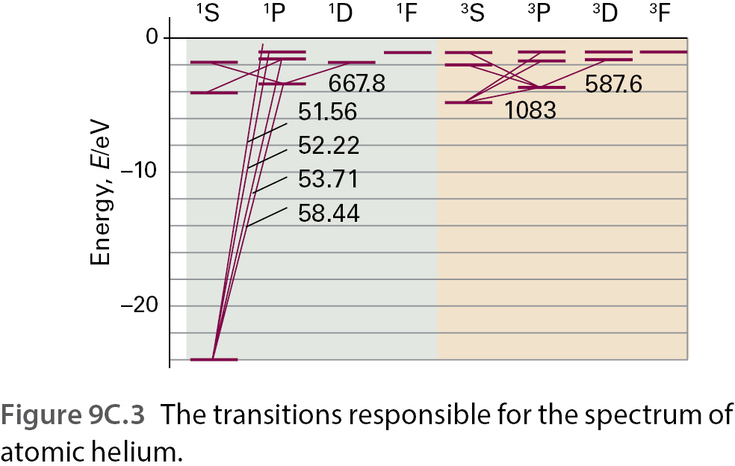
Work with your pair: (10 mins):
As discussed in the last slide, He has two possible excited 1s¹2s¹ states: the singlet and the triplet. Which one is lower in energy and why?

Slide 12
Work with your pair: (10 mins):
Explain the concepts of shielding, penetration, and spin correlation how are these related to the build-up principle?
Write down the electron configurations for the atoms Li-Ne as accurately as you can.

Slide 13
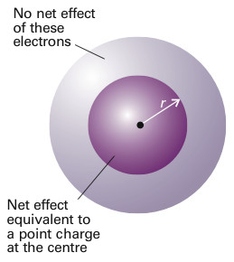
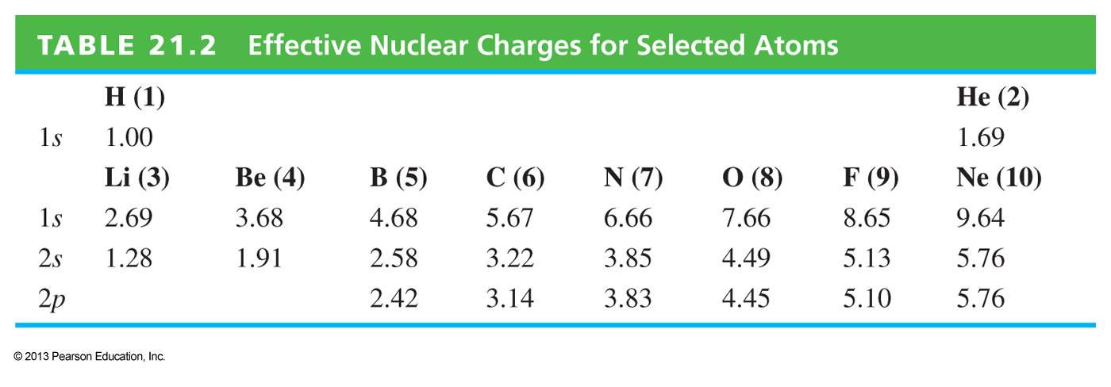
$$Z_{eff}=Z−σ$$
Shielding constant

Slide 14
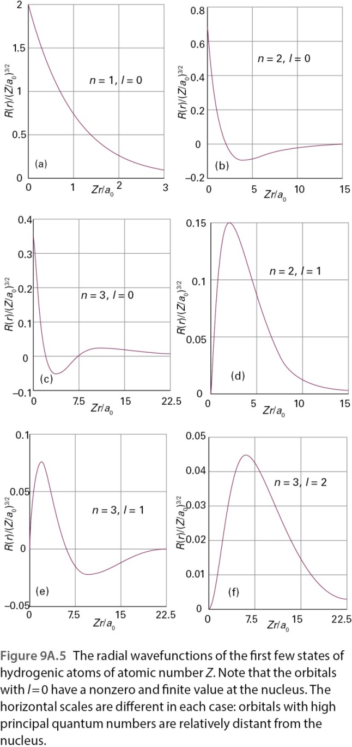
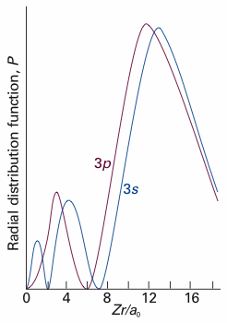
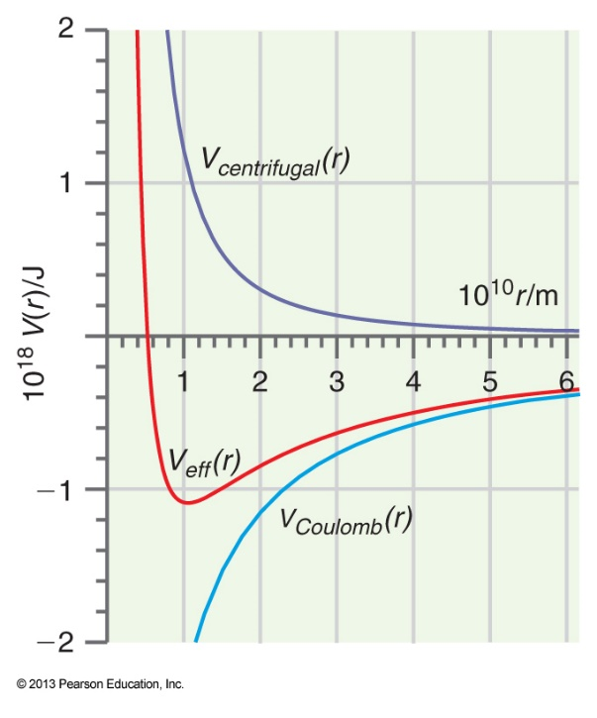
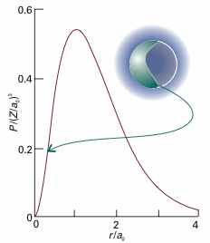
When $l>0$ the repulsive angular momentum term forces the electrons further away from the nucleus
$$V_{eff}=−\frac{Ze^{2}}{4πε_{0}r}+\frac{{l\left(l+1\right)ℏ}^{2}}{2μr^{2}}$$
$$P\left(r\right)=r^{2}R^{2}\left(r\right)$$
Penetration

Slide 15
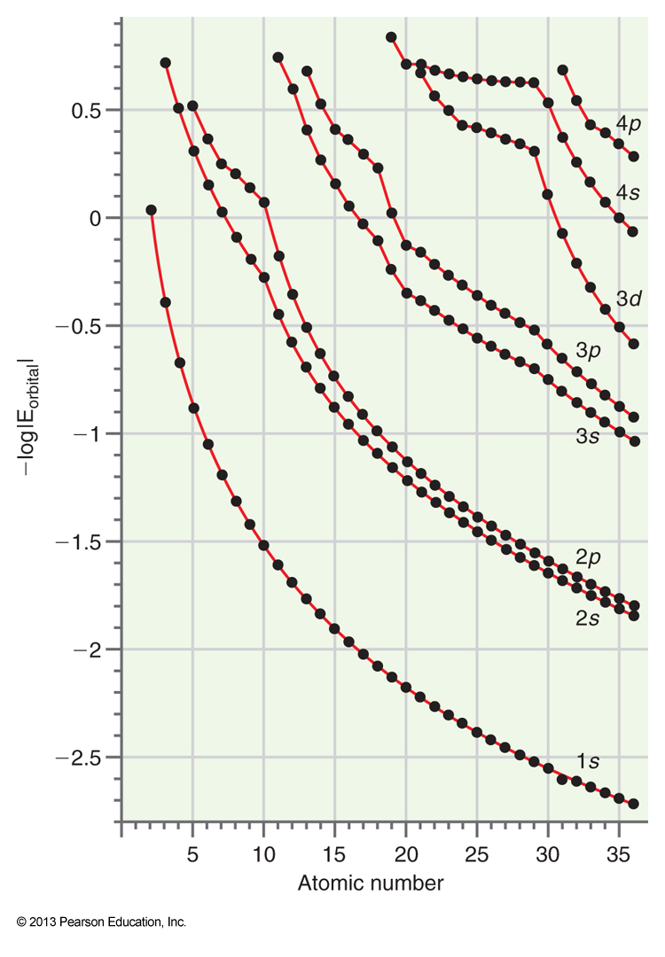
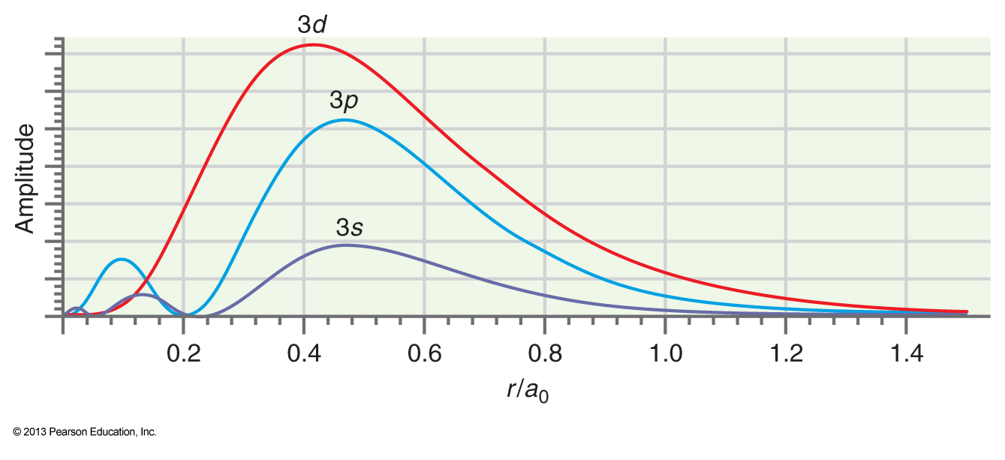

Slide 16
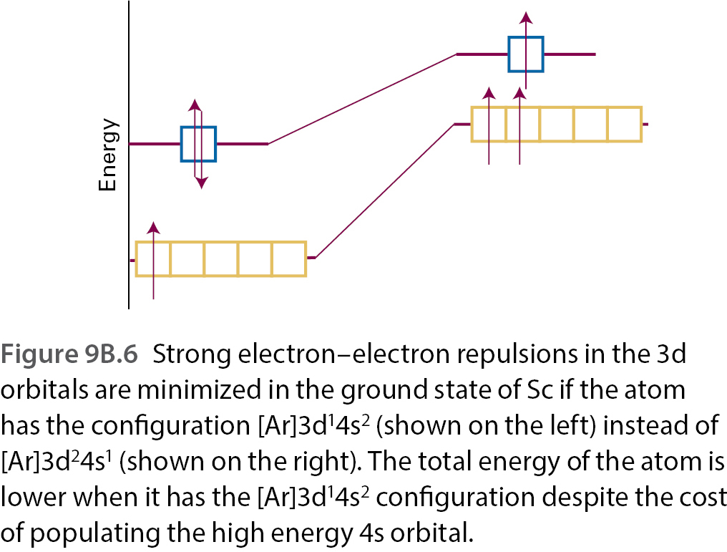
Work with your pair: (15 mins):
Look at the plot of the orbital energies on the right. What would you expect to be the electron configuration of Scandium ($Z=21$) based on this figure?
The actual configuration is [Ar]3d¹4s². Explain this difference.

Slide 17
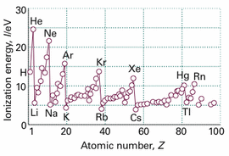
Work with your pair: (15 mins):
Below is a plot of the first ionization energies of elements. Explain the trends you observe.
Give examples of other properties that show periodicities for elements.

Slide 18
Figure references
Unless otherwise noted all Figures are taken from Chapter 7 of Atkins, P. ja De Paula, J. , L. (2014), Atkins’ Physical Chemistry, 10th edition, Oxford University Press, Oxford, New York.

