Slide 1
Quantum Mechanics
and Spectroscopy
Lauri Partanen

Slide 2
Work with your pair: (5 mins):
What kind of models for chemical bonds have you encountered thus far in your studies? Describe the focus of each of them briefly.
How are chemical bonds most accurately depicted using quantum mechanics? How is the wavefunction represented in this approach?
What is the variational principle and how is it related to the calculation of expectation values? How is it related to molecular orbitals?

Slide 3
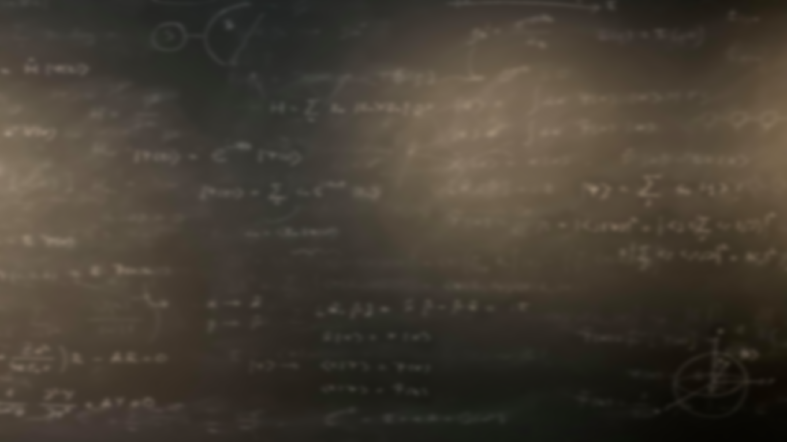
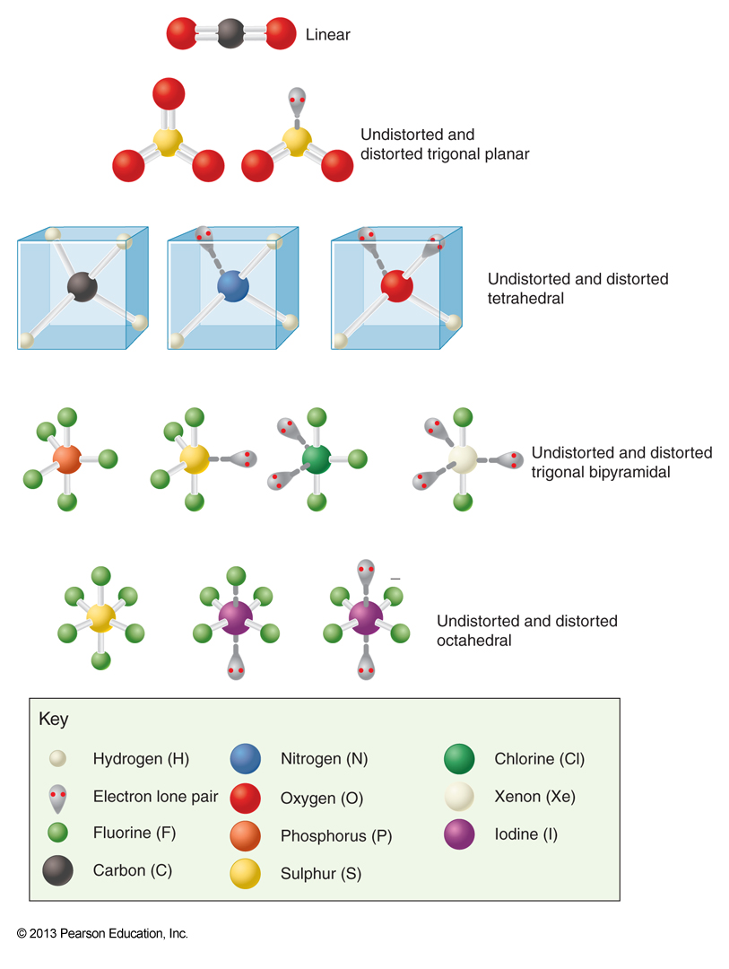
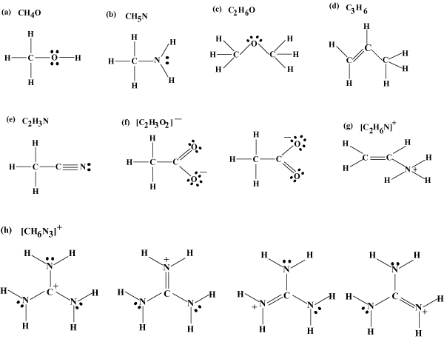
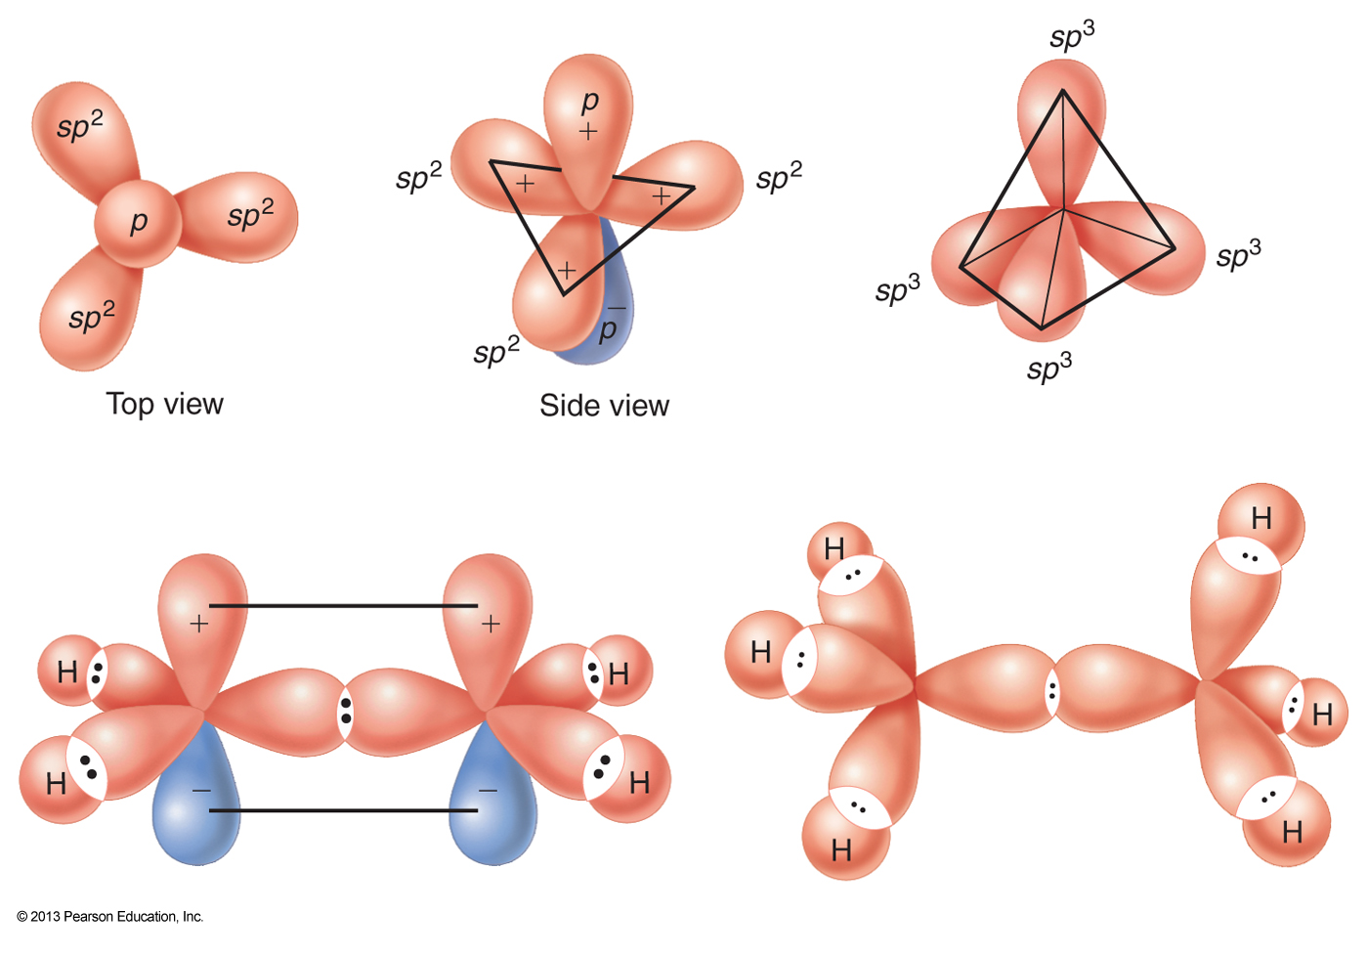
Lewis structures highlight the formation of spin pairs and free electrons
Issues in the depiction of molecular geometry
VSEPR-model provides a quantitative description of molecular geometry
Valence bond theory enables the rudimentary quantum mechanical description of the chemical bond

Slide 4
$$E_{0}=\frac{\int{ψ_{0}^{∗}\hat{H}ψ_{0}dτ }}{\int{ψ_{0}^{∗}ψ_{0}dτ }}$$
$$\left\langle \hat{A}\right\rangle =\frac{\int{ψ^{∗}\hat{A}ψdτ }}{\int{ψ^{∗}ψdτ }}$$
The expectation value of $\hat{A}$ could be calculated from:
The variational principle states that for any guess of the true wavefunction $Φ$, the expectation value for the energy is always greater than or equal to the ground state energy:
$$E=\frac{\int{Φ^{∗}\hat{H}Φdτ }}{\int{Φ^{∗}Φdτ }}≥E_{0}$$
By including variable parameters in our guess for the wavefunction and minimizing the energy with respect to these parameters we can find the optimal depiction of the true wavefunction for our initial guess.

Slide 5
Stop to think: Let’s approximate the ground state of the particle in a box with two different functions. Which one will give give an energy that is closest to the true ground state value?
$$Φ_{1}\left(x\right)=\left(\frac{x}{L}−\frac{x^{3}}{L^{3}}\right)$$
$$Φ_{2}\left(x\right)=\left(\frac{x}{L}−\frac{x^{3}}{L^{3}}\right)+α\left(\frac{x^{5}}{L^{5}}−\frac{1}{2}\left(\frac{x^{7}}{L^{7}}+\frac{x^{9}}{L^{9}}\right)\right)$$
parameter
$Φ_{1}\left(x\right)$
$Φ_{2}\left(x\right)$
More information required
The energies will be equal

Slide 6
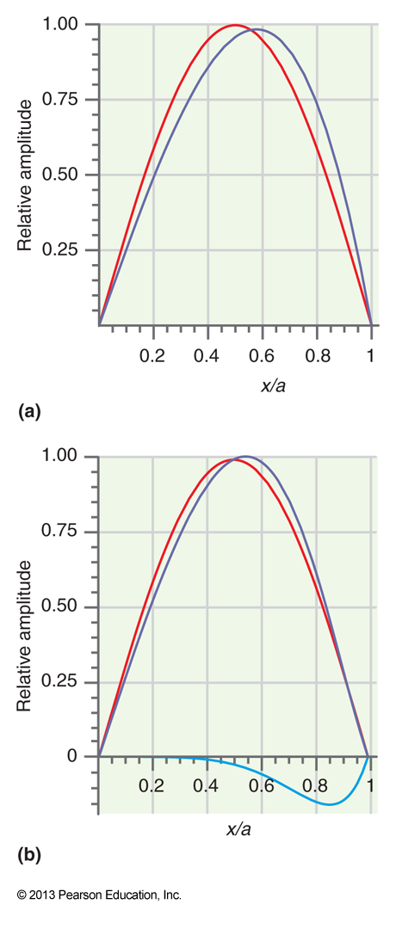
Stop to think: Let’s approximate the ground state of the particle in a box with two different functions. Which one will give give an energy that is closest to the true ground state value?
$$Φ_{1}\left(x\right)=\left(\frac{x}{L}−\frac{x^{3}}{L^{3}}\right)$$
$$Φ_{2}\left(x\right)=\left(\frac{x}{L}−\frac{x^{3}}{L^{3}}\right)+α\left(\frac{x^{5}}{L^{5}}−\frac{1}{2}\left(\frac{x^{7}}{L^{7}}+\frac{x^{9}}{L^{9}}\right)\right)$$
parameter
$Φ_{1}\left(x\right)$
$Φ_{2}\left(x\right)$
More information required
The energies will be equal
$E_{Φ_{1}}=0.133\left(\frac{h^{2}}{ma^{2}}\right)$
$E_{Φ_{2}}=0.127\left(\frac{h^{2}}{ma^{2}}\right)$
$$E_{0}=\frac{h^{2}}{8ma^{2}}=0.125\left(\frac{h^{2}}{ma^{2}}\right)$$

Slide 7
In molecular orbital theory the orbital wavefunction is formed as a linear combination (superposition) of all the atomic orbitals:
The best coefficients minimize the ground state energy of the system!
The coefficients are obtained through the variational principle!
$$ψ=\sum_{i}{c_{i}χ_{i}}$$
LCAO-MO (Linear Combination of Atomic Orbitals - Molecular Orbital)
The coefficient $c_{i}$ tells how much the molecular orbital $ψ$ resembles the atomic orbital $χ_{i}$!
Atomic orbital

Slide 8
The Born-Oppenheimer approximation
For hydrogenic and many-electron atoms, the motion of the nuclei was first separated from that of the electrons:
$$−\frac{ℏ^{2}}{2m_{e}}∇_{e}^{2}ψ_{tot}−\frac{ℏ^{2}}{2m_{n}}∇_{n}^{2}ψ_{tot}−\frac{Ze^{2}}{4πε_{0}r}ψ_{tot}=E_{tot}ψ_{tot}$$
The relative motion of the nucleus and the electron (in spherical coordinates)
For molecules the first separation is an approximation!
Separation of variables I
$$−\frac{ℏ^{2}}{2m_{tot}}∇_{c.m.}^{2}ψ_{c.m.}\left(X\right)=E_{c.m.}ψ_{c.m.}\left(X\right)$$
$−\frac{ℏ^{2}}{2μ}∇^{2}ψ(r,θ, φ)$ $−\frac{Ze^{2}}{4πε_{0}r}ψ(r,θ, φ)$ $=Eψ(r,θ, φ)$
Movement of the center of mass in space
Separation of variables II

Slide 9
Born - Oppenheimer (BO) approximation: Because the nuclei are so much more massive than the electrons, the nuclei can be thought to remain stationary while the electrons move in their electric field.
Molecular schrödinger equation
BO approximation
Nuclear SE
Electronic SE
Stop to think: How will the wavefunction look after the BO-approximation?

Slide 10
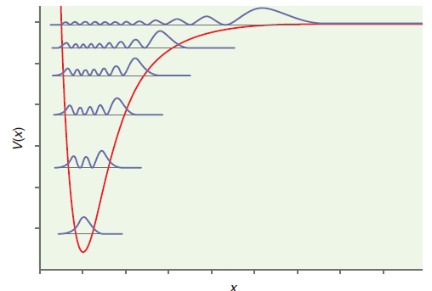
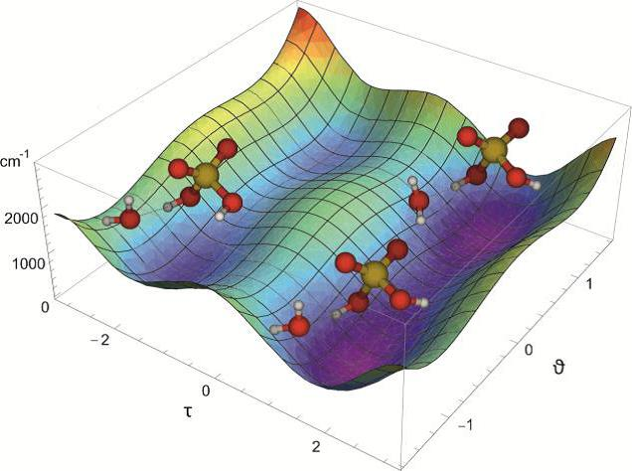
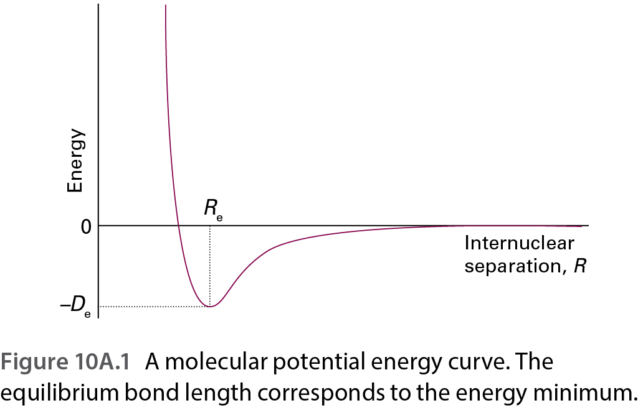
After the BO-approximation the molecular SE is solved as follows:
Molecular SE
BO approximation
Nuclear SE:
$${\hat{T}}_{n}ψ_{n}+{\hat{V}}_{n}ψ_{n}=Eψ_{n}$$
1. Choose nuclear locations
Repeat until all locations have been solved!
2. Solve electronic SE for these locations
Solve to obtain nuclear motion wavefunctions and energies (for example, vibrational energies)
3. The potential energy surface (PES) ${\hat{V}}_{n}$

Slide 11
Work with your pair: (5 mins):
Write the Hamiltonian for the $H_{2}^{+}$ -ion after the BO-approximation.
Provide a reasonable guess for the ground state wavefunction in this case. How could it be improved according to the LCAO-MO principle?
$$\hat{H}=−{\frac{ℏ^{2}}{2m}}_{e}∇_{1}^{2}−\frac{Z_{A}e^{2}}{4πε_{0}}\frac{1}{r_{A1}}−\frac{Z_{B}e^{2}}{4πε_{0}}\frac{1}{r_{B1}}+\frac{Z_{A}Z_{B}e^{2}}{4πε_{0}}\frac{1}{R_{AB}}$$
$$ψ=c_{A}χ_{A}+c_{B}χ_{B}$$

Slide 12
Work with your pair: (10 mins):
Devise a strategy to find the coefficients in $ψ=c_{A}χ_{A}+c_{B}χ_{B}$.
Show that the energy expression from the variational principle for this wavefunction is
$$S_{AB}=\int{χ_{A}^{∗}χ_{B}dτ }$$
$$H_{ij}=\int{χ_{i}^{∗}\hat{H}χ_{j}dτ }$$
$E=\frac{c_{A}^{2}H_{AA}+c_{B}^{2}H_{BB}+2c_{A}c_{B}H_{AB}}{c_{A}^{2}+c_{B}^{2}+2c_{A}c_{B}S_{AB}}$

Slide 13
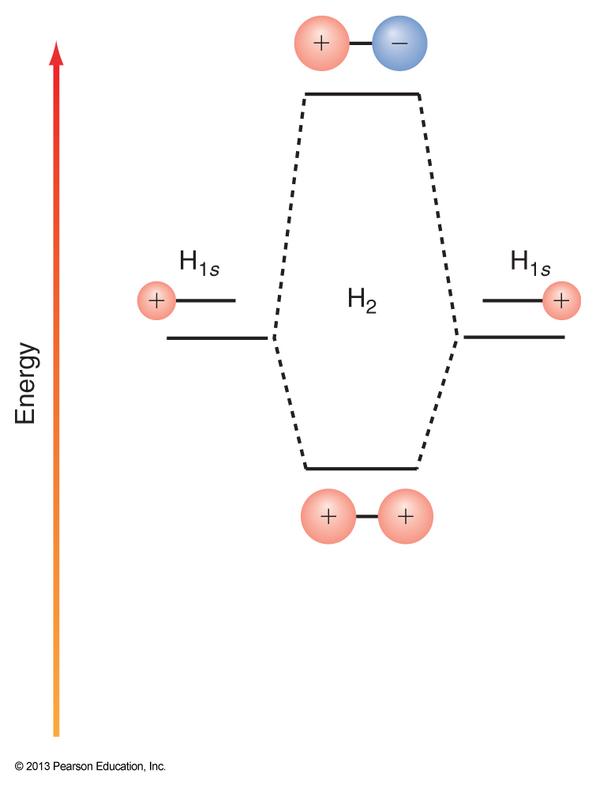
Finding the extrema of the energy yields two energies:
$$E_{±}=\frac{H_{AA}+H_{BB}+2S_{AB}H_{AB}}{2−2S_{AB}^{2}}±\frac{\sqrt{H_{AA}^{2}+{4H}_{AB}^{2}+H_{BB}^{2}−4S_{AB}H_{AB}H_{BB}−2H_{AA}\left(H_{BB}+2S_{AB}H_{AB}−2S_{AB}^{2}H_{BB}\right)}}{2−2S_{AB}^{2}}$$
$$S_{AB}=\int{χ_{A}^{∗}χ_{B}dτ }$$
$$H_{ij}=\int{χ_{i}^{∗}\hat{H}χ_{j}dτ }$$
where
and
If the nuclei A ja B are identical, the general solution becomes:
$$E_{±}=\frac{H_{AA}±H_{AB}}{1±S_{AB}}=E_{H1s}+\frac{e^{2}}{4πε_{0}}\frac{1}{R}−\frac{j±k}{1±S}$$
$$ψ_{±}=N(χ_{A}±χ_{B})$$

Slide 14
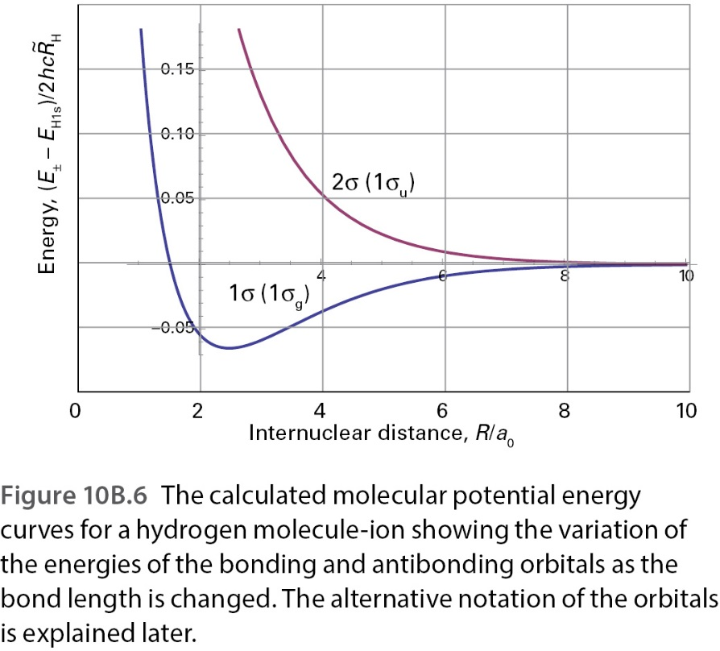
Work with your pair: (15 mins):
The figure on the right shows the energies of the two allowed orbitals.
Which one is the bonding orbital?
Obtain mathematical expressions for the probability densities of the bonding and antibonding orbitals. Sketch and compare them.

Slide 15
Work with your pair: (15 mins):
The figure on the right shows the energies of the two allowed orbitals.
What happens to the energies of the bonding and antibonding orbitals as the bond length changes? Why?
Discuss the importance of the overlap integral to chemical bonding.

Slide 16
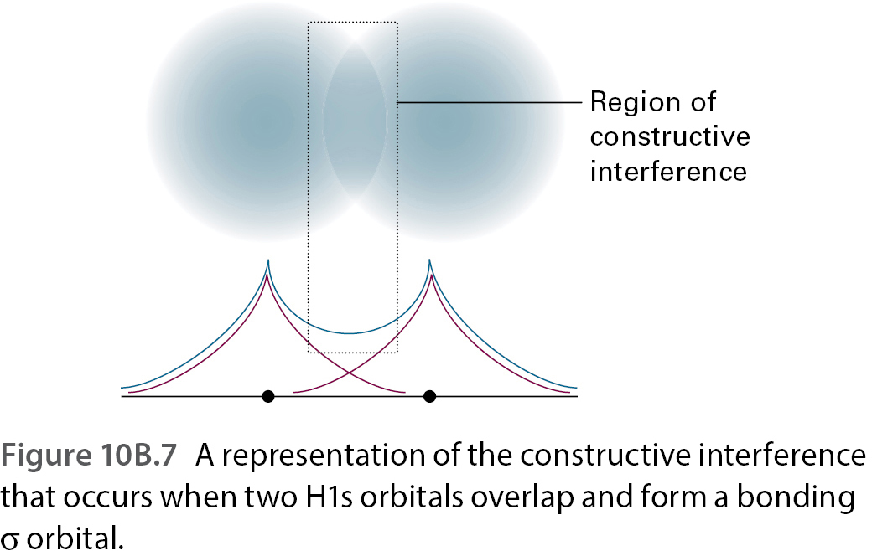
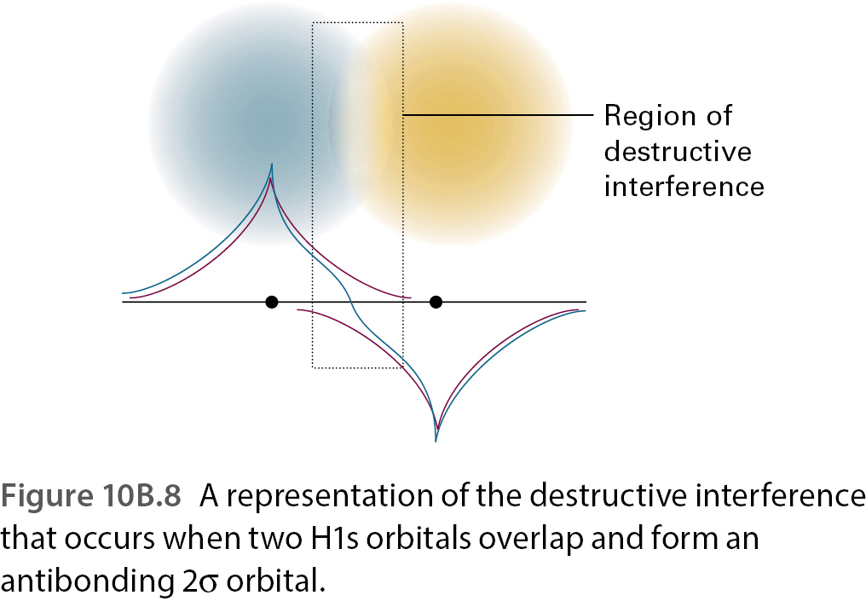
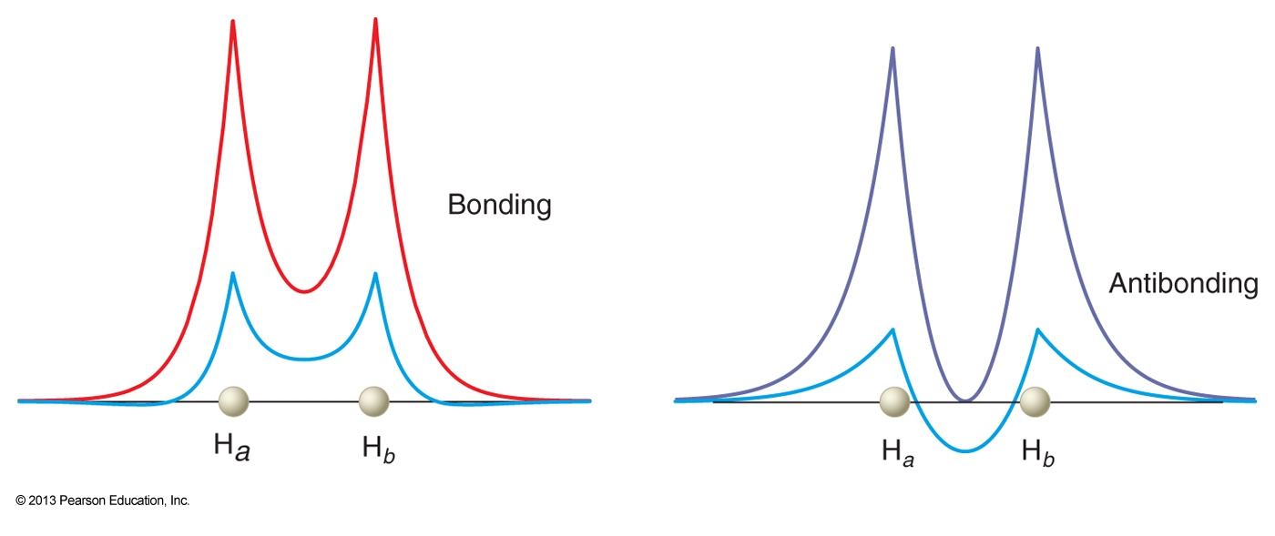
$$ψ^{2}−\frac{1}{2}ψ_{H1s_{A}}^{2}−\frac{1}{2}ψ_{H1s_{B}}^{2}$$

Slide 17
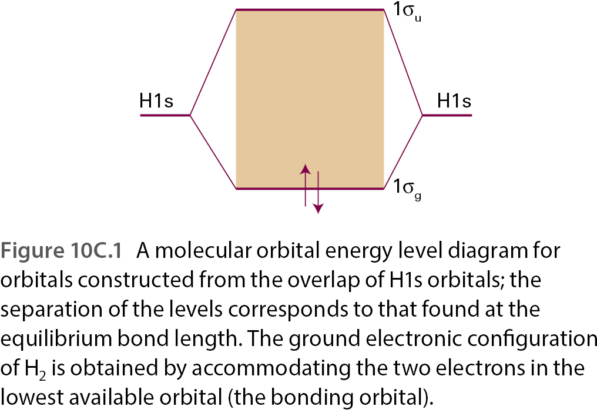
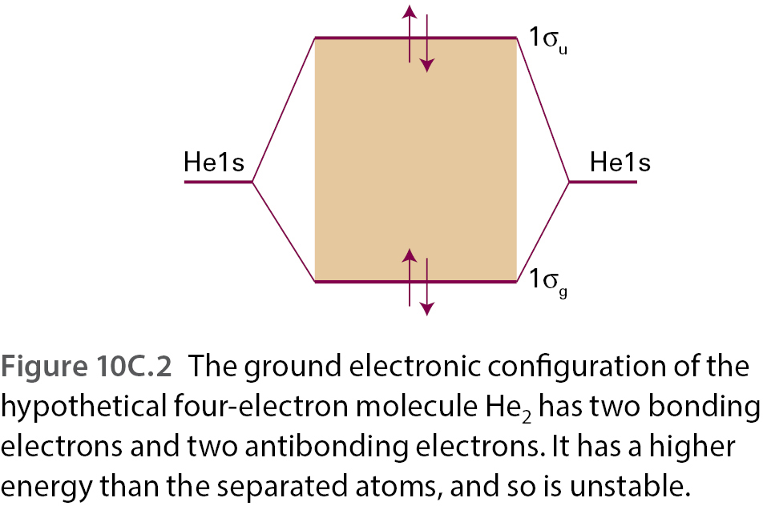
Stop and think: (5 mins):
Below is the energy level diagram for hydrogen. Based on it, is He₂ a stable molecule?

Slide 18
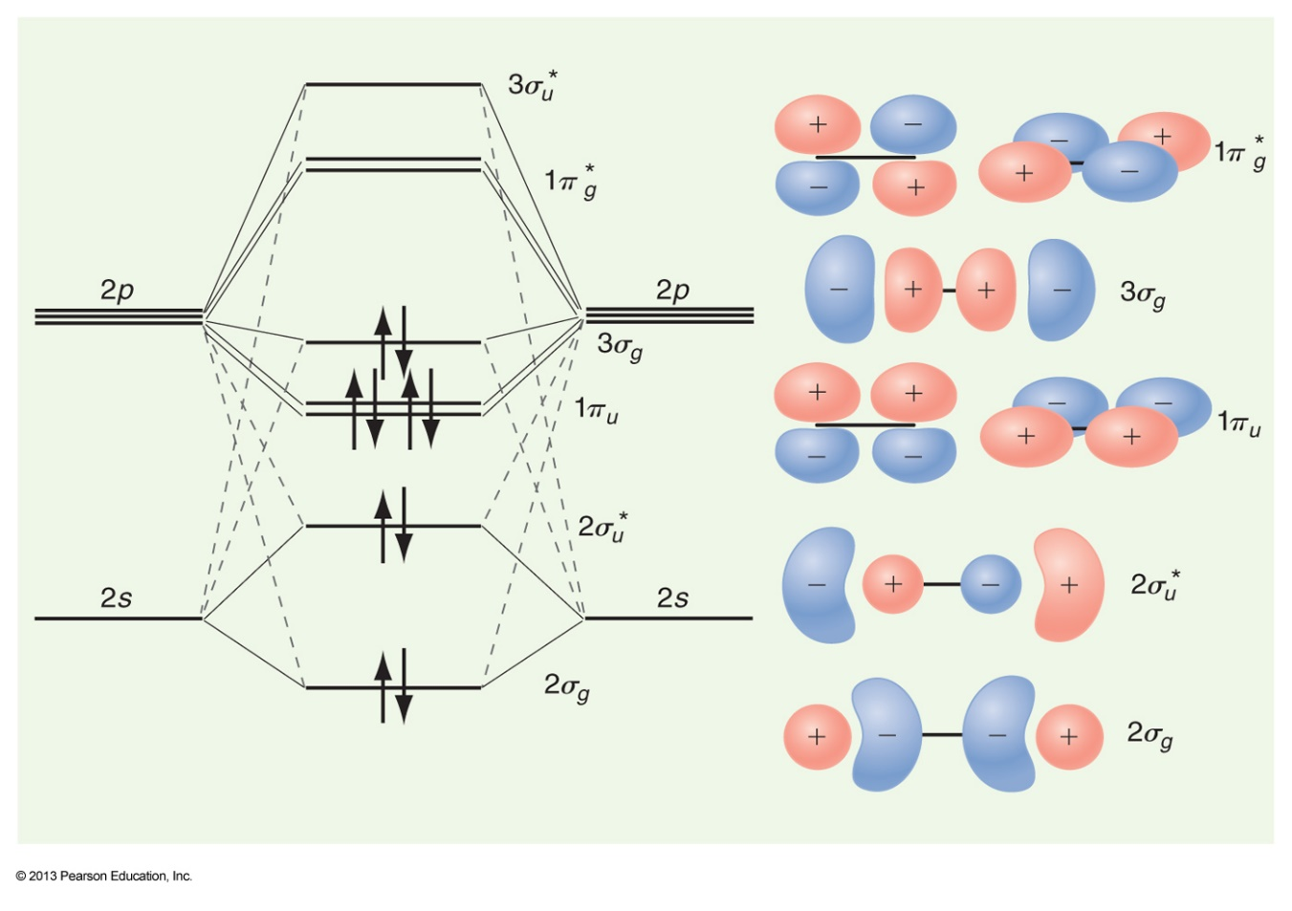
Stop and think: (5 mins):
Below is the energy level diagram for nitrogen.
Identify which atomic orbitals contribute most to which molecular orbitals.
Define bond order and calculate it for $N_{2}^{+}, N_{2},N_{2}^{−}$ ja $N_{2}^{2−}$.
$$ψ=\sum_{i}{c_{i}χ_{i}}$$
Atomic orbital
The coefficient $c_{i}$ tells how much the molecular orbital $ψ$ resembles $χ_{i}$!
Stop to think: Are there other occupied MOs? Draw their MO diagram. How do the MOs look?

Slide 19
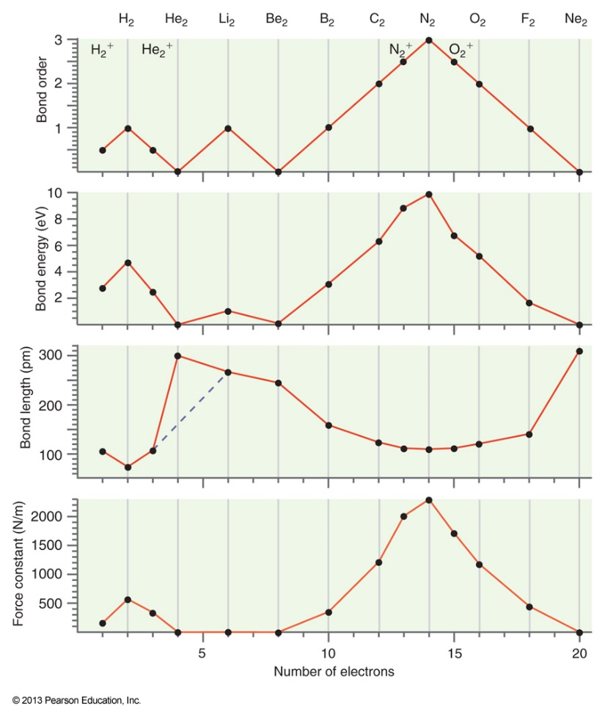
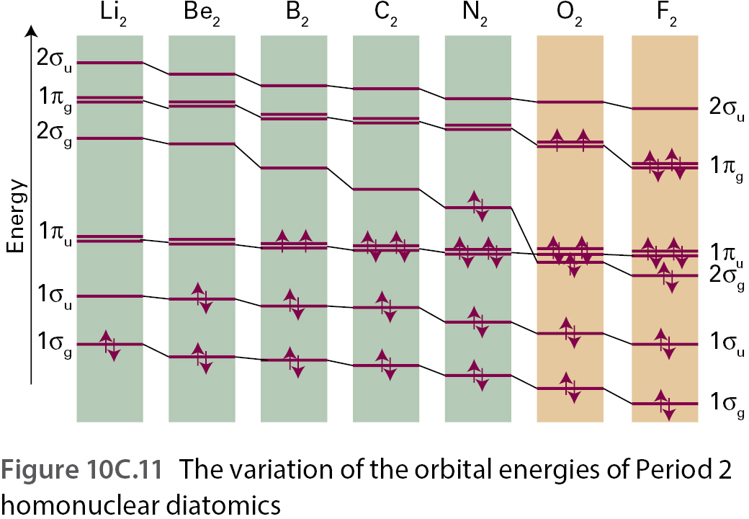

Slide 20
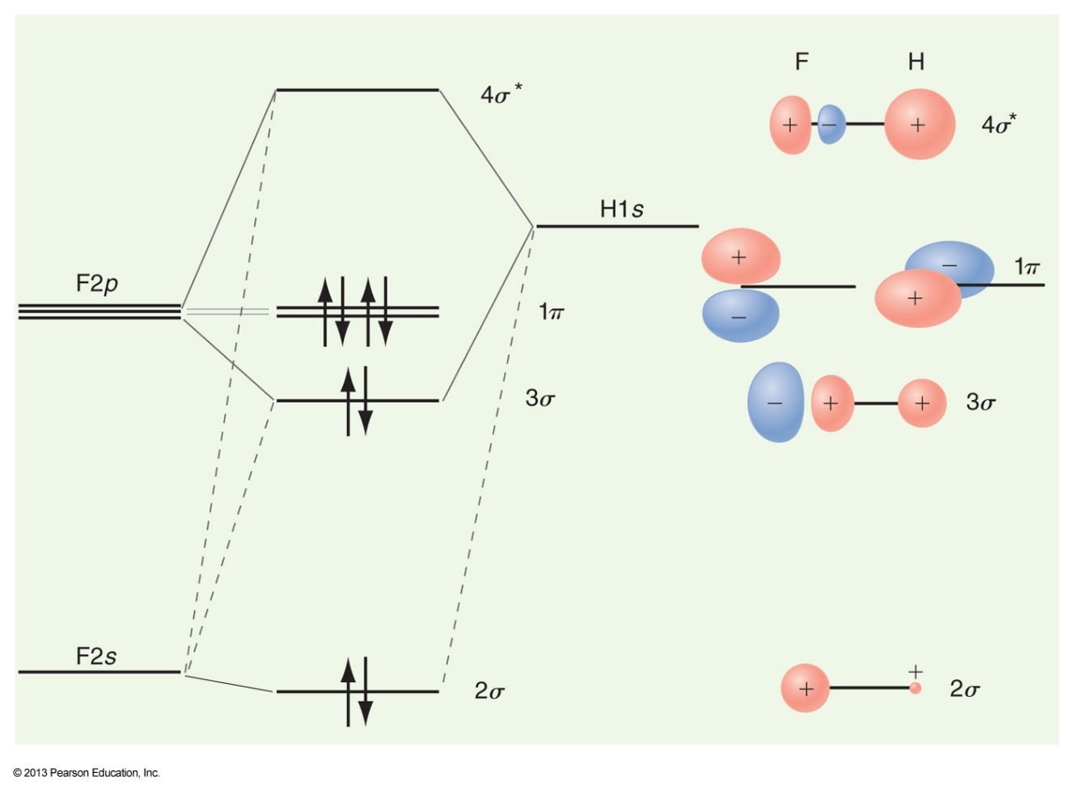
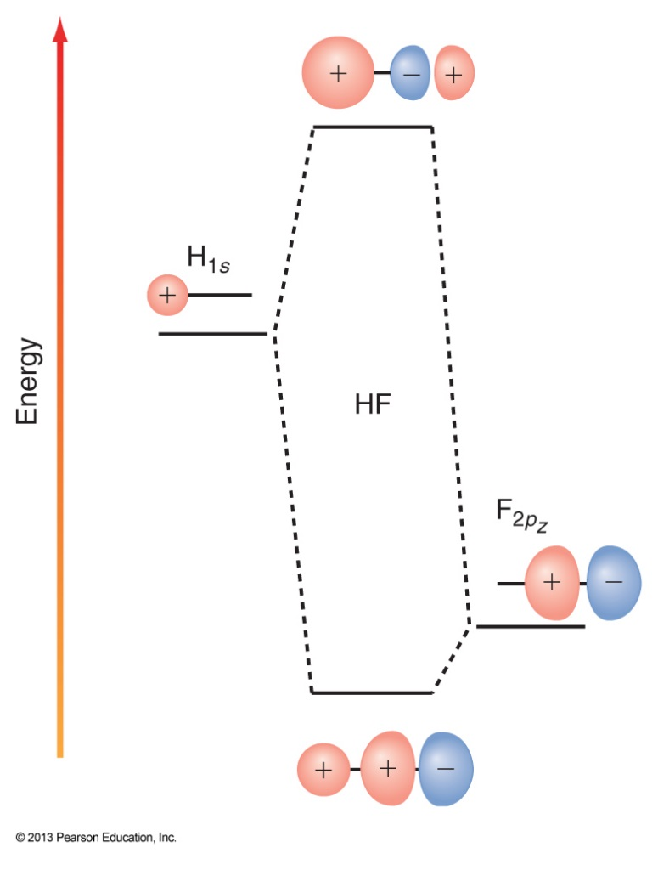
Even with the simplest possible form of the wavefunction the energies for a general two atomic –molecule look horrendous
$$ψ=c_{A}χ_{A}+c_{B}χ_{B}$$
$$E_{±}=\frac{H_{AA}+H_{BB}+2S_{AB}H_{AB}}{2−2S_{AB}^{2}}±\frac{\sqrt{H_{AA}^{2}+{4H}_{AB}^{2}+H_{BB}^{2}−4S_{AB}H_{AB}H_{BB}−2H_{AA}\left(H_{BB}+2S_{AB}H_{AB}−2S_{AB}^{2}H_{BB}\right)}}{2−2S_{AB}^{2}}$$
1σ
2σ
1π
$$S_{AB}=\int{χ_{A}^{∗}χ_{B}dτ }$$
$$H_{ij}=\int{χ_{i}^{∗}\hat{H}χ_{j}dτ }$$
missä
ja

Slide 21
Figure references
Unless otherwise noted all Figures are taken from Chapter 7 of Atkins, P. ja De Paula, J. , L. (2014), Atkins’ Physical Chemistry, 10th edition, Oxford University Press, Oxford, New York.

