Slide 1
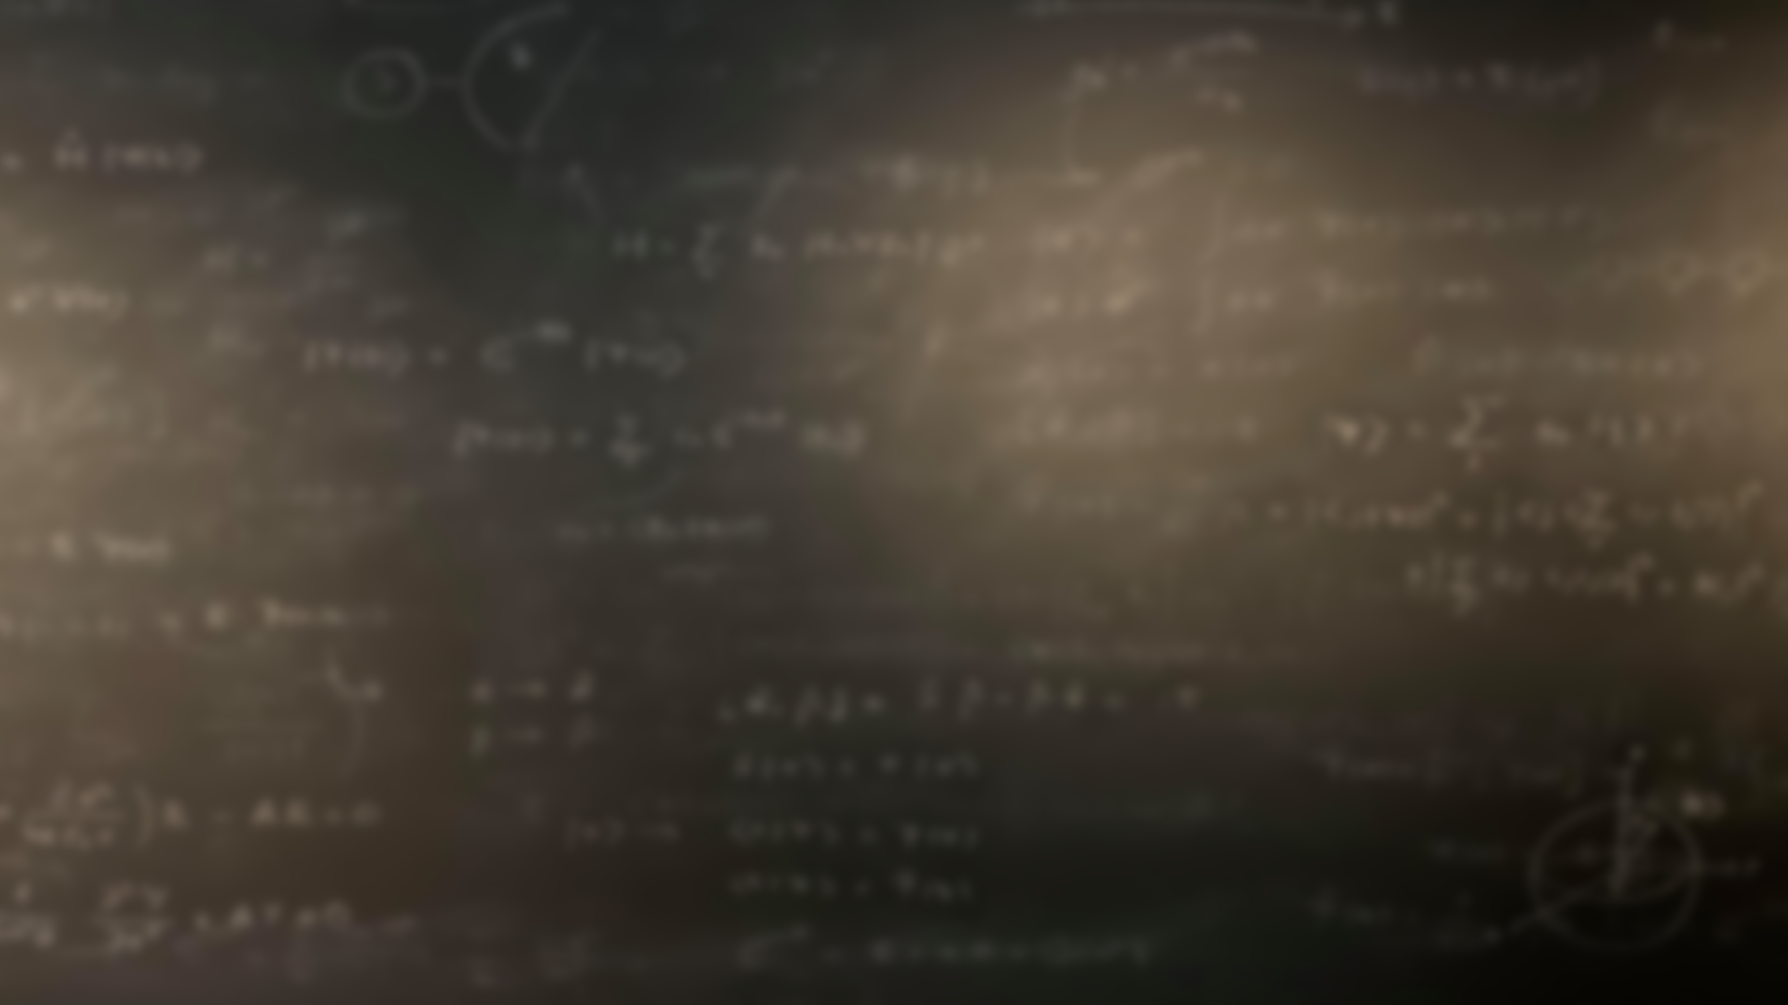
Quantum Mechanics
and Spectroscopy
Lauri Partanen

Slide 2
Getting to know operators
Work with your group in breakout rooms: (10 mins)
Why is the concept of an operator important in quantum mechanics? How are eigenvalues connected to operators?
How are the concepts of the wavefunction and operator connected?
Give an example of an operator, its eigenfunction and its eigenvalue.

Slide 3
Presemo: Which of the following functions are eigenfunctions of both the momentum, $\hat{p}$, and the kinetic energy operator, $\hat{T}$?
$\sin{kx}$
$e^{−ikx}$
$kx^{2}$
$$\hat{p}=\frac{ℏ}{i}\frac{d}{dx}$$
$$\hat{T}=−\frac{ℏ^{2}}{2m}\frac{d^{2}}{dx^{2}}$$

Slide 4
Presemo: Which of the following functions are eigenfunctions of both the momentum, $\hat{p}$, and the kinetic energy operator, $\hat{T}$?
$\sin{kx}$
$e^{−ikx}$
$kx^{2}$
$$\hat{p}=\frac{ℏ}{i}\frac{d}{dx}$$
$$\hat{T}=−\frac{ℏ^{2}}{2m}\frac{d^{2}}{dx^{2}}$$

Slide 5
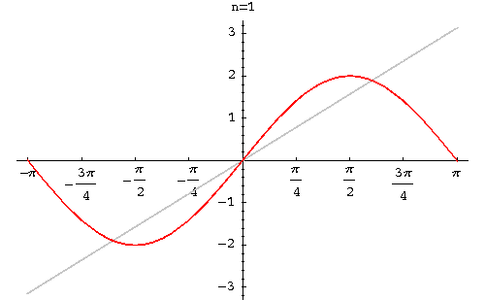
Let’s look at $sin⁡(kx)$ more carefully. Even though it is not an eigenfunction of $\hat{p}$ can it be related to true eigenfunctions?
$$\sin\left(kx\right)=\frac{1}{2i}e^{ikx}−\frac{1}{2i}e^{−ikx}$$
In general, we can represent any function as a sum of the eigenfunctions of an operator (as long as the eigenfunctions form a complete set)
$$ψ=c_{1}ψ_{1}+c_{2}ψ_{2}+…=\sum_{k}{{c_{k}ψ}_{k}}$$
Note! $c_{k}∈ℂ$
Here $ψ$ is a superposition of the functions $ψ_{k}$!

Slide 6
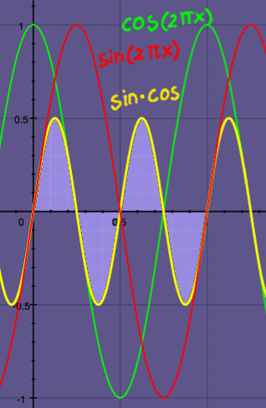
Exercise: Assume that your particle is between [- $π$,$π$] and its wavefunction has the form $ψ_{n}=\frac{1}{\sqrt{2π}}e^{inφ}$ where $n∈ℤ$, what can you say about the integrals $\int_{−π}^{π}{ψ_{n}^{∗}ψ_{m}}dφ?$
$$\int_{−π}^{π}{ψ_{n}^{∗}ψ_{m}}dφ=\left\{\begin{matrix}1, n=m \\ 0, n≠m\end{matrix}\right.$$
More generally, $ψ_{i}$ ja $ψ_{j}$ are orthogonal if
$$\int{ψ_{i}^{∗}ψ_{j}}dτ=0, kun i≠j$$

Slide 7
Hermitian operators
Think for yourself: (5 mins)
What are Hermitian operators?
2) What qualities do Hermitian operators have that make them central for quantum mechanics?
3) What is the Hamiltonian operator? Is it Hermitian?

Slide 8
Properties of the wavefunction?
?
?
Find out the system’s Hamiltonian operator (approximations etc.)
Solve the eigenfunctions of the Hamiltonian to obtain the wavefunction ψ
?
Use the wavefunction to calculate all desired properties
?
?
?

Slide 9
The expectation value
Think for yourself: (2 mins)
What is the expectation value and how do you calculate it? How does the expectation value relate to measurements made on the quantum mechanical system described by the wavefunction?
$$\left\langle \hat{A}\right\rangle =\frac{\int{ψ^{∗}\hat{A}ψdτ }}{\int{ψ^{∗}ψdτ }}$$

Slide 10
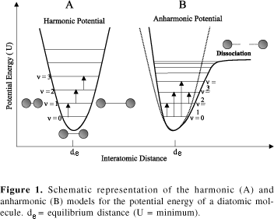
Example: If x is the displacement from the equilibrium position for a CO molecule, then the lowest vibrational state has the wavefunction
$ψ\left(x\right)=\frac{1}{\sqrt{\left(απ^{\frac{1}{2}}\right)} }e^{−\frac{x^{2}}{2α^{2}}}$.
$$\left\langle \hat{A}\right\rangle =\frac{\int{ψ^{∗}\hat{A}ψdτ }}{\int{ψ^{∗}ψdτ }}$$
Calculate the average displacement of the atoms from the equilibrium position. Is your result sensible?
x

Slide 11
Think for yourself: (5 mins)
Compare the two pictures. When does the wave have a well-defined momentum, position, and wavelength?

Slide 12
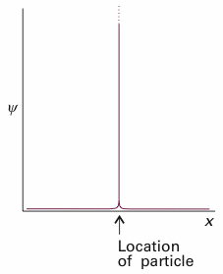
Heisenberg uncertainty principle
$$ΔpΔx≥ℏ/2$$
The derivative can have a lot of different values
The derivative only has a single value
$$Δp≈0,$$
$$Δx≈∞$$
$$Δx≈0,$$
$$Δp≈∞$$

Slide 13
Think for yourself: (5 mins)
Does the uncertainty relation only affect momentum and position? If not, how does one determine whether two quantities are bound by the uncertainty principle?
$$Δ\hat{A}Δ\hat{B}≥\frac{1}{2}\left|\left\langle \left[\hat{A},\hat{B}\right]\right\rangle \right|$$
$$\left[\hat{A},\hat{B}\right]=\hat{A}\hat{B}−\hat{B}\hat{A}$$

Slide 14
$$\left[\hat{A},\hat{B}\right]=\hat{A}\hat{B}−\hat{B}\hat{A}$$
Example: Calculate the commutator $\left[{\hat{x},\hat{p}}_{x}\right]$. Find two operators for which $\left[\hat{A},\hat{B}\right]=0$
Answer: $\left[\hat{x},{\hat{p}}_{x} \right]=iℏ$, $\left[\hat{x},{\hat{p}}_{z} \right]=0$

Slide 15
Discuss in breakout rooms: (10 mins)
The system is initially in an eigenstate of $\hat{H}.$ Explain what happens when the energy of the system is measured with a laser. (What value is obtained and what is the final state of the system?)
The system is NOT initially in an eigenstate of $\hat{H}.$ Explain what happens when the energy of the system is measured with a laser. (What value is obtained and what is the final state of the system?)
Eigenstate of $\hat{A}$: $\hat{A}ψ_{n}=a_{n}ψ_{n}$
$$ψ=\sum_{n}{c_{n}}ψ_{n}$$
For a normalized wavefunction ${\left|c_{n}\right|}^{2}$ gives the probability of obtaining the eigenstate $ψ_{n}$

Slide 16
Measurement in quantum mechanics
Work with your pair: (10 mins)
1) The system is initially in an eigenstate of $\hat{H}.$ Explain what happens when the energy of the system is measured with a laser. (What value is obtained and what is the final state of the system?)

Slide 17
Measurement in quantum mechanics
Work with your pair: (5 mins)
2) The system is NOT initially in an eigenstate of $\hat{H}.$ Explain what happens when the energy of the system is measured with a laser. (What value is obtained and what is the final state of the system?)
Eigenstate of $\hat{A}$: $\hat{A}ψ_{n}=a_{n}ψ_{n}$
$$ψ=\sum_{n}{c_{n}}ψ_{n}$$
For a normalized wavefunction ${\left|c_{n}\right|}^{2}$ gives the probability of obtaining the eigenstate $ψ_{n}$

Slide 18
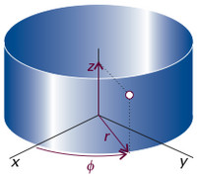
Example: An electron going around a circular particle accelerator in cern has a normalized wavefunction (in cylindrical coordinates) of the form $ψ=\frac{1}{\sqrt{3}}\frac{1}{\sqrt{2π}}e^{−2iφ}−\sqrt{\frac{2}{3}}\frac{1}{\sqrt{2π}}e^{3iφ}$,
where $ψ_{k}=\frac{1}{\sqrt{2π}}e^{ikφ}$ is a normalized eigenfunction of the angular momentum
$$ψ=\sum_{n}{c_{n}}ψ_{n}$$
What values can you measure for the angular momentum, ${\hat{p}}_{φ}=\frac{ℏ}{i}\frac{d}{dφ}$, and with what probabilities?
Calculate the expectation value for the angular momentum.
$$\left\langle \hat{A}\right\rangle =\frac{\int{ψ^{∗}\hat{A}ψdτ }}{\int{ψ^{∗}ψdτ }}$$
$$\int_{−π}^{π}{ψ_{n}^{∗}ψ_{m}}dφ=\left\{\begin{matrix}1, n=m \\ 0, n≠m\end{matrix}\right.$$

Slide 19
Measurement in quantum mechanics
Generalizing from the previous example we can connect the expectation value of an operator to the coefficients of the superposition:
$$\hat{A}ψ_{n}=a_{n}ψ_{n}$$
$$ψ=c_{1}ψ_{1}+c_{2}ψ_{2}+…=\sum_{n}{{c_{n}ψ}_{n},}$$
$$c_{n}=\int{ψ_{n}^{∗}}ψ dτ$$
$$\left\langle \hat{A}\right\rangle =\sum_{n}{{{\left|c_{n}\right|}^{2}a}_{n}}$$
Probability of finding the particle in the state $ψ_{n}$!

Slide 20
Discussion 1: We have the electron in a hydrogen atom originally in a state $ψ_{el}=c_{1}ψ_{1s}$+$c_{2}ψ_{2s}$+$c_{3}ψ_{2p_{x}}+c_{4}ψ_{3s}$. Its energy is measured and we obtain the ground state energy. What can you say about the result f the energy is measured again after some time?
You can obtain any of the four energies of the superposition, each with a probability of ${\left|c_{n}\right|}^{2}$.
You will reobtain the ground state energy.
You can obtain any of the quantized energies of the hydrogen atom, not just those represented in the superposition.
No clue.

Slide 21
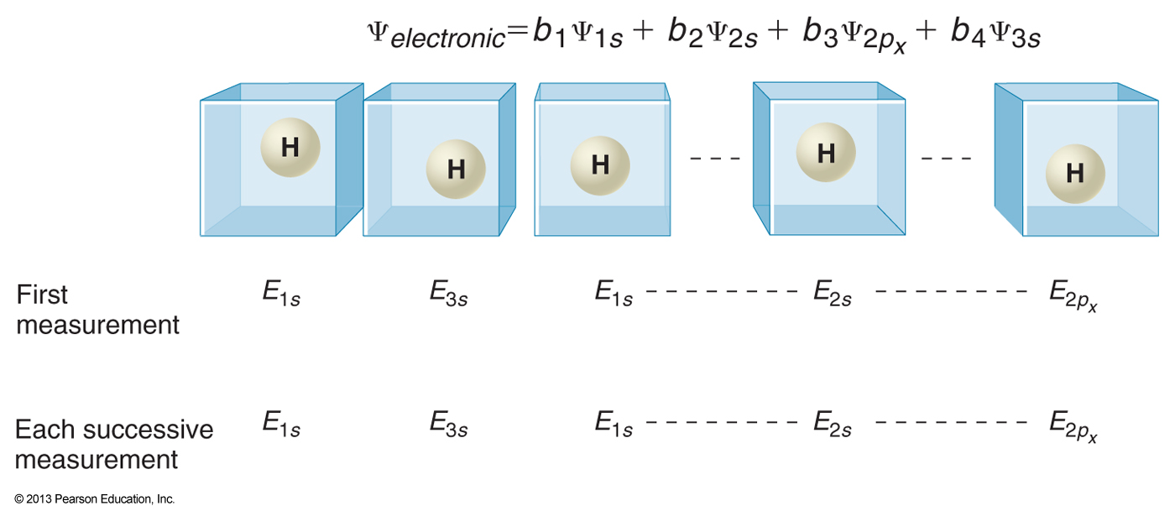
Discussion: We have the electron in a hydrogen atom originally in a state $ψ_{el}=c_{1}ψ_{1s}$+$c_{2}ψ_{2s}$+$c_{3}ψ_{2p_{x}}+c_{4}ψ_{3s}$. Its energy is measured and we obtain the ground state energy. What can you say about the result f the energy is measured again after some time?
You can obtain any of the four energies of the superposition, each with a probability of ${\left|c_{n}\right|}^{2}$.
You will reobtain the ground state energy.
You can obtain any of the quantized energies of the hydrogen atom, not just those represented in the superposition.
No clue.

Slide 22
Discussion 2: We have the electron in a hydrogen atom originally in a state $ψ_{el}=c_{1}ψ_{1s}$+$c_{2}ψ_{2s}$+$c_{3}ψ_{2p_{x}}+c_{4}ψ_{3s}$. Its energy is measured and we again obtain the ground state energy. Then we measure its momentum. What can you say about the result of a subsequent energy measurement after some time?
You can obtain any of the four energies of the superposition, each with a probability of ${\left|c_{n}\right|}^{2}$.
You will reobtain the ground state energy.
You can obtain any of the quantized energies of the hydrogen atom, not just those represented in the superposition.
No clue.

Slide 23
Discussion 2: We have the electron in a hydrogen atom originally in a state $ψ_{el}=c_{1}ψ_{1s}$+$c_{2}ψ_{2s}$+$c_{3}ψ_{2p_{x}}+c_{4}ψ_{3s}$. Its energy is measured and we again obtain the ground state energy. Then we measure its momentum. What can you say about the result of a subsequent energy measurement after some time if we know that $\left[\hat{H},{\hat{p}}_{x}\right]≠0$?
You can obtain any of the four energies of the superposition, each with a probability of ${\left|c_{n}\right|}^{2}$.
You will reobtain the ground state energy.
You can obtain any of the quantized energies of the hydrogen atom, not just those represented in the superposition.
No clue.

Slide 24
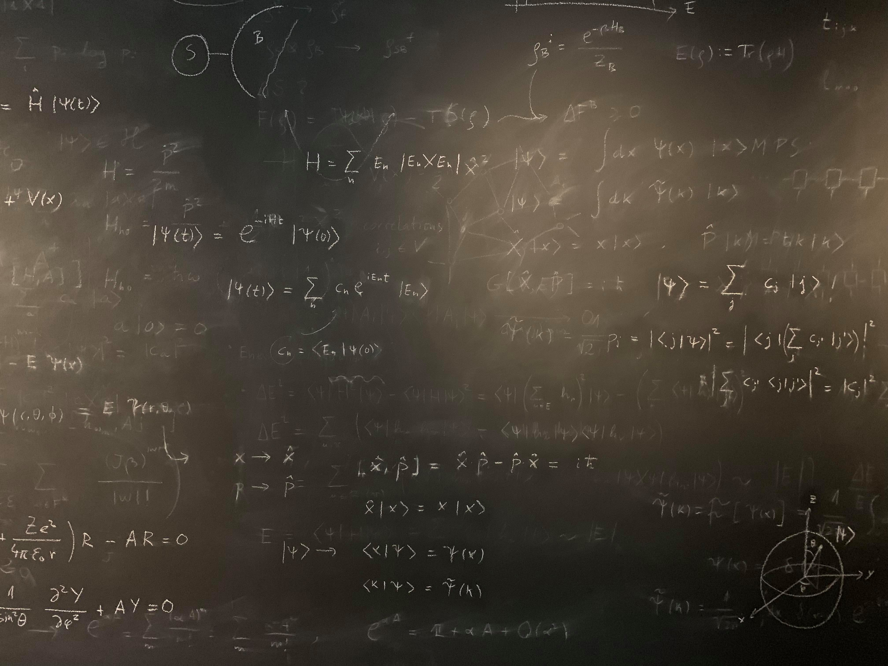
Figure references
Unless otherwise noted all Figures are taken from Chapter 7 of Atkins, P. ja De Paula, J. , L. (2014), Atkins’ Physical Chemistry, 10th edition, Oxford University Press, Oxford, New York.

