Slide 1
Quantum Mechanics
and Spectroscopy
Lauri Partanen

Slide 2
Comparing free and boxed particles
Work with your pair: (10 mins)
Write down the Hamiltonians for a freely moving (1D) particle and a particle where the motion is confined to an infinitely deep box of length L.
What constraints do the wavefunctions for the box have to fulfill?
Compare the allowed energies in the two cases.

Slide 3
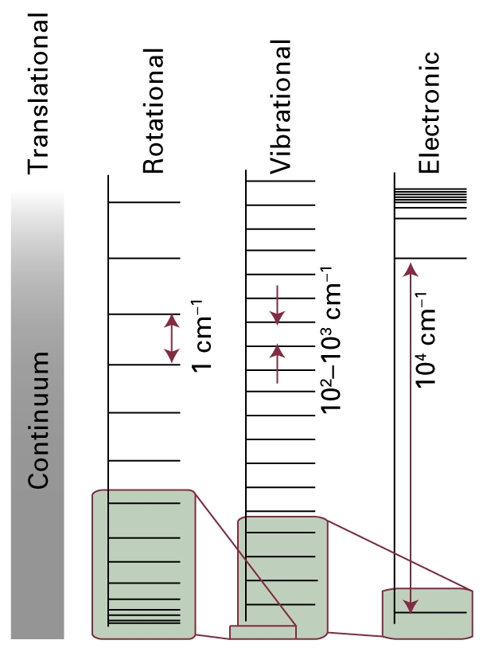
Free particle
$$ψ=Ae^{ikx}+Be^{−ikx}$$
$$−\frac{ℏ^{2}}{2m}\frac{d^{2}}{dx^{2}}ψ=Eψ$$
$$k=\sqrt{2mE/ℏ^{2}}$$
Stop to think
What can you say about the values for $\left\langle \hat{p}\right\rangle$ and $\hat{p}$ for a free particle?

Slide 4
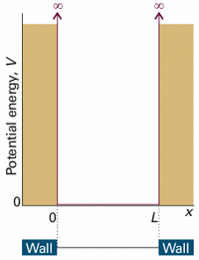
$$\left\{\begin{matrix}−\frac{ℏ^{2}}{2m}\frac{d^{2}}{dx^{2}}ψ=Eψ , 0≤x≤L \\ ψ=0, x≤0, L≤x\end{matrix}\right.$$
Particle in a box
$ψ=Ae^{ikx}+Be^{−ikx}$,
$$k=\sqrt{2mE/ℏ^{2}}$$
$\left\{\begin{matrix}ψ=\sqrt{\left(\frac{2}{L}\right)}\sin\left(\frac{nπx}{L}\right), 0≤x≤L \\ ψ=0, x≤0, L≤x\end{matrix}\right.$
$E_{n}=\frac{n^{2}h^{2}}{8mL^{2}}$, $n∈ℕ$

Slide 5
Properties of the solutions for a particle in a box
$\left\{\begin{matrix}ψ=\sqrt{\left(\frac{2}{L}\right)}\sin\left(\frac{nπx}{L}\right), 0≤x≤L \\ ψ=0, x≤0, L≤x\end{matrix}\right.$
$E_{n}=\frac{n^{2}h^{2}}{8mL^{2}}$, $n∈ℕ$
Work with your pair: (5 mins)
1) What happens to the wavefunctions as the quantum number n increases?
2) How does the energy behave when the mass, box length or quantum number increase. What happens to the distances between neighbouring energy levels?
3) What is the correspondence principle and how is it visible in the solutions?
Notes:
https://www.st-andrews.ac.uk/physics/quvis/simulations_html5/sims/infwell1d/infwell1d.html

Slide 6
Discussion: Which of the following statements are true for the wavefunction $ψ(x)=\frac{1}{\sqrt{2}}\left(ψ_{1}\left(x\right)+ψ_{2}\left(x\right)\right)$ in a one dimensional box. The functions $ψ_{n}\left(x\right)$ are the eigenfunctions of the particle in a box.
It fulfills the boundary conditions of the infinitely deep box.
It fulfills the (time independent) Schrödinger equation
Its first derivative is continuous everywhere except at the boundaries of the box.
It can be normilized.
$$ψ_{n}(x)=\sqrt{\left(\frac{2}{L}\right)}\sin\left(\frac{nπx}{L}\right), 0≤x≤L$$

Slide 7
Discussion: Which of the following statements are true for the wavefunction $ψ(x)=\frac{1}{\sqrt{2}}\left(ψ_{1}\left(x\right)+ψ_{2}\left(x\right)\right)$ in a one dimensional box. The functions $ψ_{n}\left(x\right)$ are the eigenfunctions of the particle in a box.
It fulfills the boundary conditions of the infinitely deep box.
It fulfills the (time independent) Schrödinger equation
Its first derivative is continuous everywhere except at the boundaries of the box.
It can be normilized.
$$ψ_{n}(x)=\sqrt{\left(\frac{2}{L}\right)}\sin\left(\frac{nπx}{L}\right), 0≤x≤L$$

Slide 8
Discussion: Let’s look at a potential wavefunction $ψ(x)=Nx\left(L−x\right)$ in an infinitely deep box, where N is a normalization constant. Which of the following are true?
The probability density has the form ${\left|Nx\left(L−x\right)\right|}^{2}$.
If you measure the energy of the particle, the probability of obtaining $E_{1}$is ${\left|\int_{0}^{L}{\sqrt{\frac{2}{L}}sin\left(\frac{πx}{L}\right)Nx\left(L−x\right)}dx\right|}^{2}$
The probability of finding the particle between $[x, x+dx]$ is ${x\left|Nx\left(L−x\right)\right|}^{2}dx$.
$$ψ_{n}(x)=\sqrt{\left(\frac{2}{L}\right)}\sin\left(\frac{nπx}{L}\right), 0≤x≤L$$

Slide 9
Discussion: Let’s look at a potential wavefunction $ψ(x)=Nx\left(L−x\right)$ in an infinitely deep box, where N is a normalization constant. Which of the following are true?
The probability density has the form ${\left|Nx\left(L−x\right)\right|}^{2}$.
If you measure the energy of the particle, the probability of obtaining $E_{1}$is ${\left|\int_{0}^{L}{\sqrt{\frac{2}{L}}sin\left(\frac{πx}{L}\right)Nx\left(L−x\right)}dx\right|}^{2}$
The probability of finding the particle between $[x, x+dx]$ is ${x\left|Nx\left(L−x\right)\right|}^{2}dx$.
$$ψ_{n}(x)=\sqrt{\left(\frac{2}{L}\right)}\sin\left(\frac{nπx}{L}\right), 0≤x≤L$$

Slide 10
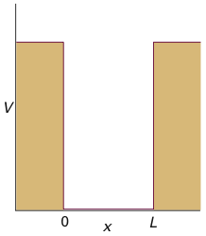
The finite well
Work with your pair: (5 mins)
1) Write down the Schrödinger equation in the different regions of the potential and the wavefunction based on the solution of the freely moving particle
$$V_{0}$$
How could we figure out the coefficients $A, A’, A’’, B, B’$ja $B’’$?
$$\left\{\begin{matrix}−\frac{ℏ^{2}}{2m}\frac{d^{2}}{dx^{2}}ψ=Eψ\text{, } −\frac{L}{2}≤x≤\frac{L}{2} \\ −\frac{ℏ^{2}}{2m}\frac{d^{2}}{dx^{2}}ψ=\left(E−V_{0}\right)ψ, x≤−\frac{L}{2},\frac{L}{2}≤x\end{matrix}\right.$$
$$\left\{\begin{matrix}ψ\left(x\right)=Ae^{−κx}+Be^{κx}\text{,} \frac{L}{2}≤x \\ ψ\left(x\right)=A^{′}e^{ikx}+B^{′}e^{−ikx}\text{,} −\frac{L}{2}≤x≤\frac{L}{2} \\ ψ\left(x\right)=A′′e^{−κx}+B′′e^{κx}\text{,} x≤−\frac{L}{2}\end{matrix}\right.$$
$$k=\sqrt{\frac{2mE}{ℏ^{2}}}$$
$$κ=\sqrt{\frac{2m(V_{0}−E)}{ℏ^{2}}}$$
-L/2
L/2

Slide 11
Work with your pair: (5 mins)
1) Go to the finite well simulator (Google QuVis -> first link -> The finite well) and investigate how changing the potential affects the energy states:
- How does the number of quantized states change?
- How do the wavefunctions behave compared to the infinite well? Any classically odd behavior?
- How does the odd behavior react to increasing quantum number?

Slide 12
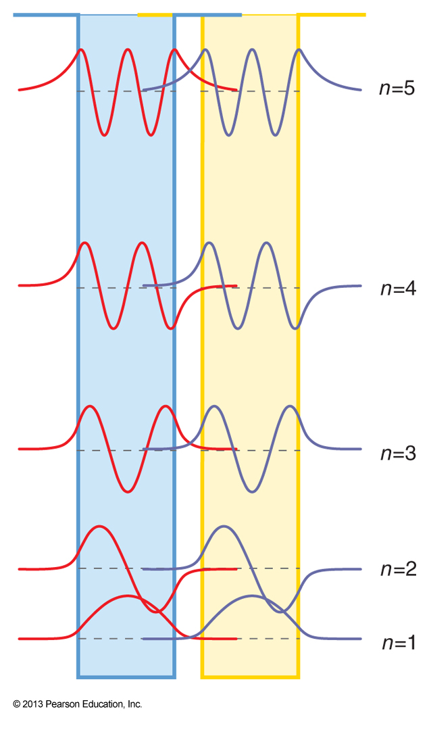
The formation of a chemical bond is connected to the overlap between the orbitals on the different atoms. Let’s model an oxygen molecule by two finite boxes. Use the figure on the left to qualitatively explain why it is always the valence electrons are involved in bond formation.
O
O

Slide 13
What happens above a finite box?
I
II
III
E
Work with your pair: (5 mins)
1) What values are allowed for the energy of the electron when $E>V_{0}$?
2) An electron is in a state with $E>V_{0}.$What can you say of its De Broglien wavelengths in regions I, II ja III?
$$V_{0}$$
-L/2
L/2

Slide 14
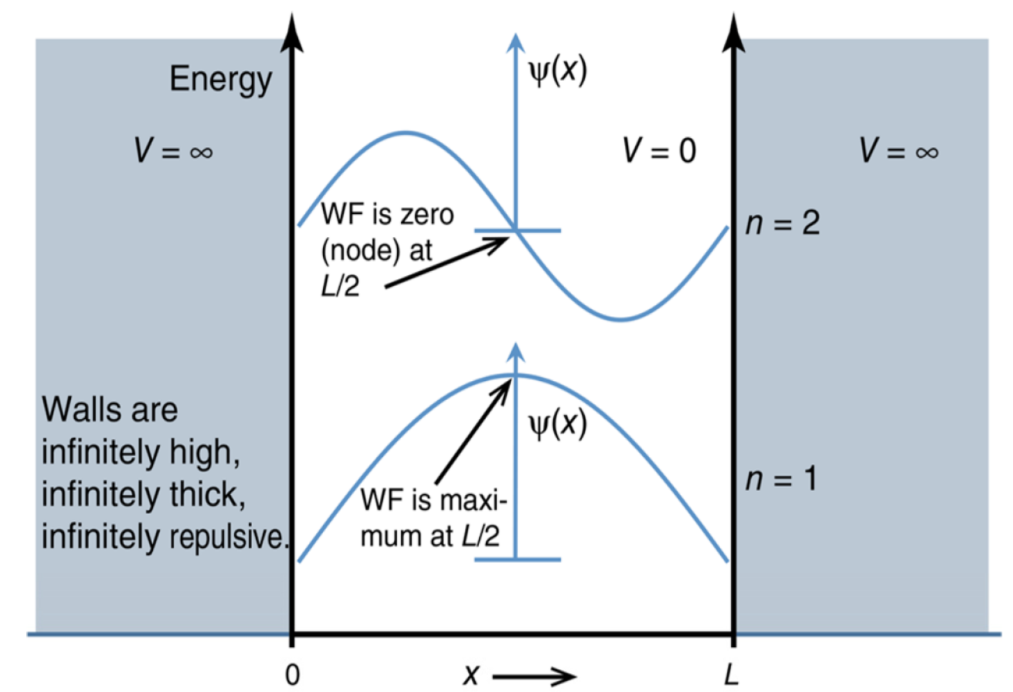

Slide 15
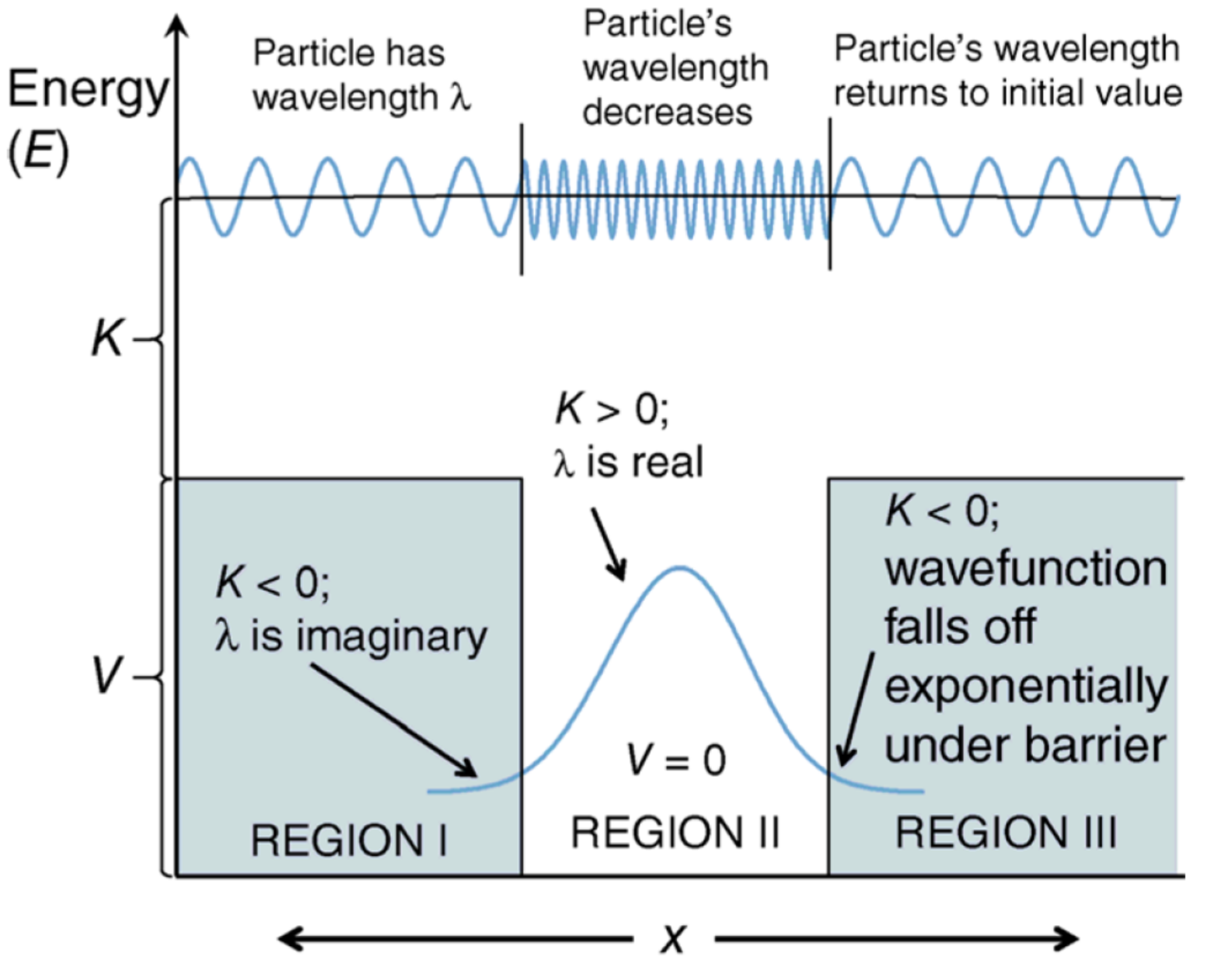
All energy values possible
Energy quantized

Slide 16
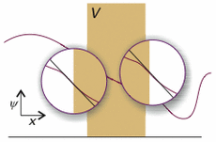
When particle hits the fan
Work with your pair: (5 mins)
Write down the Schrödinger equation in the different regions.
How would you obtain the wavefunction and the coefficients in the wavefunction?
$$\left\{\begin{matrix}−\frac{ℏ^{2}}{2m}\frac{d^{2}}{dx^{2}}ψ=Eψ, x≤0 \\ −\frac{ℏ^{2}}{2m}\frac{d^{2}}{dx^{2}}ψ=\left(E−V_{0}\right)ψ, 0≤x≤L \\ −\frac{ℏ^{2}}{2m}\frac{d^{2}}{dx^{2}}ψ=Eψ, L≤x\end{matrix}\right.$$

Slide 17
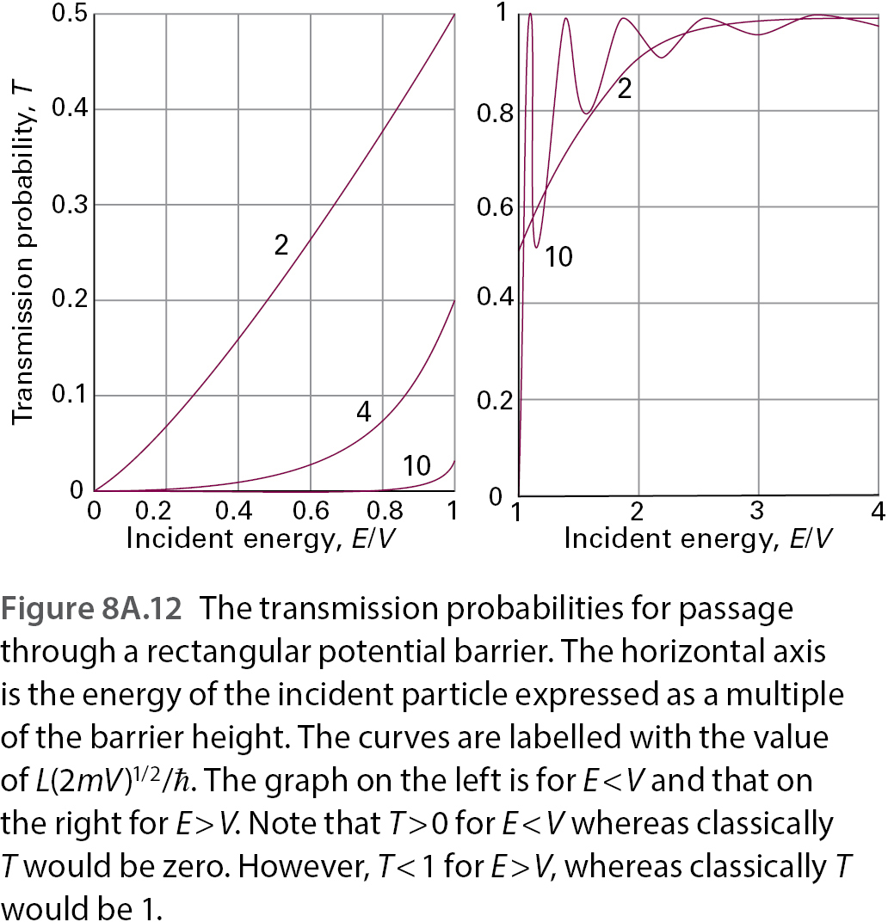
The tunneling probability through a finite barrier
$$T={\left\{1+\frac{{\left(e^{κL}−e^{−κL}\right)}^{2}}{16ε\left(1−ε\right)}\right\}}^{−1}$$
$$κ=\sqrt{\frac{2m(V_{0}−E)}{ℏ^{2}}}$$
$$ε=\frac{E}{V_{0}}$$
Work with your pair: (5 mins)
You are designing a tunneling microscope and have to make sure that particles tunnel sufficiently from your machine to the studied material. How can you increase the tunneling probability?

Slide 18
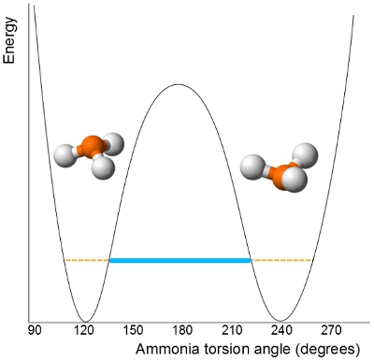
Stop and think: The inversion of ammonia is one example where tunnelling is though to play a significant role. What can you say about the energy of the ammonium molecule after tunnelling based on the Figure?
The energy has increased.
The energy has not changed
The energy is smaller than before tunneling
No clue

Slide 19
Stop and think: The inversion of ammonia is one example where tunnelling is though to play a significant role. What can you say about the energy of the ammonium molecule after tunnelling based on the Figure?
The energy has increased.
The energy has not changed
The energy is smaller than before tunneling
No clue
Contrary to intuition, tunnelling does not change the particle’s energy!

Slide 20
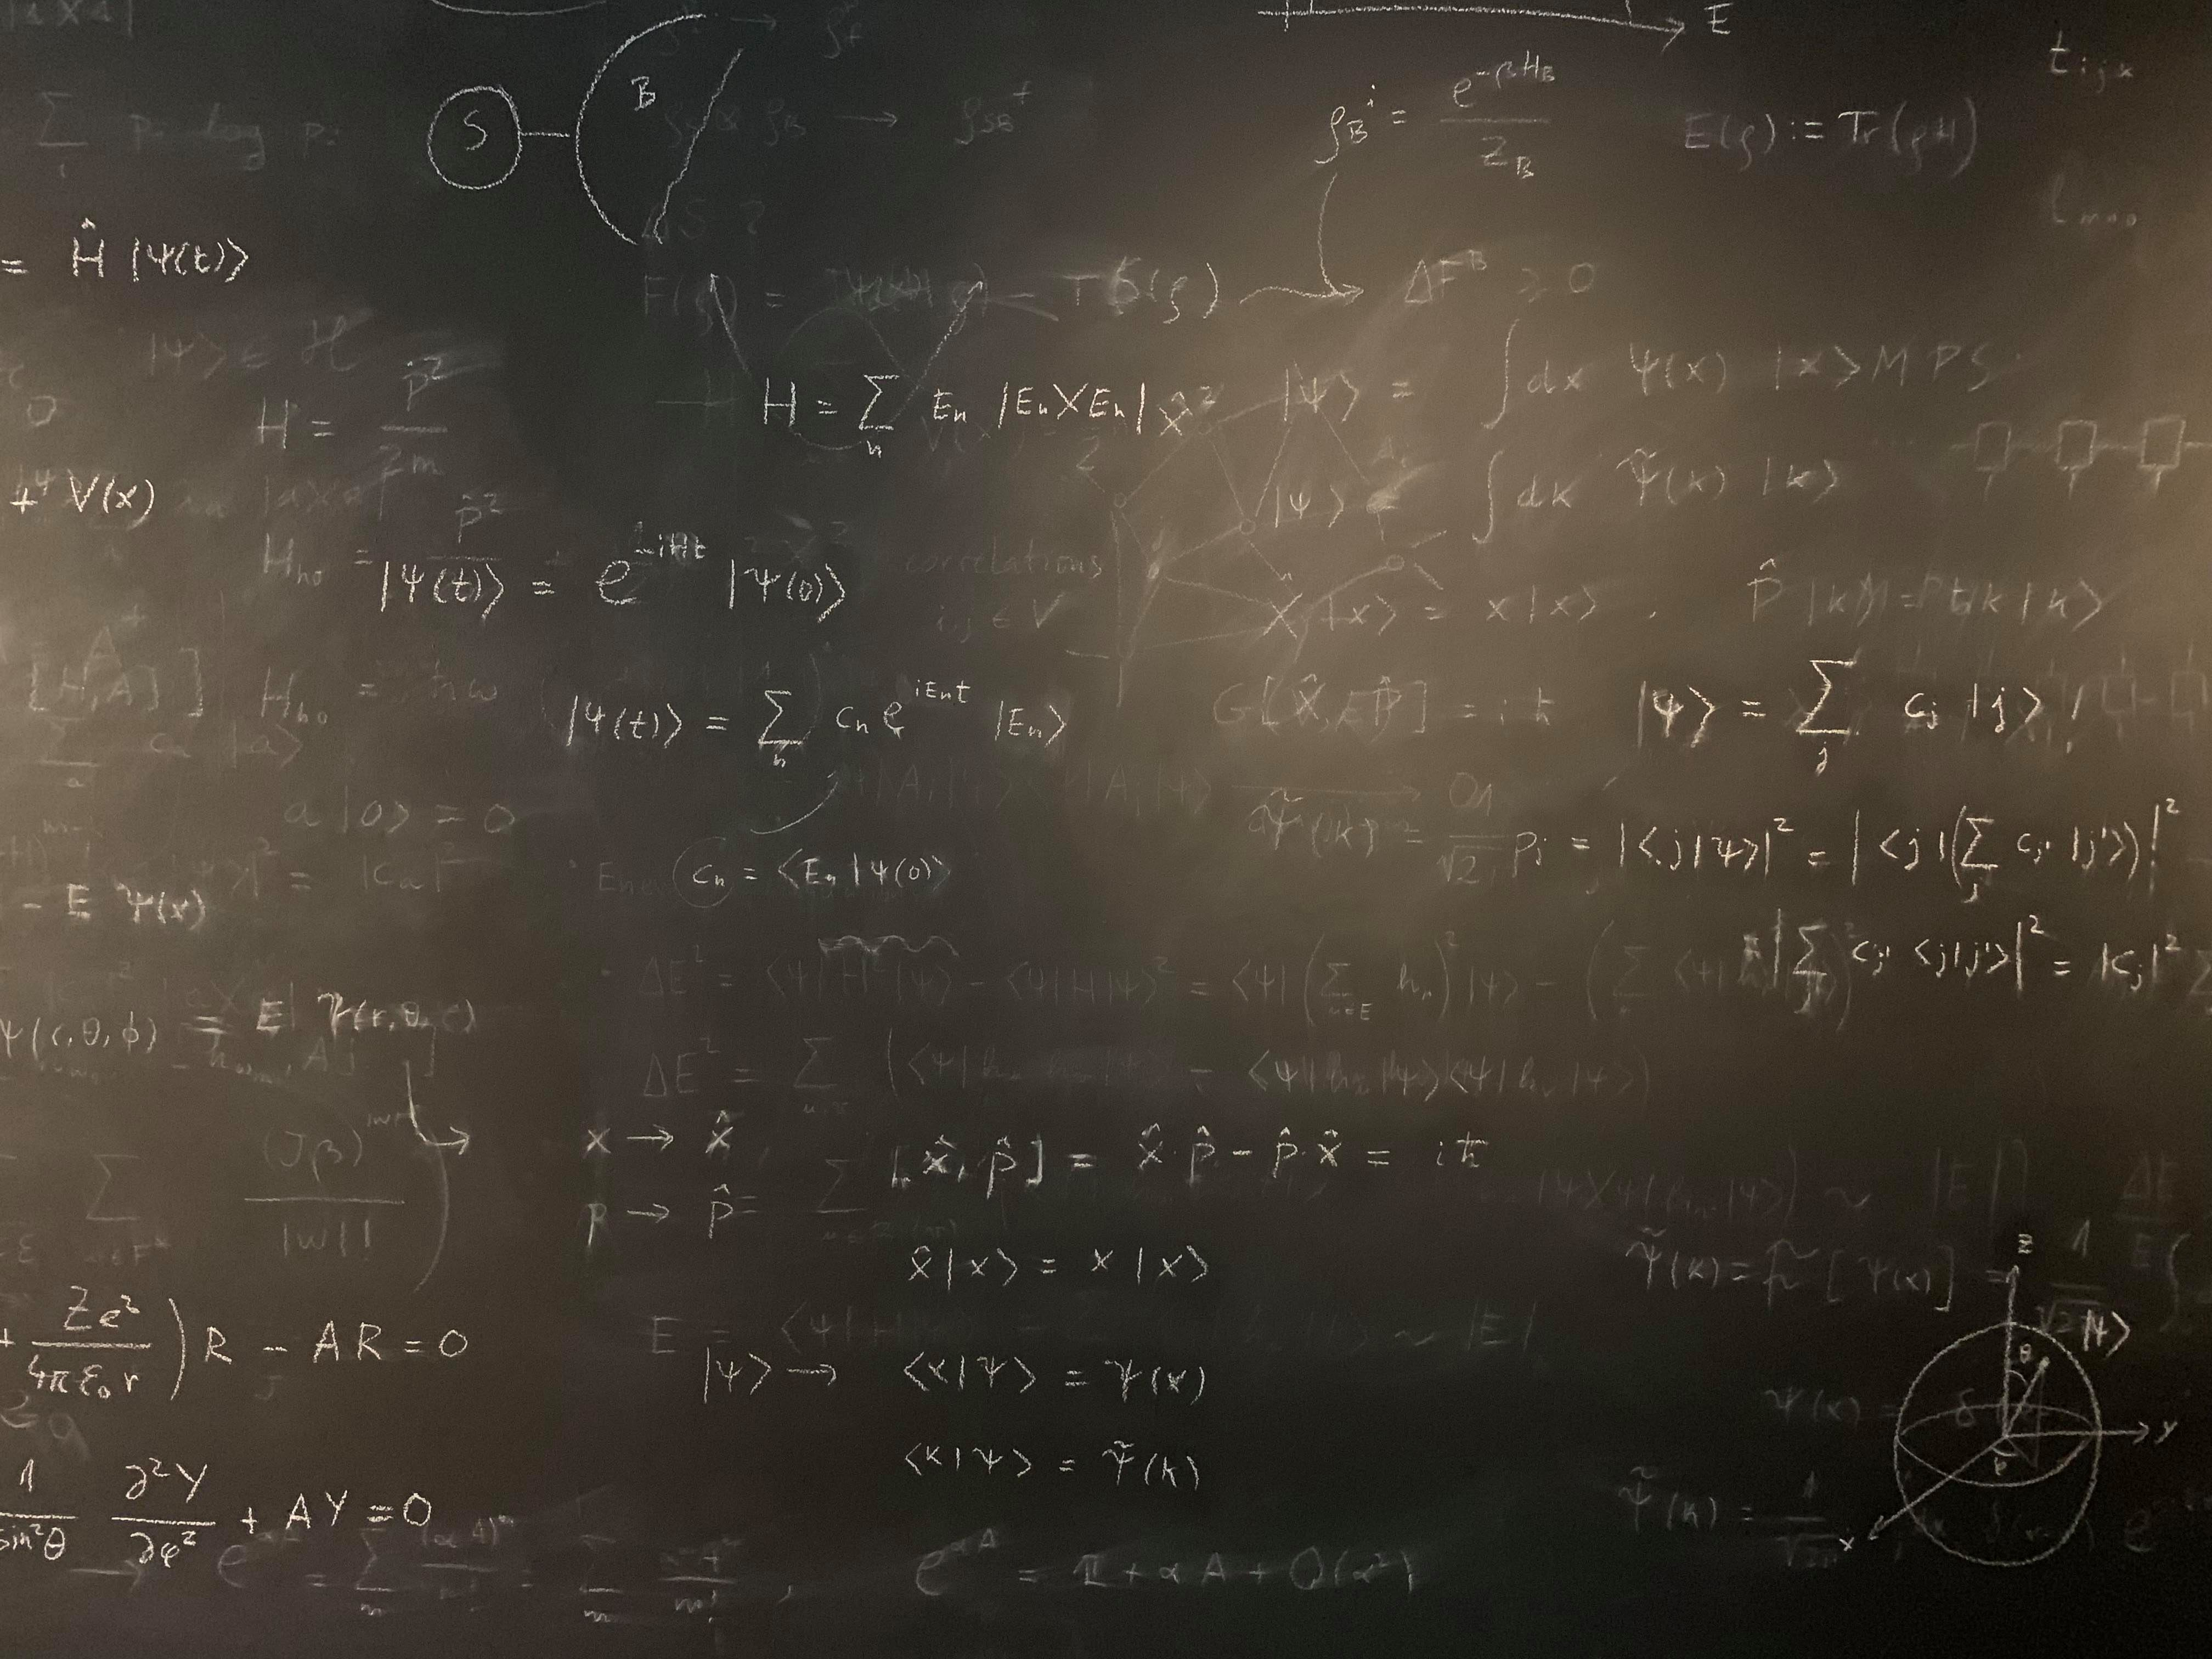
Figure references
Unless otherwise noted all Figures are taken from Chapter 7 of Atkins, P. ja De Paula, J. , L. (2014), Atkins’ Physical Chemistry, 10th edition, Oxford University Press, Oxford, New York.

