Slide 1
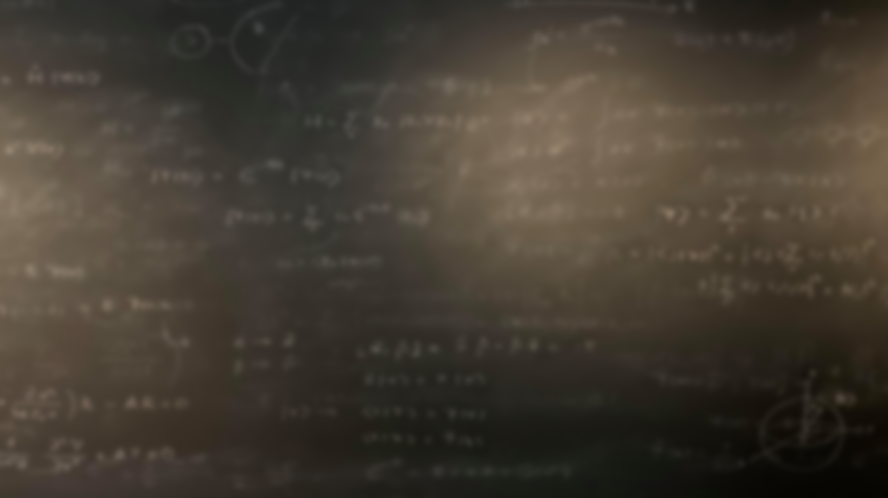
Quantum Mechanics
and Spectroscopy
Lauri Partanen

Slide 2
Work in your group:
1) Write down everything you remember about the harmonic oscillator without opening the book (Schrödinger equation, energy level equation, sketch of the energies, wavefunctions, potential energy etc.).

Slide 3
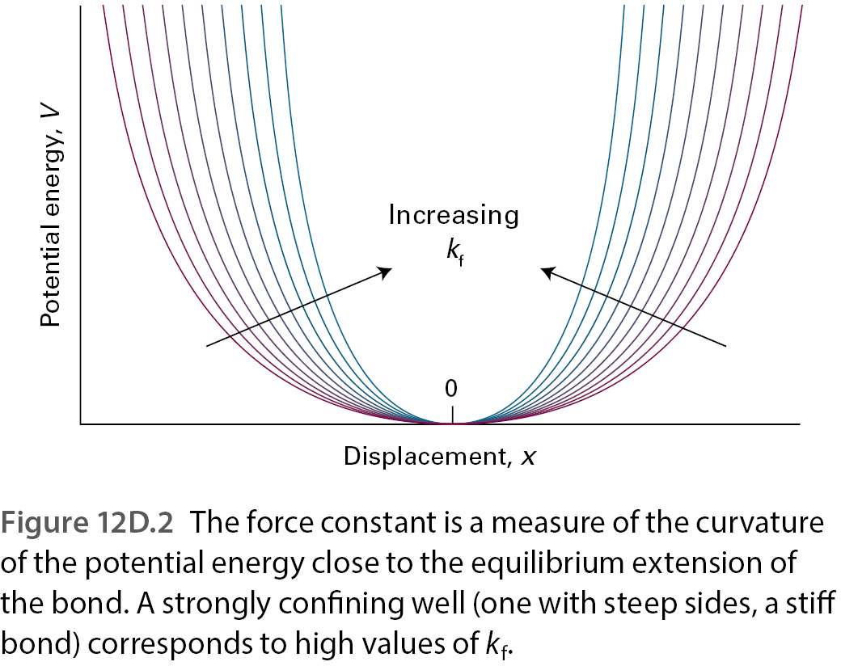
The harmonic potential
Potential
Force constant!
$$V\left(x\right)=\frac{1}{2}k_{f}x^{2}$$
($x=r−r_{0}$)

Slide 4
The Schrödinger equation
$$−\frac{ℏ^{2}}{2m}\frac{d^{2}}{dx^{2}}ψ+\frac{1}{2}k_{f}x^{2}ψ=Eψ$$
Simplest solution (problems): $ψ=Ne^{−ax^{2}}$

Slide 5
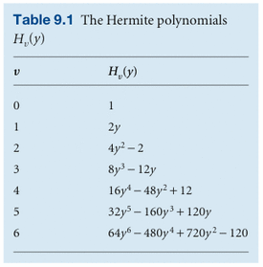
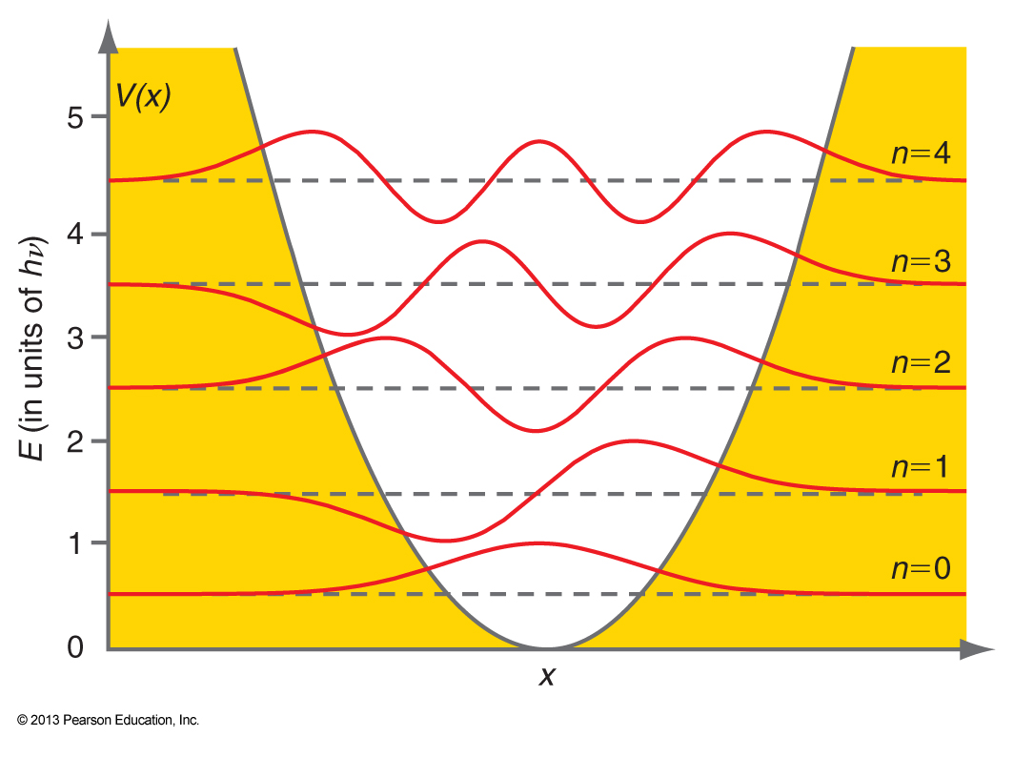
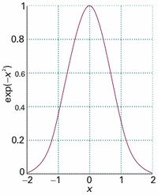
The wavefunctions
$$ψ_{v}(x)={\left(\frac{1}{απ^{\frac{1}{2}}2^{v}v!}\right)}^{\frac{1}{2}} H_{v}\left(\frac{x}{α}\right) e^{−\frac{x^{2}}{2α^{2}}}$$
$$y=x/α$$
Exponentially decreasing Gaussian
Normalization
$$α={\left(\frac{ℏ^{2}}{mk_{f}}\right)}^{\frac{1}{4}}$$
Polynomial (Hermite polynomial)

Slide 6
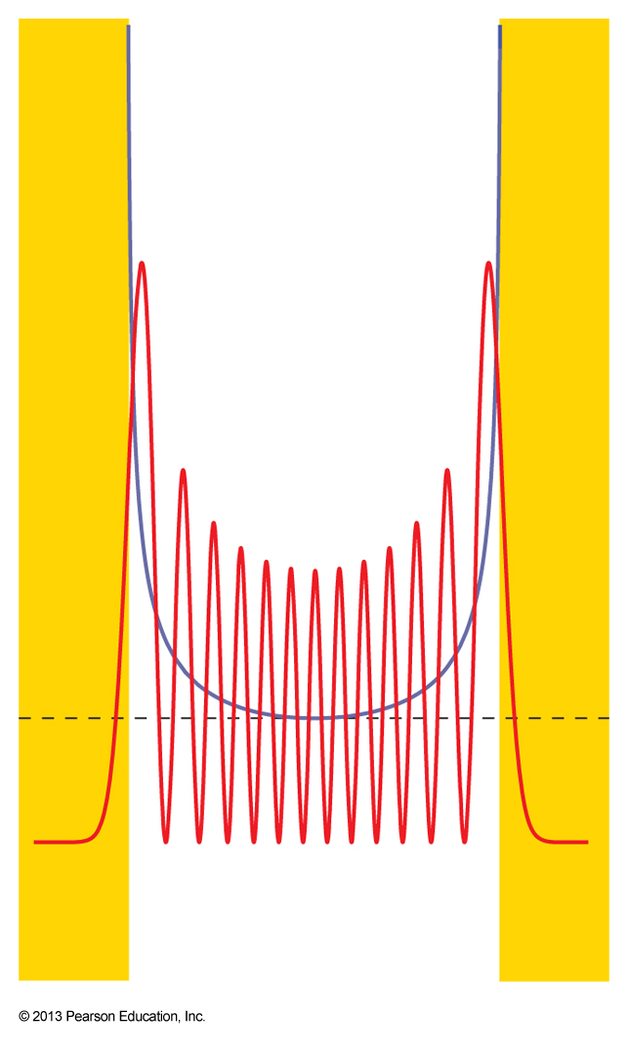
Work with your pair: (5 mins)
What can you say about the potential and kinetic energies of the oscillating particle?
Is tunneling present? How do you think the tunneling depends on the wavenumber?
Compare the probability densities with the behavior of the classical oscillator.
Is the correspondence principle relevant here?
$$v=4$$
$$v=3$$
$$v=2$$
$$v=1$$
$$v=12$$
$$v=0$$

Slide 7
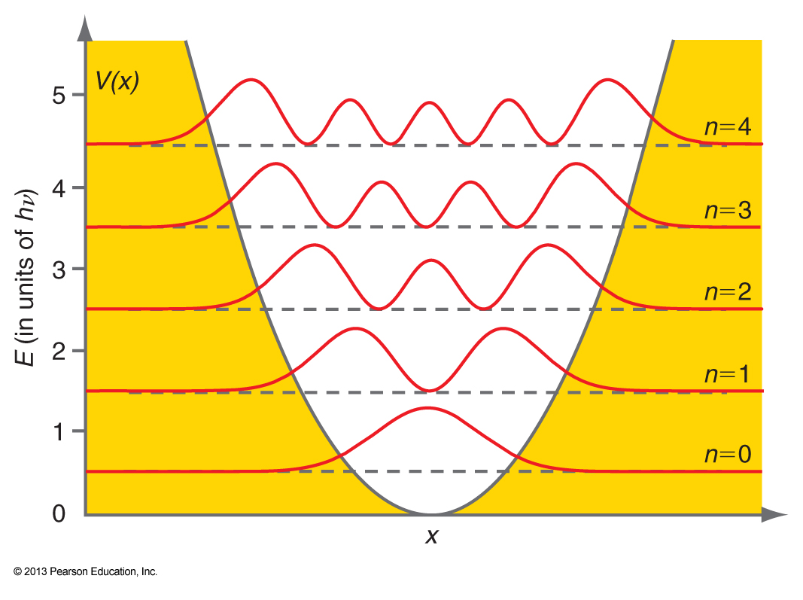
Stop and think: The figure shows the probability densities of a particle for the five first states. Use it to find out the expectation value of position for each of these states.
$${\left|ψ_{v}\right|}^{2}$$
$$v=4$$
$$v=3$$
$$v=2$$
$$v=1$$
$$v=0$$
Solution: $\left\langle \hat{x}\right\rangle =0$

Slide 8
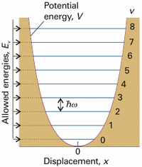
The energy levels
$$ω={\left(\frac{k_{f}}{m}\right)}^{\frac{1}{2}}$$
$E_{v}=\left(v+\frac{1}{2}\right)ℏω$,
What is the mass m for an oscillating two-atomic molecule?
$$m=μ=\frac{m_{A}m_{B}}{m_{A}\text{+}m_{B}}$$
Example: Calculate m for HI!

Slide 9
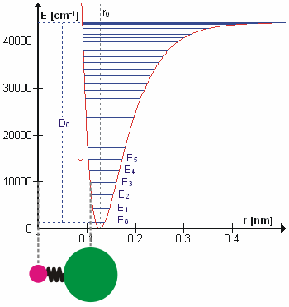
Stop and think: Draw the potential energy of a real two-atomic molecule. Place one of the atoms at origin. When is the true potential reasonably approximated by a harmonic one?

Slide 10
Summary and review:
Compare the energy levels and features of the probability density of a particle in an infinitely deep box and in a harmonic potential.

Slide 11
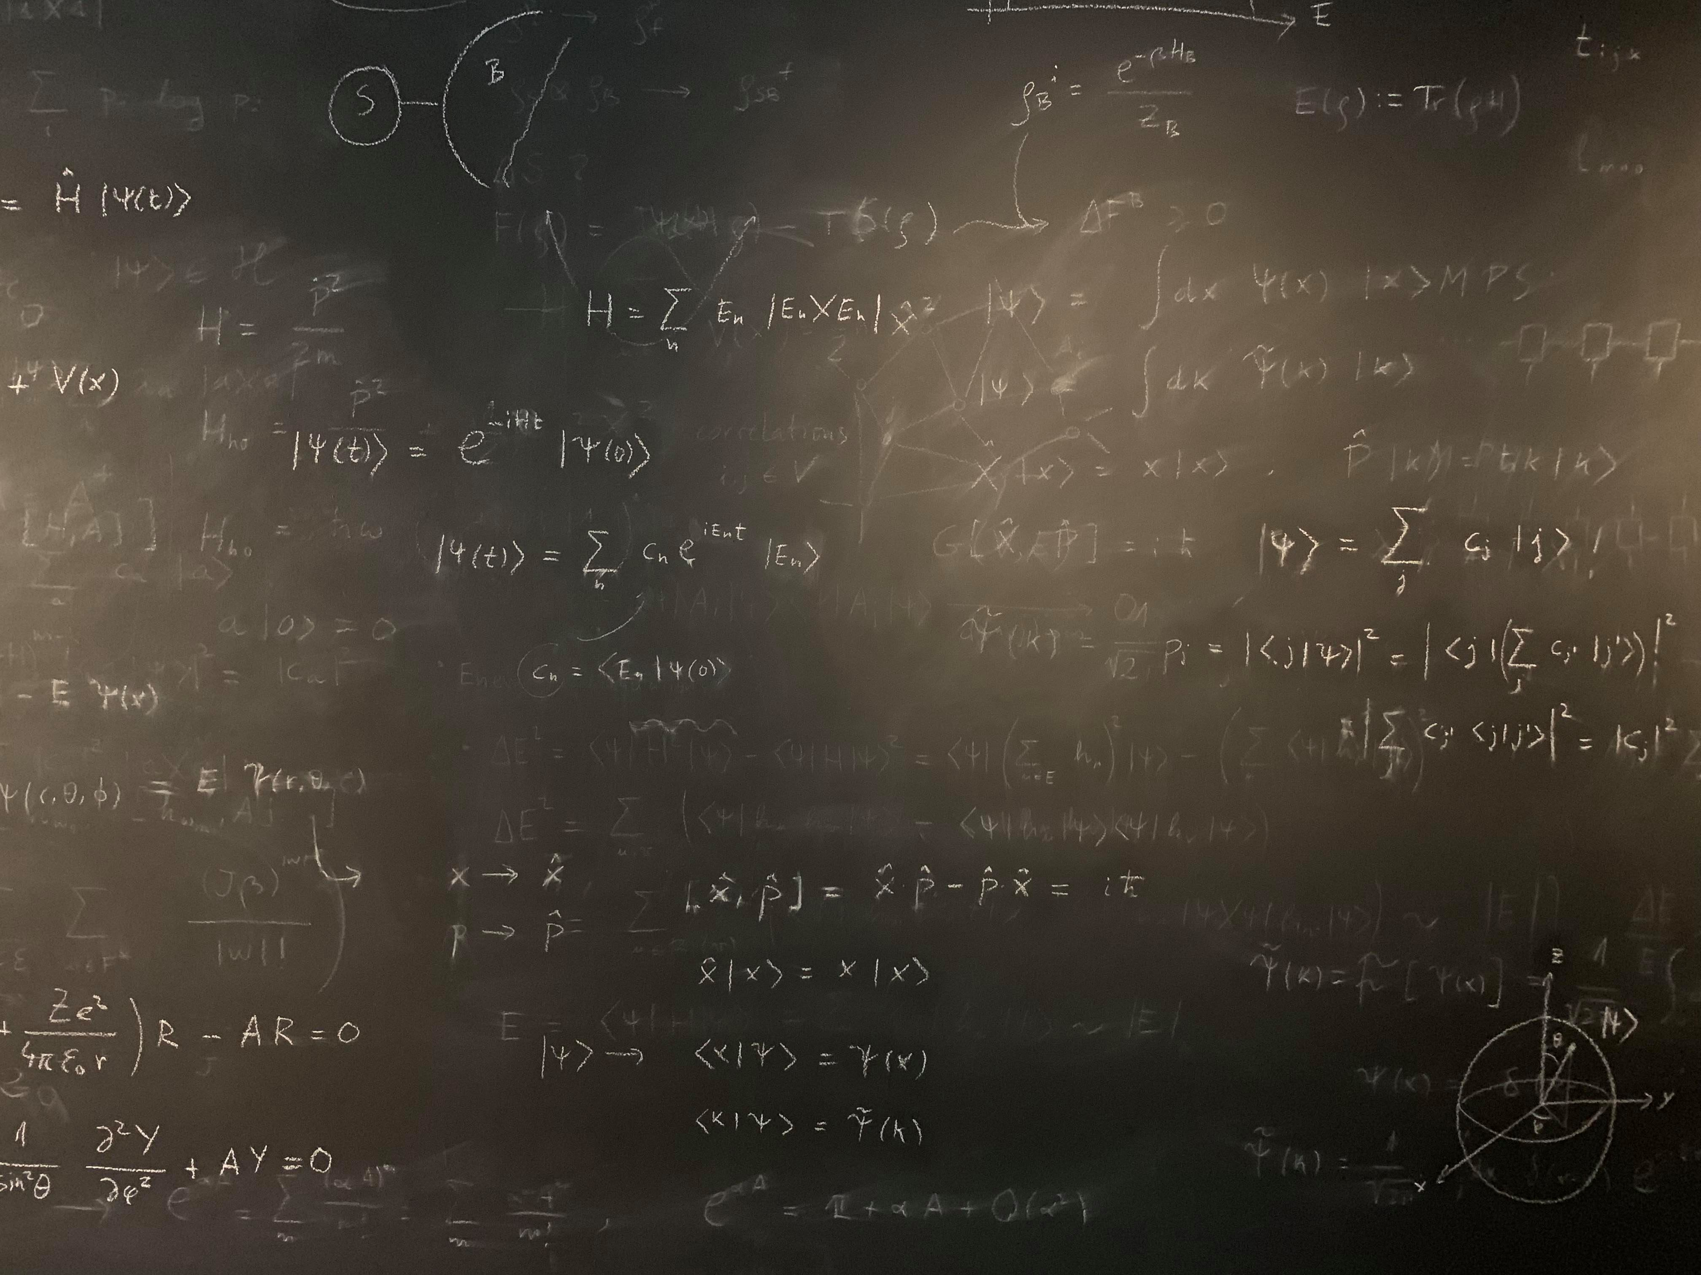
Figure references
Unless otherwise noted all Figures are taken from Chapter 7 of Atkins, P. ja De Paula, J. , L. (2014), Atkins’ Physical Chemistry, 10th edition, Oxford University Press, Oxford, New York.

