Slide 1
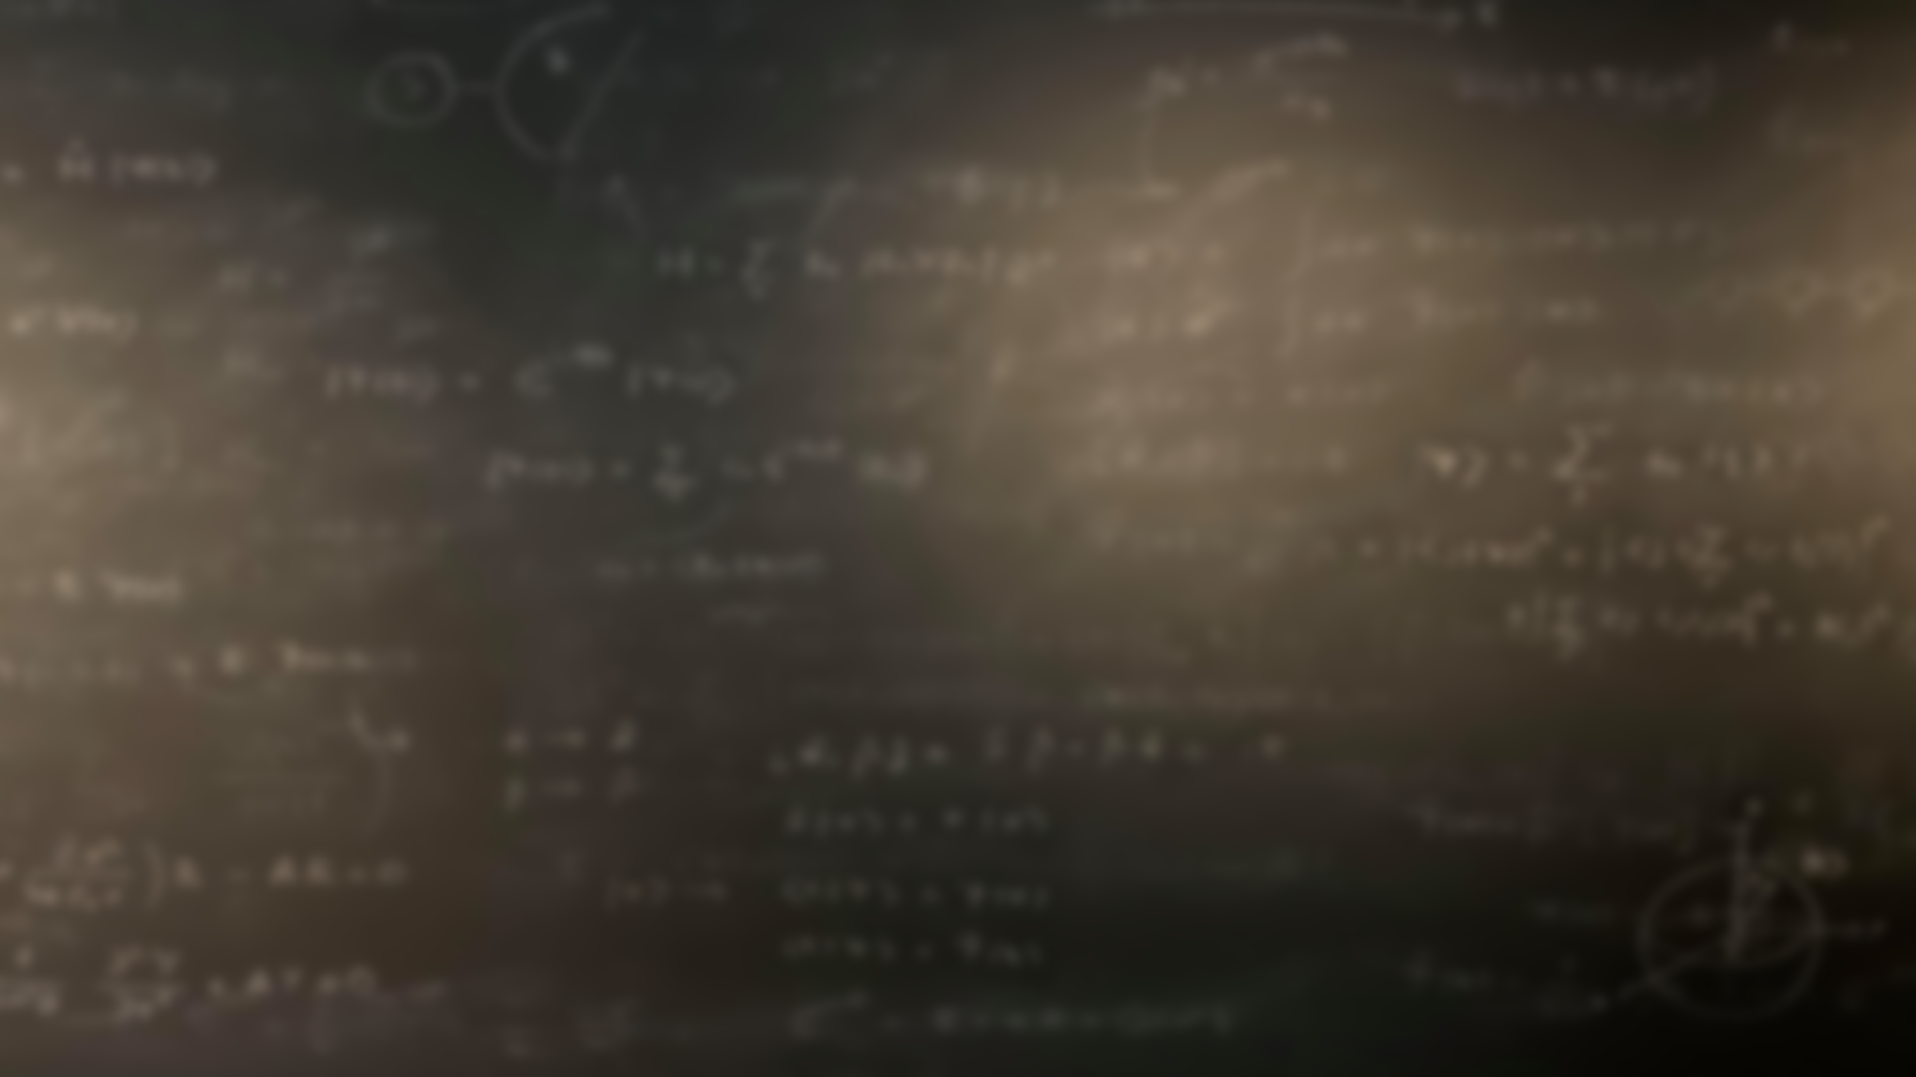
Quantum Mechanics
and Spectroscopy
Lauri Partanen

Slide 2
Recounting classical rotation
Work with your pair: (10 mins) Connect the classical concepts of rotational motion to their translational counterparts. In each case, give a description of the property, write the equation how to calculate it, and state whether there is a law of conservation related to it.
Velocity $v$
Moment of inertia $I$
K$inetic energy E_{k}$
Angular velocity $ω$
Angular momentum $J$
Mass $m$
Rotational energy $E_{r}$
Momentum $p$

Slide 3
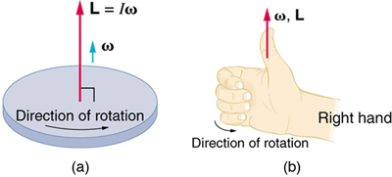
Translational motion
Rotational motion
mass $m$
Moment of Inertia $I=\sum_{i}{m_{i}x_{i}^{2}}$
velocity $v$
Angular velocity $ω$
momentum $p=mv$
Angular momentum $J=ωI$
K$inetic energy E_{k}=\frac{p^{2}}{2m}$
Rotational energy $E_{p}=\frac{J^{2}}{2I}$

Slide 4
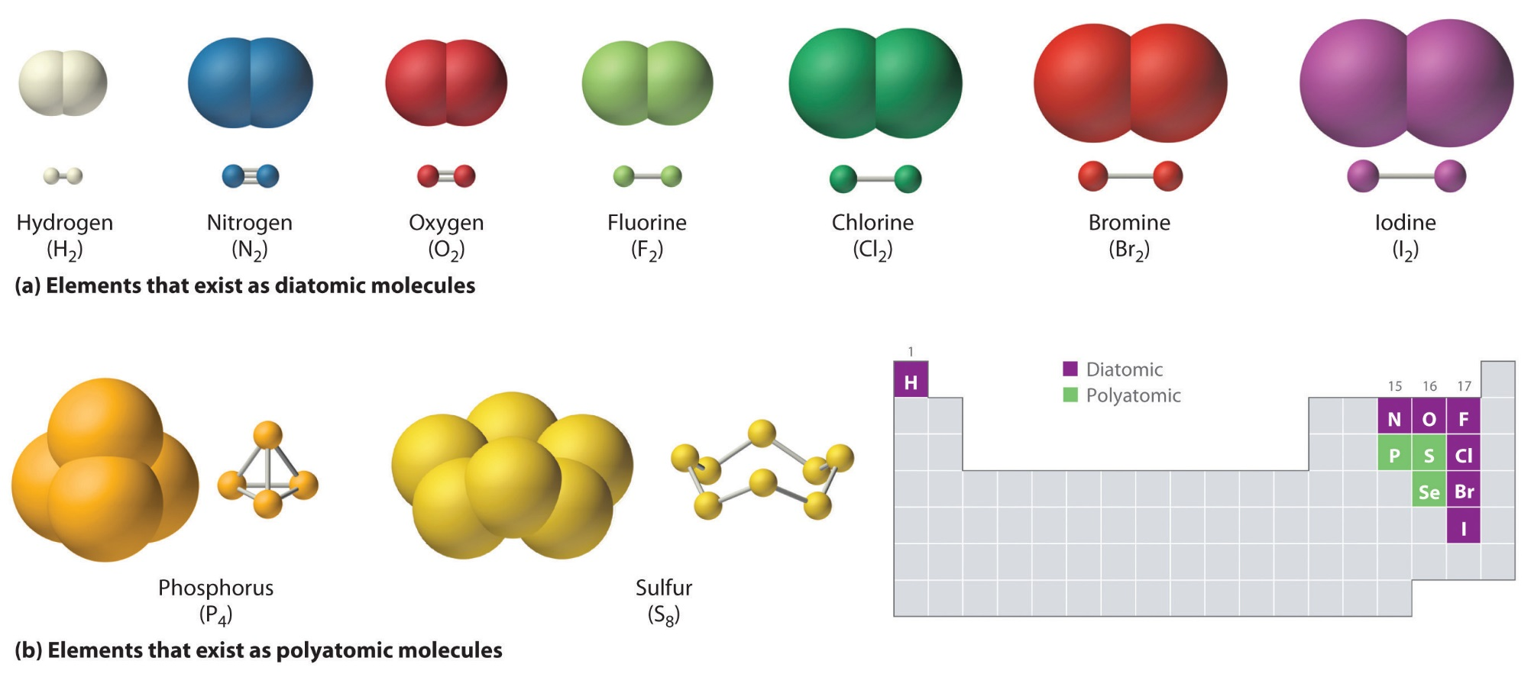
Discussion: Hydrogen, oxygen and chlorine molecules have bond lengths of 75, 121 and 199 pm. Find a formula for their moment of inertia and organize the moments of inertia from smallest to largest. What happens to the moment of inertia if the bond length increases as a consequence of vibration?
$$I=\sum_{i}{m_{i}x_{i}^{2}}$$
Vastaus: $I_{H_{2}}<I_{O_{2}}<I_{{Cl}_{2}}$

Slide 5
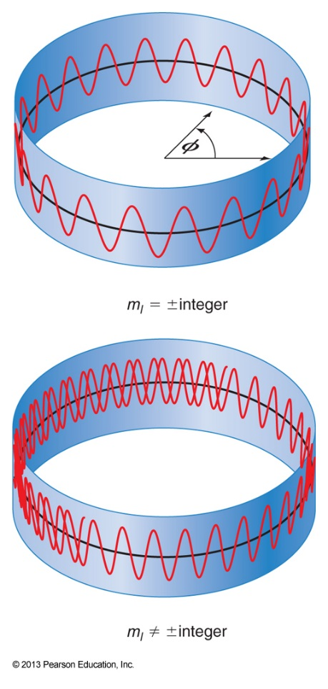
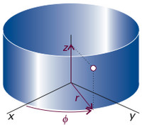
Back to quantum mechanics
Work with your pair: (10 min)
Write the SE for a particle in a ring-shaped 2 dimensional path in Cartesian coordinates. Which coordinates would be better suited for the depiction of this system?
Compare the boundary conditions for a particle in a ring to the particle in a box.
What kinds of wavefunctions and energies are permissible for the particle in a ring?
Explain the concept of degeneracy. Is it somehow relevant to the solutions? How/why?

Slide 6
The solutions for a particle on a ring
$\left\{\begin{matrix}ψ=\frac{1}{\sqrt{2π}}e^{im_{l}φ} , r=R \\ ψ=0, r≠R\end{matrix}\right.$
$$\left\{\begin{matrix}−\frac{ℏ^{2}}{2mR^{2}}\frac{∂^{2}}{∂φ^{2}}ψ=Eψ\text{,} r=R \\ ψ=0, r≠R\end{matrix}\right.$$
$E_{m_{l}}=\frac{m_{l}^{2}ℏ^{2}}{2mR^{2}}$, $m_{l}∈Z$
Except for $m_{l}=0$, every state is doubly degenerate!
Again boundary conditions caused by our potential result in the quantisation of energy!
Compare these results to the particle in a box. What can you say about the quantization of linear vs. angular momentum?

Slide 7
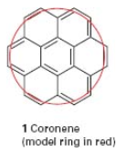
Episode VI: Return of the Coronene
Using the particle-on-a-ring model calculate the minimum energy required for excitation in coroner, when the radius of the ring is three times the carbon-carbon bond length 140 and the electrons are confined to the periphery of the molecule.

Slide 8
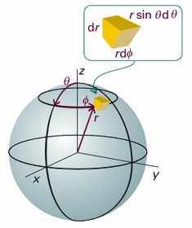
The particle on a sphere
Work with your pair: (5 mins)
What changes in the Hamiltonian (in Cartesian coordinates) when we move from the 2D ring to a 3D sphere?
Which coordinates are now better suited for describing the system?
How are the periodic boundary conditions changed?

Slide 9
Particle on a Ring
Particle on a Sphere
$$\left\{\begin{matrix}−\frac{ℏ^{2}}{2mR^{2}}\frac{∂^{2}}{∂φ^{2}}ψ=Eψ\text{;} r=R \\ ψ=0; r≠R\end{matrix}\right.$$
$$\left\{\begin{matrix}−\frac{ℏ^{2}}{2m}\left(\frac{∂^{2}}{∂x^{2}}+\frac{∂^{2}}{∂y^{2}}+\frac{∂^{2}}{∂z^{2}}\right)ψ=Eψ\text{;} \sqrt{x^{2}+y^{2}+z^{2}}=R \\ ψ=0; \sqrt{x^{2}+y^{2}+z^{2}}≠R\end{matrix}\right.$$
Cylindrical coordinates
Spherical coordinates
$$\left\{\begin{matrix}−\frac{ℏ^{2}}{2m}\left(\frac{∂^{2}}{∂r^{2}}+\frac{1}{r}\frac{∂}{∂r}+\frac{1}{r^{2}}\frac{∂^{2}}{∂φ^{2}}\right)ψ=Eψ\text{,} r=R \\ ψ=0, r≠R\end{matrix}\right.$$
$$\left\{\begin{matrix}−\frac{ℏ^{2}}{2mR^{2}}\left(\frac{1}{\sin^{2}{θ}}\frac{∂^{2}}{∂φ^{2}}+\frac{1}{\sin{θ}}\frac{∂}{∂θ}\sin{θ}\frac{∂}{∂θ}\right)ψ=Eψ\text{;} r=R \\ ψ=0, r≠R\end{matrix}\right.$$
$ψ=$ $ψ\left(φ\right)$!
$$\left\{\begin{matrix}−\frac{ℏ^{2}}{2mR^{2}}\frac{∂^{2}}{∂φ^{2}}ψ=Eψ\text{,} r=R \\ ψ=0, r≠R\end{matrix}\right.$$
Separation of variables + long derivation
Wavefunctions $ψ$, energies E

Slide 10
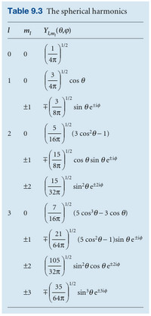
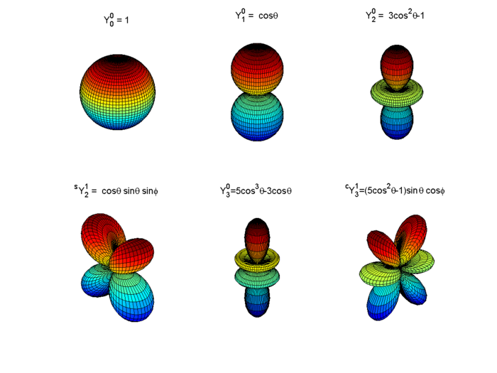
The Wavefunctions for a particle on a sphere
Work with your pair: (5 mins)
In the table to your right a series of wavefunctions for the particle in a sphere are represented.
1) Summarize their essential features.
2) What trends can be observed?

Slide 11
The energy levels for a particle on a sphere
Work with your pair: (5 mins)
How many quantum numbers arise for a particle in a sphere? What are the allowed values for the quantum numbers?
Is there zero point energy – how about degeneracy?
$$E_{l,m_{l}}=l\left(l+1\right)\frac{ℏ^{2}}{2mR^{2}}$$
$$l=0,1,2,…$$
$$m_{l}=0,±1,±2,…,±l$$
Every energy level is $2l+1$-times degenerate!
No zero point energy!
Energy is independent of the value of $m_{l}$

Slide 12
Stop and think: By comparing the classical equation for rotational energy to the obtained energy expression, what can you say about the magnitude of the angular momentum for a particle on a sphere?
$$E_{l,m_{l}}=l\left(l+1\right)\frac{ℏ^{2}}{2I}$$
$$\left|\hat{l}\right|=ℏ\sqrt{l\left(l+1\right)}$$

Slide 13
Exercise a: Use the table to find out the possible values for the z-component of the angular momentum, when the total angular momentum has the value $\sqrt{6}ℏ.$ The operator for the z-component is known to be ${\hat{l}}_{z}=\frac{ℏ}{i}\frac{∂}{∂φ}$.
$$\left|\hat{l}\right|=ℏ\sqrt{l\left(l+1\right)}$$
Exercise b: Generalize your findings in part a) to a general rule for how to obtain the z-component.

Slide 14
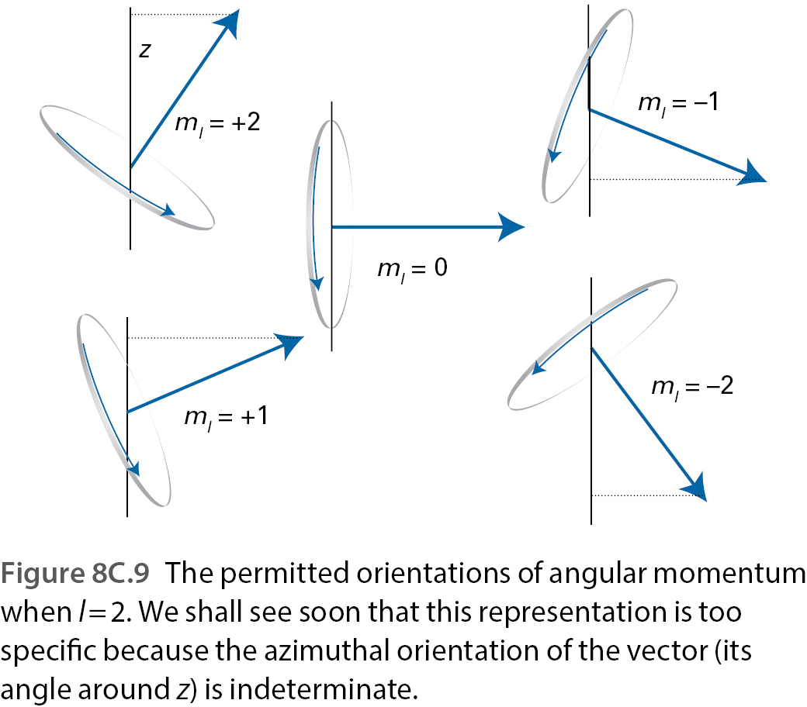
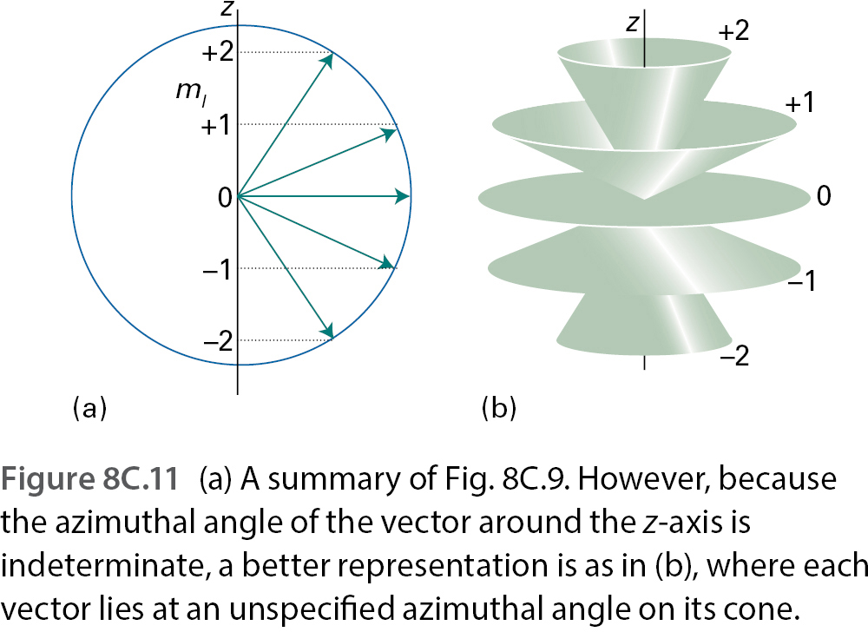
Work with your pair (10 mins):
The square of the angular momentum fulfils the following commutators $\left[{\hat{l}}^{2},{\hat{l}}_{z}\right]$=0, $\left[{\hat{l}}^{2},{\hat{l}}_{x}\right]$=0, $\left[{\hat{l}}^{2},{\hat{l}}_{y}\right]$=0, $\left[{\hat{l}}_{z},{\hat{l}}_{x}\right]=iℏ{\hat{l}}_{y}$, $\left[{\hat{l}}_{x},{\hat{l}}_{y}\right]=iℏ{\hat{l}}_{z}$, $\left[{\hat{l}}_{y},{\hat{l}}_{z}\right]=iℏ{\hat{l}}_{x}$
Explain what the different operators in the commutators signify. Then interpret what the individual commutators mean for physical measurements.
What do these commutators mean for the determination of the angular momentum? What can be determined and what not?

Slide 15
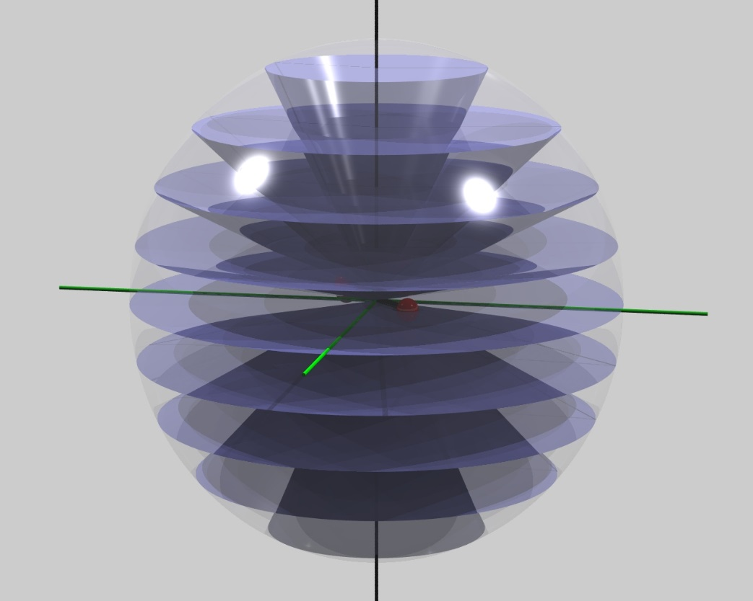
Presemo: The picture on the rights shows the possible angular momentum vectors for a particular $l$.
a
Which $l$ is at question?
Which of the cones corresponds to $ψ=Y_{l,−3}(θ,φ)$?
b
c
a
b
c
d
e
f
Now I want ice cream
d
e
f

Slide 16
Presemo: The picture on the rights shows the possible angular momentum vectors for a particular $l$.
a
Which $l$ is at question?
Which of the cones corresponds to $ψ=Y_{l,−3}(θ,φ)$?
b
c
a
b
c
d
e
f
Now I want ice cream
d
e
f

Slide 17
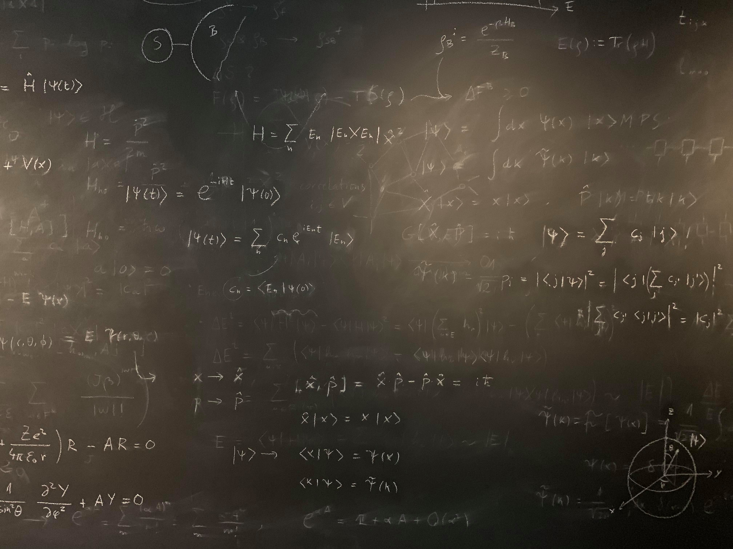
Figure references
Unless otherwise noted all Figures are taken from Chapter 7 of Atkins, P. ja De Paula, J. , L. (2014), Atkins’ Physical Chemistry, 10th edition, Oxford University Press, Oxford, New York.

