Slide 1
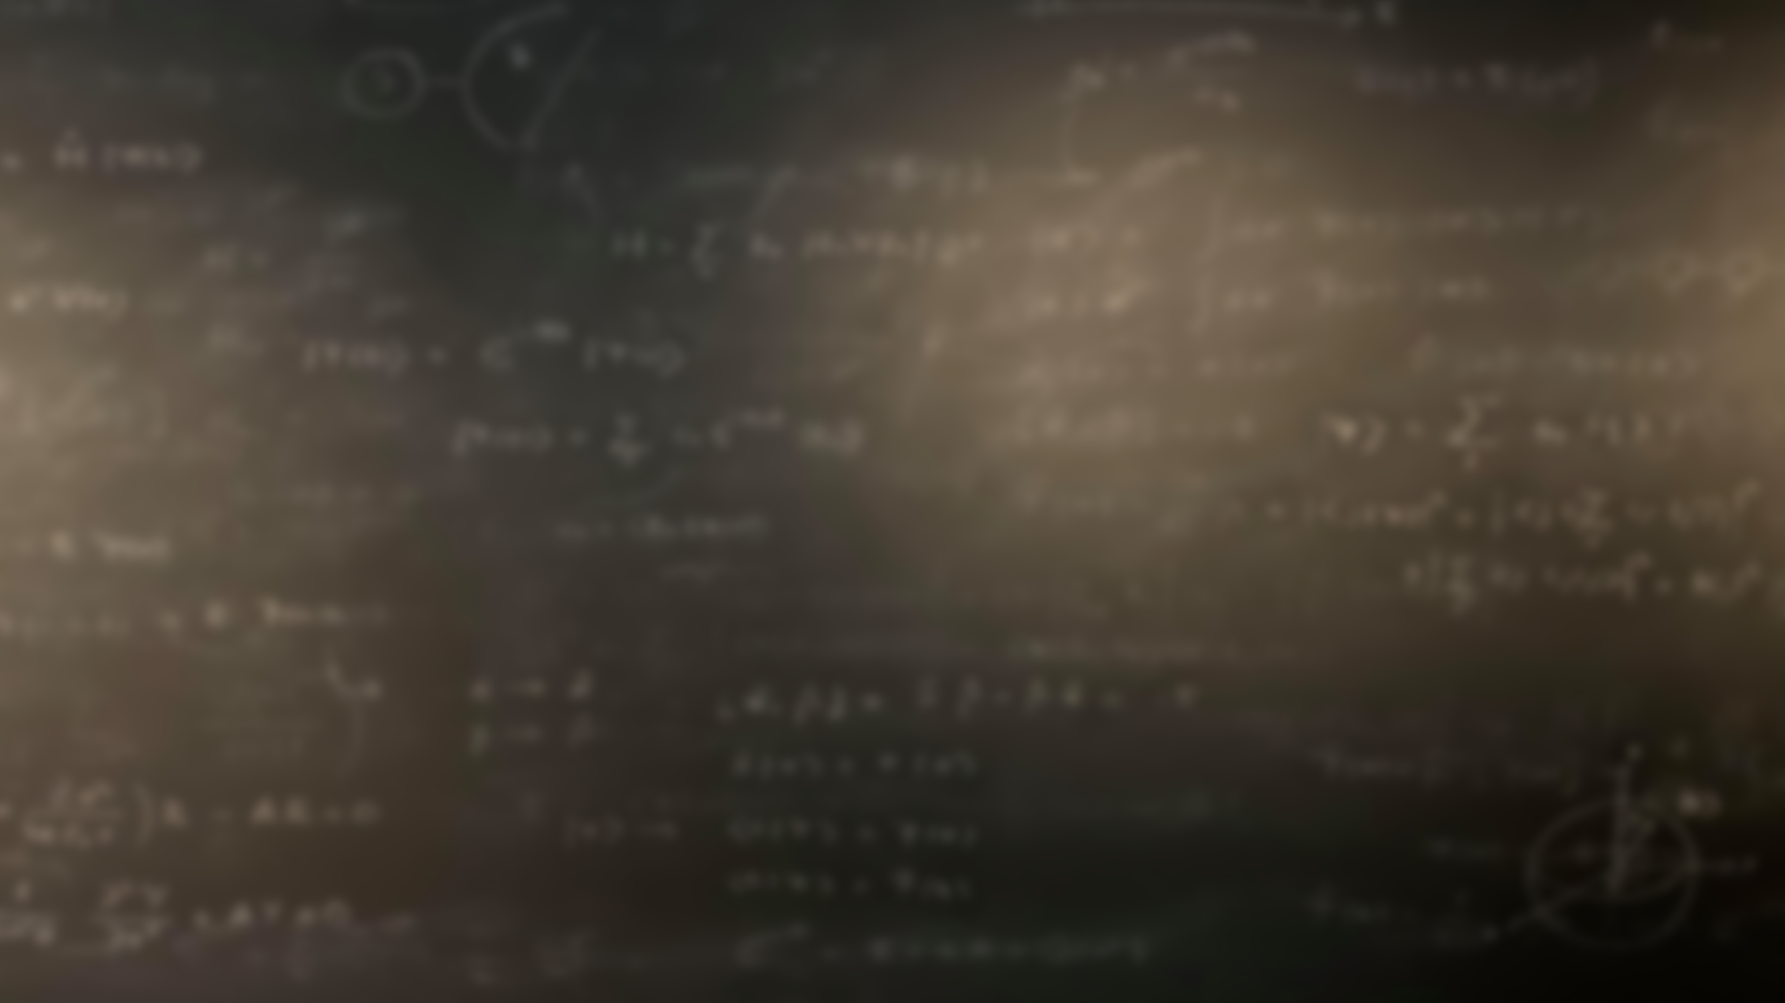
Quantum Mechanics
and Spectroscopy
Lauri Partanen

Slide 2
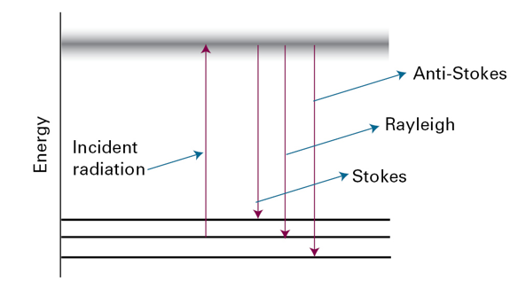
Work with your pair: (10 mins): What branches of spectroscopy can be associated with the picture below? Indicate which different branches of spectroscopy can be connected to the different lines in the picture?

Slide 3
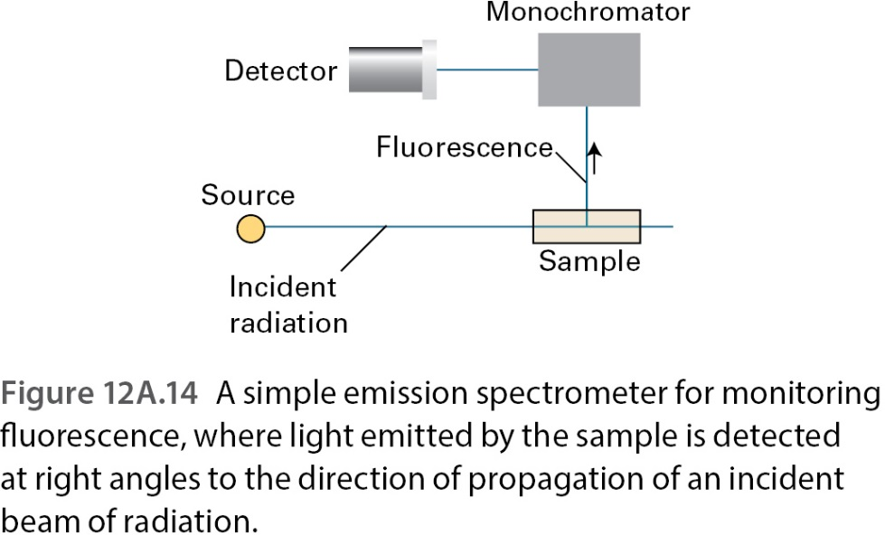
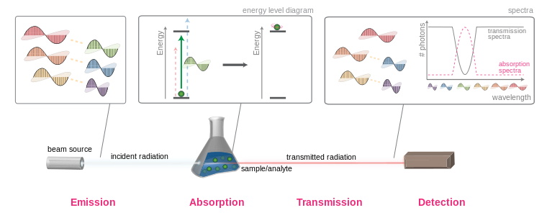
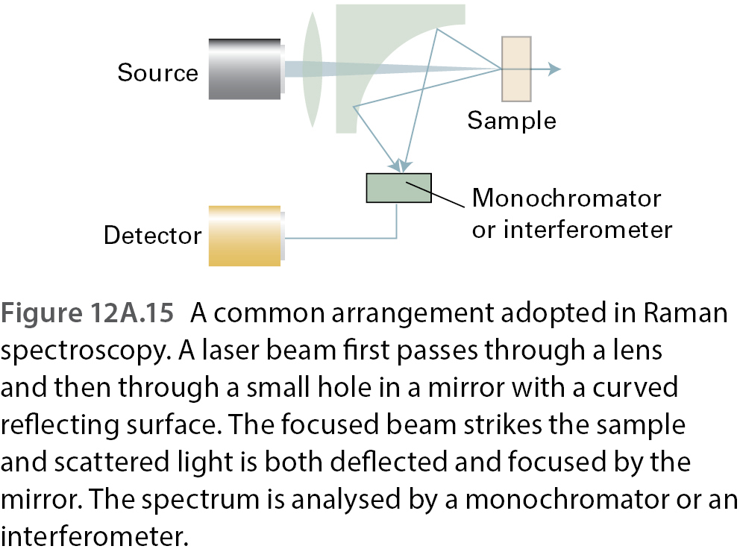

Slide 4
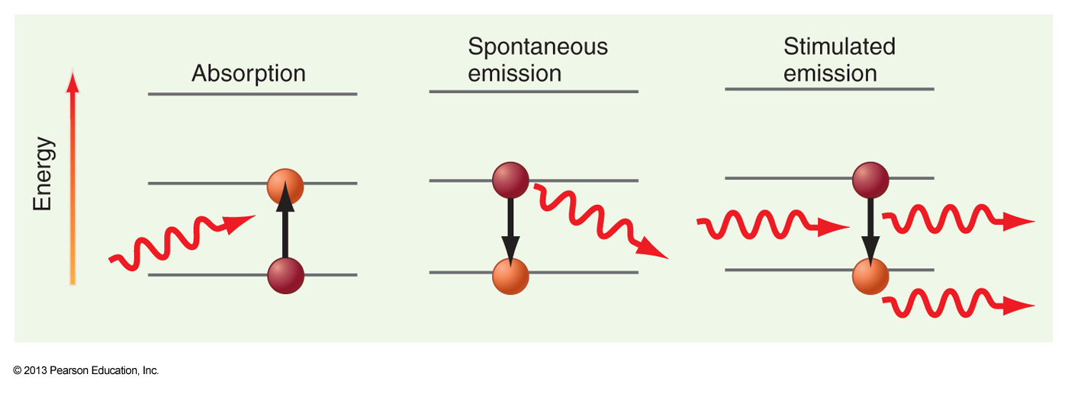
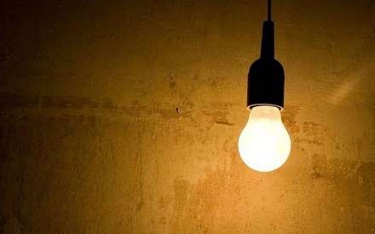
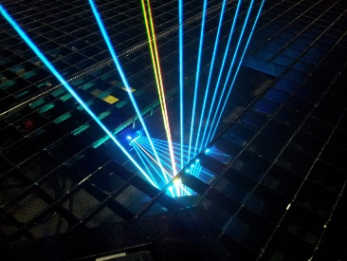
Work with your pair: (5 mins): What are the three different mechanism electromagnetic radiation can interact with matter? How do they differ?
Photons in different phases!
Photons in the same phase

Slide 5
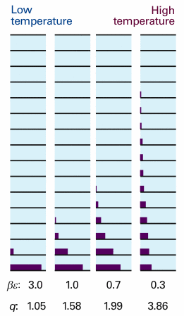
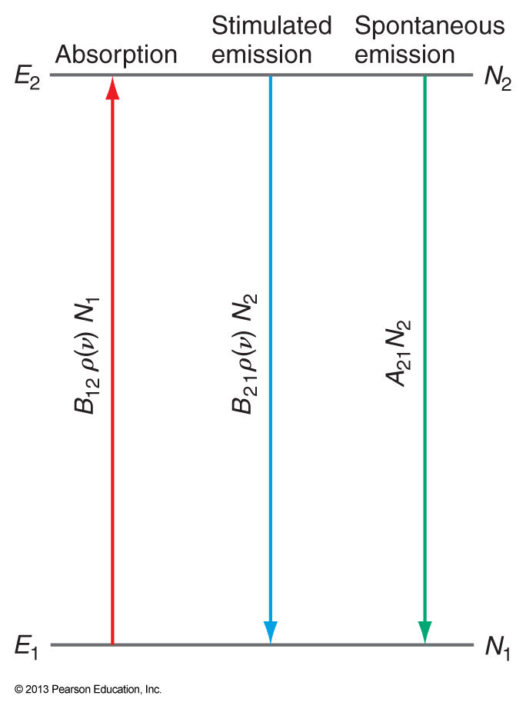
Stop and think 1a: Let’s denote the number of available photons with a certain frequency as $ρ\left(f\right)$, the number of molecules in state 1 as $N_{1}$ and those in an excited state 2 as $N_{2}$. Write the rates of absorption, stimulated emission, and spontaneous emission. What can you say about these rates at equilibrium for the frequency $f$?
$$\frac{N_{i}}{N_{j}}=\frac{g_{i}}{g_{j}}e^{−\frac{E_{i}−E_{j}}{kT}}$$

Slide 6
Stop and think 1b: The ratio of the rates to spontaneous emission to stimulated one is
$$\frac{R_{spon}}{R_{stim}}=\frac{8πhf^{3}}{c^{3}ρ\left(f\right)}, ρ\left(f,T\right)=\frac{8πhf^{3}}{c^{3}\left(e^{\frac{hf}{kT}}−1\right)}$$
What does this mean with respect to the relative importance of the two types of radiation?

Slide 7
Work with your pair: (10 mins): Define the concepts absorbance and transmittance. What is the Beer-Lambert law and how is it connected to these concepts?

Slide 8
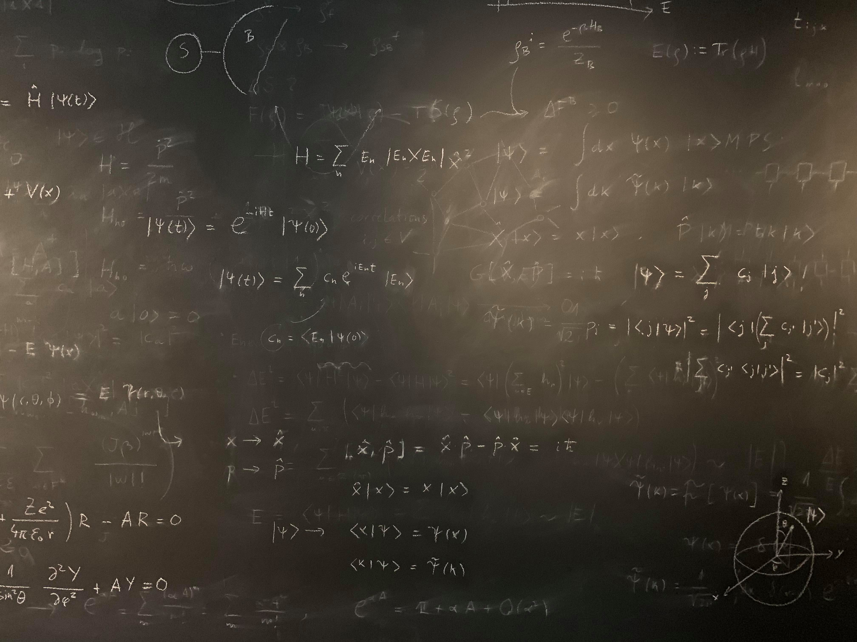
Figure references
Unless otherwise noted all Figures are taken from Chapter 7 of Atkins, P. ja De Paula, J. , L. (2014), Atkins’ Physical Chemistry, 10th edition, Oxford University Press, Oxford, New York.

