Slide 1
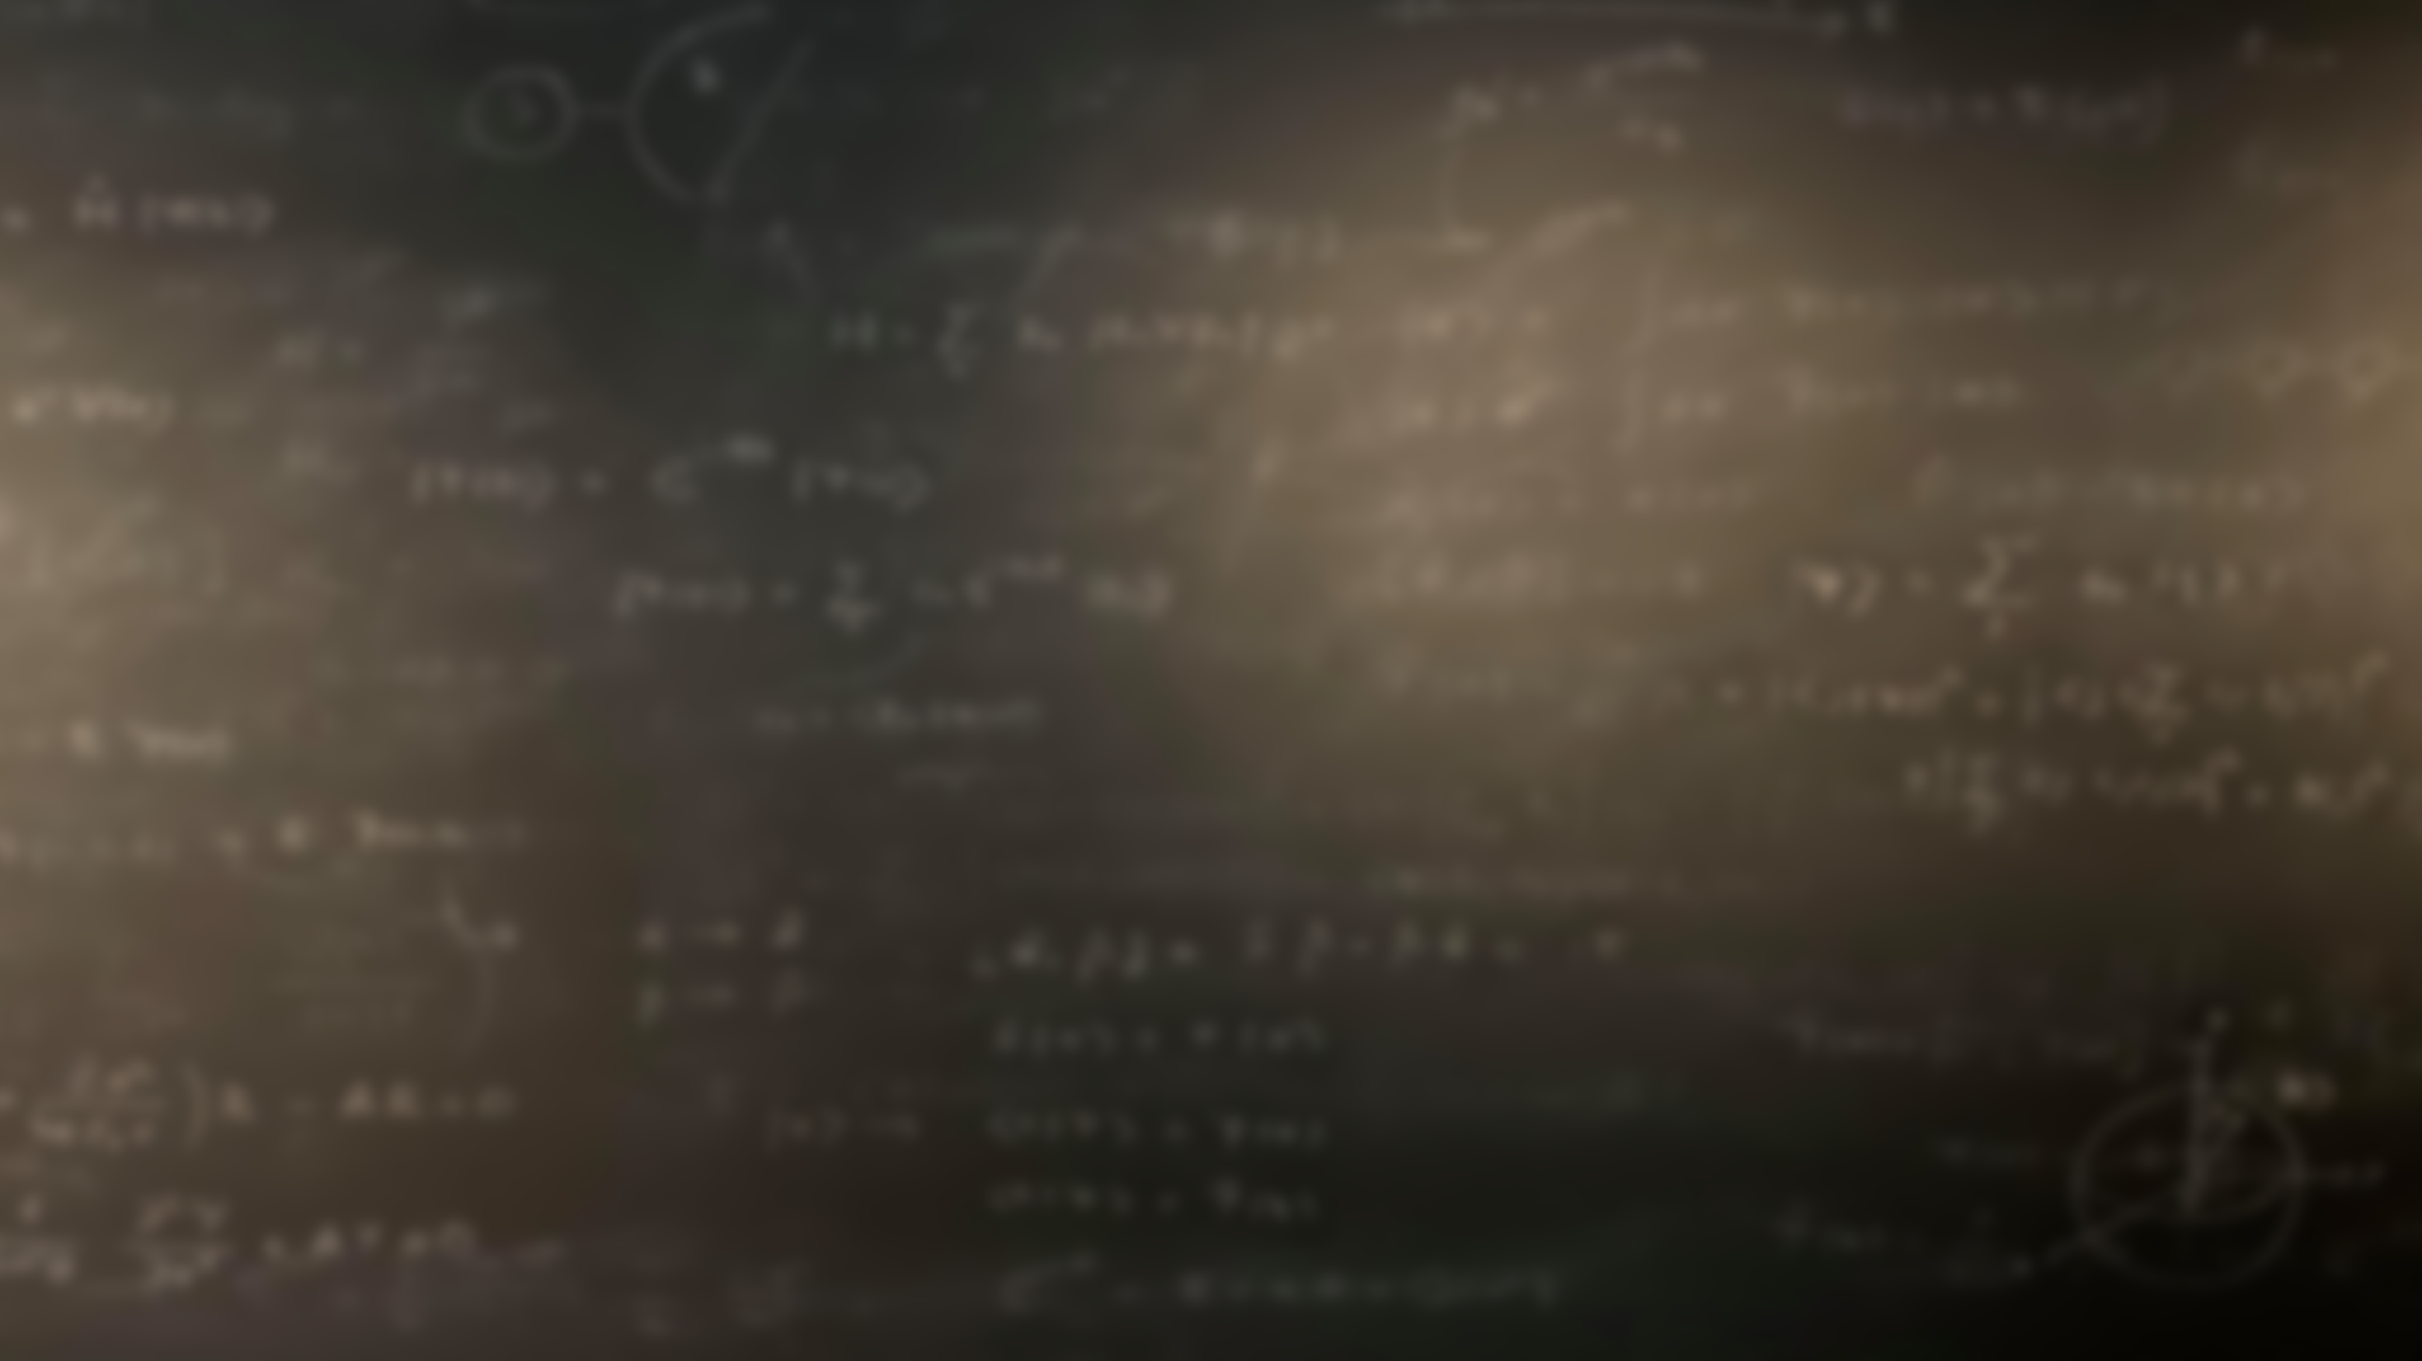
Quantum Mechanics
and Spectroscopy
Lauri Partanen

Slide 2
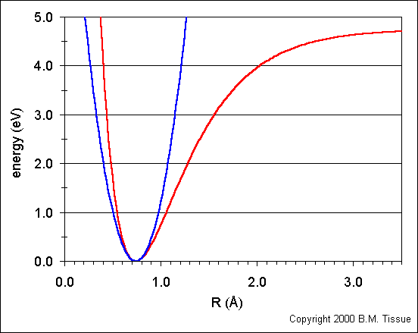
Work with your pair: (5 mins):
Based on the quantum mechanical systems we have seen thus far, what should happen to the energy levels of the system if the blue harmonic potential is replaced by the red one? Why?

Slide 3
Work with your pair: (10 mins):
What are the main physical shortcomings of the harmonic oscillator model?
Give an example of how it can be improved.
3) What does the energy level formula look like in the new model?
4) How about the potential energy term?
$$V\left(r\right)=D_{e}{\left[1−e^{−a\left(r−r_{e}\right)}\right]}^{2}$$
$E_{v}=hf\left(v+\frac{1}{2}\right)−\frac{{\left(hf\right)}^{2}}{4D_{e}}{\left(v+\frac{1}{2}\right)}^{2}$

Slide 4
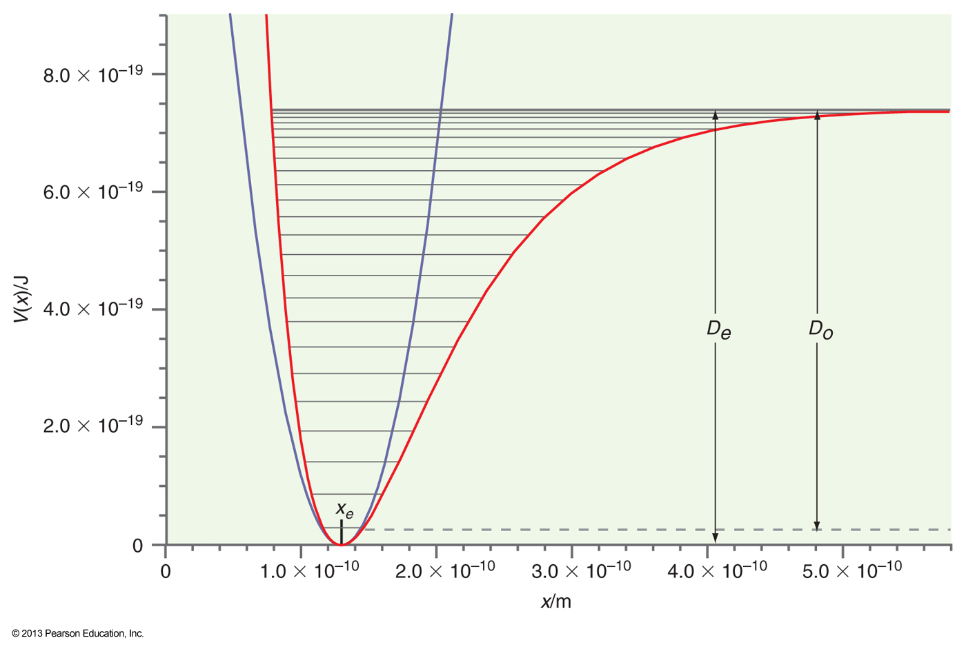
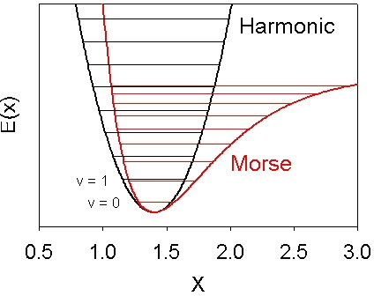
$$V\left(r\right)=\frac{1}{2}k_{f}{(r−r_{e})}^{2}$$
$$V\left(r\right)=D_{e}{\left[1−e^{−a\left(r−r_{e}\right)}\right]}^{2}$$
$E_{v}=hf\left(v+\frac{1}{2}\right)−\frac{{\left(hf\right)}^{2}}{4D_{e}}{\left(v+\frac{1}{2}\right)}^{2}$
r_{e}
r/m

Slide 5
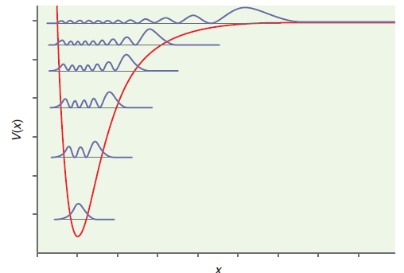
Stop to think: The picture below shows the probability density for the Morse oscillator for different vibrational states. What happens to the average bond length as the vibrational excitation increases?

Slide 6
Example: Let’s use the Morse potential to depict the dissociation of HCl. For HCl, $D_{e}=7.41⋅{10}^{−19} J$, the force constant is 516.3 N m⁻¹, and the frequency is $f=8.97⋅{10}^{13} s^{−1}$.
Estimate the bond length at the ground state.
Calculate the number of vibrational states before the bond breaks.
Calculate the bond energy of HCl.
$E_{v}=hf\left(v+\frac{1}{2}\right)−\frac{{\left(hf\right)}^{2}}{4D_{e}}{\left(v+\frac{1}{2}\right)}^{2}$
r/m

Slide 7
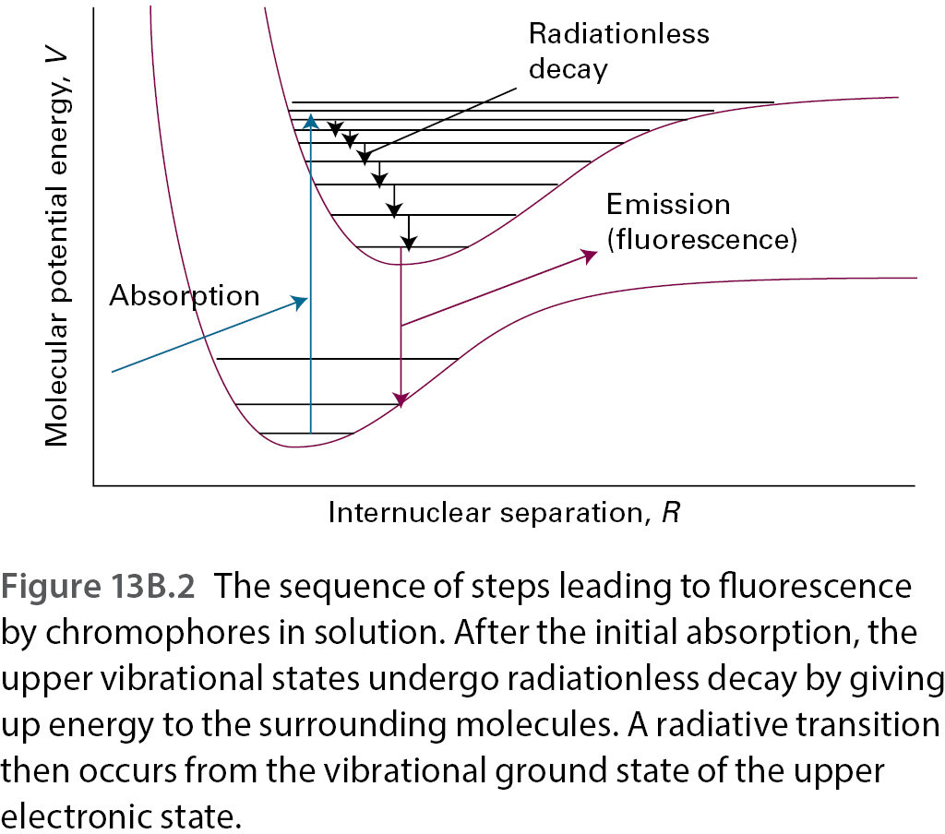
Work with your pair: (5 mins):
What are gross and specific selection rules?
What is the gross selection rule for the change in vibrational state?
What specific selection rules relate to the harmonic oscillator?
Based on these considerations, state which of the following molecules are potential greenhouse gases CO₂, H₂O, CO, Cl₂, and O₂

Slide 8
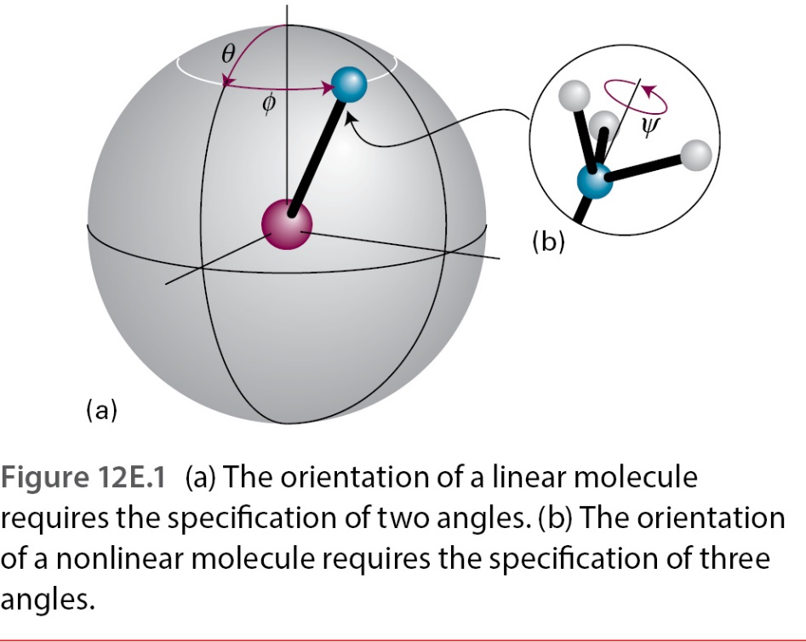
Work with your pair: (5 mins):
What changes when we start looking at polyatomic molecules?
How many vibrational motions are present in different kinds of molecules?
What are normal modes?
What selection rules hold for realistically depicted polyatomic molecules?

Slide 9
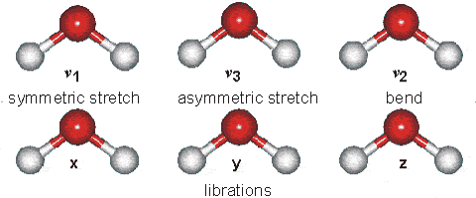
$$E_{i}\left(v_{i}\right)=hc{\tilde{ν}}_{i}\left(v_{i}+\frac{1}{2}\right)$$
Vibrational wavenumber of the normal mode i!
Vibrational quantum number of the normal mode i!

Slide 10
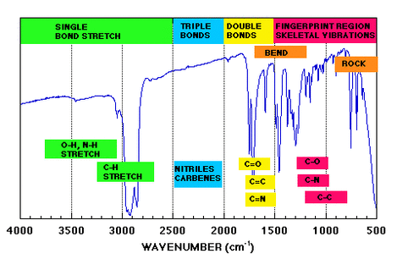

Slide 11
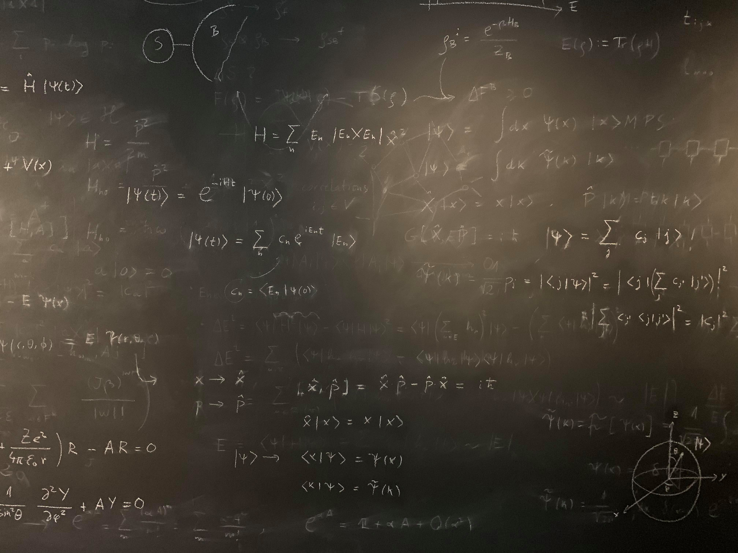
Figure references
Unless otherwise noted all Figures are taken from Chapter 7 of Atkins, P. ja De Paula, J. , L. (2014), Atkins’ Physical Chemistry, 10th edition, Oxford University Press, Oxford, New York.

