Slide 1
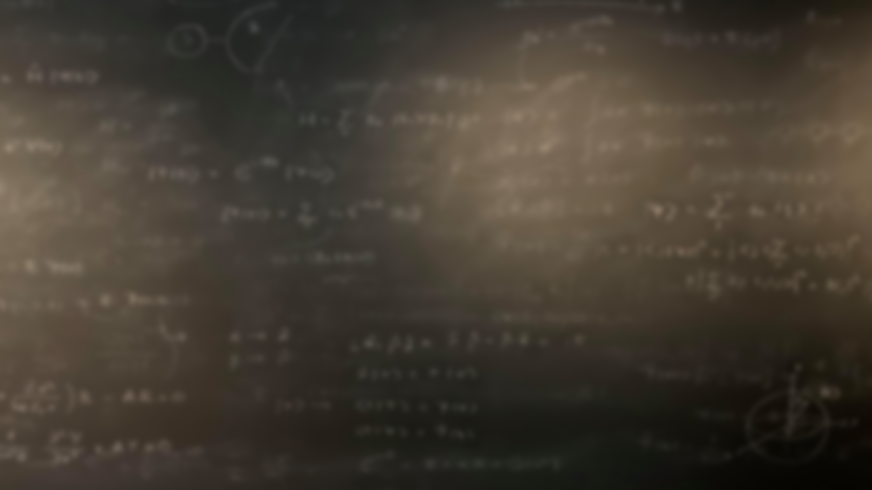
Quantum Mechanics
and Spectroscopy
Lauri Partanen

Slide 2
Work with your pair: (10 mins):
1) How are different rotating bodies classified? What kinds of classes are there and how do they differ?
2) What are the general formulae for the energy levels of rotating and (harmonically) vibrating two-atomic molecules? What were the degeneracies in each case? What is the rotational constant?

Slide 3
The rotational constant
$$E_{ J,m_{J}}=J\left(J+1\right)\frac{ℏ^{2}}{2I}$$
$$I=μR^{2}=\frac{m_{A}m_{B}}{m_{A}+m_{B}}R^{2}$$
$$E_{ J,m_{J}}=J\left(J+1\right)\frac{ℏ^{2}}{2μR^{2}}=hc\tilde{B}J\left(J+1\right)$$
$$\tilde{B}=\frac{h}{8π^{2}cμR^{2}}$$
The rotational constant

Slide 4
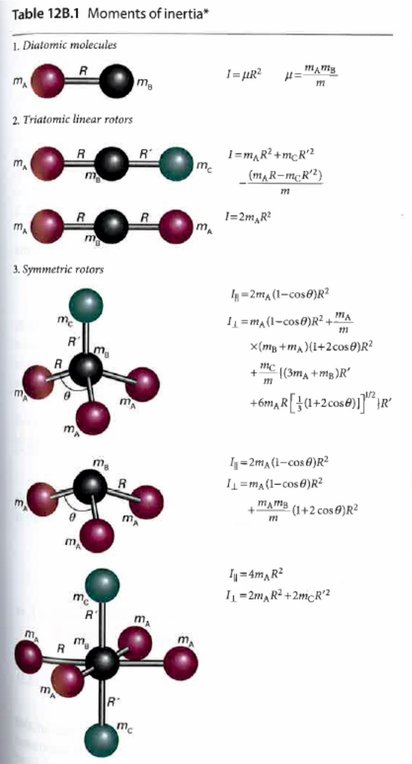

Slide 5
Work with your pair: (5 mins):
What are specific and gross selection rules? What is the gross selection rule for a rotating molecule? What are the specific selection rules if the molecule is linear? Provide a physical explanation for the rules.

Slide 6
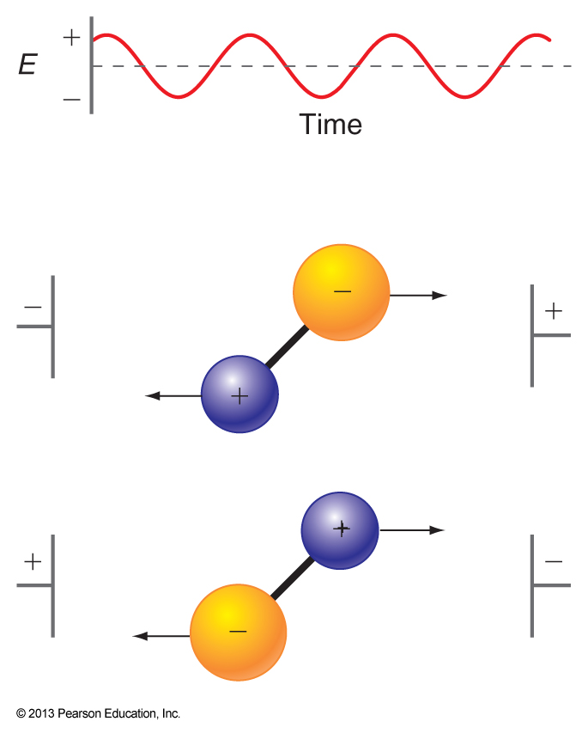
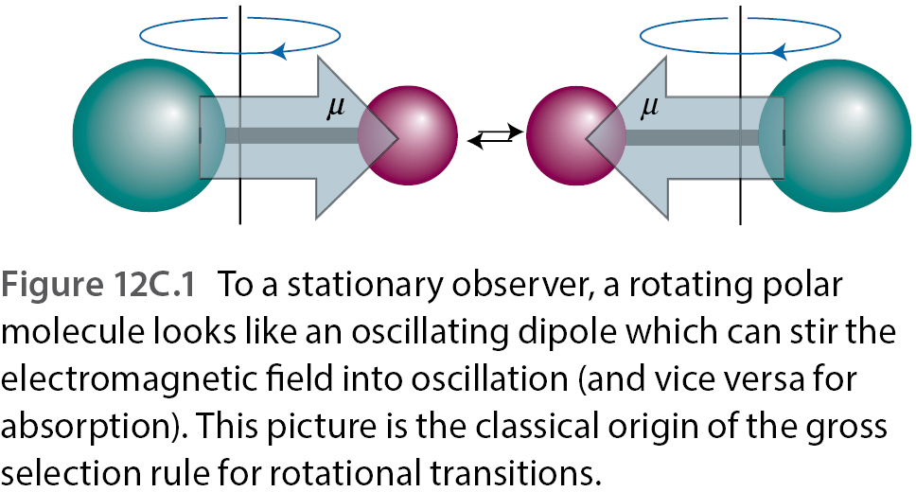
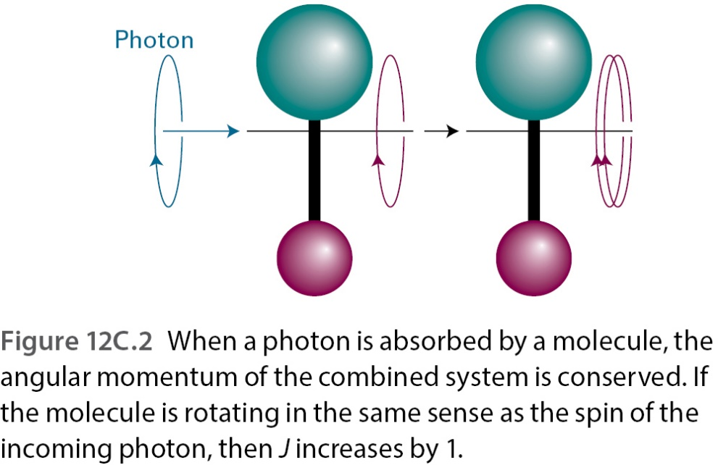

Slide 7
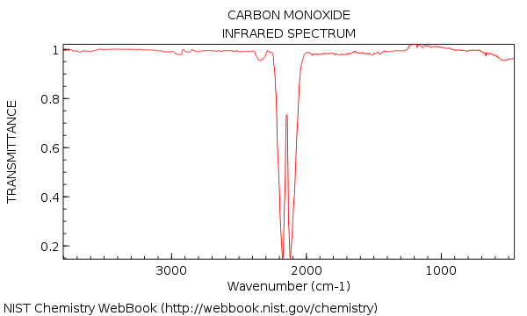
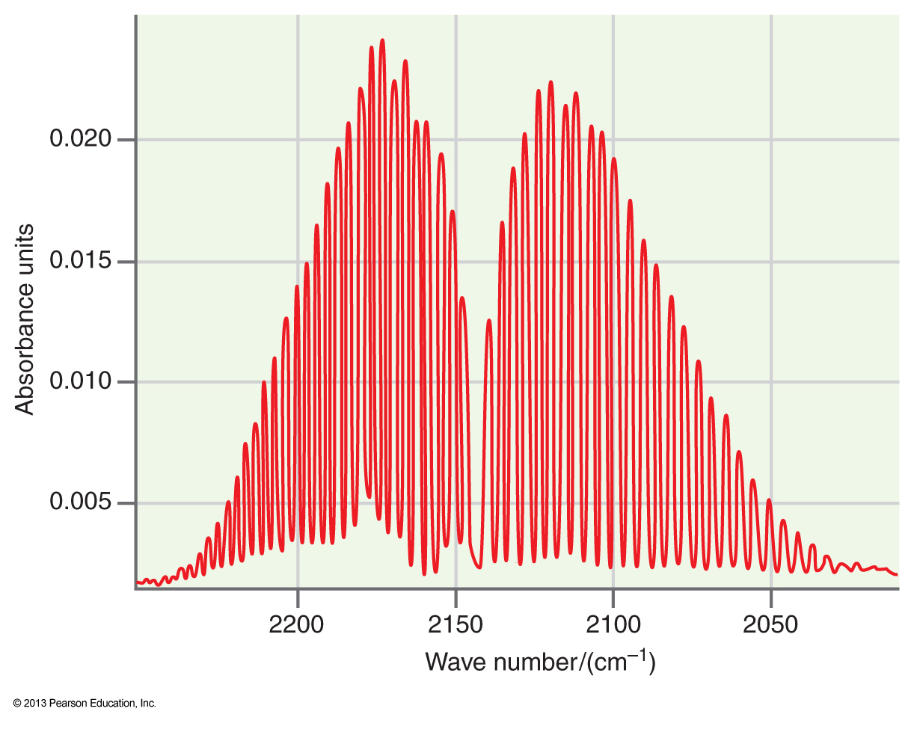
Work with your pair: (15 mins):
Study the zoom-in absorption spectrum of carbon monoxide to the right.
Why do we observe multiple peaks instead of just one?
Identify the quantum number changes for the two peaks around the central region and write expressions for the change in energy.
What is the energy difference between two neighboring peaks on the left and the right of center?
Why is there no peak in the center?
What would this spectrum look like for O₂?

Slide 8
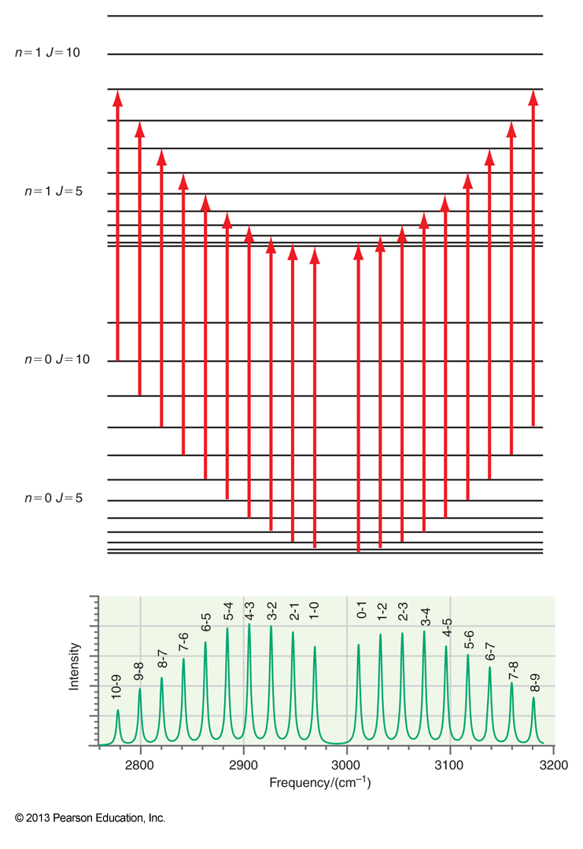
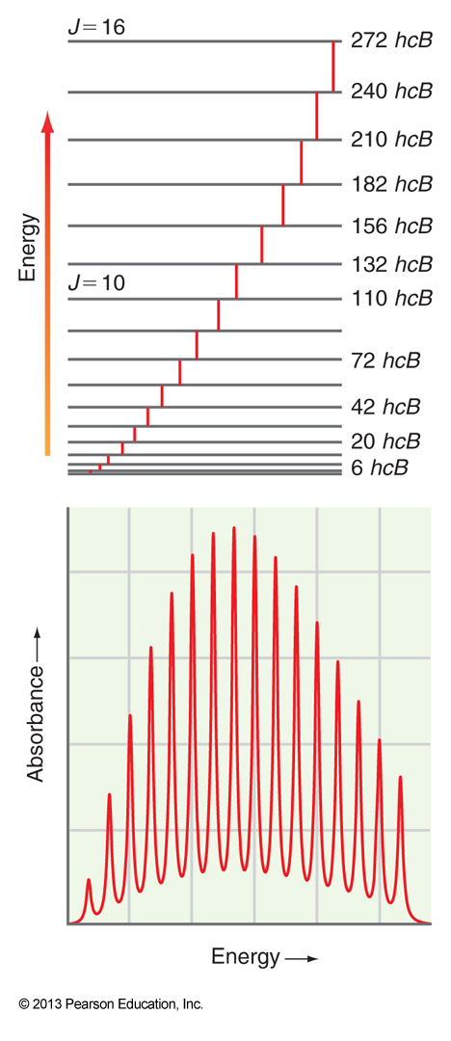
$$E_{ J,m_{J}}=hc\tilde{B}J\left(J+1\right)$$
$$J⟶J+1$$
(R branch)
$$J⟶J−1$$
(P branch)
$$J⟶J−1$$
(P branch)
$$J⟶J+1$$
(R branch)

Slide 9
Work with your pair: (5 mins):
Study the zoom-in spectrum of carbon monoxide to the right.
Look at the formula of the Boltzmann distribution – what do the different terms signify in it?
Based on this, why does the intensity of the peaks of the spectrum first increase and then decrease when moving away from the center?
$$\frac{N_{i}}{N_{j}}=\frac{g_{i}}{g_{j}}e^{−\frac{E_{i}−E_{j}}{kT}}$$

Slide 10
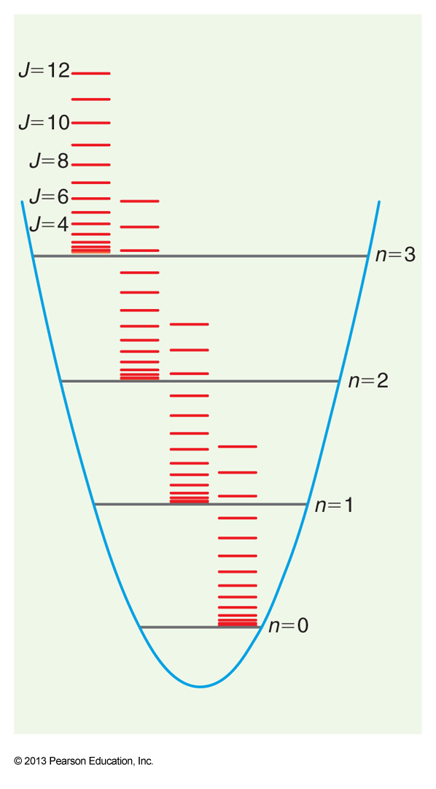
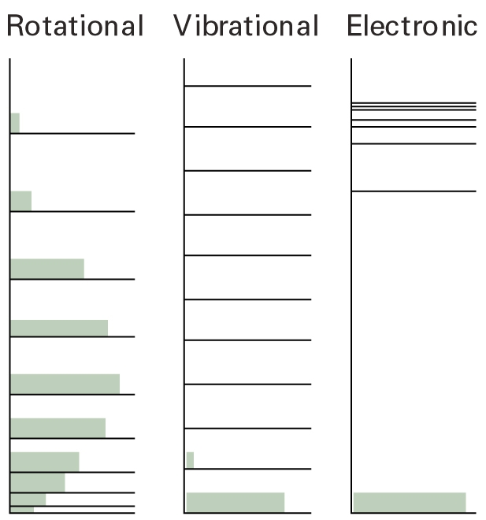
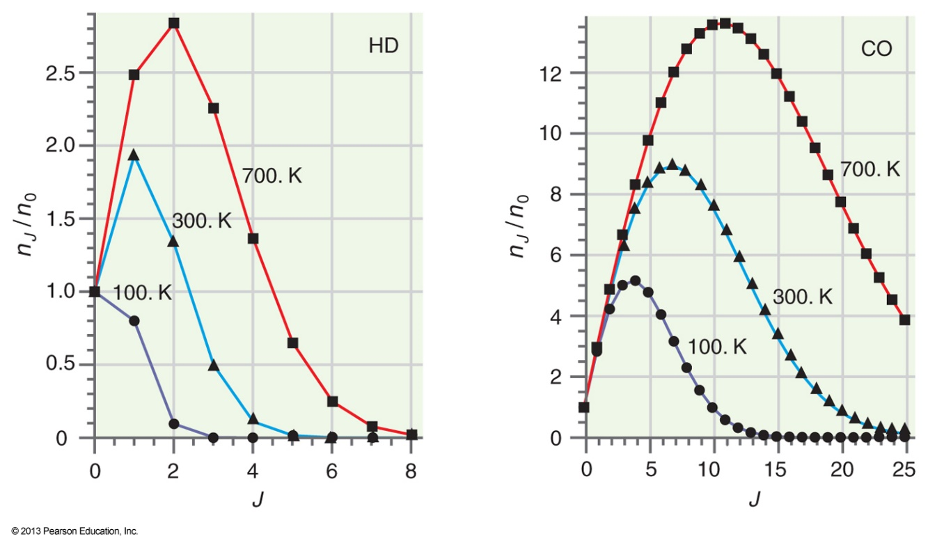
$$\frac{N_{i}}{N_{j}}=\frac{g_{i}}{g_{j}}e^{−\frac{E_{i}−E_{j}}{kT}}$$
$J⟶J+1$
$J⟶J−1$

Slide 11
Locations of rotational levels
Boltzmann distribution
Selection rules

Slide 12
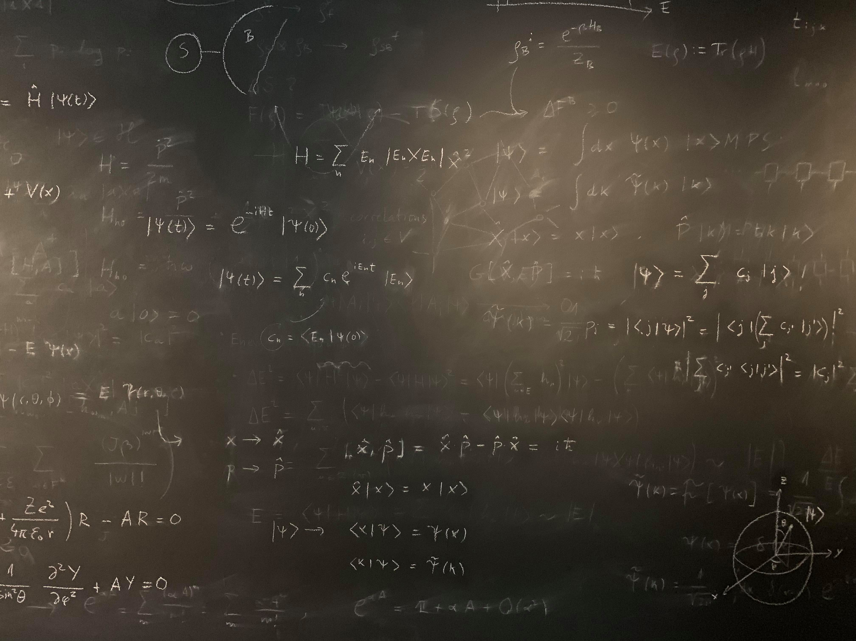
Figure references
Unless otherwise noted all Figures are taken from Chapter 7 of Atkins, P. ja De Paula, J. , L. (2014), Atkins’ Physical Chemistry, 10th edition, Oxford University Press, Oxford, New York.

