Slide 1
Quantum Mechanics
and Spectroscopy
Lauri Partanen

Slide 2
Stop and think: (2 mins):
What is a hydrogenic atom? Based on your readings draw as accurate a representation of the hydrogen atom as you can on the Post-It.

Slide 3
In hydrogenic atoms there is one positively charged nucleus and one electron.
Let’s solve the SE for these systems following our foolproof formula:
Find out the system’s Hamiltonian operator (approximations etc.)
Solve the eigenfunctions of the Hamiltonian to obtain the wavefunction ψ
Use the wavefunction to calculate all desired properties

Slide 4
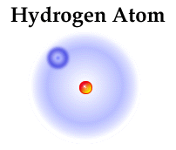
Work with your pair: (5 mins):
How do the positive nucleus and electron interact in a hydrogenic atom?
What is the form of the potential energy?
$$\hat{V}\left(r\right)=\frac{Q_{e}Q_{n}}{4πε_{0}r}=−\frac{Ze^{2}}{4πε_{0}r}$$
$$Q_{e}=−e$$
$$r$$
$$Q_{n}=+Ze$$

Slide 5
Stop to think (2 mins)
Identify the different terms in the hydrogenic schrödinger equation:
$$−\frac{ℏ^{2}}{2m_{e}}∇_{e}^{2}ψ−\frac{ℏ^{2}}{2m_{n}}∇_{n}^{2}ψ−\frac{Ze^{2}}{4πε_{0}r}ψ=E_{tot}ψ$$
Kinetic energy of the electron
Kinetic energy of the nucleus
Potential energy

Slide 6
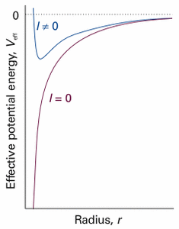
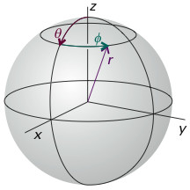
I Solution of the hydrogenic atom SE:
$$−\frac{ℏ^{2}}{2m_{e}}∇_{e}^{2}ψ_{tot}−\frac{ℏ^{2}}{2m_{n}}∇_{n}^{2}ψ_{tot}−\frac{Ze^{2}}{4πε_{0}r}ψ_{tot}=E_{tot}ψ_{tot}$$
Separation of variables I
Movement of electron with respec to nucleus (spherical coordinates)
$$−\frac{ℏ^{2}}{2m_{tot}}∇_{c.m.}^{2}ψ_{c.m.}\left(X\right)=E_{c.m.}ψ_{c.m.}\left(X\right)$$
$−\frac{ℏ^{2}}{2μ}∇^{2}ψ(r,θ, φ)$ $−\frac{Ze^{2}}{4πε_{0}r}ψ(r,θ, φ)$ $=Eψ(r,θ, φ)$
Movement of the center of mass (c.m.) through space
Separation of variables II
$$−\frac{ℏ^{2}}{2μ}\frac{d^{2}}{dr^{2}}rR\left(r\right)+V_{eff}rR\left(r\right)=ErR(r)$$
$$Λ^{2}Y\left(θ,φ\right)=−l\left(l+1\right)Y(θ,φ)$$
SE for the distance between electron and nucleus
$$V_{eff}=−\frac{Ze^{2}}{4πε_{0}r}+\frac{{l\left(l+1\right)ℏ}^{2}}{2μr^{2}}$$
SE for the orientation of the electron and nucleus

Slide 7
Stop to think (2 mins)
1) Based on the second separation of variables in the previous slide, what general form must the hydrogenic wavefunction possess?
2) How many quantum numbers are needed to specify it?
3) What do the different quantum numbers tell about the wavefunction?

Slide 8
II: Wavefunctions for the hydrogenic atom
Following separation, the wavefunction is a product of a radial and spherical part
$$−\frac{ℏ^{2}}{2μ}\frac{d^{2}}{dr^{2}}rR\left(r\right)+−\frac{Ze^{2}}{4πε_{0}r}+\frac{{l\left(l+1\right)ℏ}^{2}}{2μ}rR\left(r\right)=ErR(r)$$
$$Λ^{2}Y\left(θ,φ\right)=−l\left(l+1\right)Y(θ,φ)$$
$$ψ_{n,l,m_{l}}\left(r,θ,φ\right)=R_{n,l}\left(r\right)Y_{l,m_{l}}(θ,φ)$$
3 quantum numbers determine the shape of the wavefunction!

Slide 9
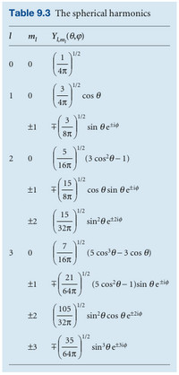
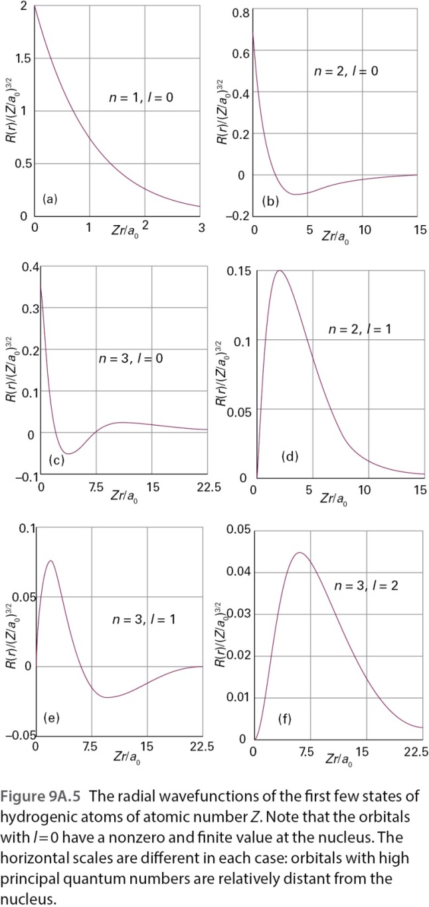
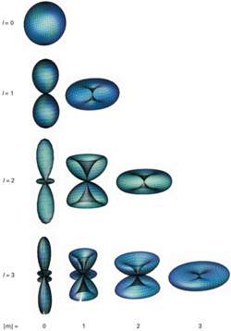
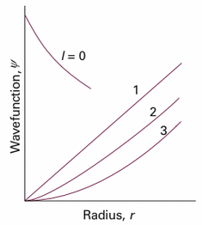
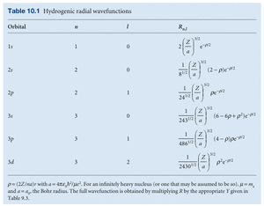
$$ψ_{n,l,m_{l}}\left(r,θ,φ\right)=R_{n,l}\left(r\right)Y_{l,m_{l}}(θ,φ)$$
Radial part $R_{n,l}\left(r\right)$:
Angular part $Y_{l,m_{l}}(θ,φ)$:
Describes how the wavefunction changes when the distance to the nucleus increases
Describes how the value of the wavefunction changes on a spherical surface a certain distance from the nucleus
The solutions are the same as for the particle on a sphere.
$$R_{n,l}\left(r\right)=N_{n,l} ρ^{l} L_{n−l−1}^{2l+1} \left(ρ\right) e^{−\frac{ρ}{2}}$$
Normalization
Polynomial part results in nodal structure.
Exponential part takes function to zero as $r→∞$
Power term determines behaviour when $r≈0$

Slide 10
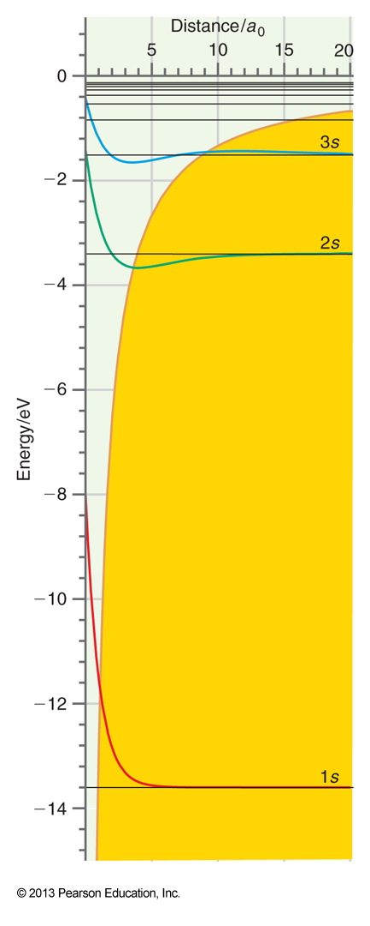
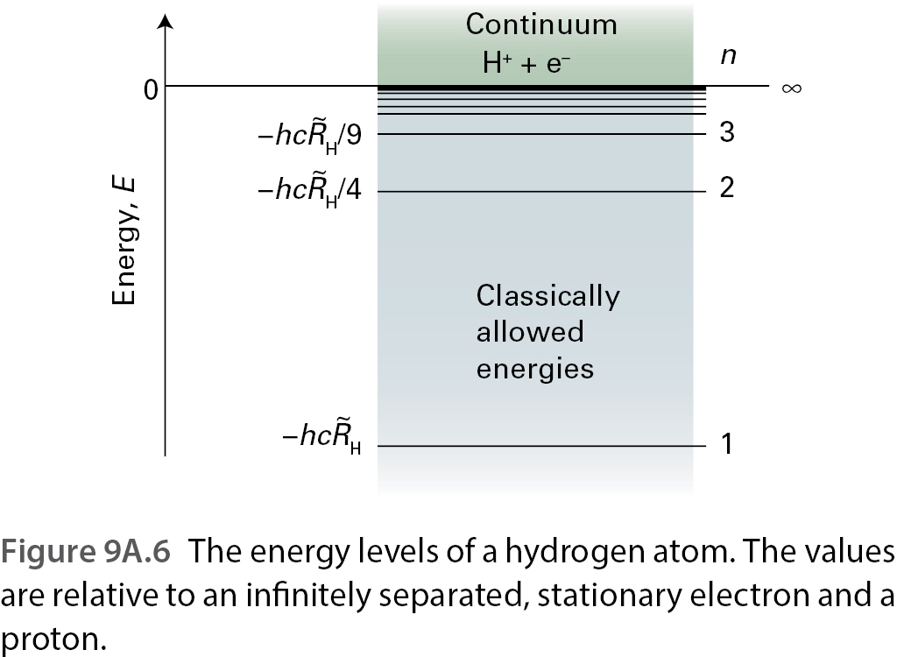
Work with your pair: (5 mins):
Sketch the potential energy $\hat{V}\left(r\right)=−\frac{Ze^{2}}{4πε_{0}r}$ of the $l=0$ orbitals for the hydrogenic atom.
Based on your drawing how do the energy levels of the hydrogenic atoms behave?
Here energy is no longer quantized!
$E_{n}=−\frac{μ}{m_{e}}⋅\frac{Z^{2}}{n^{2}}⋅hc{\tilde{R}}_{∞}$
Rydbergin vakio ${\tilde{R}}_{∞}= ?$
Rydbergin constant ${\tilde{R}}_{∞}=\frac{m_{e}e^{4}}{8ε_{0}^{2}h^{3}c}$

Slide 11
Work with your pair: (15 mins):
What values are allowed for the different quantum numbers of hydrogenic atoms?
What physical information do the different quantum numbers give you about behavior of the electron?
How do you obtain the information if you know the relevant quantum number?

Slide 12
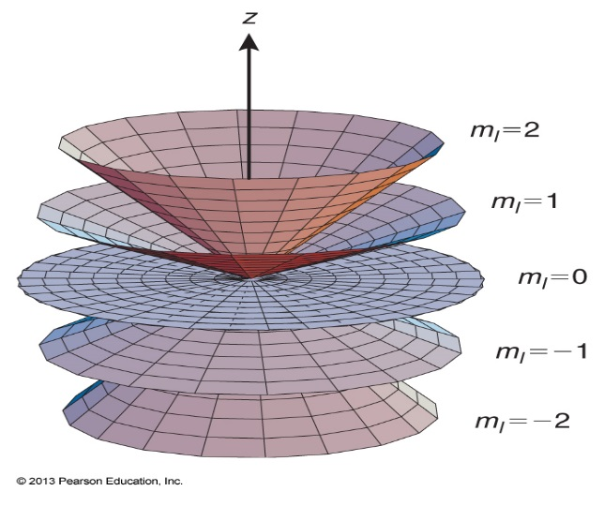
$$ψ_{n,l,m_{l}}\left(r,θ,φ\right)=R_{n,l}\left(r\right)Y_{l,m_{l}}(θ,φ)$$
Principal quantum number $n = 1,2,3…$ determines electronic energy
Orbital angular momentum quantum number $l=0,1,…, n−1$ determines the angular momentum of electrons.
Magnetic quantum number $m_{l}=0,±1,±2,…,±l$ determines the z-component of the angular momentum of the electrons
$E_{n}=−\frac{μ}{m_{e}}⋅\frac{Z^{2}}{n^{2}}⋅hc{\tilde{R}}_{∞}$
$$\left|l\right|=ℏ\sqrt{l\left(l+1\right)}$$
$$l_{z}=m_{l}ℏ$$

Slide 13
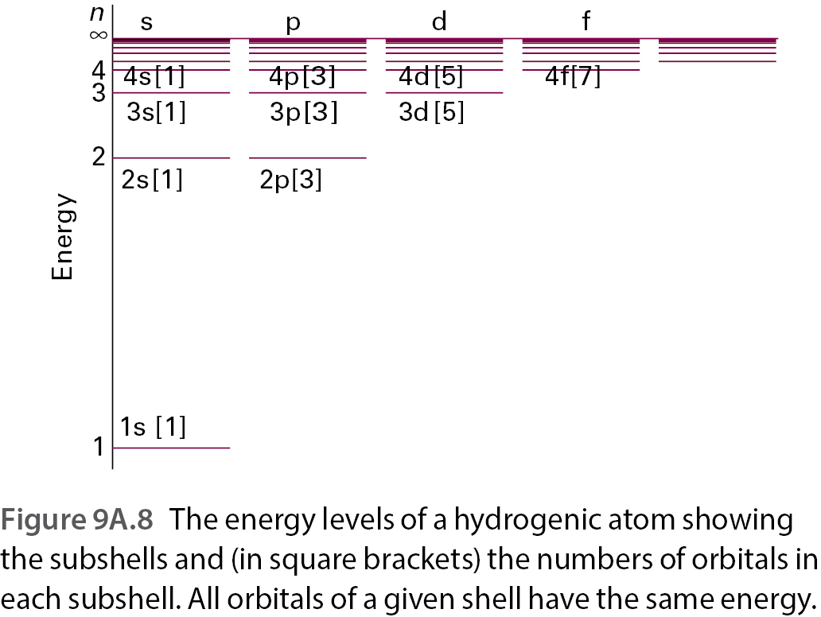
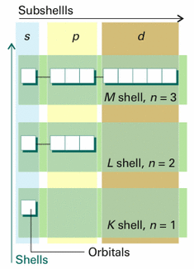

Slide 14
Stop to think: The electron in He⁺ has been excited to the M shell. What is the degeneracy of this shell?
0
1
4
9
Larger

Slide 15
Stop to think: The electron in He⁺ has been excited to the M shell. What is the degeneracy of this shell?
0
1
4
9
Larger
Stop to think 2.0:
What is the electrons angular momentum?
Use the excercise to determine the degeneracy of the shell corresponding to a general quantum number $n$
$$\left|l\right|=ℏ\sqrt{l\left(l+1\right)}$$

Slide 16
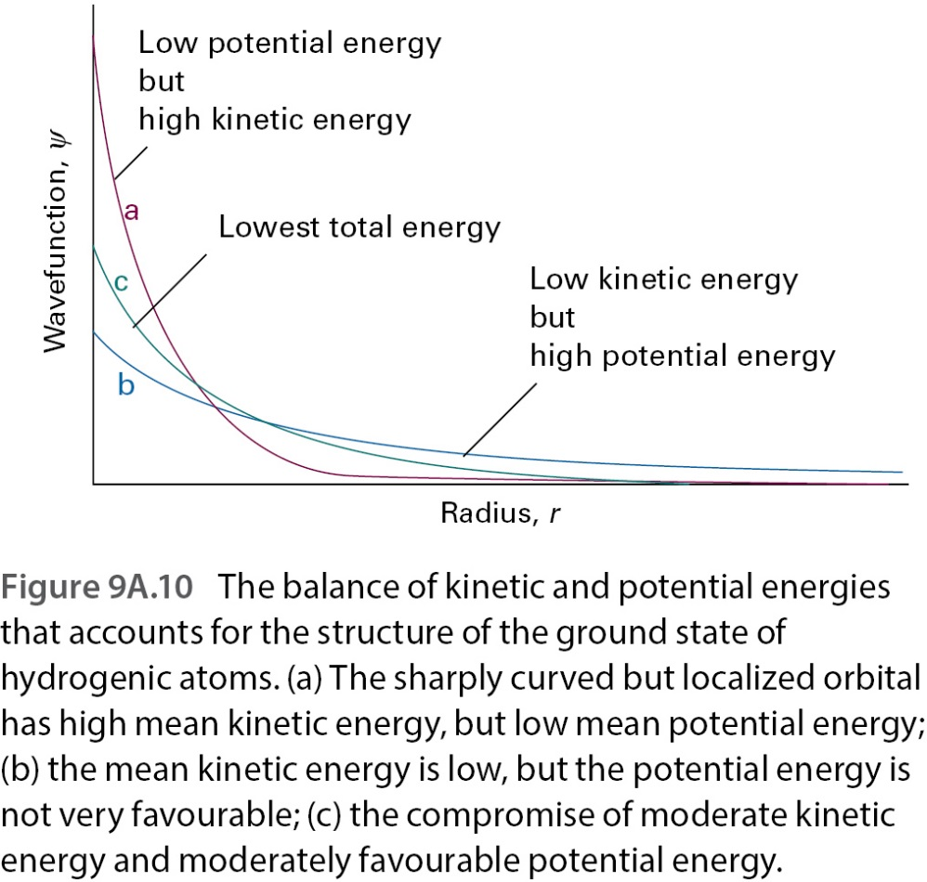
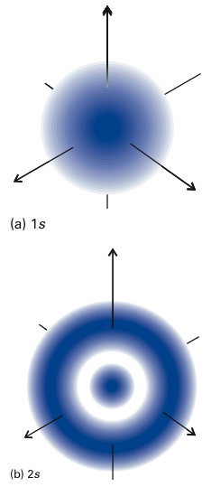
Work with your pair: (15 mins):
Use the surrounding figures to summarize the key features of hydrogenic s-orbitals

Slide 17
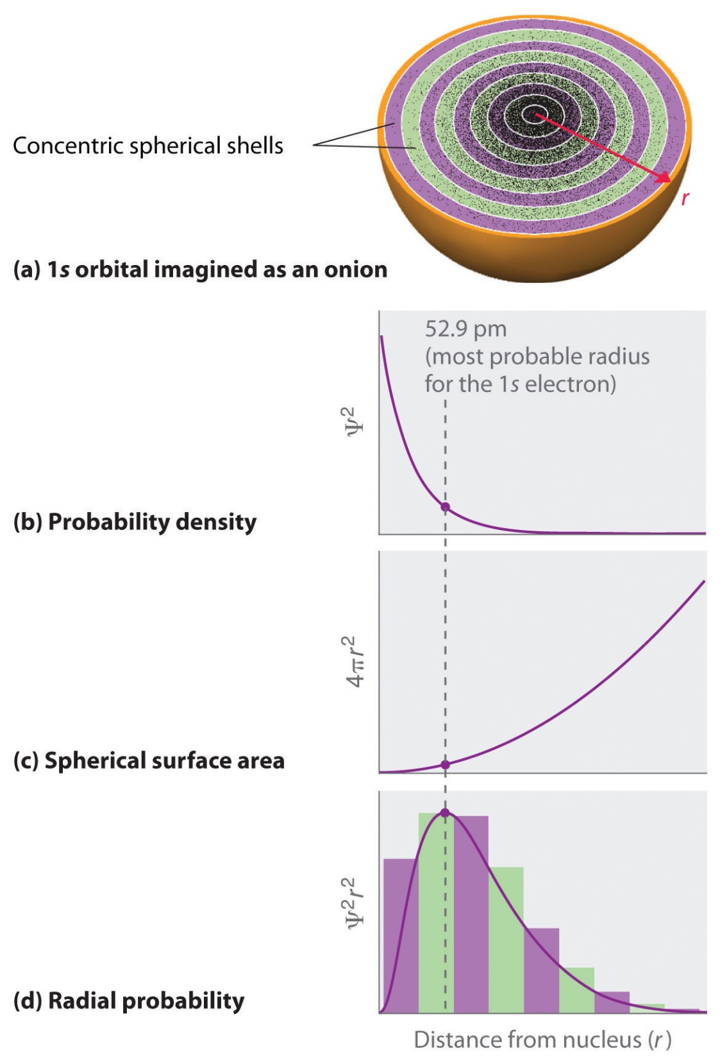
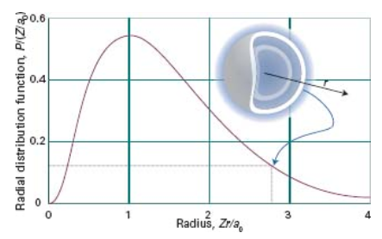
Work with your pair: (10 mins):
Define the radial distribution function and interpret it physically.
Based on the picture to the left, sketch the radial distribution functions of 2s and 2p orbitals.

Slide 18
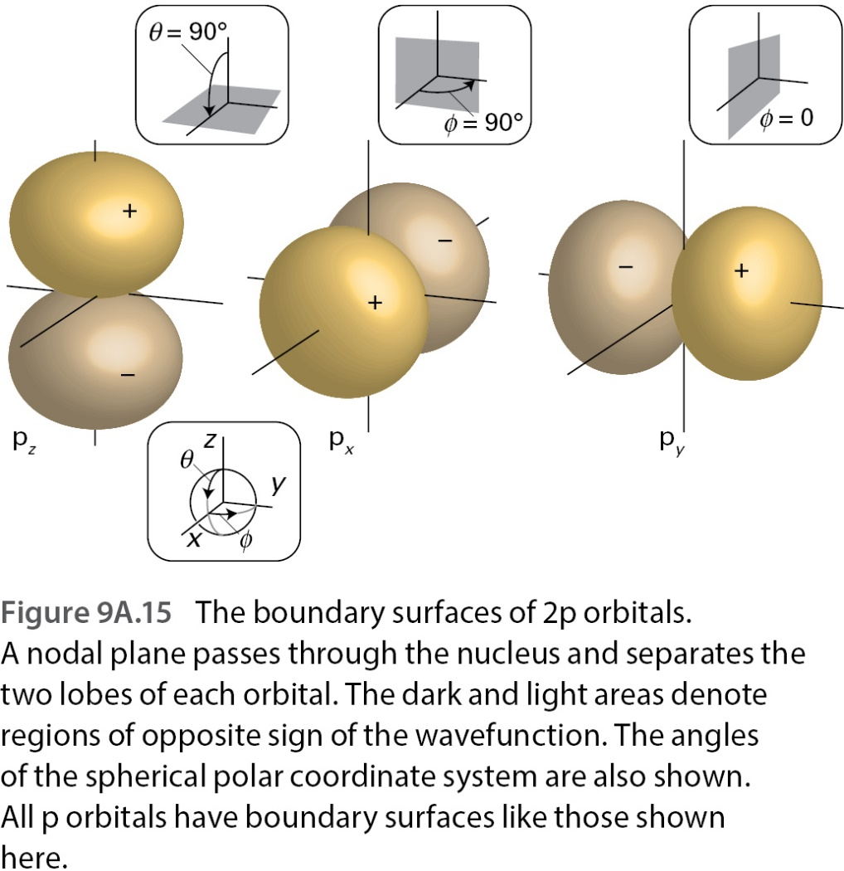
Work with your pair: (15 mins):
Compare the s and p-orbitals of a hydrogenic atom.
Write down at least one question regarding hydrogenic atoms that has remained unclear.
$$ψ_{2p_{x}}=\frac{1}{\sqrt{2}}\left(ψ_{\left(2,1,1\right)}−ψ_{\left(2,1,−1\right)}\right)$$
$$ψ_{2p_{y}}=\frac{i}{\sqrt{2}}\left(ψ_{\left(2,1,1\right)}+ψ_{\left(2,1,−1\right)}\right)$$
$E_{n}=−\frac{μ}{m_{e}}⋅\frac{Z^{2}}{n^{2}}⋅hc{\tilde{R}}_{∞}$

Slide 19
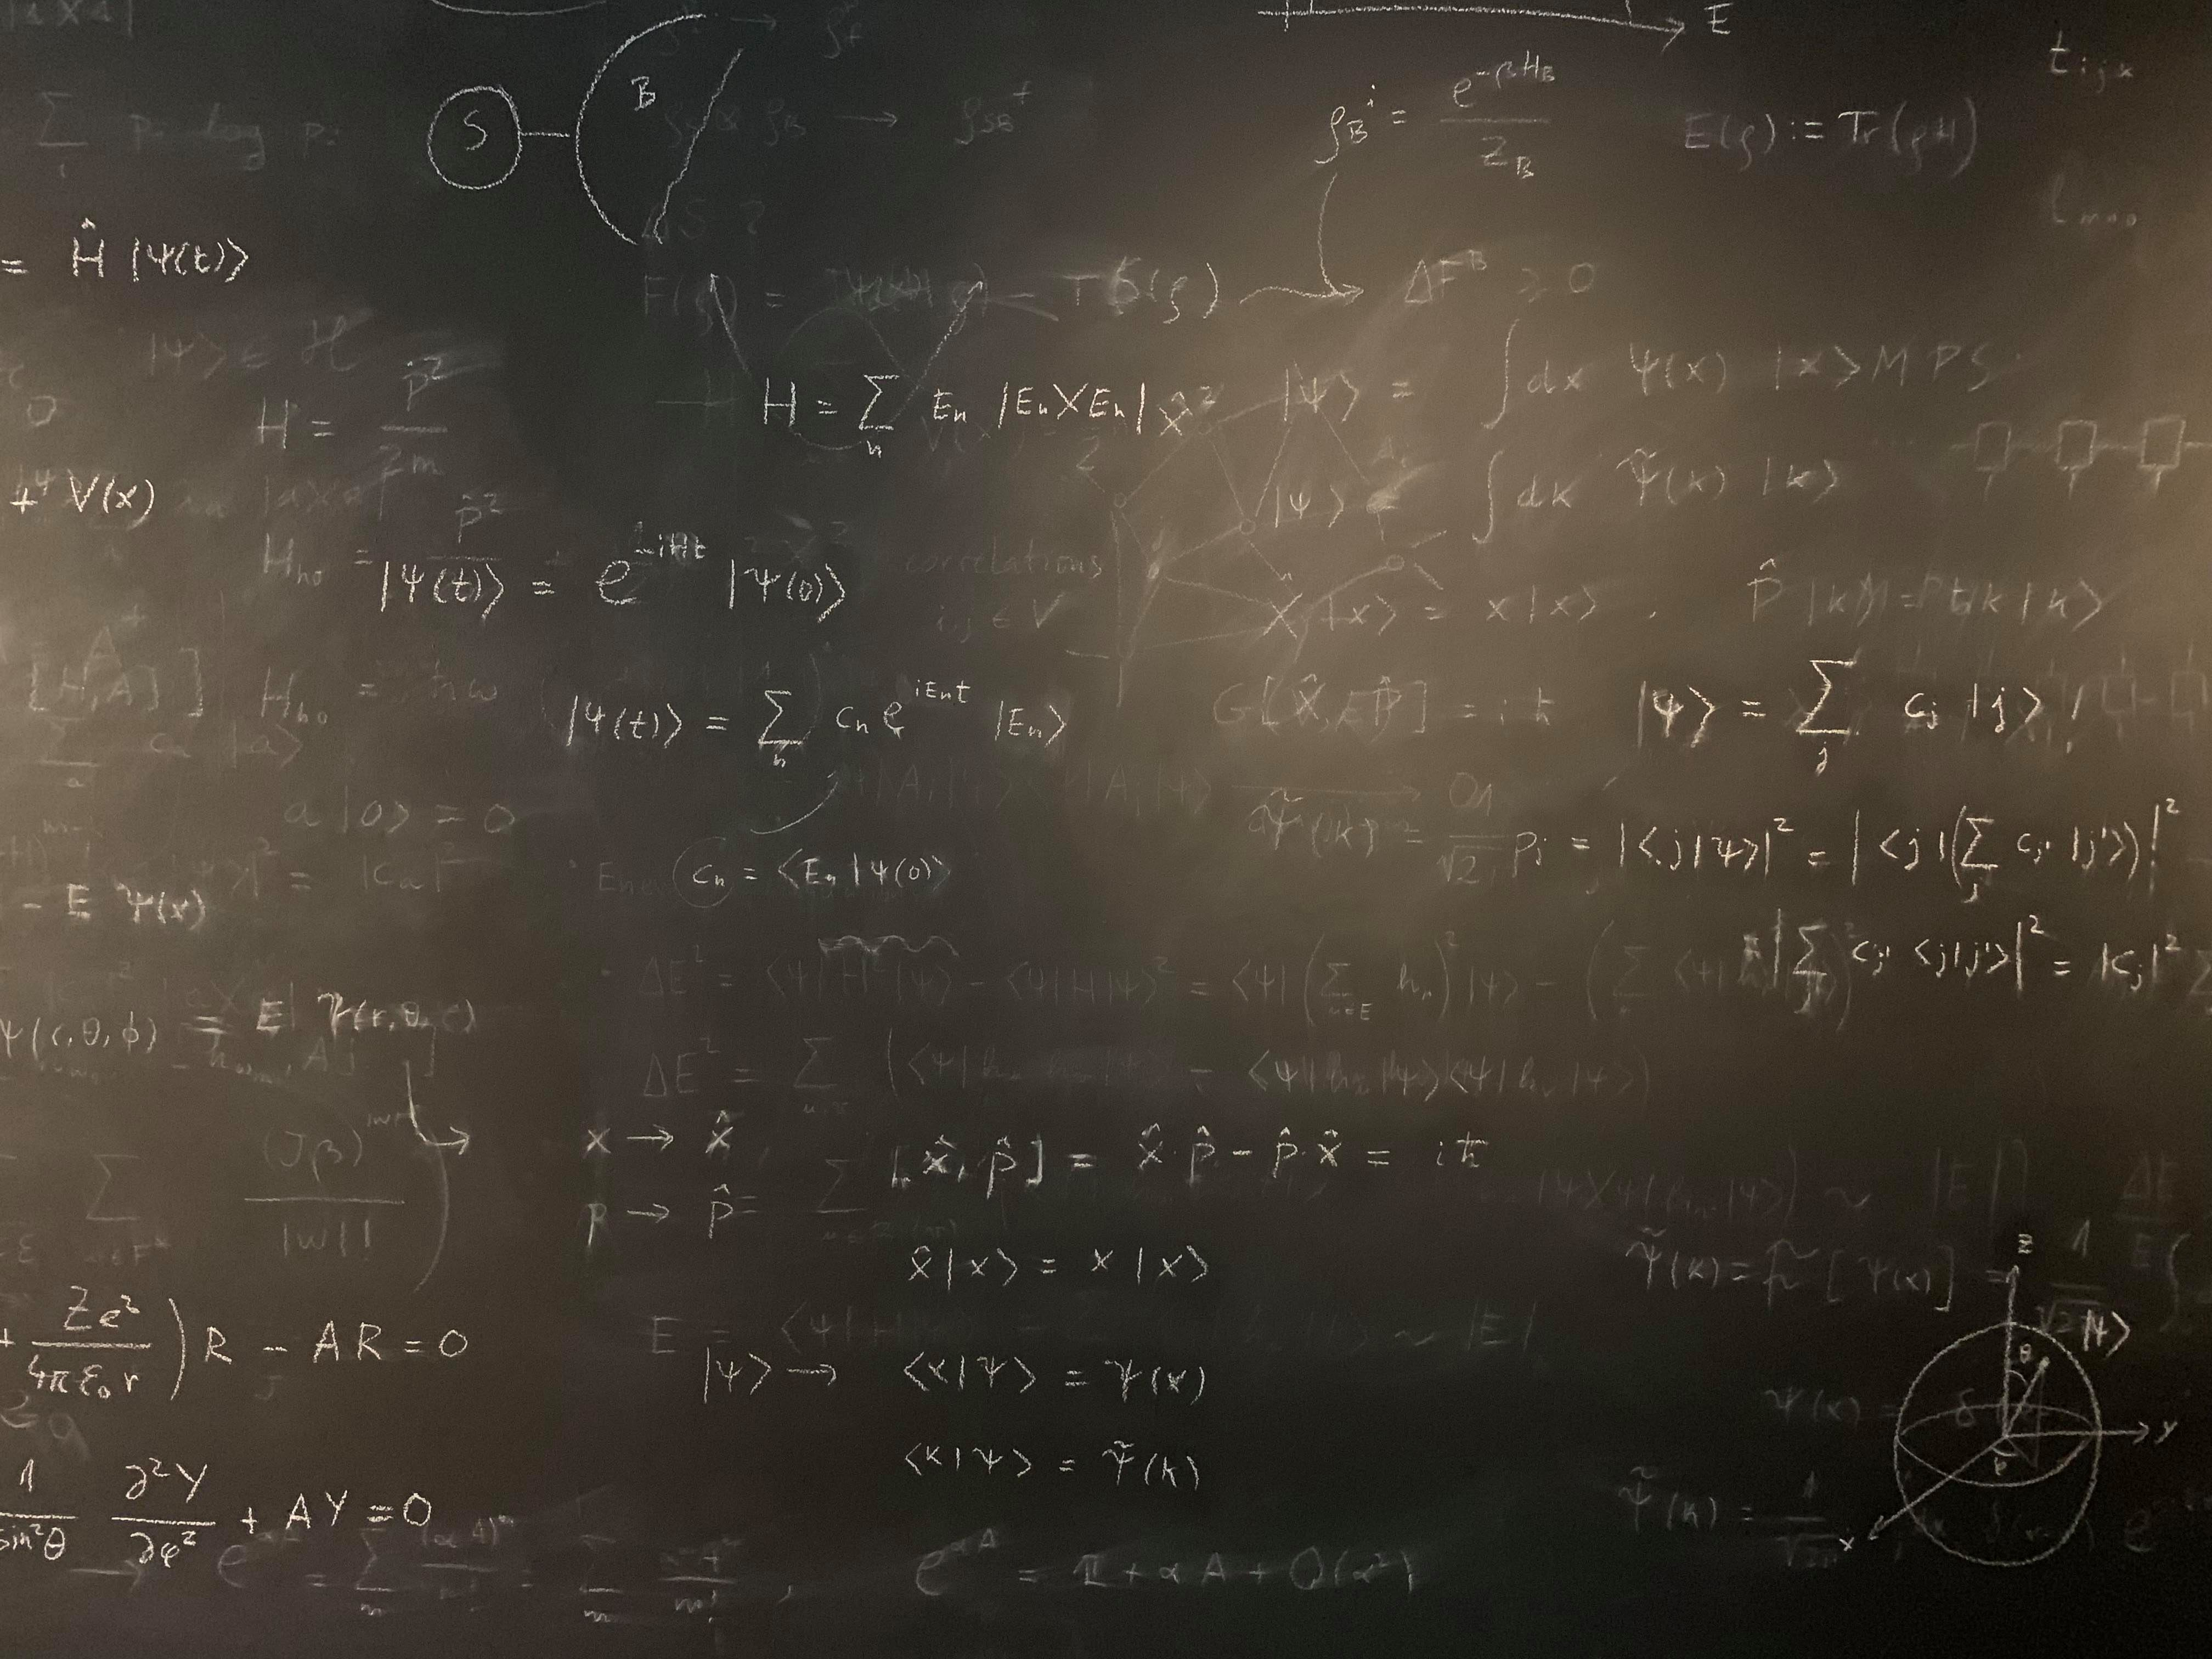
Figure references
Unless otherwise noted all Figures are taken from Chapter 7 of Atkins, P. ja De Paula, J. , L. (2014), Atkins’ Physical Chemistry, 10th edition, Oxford University Press, Oxford, New York.

