Slide 1
Final presentation 14.2.2019
Katri Astala & Sanni Wessman
KOE: Prosessi/ BA2/ Visual Communications Design/ Aalto ARTS

Slide 3

Process
Research
Two ways of touching
Final concept

Slide 4
Research
Home & living
Iittala brand
Favourite items
Home should be comfortable
Haptic eating experience
Timeless and reliable products
Emotional contact missing
Large variety of colours

Slide 5
Feel the form

Slide 6
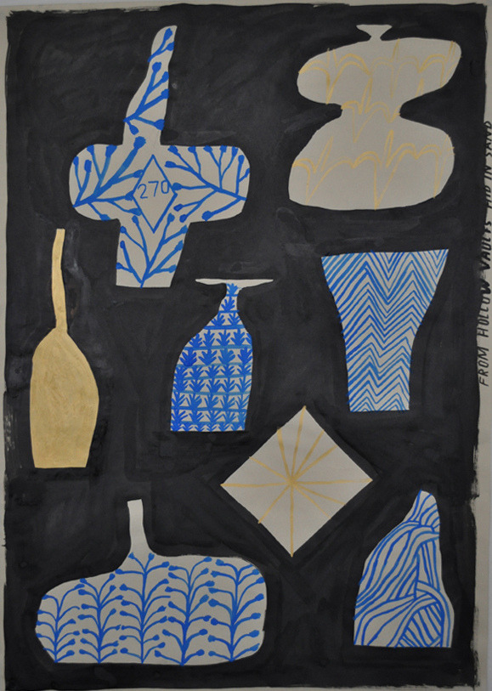
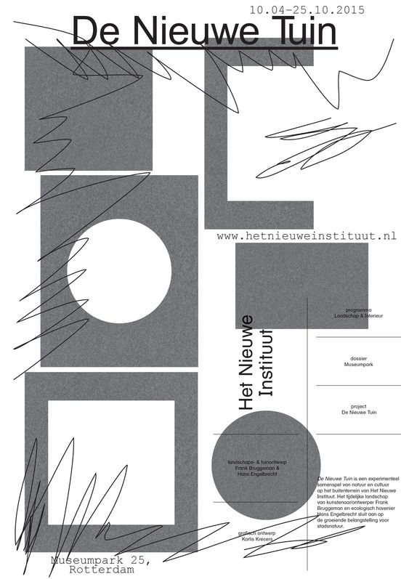
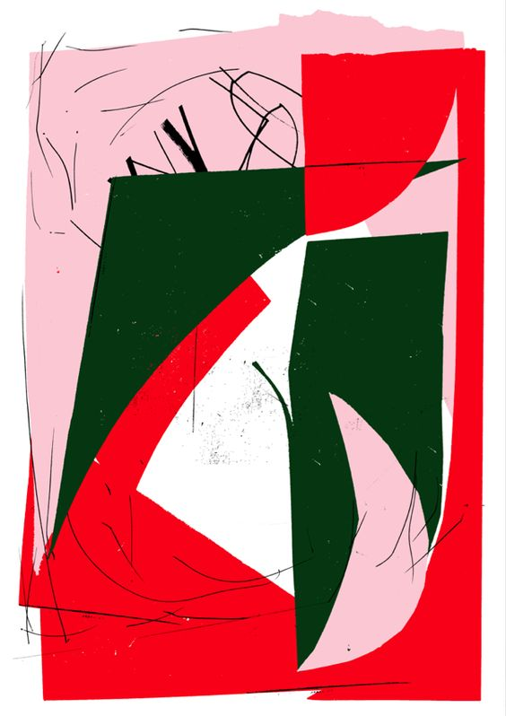
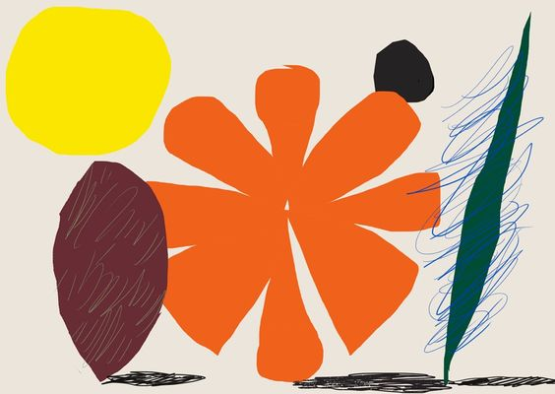

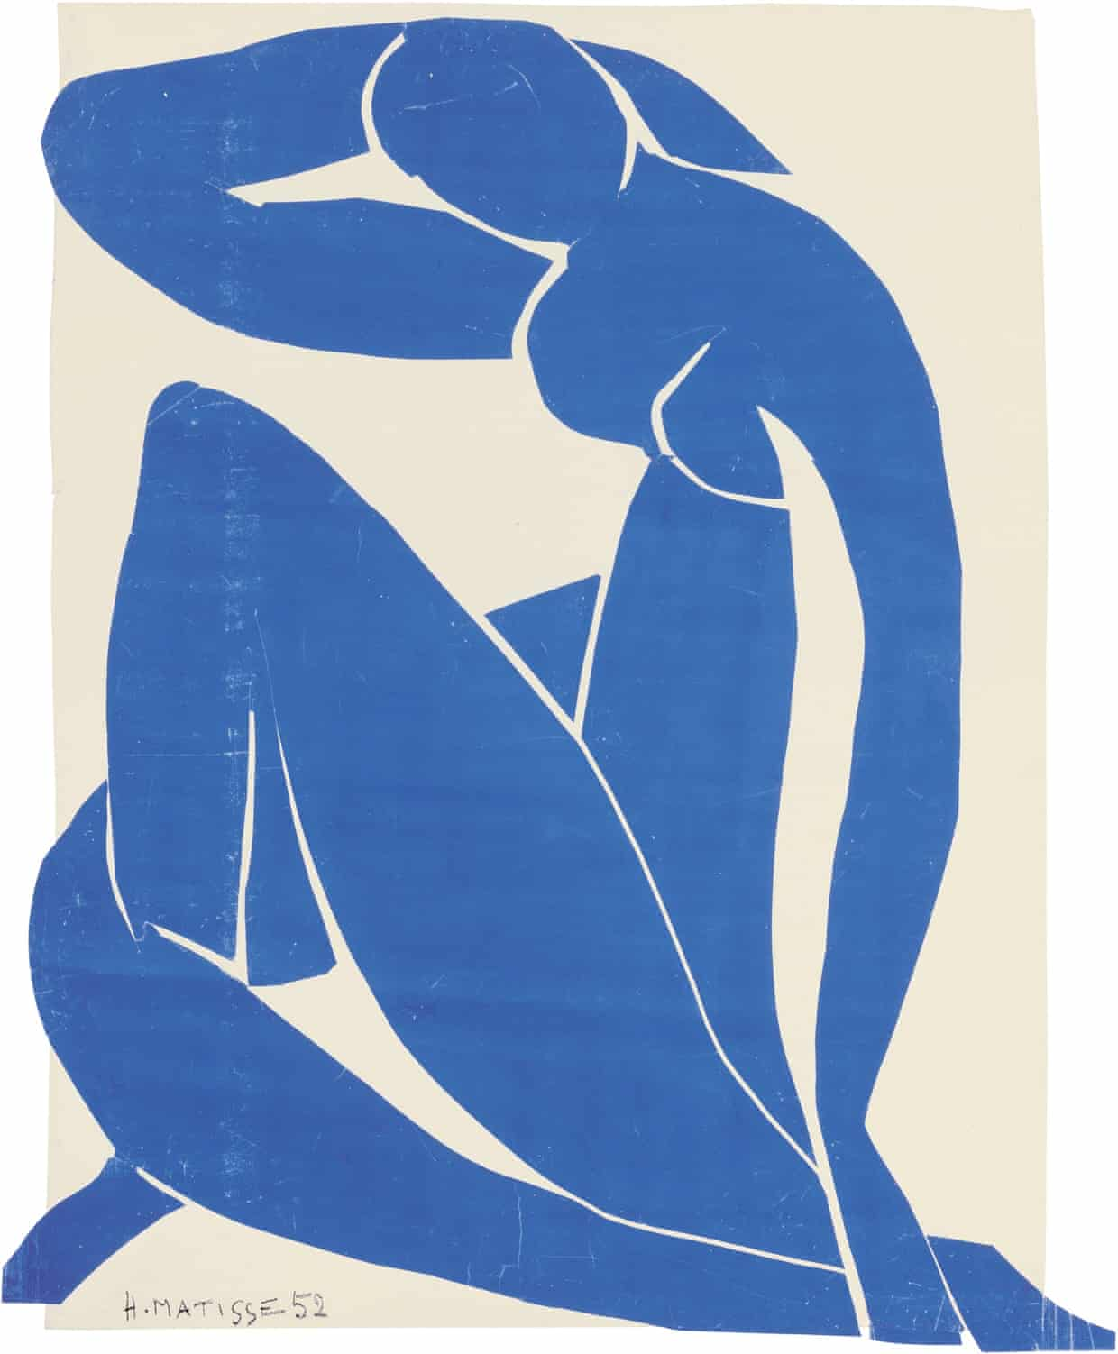
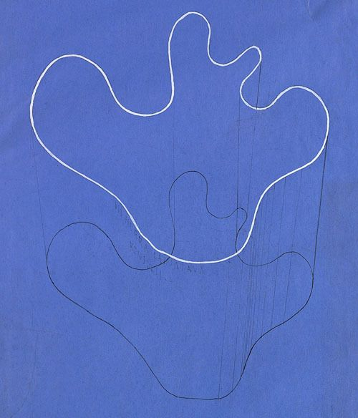
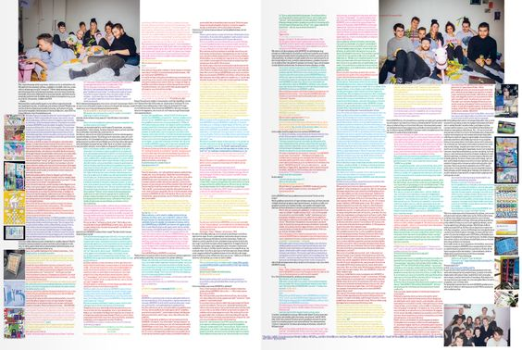
Inspiration

Slide 7
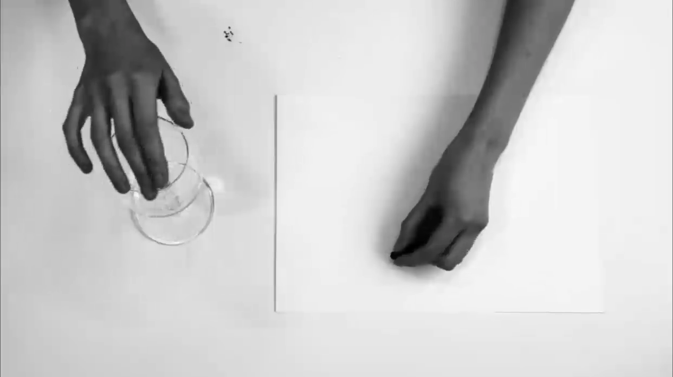
Elements: touch-based drawings

Slide 8
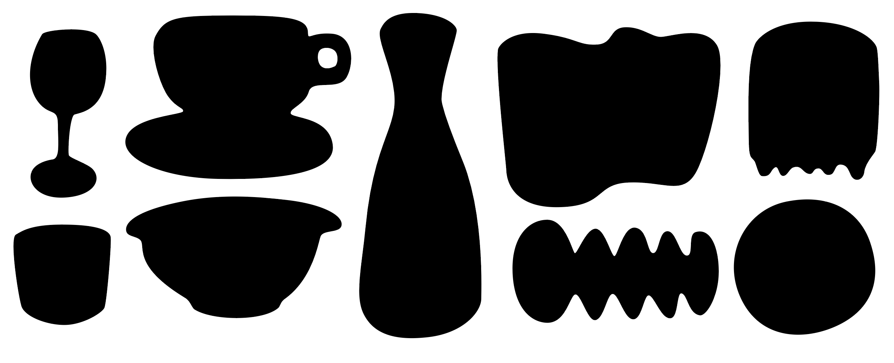
Elements: rounded forms

Slide 9
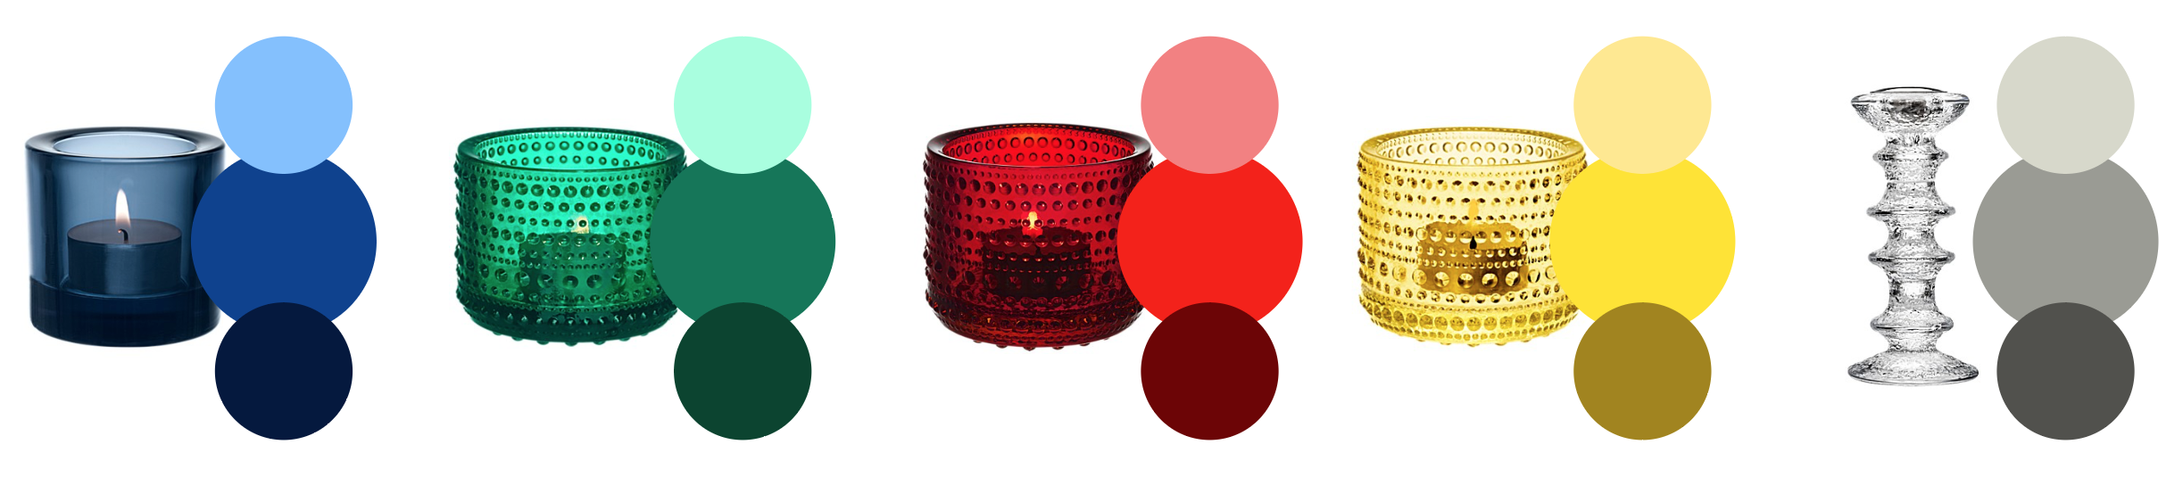
Elements: colours

Slide 10
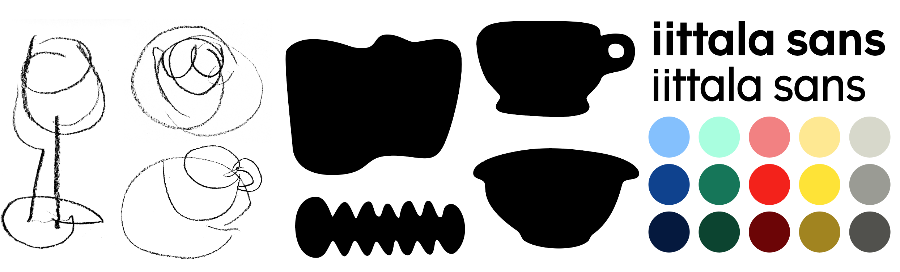
Elements
Line-drawings
Shapes
Colours
Iittala Sans

Slide 11
Visual identity

Slide 12
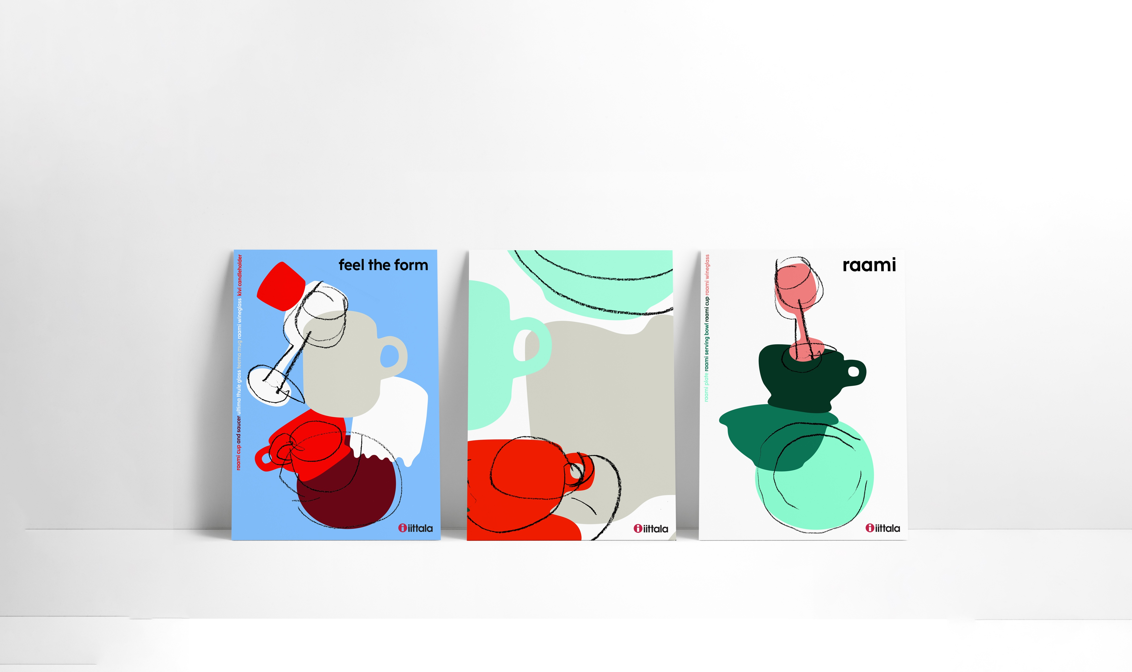
Posters and advertisements

Slide 13
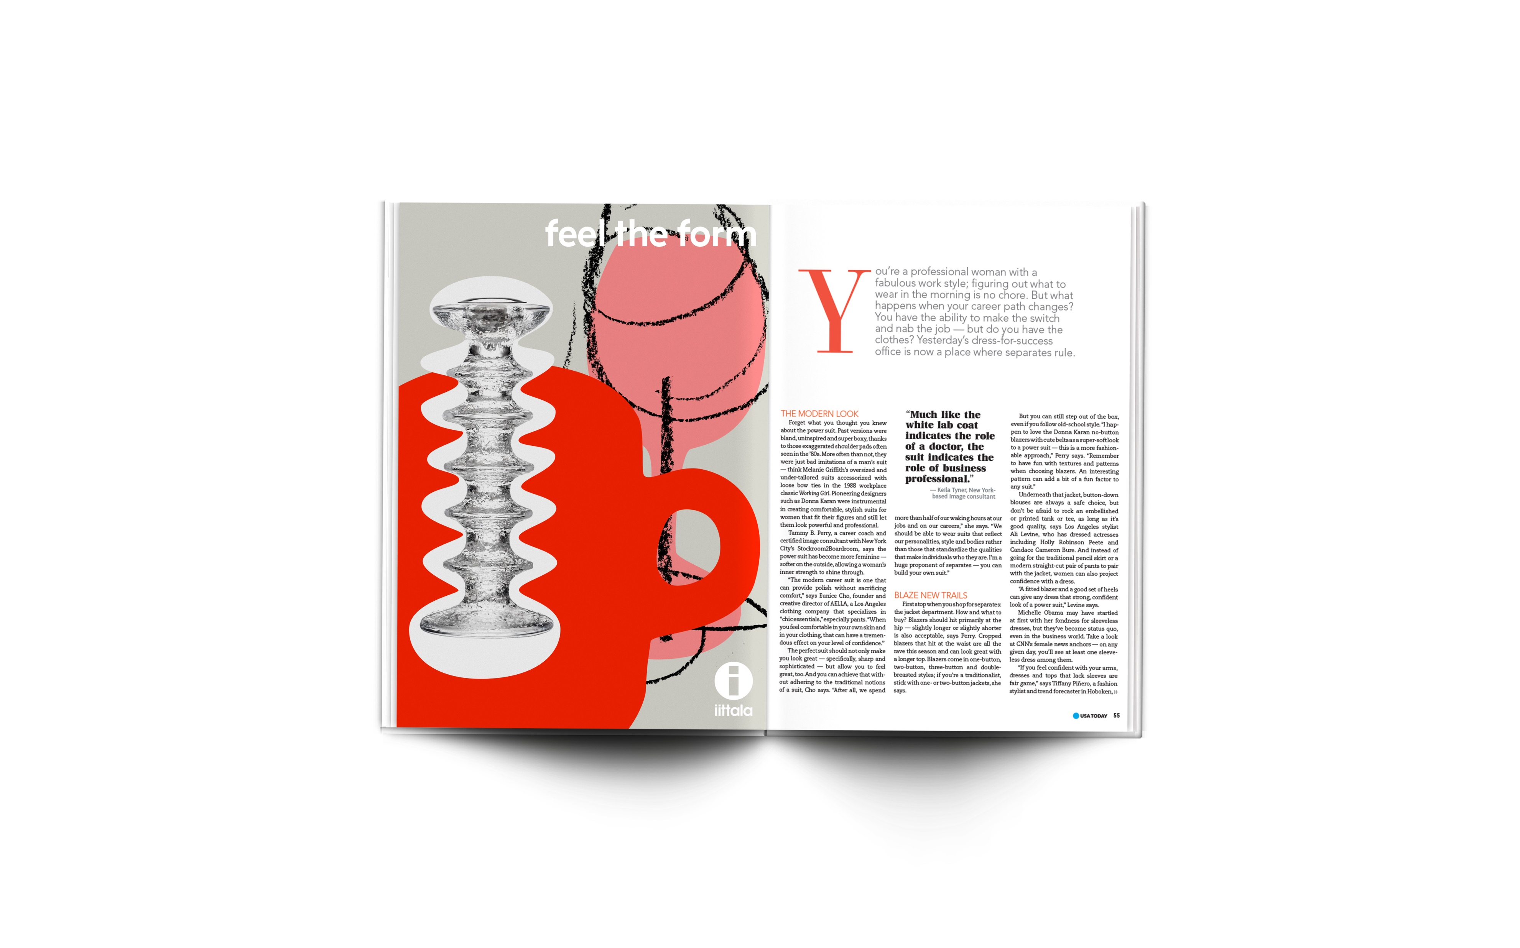
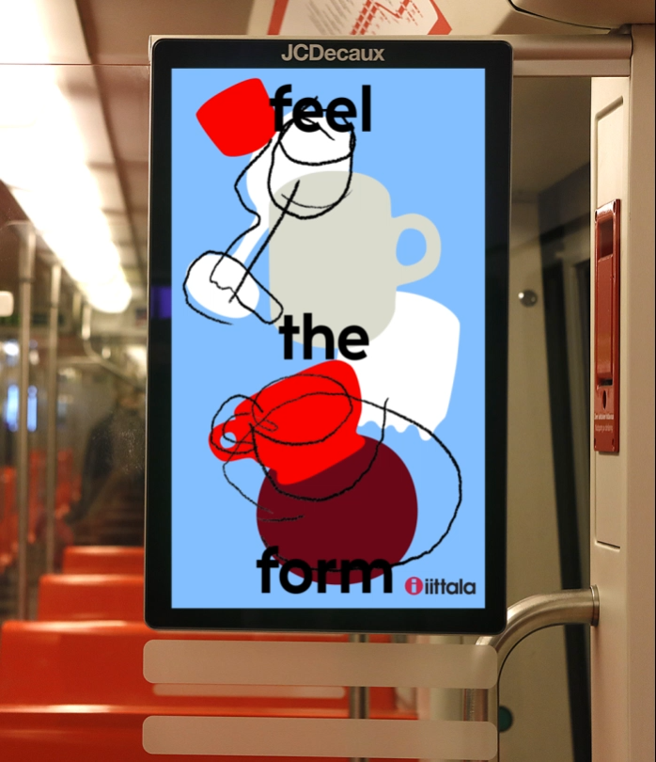
Posters and advertisements

Slide 14
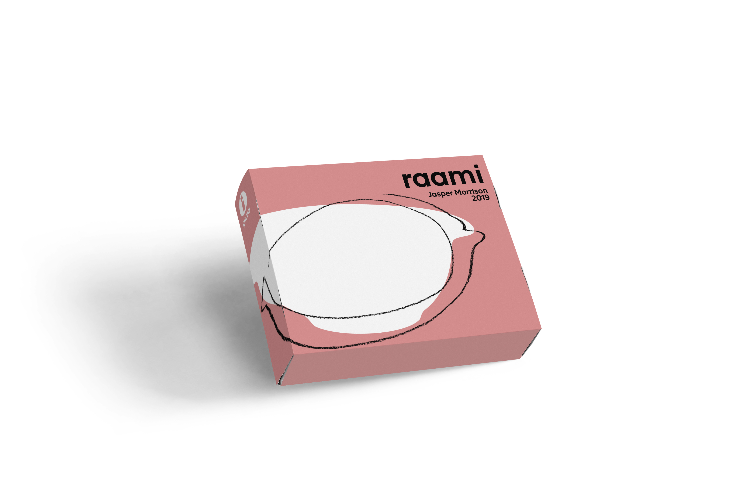
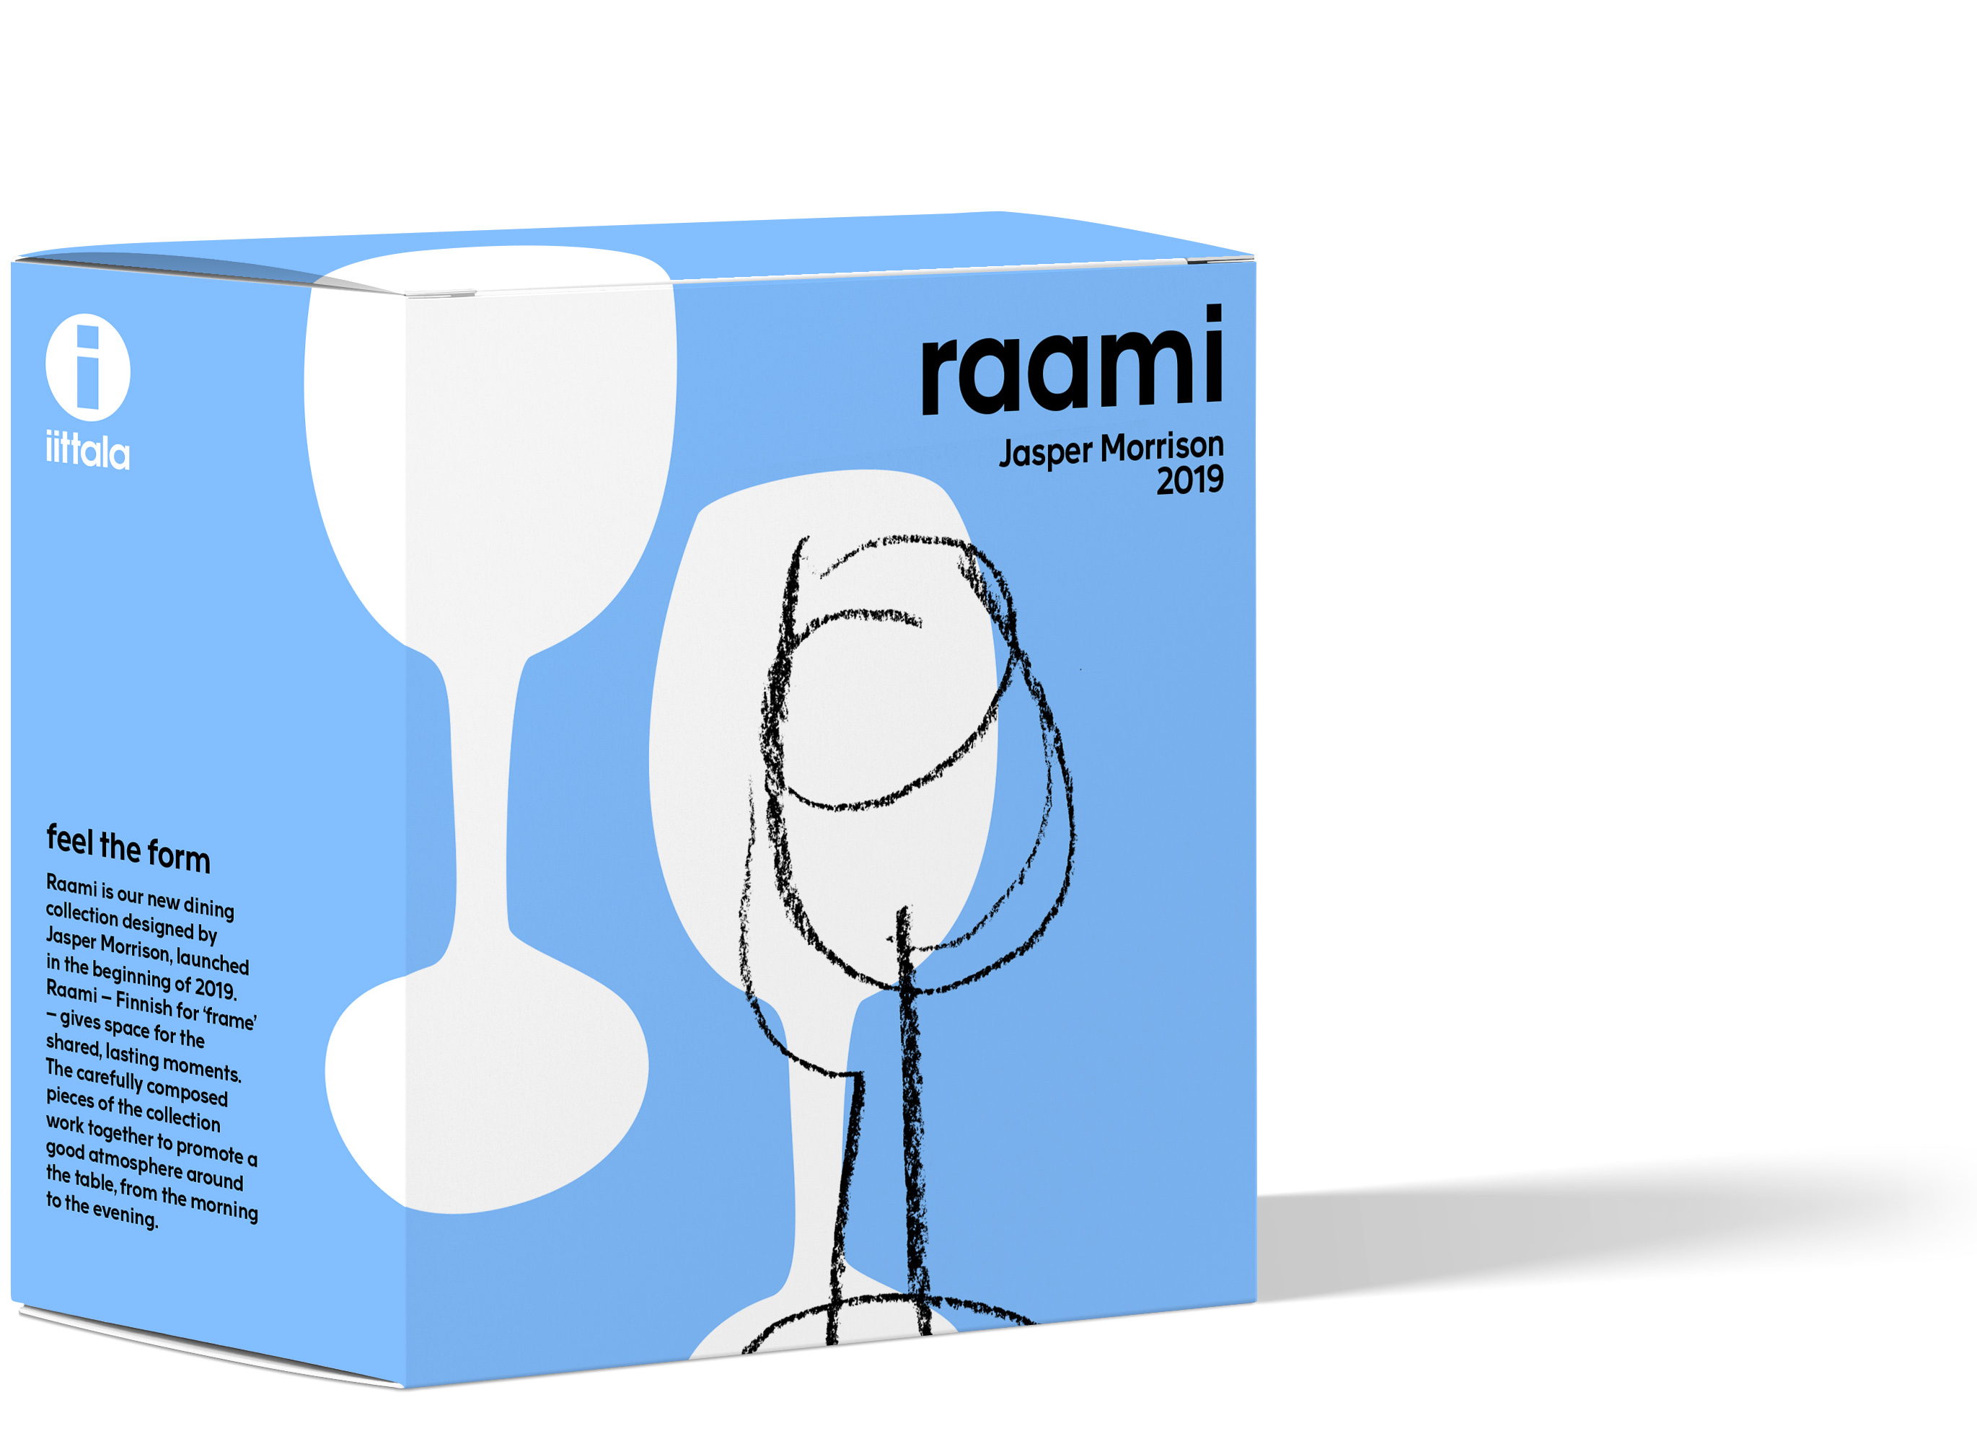
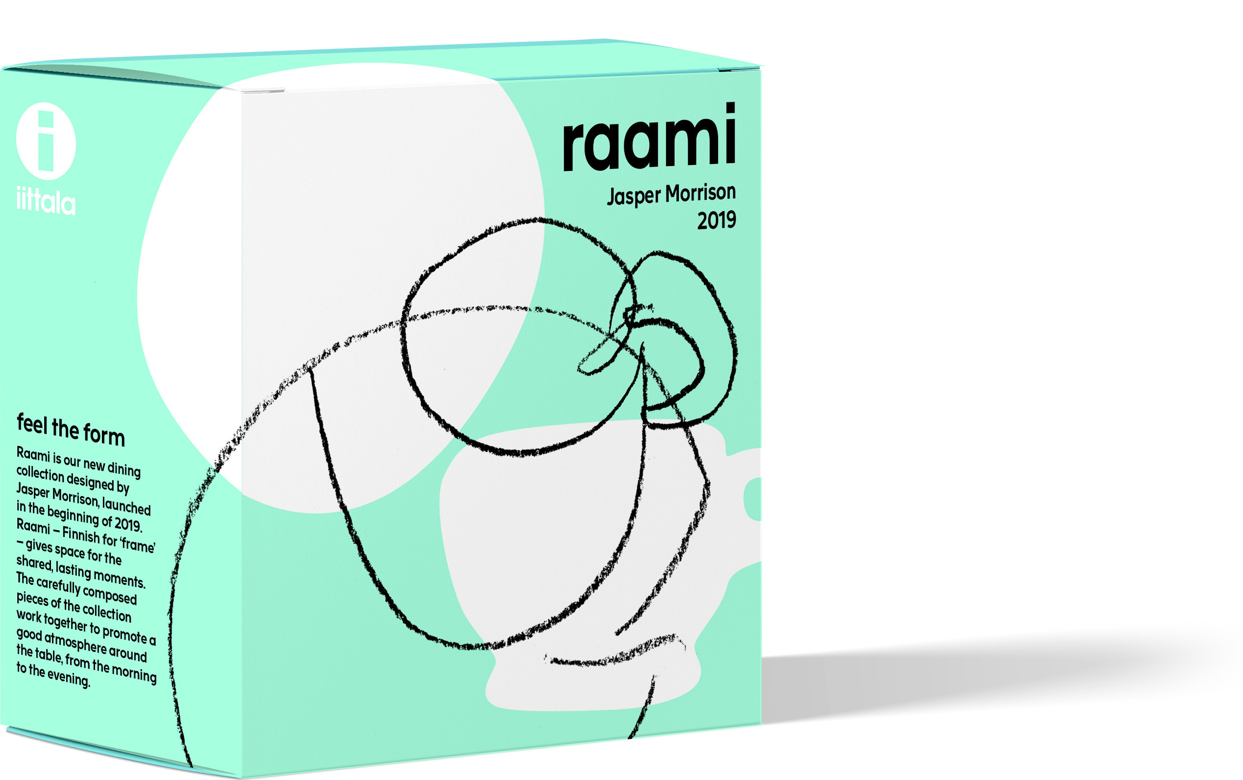
Packaging

Slide 15
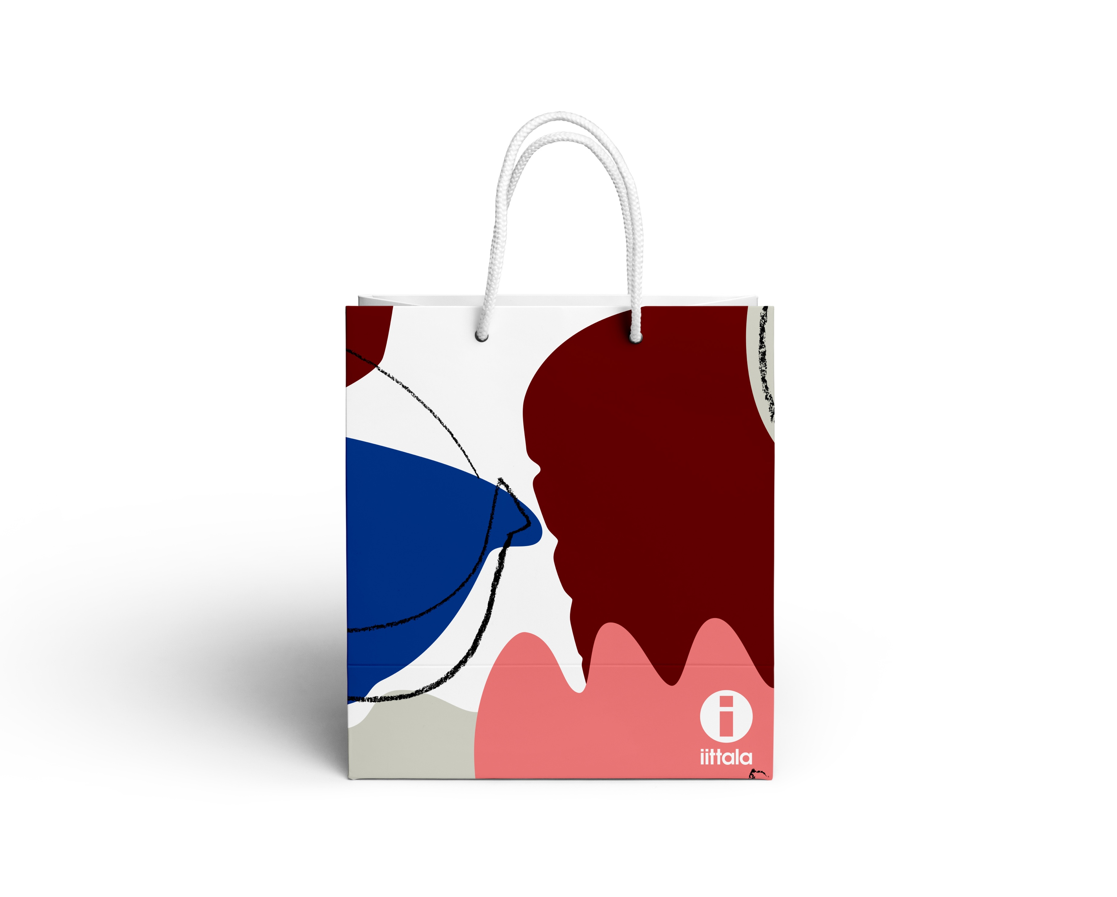
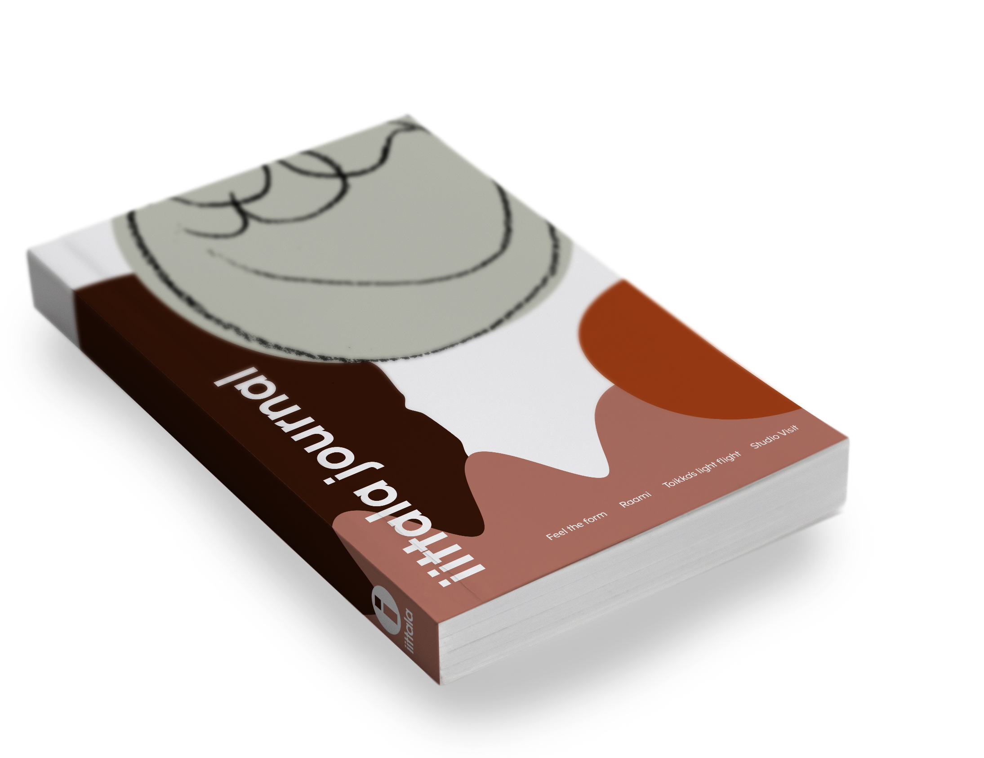
Iittala store accessories

Slide 16
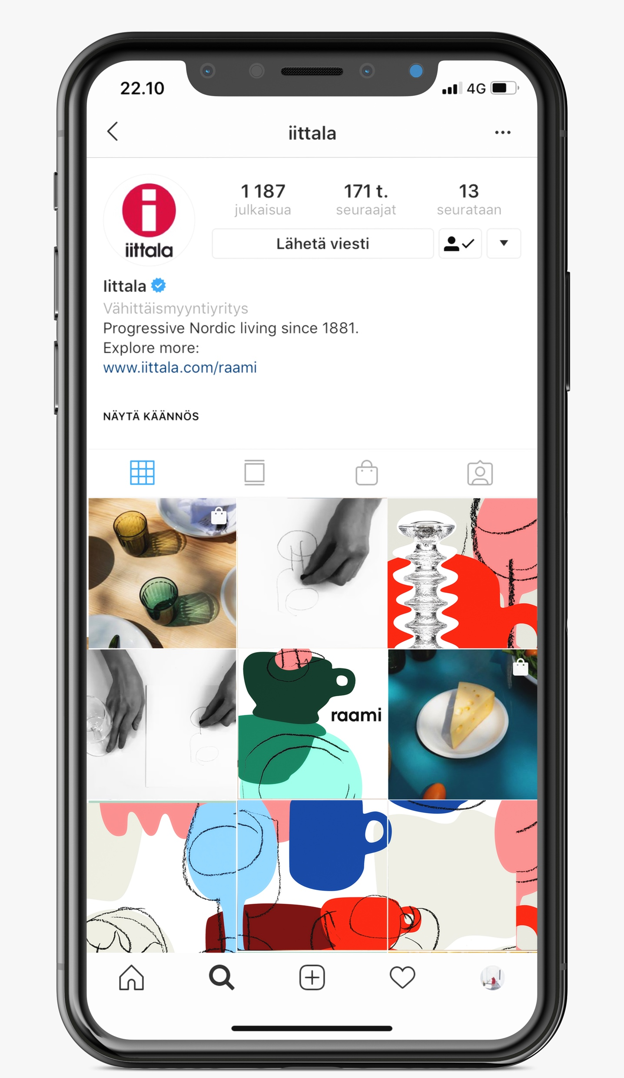
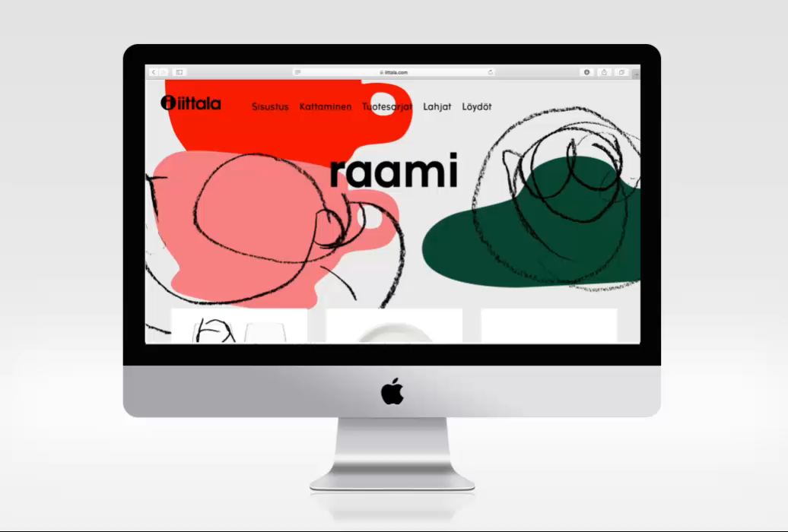
Website & social media

Slide 17
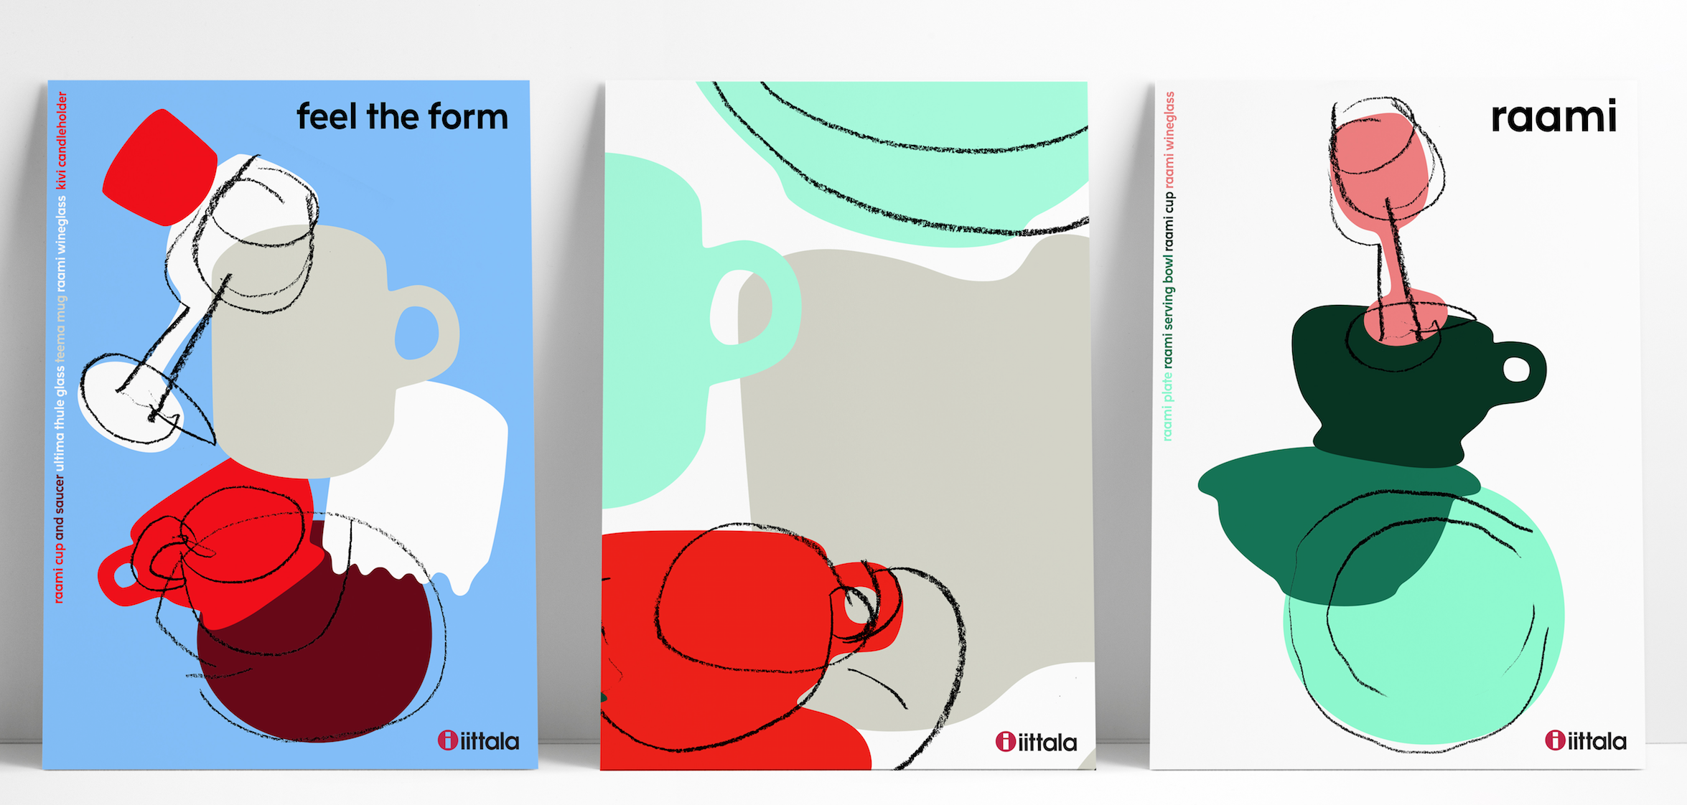
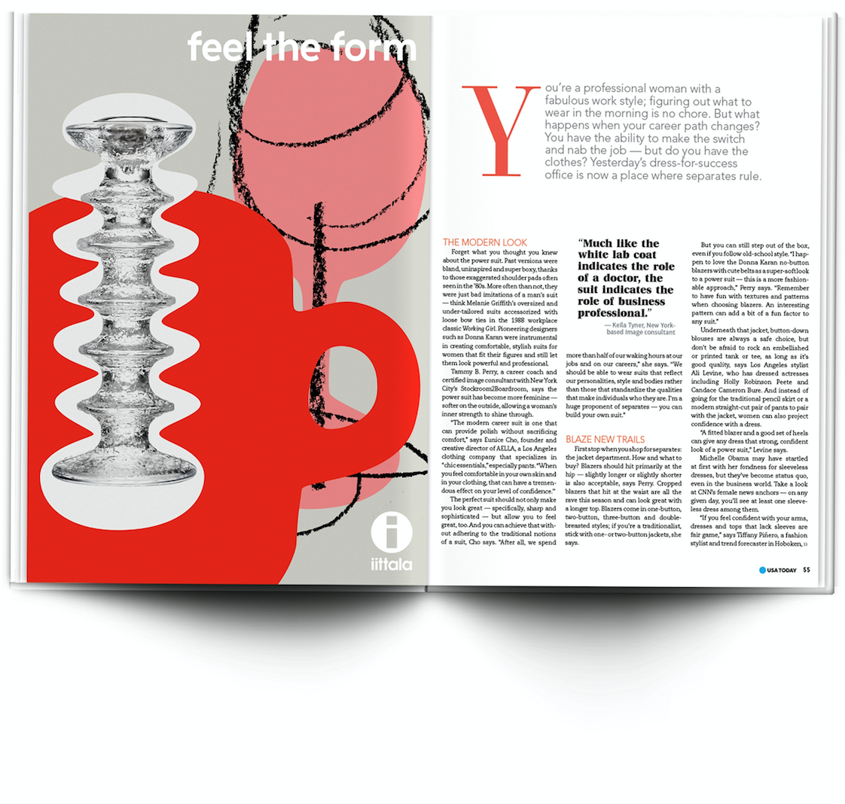
Visual identity

Slide 18
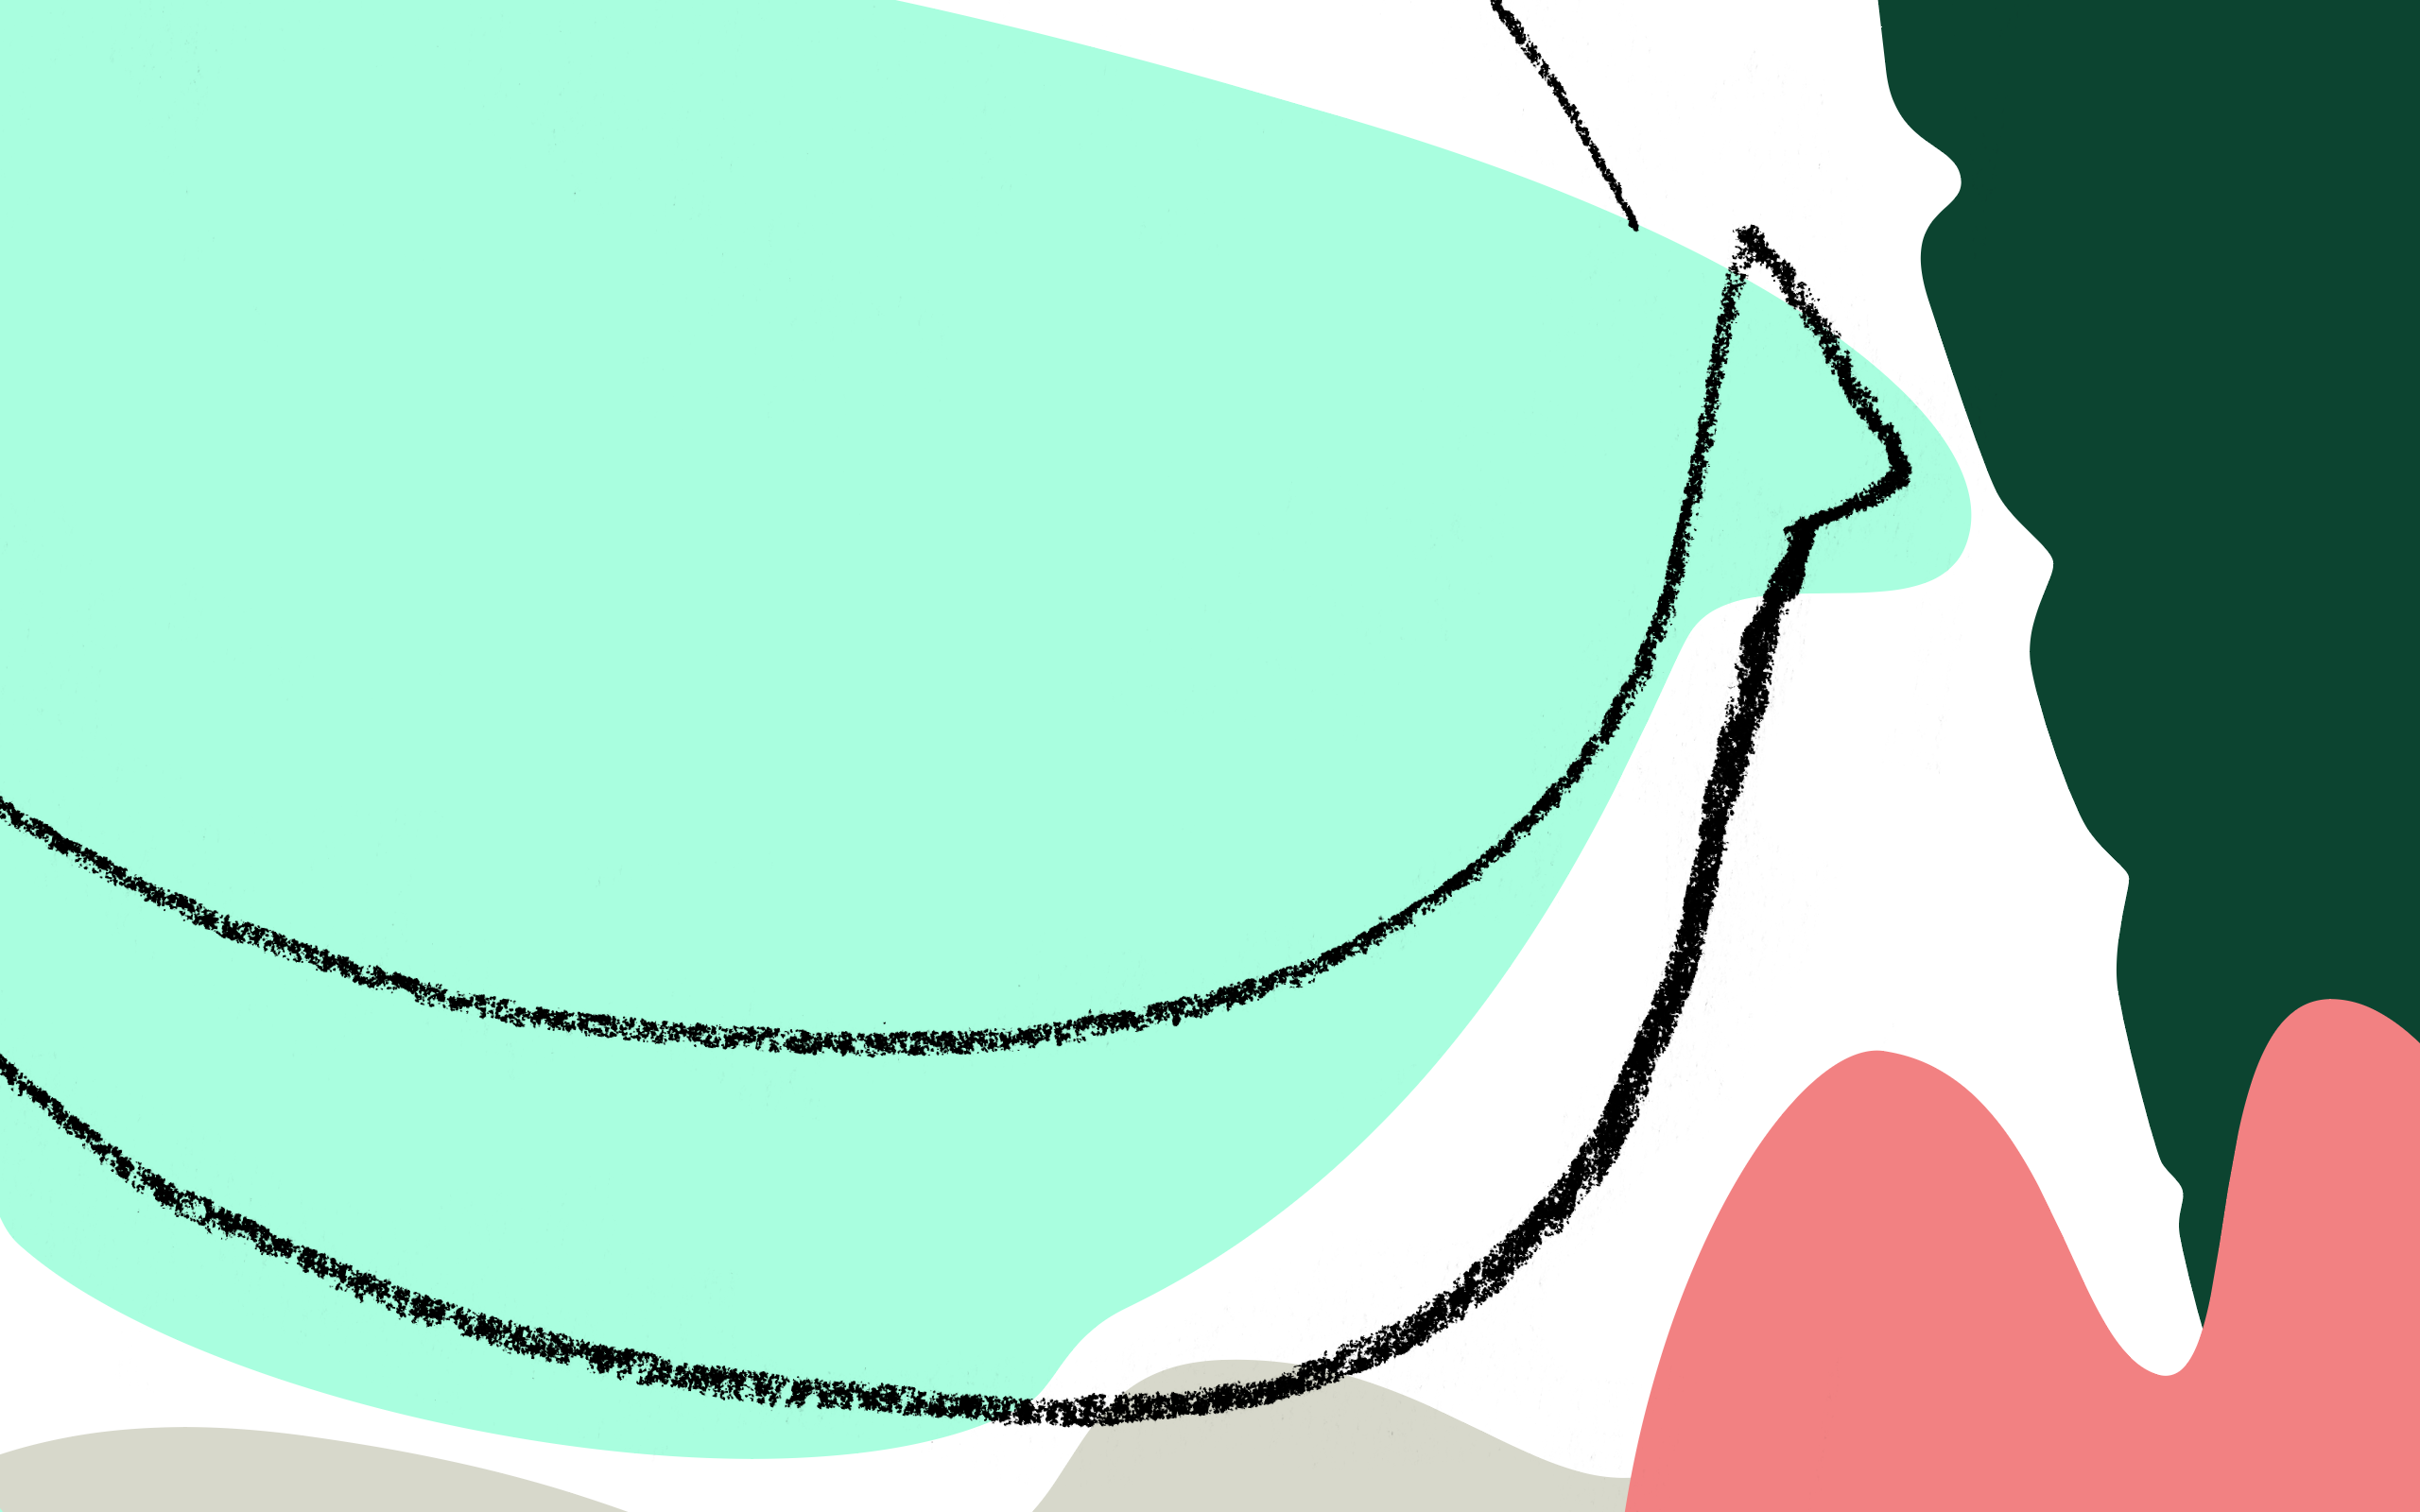
Feel the form

