Slide 1
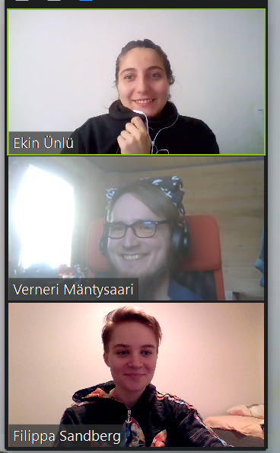
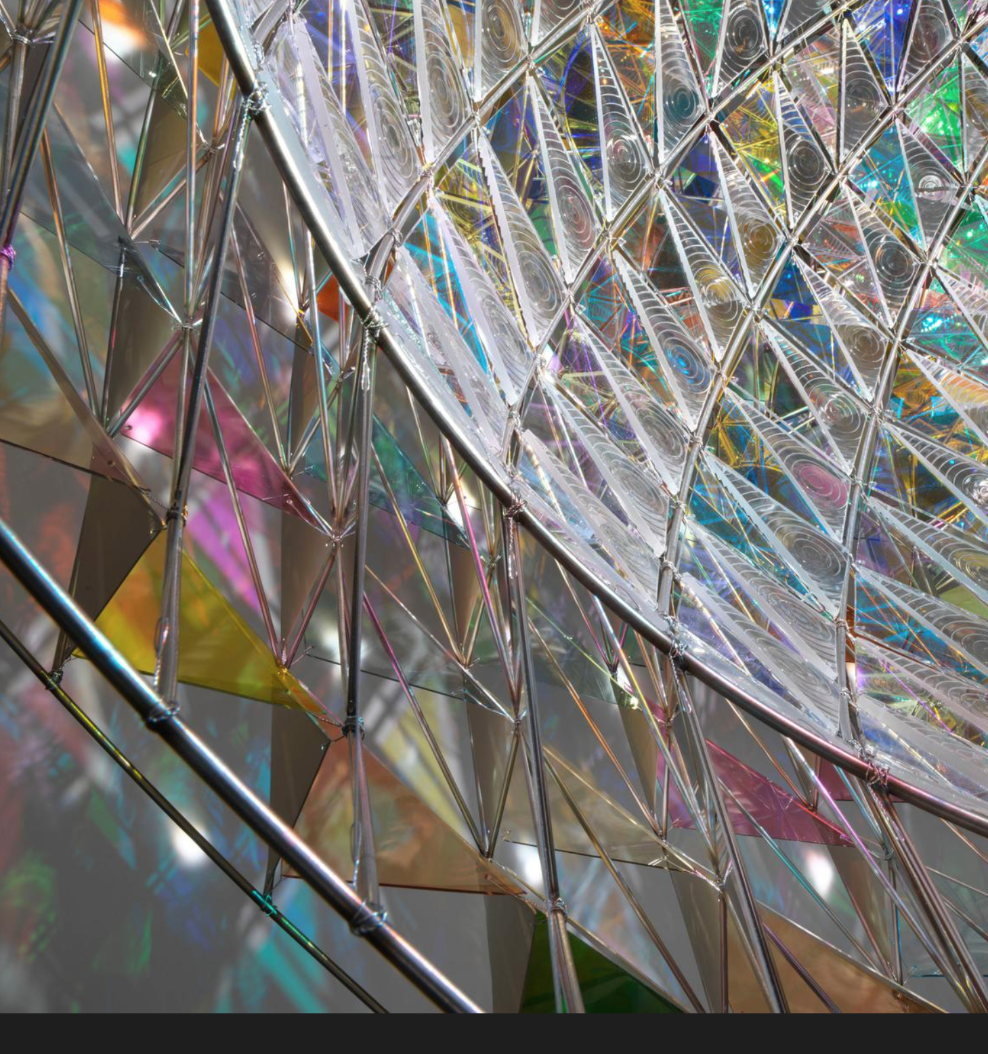
Group almost 4:
Ekin Ünlü
Program
Architectural Design
Verneri Mäntysaari
Contact person:
verneri.mantysaari@aalto.fi
Program:
Mechanical Engineering
Filippa Sandberg
Program:
Computer Engineering

Slide 2
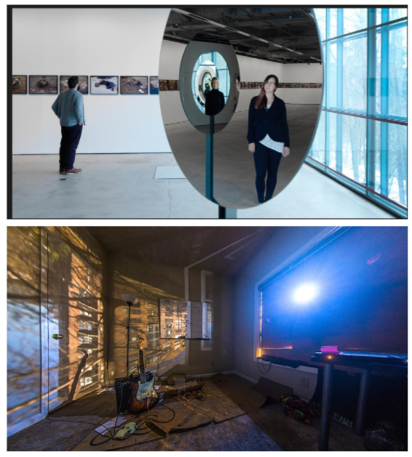
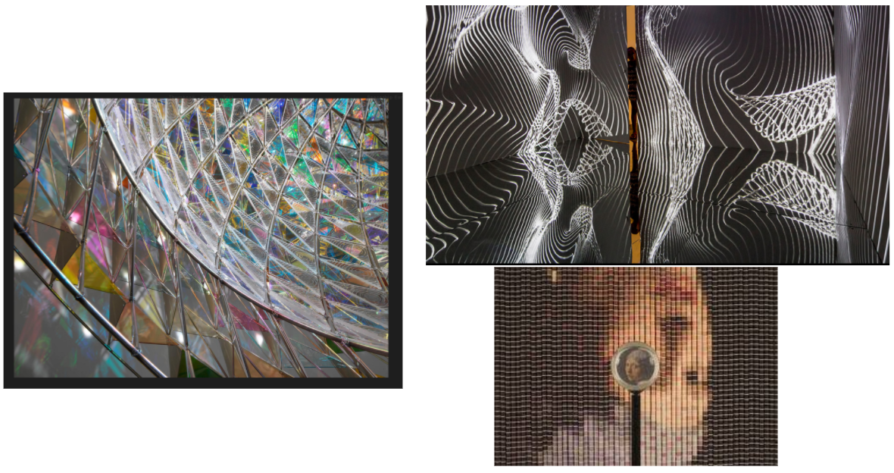

Slide 3
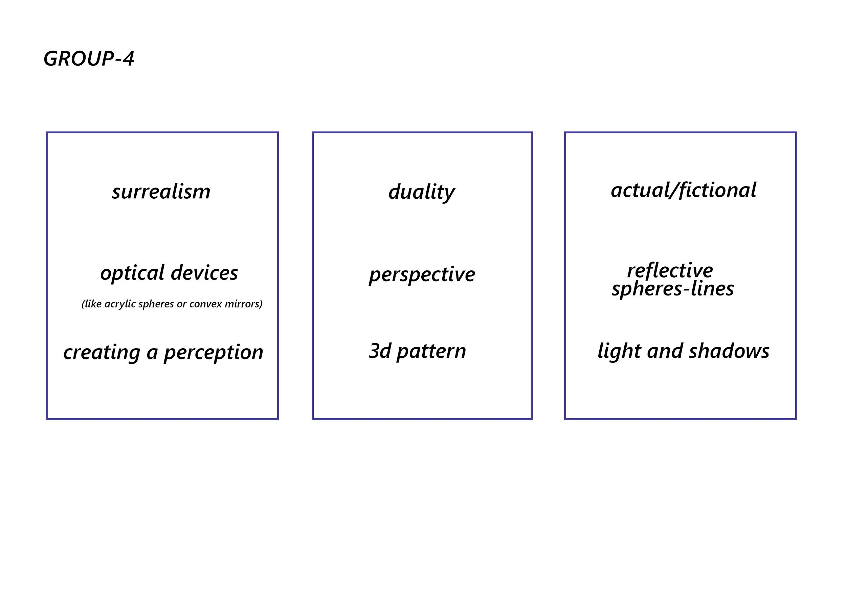
From task 1

Slide 4
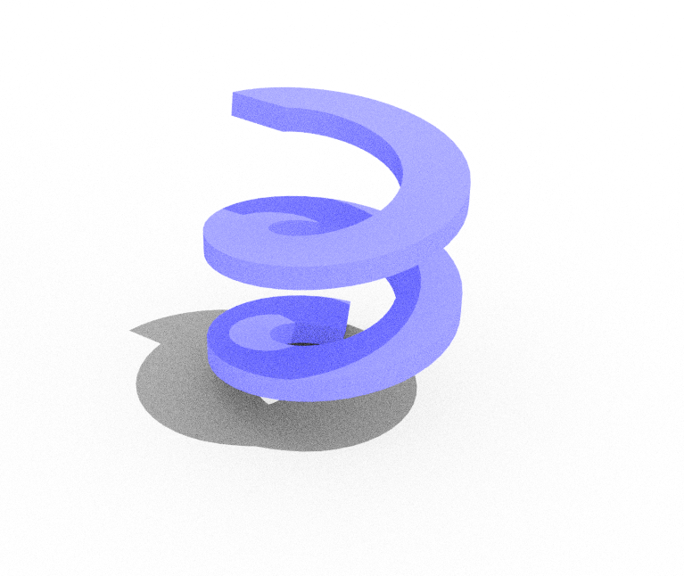
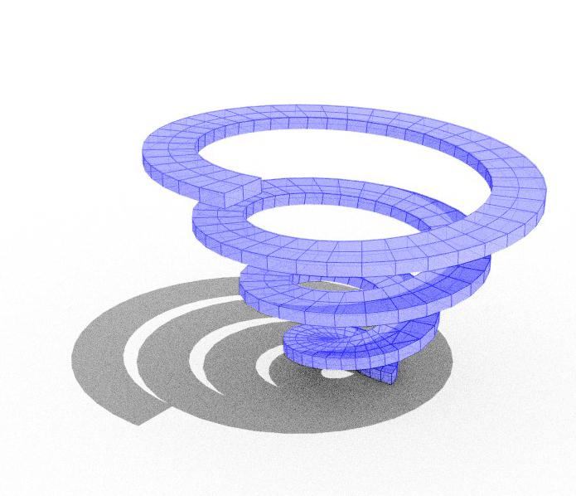
Concept 1: Helicoid
A helicoid morphed in a more spiraling shape
A mirror placed above could show that it looks like a circle from that direction, Some pattern on it would reveal a picture from above.
Telling a story
Evolution
Possible materials:
Plexi glass and stickers
A mirror

Slide 5
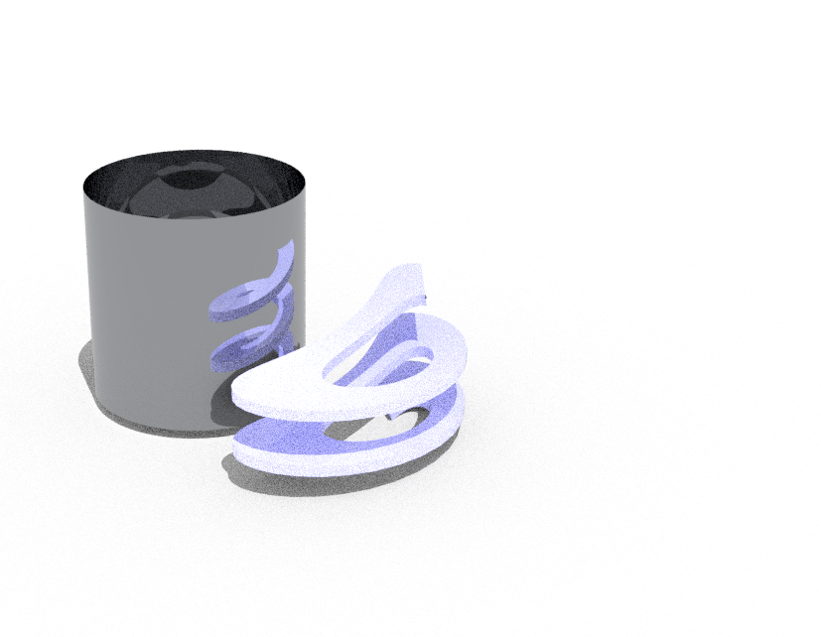
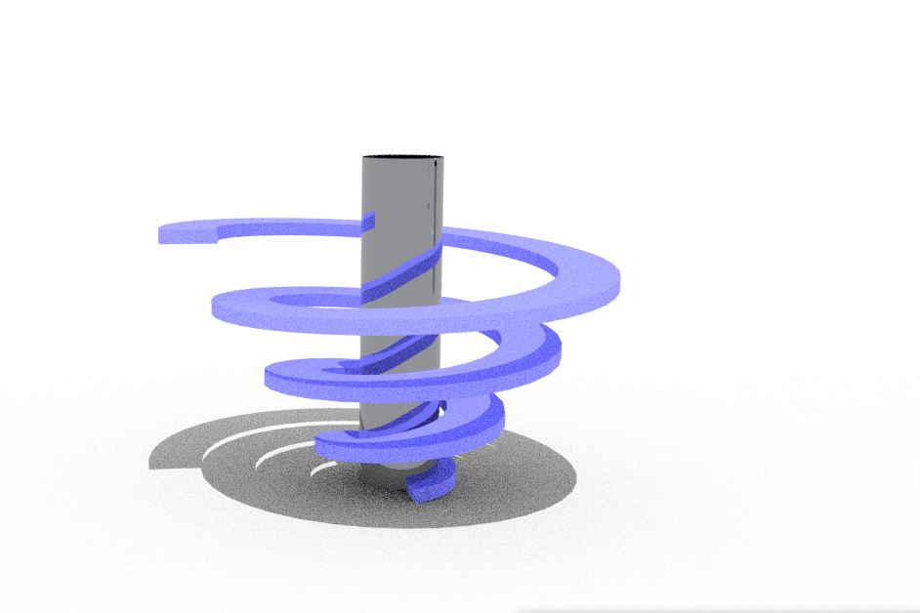
Concept 2: 3D Anamorphic
Convex mirror
A convex mirror shows a version of an object that “makes more sense” than the one we can see directly in front of it, here a helicoid is shown but we could also use an other object. From whole to piece
Possible materials:
Mirror
Plexiglass
3D-printed

Slide 6
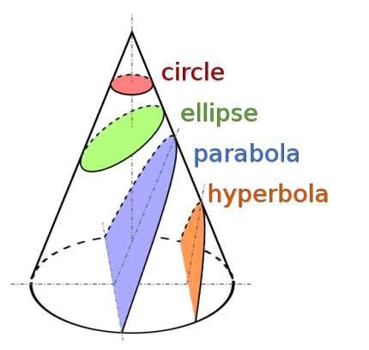
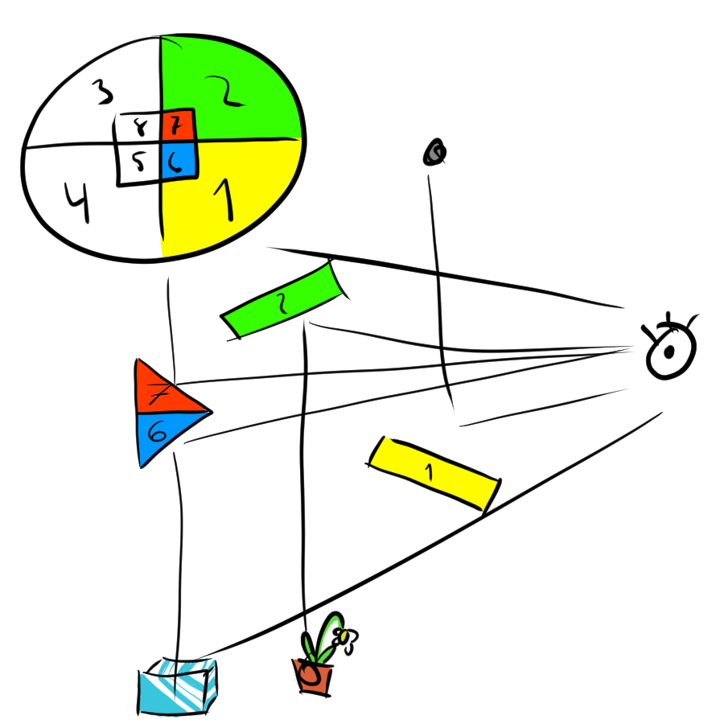
Concept 3: Mirror(s)
Mirrors viewed from a certain angle appear to create a complete picture, but they actually reflect from very different places. From to whole to the piece
Mathematical final picture
Different circles
Materials
Mirrors
Metal or plastic

