Slide 1
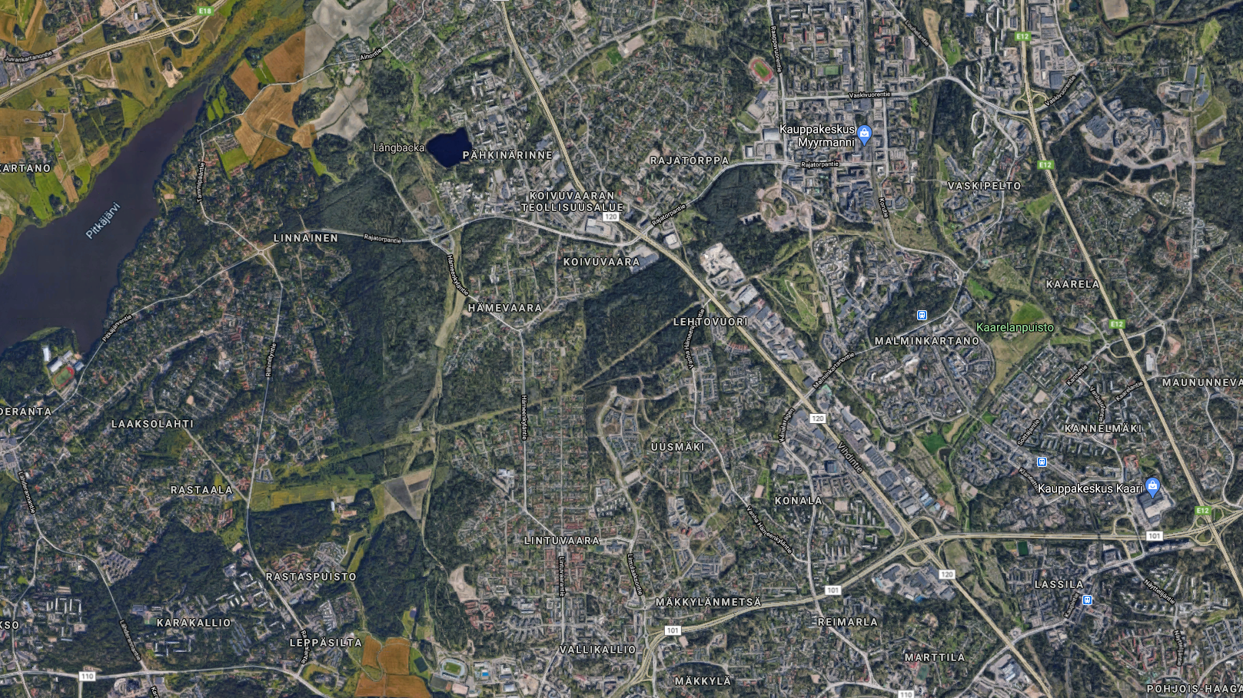
CONNECTIONS:
Necessary
Not tied to a place: find the most suitable route as a compromise between all requirements in the area.
LIGHT RAIL
STREET
GREEN CORRIDOR

Slide 2
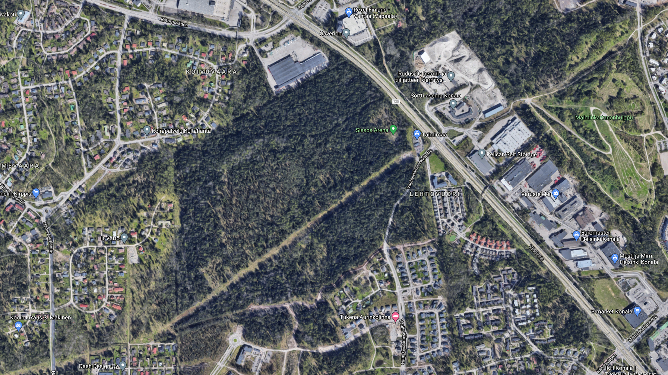
VALUES:
I class cannot be disturbed, has to be preserved.
II class can be compromised if a good overall solution is found.
Liveability: just adding apartments is not enough – inhabitants need greenspace and services (services can be low, 10% of GFA).
Creek, biodiversity values II class
Target: 6000 inhabitants (approx. 300000sqm GFA)
Flying squirrel and preserved flora,
II class values
Powerline (needs 18+18m unbuilt corridor, can be over street)
Flying squirrel,
I class values
(full conservation)
Flying squirrel, II class values

