Slide 1
ELEC-E8423 - Smart Grid Electric vehicles and their charging systems
Elena Medina Maldonado
Shamsul Arefeen Al Mahmud
27.04.2021

Slide 2
In this presentation
Introduction
Electric Vehicles
Charging System
Charging Components
Charging Methods
Smart Charging
Key factors for EV’s development
Conclusions
Source materials used
27.04.2021

Slide 3
Introduction
Electric vehicles in Finland
In Finland by end of 2019, 4661 fully electric vehicles and 24704 plug-in hybrids (previous year)
Target by 2030 is to have 250 000 EV's
Charging in Finland
993 (722) public charging stations
Goal is to have 1 public charging spot per 10 EV,s
Recommendation to have 1:100 ratio on quick charging point per fully electric vehicles currently ratio at 1:17
Recommendation to have 1:10 ratio on basic charging points per EV, currently at 9,4
Smart Charging
Controlled charging
V2X (Vehicle2Grid/Home/X)
27.04.2021
Sources: [1], [2]

Slide 4
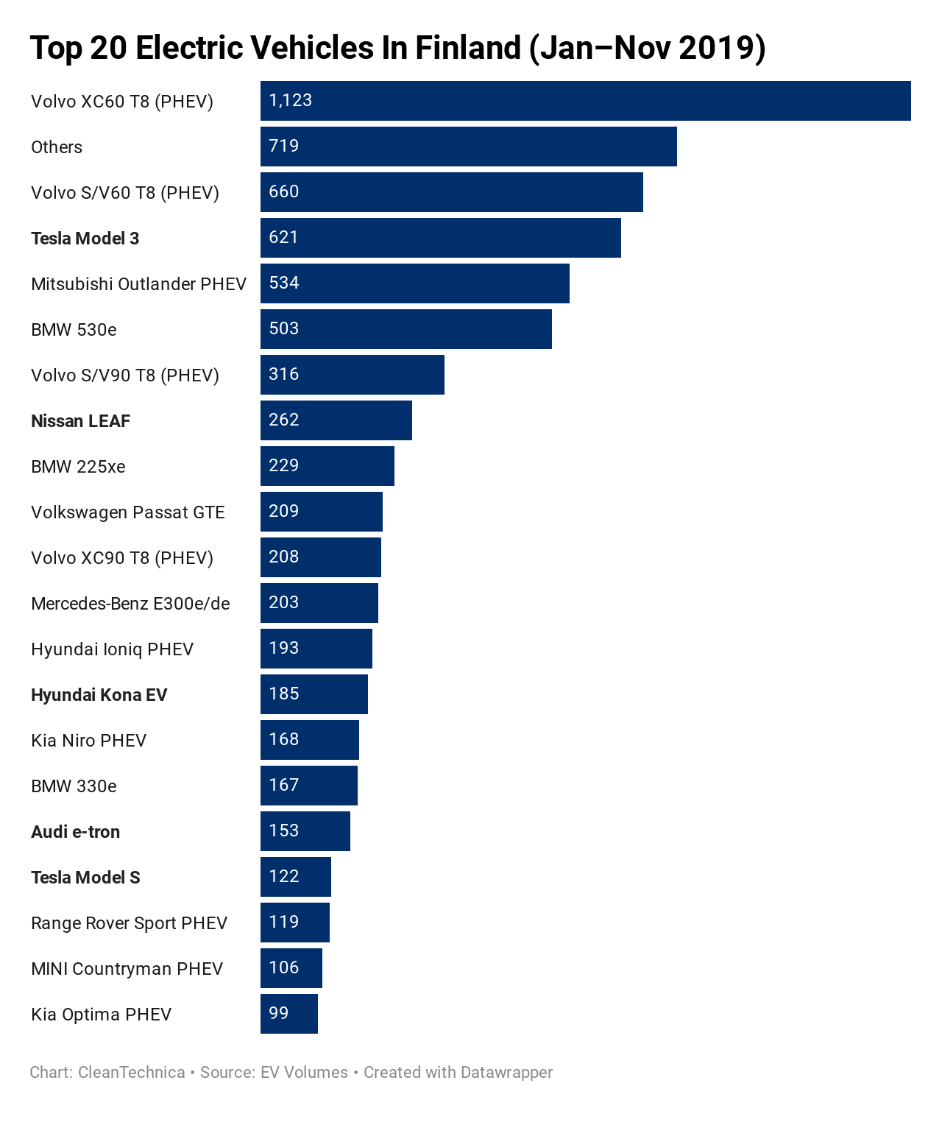
Electric vehicles
Electric vehicles
Nissan Leaf
40kWh battery up to 270 km range
Tesla model S
100kWh battery up to 610 km range
Kia e-Niro
64 kWh battery, up to 370 km range
Lithium-ion batteries
Commercial EVs
At least 30% of its bus's electric by 2025
Batteries in a range of 60 kWh to 280 kWh for city use
Finland plans to make public taxi’s wireless fast charging enable
27.04.2021
Sources: [3-5]

Slide 5
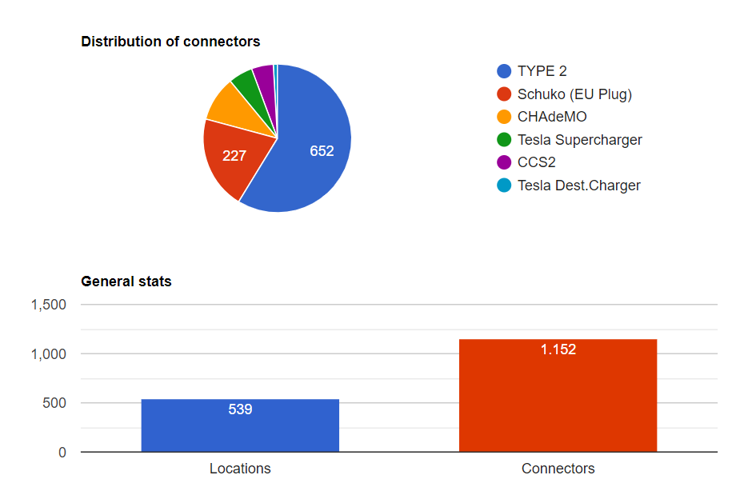
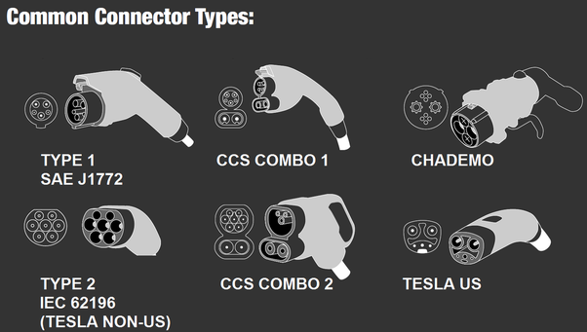
Charging System
Plug-in charging
Europe has its own standardized plugs for EV’s
Slow and basic charging (AC) -> Type 2
Quick charging (DC) -> CSS Combo
Other types are used for example Japan and US
Public charging stations shall have smart charging abilities → mode 3 or 4
Sources: [6]

Slide 6
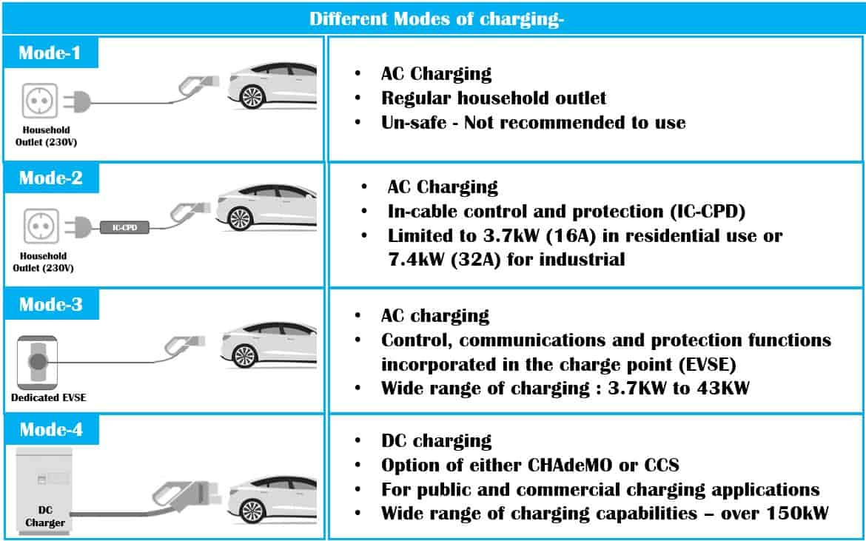
Charging modes of EV’s
Sources: [7]

Slide 7
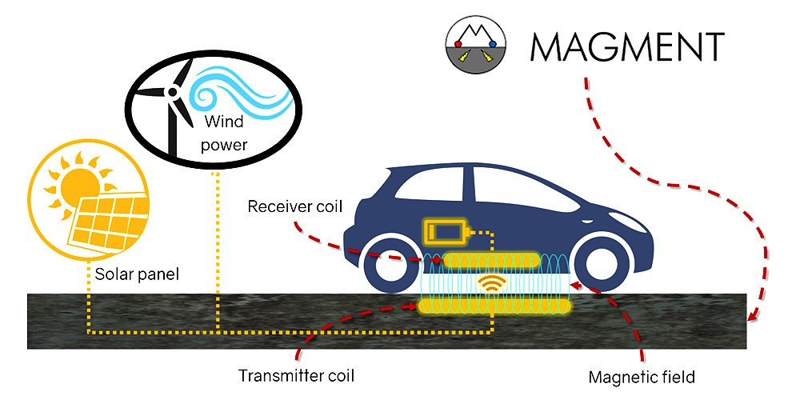
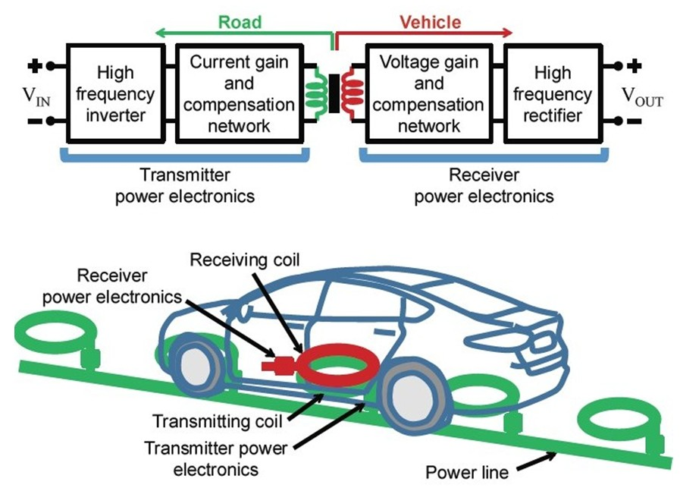
Wireless Charging Systems
Wireless charging for EVs is under development
Induction charging pads for stationary charging
Induction charging roadways for charging-on-to-move
Dynamic wireless charging solutions are developing quickly
Companies and Projects
Smart Otaniemi
Parking Energy
Fortum and city of Oslo developing
Wireless fast charging.
Sources: [1], [2]

Slide 8
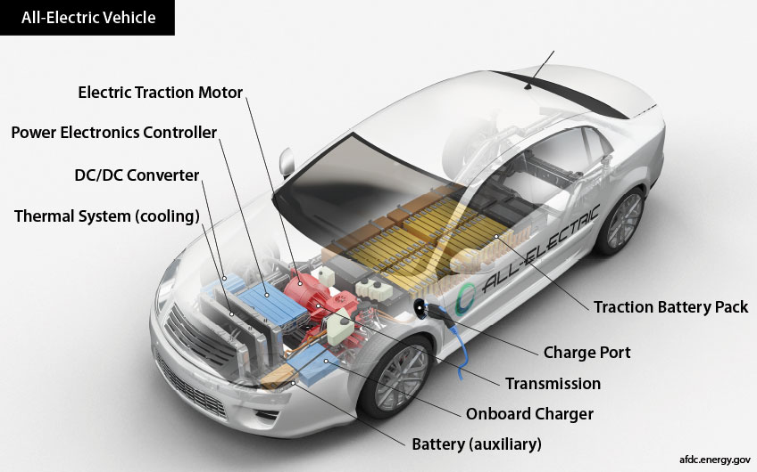
Charging components
Battery management systems (BMS) controls the charging operation
State of charge (SoC) and needed charging current
Operation shall be stopped if communication is lost
AC-DC conversion is done with on-board charger
Charging time depends from:
Charging power
Battery capacity and SoC
Temperature
Overall efficiency:
78~88 % for Grid-to-Vehicle (G2V)
64~72 % for Vehicle-to-Grid (V2G)
Sources: [1], [8]

Slide 9
EVs Charging Methods
Uncontrolled Charging
No restrains on the charging of EV
Problems for power distribution networks
Effects on grid
Congestion in lines
Increase in average peak demand to 5-10%
Voltage profile
Alternative : SMART CHARGING
Sources: [10], [11], [15]

Slide 10
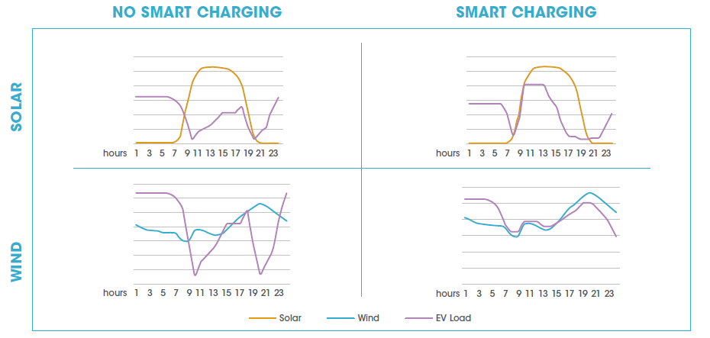
EVs Charging Methods
Smart Charging
Adapting the charging cycle of EVs:
power system ←→vehicle users
Integration of EVs
Main advantages:
- Cuts peak load
- Reduces curtailment
Allows higher integration
of renewables
Sources: [9]

Slide 11
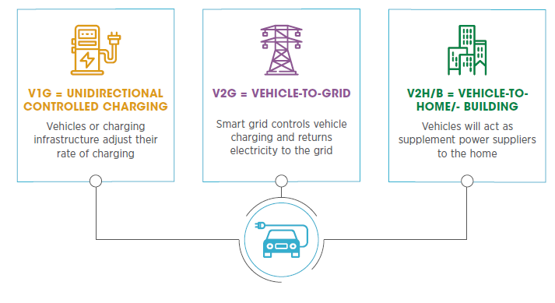
Smart Charging
Smart Charging approach
Sources: [9]

Slide 12
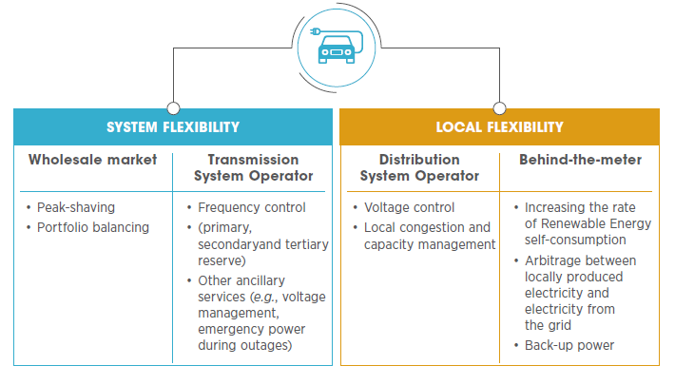
Smart Charging
Smart Charging services
Sources: [9]

Slide 13
Key factor for EVs development
Charging infrastructure:
Major investment for residential and public.
Regulation for vehicle-grid integration:
Define roles (electricity market + e-mobility market)
Incentives
ITC control and communication protocols:
Bidirectional communication for Smart Charging
Protocols OSCP, OCPP, VSL
Sources: [9], [16]

Slide 14
Conclusions
Plug-in-charging: slow and basic charging, Type 2 is the most common charging option in Europe. Wireless charging: several companies and government is planning to create wireless charging stations for taxis and personal vehicles.
Smart Charging: different services to grid, better integration of renewables
Integration of EVs in Smart Grids: regulation and development of communication technologies (protocols)

Slide 15
Source materials used
[1] Teknologiateollisuus. Visited 12.4.2020. Sähköinen liikenne -tilannekatsaus 2019 Q4. [Link]
[2] IRENA (2019), Innovation outlook: Smart charging for electric vehicles, International Renewable Energy Agency, Abu Dhabi. ISBN 978-92-9260-124-9. [Link]
[3] Nissan. Visited 12.4.2020. https://www.nissan.fi/ajoneuvot/henkiloautot/leaf.html
[4] Tesla. Visited 12.4.2020. https://www.tesla.com/fi_fi/models
[5] Top 20 Electric Vehicle in Finland (https://cleantechnica.com/2019/12/06/ev-market-share-in-finland-reached-10-last-month/)
[6] All The Electric-Car Charging Connectors In One Great Big Poster (https://www.greencarreports.com/news/1096058_all-the-electric-car-charging-connectors-in-one-great-big-poster)
[7] CHARGING BASICS 102: Electric Vehicle Charging Levels, Modes and Types Explained (https://www.emobilitysimplified.com/2019/10/ev-charging-levels-modes-types-explained.html)
[8] Smart Charging: parked EV batteries can save billions in grid balancing (https://energypost.eu/smart-charging-parked-ev-batteries-can-save-billions-in-grid-balancing/)

Slide 16
Source materials used
[9] IRENA. Electric Vehicle Smart Charging (2019). Available at:
https://www.irena.org/publications/2019/Sep/Electric-vehicle-smart-charging
[10] IRENA. Innovation Outlook. Smart charging for electric vehicles (2019).
[11] Lacey, G.; Putrus, G.; Bentley, E. Smart EV Charging Schedules: Supporting the Grid and Protecting Battery Life (2017).
[12] University of Strathclyde. Controlled and uncontrolled charging (2018).
[13] Anastasiadis, Anestis G. Kondylis, Georgios P. Polyzakis, Apostolos. Vokas, Georgios. Effects of Increased Electric Vehicles into a Distribution Network (2019).
[14] Mousavi, S.M.; Flynn, D. Controlled Charging of Electric Vehicles to Minimize Energy Losses in Distribution Systems (2016).
[15] IEA. Global EV Outlook 2020 (2020).
[16] Greenflux. Open Protocols, Avaliable at: https://www.greenflux.com/spotlights/open-protocols/

