Slide 1
ELEC-E8423 - Smart Grid Modelling of Electric Vehicle charging load
M. Usman Tariq
05.04.2021

Slide 2
In this Presentation
Introduction
Motivation and advantages of EV
Types of charging
Charging phases
Charging strategies
Modeling
Conclusion
Sources

Slide 3
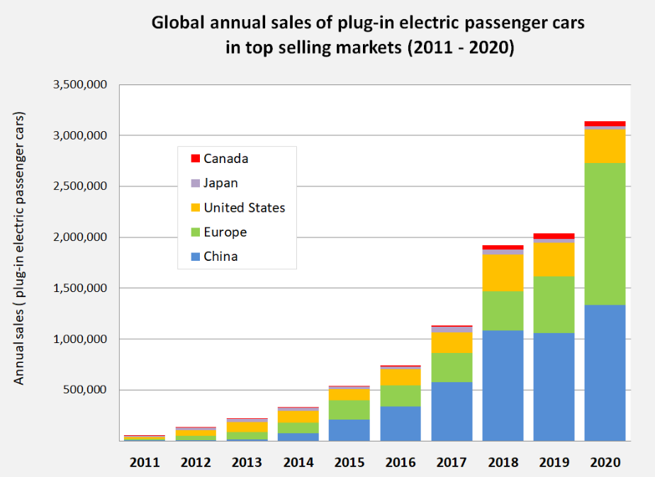
Introduction
EV - Powered solely by electric energy stored in the battery
PHEV - Powered by a combination of battery power and gasoline engine
Mass penetration of electric vehicle is expected by 2030
This will upsurge the demand of electricity
Superior method is required to dial down the load curve
Charging multiple EVs at the same time will result in congested peak loads that will increase the losses and aging of electrical networks.
[1]
Notes:
In the 2000s, the development of hybrid vehicles, plus another fuel crisis, saw the technology adopted by larger numbers than ever before. Tesla’s Roadster, which went on sale in 2008, was a game changer for the industry. The attractive design and extended range of the Roadster appealed to a larger market than ever before and encouraged competitors such as Nissan and Chevrolet to launch their own models.
You can get a government grant of up to £4,500 for an electric car and £500 towards a home charging point. Check what you could get
https://en.wikipedia.org/wiki/File:Global_plug-in_car_sales_since_2011.png

Slide 4
Motivation and advantages
Better for the environment
Less carbon footprints
Integration of renewable energy sources
Quieter than normal gasoline cars
Running costs
Cheaper to run
Cheaper to maintain
Incentives and possible future restrictions
Availability of tax credits for EV owners
Future restriction for ICE cars
Energy security
Demand shifting away from fossil fuels
Notes:
No fuel, no emissions
Running costs
Because you’re not paying for petrol or diesel to keep your car running, you can save a lot of money on fuel
Increase energy security by shifting demand away from fossil fuels to domestically produced energy supplied from renewable sources

Slide 5
Types of charging
AC charging
DC charging
[2]
Notes:
In an AC charging, the charge point or electric vehicle supply equipment (EVSE) provides the AC power to the vehicle’s onboard charger (OBC), which then converts the AC power in to DC power in order to charge the battery.
A Level 1/residential charging usually have a power source of 120VAC/230 VAC and current in the range of 12 A to 16 A with operating power range between 3-6 kW. Charging by level 1 charger can take up to 12 hours to fully charge an EV of 24 kWh battery capacity
In a DC charging, an off board charger, which converts AC to DC supplies DC power to the BMS and bypasses the onboard charger within the vehicle
Theoretically, DC charging can supply voltage between 300-750 V and current up to 400A by using the off-board charger. It takes less than 30 minutes by DC charging to charge a 24 kWh EV [33

Slide 6
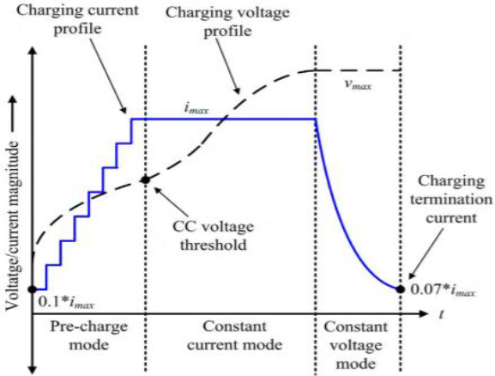
Charging phases
Pre-charge mode
Voltage increases gradually,
Current is held low
Constant current mode
SOC higher than 10%
Current is constant at high value
Voltage is limited
Constant voltage mode
Voltage remains constant
Charging current deteriorates
[3]
Notes:
This phase is often called as pre-charge phase and it starts as soon as the charging starts. During the pre-charging phase, input voltage increases gradually while the value of current is held low.
This phase is also known as constant current phase (CCP). Constant current phase starts when EV has a SOC higher than 10%. In this phase, the charge current is held constant at a high value until the voltage of the battery reaches a specified limit.
Third phase also known as constant voltage phase (CV) starts immediately after the second phase. Unlike to the constant current phase, voltage remains constant throughout this phase while charging current deteriorates exponentially.

Slide 7
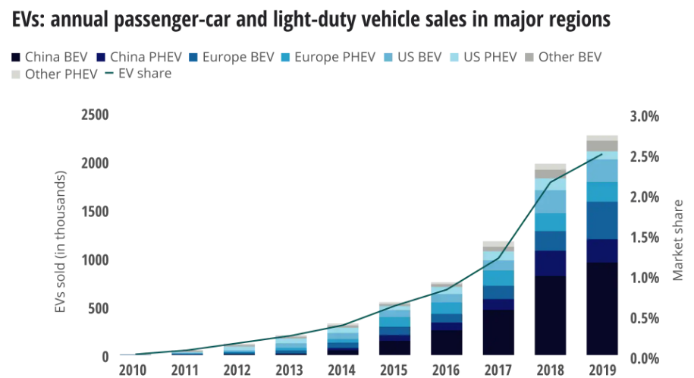
Problems for future EVs and Grid Load
Future integration of electric vehicles can extensively have negative impact on the existing infrastructure.
This mass penetration of EVs will also upsurge the demand of electricity
Continuous increase in the electricity generation from renewable energy resources within Europe poses serious concerns over power stability
Electric vehicles charging process can provide higher degrees of freedom as they have usually longer parking times depending upon the behavior of individual user
[4]
Notes:
Future integration of electric vehicles can extensively have negative impact on the existing infrastructure.
This mass penetration of EVs will also upsurge the demand of electricity, which eventually will have severe effects on the electrical distribution networks. Foreseeing this, existing power distribution networks may fail to accommodate the increased demand of electricity generated by integration of EVs. The possible concerns that comes with the increased demand from EVs are under voltages, network congestions & frequency oscillations within the power grid. Moreover, charging numerous EVs at the same time will result in congested peak loads that will increase the losses and aging of the electrical networks
On the other hand, continuous increase in the electricity generation from renewable energy resources within Germany and Europe poses serious concerns over the future power stability. Therefore, it is need of time to ensure the balance between fluctuating generation and volatile consumption. The easiest approach to counter the constantly increasing volatile demand would be the upgradation of existing power distribution networks or installation of electricity storage technologies. However, these approaches would be very unfeasible economically and will need large amount of investment
Electric vehicles charging process can provide higher degrees of freedom as they have usually longer parking times depending upon the behavior of individual user. Therefore, the controlled charging of electric vehicles is considered as more technically feasible and economically viable option, which can help to charge EVs from volatile RES and avoid peak load times and under voltages

Slide 8
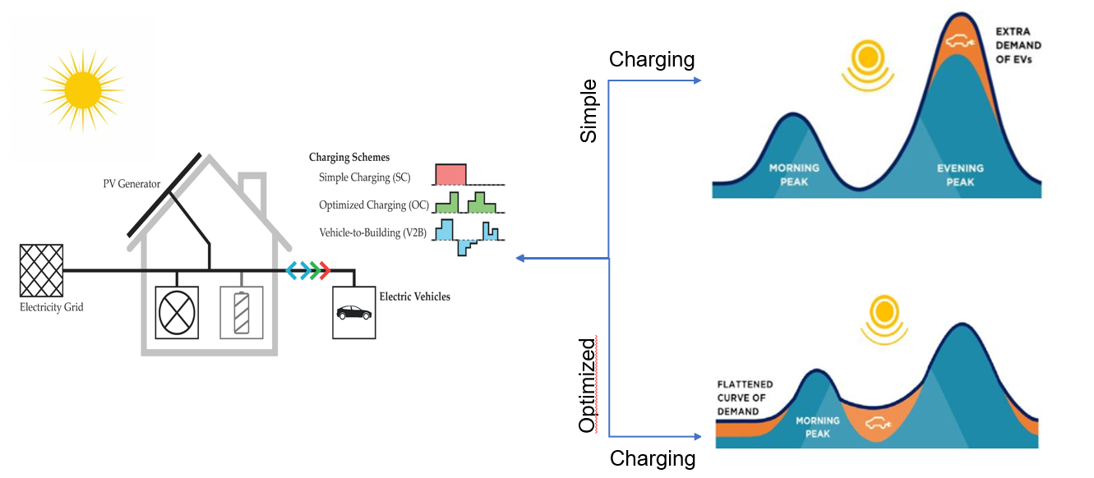
Charging strategies
[5]
Notes:
EV gets charged during low price intervals, which are forecasted, by photovoltaic overshoots and daily load profiles
Smart charging strategy works on the basis of predefined range, initial SOC and external factors such as electricity prices or forecasted photovoltaic overshoots

Slide 9
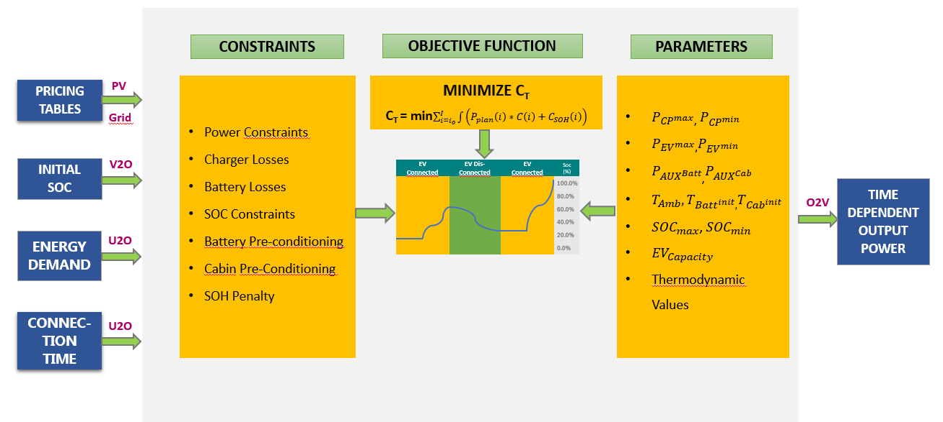
Modeling of electric vehicle charging load
Notes:
Electric vehicles charging process can provide higher degrees of freedom as they have usually longer parking times depending upon the behavior of individual user [14]. Therefore, the controlled charging of electric vehicles is considered as more technically feasible and economically viable option,
smart charging of EVs will play a major role in the integration of fluctuating renewable energy sources in future

Slide 10
Conclusions
The controlled charging of electric vehicles is a technically feasible and economically viable option,
The optimized charging strategy can also play major role in the integration of fluctuating renewable energy sources (RES) in the future
The results which can be achieved from smart charging depends heavily on external factors such as individual user profiles, EV capacity, battery technology, electrical network limitations and environmental conditions
EV demand upsurge

Slide 11
Source material used
https://en.wikipedia.org/wiki/File:Global_plug-in_car_sales_since_2011.png
X. Gong and J. Rangaraju, “Taking charge of electric vehicles – both in the vehicle and on the grid,” Texas Instruments, p. 13, 2018.
R. H. Ashique, Z. Salam, M. J. Bin Abdul Aziz, and A. R. Bhatti, “Integrated photovoltaicgrid dc fast charging system for electric vehicle: A review of the architecture and control,” Renew. Sustain. Energy Rev., vol. 69, no. May 2016, pp. 1243–1257, 2017.
https://www2.deloitte.com/content/dam/insights/us/articles/22869-electric-vehicles/figures/Fig-01.png
An optimized EV charging model considering TOU price and SOC curve,” IEEE Trans. Smart Grid, 2012
J. J. Mies, J. R. Helmus, and R. van den Hoed, “Estimating the charging profile of individual charge sessions of Electric Vehicles in The Netherlands,” World Electr. Veh. J., vol. 9, no. 2, 2018.
Y. Cao et al., “An optimized EV charging model considering TOU price and SOC curve,” IEEE Trans. Smart Grid, 2012.

