Slide 1
ELEC-E8423 - Smart Grid Demand response of EV loads
Juuso Järvenpää & Martin Mach
30.03.2021

Slide 2
In this presentation
Introduction
Potential
Type of Demand Management
Aggregation
Pros and Cons
Case study
Conclusions

Slide 3
Introduction
Demand response (DR) - consumption management to achieve equilibrium in power system
With aggregated demand response, electric vehicles (EV) have potential to
Load shifting
Provide frequency balancing
Voltage control
Rapid growth in EVs will increase storage capacity connected to power system
Potential to utilize as peak load reserve
Utilization of DR on EV loads still in pre-mature stage
Business model and customer incentives require development
Key terms: Battery Electric Vehicle (BEV), Plug-in Hybrid Vehicle (PHEV), Vehicle to Grid (V2G), Smart Charging

Slide 4
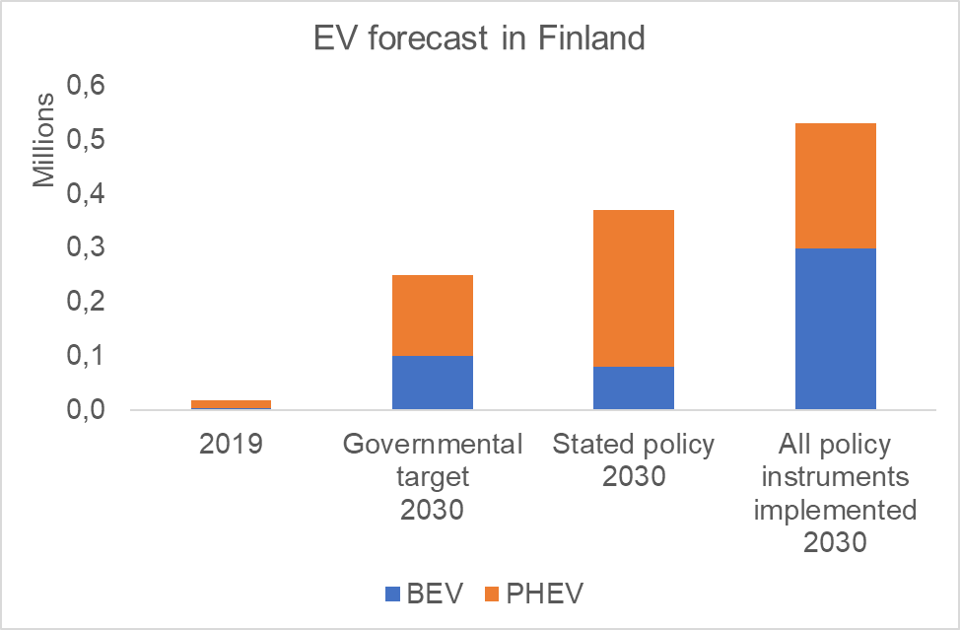
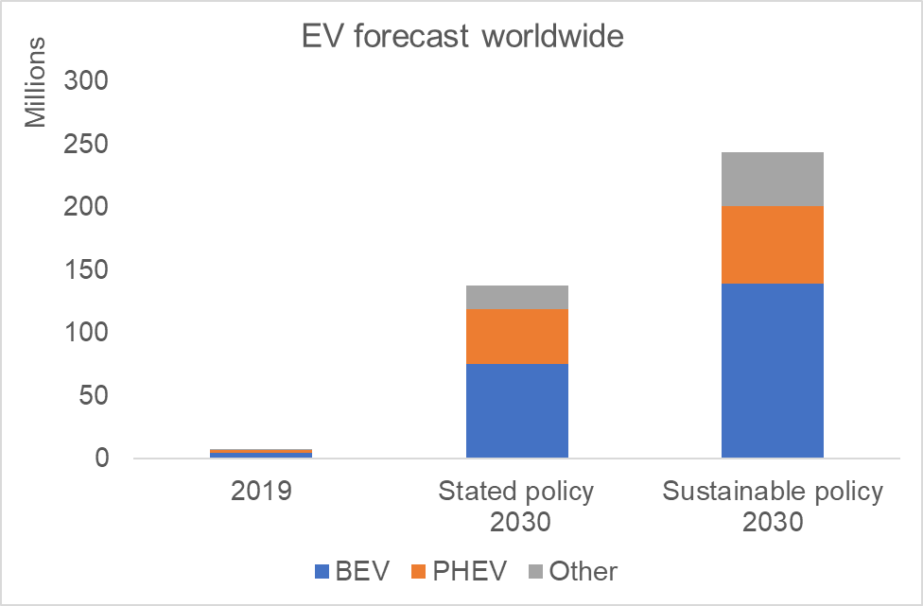
Potential of EV fleet
Pros
+ Storage capacity
+ Demand flexibility
+ Environmental aspects
Cons
- Increasing consumption ≈1TWh [1]
- Increase in peak power
Data combined from [2], [3] & [4]
Data modified from [5]
in Finland
Average battery capacity [kWh]
BEV | 43
PHEV | 11
Data from [6]
Storage capacity [MWh]
2019 | 2030 Stated policy
296 | 6 659
Typical EV charging power [kW]
Private charging | 3 - 22
Charging station | 11 - 150
Data from [7] & [8]

Slide 5
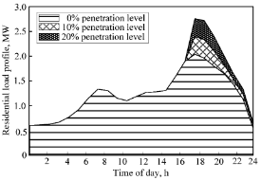
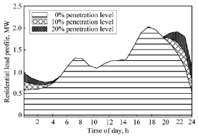
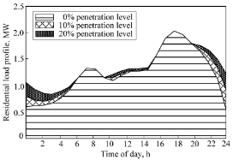
Types of the EV demand management
Uncontrolled charging – charging starts at the time of arrival without any demand optimalization
Controlled charging – charging is shifted to fixed times of low demand (night) with simple electricity tariffs or is optimized according to the grid or market conditions (smart charging)
The graphs above show the simulated added load for scenarios where 1. there is no load management (BEV's are charged when people come home from work) 2. charging is relocated to fixed off-peak time 3. smart charging is used and the charging period is flexibly controlled by the electricity market price [9]
Notes:
Uncontrolled charging means that the cars start charging at the instant of arrival at home or workplace only according to the will of the car owner. In this case, EV charging usually occurs at peak load hours which leads to severe grid impacts (excessive loads, higher voltage drops, and therefore higher losses), and the penetration level of EVs is then limited by the distribution network.
Delayed charging with a simple tariff structure can shift load to fixed off-peak hours, this results in a flattened load profile (and a decrease of the voltage drop) caused by EV charging. Another option is not to use a fixed time slot, but to accomplish flexible charging time with market incentives, this is called smart charging.
Some kind of load control is necessary for further expansion of electric vehicles. Smart charging which allows load shifting and valley filling is the most promising approach for the utilization of flexibility potential offered by EV loads.

Slide 6
Vehicle to grid
V2G – the EV is able to be discharged within a flexible time and provide support to the grid and offer ancillary services to DSO or TSO
Aggregated demand response from electrical vehicle charging can provide frequency balancing such as fast frequency response
Potential to increase system flexibility and support the integration of intermittent RES
Pilot projects with a small number of EVs are realized, technology is not yet sufficiently developed, and has significant technical deficiencies
Aggregators and related market plus regulatory changes are needed for future adoption
Notes:
In time when EV is connected to the charger for a longer time, it can be also be discharged and provide services for DSO or TSO (FFR for TSO, reactive power for voltage control in distribution networks, back up power in case of emergency)
It is believed that V2G will increase system flexibility and therefore allow further integration of intermittent renewable energy sources, especially solar.
The ENTSO-E (European Network of Transmission System Operators for Electricity) classifies V2G technology readiness on level of demonstration and development. The pilot project validated the ability of a fleet of EVs to provide fast frequency response (FFR) within 2 seconds. However, there are still technical obstacles, mostly with regard to communication.
Furthermore, there is a number of needed changes with related to electricity markets and regulations.
V2G concept can be seen as an addition to smart charging strategies. The base of the EV DR will be a small-scale demand response, mainly to reduce the charging power in small areas. The second phase can be vehicle-to-grid.

Slide 7
Demand response aggregation
By aggregating adjustable loads, sufficient capacity can be achieved and operated, e.g., in the reserve market
Distributed energy resource
Sub-aggregators
Aggregator
Balance Responsibility Party
€
€
e.g. Charging station provider
Virtual Power Plant
DR target
kWh kW
kWh kW
Industrial loads
Building loads
etc …
[10] Picture modified from presented business model in VTT (2020)

Slide 8
Benefits of EV demand response
Smart charging or even very basic load management can greatly reduce impacts on load profiles. Demand response is required to limit the stress on electricity distribution networks and allow further electrification of the transportation sector
V2G aggregator can create virtual powerplants, helping provide grid ancillary services (peak demand, frequency control etc.) in a cost effective and CO₂ neutral manner
V2G enables an increased share of renewable energy utilized by energy systems, both in individual buildings (vehicle-to-home) and the national grids
Potential to lessen the need for further investment (capital and material) for additional infrastructure related to grid services (use of available hardware)

Slide 9
Drawbacks and challenges of EV DR
In order to effectively manage the loads, robust information and communication systems are needed to enable reliable smart charging or V2G
Individual charging times are stochastic, it is very difficult to forecast them
It still remains unknown how far will be EV owners willing to join V2G or smart charging programs
Despite numerous smart charging projects, technology is still not in a state of the full commercial rollout
There is a lack of a uniform approach to aggregation and commercial deployment. Broad changes regarding government incentives and regulatory or market changes are recommended

Slide 10
Case studies – Battery degradation in V2G
V2G technology is generally considered to have potential
Key problem – battery degradation
Two case studies on the topic conducted in 2017 – Same battery, reverse result
Case 1 – Maximum revenue for EV owner
Conclusion: V2G is not economically viable [10]
Case 2 – Minimum degradation for EV battery
Conclusion: Optimal V2G usage can even increase battery lifetime [11]
Joint article from the authors stated that It is possible to make profitable use of V2G, but it requires advanced communication with grid and charging control system [12]

Slide 11
Conclusions
Demand response system for electric vehicles is necessary to allow further electrification of transportation
Smart charging and V2G technologies enable increasing the share of renewables of energy usage as well as provide support to the grid
Incentives and business models for customer participation in V2G require development

Slide 12
Source material used
[1] Fingrid Oyj. Kantaverkon kehittämissuunnitelma. (2019). Available at: https://www.fingrid.fi/globalassets/dokumentit/fi/kantaverkko/kantaverkon-kehittaminen/kantaverkon_kehittamissuunnitelma_2019-2030-luonnos.pdf
[2] GASELLI-loppuraportti. (2019). Available at: https://julkaisut.valtioneuvosto.fi/bitstream/handle/10024/161364/3-2019-GASELLI_loppuraportti_.pdf
[3] Fossiilittoman liikenteen tiekartta -työryhmän loppuraportti.(2020) Available at: https://julkaisut.valtioneuvosto.fi/bitstream/handle/10024/162516/LVM_2020_18.pdf?sequence=1
[4] HE 23/2020. (2020). Available at: https://www.eduskunta.fi/FI/vaski/HallituksenEsitys/Documents/HE_23+2020.pdf
[5] Global EV Outlook 2020. International Energy Agency. (2020). Available at: https://www.iea.org/reports/global-ev-outlook-2020
[6] Statista. Battery capacity estimates. (2020) Available at: https://www.statista.com/statistics/309584/battery-capacity-estimates-for-electric-vehicles-worldwide/
[7] Latauskartta. (2020). Available at: https://latauskartta.fi/
[8] Virta Ltd. Sähköauton lataaminen. (2020). Available at: https://www.virta.global/fi/blogi/ampeerit-kilowatit-ja-s%C3%A4hk%C3%B6auton-lataaminen-s%C3%A4hk%C3%B6opin-perusteita
[9] K. Qian, C. Zhou, M. Allan and Y. Yuan, 2011. Modeling of Load Demand Due to EV Battery Charging in Distribution Systems. IEEE Transactions on Power Systems, vol. 26, no. 2, s. 802-810 ISSN 0885-8950. DOI 10.1109/TPWRS.2010.2057456.
[10] VTT. (2020). Aggregator Business Pilot. Available at: https://cris.vtt.fi/ws/portalfiles/portal/35597444/Aggregator_Business_Pilot.pdf

Slide 13
Source material used
[10] Dubarry, M., Devie, A., and McKenzie, K. (2017). Durability and reliability of electric vehicle batteries under electric utility grid operations: Bidirectional charging impact analysis. Journal of Power Sources. doi: http://dx.doi.org/10.1016/j.jpowsour.2017.05.015
[11] Uddin, K., Jackson, T., Widanalage, W.D., Chouchelamane, G., Jennings, P., and Marco, J. (2017). On the possibility of extending the lifetime of lithium-ion batteries through optimal V2G facilitated by an integrated vehicle and smart- grid system. Energy. doi: http://dx.doi.org/10.1016/j.energy.2017.04.116
[12] Uddin, K., Dubarry, M., and Glick, M. (2018). The viability of vehicle-to-grid operations from a battery technology and policy perspective. Energy Policy. doi: https://doi.org/10.1016/j.enpol.2017.11.015
[13] ENTSO-E. (2020). Electric vehicle demand response. entsoe.eu. Available at: https://www.entsoe.eu/Technopedia/techsheets/electric-vehicle-demand-response
[14] Tamis, M., Van den Hoed, R., and Thorsdottir, H. (2017), Smart Charging in the Netherlands. European Battery, Hybrid & Electric Fuel Cell Electric Vehicle Congress Geneva, 14-16 March 2017.
[15] Kester, Johannes & Noel, Lance & Zarazua de Rubens, Gerardo & Sovacool, Benjamin. (2018). Promoting Vehicle to Grid (V2G) in the Nordic Region: Expert advice on policy mechanisms for accelerated diffusion. Energy Policy. 116. doi: 10.1016/j.enpol.2018.02.024.
[16] Faria, Pedro & Spínola, João & Vale, Zita. (2018). Distributed Energy Resources Scheduling and Aggregation in the Context of Demand Response Programs. Energies. 11. 1987. doi: 10.3390/en11081987.
[17] Noel, Lance & Zarazua de Rubens, Gerardo & Kester, Johannes & Sovacool, Benjamin. (2018). Beyond Emissions and Economics: Rethinking the co-benefits of Electric Vehicles (EVs) and Vehicle-To-Grid (V2G). Transport Policy. 71. doi: 10.1016/j.tranpol.2018.08.004.
[18] Fathurrahman, Fathurrahman. (2017). Grid to Vehicle and Vehicle to Grid (V2G) Overview in the Smart Grid. CIRCUIT: Jurnal Ilmiah Pendidikan Teknik Elektro. 1. doi: 10.22373/crc.v1i2.2088.

